Slide 1
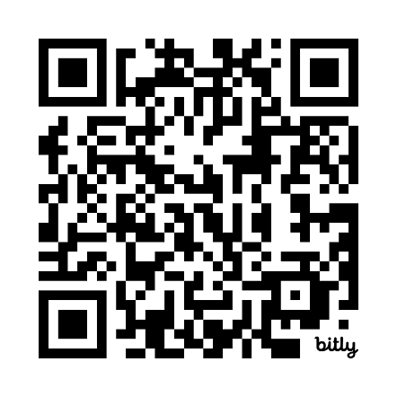
The Accessible Math Handbook Roadmap
Darrin Evans
VLC PC Center Director
daevans3@waketech.edu
bit.ly/csundaisy

Slide 2

The Professional Development Center
VLC Professional Development Center
Hosted at Wake Technical Community College
Provide training and support on accessibility to faculty throughout the NCCCS
Contact information
Darrin Evans, Center Director
919-866-5636
daevans3@waketech.edu

Slide 3
Objectives
Participants will understand a framework for creating a math guide
Participants will learn the latest research in accessible math

Slide 4
Some Background Definitions [1of3]
MathML : Mathematical Markup Language. A method of encoding math on the web
accessible math : math that is perceivable, reflowable, and operable
assistive technology : software or hardware that individuals with disabilities use to interact more easily with the web
LaTeX : a document preparation system used by many STEM professionals
math mode : the method used in LaTeX to distinguish math formulae from regular text (e.g., a dollar sign symbol surrounds the math; $ formula $)

Slide 5
Some Background Definitions [2of3]
MathPix : a commercial OCR product the recognizes math content and outputs it to MathML, LaTeX,
MathType : a commercial math editing software product that works as a stand-alone tool and integrates in many Learning Management Systems (LMS) and word processing programs
Office Math : native equation format for MS Office equations
optical character recognition (OCR) : The process of converting images of text or math into actual selectable and discoverable text

Slide 6
Some Background Definitions [3of3]
Desmos : a set of free, online math tools, including a graphing calculator, which are accessible to assistive technologies
Pandoc : a free command line utility that enables the conversion of files from one format to another (e.g., a MS Word file with math is converted to HTML + MathML)
MathJax : a JavaScript library that ensures that LaTeX, MathML, or AsciiMath will be displayed properly on all web browsers
publish to mathpage : A MathType menu item which saves the MS Word file as an HTML document. There are various export options, such as HTML + MathJax

Slide 7
What is Accessible Math?
Math that Everyone can perceive, interact with, and explore

Slide 8
What Makes Accessible Math Work?
An accessible math element is encoded with information about its
presentation
meaning
MathML (Math Markup Language) is the common way to encode this info

Slide 9

The Math Quiz as Spoken by JAWS
Here is the text of what is spoken by JAWS:
Heading level 1 Quiz Question 1
Solve the following question and then chose the answer from the radio buttons below.
The square root of 4 plus 5 MathContent.
Choices: 9, 7, 3, 2

Slide 10
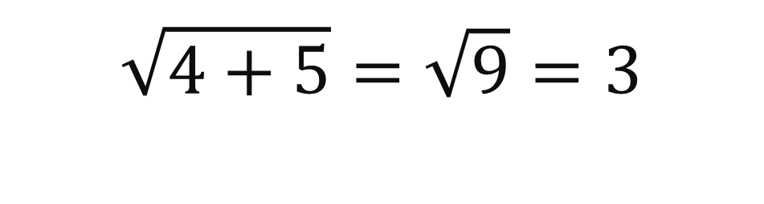
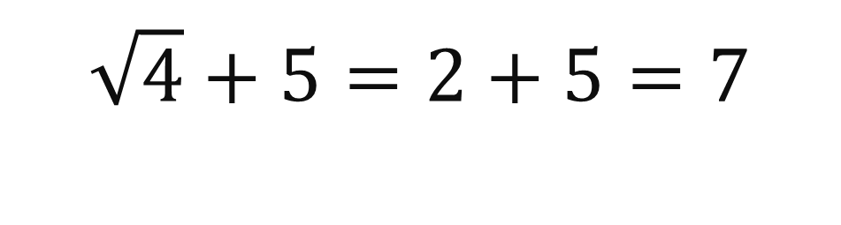
Two Possibilities
If the square root extended over the quantity 4 plus 5, the answer would be the square root of 9, which is 3.
$$\sqrt{4+5}=\sqrt{9}=3$$
However, if the square root only extended over the 4, then the square root of 4 is 2 and the answer would be 2 plus 5, which is 7.
$$\sqrt{4}+5=2+5=7$$
Unfortunately, the default settings in JAWS (as of March ’24) speaks either possibility the same way.
The square root of 4 plus 5 MathContent

Slide 11
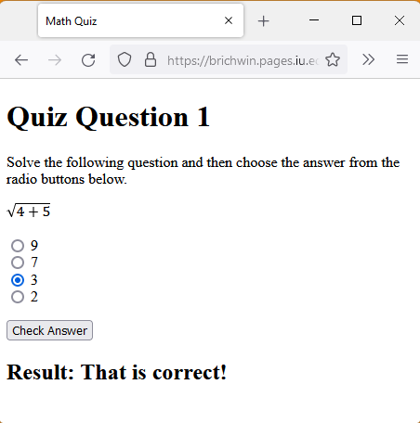
The Quiz Question’s Correct Answer
The correct answer is 3.
The square root was to be taken of the sum of the two terms.

Slide 12
Recommendation for Accessing Math with Speech
For non-visual access to digital mathematics on Windows OS, we recommend the NVDA Screen Reader combined with the MathCAT plug-in
Provides settings to customize output.
For beginners, we recommend:
Generate speech for: Blindness
Speech style: ClearSpeak
Speech amount: Verbose
Provides access to Math in web pages, Word docs, and EPUBs (use Thorium Reader)
Notes:
For those of you using MathCAT with NVDA, the latest version of MathCAT can be found on the new NVDA addons store <https://nvda-addons.org/>. As of May 16, this version of MathCAT is compatible with NVDA 2023.1 and also earlier versions.
Unfortunately, we cannot yet recommend that JAWS be used for speech access to digital mathematics.

Slide 13
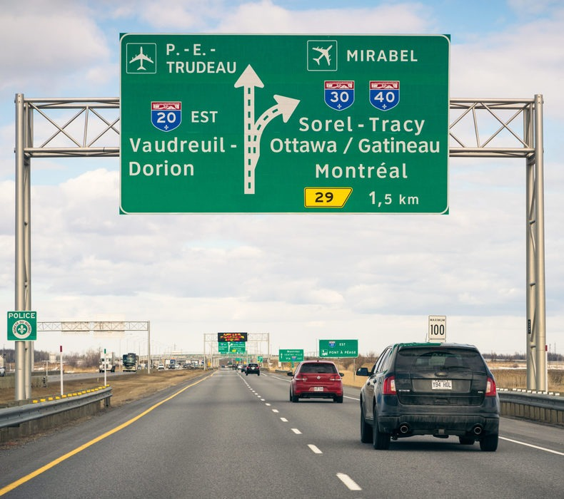
What Your Road Map Should Contain
Workflows
Optical Character Recognition/PDF (OCR)
Learning Management System math authoring
Math Manipulative Kit Recommendations

Slide 14

Generic Accessible Math Workflow
Determine your preferred authoring environment
Choose the math authoring tool
LaTeX
math editor
WordToEPUB
copy math code from a math OCR
Convert to HTML or Save as Course Page in LMS

Slide 15



What is Math OCR?
EquatIO
integrates with MS 365 and Google
free for educators
robust literacy support for students
best for campus-wide accessibility implementation
MathPix
License tiers offer differing number of snips per month
copy and paste math as OfficeMath or MathType into MS Word document
OCR API allows for batch processing and conversion of PDFs
Infty Reader
$220 for a perpetual license; $45 for a yearly license (per seat)
performs OCR on an entire PDF
best option for alternative media production houses

Slide 16

Mathpix
Mathpix is a tool that can screenshot any math and have it rendered to a variety of formats. Export images and PDFs to LaTex, or DOCX.

Slide 17
Math & Learning Management Systems
Some LMSs support MathJax rendering. If you are not sure:
Paste this code into your LMS: $$\sqrt{\frac{a}{b}}$$
Do you see or LaTeX?
If math doesn’t display, add MathJax JS code in the HTML editor and change the math delimiters \(...\)

Slide 18
What is LaTeX?
LaTeX is a typesetting system used by many STEM professionals
$\frac{3^3}{3}$ =
$$\sqrt{\frac{a}{b}}$$ =

Slide 19
What is WordToEPUB?
Word to EPUB is a free tool from the daisy consortium that can be used to create EPUBs from an accessible Word document with just a few clicks. To download the free Word to EPUB tool visit the DAISY website. (PC only)

Slide 20
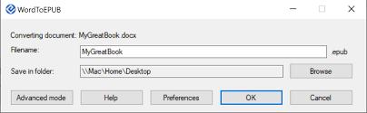
WordToEPUB
WordToEPUB, is a free software tool that lets you convert structured accessible Word documents to the latest EPUB 3 format. EPUB is a format for reading publications on laptops, tablets, and smartphones, and it includes features such as rich navigation and great accessibility.

Slide 21

Thorium Reader
Thorium Reader is an accessible EPUB reader that can interact with math content using the WordToEPUB toolbar.

Slide 22

Easy EPUB Math

Slide 23
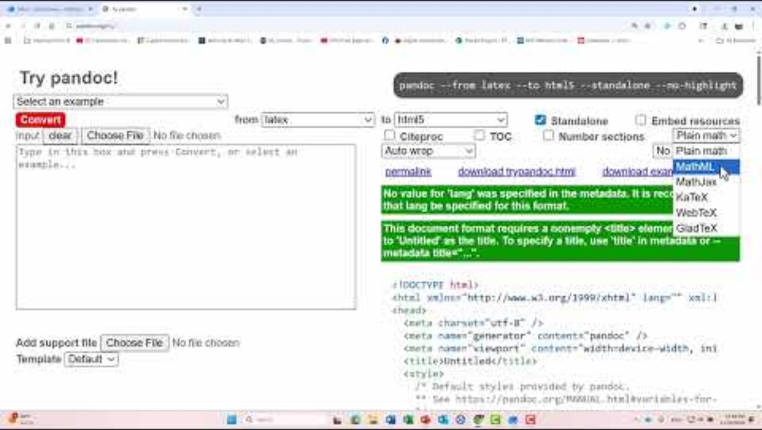
Using Pandoc Online

Slide 24
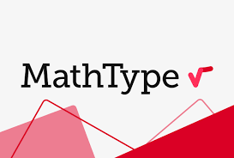
MathType
MathType is math editing software designed to help type and hand-write mathematical notation to include quality math equations in documents and digital content easily. MathType is available for desktop, web (Google Docs), and Microsoft Word on iPad.

Slide 25

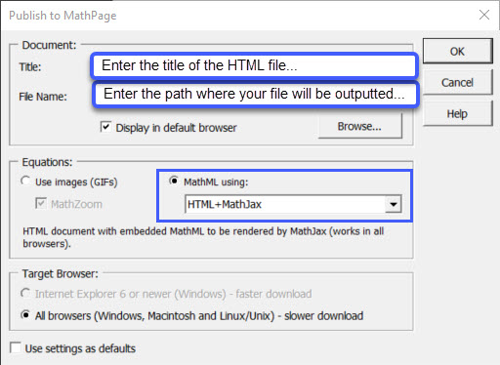
Using MathType
Convert .docx file using MathType’s MS Word add-in
Select Publish to MathPage
Enter a title for the HTML file
Enter the path where the file will be outputted
Select HTML+MathJax

Slide 26

ANALOGUE TOOLS

Slide 27
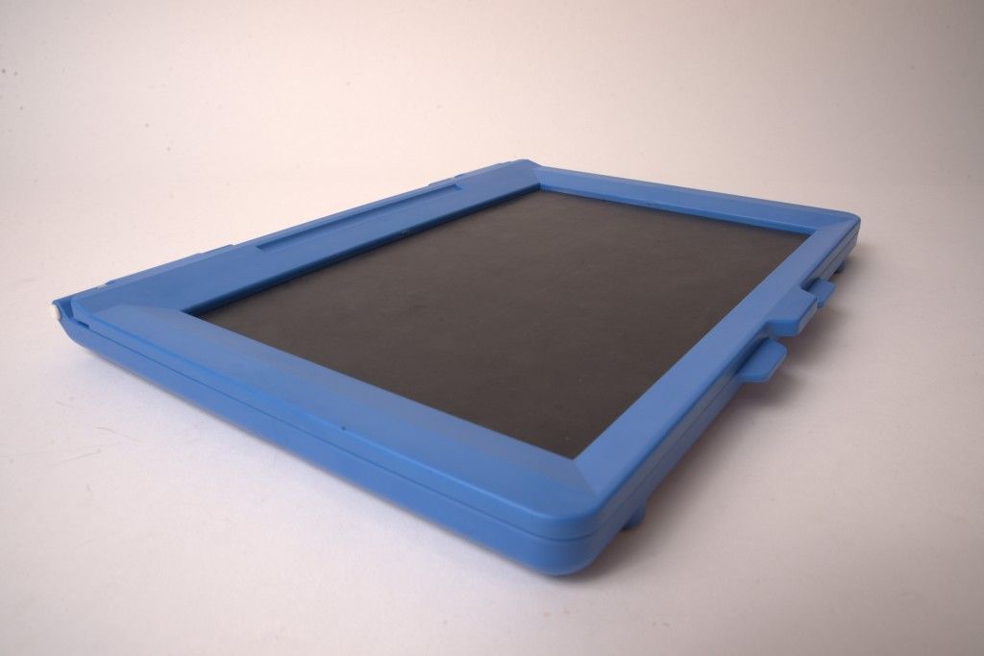
INTACT SKETCHPAD
Visit easytactile graphics to learn more about the Intact Sketchpad [new window]
Direct Link: http://www.easytactilegraphics.com/product/intact-sketchpad/
Allows users to create tactile graphics by hand using the pad and the included stylus.

Slide 28
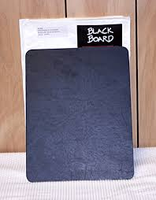
SENSATIONAL BLACKBOARD
The Sensational Blackboard allows users to create tactile graphics using plain paper.
To learn more about the sensational blackboard visit sensational books [new window]
Direct Link: http://www.sensationalbooks.com/products.html#blackboard

Slide 29
Math Accessibility Resources
Mathjax
Pandoc
Overleaf
Visual Math Editor
MathCAT
Mathpix
MathType
WordToEPUB
Thorium Reader
Math Kicker

Slide 30
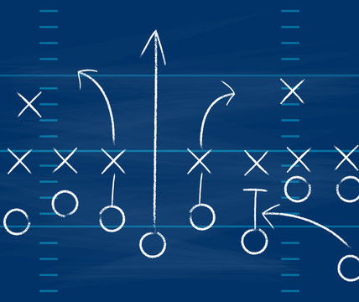
Putting It Together
Go to bit.ly/csundaisy
Download all the math resources Declawing MathCAT, A Comparison of Different Styles of Speech for Mathematics, Reading and Writing Math, and The Accessible Math Guide.
Use these resources to get started with your own Accessible Math Guide

Slide 31
Reading and Writing Math Group
Meets monthly to address solutions for reading and writing mathematical content for the visually impaired.
Works to document existing solutions and to develop and promote new ones.
You can join the list by sending a blank email to: math-join@daisylists.org

Slide 32

Questions

