Slide 1
Unlocking the ABCs of procuring accessible products
Nov 21, 2025
Becky Gibson
Lead Accessibility Specialist

Slide 2

Speaker introduction
30+ year career in high tech
20 years focusing on Accessibility
Passionate about making Web usable for all
Fun fact: Took up figure skating in my 40’s
Becky Gibson
She/her/hers
Lead Accessibility Engineer

Slide 3
Session takeaways
Interpret Accessibility Terms
Assistive Technologies
WCAG
ACR
WCAG, VPAT, ACR, A11y, AT, ARIA
Perceive how people with disabilities navigate the digital world
Learn the basics of the Web Content Accessibility Guidelines (WCAG)
Gain confidence reviewing an Accessibility Conformance Report (ACR)

Slide 4
Accessibility Numeronym
Accessibility
A[11 letters]Y
A11y

Slide 5

WCAG – Web Content Accessibility Guidelines
A set of guidelines to make websites usable for everyone, especially people with disabilities.
W3C = World Wide Web Consortium; WAI = Web Accessibility Initiative

Slide 6

ACR – Accessibility Conformance Report
A document to demonstrate how accessible a product is for people with disabilities.
Think of it as a report card for accessibility.
Not just for Web products
Notes:
Helps organizations understand if the product meets accessibility standards and identifies areas needing improvement

Slide 7
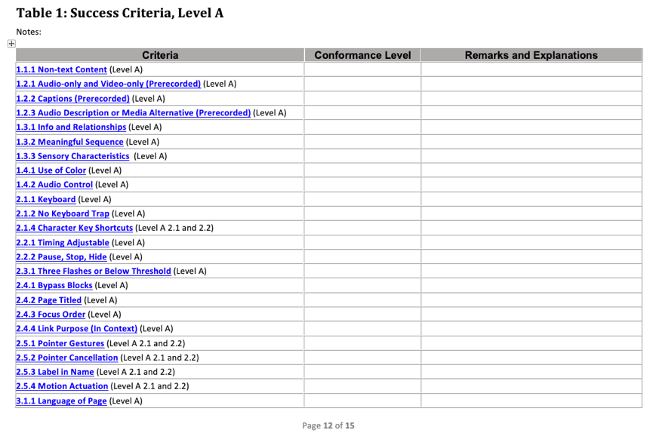
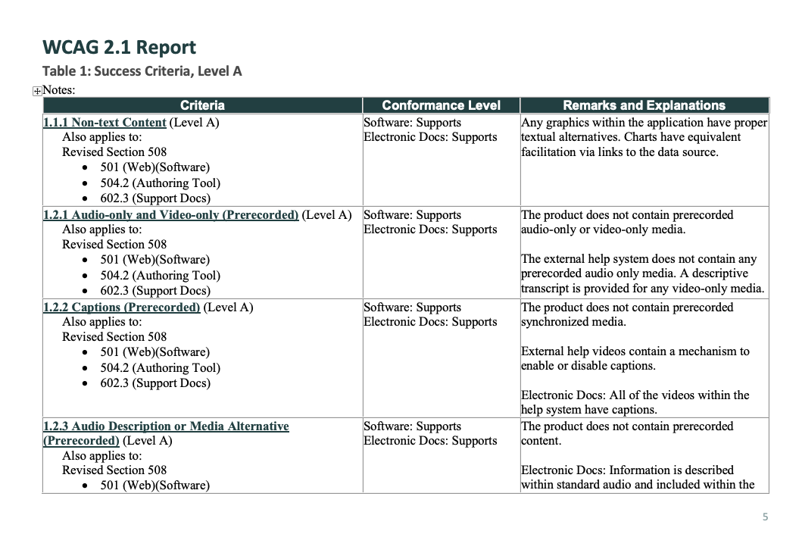
VPAT – Voluntary Product Accessibility Template
VPAT
Completed
ACR

Slide 8
Accessibility Audit
Thorough review of product using various tools and assistive technology
Lists each violation that is found
  Usually based on common use cases
Report formats will vary, some include suggested fixes
More detailed than an ACR
You need an Audit to create an ACR

Slide 9
ARIA – Accessible Rich Internet Specification Info
W3C specification
Enhances Accessibility
Improves User Experience

Slide 10
How people with disabilities navigate the web

Slide 11
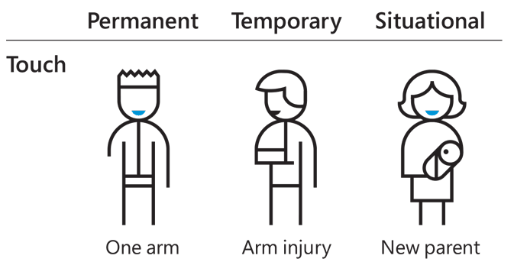
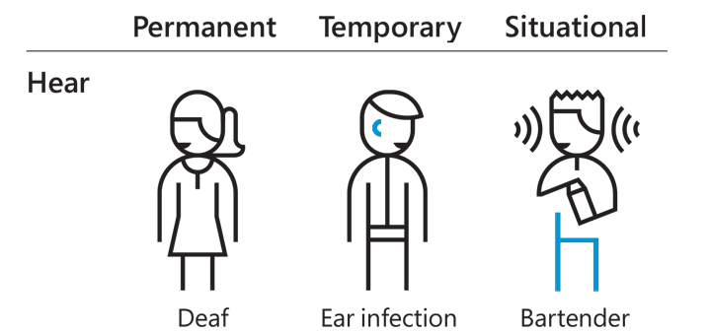
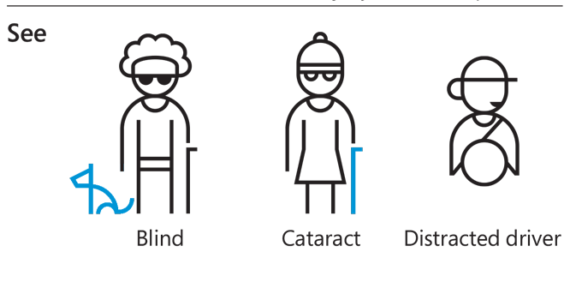
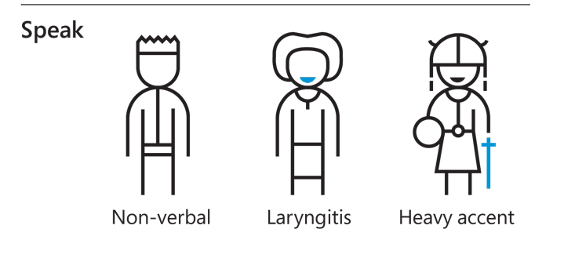
Types of disabilities
Source: Microsoft Inclusive Design Toolkit
Notes:
There are different levels of disability. Some might encounter disabilities that are permanent, temporary, or situational. We use the Microsoft Inclusive Design Toolkit to illustrate some of these.​
​
Related to Touch, someone might have only one arm, suffer an arm injury, or be holding a baby.​
​
With vision, someone might be blind, experience cataracts, or turn their attention to something else while they are driving.​
​
Hearing disabilities could include those who are deaf, with an ear infection, or those in a noisy environment. ​
​
Speech disabilities might include someone who is non-verbal, has lost their voice due to laryngitis, or someone with a heavy accent. ​
​
This representation of disabilities isn’t exhaustive and also doesn’t cover a wide array of invisible disabilities. ​
​
Image Credit: https://i.pinimg.com/originals/e5/01/bb/e501bb70300635ecc034b451250abd44.png​

Slide 12
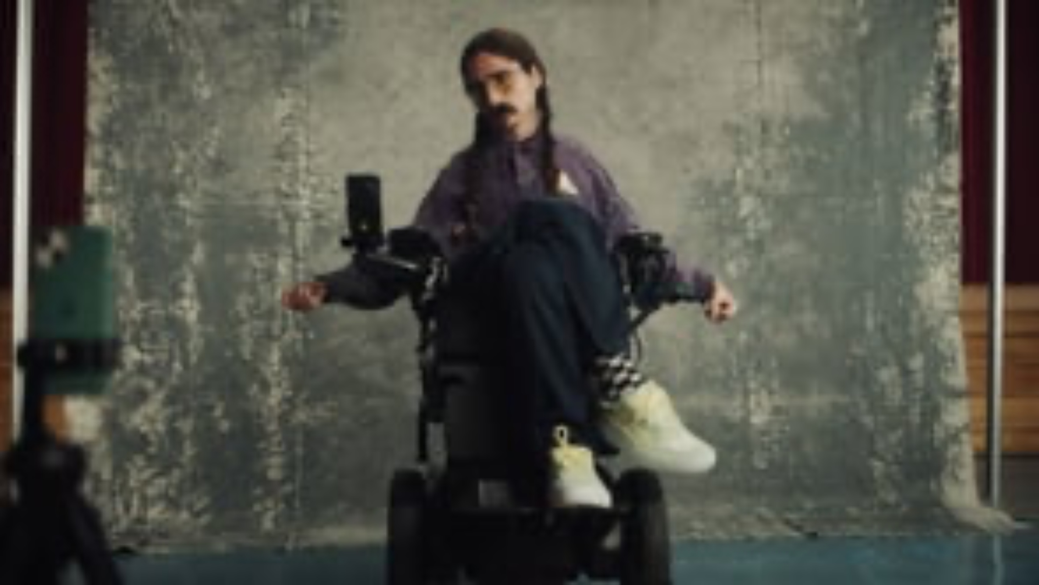
AT in action
The Apple Greatist Video on Vimeo

Slide 13

Speech input

Slide 14

Zoom / magnification

Slide 15
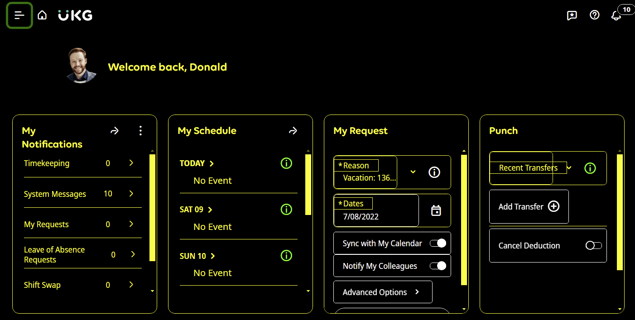
High contrast & custom settings

Slide 16
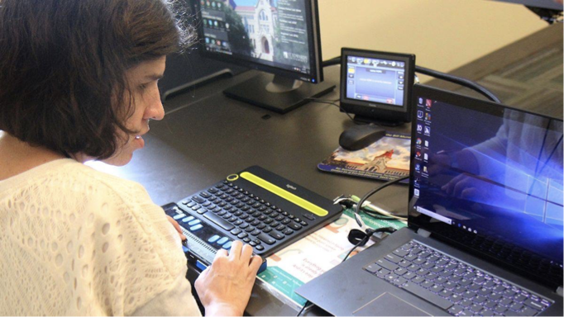
Screen reader & braille
Notes:
Not just for those who are blind.

Slide 17
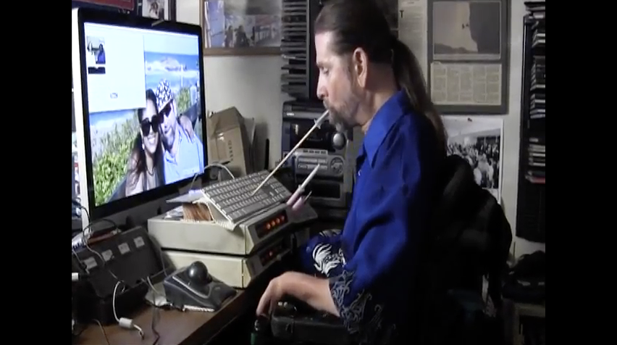
Switch devices & alternative input
Notes:
Mouth stick, eye trackers, keyboard only, single switch

Slide 18

Captions & sign language
Notes:
Captions and sign language interpretation

Slide 19
WCAG
Web Content Accessibility Guidelines

Slide 20

Four principles of accessibility - POUR
Perceivable
Operable
Understandable
Robust
Web Content Accessibility Guidelines

Slide 21

WCAG 2.2 structure
4 Principles
13 Guidelines
WCAG 2.2
86 Success Criteria

Slide 22

1. Perceivable
Users must be able to perceive the site in some way using one or more senses.
1.1 Text Alternatives
Success Criterion 1.1.1
1.2 Time-based Media
Success Criterion 1.2.1 – 1.2.9
1.3 Adaptable
Success Criterion 1.3.1 – 1.3.6
1.4 Distinguishable
Success Criterion 1.4.1 – 1.4.13

Slide 23
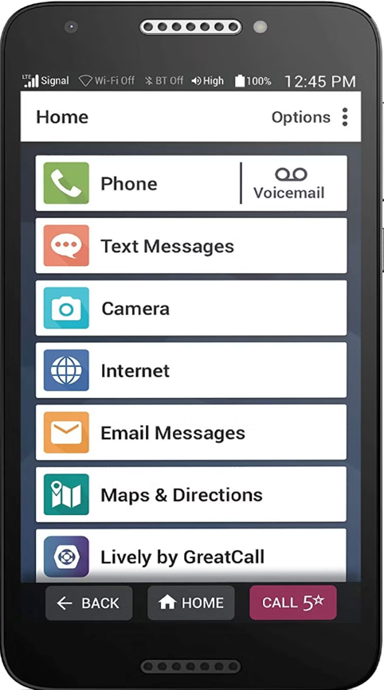
2. Operable
Users must be able to control and navigate interactive elements.
2.1 Keyboard accessible
Success Criterion 2.1.1 – 2.1.4
2.2 Enough Time
Success Criterion 2.2.1 – 2.2.6
2.3 Seizures & Physical Reactions
Success Criterion 2.3.1 – 2.3.3
2.4 Navigable
Success Criterion 2.4.1 – 2.4.13
2.5 Input Modalities
Success Criterion 2.5.1 – 2.5.8

Slide 24

3. Understandable
Users must be able to control and navigate interactive elements.
3.1 Readable
Success Criterion 3.1.1 – 3.1.6
3.2 Predictable
Success Criterion 3.2.1 – 3.2.6
3.3 Input Assistance
Success Criterion 3.3.1 – 3.3.9

Slide 25

4. Robust
Content must be robust enough that it can be interpreted by a wide variety of browsers and assistive technologies now and into the future.
4.1 Compatible
Success Criterion 4.1.1, 4.1.3

Slide 26
3 Levels of accessibility – A
Level A - minimum
Level AA – must have
Level AAA – more specific
31
Success Criteria

Slide 27
3 Levels of accessibility – AA
Most software vendors target Level AA
Level A - minimum
Level AA – must have
Level AAA – more specific
31
Success Criteria
24
Success Criteria

Slide 28
3 Levels of accessibility – AAA
Most software vendors target Level AA
Level A - minimum
Level AA – must have
Level AAA – more specific
31
Success Criteria
24
Success Criteria
31
Success Criteria

Slide 29

Success criteria
Address various accessibility needs
  Vision / Color
  Auditory
  Mobility
  Cognitive
Are testable statements
Specification provides documentation for each
  Understanding
  How to Meet

Slide 30
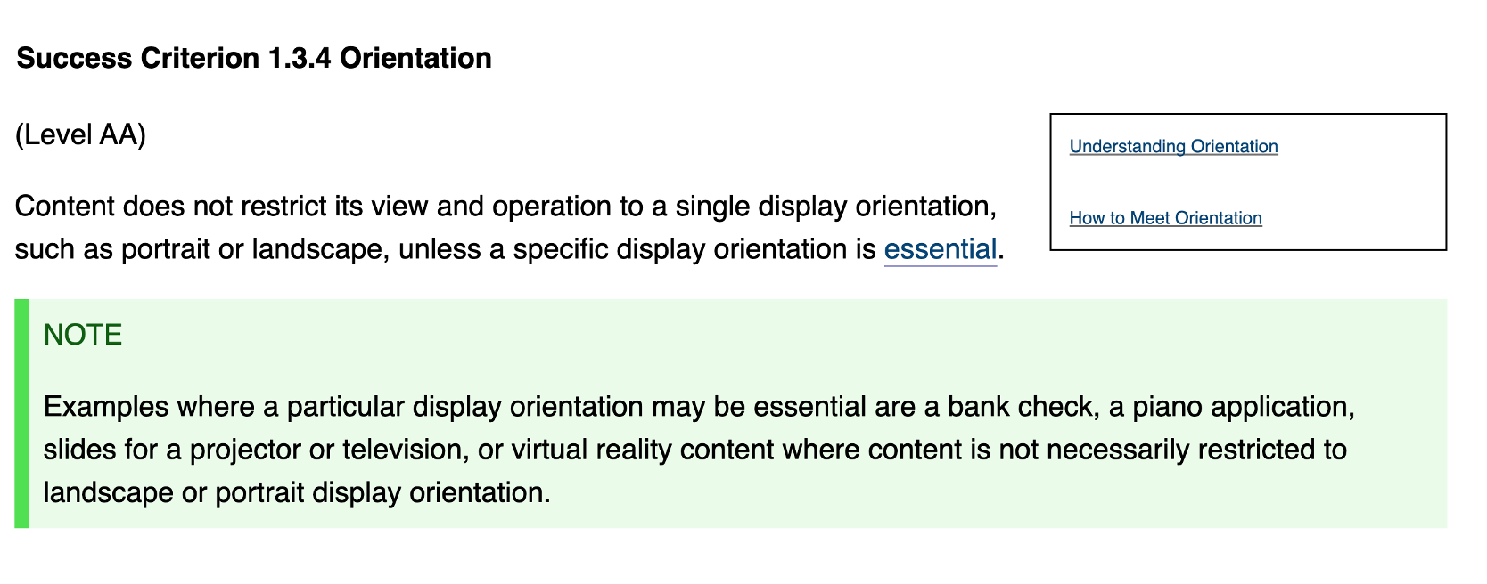
Example success criterion

Slide 31
ACR format
Accessibility Conformance Report

Slide 32
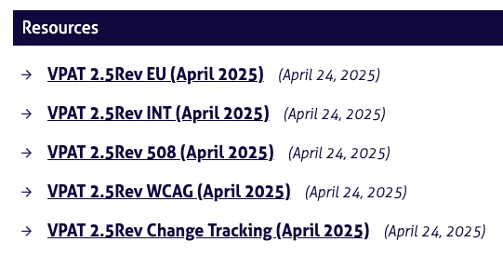
VPAT editions and versions
4 Editions
  EU – supports EN 349 501 and WCAG 2.0, 2.1
  508 – supports US Section 508 and WCAG 2.0
  WCAG – supports WCAG version 2.0, 2.1, 2.2
  International – combines above 3 into one template
Current Version is 2.5Rev from April 2025
Download VPAT from Information Technology Industry Council (ITI)
This template is the defacto standard but is not required

Slide 33
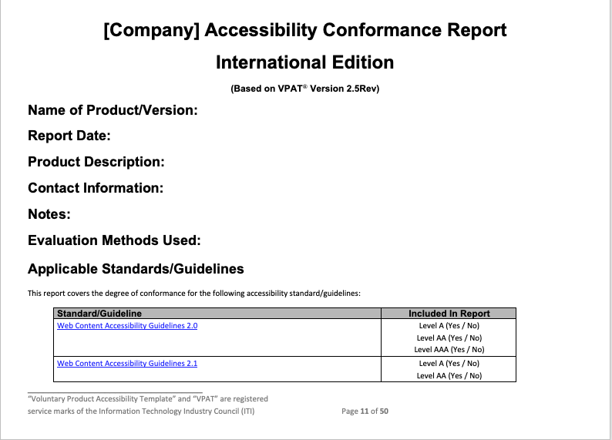
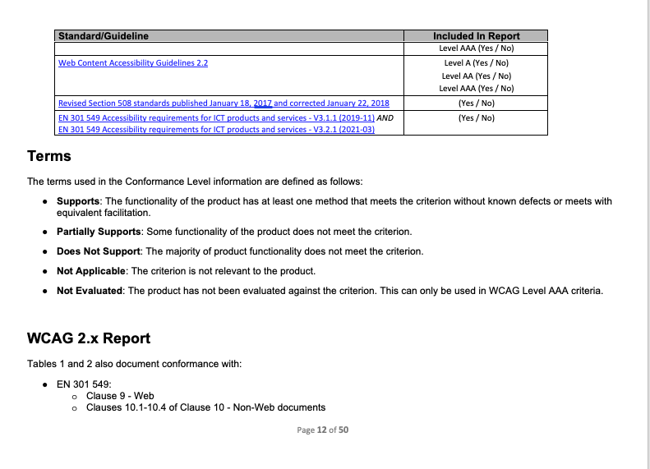
Standard ACR header

Slide 34
VPAT / ACR terms
The terms used in the Conformance Level information are defined as follows:
Supports: The functionality of the product has at least one method that meets the criterion without known defects or meets with equivalent facilitation.
Partially Supports: Some functionality of the product does not meet the criterion.
Does Not Support: The majority of product functionality does not meet the criterion.
Not Applicable*: The criterion is not relevant to the product.
Not Evaluated: The product has not been evaluated against the criterion. This can be used only in WCAG 2.0 Level AAA.
*Can use Supports when there is no content to which a success criterion applies, thus it is satisfied.

Slide 35
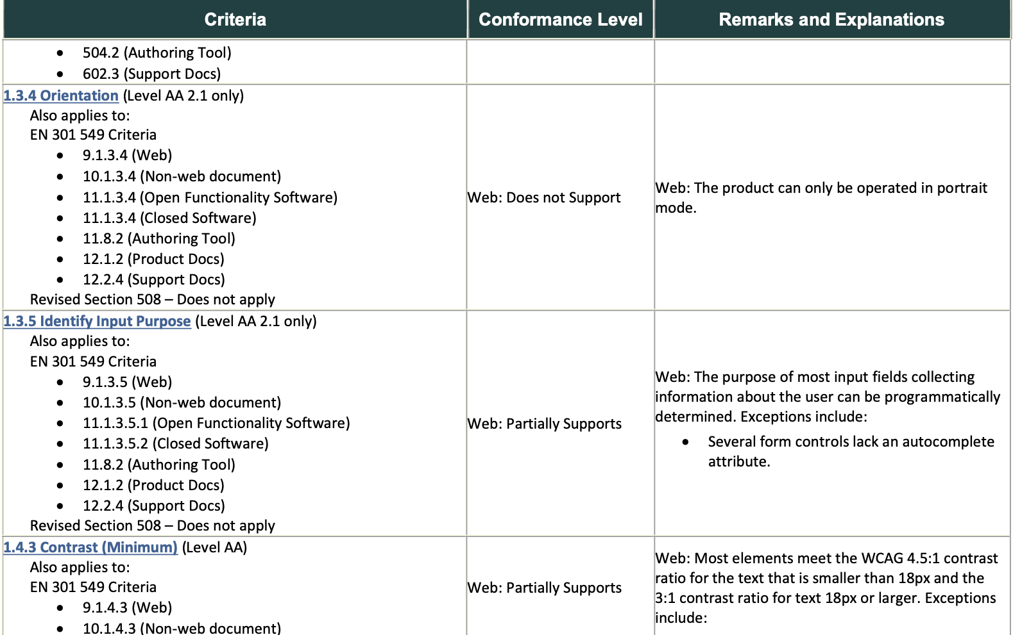
ACR example

Slide 36
Requesting and reviewing an ACR

Slide 37
Where to obtain an ACR
Make it part of your RFP (request for proposal)
Look on a company’s website
Submit a formal request
  Many companies do not publicly post

Slide 38
RFP language examples
Is this product compliant with WCAG 2.2 accessibility requirements? If no, is WCAG 2.2 compliance on the product roadmap? If yes, please send the most recent product VPAT supporting compliance with WCAG 2.2.
Proposers shall include an Accessibility Conformance Report (ACR) with their proposal, detailing how the proposed solution meets accessibility standards.
Proposers are required to provide an Accessibility Conformance Report (ACR) demonstrating conformance to WCAG 2.2 Level AA and Section 508 requirements for all proposed products and services. The ACR must include [specific requirements like VPAT version, evidence of testing, remediation plans].

Slide 39

ACR != good accessibility
The existence of an ACR does not imply an accessible product
Beware of ACR’s that have Supports for all entries
Uses correct terms
  Not tested is not a valid response
  Understand how “Not Applicable” has been used
  Not evaluated is only valid if reporting on Level AAA

Slide 40

What to look for in an ACR
Was it created by a third party or internally?
What assistive technologies were used for testing?
Are specific use cases listed?
Items marked partially supports have an explanation
Number of each response type:
  Supports, Partially Supports, Does Not Support
  Understand how Supports is used

Slide 41

Your goals
Establish the accuracy of the ACR
Evaluate the vendor’s accessibility knowledge
Determine the vendor’s commitment to accessibility
Have confidence your employees can successfully use the product
Know that accessibility concerns will be addressed

Slide 42

Questions to ask the vendor
Who created the ACR?
How often is the ACR updated?
Is there a roadmap to address accessibility issues?
Is there an accessibility team?
  What is their background, certifications, experience?
How are accessibility issues reported?
  How are they addressed?

Slide 43
Let’s look at some ACRS
Google Gmail
NIH Workplace Equity and Diversity Survey
Microsoft (downloads for all products)
Zoom
ESRI

Slide 44
Your Mission
Raise Awareness
Understand your audience
Know the basics
Prioritize Accessibility
Hold vendors accountable
Know the Accessibility acronyms and share
Understand how all people use the Web
Awareness of WCAG and POUR
Request and review ACRs to select accessible products
Negotiate with vendors to support accessibility

Slide 45
Your Mission 2 of 5
Understand your audience
Raise Awareness
Know the basics
Prioritize Accessibility
Hold vendors accountable
Know the Accessibility acronyms and share
Understand how all people use the Web
Awareness of WCAG and POUR
Request and review ACRs to select accessible products
Negotiate with vendors to support accessibility

Slide 46
Your Mission 3 of 5
Know the basics
Raise Awareness
Understand your audience
Prioritize Accessibility
Hold vendors accountable
Know the Accessibility acronyms and share
Understand how all people use the Web
Awareness of WCAG and POUR
Request and review ACRs to select accessible products
Negotiate with vendors to support accessibility

Slide 47
Your Mission 4 of 5
Prioritize Accessibility
Raise Awareness
Understand your audience
Know the basics
Hold vendors accountable
Know the Accessibility acronyms and share
Understand how all people use the Web
Awareness of WCAG and POUR
Request and review ACRs to select accessible products
Negotiate with vendors to support accessibility

Slide 48
Your Mission 5 of 5
Hold vendors accountable
Raise Awareness
Understand your audience
Know the basics
Prioritize Accessibility
Know the Accessibility acronyms and share
Understand how all people use the Web
Awareness of WCAG and POUR
Request and review ACRs to select accessible products
Negotiate with vendors to support accessibility

Slide 49

Hold companies accountable for accessibility

Slide 50
Learn more about Accessibility
World Wide Web Consortium Web Accessibility Initiative – w3.org/WAI
Non-Profit organizations
  Web Accessibility in Mind, learning resources, training, WAVE evaluation tool– WebAIM.org
  Knowbility – learning resources & yearly conference, research assistance – Knowbility.org
Accessibility Consulting Organizations
  Deque
  Level Access
  TPGi
  Tetralogical
Learn to use a keyboard and check for visible focus

Slide 51

Questions?
Becky Gibson
becky.gibson@ukg.com
becky@weba11y.com

