Slide 1


Sustainable A11Y in Action: Lived Lessons & Challenges in Shifting-Left
because a11y should be wicked good

Slide 2

goodwitch of a11y
Glenda Sims
Chief Information Accessibility Officer Deque

Slide 3

Welcome to Oz: where accessibility is not a fantasy
Real world
Lived experience
Not theory
No magic

Slide 4
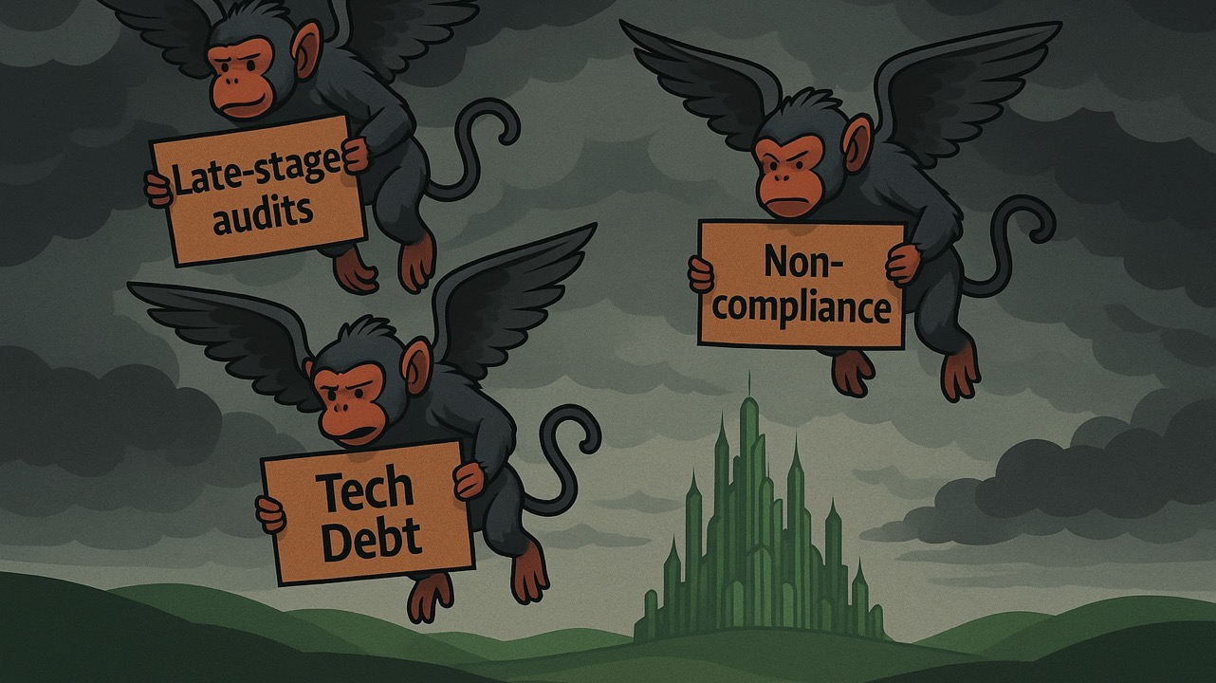
Reactive Accessibility

Slide 5
Sustainable A11Y: Defying Gravity
Policy
Budget
Training
Communicate
Help Desk Support
Govern
SDLC
HR
Culture
Procure
Notes:
Doing the right thing shouldn’t drag you down

Slide 6
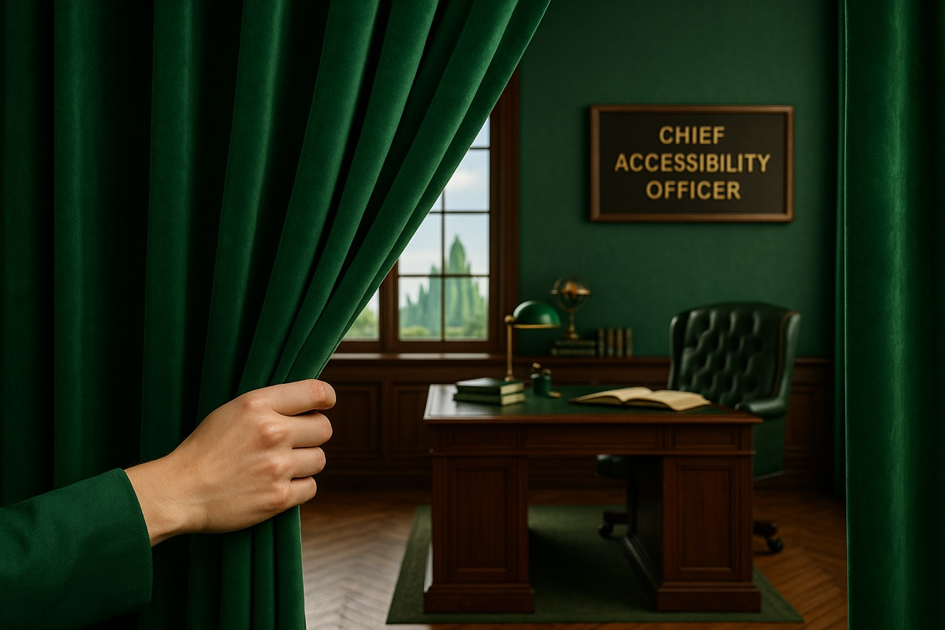
Let’s peek behind the curtain

Slide 7
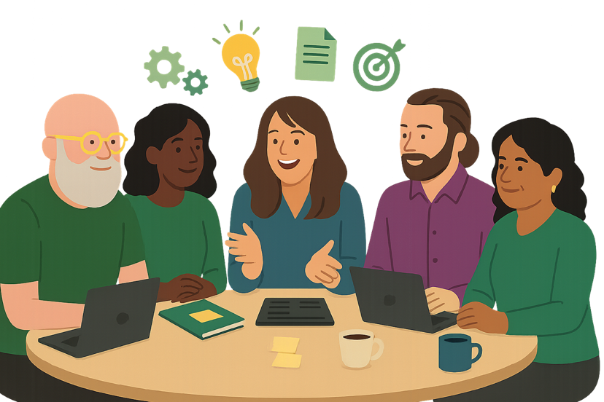
The power of collaboration & community
Title
Chief Accessibility Officer?
Chief Information Accessibility Officer?
Job description
Goals
Metrics
Notes:
Drafting my Job Description
With Deque’s Strategic Consultants
Chief Accessibility Officer
Chief Info Accessibility Officer
Brainstorming where to start
How to equip, motivate, measure
Sharing challenges, pressure testing ideas, benefiting from different perspectives

Slide 8

Creating a sustainable a11y program: What should happen first? It does not matter.
Culture
Policy
Budget
Training
Communications
Help Desk/Support
Governance
SDLC
Procurement
HR

Slide 9

There is no 1 size fits all magic plan
Notes:
There is not a 1 size fits all solution. No magic wand or magic shoes.

Slide 10
Start where it works for your org
A11Y Dimension | Phase 0 for me | Phase 1 for me | Phase 2 for me | Phase 3 for me
1. Culture | Digital equality | Nurture | Nurture | Nurture
2. Policy/Process | External in place | Draft internal process & metrics | Internal process & metrics approved | Measurement + consequences
3. Budget | Training, Tools, Time | Dedicated Experts | Tune for efficiency | Keep tuning
4. Training | Available | Required | Ongoing | Ongoing
5. Communications | Assumed | Required | Tune for efficiency | Keep tuning
6. Help Desk/Support | Training/Triage
7. Governance | Kinda (dashboard) | Monitoring | Improvements! | More Improvements!
8. SDLC | Available | Available | Required | Continuously Improve
9. Procurement | Assumed | Assumed | Policy drafted | Policy approved
10. HR | A11Y hiring & accommodations | A11Y intro in onboarding | Upskill for digital doc a11y | A11Y in job descriptions drafted
1 - 10 reference : A11Y Maturity Model

Slide 11

What did Glinda do?

Slide 12

Culture: Why a11y matters
Digital equality = Deque mission
Deque accessibility awareness lab
Opportunities to work and hang out with people with disabilities (pwd)
Listen
Learn
Ask questions
Collaborate
Design and develop with pwd
Discover your A11Y Allies
1 Culture: A11Y Maturity Model

Slide 13


What if risk is your org’s primary driver?
Start where your leaders are
Risk avoidance/response is valid
Don’t stop there
Risk-only mindset = bare min, reactive, unsustainable
Build bridge to business value
Once leadership feels safe, introduce accessibility as:
driver of brand trust and market growth
foundation for inclusive innovation
magnet for top talent and diverse perspectives
1 Culture: A11Y Maturity Model
Notes:
“If risk is what gets leadership to approve accessibility work, that’s OK. Meet them there. But don’t camp out there forever. As soon as the fires are out, be ready with the story of accessibility as a business advantage.”

Slide 14


Accessibility Statement (external)
Commitment to standards
EN 301 549
WCAG 2.2 A/AA
508
Feedback method
Product VPATs
From WCAG to International
Minimum pre-reqs:
training, tools, a11y lead role
A11Y Statement
2 Policy: A11Y Maturity Model

Slide 15
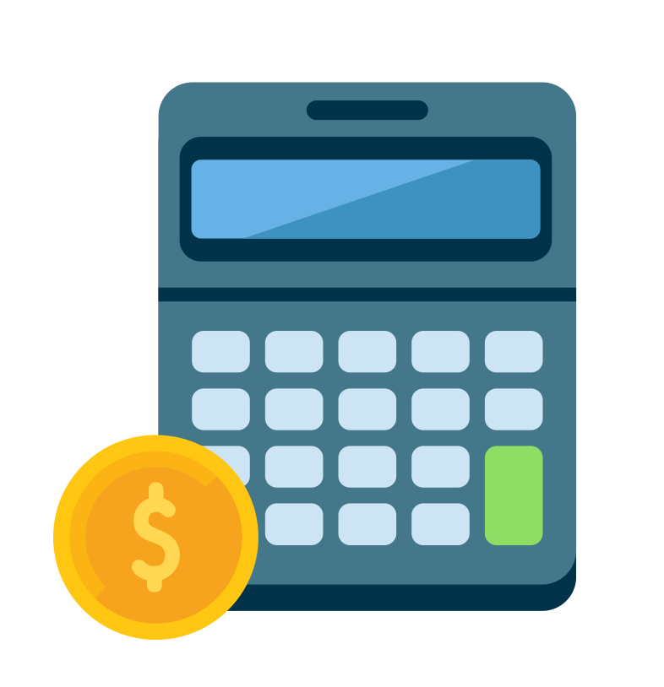
Budget: lower cost now or pay really BIG later
Accessibility is a budgeted line item
Training & Tools: Access to DequeU + axe suite
Expert Support: Budgeted certified a11y SMEs
Remediation Time: Built into sprints, not deferred
Manual Audits + VPATs every major release
Smart Spend, Measurable ROI
A11Y is like security
no budget = no consistency
Fixing issues post-release costs up to 30x more
deque.com/accessibility-roi-calculator
A11Y ROI
3 Budget: A11Y Maturity Model
Notes:
Share https://www.deque.com/accessibility-roi-calculator/

Slide 16
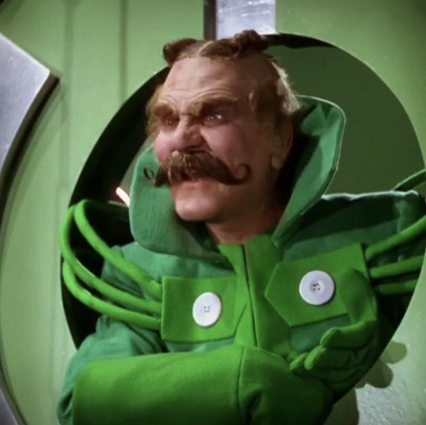
Don’t Give Up
No. No. No. No. No. No. No. No. No. Ok.
Plant seeds
Improve what you can
Document
time saved
bugs avoided
Share user feedback
Build allies
Connect to community
Keep trying! You are not alone.

Slide 17


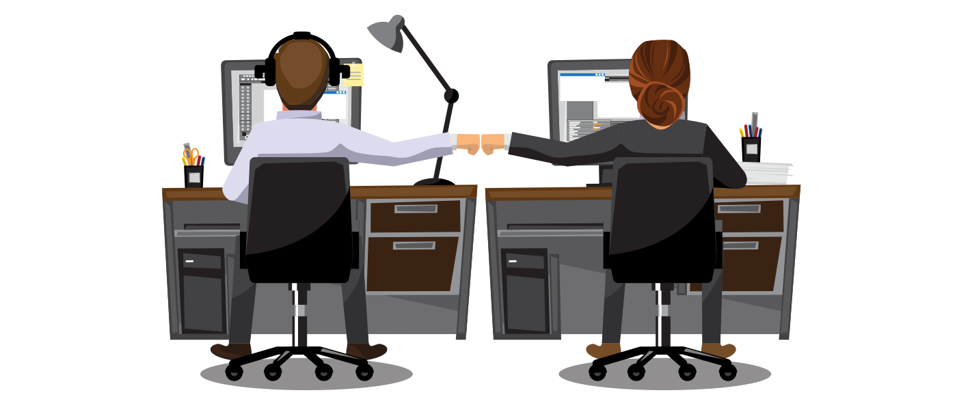
Training & just-in-time learning
Encourage IAAP Certifications
Deque pays for exam cost (1 time per cert)
Continuing Education Credits
Deque University
Required:
Customer Services for People with Disabilities
Accessible emails and digital documents
Role Based Quick Start Trainings
axe Assistant (a11y savvy AI guide 24/7)
Access to a11y experts as needed
4 Training: A11Y Maturity Model

Slide 18
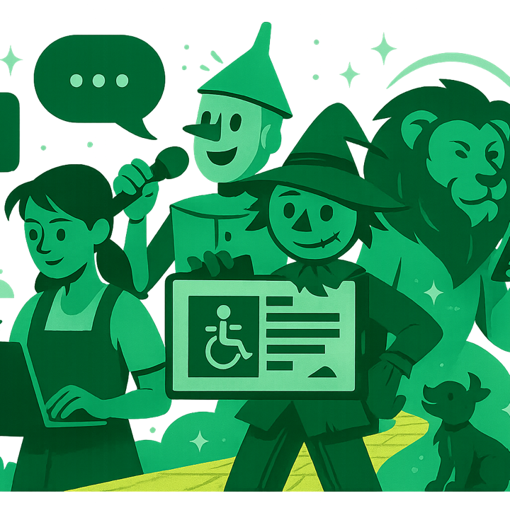
Communications
4 short required courses
Serving Customers with Disabilities
Disability Etiquette Basics
Effective Communication
In-Person
Remote (Digital)
Presenting best practices
Additional role-based training
How to ask for help
5 Communications: A11Y Maturity Model
Notes:
Deque’s accessible communication strategy is:
Structured through mandatory training and clear expectations
Supported with practical tools, job aids, and internal coaching
Reinforced by leadership, our culture, and our community norms
Continuously evolving based on roles, channels, and audience needs
This is how we speak, write, present, and collaborate, with intentional inclusion built into every interaction.

Slide 19

Help Desk / Support
Required training: customer service for people with disabilities
Triage complex issues to
Accessibility expert(s)
Product experts(s)
Accessible
Product documentation
Online help center
Methods to report a11y problems
Future: Monitor customer satisfaction for people with disabilities
6 Help Desk/Support: A11Y Maturity Model

Slide 20
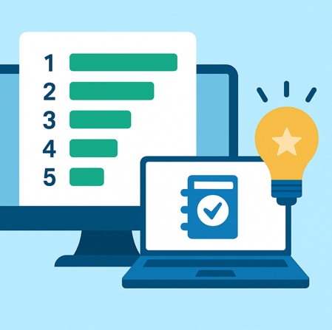
Simple A11Y Leaderboard
Published leaderboard internally
Scores from our axe Monitor
Simple VPAT scores example
WCAG 2.1 A/AA + 50 Success Criteria (SC)
2 points - SC with “Supports”
0 points - SC with “Partially Supports”
0 points - SC with ”Do Not Support”
”Does Not Support” unacceptable
A11Y help as needed
Prioritization, how to fix, why it matters…
Motivation
Everybody can see it
Creates delightful competition
7 Governance: A11Y Maturity Model

Slide 21

A11Y
SDLC (Software Development Life Cycle)
8 SDLC: A11Y Maturity Model

Slide 22

What every product owner & product manager must know

Slide 23
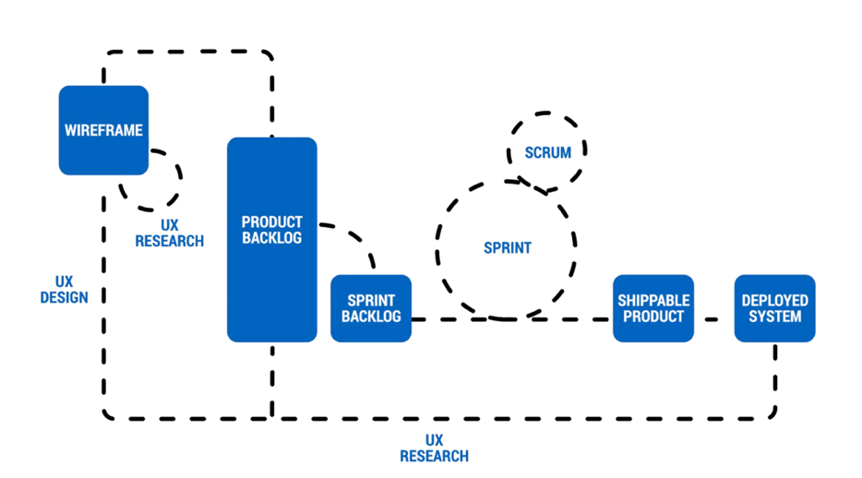
Where do YOU want to catch bugs?

Slide 24
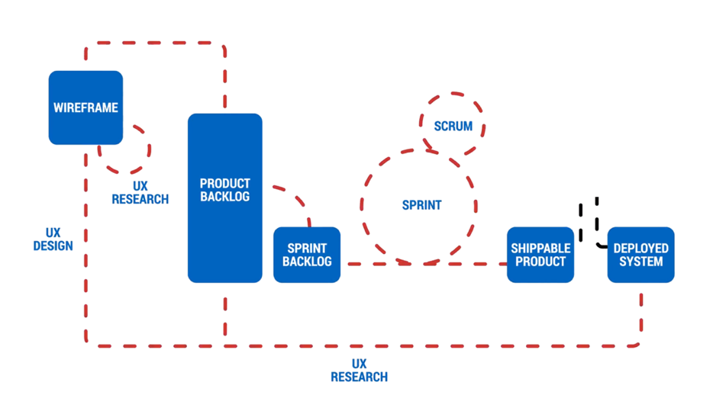

Reactive A11Y = surprise, risk, higher cost
Reactive A11Y Testing

Slide 25
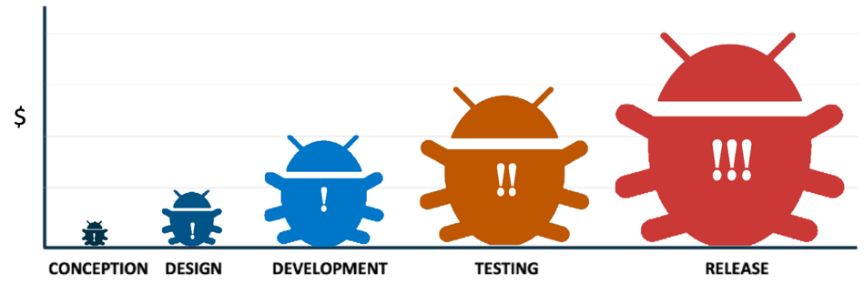
Cost of accessibility bugs
The longer it takes to discover an accessibility bug, the more it will cost your organization to fix it.

Slide 26

Shift left for efficient A11Y
67% a11y defect reduction in Design
Proactive
A11Y
Testing & Tools
Proactive
A11Y
Design Review
Smart A11Y Validation Testing
A11Y Leaderboard

Slide 27
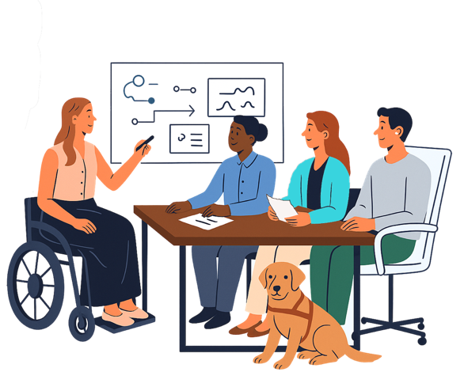
Design with & for everyone from day one
Design Lead with strong A11Y skills
UX Research
Inclusive from ideation to wireframes
A11Y Annotations using free tools:
axe for Designers
Accessibility Assistant from Microsoft
Usability testing with people with disabilities
Wizard of Oz usability testing
8 SDLC: A11Y Maturity Model

Slide 28

SDLC: Build it right the first time
A11y annotated designs
Cauldron: free accessible components
cauldron.dequelabs.com
A11Y design & dev from start
Tested by experts/people with disabilities
axe Linter: IDE assistance
axe DevTools browser extension
axe-core
advanced rules (AI)
Intelligent Guided Tests (IGT)
CI/CD: axe API scans before merge
axe Assistant for 24/7 guidance
Coaching from a11y experts as needed
8 SDLC: A11Y Maturity Model

Slide 29
Legacy Systems

Slide 30

A true story: from wicked to good
Wicked
Legacy code
Known a11y issues
What to do?
Redesign coming
Opportunity
New Product Owner (ally)
Why is this happening?
Sweet Sweet Victory
Required Quick Start Training for Devs
Import a11y issues into GitHub repo
PO prioritized a11y bugs to be fixed
Redesign launched
VPAT makes an “A” in A11y
8 SDLC: A11Y Maturity Model

Slide 31
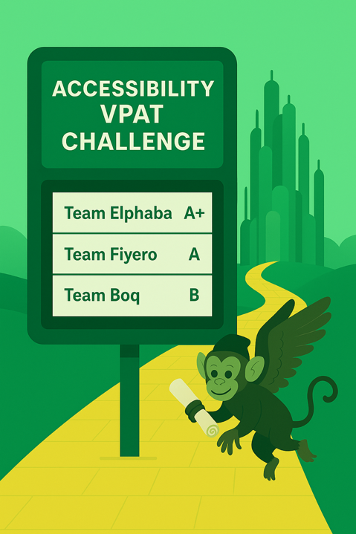
Governance & Monitoring
Weekly axe Monitor scans
CI/CD axe API scans before merge
VPAT requirement for each product
Every major release or at least once a year
Manual audits done by CIAO expert team
Make an “A” in accessibility on the VPAT
Reasonable timeframe to fix VPAT issues
Email every other week to each product owner
# of VPAT issues for THEIR Product
Ability to see full report for each product
Dashboard for Exec Leadership
7 Governance: A11Y Maturity Model
Notes:
See this great article too https://github.blog/ai-and-ml/github-copilot/how-we-automated-accessibility-compliance-in-five-hours-with-github-copilot/

Slide 32


On October 1, 2025
1:01 am Weekly axe Monitor score on 1 asset dropped from 97% to 79%
cause: new color contrast issue on 21 screens
validated: using axe DevTools browser extension
9:52 am: CIAO shared axe issue with Lead Dev
9:57 am: Lead Dev responded:
I plan to push a new version of the theme out on Friday, so I will figure out the problem, and it will be updated then. Thanks for sending this along.
10:36 am: Lead Dev:
Turns out that the Able player plugin updated and it included a completely reworked CSS stylesheet that broke the playlist enhancements I built. I've patched the live site and so it is back to 0 automated issues in DevTools. I will update my enhancements to be more robust to anticipate future plugin updates. Thank goodness for axe Monitor, keeping track of our production site!
10:49 am: CIAO validated fix using axe DevTools browser extension
10:50 am: Do an a11y happy dance!

Slide 33
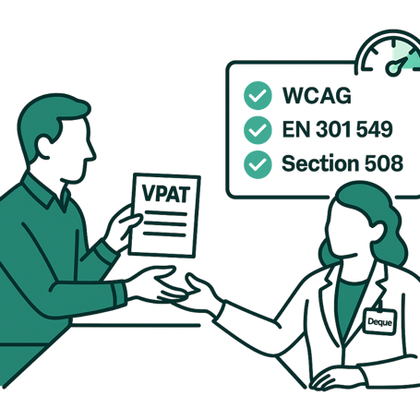
Procurement: Buy Accessible
Required VPATs for all ICT purchases
internal & external-facing tools
Impact-based review:
High, medium, low tiers guide testing rigor
CIAO-led audits for high-risk tools
Automated + manual testing
Assistive Technology acceptance testing
Exceptions require:
Justification
RAAP (Reasonable Accommodation Access Plan)
Approval from CEO or CIAO
9 Procurement: A11Y Maturity Model

Slide 34
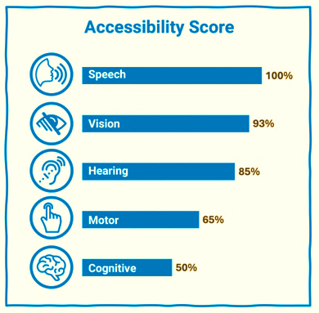
Procurement Contracts & Questions
Contract language that requires:
Accessibility warranty
Vendor accountable for remediation
Right to audit
Ask key questions
Consider using HECVAT a11y questions (Higher Education Community Vendor Assessment Toolkit )
9 Procurement: A11Y Maturity Model

Slide 35
HECVAT A11Y Questions
1-5 Provide Accessibility Contact Name, Title, Email, Phone Number and Web Accessibility Statement or VPAT.
Has a VPAT or ACR been created or updated for the solution and version under consideration within the past 12 months?
Will your company agree to meet your stated accessibility standard or WCAG 2.1 AA as part of your contractual agreement for the solution?
Does the solution substantially conform to WCAG 2.1 AA?
Do you have a documented and implemented process for reporting and tracking accessibility issues?
Do you have documentation to support the accessibility features of your solution?
Has a third-party expert conducted an audit of the most recent version of your solution?
Do you have a documented and implemented process for verifying accessibility conformance?
Have you adopted a technical or legal standard of conformance for the solution?
Can you provide a current, detailed accessibility roadmap with delivery timelines?
Do you expect your staff to maintain a current skill set in IT accessibility?
Do you have documented processes and procedures for implementing accessibility into your development lifecycle?
Can all functions of the application or service be performed using only the keyboard?
Does your product rely on activating a special "accessibility mode," a "lite version," or using an alternate interface (including “overlay” or AI-based alternates) for accessibility purposes?
educause.edu/higher-education-community-vendor-assessment-toolkit
9 Procurement: A11Y Maturity Model

Slide 36
Goodwitch’s Version of A11Y Questions
v
Do all product interfaces (both for administrators and end-users) substantially conform with EN 301 549, WCAG 2.2 A/AA, and/or Section 508?
Provide a Voluntary Product Accessibility Template (VPAT) for your product.
Describe your accessibility conformance testing process.
Do you test with users with disabilities?
If so, describe the process and provide an overview of the disability types and assistive technologies included
Is accessibility testing performed prior to each major release?
Do you use a third-party accessibility evaluation company to verify your accessibility compliance?
If so, please provide a copy of your most recent evaluation report.
Do you have a designated a11y representative to address issues or questions and provide oversight related to the a11y of your product?
If yes, what is their name, title and email address?
What is your timeline for resolving a11y barriers identified under EN 301 549, WCAG 2.2 A/AA, or Section 508?
If your product is not fully accessible, do you have a roadmap to make your product fully compliant?
If so, include your roadmap.
What methods do you use to inform customers of accessibility errors?
9 Procurement: A11Y Maturity Model

Slide 37
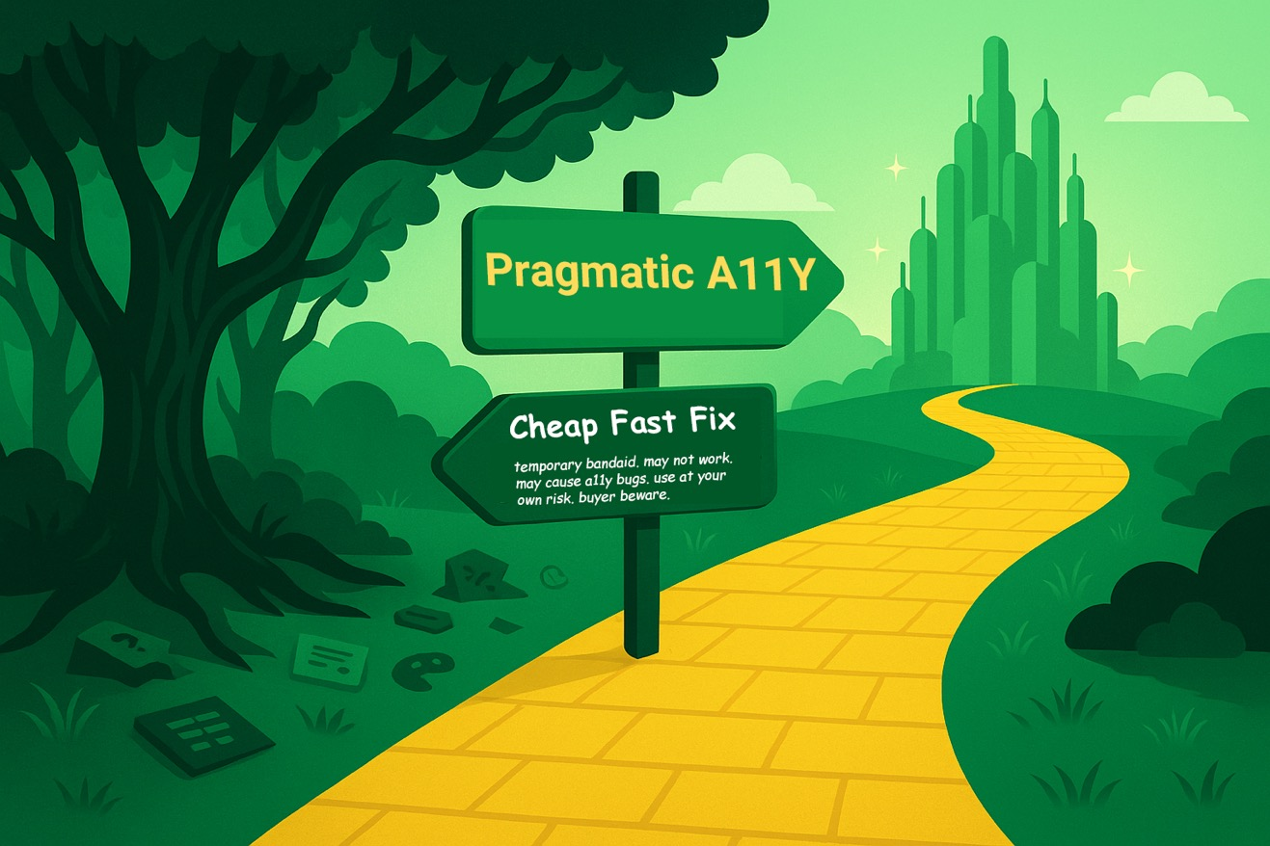
Dangers on the road to a11y

Slide 38
Accessibility in every HR process at Deque
Recruiting | Onboarding | Day-to-Day Work | Feedback & Growth
Accessible job postings & HR platform | Accessible training materials | Work, meetings, and communications designed to be a11y | Accessible performance reviews
Clear accommodation statement | Accessible software tools (or proactive accommodation plans) | HR central support for accommodations | Mentorship to nurture, growth and promote talent
Accessible interviews and equitable hiring | Required accessible communications training | Chief Info A11Y Officer available for research and solutioning | Equitable promotion paths
Accessibility is core to how we recruit, hire, support, and grow talent
10 HR: A11Y Maturity Model

Slide 39
Sustainable A11Y: Full Circle
Policy
Budget
Training
Communicate
Help Desk Support
Govern
SDLC
HR
Culture
Procure

Slide 40
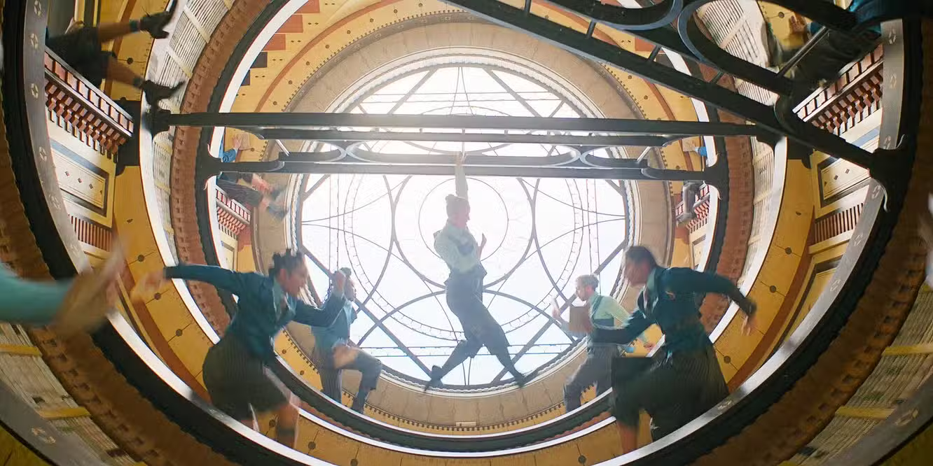
Sustainable A11Y Requires Collaboration
Notes:
There is a scene from the 1st Wicked movie that remind me of sustainable a11y programs. It is Dancing Through Life, in the library with spinning bookshelf wheels with amazing choreography. Just like a well tuned sustainable a11y program - There are so many moving parts…design, development, testing, procurement, policy, training, culture… and they’re all spinning at the same time. No single person can do all the things alone. Sustainable accessibility only happens when everyone plays their part, and when those parts are in sync. The magic is in collaboration: turning what looks like chaos into coordinated momentum."

Slide 41
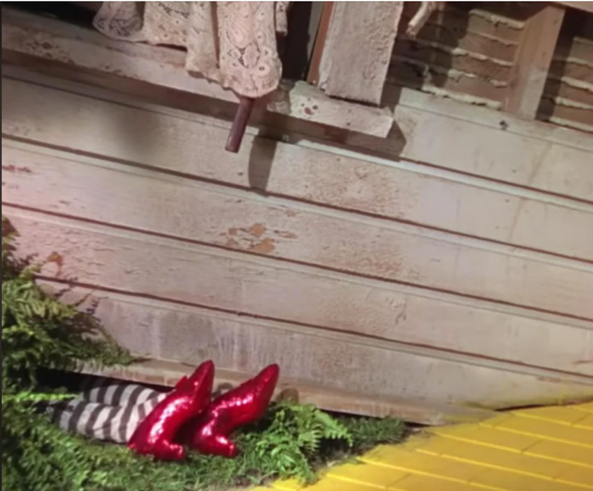
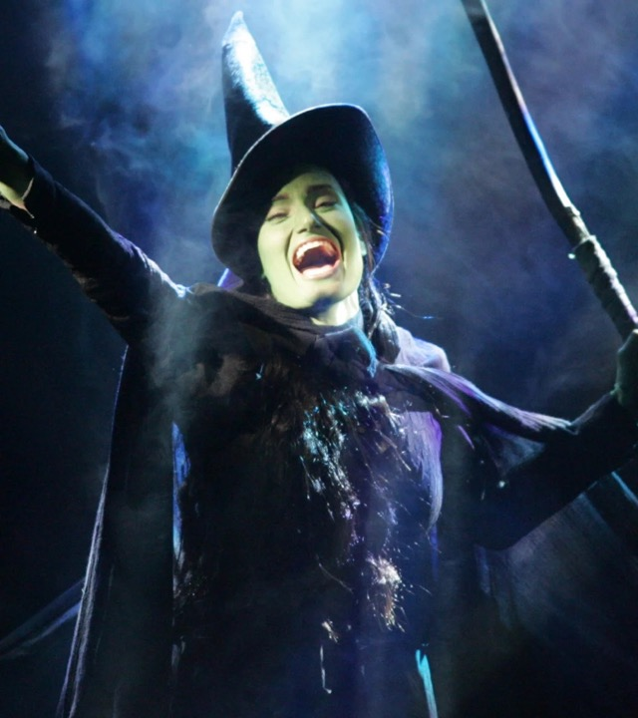
How are you feeling?

Slide 42
Where will YOU move A11Y forward in your org ?
Policy
Govern
Training
Procure
Help Desk Support
SDLC
Budget
Comms
HR
Culture

Slide 43

A11Y for Good
Because everyone deserves Digital Equality

