Slide 1
Introducing Everway
Neurotechnology, UDL and What’s Next for Tools Supporting Every Learner in Higher Education

Slide 2


Hello!
Rachel Kruzel, ATP
Strategic Customer Success Manager - Higher Education
Everway
Email: r.kruzel@everway.com
Phone: 651-245-3128

Slide 3
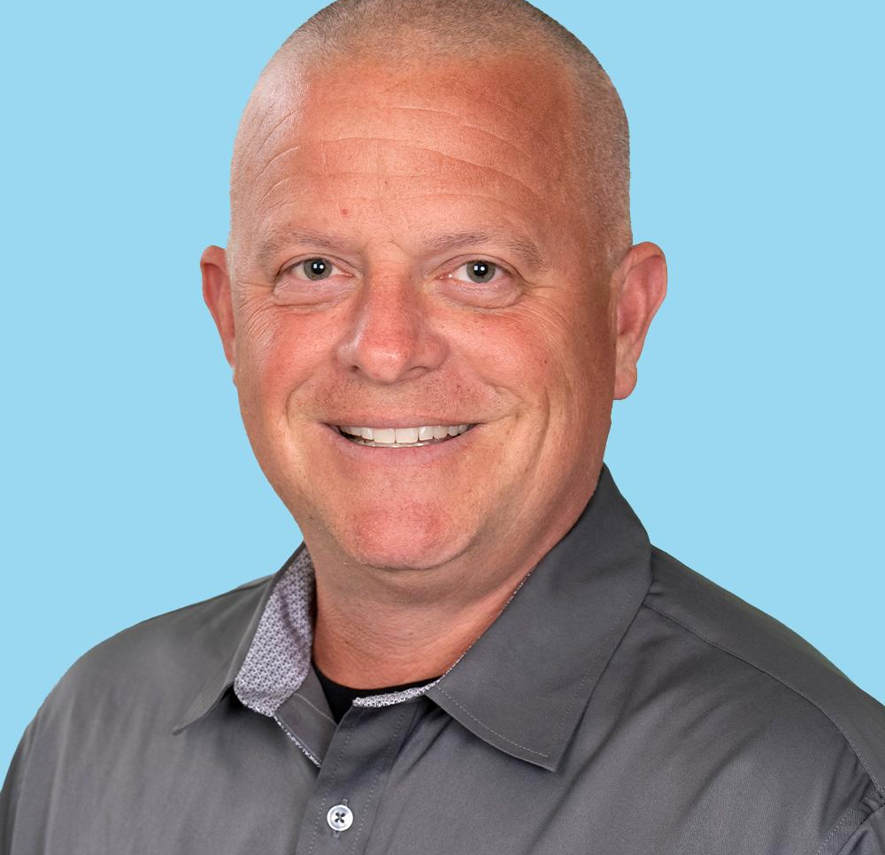
Hello from Louis!
Louis Shanafelt
Senior Product Manager, Equatio
Everway
Email: l.shanafelt@everway.com
Phone: 407-717-8854

Slide 4
Agenda
Higher Education Landscape
Inclusive learning, UDL and Neurodiversity
Inclusive Technology in Action
Get to know Everway and neurotechnology
Discussions & Questions

Slide 5

Higher Education Landscape

Slide 6
Shift to inclusive learning environments
Student differentiation
Variability between, within and amongst students
Embracing neurodiversity
Increased focus on neurodiversity of learners given data and identification
Accommodation to universal inclusion
Maximize inclusion for all students; reactive to proactive
Universal Design for Learning
A continued focus on UDL as a method for creating inclusive learning; designing for variability, not exception

Slide 7
Neurodiversity in higher ed
Neurodiversity
Natural variation in how people think, learn and process
Diagnosis and self-identification
ADHD, dyslexia, autism, dyscalculia, anxiety and self-identification
Strength-based approach
Innovation, creativity, focus and attention, problem-solving
Conversational shifts
Strengths over deficits; uniqueness and variability

Slide 8
Neurodiversity in higher ed: challenges and opportunities
Challenges
Current reliance on self-disclosure and accommodations
Inconsistent faculty awareness
Campus supports, bandwidth, expertise, silos and fragmentation
Stigma and misunderstanding
Opportunities
Continued UDL adoption
Pedagogical shifts towards neuroinclusive courses
Cross-departmental collaboration; Teaching & Learning, Student Success/Student Support, Faculty
Integration of inclusive technology

Slide 9
Inclusive Technology in Action

Slide 10
Importance of inclusive technology
Supports neurodiversity & student variability
Executive functioning, expression, comprehension, supporting learners broadly
Promotes equitable access
Decreases need for diagnosis, disclosure and accommodations
Personalized learning
Learn and engage with course content in methods and ways that fit best
Reinforces UDL and inclusion
Continue promotion of UDL and inclusion efforts

Slide 11

Everway

Slide 12
Our vision
Everway will lead the world in neurotechnology software, helping transform the way we understand and are understood.

Slide 13
Everway Tools
Planning
Our planning tools provide the data and insights to support educators in their instructional decision-making.
Assisting
Our tools break down barriers and empower individuals to succeed, in the classroom, at college, and in the workplace.
Instructing
Our curriculum and instruction tools give teachers the resources and support they need to create differentiated learning experiences based on students’ diverse needs.

Slide 14

Read&Write

Slide 15
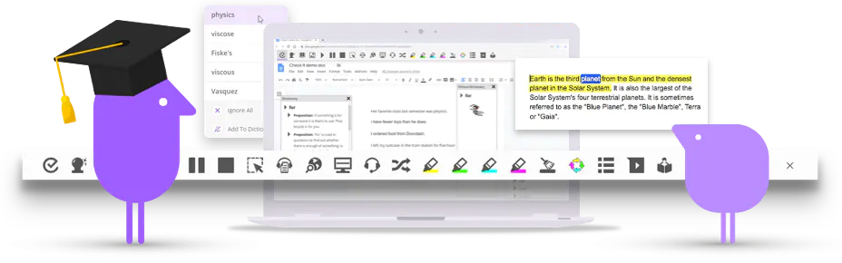

Read&Write overview
Help students understand, engage and express themselves
Read&Write is a literacy support tool that offers help with everyday tasks like reading text out loud, understanding unfamiliar words, researching assignments and proofing written work.

Slide 16
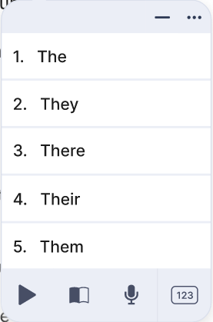
One toolbar, three “views”
Horizontal
Vertical
Writing
Students can choose the toolbar experience that works best for them.

Slide 17

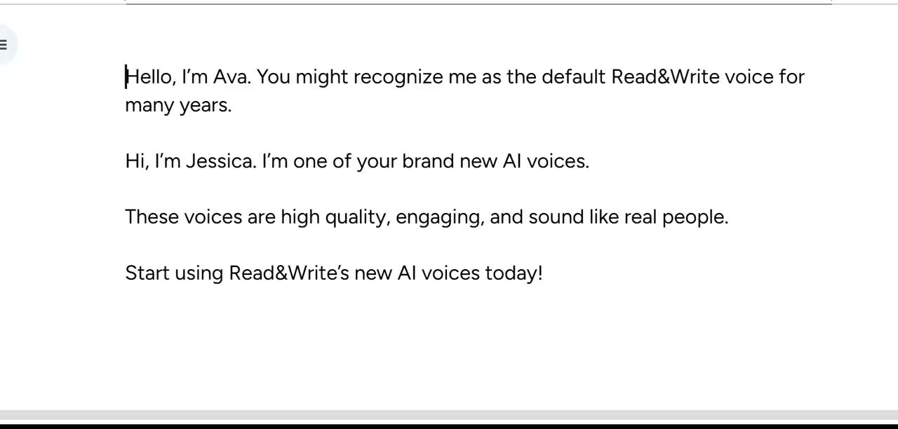
AI Voices
Realistic, high quality voices with natural tone and expression.
Provided by Elevenlabs, an industry leader in AI voice technology.
Now available in Read&Write on Chrome, Microsoft Edge, and Windows.

Slide 18
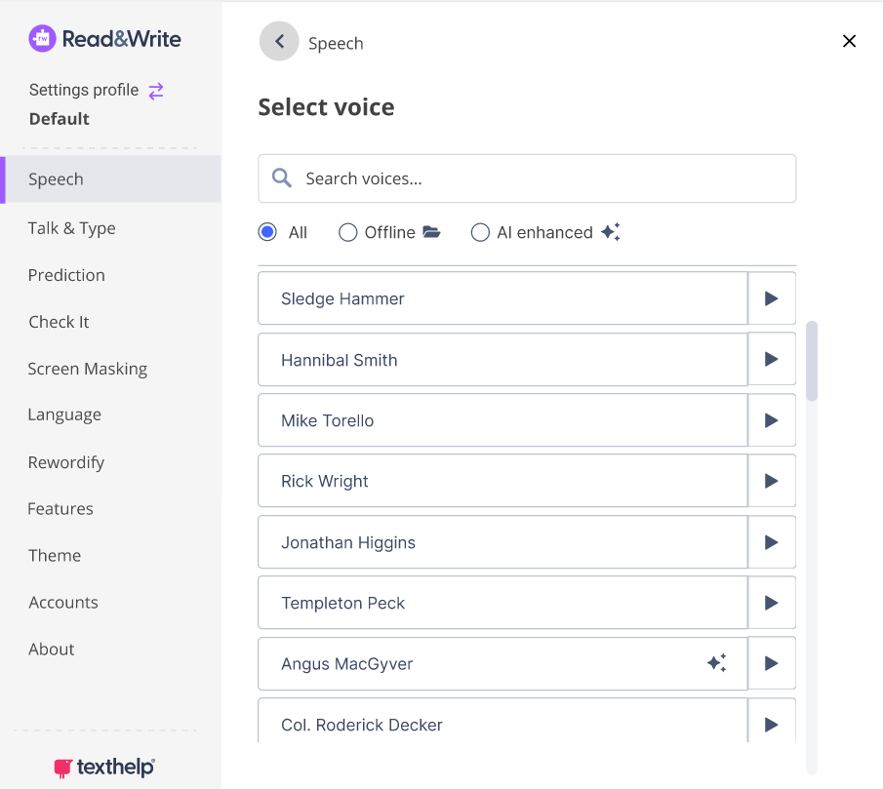
New and improved voice list
The new voice list makes it easier for students to find the voice that works best for them.
This includes new filtering options, and the ability to preview what the voices sound like.

Slide 19
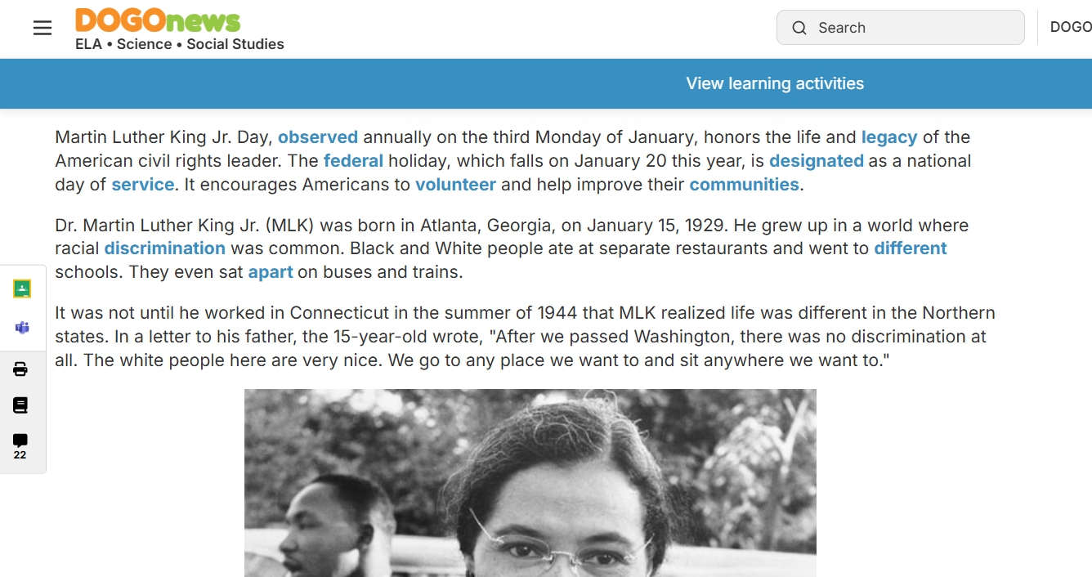
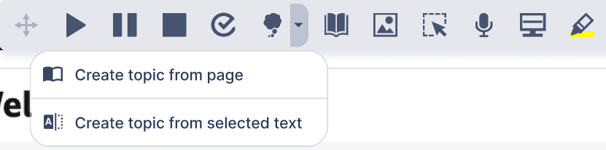
Custom topics
Create your own topics from a website, document, or any selected text.
This adds and prioritizes more subject-specific words in your prediction list.
This can be helpful when repeatedly using words that are complex or difficult to spell.

Slide 20
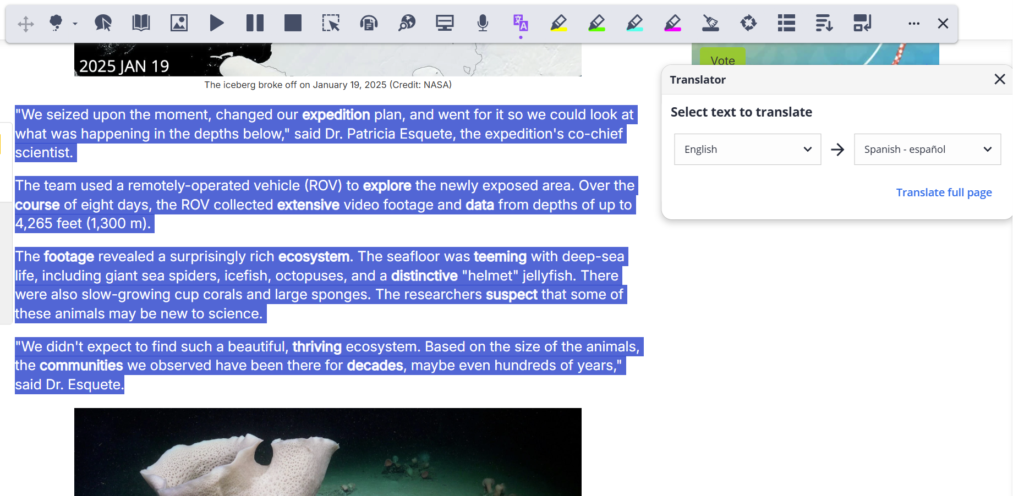
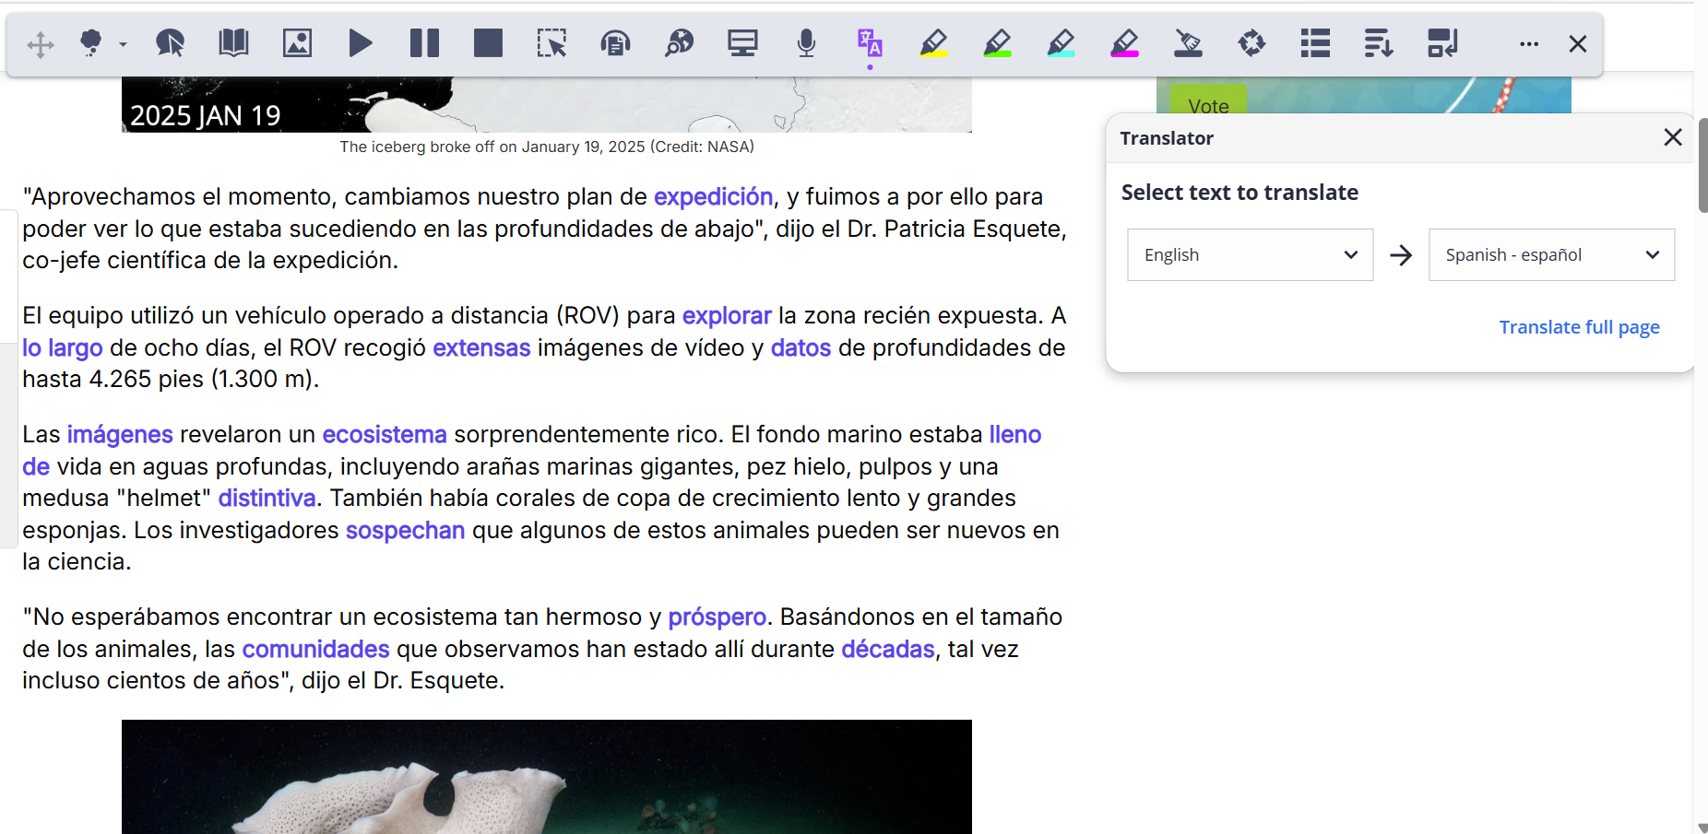
Paragraph and Page Translation
Translate any amount of text in Docs, Slides, Word, and on the web.
Translated text displays directly on webpages, and in the Translator window in other environments.
30+ languages available including the top used and requested languages from our customers.

Slide 21
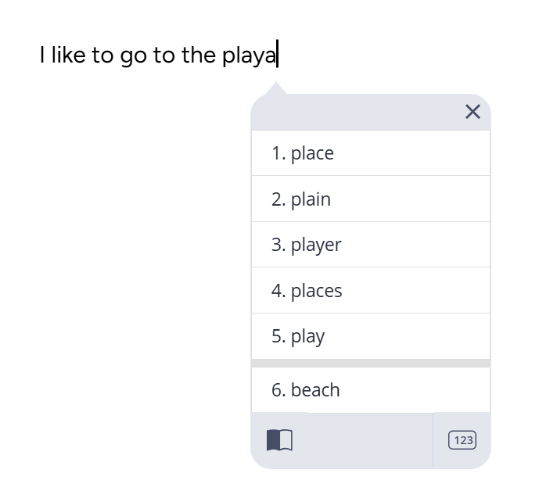
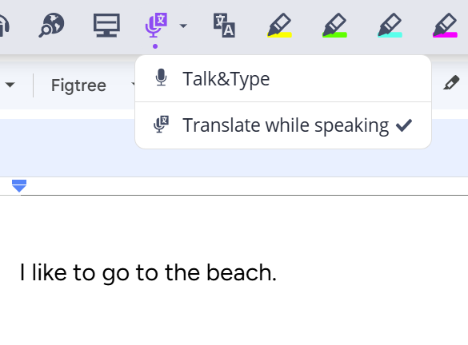
Translate while typing or speaking
Speak in one language, and have your text transcribed in another language. Or type a word in one language, and get a suggested translation.
Ideal for multilingual students, international students, or anyone needing additional support communicating.
“Me gusta ir a la playa”

Slide 22
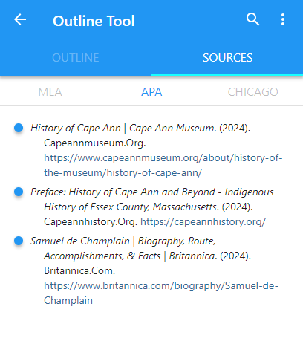
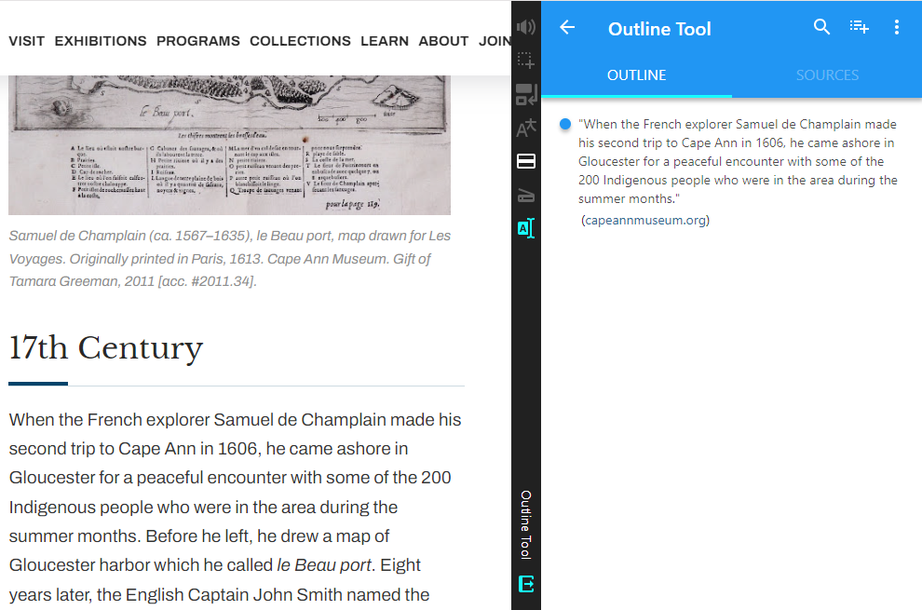
Outline Tool & Citation Generator
What’s Later
Create your own Outline with quotes from multiple resources into a single outline.
Automatically save citation information and provide citation support for MLA - APA - Chicago.

Slide 23

Read&Write (Education)
Robust translation
Paragraph and page translation allows users to translate entire paragraphs or web pages of text. Translation while speaking or typing allow users to type or speak in one language and have that content translated to another language.
Improved text to speech in more places
Behind the scenes improvements to make text to speech more consistent in Learning Management Systems such as D2L Brightspace.
Arabic text to speech
Adding the Arabic Zeina voice to support current and prospective users in Arabic speaking regions.
Rewordify enhancements
A new setting to display rewordified text with a purple highlight, based on stakeholder feedback and input.

Slide 24

OrbitNote

Slide 25

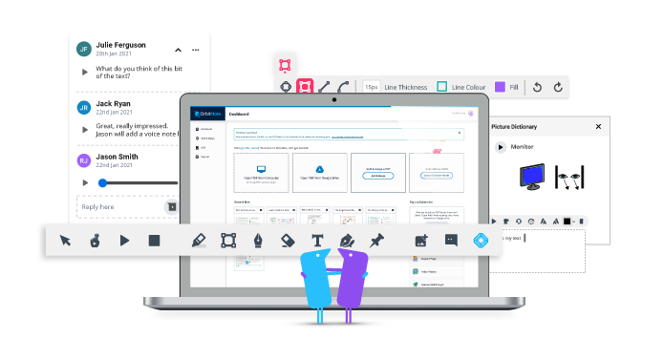
OrbitNote overview
Create, convert, connect:
Take your documents to the next level
OrbitNote allows you to transform and interact with documents in a completely different way. Create an accessible, dynamic and collaborative space that works for everyone.

Slide 26
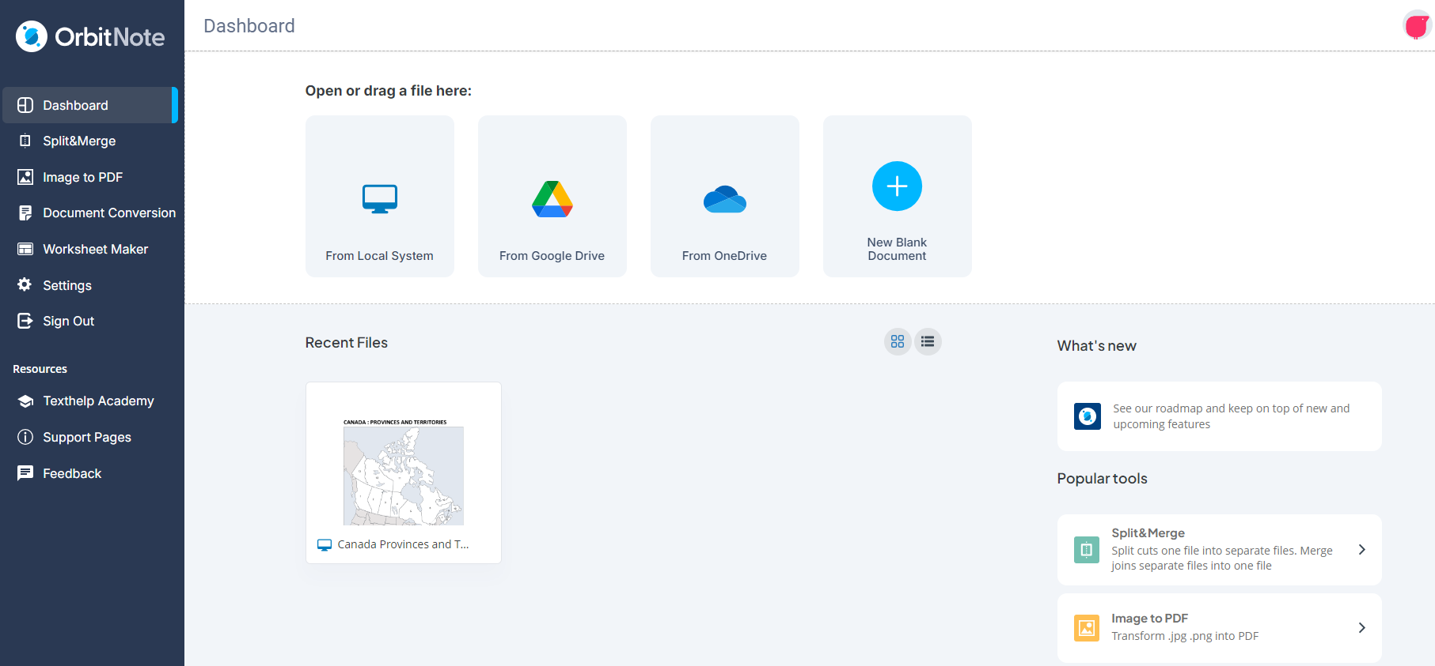
OrbitNote Modern - Redesigned Dashboard

Slide 27
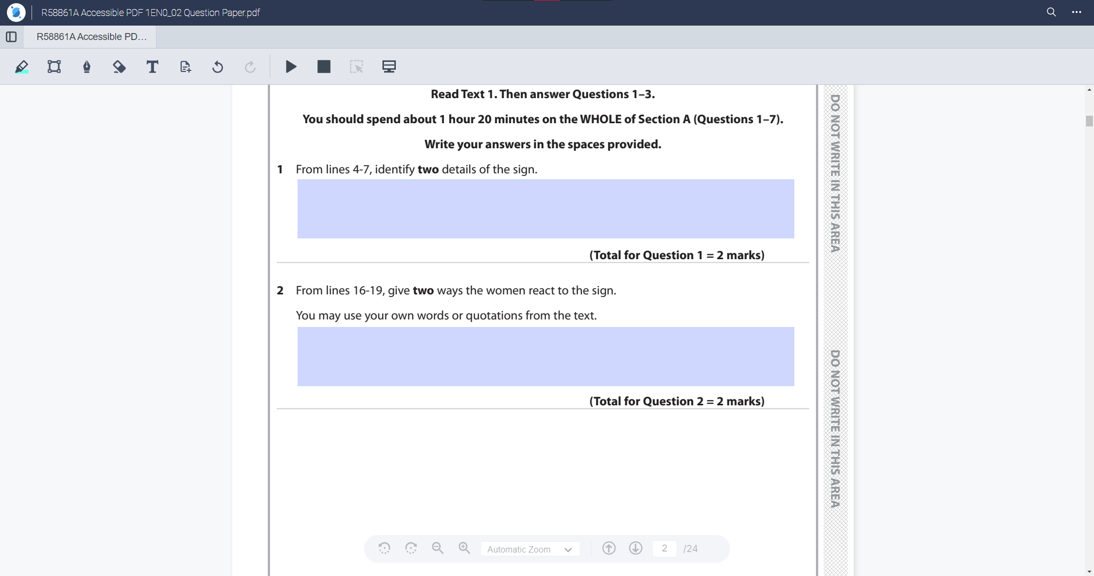
Support for Fillable Areas on PDFs

Slide 28

OrbitNote updates
ON Classic to Modern Migration
The OrbitNote Product team is hard at work to migrate customers over to our ON Modern product
Canvas Integration
OrbitNote Modern now has a direct integration with the Canvas LMS. Canvas is a popular LMS used by many customers, and this is a key ‘parity’ goal for the OrbitNote Modern revamp.

Slide 29

Equatio

Slide 30
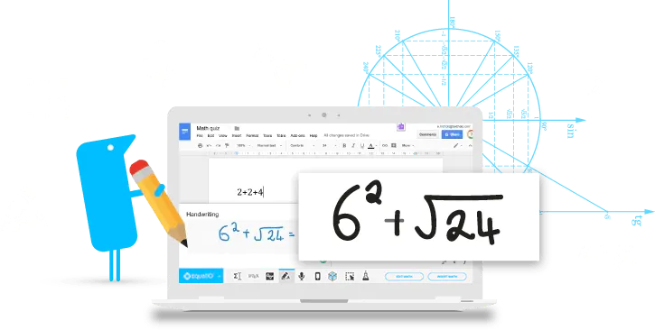


Equatio overview
Make math Digital
Our mission is to make math accessible, inclusive, and engaging for every learner.

Slide 31
Benefits of Equatio as a UDL tool include:
Multiple means of expression: Students can demonstrate understanding using voice, handwriting, or typing which makes math more accessible to diverse learners.
Multiple means of representation: Math to Speech reads equations aloud, helping students visualize and hear concepts simultaneously for deeper comprehension and helps students build a proper math vocabulary.
Multiple means of engagement: Interactive features, such as digital manipulatives and visual math creation, foster curiosity and confidence in learners of all abilities.
Supports inclusive STEM instruction: Ensures every student can participate in rigorous math and science learning without barriers.
Built for flexibility and compliance: Works seamlessly across platforms and aligns with WCAG accessibility standards to help districts meet federal inclusion mandates.

Slide 32
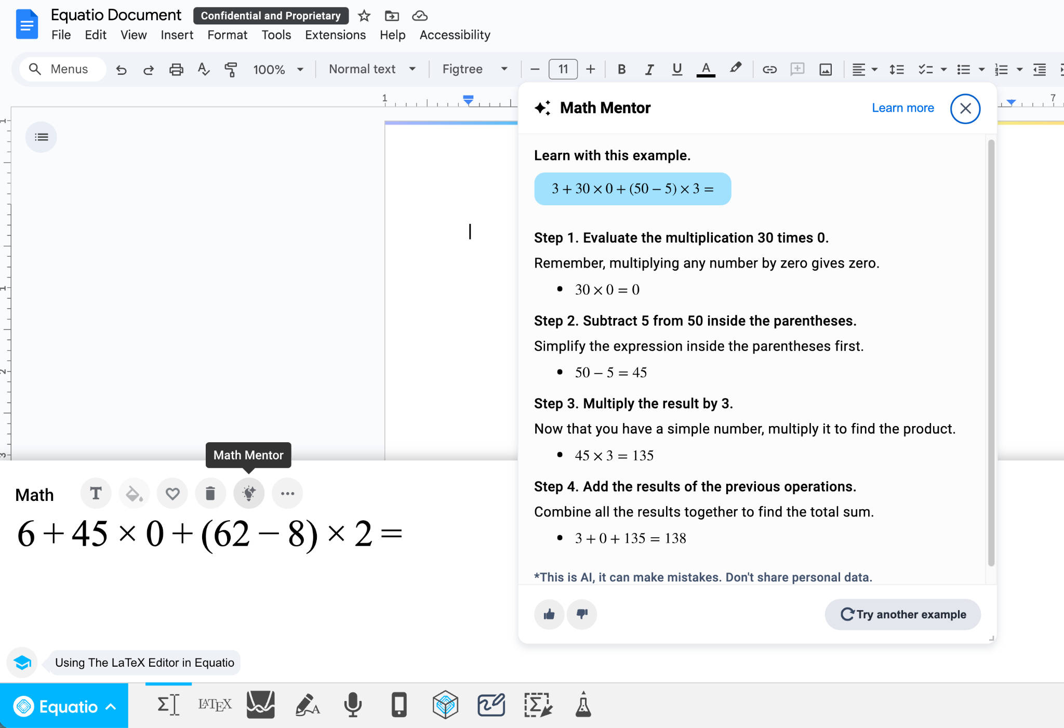
Equatio Math Mentor
Provides guidance to learners when completing assignments.
Academic integrity considerations - does not give answer to problem.
Embedded in the tool for ease of use and access.
Ability to turn on and off for assessment.

Slide 33
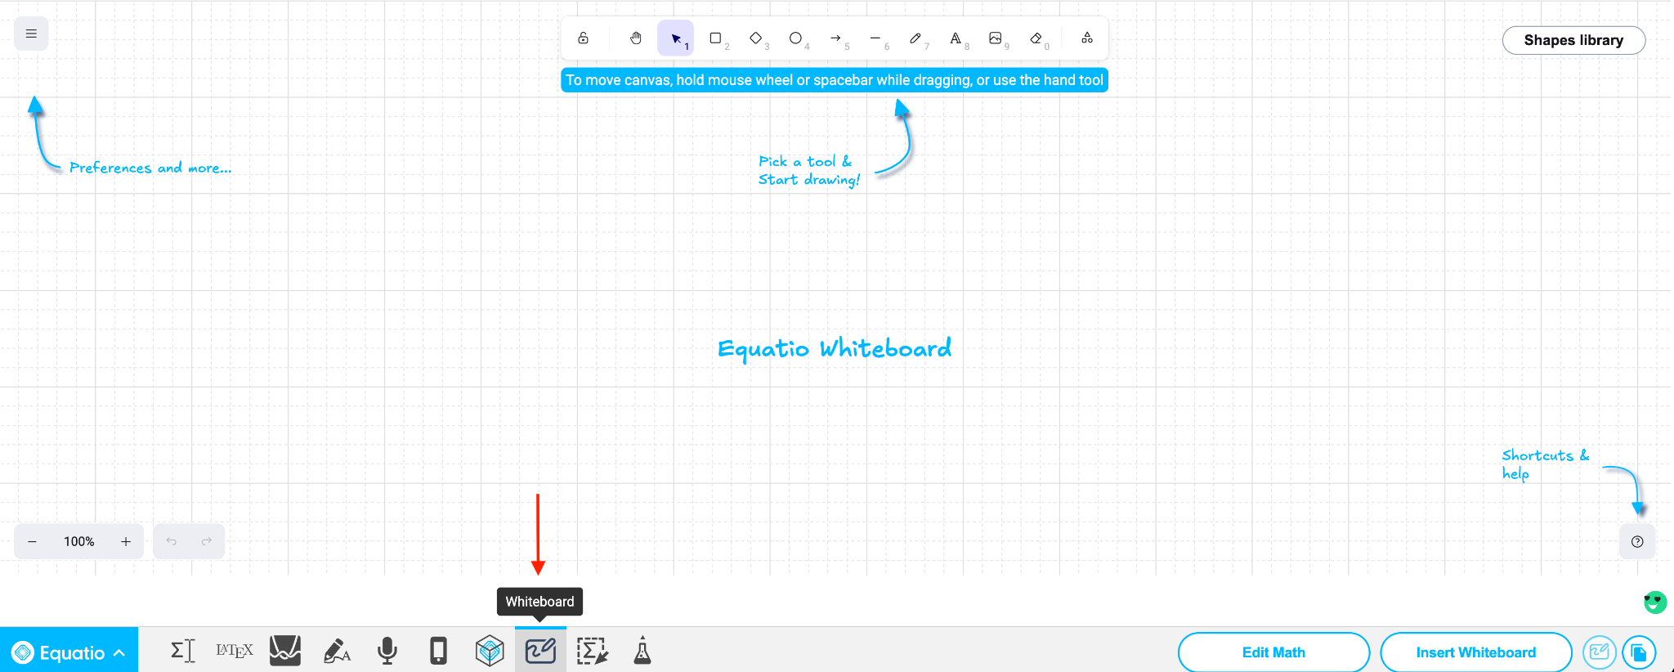
Equatio Whiteboard
New feature added to Chrome and Windows Desktop.
Alternative to Insert Mathspace to create non-equation based content and the ability to show work.
Additional capability and features coming soon to support additional functionality and accessibility.

Slide 34
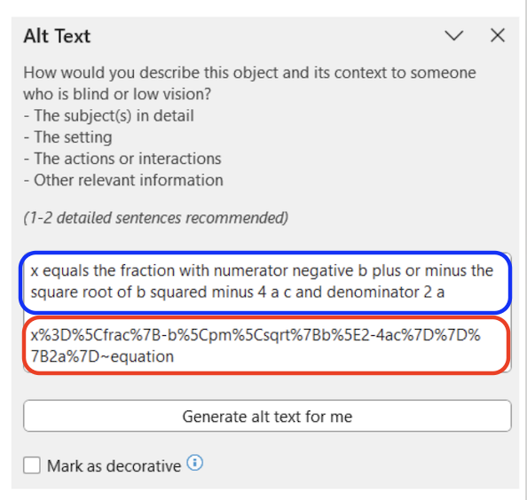
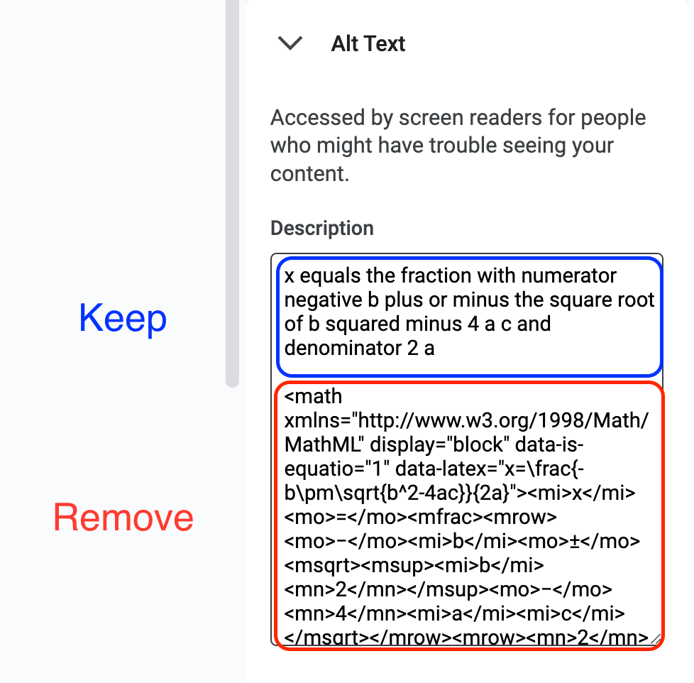
Alt Text/Description Box
Removal of URL encoded LaTeX within Alt Text/Description boxes in Desktop.
Removal of MathML within Alt Text/Description boxes in Google Apps.
Spoken text description still available within Alt Text box but removes additional text which is unnecessary for accessibility.

Slide 35

Equatio updates
Prediction Box
Smarter Math suggestions. When typing in the Equation Editor, the most commonly used items will now appear first. A prioritization algorithm will showcase results that are most helpful to our users.
Next-Gen Mathspace: Better Tools, Smoother Annotations
This next-gen mathspace will provide better tools and smoother annotations.
Enhanced Whiteboard
Enhanced Whiteboard in Equatio will include more fonts, cropping functionality and more.

Slide 36
Every mind matters
Neuroinclusion is here to stay
It is not a trend, it’s the future of higher education and our world
Neuroinclusive campuses
Strengthen community, belonging and student success
UDL and inclusive technology
Provides empowerment, equity and engagement

Slide 37
Questions & Discussion

