Slide 1
From Insight to Impact
Emerging Trends and Tools Transforming Higher Education

Slide 2


Hello!
Rachel Kruzel, ATP
Strategic Customer Success Manager - Higher Education
Everway
Email: r.kruzel@everway.com
Phone: 651-245-3128

Slide 3
Agenda
1. Introduction & Agenda
2. Transformative Tech Topics
3. Application & Examples
4. Reflection & Understanding
5. Questions & Discussion

Slide 4
Why is this important?
Collaboration
The dismantling of silos is more important than ever, we work in a larger ecosystem of our campuses and the field of higher education.
The influence of technology
Centrality of technology to our lives, core component of how our campuses operate and how we do our jobs.
Pivotal time
Connectedness is more important than ever given the rocky landscape that is ahead of us.
Enhance and amplify your work
Alignment with this work elevates your office and the support you can provide to students, stewards of accessibility and student support.

Slide 5

Digital Transformation

Slide 6
What is Digital Transformation?
“Digital transformation in higher education is the strategic use of digital technologies to improve the educational experience of how institutions operate. It involves a comprehensive approach that changes how institutions deliver value to students and staff, and requires a strategic approach across multiple departments, faculties, and campuses.”

Slide 7
Key ideas about digital transformation
Strategic Plan for technology
Long term planning with stakeholders focused on goals and impacts technology can make on the educational experience.
Implementation of identified assets
Putting into practice identified technologies to improve campus offerings.
Review and reflection
What has worked? Have we seen an impact? What are campus’ thoughts?
Iterative process
Where do we go from here now? What has changed in academia that we need to be mindful of?

Slide 8
Key statistics on digital transformation
“About two out of three CTOs said that digital transformation of their institution is essential (23 percent) or a high priority (39 percent).”
“Regarding their institution’s priority areas for digital transformation efforts, many CTOs (81 percent) cited student success.”
Source: Most Campus Tech Leaders Say Higher Ed is Unprepared for AI’s Rise

Slide 9
Application of digital transformation
Increased access to AT
Assistive technology is technology, and is becoming more central to how individuals with disabilities navigate the world.
AT becoming EdTech and built-in tools
Increase availability of AT tools and accessibility features innately built into software tools and platforms.
Digital accessibility efforts owned by campus
The shared responsibility of digital accessibility of campus stakeholders and departments; the adoption of accessibility focused tools to support these efforts to become a more inclusive campus.

Slide 10
Let’s reflect on digital transformation
What is your campus doing to focus on digital transformation to provide sustainable support for the learners coming to your campus this coming year and beyond?
What are some steps you can take to better understand or support the digital transformation being done on your campus?

Slide 11



Everway Tools

Slide 12
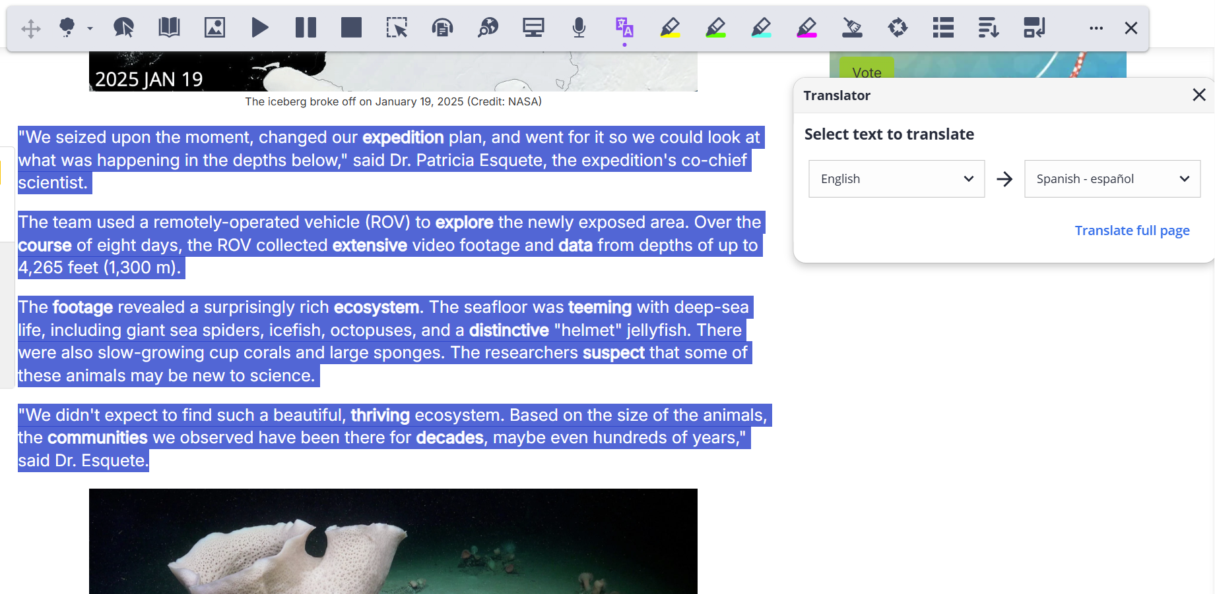
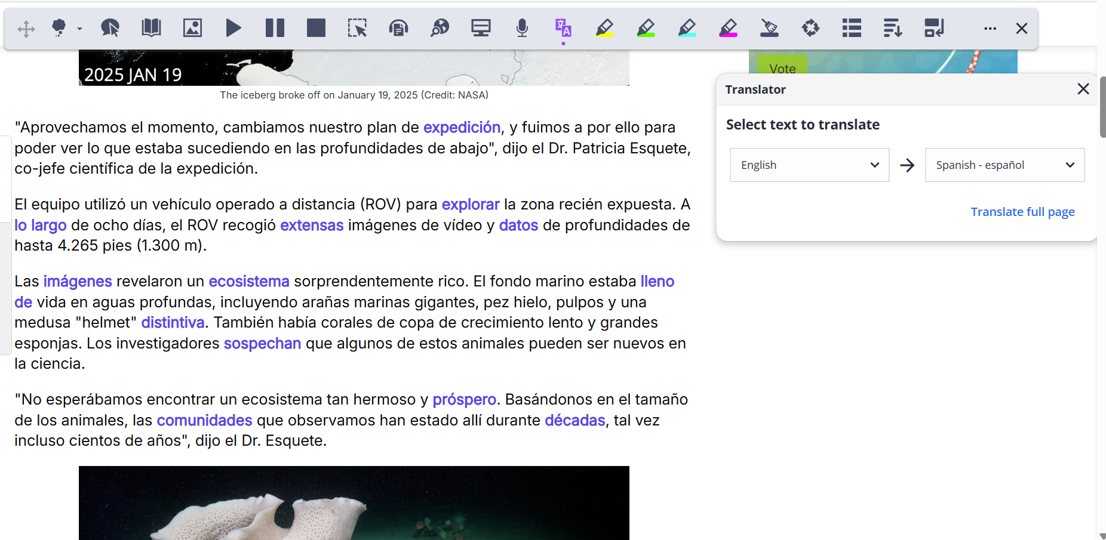
Paragraph and Page Translation
Translate any amount of text in Docs, Slides, Word, and on the web.
Translated text displays directly on webpages, and in the Translator window in other environments.
30+ languages available including the top used and requested languages from our customers.

Slide 13
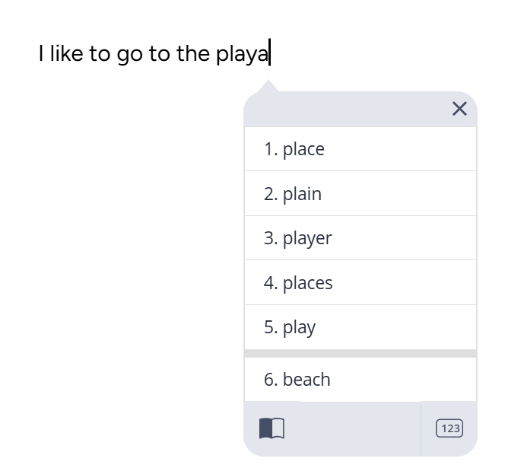
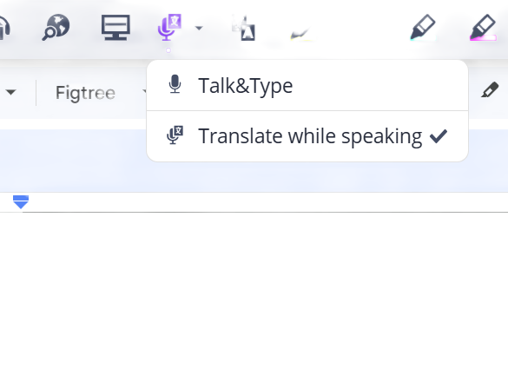
Translate while typing or speaking
Speak in one language, and have your text transcribed in another language. Or type a word in one language, and get a suggested translation.
Ideal for multilingual students, international students, or anyone needing additional support communicating.
“Me gusta ir a la playa”

Slide 14
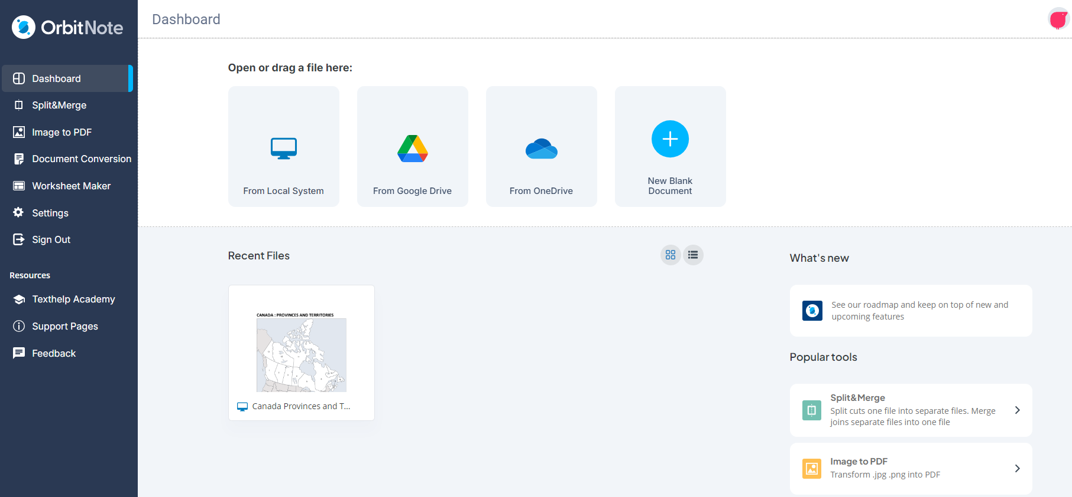
OrbitNote Modern - Redesigned Dashboard

Slide 15
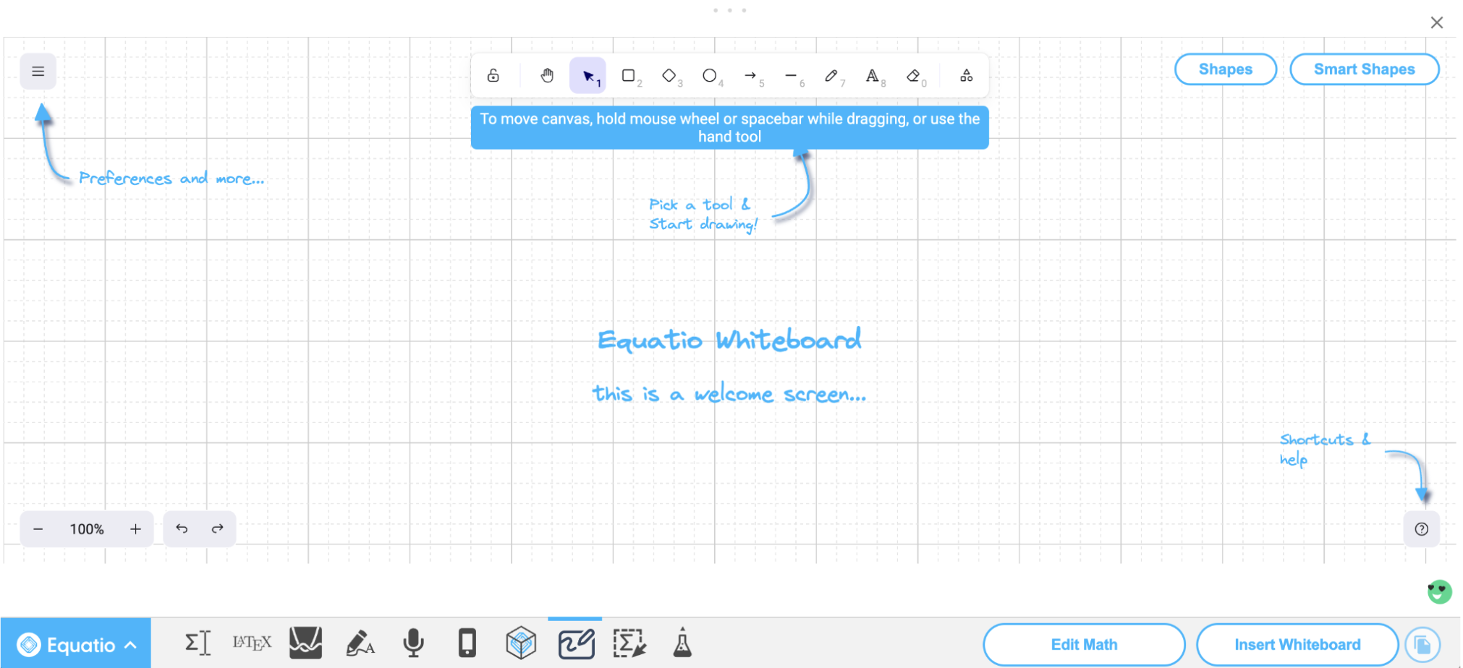
Equatio Whiteboard
New feature added to Chrome and Windows Desktop.
Alternative to Insert Mathspace to create non-equation based content and the ability to show work.
Additional capability and features coming soon to support additional functionality and accessibility.

Slide 16
Artificial Intelligence

Slide 17
What is AI?
Computer systems that perform tasks which typically require human intelligence.
Analysis of datasets, reasoning, learning, perception, problem solving, natural language processing, pattern recognition.

Slide 18
Key challenges about AI
Equity
Are these tools built with equity in mind? Does it include voices and experiences of all? Example: disability community
Access
Who are these available to? Example: institutional type
Academic integrity
Is it being used for good or malice (unintentionally or intentionally) by learners or instructors?
Campus readiness
Are segments of our campus populations ready; training, support, resources digital literacy, and mindset.

Slide 19
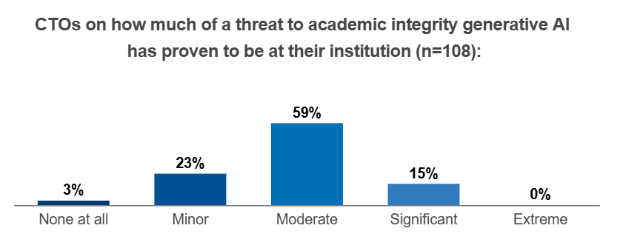
Key statistics on AI and academic integrity
“Three in four chief technology officers say that artificial intelligence has proven to be a moderate or significant risk to academic integrity.”
Source: AI and Threats to Academic Integrity: What to Do

Slide 20
Key statistics on AI & student use
“42 percent of students use generative-AI tools daily or weekly in the spring of 2025, up from 36 percent the previous spring.”
“...the ways in which students commonly use AI: including to start papers and projects, summarize long texts, brainstorm, explore topics, edit writing, solve math problems, conduct research, tutor themselves, and create lesson plans.”
Source: AI to the Rescue

Slide 21
Student use case
“It began with an anatomy and physiology course… she asked ChatGPT about a bone that she didn’t quite understand, and was amazed by the clear explanation. Abeldt began building her AI arsenal. She used ChatGPT and watched YouTube videos to break down complex topics. Perplexity, an AI-powered search engine, helped her find information. Google NotebookLM turned class notes and lecture slides into study guides and podcasts, which she listened to on the way to class. Quizlet made flashcards and ChatGPT created mock exams and quizzes. Abeldt even used AI to develop a study plan to avoid procrastinating or spending too much time on any one assignment. She followed its guidance, and it worked.”
Source: AI to the Rescue

Slide 22
Application of AI
AI voices in text-to-speech
AI voices have become the norm in programs providing key literacy support to students.
AI summaries in notetaking or transcription tools
More accurate and robust summaries of notes taken or audio recordings of lectures.
Summarization tools
Provides summaries of documents and chapters to support the comprehension and reading preparedness of the learners reaching our campuses.
Remediation & accessibility
Built into document remediation software to ease the work and expedite outputs during the creation of accessible documents.

Slide 23
Let’s reflect on AI
What is the general sentiment of your campus and the key groups (students, faculty, staff, IT/Instructional Design) about AI use and adoption?
How or in what ways are you and/or your campus adoption (or rejecting) AI to support learners academically?

Slide 24
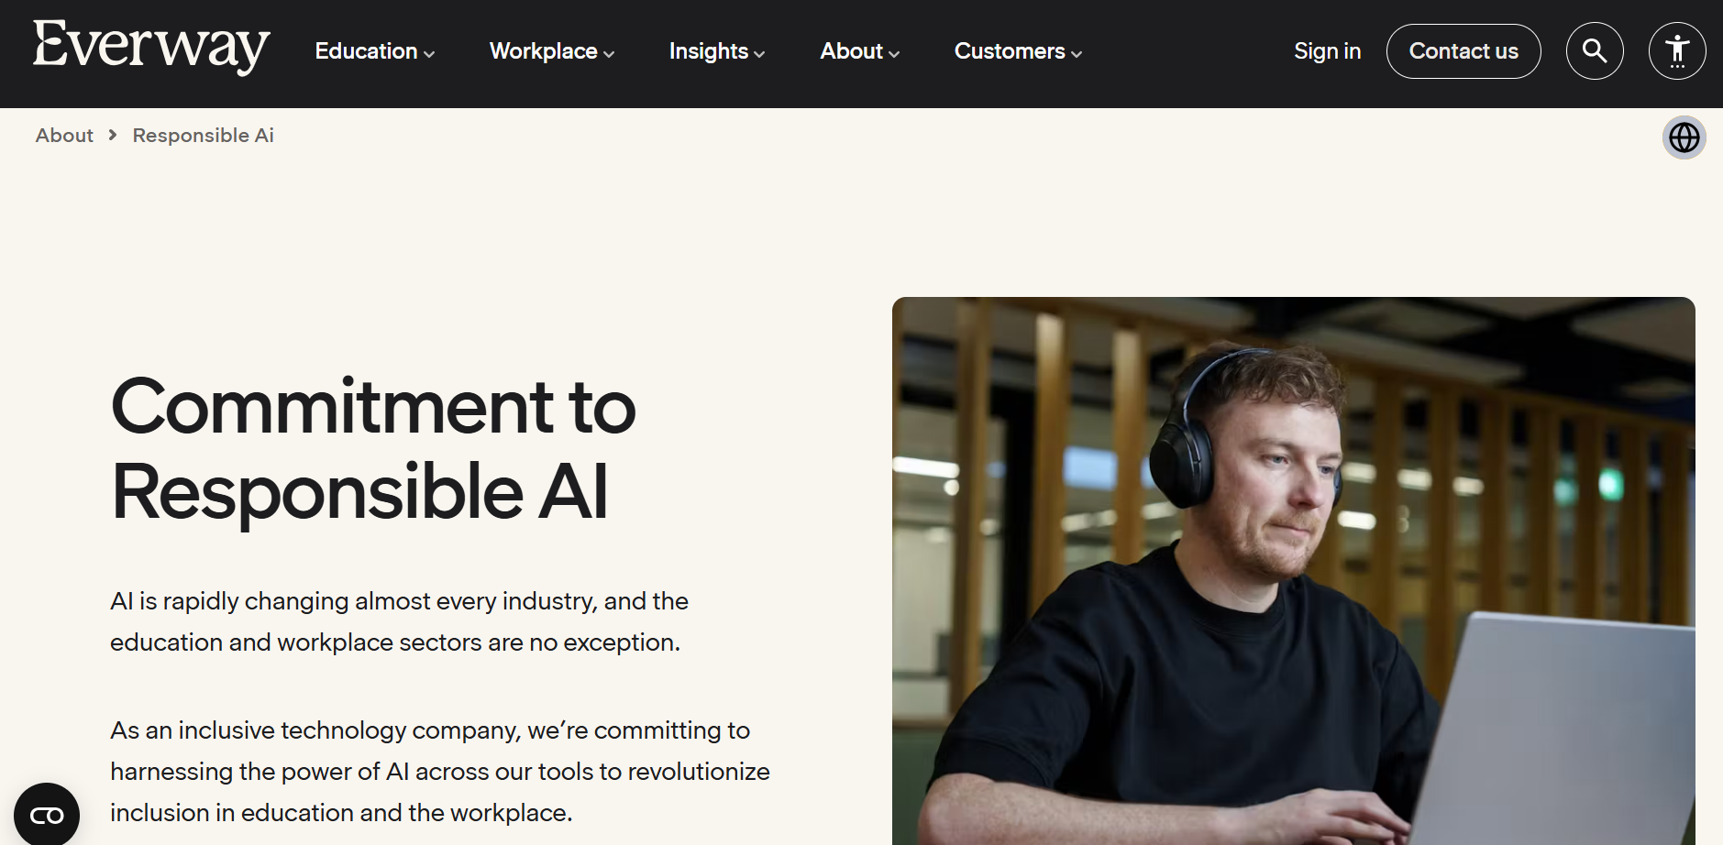
Responsible AI

Slide 25

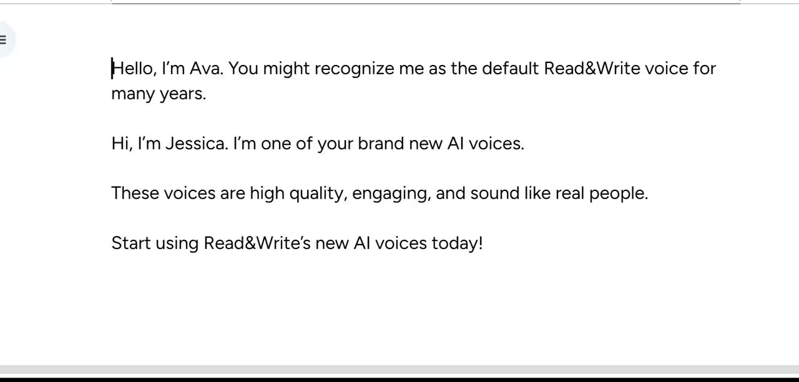
AI Voices
Realistic, high quality voices with natural tone and expression.
Provided by Elevenlabs, an industry leader in AI voice technology.
Now available in Read&Write on Chrome, Microsoft Edge, and Windows.

Slide 26
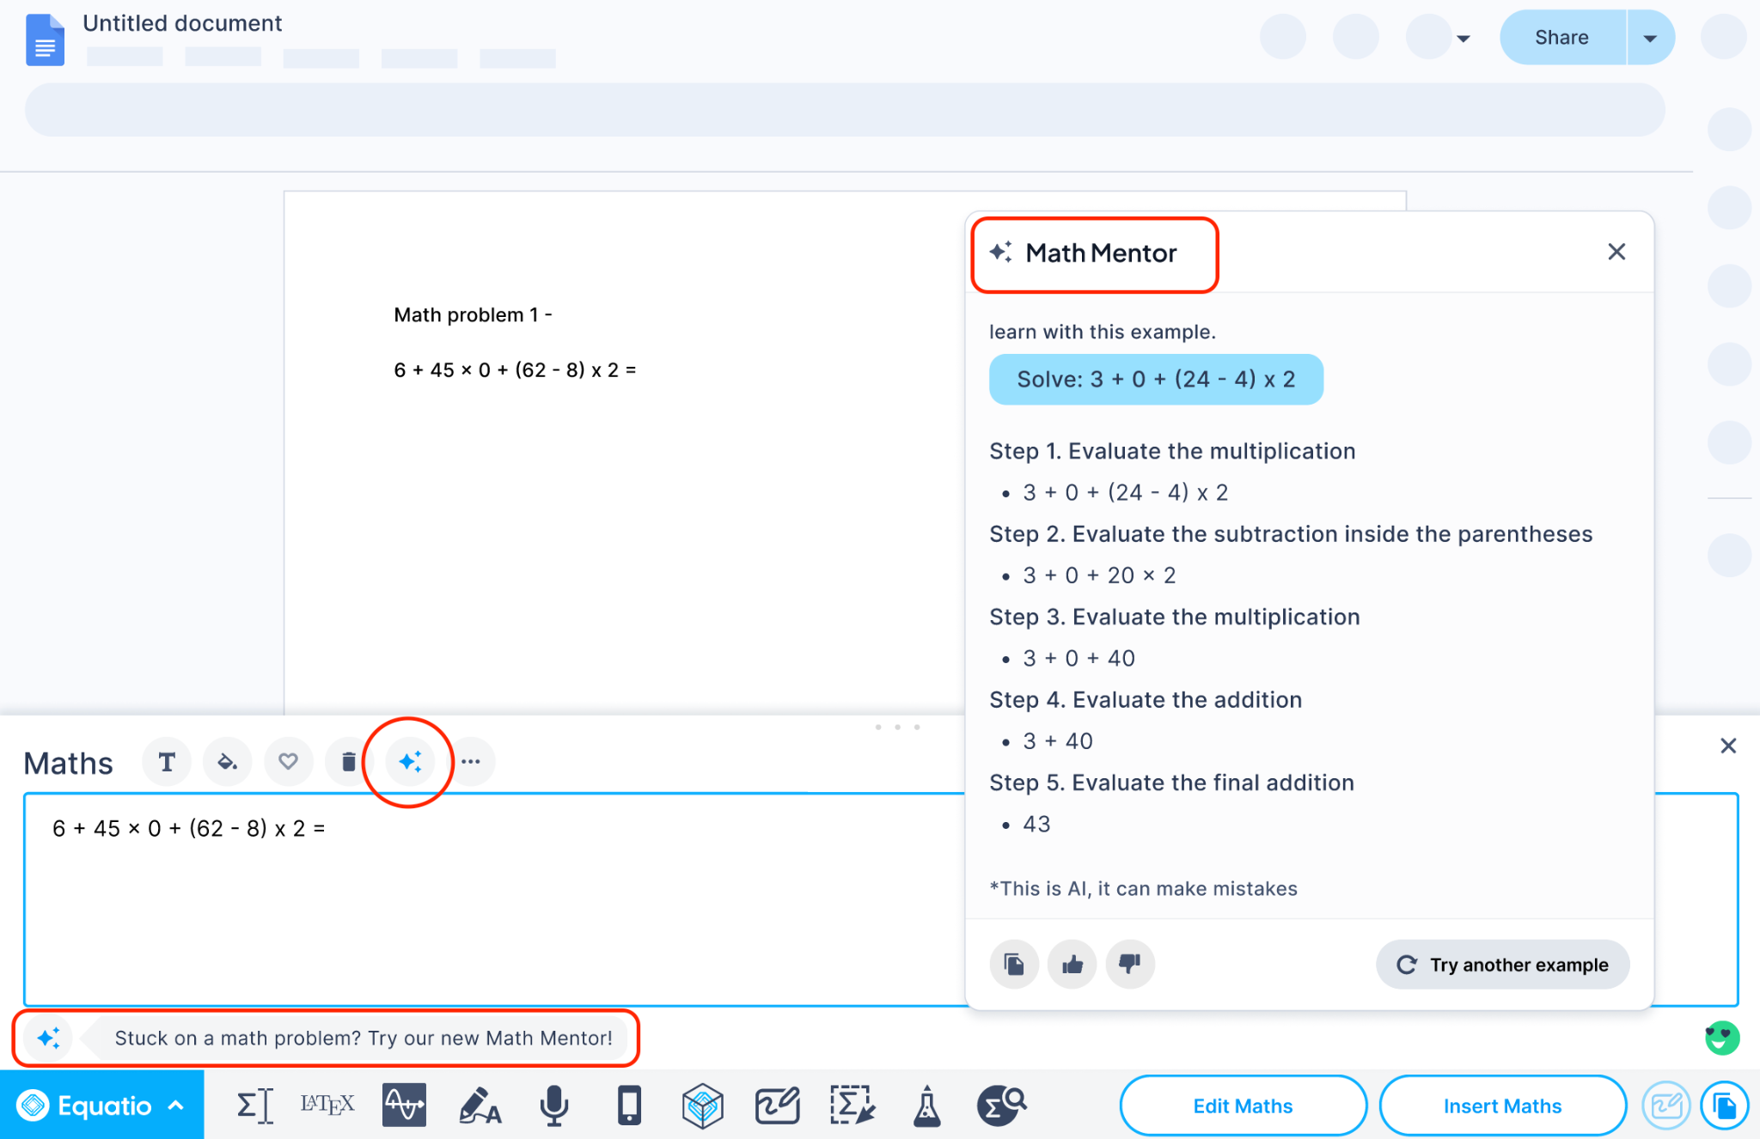
Equatio Math Mentor
Provides guidance to learners when completing assignments.
Academic integrity considerations - does not give answer to problem.
Embedded in the tool for ease of use and access.
Ability to turn on and off for assessment.

Slide 27
Data-Driven Decision Making

Slide 28
What is data-driven decision making?
Utilizing data and analytics to drive decision making about aspects of your campus; such as student support, allocation of resources, and adoption of software.
Academic Return on Investment (AROI) is a key metrics used in higher education.

Slide 29
Key ideas about data-driven decision making
Data is truth
Data and analytics provides clarity instead of ambiguous decision making.
Guides decision making
Objective methods of making hard decisions in turbulent times.
Even bad data is good data
Baseline levels provide catalyst for goal setting, active implementation and accountability - and are all part of the story of data and analytics.
Guidance towards action
Insights which are key for improving student success, individual support, meeting our learners where they are at.

Slide 30
Budgets, funding & resources allocation
Informed prioritization
Data used to identify and fund which initiatives, programs or services will have the biggest impact on student success.
Improve efficiency
Analysis of operational data to find opportunities for cost savings and better resource utilization while being mindful of impact and quality.
Equity-focused investments
Use data to ensure equitable resource distribution, addressing key group of learners and supports populations most in need of support.
Demonstrating impact
Leadership and stakeholders use outcomes data to justify budget request and demonstrate a return on investment.

Slide 31
Key benefits about data-driven decision making
Improved student outcomes ¹
Identifying where students need support and implementing solutions.
Enhanced resources efficiency ²
Optimize spending and ensure effective use of resources.
Better strategic planning ²
Informed decisions based on long-term goal setting and objectives.
Increase institutional competitiveness ³
Effective response to changes in the market while being ahead of trends and on the cutting edge.
Reduced bias ⁴
Decisions based on data, not intuition or personal stake.

Slide 32
Let’s reflect on data-driven decision making
In what ways is your campus embracing data-driven decision making? How has this changed over the last 3 -5 years?
What challenges or barriers does your campus face when trying to use data to inform decisions? How might you address them?

Slide 33
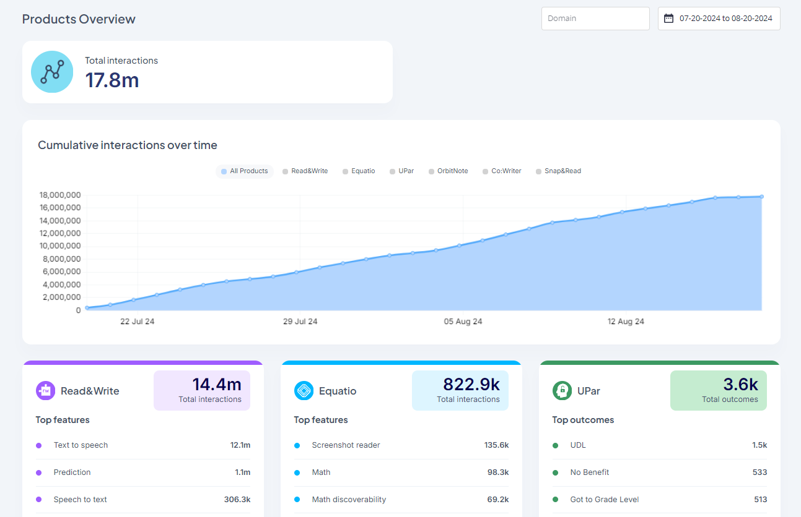
What is the Data Dashboard?
The Data Dashboard is an overview of data engagement trends for all your Everway products
What you can see in your data dashboard:
Total interactions
An interaction is any meaningful way that a user interacts with the procut - clicks, inserts, and other actions.
Engagement trends based on date range with default set to 1 month from current date
Access: datadashboard.texthelp.com - reach out to be added

Slide 34
Discussion & Questions

Slide 35
Let’s Connect!
Rachel Kruzel, ATP
Strategic Customer Success Manager - Higher Education
Everway
Email: r.kruzel@everway.com
Phone: 651-245-3128

