Slide 1

FIU’s Data-Driven Approach: Enhancing student experiences in Disability Services How FIU’s DRC leverages accessible systems, storytelling, and analytics to advance student success Martha Wong, M.S. Associate Director of DRC, ADAC Ashley Pozos Romero, Adaptive Technology Specialist at DRC

Slide 2

Learning Outcomes
Explore how FIU’s DRC integrates technology and data to enhance accessibility.
Examine how storytelling humanizes assistive technology.
Identify strategies for data-informed outreach and inclusive course design.
Notes:
This presentation will explore how storytelling, adaptive technology, and accessible system design come together to support student success, data-informed strategy, and digital equity across campus.

Slide 3
FIU at a Glance
6th largest university in the US
56,000+ enrolled students. 17,000+ graduates in 2024
3,600+ registered with the DRC
Notes:
Founded: 1965 Over 65% Hispanic, making FIU a Hispanic-Serving Institution (HSI)
Students represent 150+ countries
First-generation students: approximately 60%
11 (including Engineering, Medicine, Law, Business, Public Health, and Arts & Sciences) As of January 2025, Florida International University (FIU) employs approximately 12,000 individuals across various continents, including North America, Asia, and Europe and we offer over 200-degree programs.
Now some DRC dept Info on the next slide…..

Slide 4
Who is FIU DRC?
The Disability Resource Center strives to promote student success and retention by ensuring participation for students with disabilities in an inclusive educational environment at FIU.
To fulfill our mission, there are three necessary components:
Provide expert consultation to professors and administrators for practices that include all students’ learning abilities and needs.
Offer University-wide training on legal compliance standards pertaining to ADA accommodations.
Serve as the centralized operational department at FIU that handles all student’s disability-related requests from academic accommodation implementation to disability-related programming.
Notes:
- The number of students registered with the DRC has increased exponentially by over 80% to a total of 4,200 students since 2006.
DRC is currently serving over 3600 students and students from several academic levels and specialty programs such as COM and COL.
Top disability types
ADD/ADHD, Mental Illness, Learning Disability, Autism, Mobility Impairment, and Specific medical condition
Top Accommodations Provided
Adaptive Technology, Extended time on exams, Minimal Distraction Testing Rooms, Digital Recorders, remote cart/transcriptions, disability-related absences, and extensions on assignments
Ashley will now talk a little bit about what are some common adaptive technology tools we offer, many of which are probably the same that are offered in your institutions:

Slide 5
Core Tools used at DRC
SensusAccess – Document conversion
Kurzweil 3000 – Literacy and comprehension support
Genio/Note-taking software – Promotes independent learning
JAWS – Screen reader for blind/VI students
Otter.Ai
Notes:
Ashley’s slide

Slide 6
Vision – The Why?
Assess current challenges and gaps
Gather input from stakeholders and engage your most critical client
Informs resource allocation and funding priorities
Clarify why change matters and what is the purpose that you want to meet
Prioritize key changes and consider a multi-faceted implementation
Notes:
MARTHA Why did we become so data obsessed? Our goals were to:
2. Expand DRC procedures to increase effectiveness in implementation of accommodations through technology and also allow for our numbers to show our gaps
3. Negotiate with vendors and engage companies on including Accessibility Language in Contracts
1. Attain a consistent method of data input, user functionality, and reporting for assessment and data purposes (to accurately report our yearly goals) Florida International University is accredited by the Southern Association of Colleges and Schools Commission on Colleges (SACSCOC)
FIU is using the Transparency Framework from the National Institute for Learning Outcomes Assessment (NILOA) to frame and contextualize institutional assessment practices.
Now we needed a database that allowed us to track this data and measure these outcomes. (next slide)

Slide 7
Access Resource Manager (ARM database)
Customizable data management system to manage students, disabilities, accommodations, & case notes
Custom workflows and data modeling
Built in business intelligence and specialized testing workflow
Customizable for any given business requirement and multi-campus deployment
Integrates with any university system via web services (Panthersoft, Canvas, MyApps)
Offers accessibility features and usability enhancements
Was created with specifically disability services needs in mind!
Notes:
MARTHA The system enables the DRC to monitor tool usage, identify student needs, and coordinate targeted outreach, training, and support across campus. Communicate progress, share data and dashboards, student interaction, and measure satisfaction and usage among others. Incorporating user feedback – We conducted surveys about current practices and what are some recommendations or wants Addressed critical pain points and where we realized a new system was not the “fix” to a situation We conducted trainings (although this wasn’t our initial intended purpose, this shed light on some gaps in understanding our process and procedures Improved our forms, website language, and manuals CRM (customer relationship management) system for access resource management. Offers modules for student management, testing, equipment, accommodations, student and faculty notifications, and disability information. The system is flexible for any given workflow requirement (ex testing groups, cover letter, testing reminders). Unlike our previous application, ARM is web and mobile friendly. It can integrate with any campus solutions or 3rd party software via web services. Additionally, it has built in analytics. Policy alignment: Integrating existing workflows, compliance with institutional and legal guidelines, procurement rules, and ensuring data security REDUNDANT COMMUNICATION AND DIFFERENT ACCESSIBLE FORMS OF COMMUNICATION referred back to our background and training on UDL – using different forms of representation - - timelines and milestones – In all of this, our biggest priority was to keep our most difficult clients engaged, our Faculty…. Next slide

Slide 8
Importance of Data and Reporting
Informed Decision Making Data provides the foundation for sound, evidence-based decisions.
Accountability and Transparency Accurate reporting ensures transparency and holds us accountable.
Tracking Progress and Outcomes Regular reporting allows for tracking of goals and learning outcomes.
Notes:
MARTHA visibility – We were intentional in communicating the progress and outcomes VOICE – ENGAGE STAKEHOLDERS: FACULTY AND STUDENT ALLIES by sharing the importance of the data we were collecting.
By analyzing trends, we can make strategic choices that align with organizational goals.
It enables clear communication of progress and outcomes to stakeholders.
driving process optimization and better resource allocation. It ensures continuous assessment of whether strategies are working or need adjustments. Compliance and Risk Management Proper data collection and reporting help ensure compliance with regulations and reduce risks related to audits or violations. So we drilled all this data and outcomes to our stakeholders plus were still missing a critical piece, we needed to humanize these numbers…. (next slide)

Slide 9

Storytelling as a Change Agent
Connects empathy with data
Humanizes technology
Increases engagement and awareness
Encourage to test out and navigate your course content through the lens of someone with a disability, such as a user who is blind and uses a screen reader
Notes:
With this background and strategies, we want to empower you to look at this as an opportunity instead of a task. Even through our conversations with faculty, accommodations sometimes are not fully taken seriously until they have the student in front of them in a classroom so we knew that our student stories was critical to these conversations. Next slide….

Slide 10
Student Stories
Real stories to validate institutional investments
Students | Accommodation and Collab | AT Tools
Student with Vestibular Hypofunction, lack of balance from a malfunction in the vestibular system | Static, downloadable materials, AT software – FIU Online, MTS, Faculty allies | Kurzweil + AT Format
Student blind/low vision and TBI | Dialogue with instructor, reader/scribe, AT software, Extended Time | JAWS + Sensus Access
Student who is quadriplegic who is bedridden and fully online | Ongoing dialogue with faculty and Dept Chair; innovative implementation of accommodations remotely | Dragon + Extended Time
Notes:
- She gets disabling vertigo as a result of motion and visual scanning, so scrolling through websites and PDFs can exacerbate her symptoms
- Struggles with inaccessible online content and lives out of state. Does not use a screen reader since he is adjusting to his new loss of sight. Also was registered in human and physiology classes
- Student also has speech impairment so typical adaptive technology for mobility impairments are not usable. Simplicity! This is the problem, let me give you an example of how this problem effects a particular student and their experience at FIU, and now tell me, what are the suggestions…. Mention Duo Mobile requirement through the app and no longer allowing call options.

Slide 11
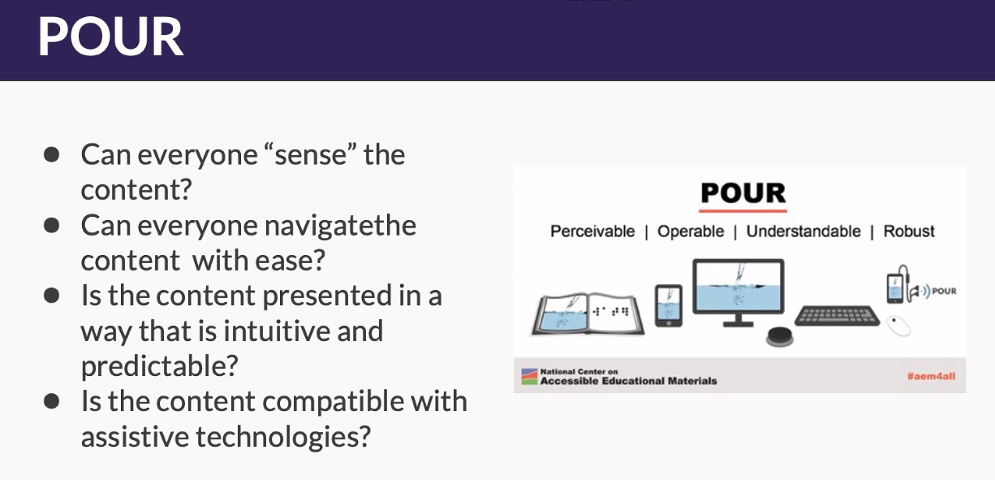
POUR
Notes:
Ashley’s slide
So now that we dove a little into actual student stories, what does this mean? How did we apply this knowledge to revamp our trainings and better equip our FIU Community and DRC champions
How can we design learning experiences so that they are meaningful and challenging for all learners when working with online environments?
The acronym POUR consists of four principes that are needed to support an an accessible educational experience and they are at the foundation of the Web Content Accessibility Guidelines (WCAG) an international standard for making web content accessible.
Perceivable
Perceivable content will make it possible for all your learners to see and hear the information.
Operable
Operable content will help all your learners navigate the information independently using their preferred tools.
Understandable
Understandable content will support your learners' understanding through a consistent and predictable design.
Robust
Robust content will work for your learners on a range of current and future technologies, including assistive technologies.
Captions for videos
Alt text for images
Is the content in the environment accessible? Speech commands and keyboard can be used instead of just the mouse?
Is the content understandable for everyone?
Is content compatible with a screen reader?
Are buttons easy to identify?

Slide 12
Validation: Measuring success and continuous improvement
Key performance indicators or learning outcomes
Gathering post-implementation feedback and tracking
Adapting and improving based on results
Be flexible, redundant, and malleable
Notes:
MARTHA Measuring success and adapting based on results is like sailing a ship across the ocean. The destination is the goal, but the winds (results) guide your course. You adjust the sails (strategy) as the wind shifts, continuously fine-tuning your journey to ensure you reach your destination with precision.
As were measuring outcomes, we also need to make changes so that we show our stakeholders were listening. Work in phases Identifies low-engagement departments or areas in which we have higher needs or more complex populations and prioritize them. – TAILOR TRAININGS TO SPECIFIC AREAS-
Provides targeted training and accessibility toolkits – DEVELOP RESOURCES AND DOCS IN SEVERAL FORMATS TO ENSURE UNDERSTANDING - Manage Up – Provides data and validation for when meeting with executive leadership. Embeds accessibility into faculty development and Orientations!
There will and have been many challenges along the way and we are no where near where we should be with this volume of students but there are many changes that have already been implemented for the betterment of our students that can be attributed to being more intentional in our work….. Next slide…..

Slide 13
Lessons Learned
Measurable outcomes
Storytelling shifts culture
Visibility + training = sustained adoption
Campus-wide AT policy and University Licenses
Expanded analytics dashboards
Notes:
HOW DID WE ENHANCE STUDENT EXPERIENCES IN THE PAST TWO YEARS??
Early semester AT engagement and syllabus development Faculty Senate annual meeting. Data needed for Faculty senate conversations CROSS DEPARTMENTAL COLLABORATIONS and annual dept trainings (Mention UTC, Parking and Transportation, Library, Study Abroad, Admissions, Housing) Higher faculty response rates to DRC communication and procedure updates
Improved student independence through systems like ARM (LTPs) or even through social media!!
Center for Advancement and Teaching that focuses workshops and trainings on accessibility Faculty Orientation and Student Orientation and Panther Camps!!!

Slide 14
Key Takeaways
Storytelling personalizes accessibility
Data informs equity-driven decisions
Collaboration sustains digital inclusion
Vision: Why change matters
Voice: Engage stakeholders
Visibility: Communicate progress
Notes:
ASHLEY

Slide 15
THANK YOU!

