Slide 1

Developing an Accessibility Project Team within an Academic Unit
Andy George, Access Consultant
Amy Park, Arts & Sciences Project Coordinator

Slide 2
Lansing Community College’s (LCC) Accessibility Initiative
In 2018, Provost Elaine Pogoncheff launched LCC’s Accessibility Initiative. The goal was to provide materials, products, devices, services, and environments that are usable to as many people as possible.
This is a community responsibility. Every person has the individual responsibility of ensuring that all classroom materials, forms, and documents are accessible.
As we have moved from an intensive phase to a maintenance phase, several options for supporting faculty and other content creators with accessibility work have been developed.

Slide 3
The Center for Student Access (CSA)
The Center for Student Access (CSA) recognizes disability as an integral component of diversity. We consult with students, faculty, and staff to support the ongoing development of an accessible college.
We also recognize that we are part of a larger system of support that includes parents, families, community advocates and organizations, and the many high schools that feed into LCC. To that end, we regularly speak with families, work with various community partners, and visit with high school classes to discuss the transition to college.

Slide 4
eLearning
The eLearning Department is responsible for the administration of D2L, LCC’s Course Management System (CMS). eLearning provides comprehensive D2L support to all students, instructors, and staff using D2L and D2L integrations.
Accessibility Resources
Ally – 86.3% average score for all materials in D2L
LCC’s Accessibility Guidelines Webpage and training videos
D2L Course Design Resources

Slide 5
Accessibility Committee for Quality Assurance (ACQA)
This committee, made up of representatives from academic and non-academic areas of the College, is charged with developing and monitoring, oversight, and quality review processes.
Areas of focus:
Establishing guidelines
Systematic accessibility review system
Consistent and relevant training
Communication about accessibility

Slide 6
Arts & Sciences Division
A&S Division – Biggest division at LCC
Business, Communication, and the Arts
English, Humanities, and Social Sciences
Science and Math
Fall 2025 headcount - 8,398 and seat count – 19,575
Full-time and adjunct A&S faculty teaching Fall 2025 – 294

Slide 7
A&S Accessibility Team
Dean Andrea Hoagland asked us to create a team to help with large or unusual projects.
This began as a resource for faculty before training was available.
Faculty still do the day-to-day work to make their instructional materials accessible.
Designed to help in unusual situations.
MATH 098
Assisting the Center for Student Access
Making OERs accessible
Captioning ORT class recordings

Slide 8
Accessibility Request Process
Faculty must have supervisor approval.
Faculty then meet with the A&S Project Coordinator to come up with a plan and a timeline for completion.
A&S Project Coordinator works with the four support staff members and assigns work based on current workloads.
Projects are tracked in a shared spreadsheet.
Staff work collaboratively with the each other, the Center for Student Access, and the instructor.

Slide 9
How to Recreate an Accessibility Team in Your Area
The most important thing is to get leadership on board!
This is not a full-time task for staff but something they work on when time is available. Summer is a great time for this work in our area.
This is really helpful to faculty who may be struggling.
Staff teach faculty ways to make documents accessible going forward.
Having staff that are well-trained in accessibility will ensure that documents that are created on a daily basis are accessible saving the hassle of remediation.

Slide 10
Get Staff on Board
They will gain valuable skills that they can take with them throughout their career.
Train enough staff that it does not become a burden on just one particular person.
Work with supervisors and staff to determine workload before assigning accessibility work.

Slide 11
And now some words from our team!
“Accessibility feels like a small deal to those who don’t use it, but it is actually a big deal. It can be the difference in being able to function in our fast paced world and being stuck outside of it. Everyone should be able to do their homework, complete their work tasks, or learn something new. A little extra effort can be the difference between gatekeeping and holding the door open for others.
Our team cares about helping people where we can. It definitely helps that our leadership cares about making things open and accessible. We have a supportive environment where people can ask questions and collaborate. I am proud to work in an office dedicated to accessibility.”
Lydia Warnke

Slide 12
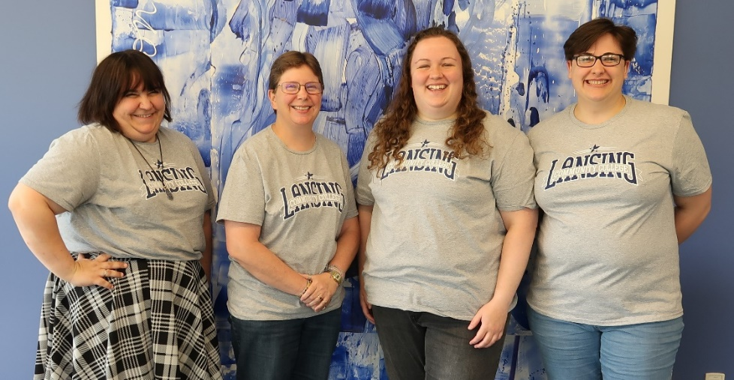
A&S Accessibility Team – LCC Stars!
“All aspects of life should be made accessible for everyone, digital accessibility included. Knowing we are making it possible for students to have equal and fair access to all course content alone makes all of this process worth it. It can be difficult based on the type of content requested to make accessible yet I look forward to working through the sometimes-challenging projects knowing I’m making a difference in a student’s education.”
Jodi Leslie
Charlie Mierzejewski, Kit Parker, Jodi Leslie, Lydia Warnke

Slide 13
Questions?

