Slide 1
DIY Tactile Graphics: Tips for Clear and Effective Tactile Graphics
Accessing Higher Ground – November 2025 Em Kribs, Wichita State University

Slide 2
Objectives for today
Understand principles behind effective tactile graphics
Improved ability to analyze, interpret and triage graphics
Increased comfort with adapting, simplifying and redesigning graphics for tactile formats

Slide 3
Briefly: Who am I and what do I know, anyway?

Slide 4

Wichita State University
Public research university in Wichita, KS
Enrollment of 25,147 students
www.wichita.edu

Slide 5
Academic Accommodations and Accessibility
Also known as AAA or triple-A
Office in the Media Resources Center at Wichita State University
Built from scratch by Jay Castor
We have graduated three students who used our braille materials
One is now in medical school
Another of our graduates told us that he had considered leaving WSU due to some uncooperative instructors, but he stayed specifically for the quality of his materials
Two more are expected to graduate before next fall

Slide 6
Our experience: Some data*
In AY24-25, we created 7,976 tactile graphics:
Fall 2024 4,035
Spring 2025 2,295
Summer 2025 1,646
So far in Fall 2025 (as of Oct. 30, 2025), we’ve created 1,864 tactile graphics
*Data is only as good as our record-keeping, and our record-keeping is a work in progress; these numbers are lower than actual outputs.

Slide 7
Let’s talk tactile graphics

Slide 8
What are tactile graphics?
“Tactile graphics, including tactile pictures, tactile diagrams, tactile maps, and tactile graphs, are images that use raised surfaces so that a visually impaired person can feel them. They are used to convey non-textual information such as maps, paintings, graphs and diagrams.”
—Wikipedia, https://en.wikipedia.org/wiki/Tactile_graphic

Slide 9
Benefits of tactile graphics
Makes spatial information available
Better parity with other students’ learning experiences
Improved subject literacy
Offloads working memory
Provide alternative presentation of information

Slide 10
Tactile graphic formats
Collage / arts and crafts
Dot-embossed
Swell paper / microcapsule
3D models

Slide 11
Tactile graphic format: Collage
“In tactile graphics, the term is used to describe the process of using textured items (such as papers, fabrics, threads, ‘found’ objects) to represent the information in the print graphic. Items are adhered to a flat surface, producing layers of the textures.”
Source: https://www.tactilegraphics.org/collage.html
Pros:
Can be relatively accessible and affordable.
Wider variety of textures available.
Cons:
Replication is as much work as making it the first time.

Slide 12
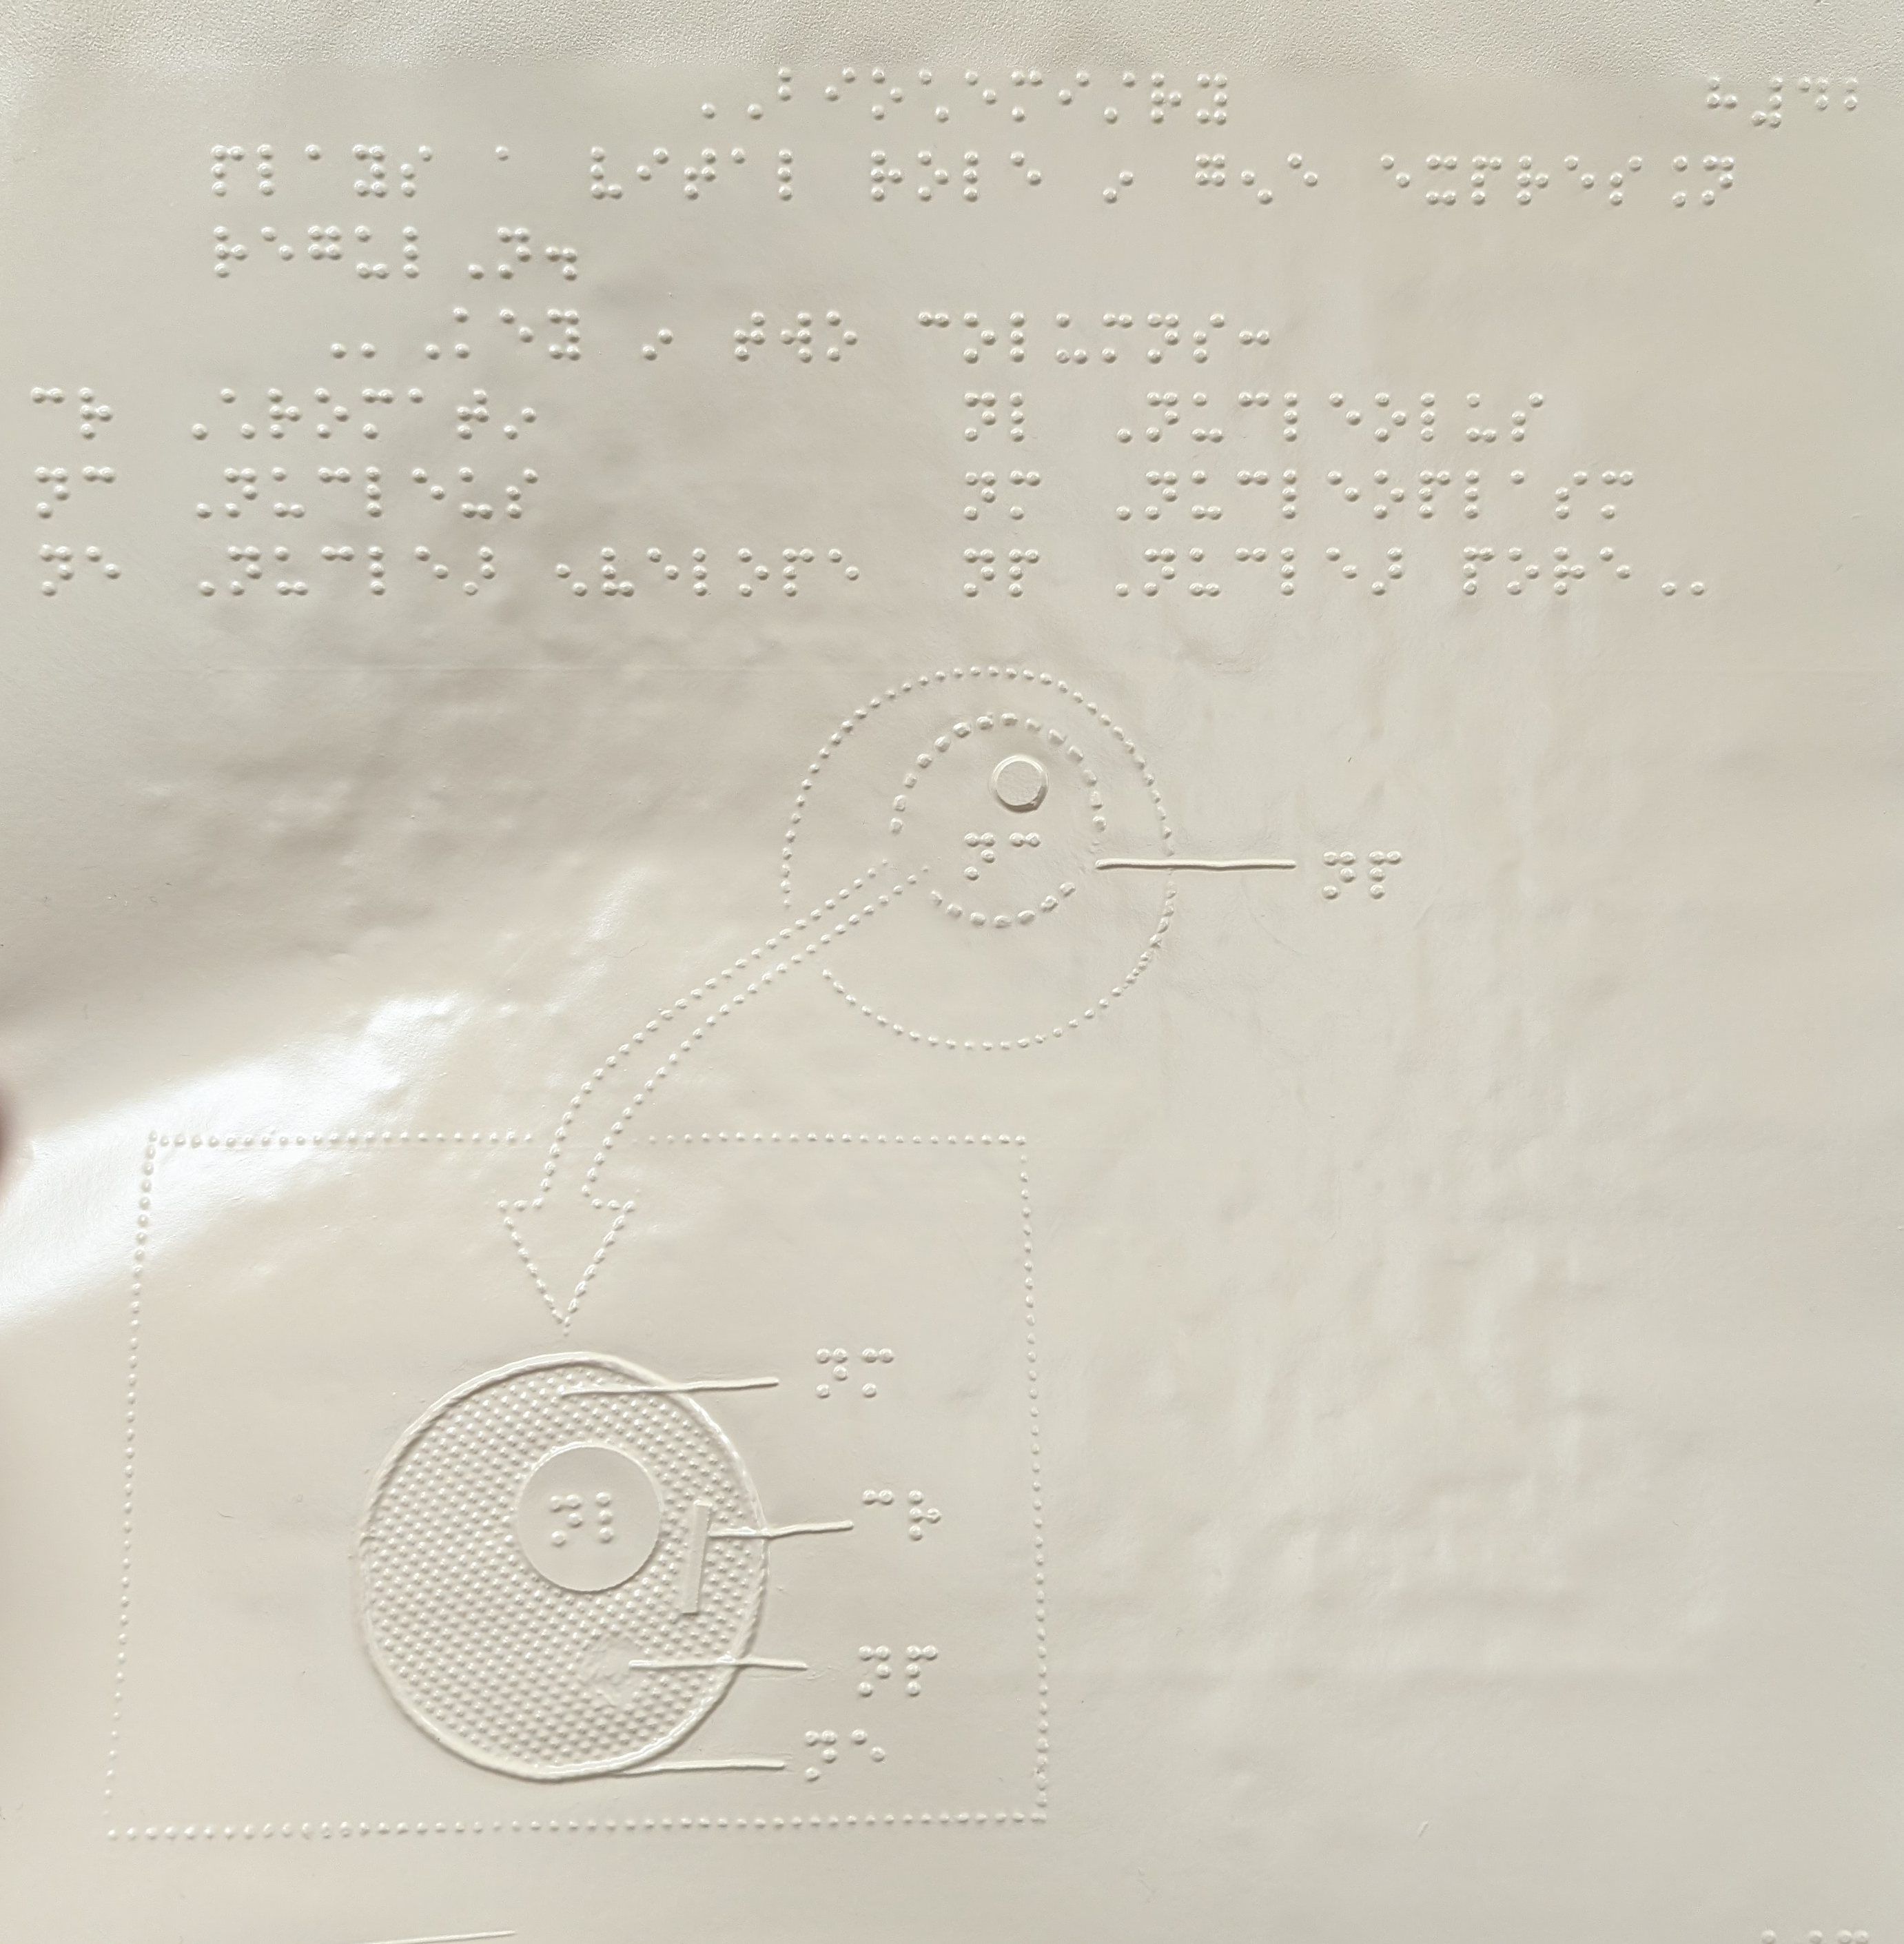
Collage tactile graphic example

Slide 13
Tactile graphic format: Dot-embossed
Tactile graphics produced by dot-embossers like those used to produce braille text. Some embossers have more pins, which allows for more detail and clarity.
Pros:
Embosser can also be used for braille text.
Very affordable option after up-front costs.
Feels like paper, which some find preferable to alternatives.
Cons:
“Lower resolution” requires graphics to be larger and less detailed; allows for less differentiation.

Slide 14
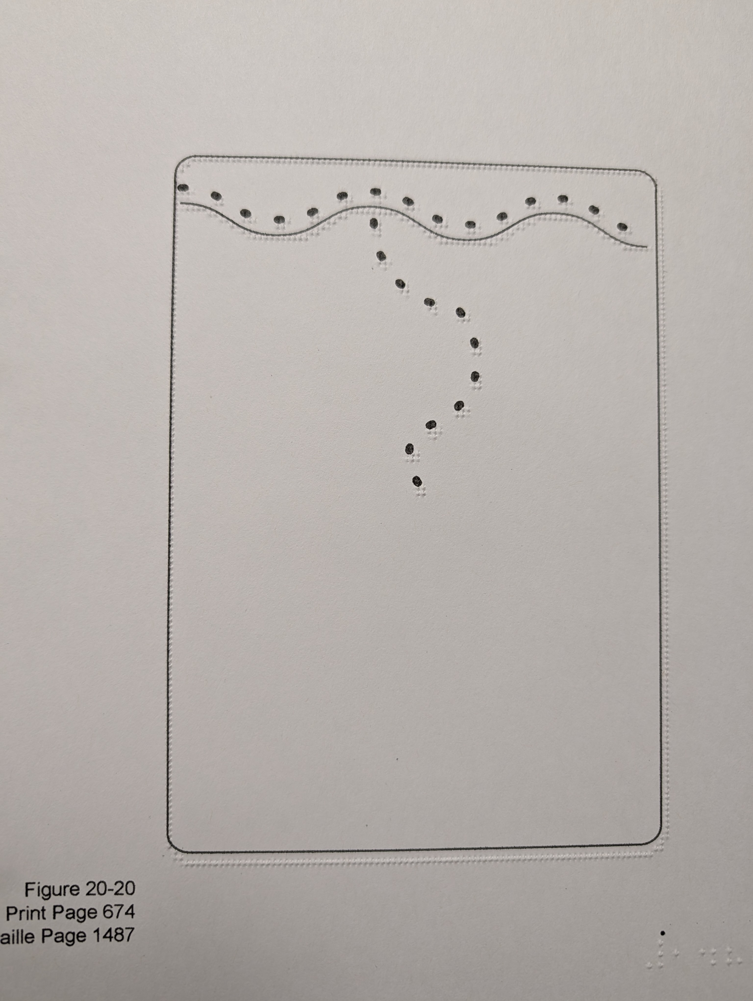
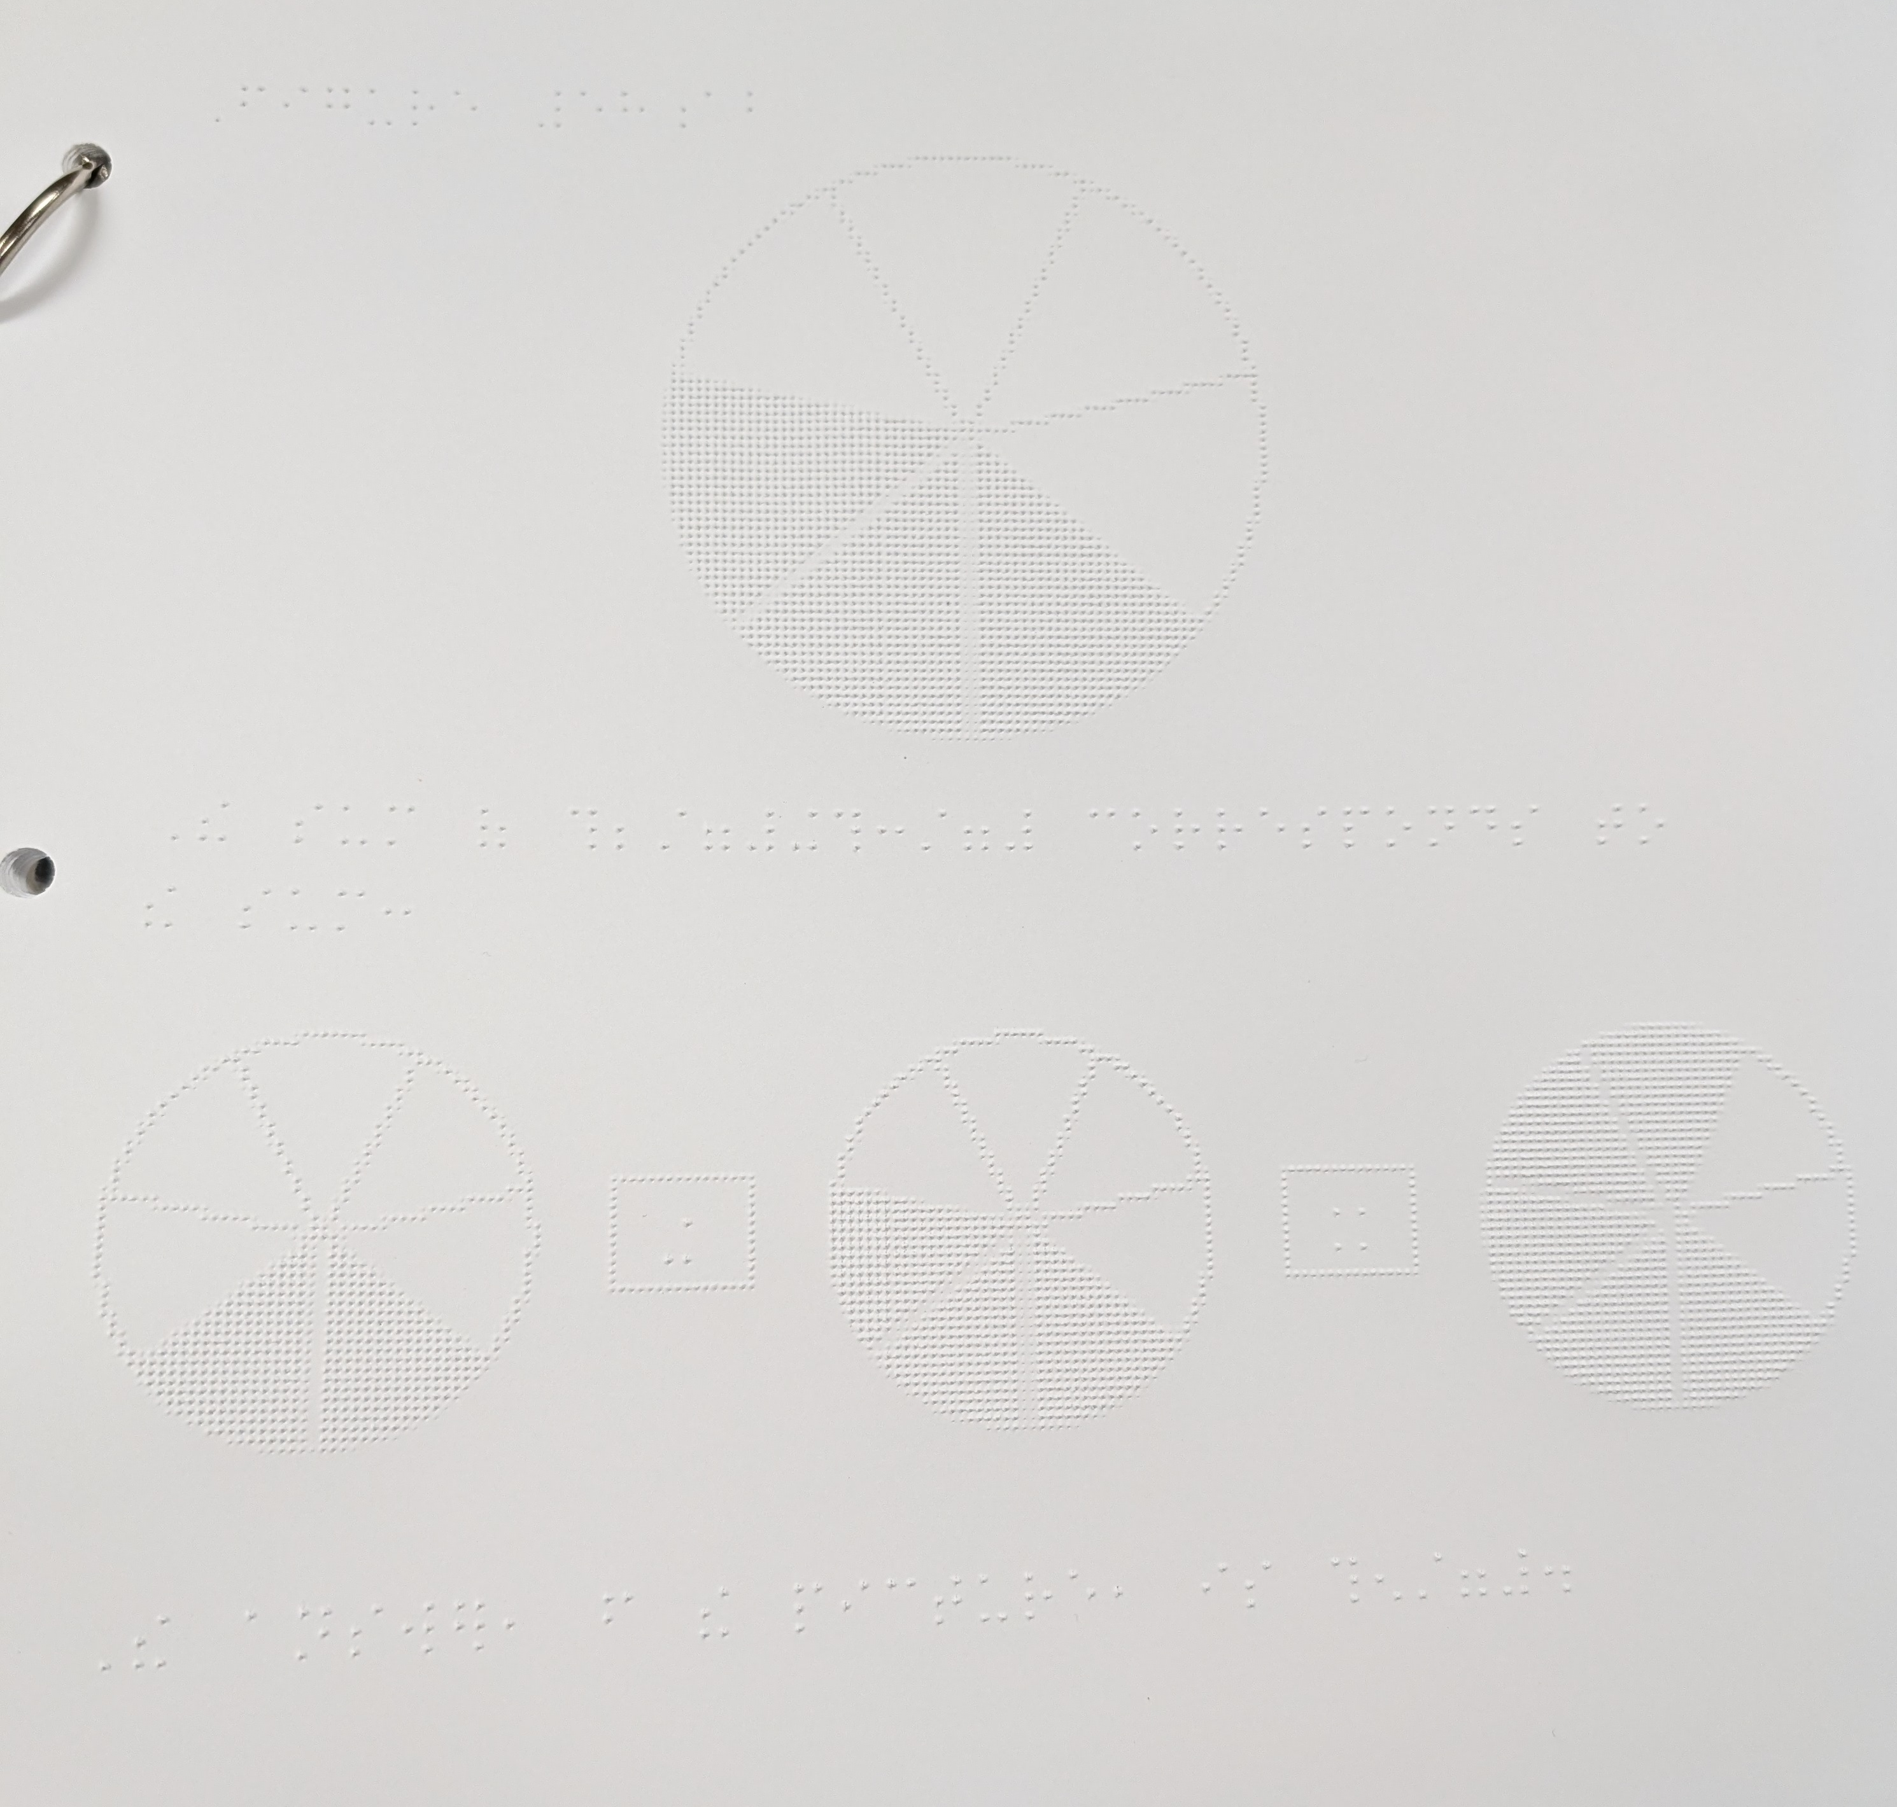
Dot-embossed tactile graphic examples

Slide 15
Tactile graphic format: Swell paper
Tactile graphics can be printed on swell paper, which is coated in small capsules that puff up when heated. The paper is fed through a light-based heater so the heat is concentrated where the ink is.
Pros:
Produces clear, consistent tactile graphics
“Higher resolution” allows for more details and differentiation
Cons:
Swell paper is relatively expensive
Overheated swell paper will “explode” (not dangerous, but not useful either)
Underheated swell paper will not rise sufficiently and be less legible
Some users find it a little sticky and unpleasant to touch

Slide 16
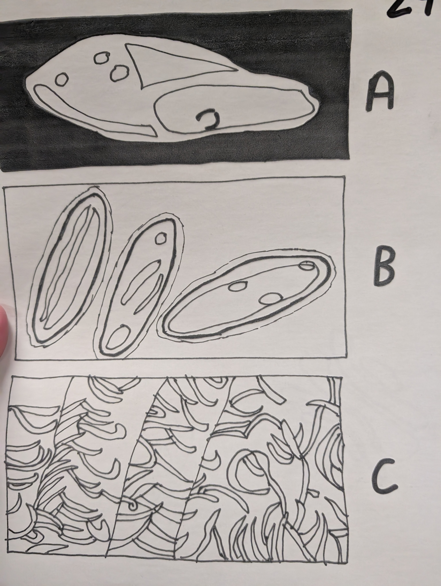
Swell paper tactile graphic example

Slide 17
Tactile graphic format: 3D models
A 3-dimensional representation that allows a student to interact
Can be 3D-printed, purchased
Pros:
Can be relatively accessible and affordable (pipe cleaners, Wikki Stix)
Provides spatial information on multiple axes
Cons:
3D printing can be expensive, time-consuming
Often unrealistic for high volume of work

Slide 18
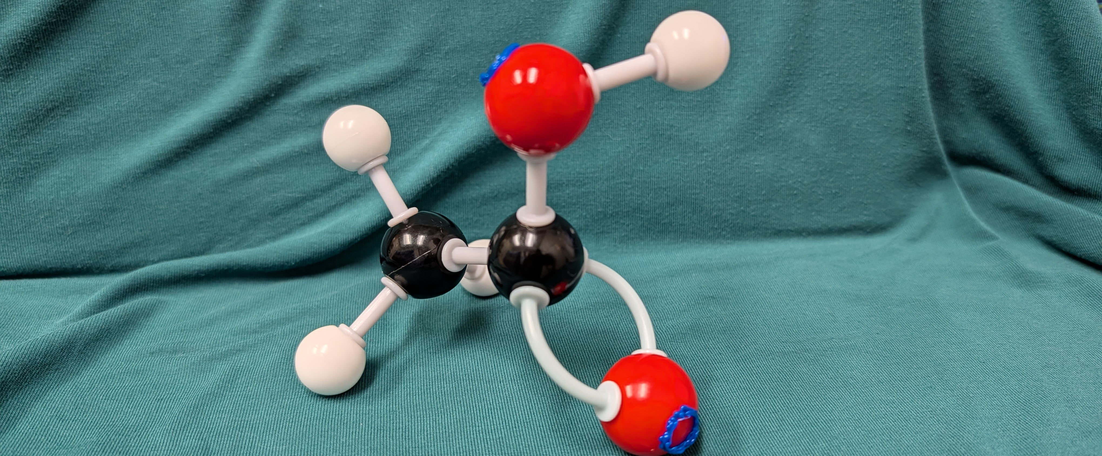
3D model example: Molecular model kit

Slide 19
Tactile graphics on the fly
Draftsman Tactile Drawing Board ($263)
https://www.aph.org/product/draftsman-tactile-drawing-board/
Example use case: An in-class assistant drew the instructor’s board work for a blind student in a chemistry class.
Magnet board (cost varies)
Example use case: A blind chemistry student used a magnetic baking sheet and magnets to create molecules as part of a chemistry exam.
PIAF + swell paper + swell touch markers
Example use case: We had biology students draw what they saw under a microscope for a classmate who is blind.

Slide 20
Analyzing graphics for conversion to tactile formats

Slide 21
Why is braille written in six-dot cells? Why don’t we just emboss print text?

Slide 22
Touch and sight are different
For most people, sight can provide far more information far more quickly than touch.
Humans have evolved for sight to be one of the main ways we receive information.
Human brains can receive and sort a lot of visual information very quickly.
Touch is more limited in what it can perceive.
Think of tactile information as black and white – it’s on or it’s off.
(Sometimes people with a missing/impaired sense will develop heightened sensitivity in other areas, but you should not count on this.)
Many graphics are designed for sighted users, and you’ll need to alter or reformat them in order for them to make sense by touch.

Slide 23

Tactile graphics as a medium (1/2)
Legibility is determined by touch.
Tactile graphics can communicate less detail than visual ones.
Tactile graphics are more limited in what they can convey. For example, the images on the right feel the same.

Slide 24
Tactile graphics as a medium (2/2)
Dot-embossed
Lower resolution, so everything needs to be big, simple, and clean.
Swell paper
Higher resolution, so more detail is possible.
Overheating will cause microcapsules on the page to rupture, and overheating is more likely when you include large, dark sections.
Large dark sections are also not hand-catching in the same way they might be eye-catching; shading tends to obscure, not highlight.

Slide 25
Analysis: Context
Purpose
What is the purpose of the course?
What is the purpose of this document?
What is the purpose of this graphic?
Audience
What level of expertise does the course’s intended audience have?
How is the student going to use this information?
Are there other graphics in this document? Do the graphics have a relationship to one another?
E.g. The same graphic evolves over time, or there are two graphics side-by-side for comparison

Slide 26
Analysis: Content
What is the document intended to communicate?
What is the graphic intended to communicate? How?
What role do its various components play in delivering that information?
What are the most important parts?
Which parts are superfluous?
Is a tactile graphic the best way to communicate this to a user who is blind or visually impaired?

Slide 27
Qualities of good tactile graphics
Clearly communicates necessary or helpful information in a way that is legible by touch.
Improves student’s understanding of course content.
Contains important or helpful information
Improves student’s understanding of course content
Offers alternative way of understanding
Communicates clearly
Simple
Legible
Appropriate for medium

Slide 28
Non-goals for tactile graphics (1/2)
Aesthetically pleasing to sighted users
It’s not for them!
Sometimes the graphic you’re starting from is complicated, messy, or otherwise terrible to behold, and making it tactile will not improve the situation. Embrace this. Blind people should also be allowed to experience convoluted graphics and say, “Oh. Oh no.”
Exact replica of original graphic
This can be a solid starting point, especially if you’re not sure what is and isn’t important, but keep in mind that fingers aren’t eyes. Some alterations may be helpful, and others may be mandatory.
(E.g. You can’t just leave it color-coded.)

Slide 29
Non-goals for tactile graphics (2/2)
Densely packed with information
Simplicity and white space are your friends.
There are not a lot of good ways to highlight something or make it pop out more than the rest of the page when making a tactile graphic. The best way is just to avoid clutter when possible.
(But again, sometimes the original graphic is just unavoidably messy.)

Slide 30
Visual hazards to watch out for (1/3)
Color coding and shading – When making tactile graphics, you don’t have colors. You have black and white, on and off.
Transparency and 3D images – With tactile graphics, nothing feels closer or farther away than anything else. Sometimes dotted / dashed lines help convey that something is behind or inside something else, but it lacks the clarity of many 3D images. Additional labels or transcriber’s notes might be necessary.
Small things and fine details – Remember that tactile graphics are low resolution, that touch is less sensitive, and that touch covers a smaller area at a time than sight. No detail on the page should be smaller than a quarter inch (around 7 millimeters).

Slide 31
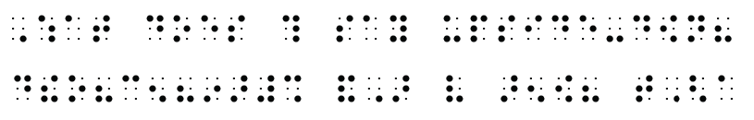
Visual hazards to watch out for (2/3)
Rotated text – You know how in printed text, lowercase b, d, p and q all look like flipped versions of each other? Imagine if every single character could do that. Braille text still functions as text upside-down and backwards, so braille-users don’t have the same visual cues to let them know something has been rotated. Avoid rotating braille. If you absolutely have to, let the user know beforehand (e.g. a transcriber’s note on the previous page).
What does this say upside-down?
dtheo?cen?inar# andAr very arenow? tGha

Slide 32




Visual hazards to watch out for (3/3)
Icons – These tend to rely on visual shorthand that does not exist in the same way in tactile formats. Your eyes may be able to recognize these without other context clues, but many blind and visually impaired people will not know what these are without some kind of priming.

Slide 33
Some examples

Slide 34
Some common types of graphics
Tables
Flow charts
Maps
Graphs
Charts
Diagrams
Spatially arranged equations

Slide 35
Our process (1/3)
Analyze the images in your document.
Which ones should be image descriptions?
Which ones should be skipped?
Which ones need to be converted to a tactile format? How will they be used?
Acquire images that need to be embossed. We usually take screenshots of images from digital files like PowerPoint documents and PDF textbooks.
Bigger is usually better – zoom in when taking screenshots.
We use screenshots instead of saving images to ensure they’re all PNGs, but without transparency.

Slide 36
Our process (2/3)
Transcribe text that will appear in the graphic.
You can save space by using Nemeth and only capitalizing when absolutely necessary for comprehension. You can also sometimes skip number signs (#)
Insert original image into Illustrator template on semitransparent layer. Lock this layer.
Trace basic shapes on fully opaque art layer. I generally use the pen tool, curve tool, and line tool.
Paste in braille labels on text layer. (Make sure you are using the right font size for the specific braille font you are using.)

Slide 37
Our process (3/3)
Hide or delete anything you don’t want in the end product, like the original graphic or guidelines.
Emboss graphic using either the Elite or the PIAF:
Elite: “Print” to Elite, which embosses the graphic directly onto 11×11.5” tractor feed braille paper.
PIAF: Print to regular printer / copier on tabloid-size regular printer paper. We then copy the graphic onto swell paper.
(You can store swell paper in a printer, but then you run the risk of someone printing on swell paper by accident. Also, the paper functions by heat, so a warm copier might negatively affect the quality of your images.) The swell paper is then fed through the PIAF, which heats the paper using light.

Slide 38
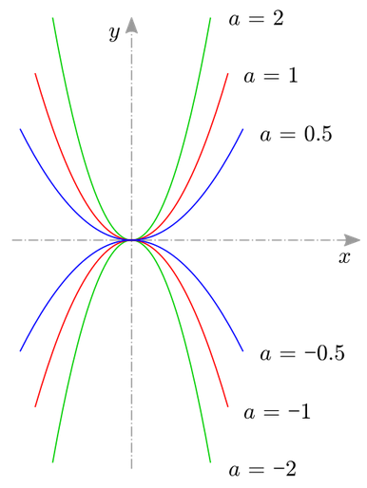
Reformatting a Graphic: Color-coded (1/4)
This graph is color-coded, and the graphed lines intersect. I need to find a way to tell each function apart without colors.

Slide 39
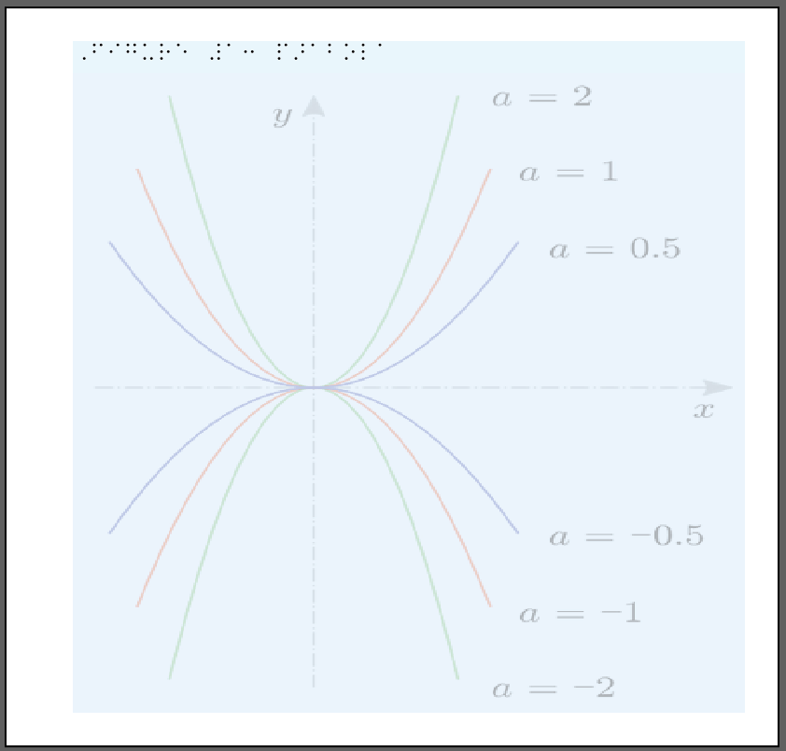
Reformatting a Graphic: Color-coded (2/4)
I’ve inserted the image into Illustrator on a semi-transparent layer so I can trace the original design.
I’ve also made the original image wider; this is fine as long as it’s consistent and everything within the image stays in proportion.

Slide 40
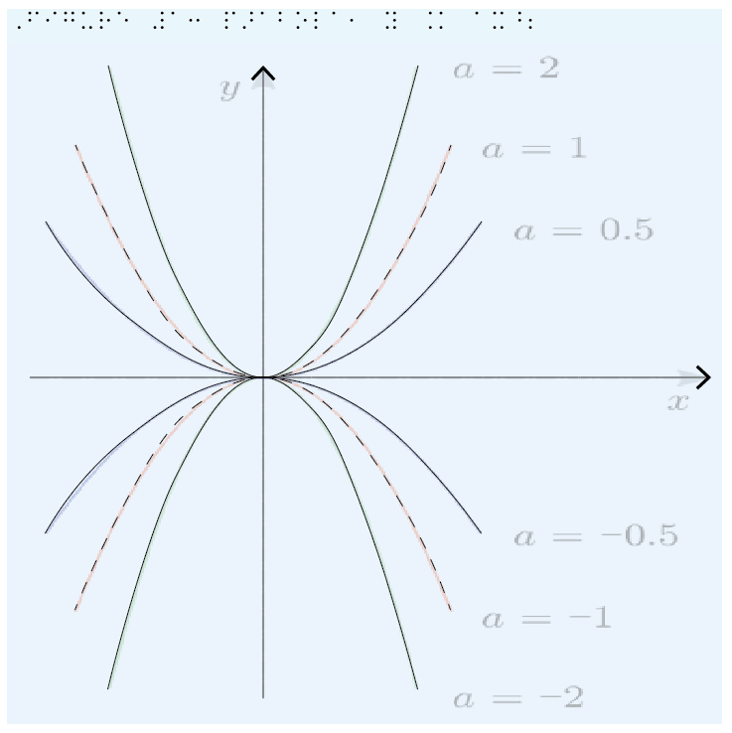
Reformatting a Graphic: Color-coded (3/4)
Here I’ve drawn the graph axes and the graphed lines. Apart from the title, there are no labels yet. The graphed lines alternate between solid and dashed lines.
There’s not a lot of room on the left side of the image, so I will move the graphed lines and the y-axis to the right.

Slide 41
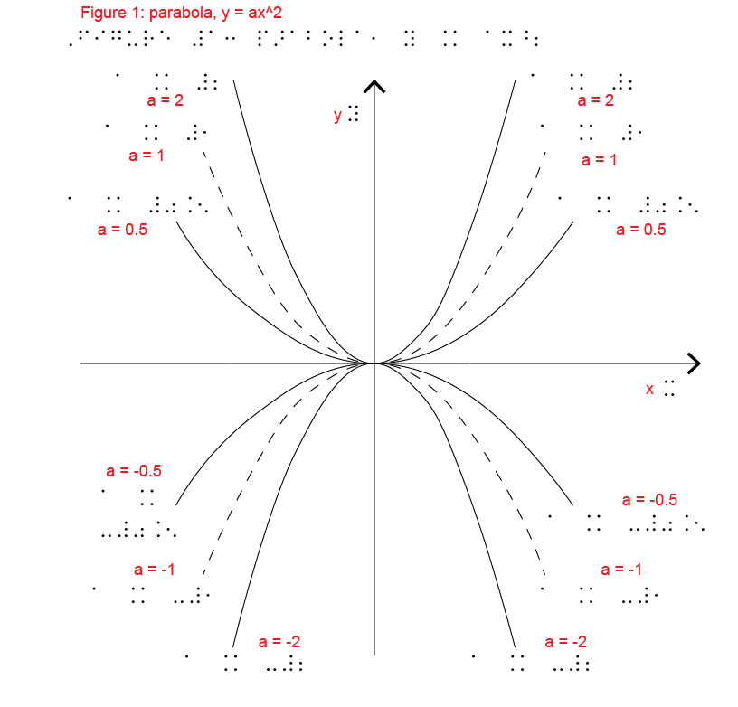
Reformatting a Graphic: Color-coded (4/4)
I wanted to move the graph to the right so I had room to put labels on both sides. Since the lines intersect at origin and the point of the graphic is to illustrate how the value of a changes the parabola, I wanted labels on both ends of every line.

Slide 42
Reformatting a Graphic: Complexity (1/7)
Sometimes the original graphic will be cluttered, complicated, and/or hard to parse, even for a sighted person. See the example on the next slide.
Example Information: Psychrometric chart for 1 atm (SI units). Source: Z. Zhang and M. B. Pate, “A Methodology for Implementing a Psychrometric Chart in a Computer Graphics System,” ASHRAE Transactions, Vol. 94, Pt. 1, 1988.
You can split the information in a graphic across multiple pages to give it breathing room.
Remember to clearly explain what you’re doing so the user knows what’s going on!

Slide 43
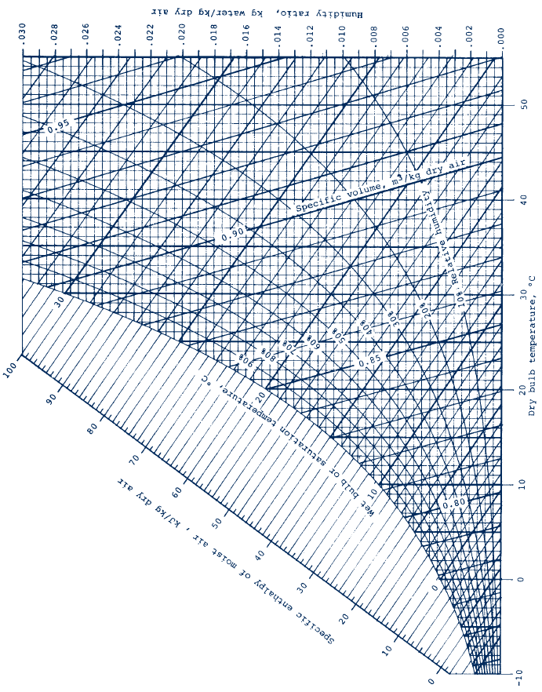
Reformatting a Graphic: Complexity (2/7)
Notes:
Psychrometric chart for 1 atm (SI units). Source: Z. Zhang and M. B. Pate, “A Methodology for Implementing a Psychrometric Chart in a Computer Graphics System,” ASHRAE Transactions, Vol. 94, Pt. 1, 1988.

Slide 44
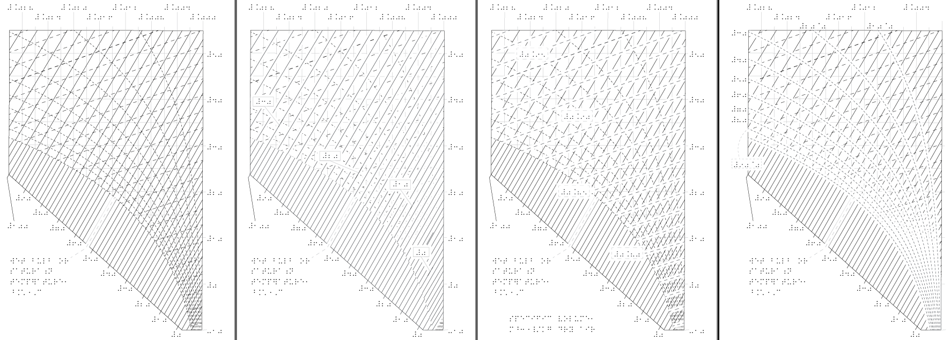
Reformatting a Graphic: Complexity (3/7)
Notes:
Enthalpy–entropy diagram for water (SI units) from Fundamentals of Engineering Thermodynamics, 9e. Source: J. B. Jones and G. A. Hawkins, Engineering Thermodynamics, 2nd ed., Wiley, New York, 1986.

Slide 45
Reformatting a Graphic: Complexity (4/7)
Some changes I made in order to make this work as a tactile graphic:
Used tabloid-size swell paper in vertical orientation (90° rotation from normal orientation).
Oriented all braille text in one direction.
Used solid, dashed, and dotted lines to distinguish different axes.

Slide 46
Reformatting a Graphic: Complexity (5/7)
Some changes I made in order to make this work as a tactile graphic (continued):
Converted one graph into four pages of graphics:
Page 1 shows all lines and axis labels, but no labels on interior lines.
Each of the following pages adds a white stroke (outline) to certain types of lines to help them stand out more, as well as the interior labels for those lines. (Make sure your braille labels are on a white background so they’re legible!)
Note: The tactile graphic user doesn’t have the original graphic as reference, and doesn’t know what’s under the labels, lead lines, etc. Make sure you’re not covering up so much of the diagram that it disappears!

Slide 47
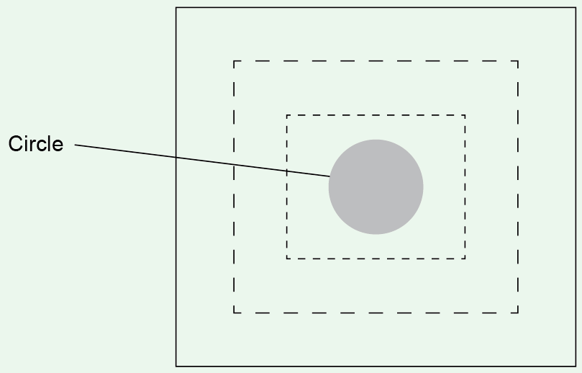
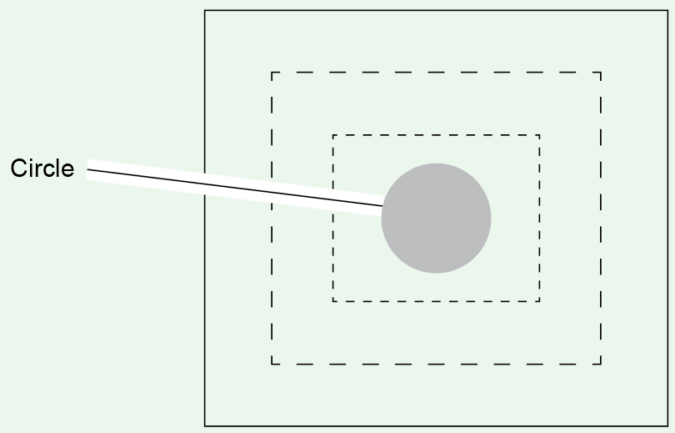
Reformatting a Graphic: Complexity (6/7)
Without white stroke
With white stroke

Slide 48
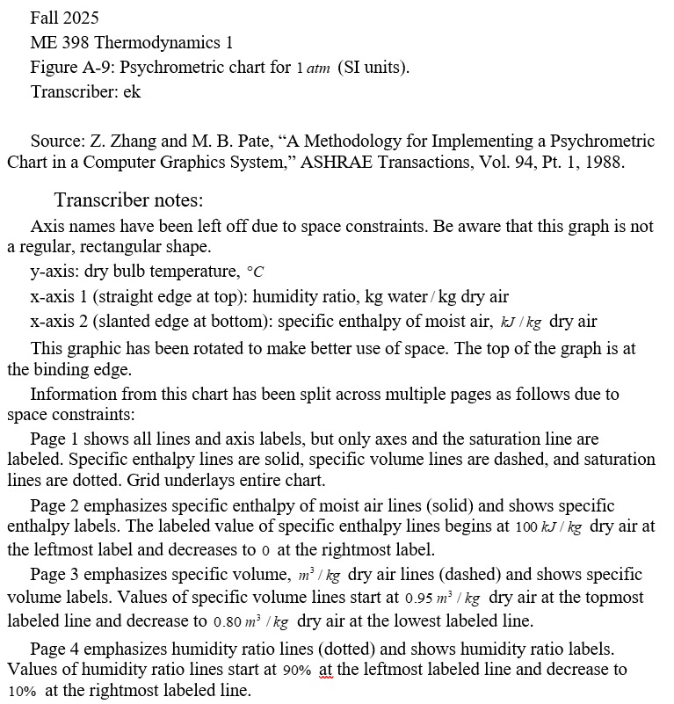
Reformatting a Graphic: Complexity (7/7)
Changes I made in order to make this work as a tactile graphic (continued):
I included some cover pages explaining all of the changes and what the user would find on each page.

Slide 49
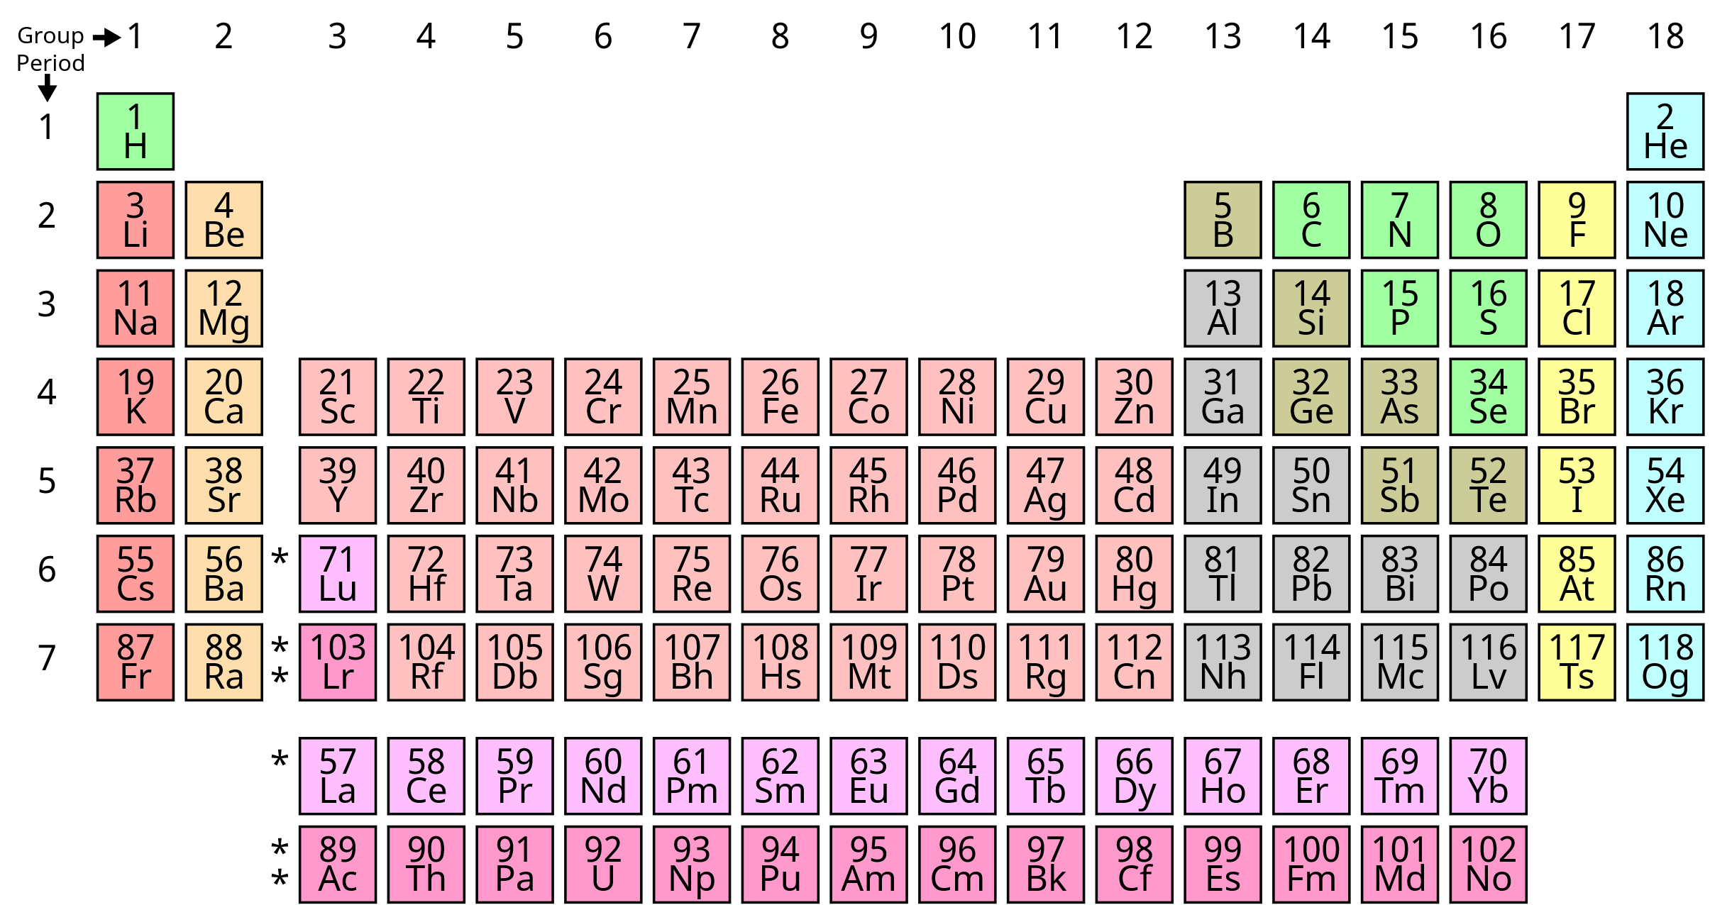
Reformatting a Graphic: Large (1/3)
Some graphics are just going to use a lot of space, like the Periodic Table of Elements.
These can take up multiple pages (see example on next slide, where the Periodic Table is spread across a 2×2 grid).

Slide 50
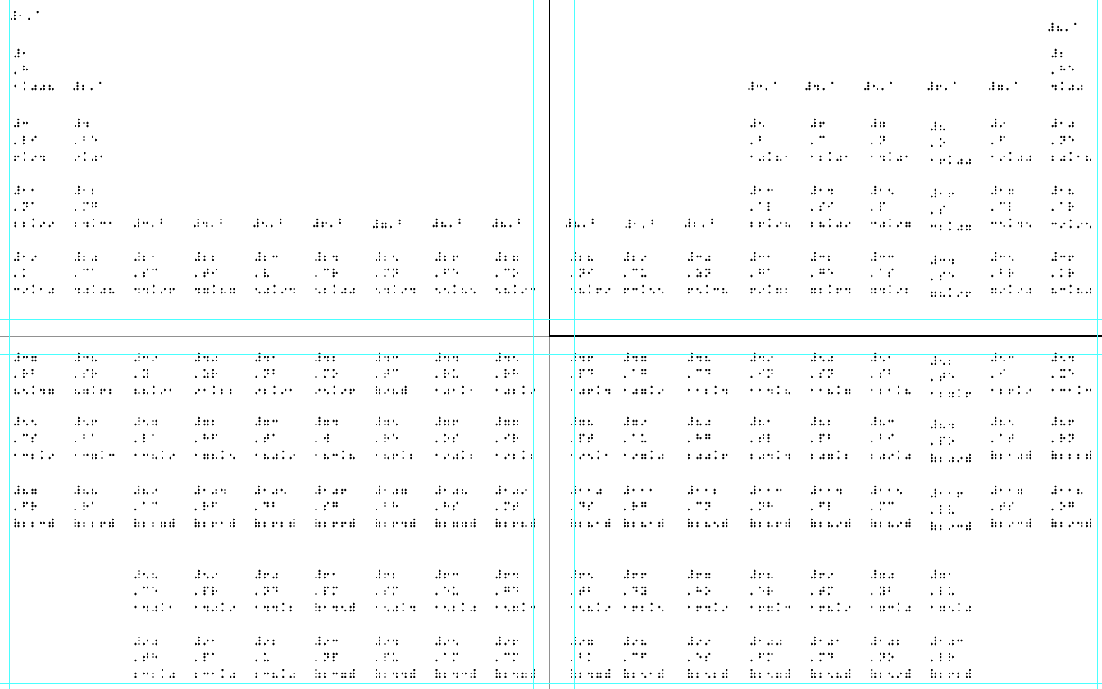
Reformatting a Graphic: Large (2/3)

Slide 51
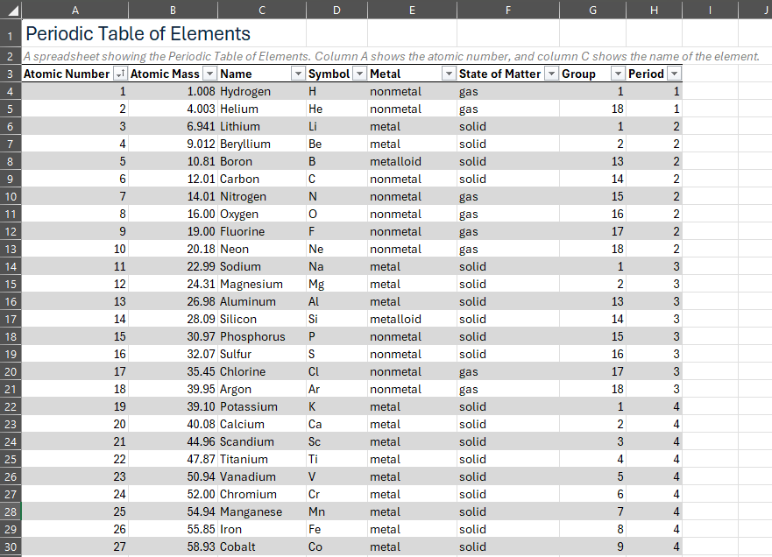
Reformatting a Graphic: Large (3/3)
In the case of the Periodic Table of Elements and other large tables where the purpose may be looking up specific values, you can often convert the information to a spreadsheet that can be navigated with a screen reader to make it easier to look up specific information.

Slide 52
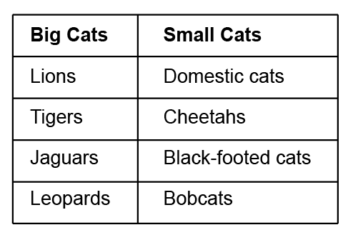
Reformatting a Graphic: Fake Tables
Sometimes the original document… did not use the correct format for their graphic.
For example, there are a lot of “tables” out there that are actually lists, like the one on this slide.
While columns have a consistent theme, the rows have no relationship.

Slide 53
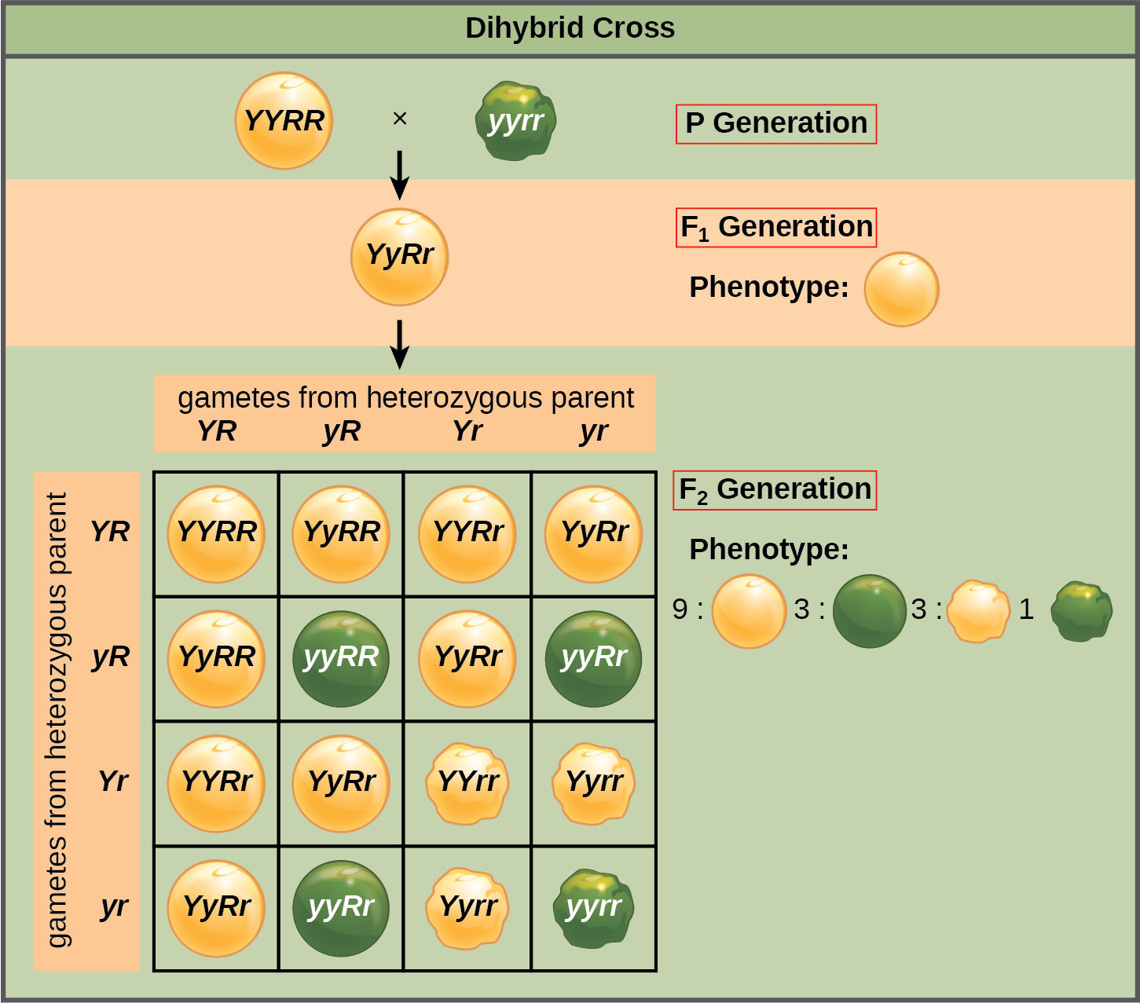
Reformatting a Graphic: Keys and Legends (1/2)
Sometimes graphics are complicated, and it’s not reasonable or feasible to include all information directly on the graphic.
For example, for this graphic it would be tricky to include both the genotypes and phenotypes together in the image. It’s also hard to clearly show a wrinkly pea versus a round one.

Slide 54
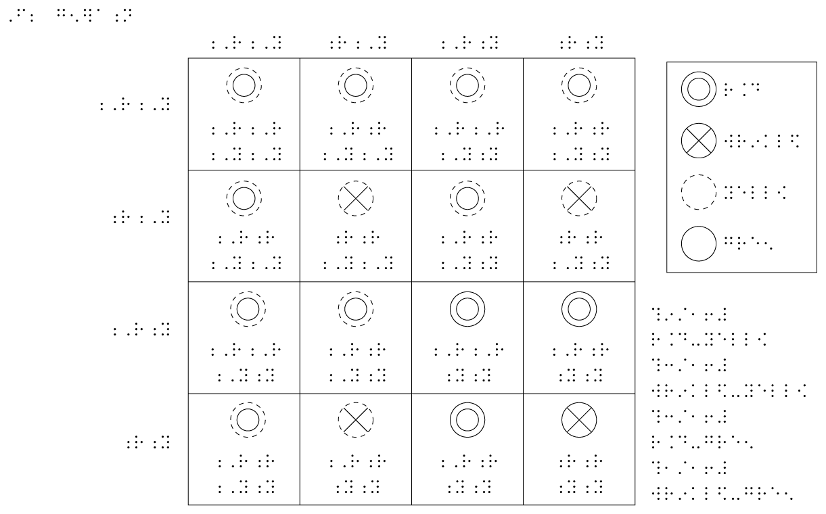
Reformatting a Graphic: Keys and Legends (2/2)
In cases like this, it may be helpful to use symbolism and use a legend or key instead of labelling the image directly. Now yellow is dotted, green is solid, round contains a circle, and wrinkly contains an X.
Keys should be avoided when possible because they’re less convenient and require more working memory, but they can be a useful option.

Slide 55
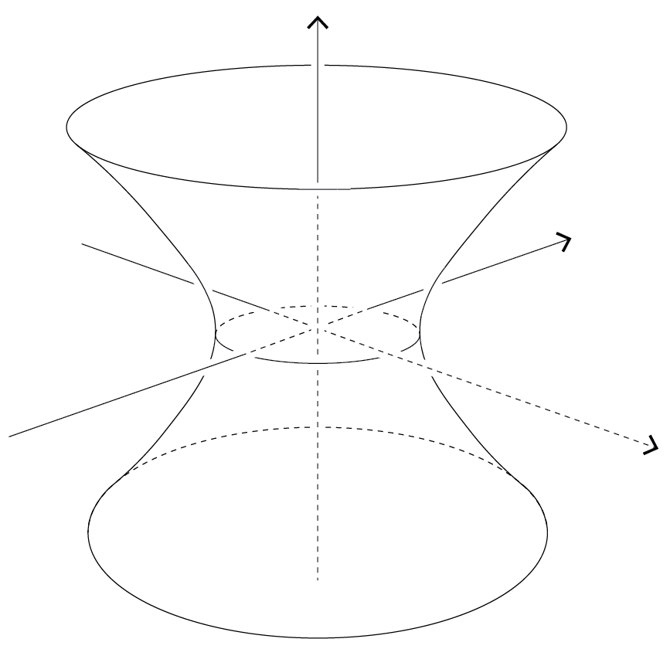
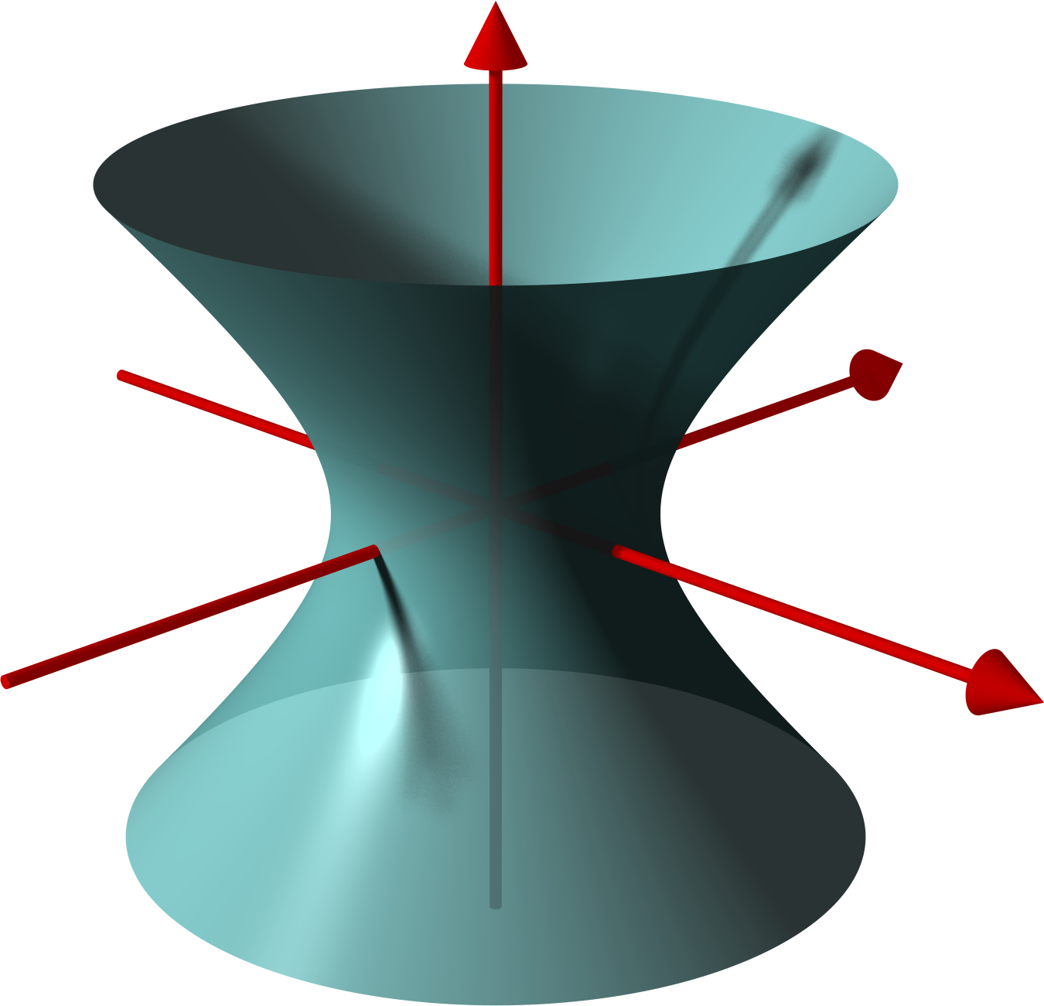
Image Descriptions and Descriptive Text (1/3)
Can be used on their own or in conjunction with tactile graphics. Some example use cases:
Describing a tactile graphic as it will appear on the next page to help student parse the graphic.
“The following graphic shows a depiction of a 3D hyperboloid of one sheet, centered on origin. It resembles a tube standing vertically on one end, with the tube growing narrower as it approaches origin and wider as it moves away from origin.”
Explaining any alterations to a graphic. (Examples on following slide.)
Notes:
Source: https://en.wikipedia.org/wiki/Hyperbola#/media/File:Hyperboloid1.png

Slide 56
Image Descriptions and Descriptive Text (2/3)
Can be used on their own or in conjunction with tactile graphics. Some example use cases:
Explaining any alterations to a graphic.
“The graphic on the following page has been rotated 90° counterclockwise due to space constraints. The top of the graphic will be on the binding edge. The top and bottom of the page will also be labeled in the right-hand corners.”
“Where the original document used cartoon frogs, the following graphic will use triangles to improve legibility.”
“The original document was color-coded. This document will use solid lines in place of orange and dashed lines in place of blue.”
“Due to space constraints, the following graphic has been split across three pages. Page 1 will show all lines without labels. Page 2 will show values for temperature. Page 3 will show values for pressure.”

Slide 57
Image Descriptions and Descriptive Text (3/3)
Sometimes image descriptions are more useful than a tactile graphic. For example:
Most photos
Icons, emoji, and graphics that just won’t mean anything when interpreted by touch.
Complicated graphs or charts with a basic point (e.g. “Negative attitudes about [topic] have tripled between 1955 and 2015.”)

Slide 58
Resources for Writing Image Descriptions
Accessible Publishing Canada
https://www.accessiblepublishing.ca/a-guide-to-image-description/
American Anthropological Association
https://americananthro.org/accessibility/image-descriptions/
Diagram Center
http://diagramcenter.org/general-guidelines-final-draft.html
Perkins
https://www.perkins.org/resource/how-write-alt-text-and-image-descriptions-visually-impaired/

Slide 59
Some tips (1/2)
Instructor buy-in, involvement, and feedback are very helpful, especially for unfamiliar topics.
Ask questions and check in when you’re unsure.
If you have the time, it may be helpful to sit in on a class session to get a sense of how graphics are being used.
It’s also helpful for people making tactile graphics to have some experience / familiarity with pedagogy.
You may be able to find pre-existing tactile graphics or line art online, which can provide a shortcut.
See Additional Resources slides at the end.

Slide 60
Some tips (2/2)
Brailling takes time, and that time adds up quickly.
Equations, images, tables, and lousy file formats all increase the amount of time you’ll need.
Tactile graphics are often the most time-intensive part of this process.
Braille is wide; give yourself plenty of horizontal space.
Use Nemeth braille if possible, since it’s more concise.
You can often skip the Nemeth indicators on either side for tactile graphics.
Make sure not to stretch or warp braille text!
Keeping text on a separate layer from the drawing can help.

Slide 61
Tactile Graphics Equipment

Slide 62
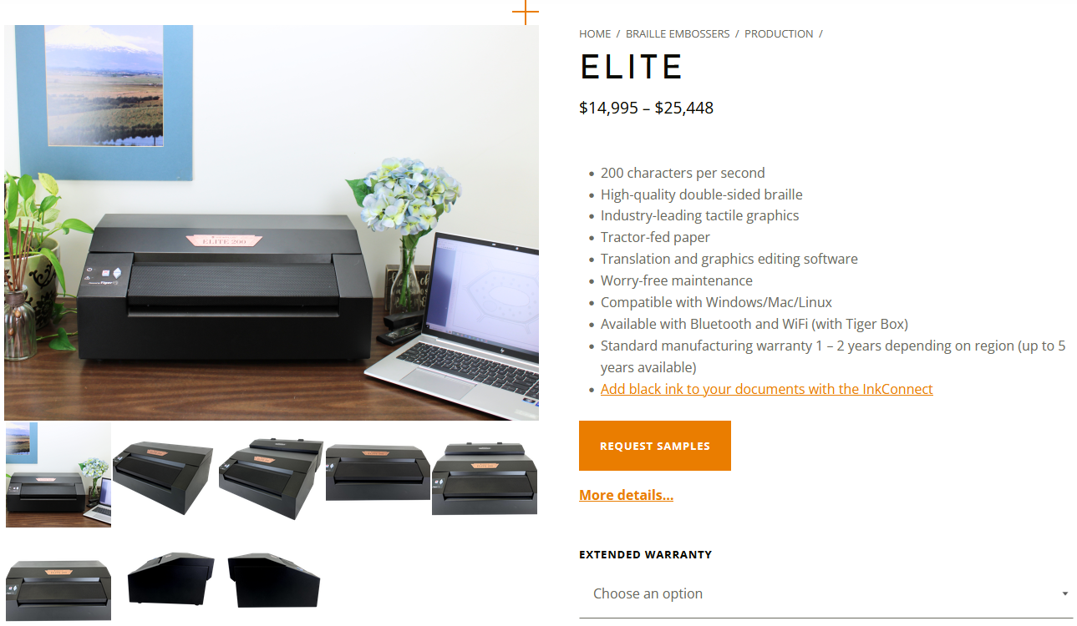
Elite 200 Embosser: $14,995 – $40,448

Slide 63
Supplies for Elite Embosser
11×11.5” Continuous Feed Braille Paper: $50.99 per 1,000 sheets
https://americanthermoform.com/product/braille-paper-11x11-5-plain-continuous-sheets/
Drawing program and braille translation software
More on these on Software slide.

Slide 64
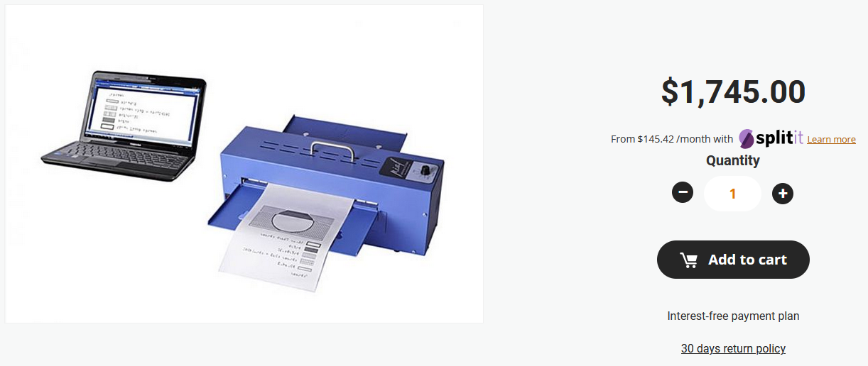
PIAF: $1,745

Slide 65
Supplies for PIAF
Tabloid-size Swell Paper: $225 per 100 sheets
https://americanthermoform.com/product/swell-touch-paper/
11×11.5” Swell Paper: $165 per 100 sheets
https://americanthermoform.com/product/swell-touch-paper/
Swell Touch Markers: $8 for 2 markers, one thick and one thin
https://americanthermoform.com/product/swell-marker/
Drawing program, braille translation software, printer
More on these on Software slide.

Slide 66
Software
Adobe Illustrator or other vector drawing program
Braille translation software
We use Duxbury Braille Translator: $795 per user
https://www.duxburysystems.com/default.asp
Save your installer!
Microsoft Word (used with Duxbury)
MathType: $51.16 per user per year with email ending in .edu
https://store.wiris.com/en/

Slide 67
Also need
A printer/copier and its requisite supplies
Normal office supplies (desk, computer, etc.)
Staff
Recommended:
Somewhere to put this stuff with great soundproofing or where no one will mind the noise
Feedback from actual braille users
(Not necessary: artistic talent)

Slide 68
Additional Resources (1/2)
American Printing House for the Blind: https://www.aph.org/
APH Tactile Graphics Library: https://imagelibrary.aph.org/portals/aphb/
Benetech: https://imageshare.benetech.org/resources/
BTactile: https://btactile.com/
HARPO: https://piaf-tactile.com/tactile-graphic-resources/
IAGD: https://tactileimages.theiagd.org/
Perkins: https://www.perkins.org/resource/tactile-graphics-library/

Slide 69
Additional Resources (2/2)
Pro Blind: https://share.problind.org/app/browse?authorId=674&language=en
Tactile Graphics Website: https://www.tactilegraphics.org/index.html
Thingiverse (3D printing files): https://www.thingiverse.com/
ZyChem: https://zychemltd.com/tactile-graphics-blog-zychem/

Slide 70

Questions?
Contact Information:
em.kribs@wichita.edu
aaa@wichita.edu
braille@wichita.edu

