Slide 1
Beyond Adoption:
Strategies to Scale EdTech Impact and Drive Campus-wide Engagement

Slide 2

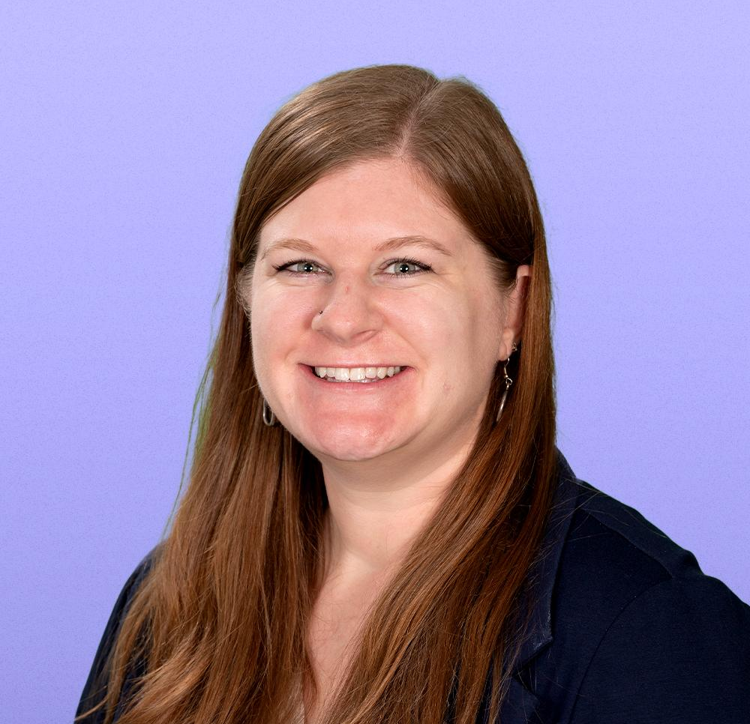
Hello!
Rachel Kruzel, ATP
Strategic Customer Success Manager - Higher Education
Everway
Email: r.kruzel@everway.com
Phone: 651-245-3128

Slide 3
Agenda
Introduction & Agenda
Adoption, Impact, Usage & Engagement
The ‘Messy Middle’
Stakeholder Mapping
Change Management Checklist
Discussion & Questions

Slide 4

Where are you on your implementation journey?

Slide 5
Adoption ≠ Impact
Adoption = tool is acquired or turned on
Adoption is:
Signed contract, integration completed, permissions configured, first steps around promotion and training
Impact = improving learning, access, student success in measurable ways
Impact is:
Demonstrable benefits, barriers reduced, changing instructional, institutional or accessibility practices, measurable gains, positive feedback, problems being solved

Slide 6
Usage ≠ Engagement
Usage = logging in or clicking a feature
Usage is:
Student used the tool once and didn’t again, uneven use amongst department, basic actions without understanding the full benefits, usage only when incentivized
Engagement = meaningful and consistent use which creates value
Engagement is:
Regular use due to the benefits of the tool, integration into pedagogy and courses, embedding in study routines, use for decision making, demand expands organically

Slide 7
At the Core
Usage is technical or administrative step(s).
Your can have adoption without impact.
This is the most common implementation failure point in higher education.
Usage is often accidental, minimal or non-sustained.
Engagement is purposeful, repeated and outcome-driven.

Slide 8
Why Framing Matters
The work ahead
Adoption is 40% of the work the adoption and integration, the remaining 60% of the adoption is what’s ahead
Premature Success Celebrations
Celebrating success too early: tool purchase, single user(s), early interest usage not sustained long-term
Meaningful change is not guaranteed
False starts, use by small subset of the populations, reach doesn’t impact intended and users needing the tool, struggle to demonstrate ROI, loss of support during budget reviews
Activity ≠ Outcomes
Only data and impact can be called outcomes

Slide 9
Change Agent
Go beyond:
How do we get people to try this?
Toward:
How do make this something people rely on every day?

Slide 10
The Messy Middle of EdTech

Slide 11
Defining the Messy Middle
Difficult, uncomfortable, uncertain, challenging part of any process, project or journey when you’ve moved past the initial idea and excitement but you haven’t reached the end yet
Dubbed ‘Day 2’
Day 1 = initial excitement
Day 3 = the final outcome

Slide 12
The Beauty of The Messy Middle
Growth through challenges
When we’re forced to persevere we develop and learn
Non-negotiable part of the process
It can’t be skipped over, the messy middle is part of any story or journey to growth (think of any story book or movie)
Transformation Point
Grow, learn, build grit and resilience by leaning into what is the uncomfortable unknown
“The middle is messy but it’s also where the magic happens.”

Slide 13
Why is the middle messy?
Adoption versus implementation versus long-term integration
Barriers to integration and scaling use:
Limited bandwidth
Limited prioritization
Siloed decision-making and support
Lack of awareness
Lack of expertise for implementation
Lack of buy-in or executive support

Slide 14
What is your biggest implementation challenge?

Slide 15
Build Awareness: Create Campus-wide Visibility
Different messaging for different personas
Students, faculty, staff, leadership, IT
Multi-channel communication plan
Emails, LMS banners, workshops, student ambassadors
Leverage Early Adopters and Champions
Diffusion of Innovation Theory
Connect your efforts to Institutional Priorities
Increases visibility, buy-in, and rationale

Slide 16
What are some effective awareness campaigns you’ve experienced on campus?

Slide 17
Stakeholder Mapping

Slide 18
Partnerships & Shared Responsibility
Cross-functional support is key
Resources, influence, power, expertise; shared ownership
Influencers enable and drive institutional change
Scope and reach of influencers on subsets of the population; champions
Understanding why and how behavior changes
Culture, incentives, buy-in, persuasion
Reduce friction, integrate into embedded systems and workflows
Maximize possibility of use and awareness

Slide 19
Stakeholder Mapping Exercise

Slide 20
Stakeholder Mapping Reflection

Slide 21
Change Management Planning

Slide 22
Long-Term Planning
Ongoing efforts
Not episodic; iterative, ongoing and continued campaigns to build awareness and drive use
Multi-channel approach
Based on persona and varied ways people engage with information
Cyclical practice
Academic year, semester, key points during semester, turnover in students, faculty and staff
User-centered reinforcement
Messaging, professional development, ongoing awareness refreshers

Slide 23
Data as an Asset
Usage versus engagement metrics
Clicks and logins versus qualitative and quantitative metrics of engagement
Leading versus lagging indicators
Areas where it’s excelling versus areas of growth and opportunity; using data to identify gaps, departments needing support, and “white space” opportunities
Benchmark your data
Design iterative improvements
Connect data to Institutional Priorities
Shows impact to the mission and vision, increase resource and stakeholder support
Storytelling with data
Showcase your wins to stakeholders and leadership; sustained support

Slide 24
Change Management Checklist

Slide 25
Checklist Focus Areas
Pre-Launch: clarity, alignment, readiness
Awareness & Communication Strategy: what is it, why it matters, and how to use it
Training & Capacity Building: empowerment, confidence, support
Launch Execution: roll out with clear guidance and visibility
Engagement Monitoring: what’s working & what is not
Sustainment & Long-Term Integration: move from new to routine

Slide 26
Discussion & Questions

Slide 27
Let’s Connect!
Rachel Kruzel, ATP
Strategic Customer Success Manager - Higher Education
Everway
Email: r.kruzel@everway.com
Phone: 651-245-3128

