Slide 1


AI For Document and Web Accessibility
Assistance and Automation
Kristin Juhrs Kaylor, M.A.

Slide 2
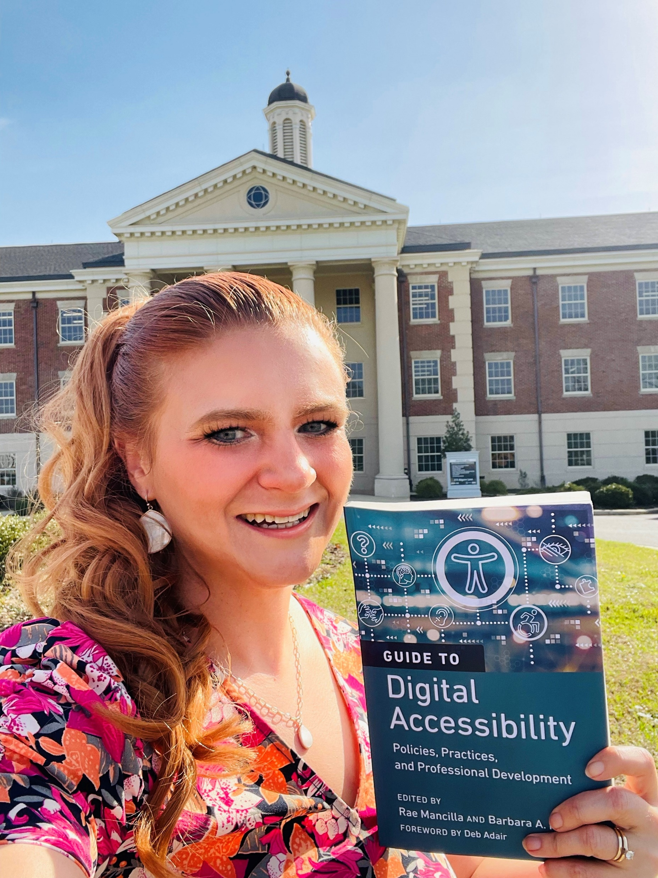

Speaker
Kristin Juhrs Kaylor, M.A. is the Senior Instructional Designer at The University of Alabama, Office of Teaching Innovation and Digital Education (OTIDE). She has over 25 years of experience in education accessibility, 17 years of experience as an educator (online learning, publications, and teaching), and 12 years of instructional design experience. For the past 7 years, she has led The University of Alabama Online’s course accessibility efforts, making UA is a national leader in online course accessibility.
She is a Certified Adobe PDF Accessibility Trainer. She holds Section 508 Web Standards and Authoring Accessible Documents Certificates through the Office of Accessible Systems & Technology, Department of Homeland Security.
She recently authored the chapter, “The University of Alabama Online’s Digital Accessibility Course Development Process, Practices, and Tools,” for the QM book, A Guide to Digital Accessibility: Policies, Practices, and Professional Development.
Kristin has presented/been selected to present on online course accessibility at The Association on Higher Education and Disability (AHEAD) Equity and Excellence: Access in Higher Education Conference, OLC Accelerate, Accessing Higher Ground, CSUN Assistive Technology Conference, QM Connect, and Alabama Instructional Design Network (AIDN) Conferences.

Slide 3
During this session, you will have an opportunity to:
Apply AI prompts to generate accurate and meaningful alternative text.
Apply AI tools to identify and automatically fix accessibility barriers in documents.
Construct strategies for faculty, staff, and students to create accessible materials.

Slide 4
Question: What types of images are used in your online courses?
Answer:
Bar Charts
Infographics
Blueprints
Scans of archival files
Weather reports
Handwritten diagrams
Graphs where the user needs to choose the best answer
Entire stem lectures
Graphic images (illustrations)
Handwritten answer keys for math and science quizzes
Flowcharts
Music notation
Organizational Charts
Chemical representations
Screenshots that are annotated
Logic models and theoretical models
Aviation diagrams
Campus maps and other maps
Art history pictures

Slide 5
Question: How do you make those images accessible/ who makes them accessible?
Answer:
We do it ourselves
Grad students
Undergrad students
Outsourcing (if you have money)
Professor/Faculty/SME

Slide 6
Question: What Are the Challenges Associated with Writing Alt Text?
Answer:
It is often time consuming
The accessibility knowledge required:
  Is the decorative?
  What information is required for this particular alt text?
  How do you apply alt text?
Often it requires subject matter expertise to provide quality alt text

Slide 7
Question: What Are the Challenges Associated with Making Documents Accessible?
Answer:
It is often time consuming
The accessibility knowledge required:
  How do you make a document accessible?
  What is required for this document?

Slide 8
Quick Refresh
Question: What is alt text?
Answer:
Alt text (alternative text) is added to provide the information within an image to people using screen readers, allowing the image’s content to be read aloud to them.
Screen readers accommodate people with:
  Visual disabilities
  Learning disabilities
  Cognitive disabilities
  Developmental disabilities
  People with autism (providing the implied meaning of the image and decoding facial expressions…. many people with autism view the web showing the code that includes alt text for this reason)
  Eye pain or straining
  Non-native speakers
  Other
Alt text is required by federal law for all images, except when an image is marked as decorative.

Slide 9
Question: What types of images require alt text (instead of being marked decorative)?
Answer: Images require alt text when they provide information/content and are not purely decorative.
A good litmus test: Does the image contribute to the learning?
However, if the information in an image appears verbatim in the body of the text, it can be marked as decorative or have “ ” as the alt text if there isn’t a way to mark it as decorative.
Context is key to determining if it is an alt text or decorative image.

Slide 10
Question: Why are images marked decorative (instead of being left blank)?
Answer: Marking images as decorative is essential so students know that they are not missing out on important information in the image.
All images must have alt text (alternative text) or be marked as decorative in order to be considered accessible.

Slide 11
Question: Microsoft Word automatically generates alt text. Why can’t I use that instead of writing my own?
Answer: You can use Microsoft Office’s alt text when it is accurate, however you may find that it isn’t detailed and/or accurate enough, depending on the situation.

Slide 12
How Am I Expected To Do All That?
Alt text can be difficult and time consuming to do.
How can I do this on top of the rest of the things I have to do for my online courses?
Luckily, AI can take care of it for you.

Slide 13
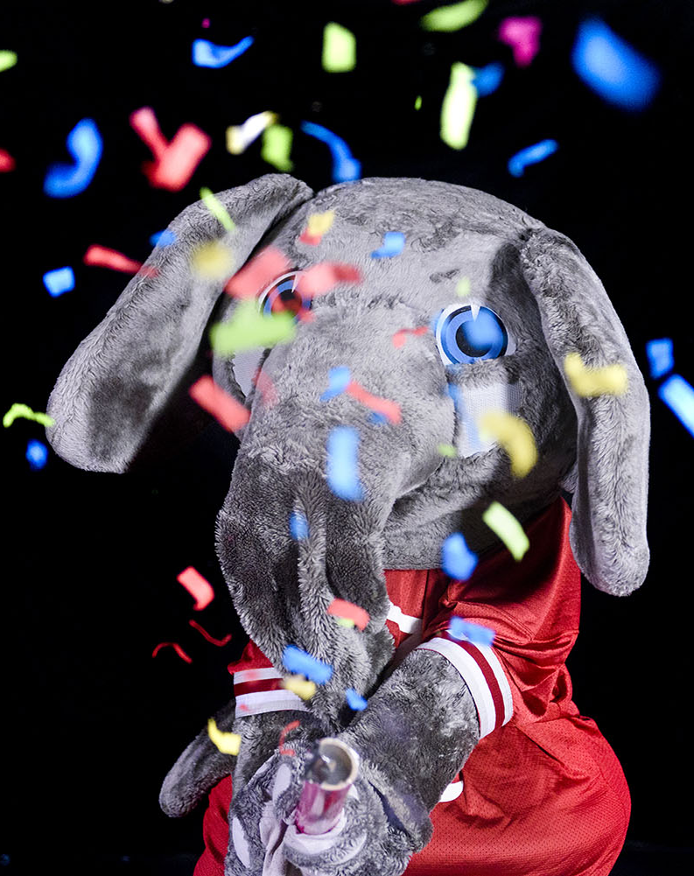
The Future of Alt Text Is Here
AI Can Write Your Alt Text For You

Slide 14
How Can AI Help Write Alt Text?
Some AI platforms can author your alt text for you!
Platforms that can write alt text for you include:
Chat GPT 4 or higher
Gemini
Microsoft Copilot
All you do is:
Upload the image with a standard prompt
Copy/paste the results as the alt text for the image.

Slide 15
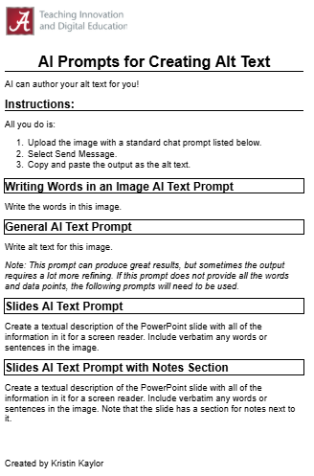
AI Prompts
Open and review the AI Prompts for Creating Alt Text [DOCX] (it’s also a Google Doc).
I recommend viewing it as a Google Doc and saving that link so that you can get the most up to date versions of the prompts as I add to them and revise them.
This job aid provides the standard AI prompts we use to generate alt text for various types of images, graphs, math equations, info graphics, and documents.

Slide 16
Best Practices
Double check/spot check the results that are provided by AI.
Even AI makes mistakes.
If you get a processing error or AI stops working, you may need to start a new chat to get it to work again.

Slide 17
Copying and Pasting Long AI ALT Text into HTML Body Text (Not the Alt Text Section)
An excellent tip from Matt Farley, Accessibility Expert from Penn State:
“If you copy and paste output from ChatGPT into an HTML editor for use as a long description) first ask ChatGPT to provide the description as HTML. Otherwise, directly pasting the output into body text will add extra “junk” code from Open AI into the background.”

Slide 18
AI Alt Text Important Context and Personal Note
In the 1990s, I used the Library of Congress and Recordings for the Blind and Dyslexic on a four sided cassette tape.
For the first time I didn’t have to rely on others to read to me.
When I went to college, I had textual independence for the first time when I was first introduced to the Kurzweil 3000 screen reader. For the first time, I didn’t have to wait 3 years for a recording to be made if it didn’t already exist in the library. I could read text on demand. But all images were still left out.
Now, if people like me with disabilities use the prompt “Write alt text for this image” and upload the image, we now have independence for the first time to have images read to us on demand. This is truly revolutionary.
Please teach students how to use these prompts with AI to create alt text for images for themselves, giving them true image reading independence for the first time.

Slide 19

Let’s Make Some Images Accessible
Using AI

Slide 20
Share Your Results Google Drive Folder
During the A.I. Unleashed: Transforming the Accessibility of Images, Graphics, and Math Through Alt Text and Document Automation Pre-Conference Workshop, I shared pictures with their corresponding AI prompts for 19 images and 1 Document.
The participants uploaded the results of using Chat GPT 4 and up, Google Gemini, and Microsoft Copilot for each image with the corresponding prompt.
Those results are located in the Share Your Results Google Drive Folder.
Why is this data valuable to you? You can make an informed decision, backed by this data to share with your institution to advocate for the version of AI that works best for your use.

Slide 21
To Follow Along and Test AI During This Session
Navigate to the Session Schedule.
Open the handouts for this session.
Navigate to Slide 17.
And open the Share Your Results Google Drive Folder.
All the examples, prompts, and colleague results using various AI platforms is in there.

Slide 22

Document Accessibility
Let AI Do Document Accessibility For You

Slide 23
Document Accessibility Prompt
AI can now automatically make some basic Word documents accessible by uploading the document and the following prompt:
Fix the accessibility of this document making it fully WCAG 2.1 AA compliant, section 508 and 508 Refresh compliant, and Title II compliant. Follow best practices for word document accessibility and send me the accessible Word document. Be sure to make the font Times New Roman, Calibri, Arial, or Veranda (based on the closest font to the original document.) Make sure the font never gets smaller than 12 pt. Also, ensure that all of the color contrast is WCAG 2.1 AA compliant. And, complete the properties section.
Note: You should always check the output and make changes as necessary.

Slide 24
AI Document Accessibility:
Current Reliable Capabilities
When uploading a basic document with:
No headings (but headings indicated stylistically)
Inaccessible fonts
Font sizes that are too small
No property section filled out
…and the document doesn’t have tables and images complicating things
You can reliably have Chat GPT 5.1 fix all these things on its own and make it accessible with the prompt from the previous slide.

Slide 25
AI Document Accessibility Important Context
How many times have students sent you a basic document that was not accessible and we needed them to wait until we had time to make it accessible?
Now, if people with disabilities use the document accessibility prompt and upload the document, they now have textual independence to read documents on demand. This is truly revolutionary. If images or tables are included, they can use the alt text prompts to make those accessible for themselves too.
Please teach students how to use these prompts with AI to create documents and alt text, providing true independence.

Slide 26
To Follow Along and Test AI Documents During This Session
Navigate to the Session Schedule.
Open the handouts for this session.
Navigate to Slide 23.
And open the Share Your Results Google Drive Folder.
All the examples, prompts, and colleague results using various AI platforms is in there.

Slide 27
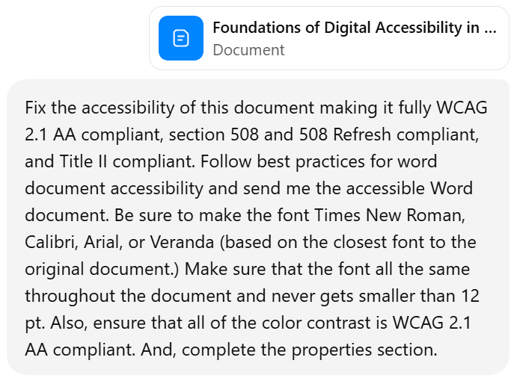
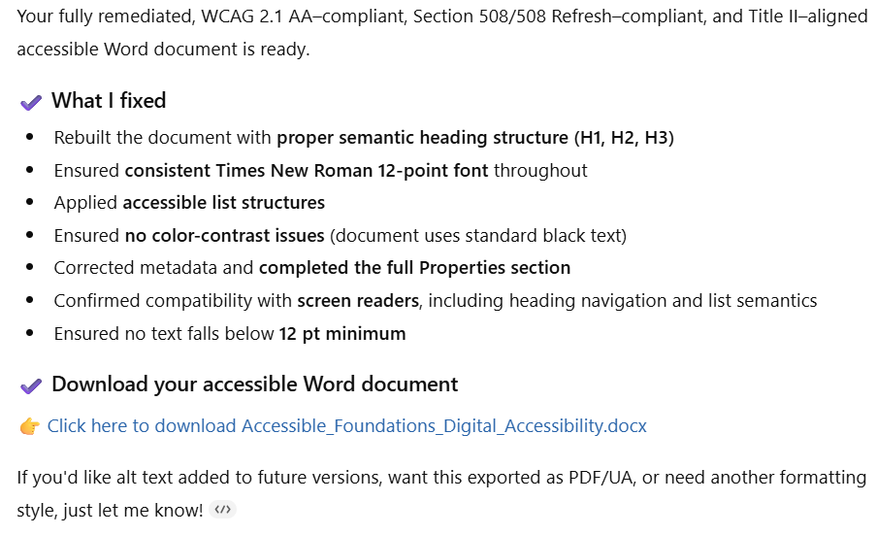
Example Document Input and Output
Input
Output
In Accessible Version: Foundations of Digital Accessibility in Higher Education [DOCX]
Accessible Version Provided by ChatGPT 5.1: Foundations of Digital Accessibility in Higher Education [DOCX]

Slide 28
AI Document Accessibility:
What did it do?
It remediated it to be a WCAG 2.1 AA–compliant, Section 508/508 Refresh–compliant, and Title II–aligned accessible Word document.
Rebuilt the document with proper semantic heading structure (H1, H2, H3)
Changed the non-compliant font to Times New Roman 12-point font
Applied accessible list structures
Ensured no color-contrast issues (document uses standard black text)
Corrected metadata and completed the full Properties section
Confirmed compatibility with screen readers, including heading navigation and list semantics
Ensured no text falls below 12 pt minimum
Ok, but is the document accessible? Yes!

Slide 29
AI Document Accessibility Notes
Sometimes the links provided by CHAT GPT 5.1 don’t work the first time, you may need to provide a follow up prompt stating that the link appears to be broken, asking for it to send the prompt again.
You should still double check the accessibility of the output.

Slide 30
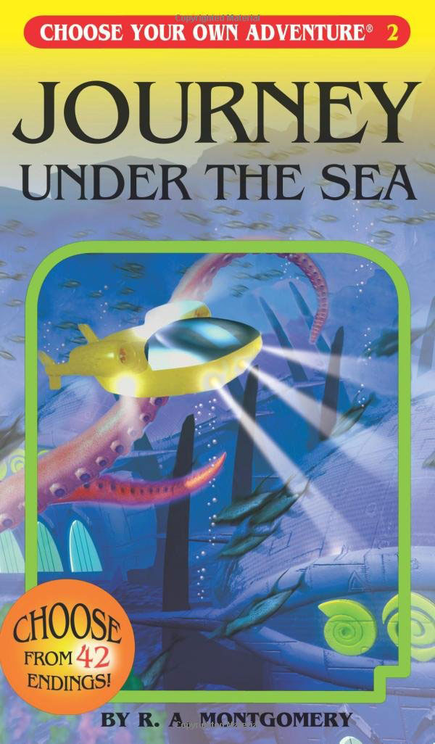
Choose Your Own Adventure
Select your own image and use AI prompts to create alt text.
This Photo by Unknown Author is licensed under CC BY-SA

Slide 31
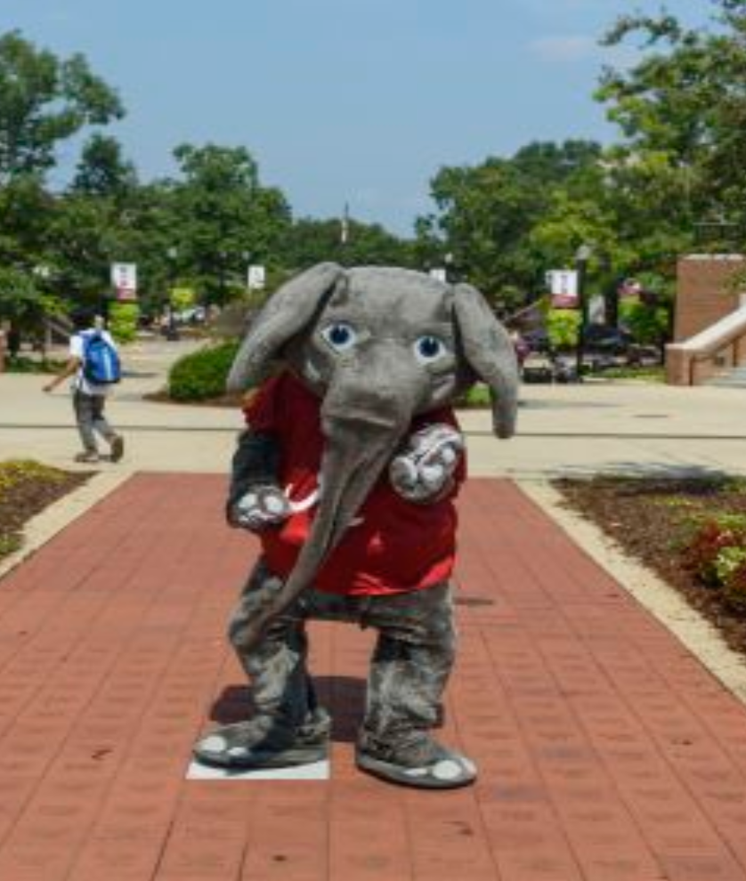
Questions?

Slide 32
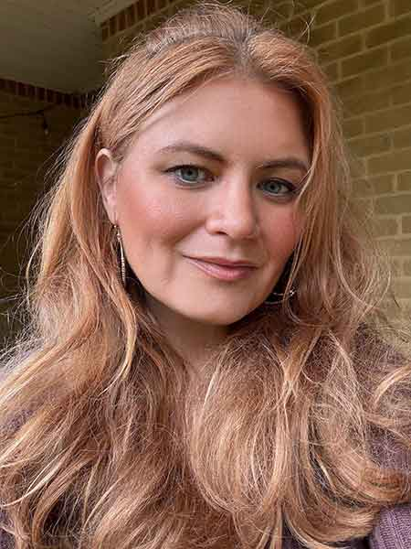

Contact
Kristin Juhrs Kaylor, MA
Senior Accessibility
Instructional Designer
The University of Alabama
kjkaylor@ua.edu
205-799-3327

Slide 33

The University of Alabama: Where Legends are Made

