Slide 1
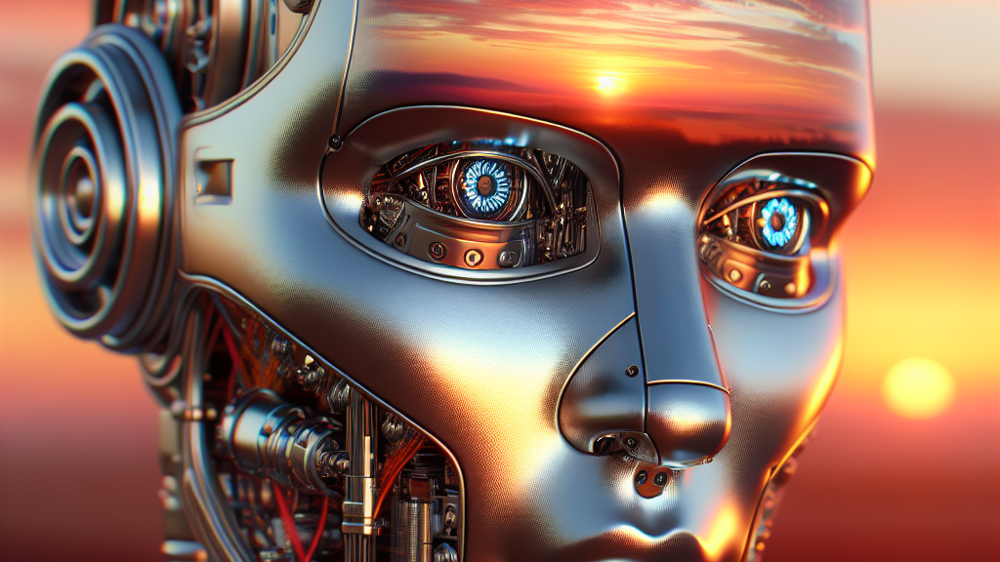
AI and Digital Accessibility:
The Good,
The Bad,
The Hopeful

Slide 2

Agenda
How we got here
How AI Helps
Where AI Falls Short
What Gives Us Hope
The Path Forward

Slide 3
We’re going to see more change in the next five years than we’ve seen in the last 50.
Jack Ma

Slide 4

The Spark That Lit the AI Revolution
Alan Turing: The Father of Modern AI
Alan Turing was a British mathematician who imagined a machine that could follow instructions to solve any logical problem.
This idea became the foundation of modern computers.
He created the Turing Test—a way to check if a machine can “think.” If a person chats with both a human and a machine and can’t tell which is which, the machine is considered intelligent.
His work sparked decades of research into machine intelligence.
The Dartmouth Conference: Where AI Got Its Name
In 1956, a group of scientists met at Dartmouth College to explore how machines could simulate human intelligence.
This event officially introduced the term “Artificial Intelligence.”
The conference launched AI as a field of study and inspired generations of innovation.

Slide 5
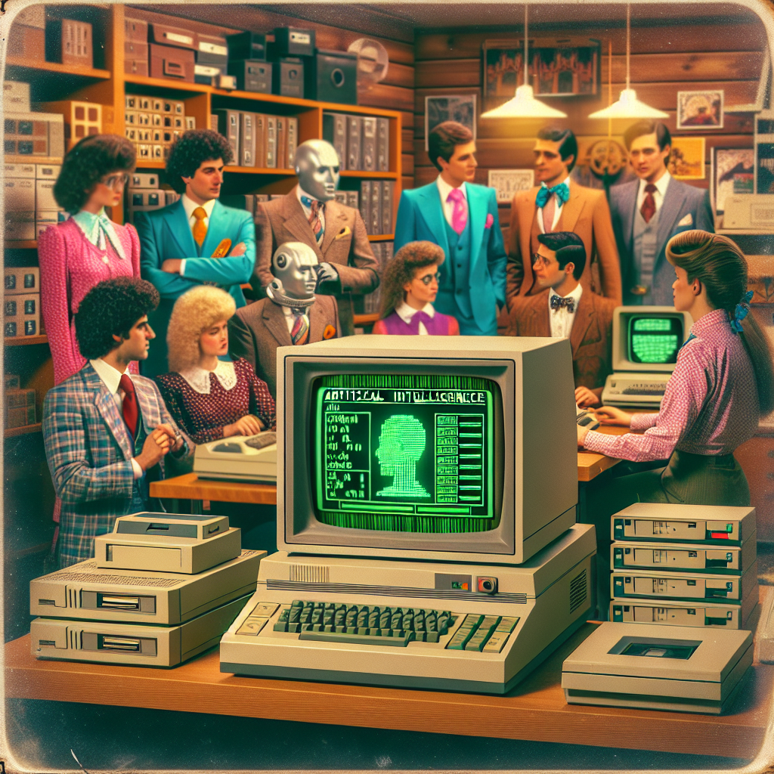
AI in the 80’s
The 1980s marked a turning point for AI, with growing interest from industries, governments, and academics. The focus was primarily on knowledge representation, expert systems, and machine learning.
Expert Systems
Machine Learning
Industrial Interest

Slide 6
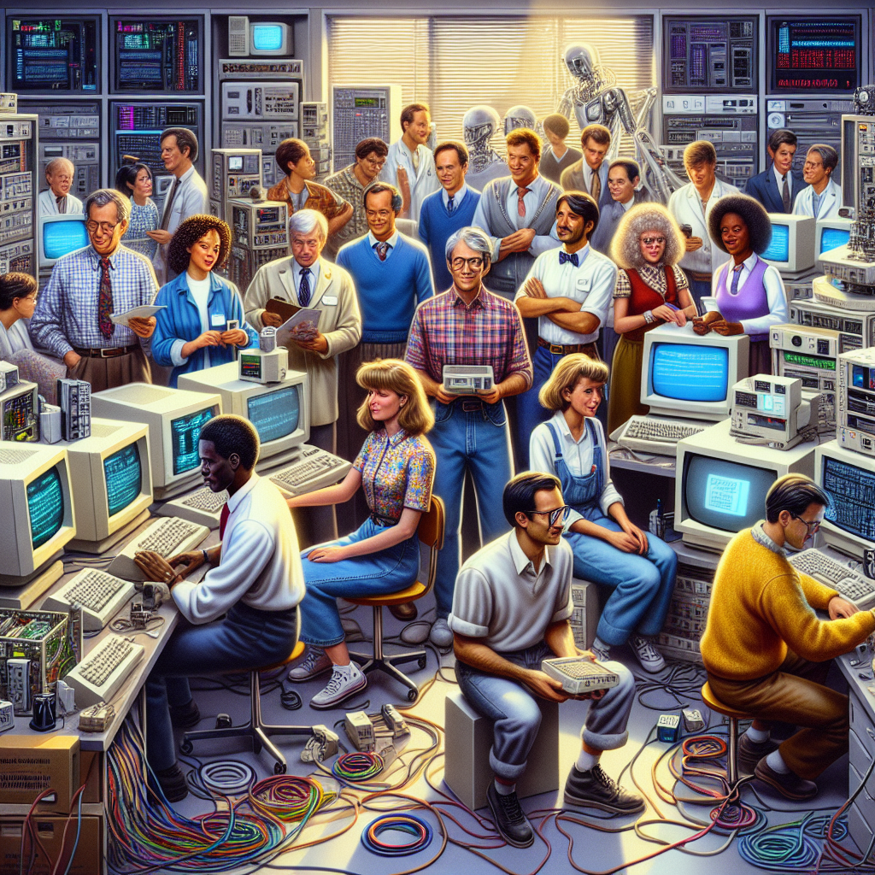
AI in the 90’s
The 1990s brought more processing power and commercial interest, giving rise to projects with real-world impact. This decade also saw some AI projects succeed spectacularly and others falter, helping researchers refine their approaches.
Data-Driven AI
Speech Recognition Becomes Possible

Slide 7

AI Winters
Overpromising, underdelivering: Hype outpaced reality.
Funding dried up: when progress stalled, leading to periods of stagnation known as “AI winters”.

Slide 8

Checkmate by IBM
“No Computer will ever beat me!” – Garry Kasparov
In 1997, IBM’s Deep Blue became the first computer system to defeat a reigning world chess champion in a match under standard tournament controls. Big Blue’s victory in the six-game match against Garry Kasparov marked a change in computing, predicting a future in which supercomputers and artificial intelligence could simulate human thinking.
Deep Blue used 32 processors and was able to evaluate 200 million chess positions per second, achieving a processing speed of 11.38 billion floating-point operations per second, or flops. By comparison, IBM’s first supercomputer, Stretch, introduced in 1961, had a processing speed of less than 500 flops.
Deep Blue wasn’t just a breakthrough for the world of chess. Its underlying technology advanced the ability of supercomputers to tackle the complex calculations needed to discover new pharmaceuticals, assess financial risk, uncover patterns in massive databases, and explore the inner workings of human genes.

Slide 9
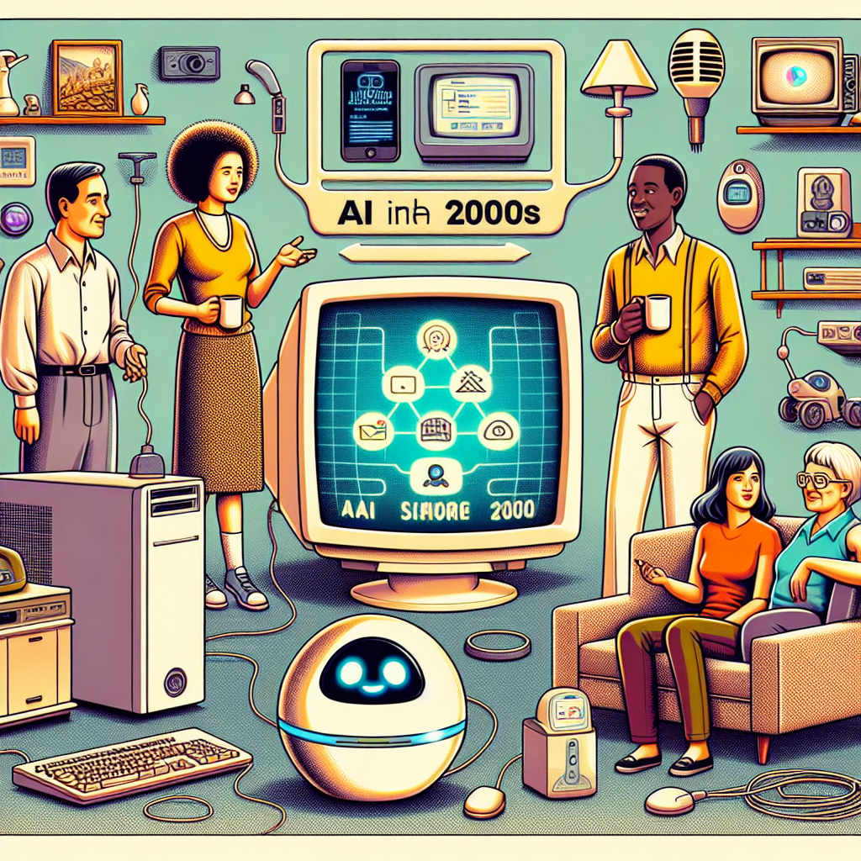
AI in the Early 2000’s
Machine learning and big data revived AI
Deep learning
Transformer architecture

Slide 10
Why Didn’t it Work the First time?
Not everything in the 80s and 90s was smooth sailing. Funding was notoriously volatile, with what’s often called the second “AI winter” occurring in the late 80s and early 90s. Despite some breakthroughs, many projects failed to meet the high expectations set by their initial promise, leading to skepticism and funding cuts.
Overhyped Systems
Limited Processing Power
Technology before it’s Time

Slide 11
AI will be the most transformative technology since electricity.
Eric Schmidt

Slide 12
Top AI Models and Their Host Products
GPT-5 by OpenAI used for ChatGPT, Microsoft Copilot, Duolingo, Khan Academy
Claude 4 by Anthropic used for Claude AI assistant, Notion AI, Slack integrations
Gemini 2.5 Pro by Google DeepMind used for Bard (Google’s AI), Android devices, Google Workspace
DeepSeek V3 by DeepSeek used for Open-source deployments, developer tools
LLaMA 4 by Meta used for Meta’s internal tools, open-source research
OpenAI o3-mini by OpenAI used for Lightweight reasoning tasks, embedded systems
Grok 3 by xAI used for X (formerly Twitter), real-time social intelligence
Qwen 3 by Alibaba used for Multilingual applications, e-commerce platforms
Command R+ by Cohere used for Real-time systems, enterprise AI solutions
Mistral 3 by Mistral AI used for Privacy-first applications, European enterprise tools
AlphaCode by DeepMind used for Coding assistants, developer platforms
DALL·E 3 by OpenAI used for Image generation in ChatGPT, Microsoft Designer
Tesla Autopilot AI by Tesla used for Autonomous driving systems
BERT by Google used for Search engines, healthcare NLP, retail analytics
These models vary in size, speed, modality (text, image, audio), and specialization. Some are optimized for reasoning, others for creativity, and some for multilingual support or real-time responsiveness.
IQ of an Average human is 100. IQ of a Genius is 130.

Slide 13
Intelligence across Topics – The Impressive
Chess IQ 250+ Superhuman
(error rate <0.1% - nearly perfect play)
Go IQ 250+ Superhuman
(error rate <0.1% - superhuman consistency)
Poker IQ 180+ Near superhuman
(error rate 5-10% - strong but exploitable patterns
StarCraft II IQ 180+ near superhuman
(error rate 5% - strong but predictable strategies, very fast)
Numerical Computation IQ 170+
(error rate ~0.1% - perfect arithmetic)
Protein Folding IQ 170+
(error rate 5% - revolutionary but not perfect)
Language Translation IQ 140+
(error rate 10-20% - fluent but context errors)
Facial Recognition IQ 140-160
(error rate 1-2% - high accuracy but concerning false positives)
Pure Mathematics IQ 140-160
(error rate 10-20% - theorem proving limited by logical gaps)
Applied Mathematics IQ 140
(error rate 10-20% - good at standard problems)
Statistics IQ 130-150
(error rate 5-10% - excellent pattern detection)
Image Recognition IQ 130
(error rate 2% - good but fails on edge cases)
Medical Imaging IQ 125-140
(error rate 5-15% - matches radiologists but inconsistent)
Climate Modeling IQ 120-140
(error rate 20-40% - complex systems are inherently uncertain)
Medical Diagnosis IQ 115-130
(error rate 20-35% - helpful but requires human oversight)
Legal Research IQ 115-130
(error rate 15-25% - good at finding precedents, bad at hallucinations)

Slide 14
Cost of Top AI Models
OpenAI
  Chat GPT Free
  Chat GPT Plus $20/month
  Chat GPT Pro $200/month
  Chat GPT Business $25/user
Microsoft Copilot
  Copilot Pro $20/month
  Copilot for M365 $30/user
Duolingo
  Super Duolingo $12.99/month
  Duolingo Max $14.99/month
Khan Academy
  Khanmigo $4/month
Anthropic
  Claude Pro $20/month
  Claude Max $100-200/month
Notion AI
  Business Plan $20/user
Slack AI
  Slack AII $10/user
Google Gemini
  Gemini Pro $19.99
  Gemini Ultra $249.99
Grok
  Grok 3 $16/month
OpenAI DALL E3
  $20/month

Slide 15

AI passes the Test
Becoming a Chartered Financial Analyst (CFA) is not an easy task. Indeed, the exam has three levels, and most people spend several years and about 1,000 hours studying before they can pass. Two years ago, AI models could only pass the first two parts of a rigorous test
Artificial intelligence can now pass even the toughest part (the Level III mock exams) in just minutes. This shows just how quickly AI is improving, especially in areas that require complex reasoning and problem-solving.
Researchers tested 23 large language models on Level III mock exams, which include both multiple-choice and essay questions.
OpenAI's o4-mini, Google's Gemini 2.5 Pro, and Anthropic's Claude Opus, managed to pass by using “chain-of-thought prompting.” This is a method where the AI explains its steps as it solves problems.

Slide 16
Intelligence across Topics - The Questionable
Drug Discovery IQ 130-150
(error rate 20-40% - high failure rate in real trials)
Software Engineering IQ 120-130
(error rate 15-25%% - functional code but bugs common)
Astronomical Analysis IQ 115-130
(error rate 15-25% - good pattern recognition)
Financial Trading IQ 110-125
(error rate 25-40% - market unpredictability)
Technical Documentation IQ 110-125
(error rate 10-20% - may miss nuances)
Legal Writing IQ 110-125
(error rate 20-30% - miss legal subtleties, not always truthful)
Sentiment Analysis IQ 110-125
(error rate 20-35% - misses sarcasm, context)
Conversation IQ 105-120
(error rate 25-40% - coherent but factual errors)
Behavioral Prediction IQ 105-120
(error rate 30-50% - human behavior is complex)
Creative Writing IQ 95-110
(error rate 30-50% - coherent but lacks originality)
Visual Art Generation IQ 95-110
(error rate 40-60% - impressive but often uncanny)
Autonomous Driving IQ 90-105
(error rate 20-40% - improving but critical safety issues)
Music Composition IQ 90-105
(error rate 40-60% - technically sound but emotionally flat)
Game Design IQ 85-100
(error rate 50-70% - functional but often unbalanced
Contextual Humor IQ 70-80
(error rate 50% - poor at creating funny jokes)

Slide 17
AI is a fundamental risk to the existence of human civilization.
Elon Musk

Slide 18
AI Benefiting PWD
AI is making a real difference in the lives of people with disabilities—sometimes in ways that feel straight out of science fiction.

Slide 19
How can AI improve Digital Accessibility?
AI is transforming digital accessibility by breaking down barriers and making technology more inclusive for people with disabilities. Here’s how it’s making a real impact:
Speech & Language Tools
Real-time transcription: Apps like Caption.Ed and Ava use AI to transcribe spoken words instantly, helping people with hearing impairments follow conversations and lectures.
Automated captioning & translation: AI-powered tools like Microsoft Translator and Google Translate provide accurate subtitles and multilingual support for videos and live events.
Visual Assistance
Image recognition: AI can describe images, identify objects, and even interpret facial expressions—helping users with visual impairments understand visual content.
Screen readers & text-to-speech: AI enhances these tools by improving voice quality, reading accuracy, and even summarizing long texts for easier comprehension.
Document Accessibility
PDF conversion: Generative AI can restructure untagged or image-only PDFs into accessible formats like HTML or Word, making them readable by screen readers.
Table formatting: AI can reformat messy data tables into clean, readable layouts for easier navigation.
Authentication & Navigation
Facial recognition: AI enables hands-free login and navigation, which is especially helpful for users with mobility challenges.
Alternative to CAPTCHA: AI-driven facial recognition is being explored as a more accessible alternative to traditional CAPTCHA tests.
Cognitive Support
Summarization tools: AI can break down complex or lengthy content into digestible summaries, aiding users with cognitive disabilities or attention challenges.
These innovations aren’t just helpful—they’re empowering. They’re turning digital spaces into places where everyone can participate, learn, and thrive.

Slide 20
How can AI help PWD?
AI has enormous potential to empower people with disabilities, but it must be designed thoughtfully to avoid unintentionally creating new barriers.
Communication & Interaction
Speech-to-text and text-to-speech tools help people with hearing or speech impairments engage in conversations.
Eye-tracking software enables users with limited mobility to control devices using only eye movement.
Sign language avatars and real-time captioning in platforms like Zoom and Teams make meetings more inclusive.
Navigation & Mobility
AI-powered apps like Be My Eyes and Aira assist visually impaired users by connecting them with remote helpers or using computer vision to describe surroundings.
Smart wheelchairs and robotic arms (like the pizza-making robot from Virginia Tech) help users perform daily tasks independently.
Employment and Career Support
Platforms like Enabled Talent use AI to match disabled job seekers with accessible roles, offer voice-guided assistants, and even provide AI career coaching for neurodivergent users.
Cognitive & Emotional Support
AI tools can help with task planning, emotional regulation, and goal setting, especially for neurodivergent individuals or those with cognitive disabilities.
Notes:
AI has great potential to empower people with disabilities—but only if designed with care.
It enhances communication through speech-to-text, eye-tracking, and sign language avatars.
Navigation tools like Be My Eyes and smart mobility devices support independence.
In employment, AI platforms match users with accessible jobs and offer tailored coaching.
For cognitive and emotional support, AI helps with planning, goal setting, and emotional regulation.
When thoughtfully built, AI can break barriers—not create them.

Slide 21
AI is like a rocket ship: without the right control systems, it’s a bomb.
Mark Cuban

Slide 22
AI Hindering PWD
AI is also hindering digital accessibility, particularly for people with disabilities.

Slide 23
What are the Concerns with using AI?
False Positives, Not perfect, Inconsistent, Context errors, Poor at creating funny jokes, Not always truthful, Missing legal subtleties, Requires human oversight, Exploitable patterns, Limited by logic, Critical safety issues, Unbalanced, Emotionally flat, Uncanny, Lacks originality, Factual errors, Missing sarcasm, High failure rate, Missed nuances, Unpredictability, Uncertain, Hallucinations

Slide 24
The Bad – Part 1
Hiring Algorithms: Amazon scrapped an AI recruiting tool after discovering it was biased against women. The system had been trained on resumes submitted over a 10-year period, which reflected historical gender biases in tech hiring.
Facial Recognition: Studies (e.g., by MIT Media Lab) found that facial recognition systems from major companies had significantly higher error rates for people with darker skin tones, especially women, leading to misidentification and potential wrongful arrests.
Smart Devices: Voice assistants like Alexa and Google Assistant have been caught recording conversations without consent, leading to concerns about constant surveillance in private spaces.
Automation in Manufacturing and Retail: AI-driven automation has replaced many low-skill jobs, such as cashiers, warehouse workers, and assembly line operators. This has led to economic hardship in some communities, especially where alternative employment is scarce.

Slide 25
The Bad – Part 2
Fake News Generation: AI tools have been used to create convincing fake news articles and social media posts, influencing public opinion and even elections.
Deepfakes: AI-generated videos and audio clips have been used to impersonate public figures or private individuals, leading to reputational damage, fraud, and harassment.
Social Media Algorithms: Platforms like Facebook and TikTok use AI to maximize engagement, which can lead to addictive behavior, echo chambers, and increased anxiety or depression—especially among teens.
Content Moderation Failures: AI moderation tools often fail to catch harmful content or mistakenly censor legitimate posts, affecting freedom of expression.
Self-Driving Car Accidents: There have been fatal accidents involving autonomous vehicles (e.g., Uber’s self-driving car hitting a pedestrian in 2018), raising questions about the readiness and accountability of AI in life-critical systems.

Slide 26
What is AI not good at?
AI has come a long way—but it's not invincible! There are some areas where it's still clumsy, limited, or just... totally out of its depth. Here are a few things that AI tends to struggle with:
Human Emotion & Nuance
Understanding deep emotions, empathy, or sarcasm can be tricky.
It can mimic emotional tone, but it doesn't feel anything—so it might misinterpret context or intent.
Creativity With Soul
It can produce art, music, or stories—but truly groundbreaking or emotionally resonant work often comes from lived experience and intuition.
AI-generated content can feel generic or “flat” without human vision behind it.
Common Sense & Real-World Judgment
AI doesn’t have everyday lived experience, so it might miss obvious facts or make bizarre recommendations.
It can struggle with tasks that require physical intuition or tactile feedback (like folding laundry or fixing a leaky faucet).
Ethical Decision-Making
Morality isn’t just logic—it’s values, context, and conscience.
AI can follow rules but doesn’t “understand” what’s fair, kind, or just in the way a person might.
Privacy & Trust
Many people are rightly cautious about how AI uses data.
It can’t guarantee confidentiality or make moral choices about information sharing.
Human Relationships
It can chat, joke, and offer support—but it can’t form genuine bonds or really know what it’s like to be in love, be heartbroken, or raise a child.

Slide 27
I’m increasingly inclined to think that there should be some regulatory oversight, maybe at the national and international level, just to make sure that we don’t do something very foolish.
Elon Musk

Slide 28
Asking AI
AI answers the hard questions.

Slide 29
Asking AI: How is AI leaving PWD Behind? (Part 1)
AI can be a powerful force for inclusion—but when it's not designed with accessibility in mind, it can leave people with disabilities behind in subtle and serious ways. Here's how:
Bias in Training Data
AI systems learn from massive datasets, and if those datasets lack representation of people with disabilities, the results can be exclusionary.
Image generators may “erase” disabilities, as in the case of a Paralympic swimmer whose AI-generated image gave her two arms instead of one.
Facial recognition tools have shown high error rates for people with atypical facial features or assistive devices.
AI reflects society’s biases unless we actively correct them.
Inaccessible Interfaces
Many AI-powered platforms—like chatbots, voice assistants, or productivity tools—aren’t compatible with screen readers or keyboard navigation.
This locks out users with visual or motor impairments.
Voice-only interfaces can exclude people with speech disabilities.

Slide 30
Asking AI: How is AI leaving PWD Behind? (Part 2)
Exclusion from Decision-Making
Disabled people are often not consulted during the design and testing of AI systems.
This leads to products that don’t meet their needs or even actively discriminate.
For example, job screening algorithms may penalize candidates who disclose disability-related accommodations or gaps in employment.
Automated Systems in Public Services
AI is increasingly used in government and healthcare systems to determine eligibility for services.
If these systems don’t account for disability-specific needs, they can deny access unfairly.
Gerard Quinn, former UN Special Rapporteur, warned that AI could reshape the relationship between disabled people and the state—sometimes for the worse.
Erasure of Identity
AI tools that “fix” or “normalize” disability in images or avatars send a harmful message:
That disability is something to hide, rather than embrace.
This undermines the identity and dignity of disabled individuals.

Slide 31
Asking AI: Will AI ever replace human jobs?
AI is already reshaping the job market—and yes, it’s replacing some roles, especially those that involve repetitive or routine tasks. But the full picture is more nuanced
Jobs Most at Risk
Administrative roles like data entry, scheduling, and basic customer service are being automated rapidly.
Entry-level white-collar jobs, including telesales and HR support, are seeing early disruption.
Microsoft research suggests roles like interpreters, writers, and advisors may be highly susceptible to AI replacement.
Jobs That Are Safer (For Now)
Roles requiring empathy, creativity, and complex judgment—like therapists, teachers, and skilled trades—are harder for AI to replicate.
Many experts believe AI will augment rather than fully replace these jobs, helping humans work more efficiently.
The Bigger Shift
According to the World Economic Forum, while millions of jobs may be displaced, even more new roles could be created in AI development, oversight, and collaboration.
Bill Gates and other tech leaders warn that the pace of change is accelerating, and industries must adapt quickly to avoid mass disruption.
So yes, AI will replace some jobs—but it’s also creating new ones and transforming how we work.

Slide 32
Asking AI: Why is AI not equitable?
AI often falls short of being equitable because it reflects—and sometimes amplifies—the inequalities already present in society. Here’s a breakdown of why that happens:
Biased Training Data
Unequal Access to Technology
Lack of Diverse Perspectives in Development
Language and Cultural Gaps
Opaque Decision-Making
Economic Displacement

Slide 33
The most valuable businesses of the coming decades will be built by entrepreneurs who seek to empower people rather than try to make them obsolete.
Peter Thiel

Slide 34
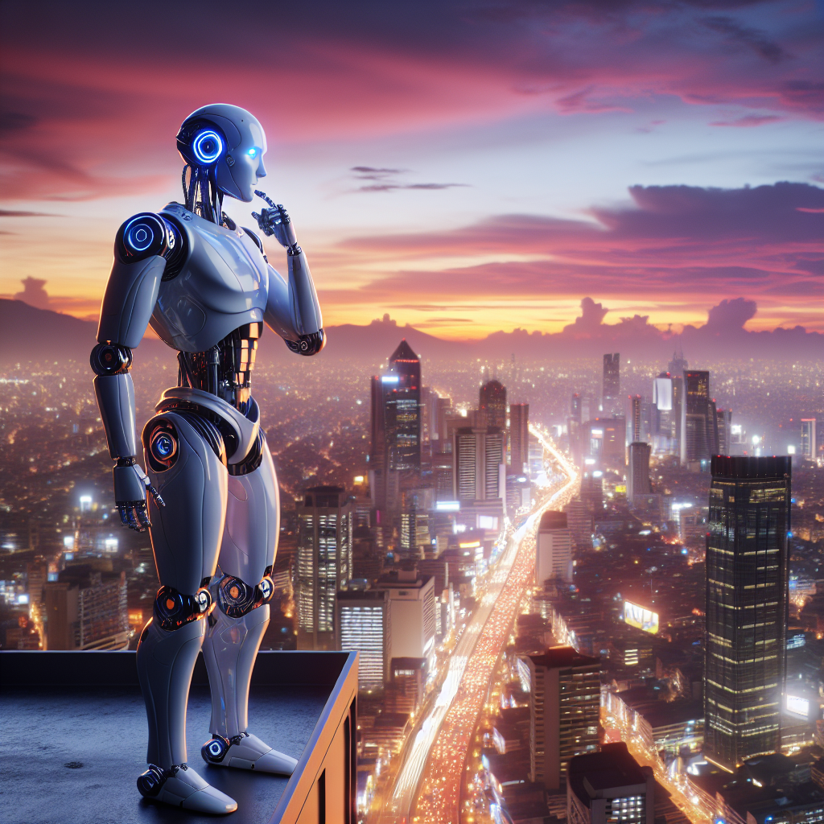
The Hopeful
Accessibility must be integrated into AI development early and often—just like security and UX. When we treat accessibility as a core design principle, not an afterthought, we create features that truly benefit everyone.
Following guidelines isn’t enough if the result isn’t usable.

Slide 35
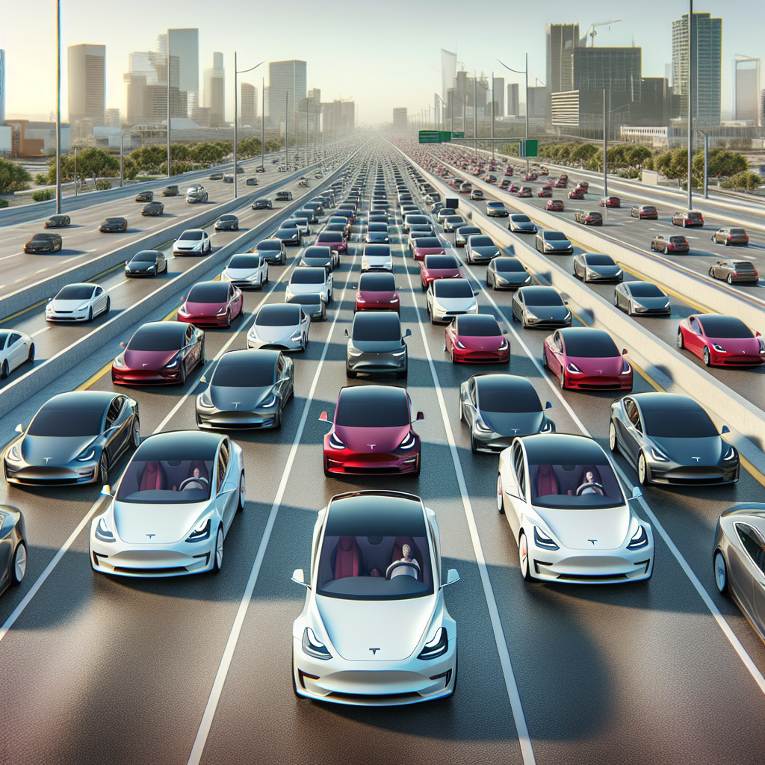
AI should Empower, not Exclude
AI holds the power to level the playing field—but only if accessibility is a priority from the start.
We must challenge developers to move beyond bare-minimum compliance and design technology that truly includes everyone. Real innovation happens when every voice is heard, and every person has a seat at the table.

Slide 36

AI, the Path Forward
Improving AI accessibility isn’t just a technical fix—it’s about rethinking who benefits and how. To make AI more inclusive and empowering, consider these key areas:
Expand language and cultural support
Simplify the user experience
Lower technical barriers
Ensure economic accessibility
Build trust through transparency
Design with disability inclusion in mind

Slide 37
Accessibility isn’t a checkbox—it’s a mindset. The more we design AI with empathy and diversity in mind, the more powerful and transformative it becomes.
Microsoft CoPilot

