Slide 1


AI Unleashed Transforming the Accessibility of Images, Graphics, and Math Through Alt Text and Document Automation
Kristin Juhrs Kaylor, M.A.

Slide 2
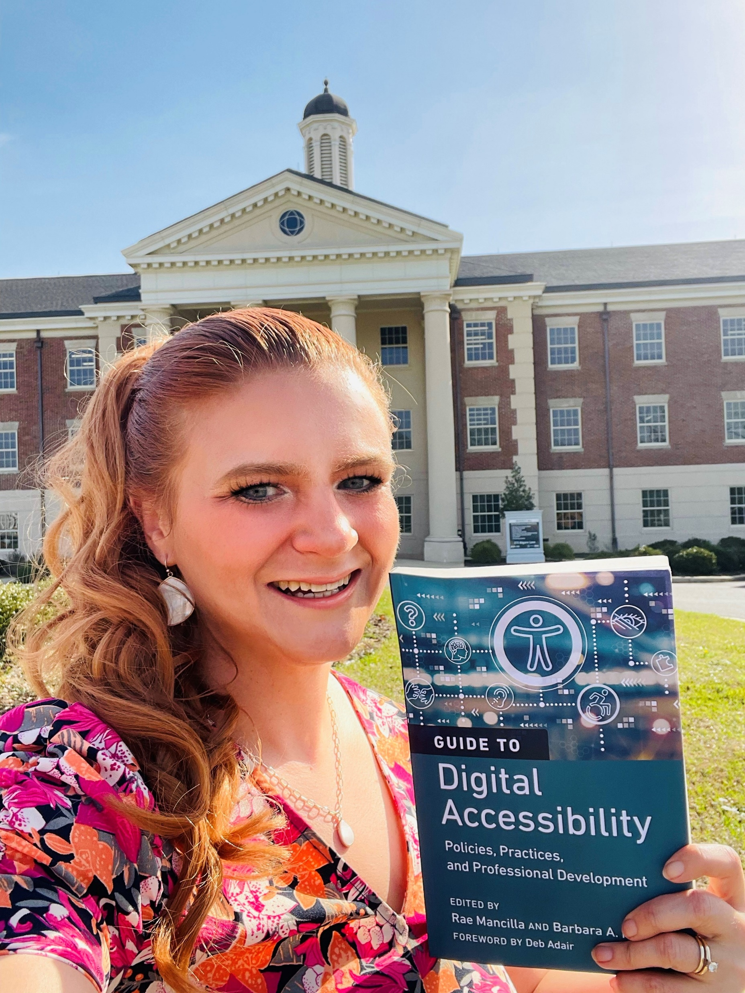

Speaker
Kristin Juhrs Kaylor, M.A. is the Senior Instructional Designer at The University of Alabama, Office of Teaching Innovation and Digital Education (OTIDE). She has over 25 years of experience in education accessibility, 17 years of experience as an educator (online learning, publications, and teaching), and 12 years of instructional design experience. For the past 7 years, she has led The University of Alabama Online’s course accessibility efforts, making UA is a national leader in online course accessibility.
She is a Certified Adobe PDF Accessibility Trainer. She holds Section 508 Web Standards and Authoring Accessible Documents Certificates through the Office of Accessible Systems & Technology, Department of Homeland Security.
She recently authored the chapter, “The University of Alabama Online’s Digital Accessibility Course Development Process, Practices, and Tools,” for the QM book, A Guide to Digital Accessibility: Policies, Practices, and Professional Development.
Kristin has presented/been selected to present on online course accessibility at The Association on Higher Education and Disability (AHEAD) Equity and Excellence: Access in Higher Education Conference, OLC Accelerate, Accessing Higher Ground, CSUN Assistive Technology Conference, QM Connect, and Alabama Instructional Design Network (AIDN) Conferences.

Slide 3
During this session, you will have an opportunity to:
Share and brainstorm how you use images in your online courses.
Analyze what makes an image accessible.
Evaluate image accessibility.
Analyze the challenges with making images accessible.
Identify best practices for generating alt text with AI.
Compare various AI platforms for generating alt text.
Evaluate standard AI prompts for quickly generating alt text.
Apply AI to generate alt text for images.
Generate alt text using AI for images you have selected for an online course.
Use AI to make a document accessible.

Slide 4
Question: How are images used in your online courses?
Bar Charts
Infographics
Blueprints
Scans of archival files
Weather reports
Handwritten diagrams
Graphs where the user needs to choose the best answer
Entire stem lectures
Graphic images (illustrations)
Handwritten answer keys for math and science quizzes
Flowcharts
Music notation
Organizational Charts
Chemical representations
Screenshots that are annotated
Logic models and theoretical models
Aviation diagrams
Campus maps and other maps
Art history pictures

Slide 5
Answer: How are images used in your online courses?
Some examples include:
Readings
PowerPoints
Examples/Demonstrations
Infographics
Introductions
Decorations

Slide 6
Question: What are some examples of the types of images that appear in your online courses?
[Answers from the session will be provided.]

Slide 7
Answer: What are some examples of the types of images that appear in your online courses?
Some images are decorative, while others are essential to teaching information.
Examples of images we typically see in online courses are:
Art appreciation
Figurative/metaphorical images
Illustrative
Infographics
Diagrams
Charts
Tables
Graphs
Scatter plots
Complex math equations

Slide 8
Question: How do you make images accessible? What steps do you take?
We do it ourselves
Grad students
Undergrad students
Outsourcing (if you have money)
Professor/Faculty/SME

Slide 9
Answer: How do you make images accessible? What steps do you take?
Provide each image with alt text that is written by an accessibility professional/subject matter expert/professor.
The process for providing alt text is different for every platform, but generally there is an option for providing alt text that can be found when the user selects the image, selects the option for Alt Text, and either types the alternative text into the alt text textbox or marks the image as decorative.

Slide 10
Quick Refresh Question: What is alt text?
What you would say if the image wasn’t there
If you were tutoring someone over the phone
Provide enough information to make an informed decision based on the image (if in a test)
Only add it if it adds value (isn’t decorative)
Image description context
Alt text is more complex description

Slide 11
Quick Refresh Answer: What is alt text?
Alt text (alternative text) is added to provide the information within an image to people using screen readers, allowing the image’s content to be read aloud to them.
Screen readers accommodate people with:
Visual disabilities
Learning disabilities
Cognitive disabilities
Eye pain or straining
Non-native speakers
Other
Alt text is required by federal law for all images, except when an image is marked as decorative.
Plus, it’s the right thing to do.

Slide 12
Question: What types of images require alt text (instead of being marked decorative)?
Images that aren’t decoratative

Slide 13
Answer: What types of images require alt text (instead of being marked decorative)?
Images require alt text when they provide information/content and are not purely decorative.
A good litmus test: Does the image contribute to the learning?
However, if the information in an image appears verbatim in the body of the text, it can be marked as decorative.
Context is key to determining if it is an alt text or decorative image.

Slide 14
Question: How do I know if an image is decorative?
[Answers from the session will be provided.]

Slide 15
Answer: How do I know if an image is decorative?
If there is no educational information or content in the image, it must be marked as decorative in the alt text
If the information in an image appears verbatim in the body of the text, it can be marked as decorative.
Context is key to determining if an image is decorative image.

Slide 16
Question: Why are images marked decorative?
[Answers from the session will be provided.]

Slide 17
Answer: Why are images marked decorative?
Marking images as decorative is essential so students know that they are not missing out on important information in the image.

Slide 18
The Key to Accessible Images is Alt Text
All images must have alt text (alternative text) or be marked as decorative in order to be considered accessible.

Slide 19
Question: How detailed does the alt text need to be?
Should fit the context of the page
Olden days : 250 characters or less
As long as it needs to be in order to describe it

Slide 20
Answer: How detailed does the alt text need to be?
Only include relevant information in the alt text.
You do not need to include unnecessary description that is not relevant to the information in the image.
Include all words, context, relevant information, facts, figures, and datapoints in the image.

Slide 21
Question: What is the alt text requirement if an image is decorative?
[Answers from the session will be provided.]

Slide 22
Answer: What is the alt text requirement if an image is decorative?
If an image is decorative:
Select the decorative option/checkbox.
Or, type “ ” in the alt text textbox.

Slide 23
Question: Microsoft Word automatically generates alt text. Why can’t I use that instead of writing my own?
[Answers from the session will be provided.]

Slide 24
Answer: Microsoft Word automatically generates alt text. Why can’t I use that instead of writing my own?
You can use Microsoft Office’s alt text when it is accurate, however you may find that it isn’t detailed and/or accurate enough, depending on the situation.

Slide 25
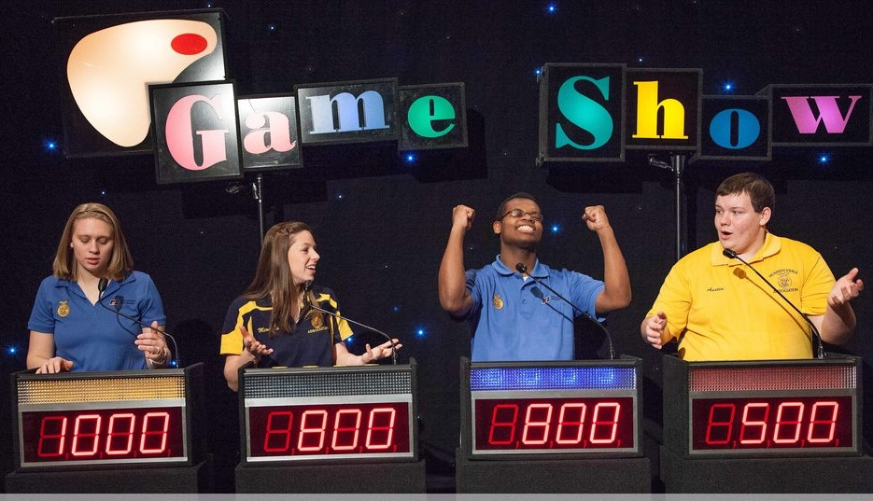
Decorative or Not Decorative
Potentially America’s Next Favorite Game Show

Slide 26
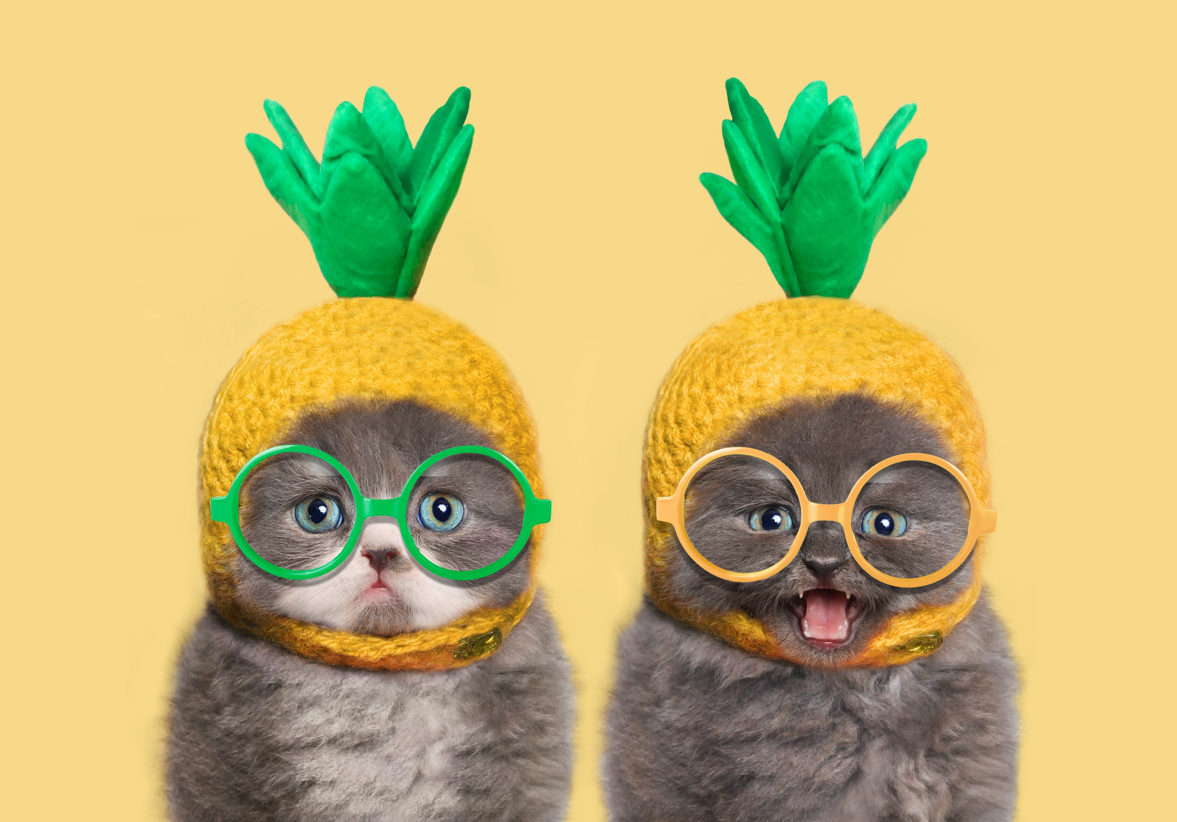
Question 1: Does this image require alt text? Why?
[Answers from the session will be provided.]

Slide 27
Answer 1: Does this image require alt text? Why?
Probably Not: The image of the two cats with crocheted pineapple hats probably doesn’t provide any content/learning other than decoration.
Unless:
It could need alt text if it is an example of a pineapple hat for a crochet project tutorial
An illustration for a question where the viewer is supposed to identify what is happening in the image.

Slide 28
Question 2: What should the alt text be?
Two gray cats wearing crocheted pineapple headwear and colored glasses. One grumpy and one happy.

Slide 29
Answer 2: What should the alt text be?
Alt text for a crochet manual: Kittens in crocheted pineapple hats and glasses. The first one is pouting with green glasses on, and the second is smiling with yellow glasses on. The hats look like crocheted yellow swim caps with the tall green leaves sprouting from the top.
Decorative: “Mark as decorative” checkbox is selected or “ ” is typed in the alt text textbox.

Slide 30
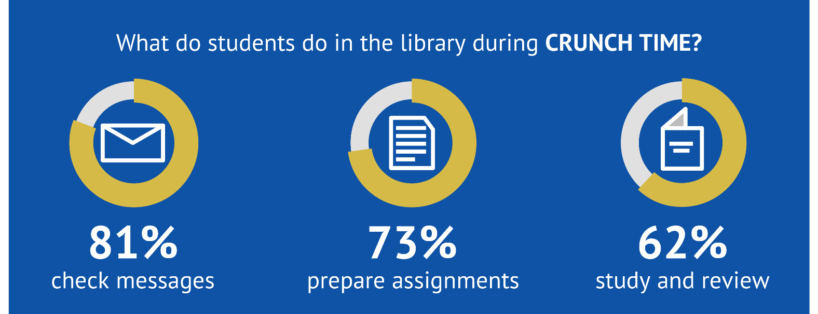
Question 3: Does this image of text require alt text? Why?
[Answers from the session will be provided.]
This Photo by Unknown Author is licensed under CC BY

Slide 31
Answer 3: Does this image of text require alt text? Why?
Yes, it provides information.
This Photo by Unknown Author is licensed under CC BY

Slide 32
Question 4: What would the alt text be?
[Answers from the session will be provided.]
This Photo by Unknown Author is licensed under CC BY

Slide 33
Answer 4: What would the alt text be?
It should appear word for word:
What do students do in the library during CRUNCH TIME? 81% check messages 73% prepare assignments 62% study and review
This Photo by Unknown Author is licensed under CC BY

Slide 34
Question 5: Does this image require alt text? Why?
Example
Answer
[Answers from the session will be provided.]
Final exam season can be stressful for students and faculty alike.
What do students do in the library during CRUNCH TIME? 81% of students check messages, 73% prepare assignments, 62% study and review
This Photo by Unknown Author is licensed under CC BY

Slide 35
Answer 5: Does this image require alt text? Why?
Example
Answer
The image can be marked as decorative because the text in the image is repeated in the body of the text.
Final exam season can be stressful for students and faculty alike.
What do students do in the library during CRUNCH TIME? 81% of students check messages, 73% prepare assignments, 62% study and review
This Photo by Unknown Author is licensed under CC BY

Slide 36

Let’s Create Alt Text Together

Slide 37
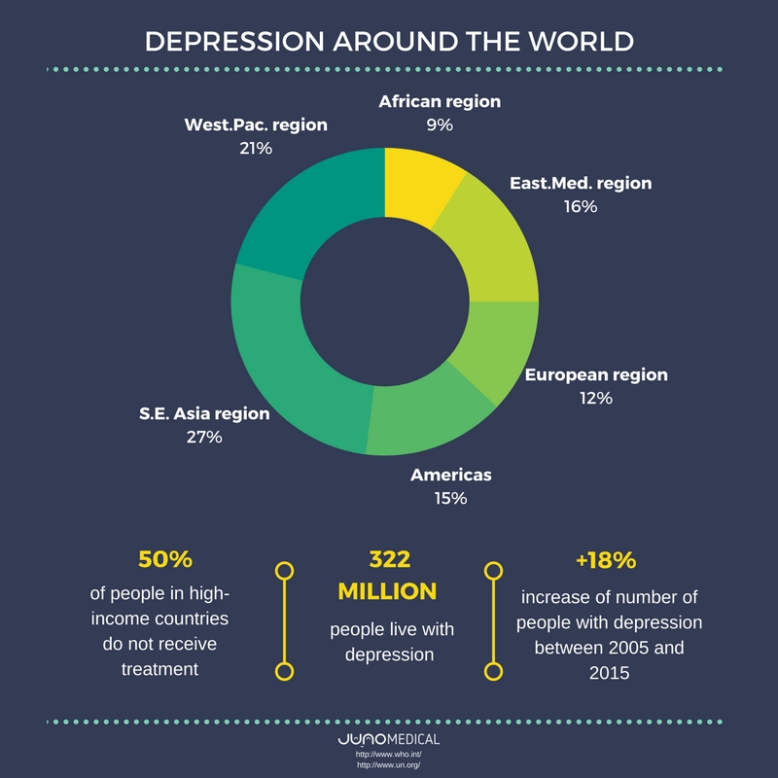
Question: What would the alt text for this image be?
[Answers from the session will be provided.]
This Photo by Unknown Author is licensed under CC BY

Slide 38
Answer: What would the alt text for this image be?
Title: Depression Around the World
Pie Chart: Western Pacific region 21%, African region 9%, Eastern Mediterranean region 16%, European region 12%, Americas 15%, and South East Asia Region 27%.
Facts: 50% of people in high income countries do not receive treatment; 323 million people live with depression; +18% increase of number of people with depression between 2005 and 2015.
Citation: JUNO Medical; http://www.who.int; http://www.un.org
This Photo by Unknown Author is licensed under CC BY

Slide 39
Question: How do I add that alt text to the image itself in this Microsoft PowerPoint Slide?
[Answers from the session will be provided.]
This Photo by Unknown Author is licensed under CC BY

Slide 40
Answer: Adding Alt Text in a Microsoft PowerPoint Slide
Select the image.
Right click on the image.
Select “View Alt Text.”
Type or paste the alt text in the textbox.
Select anywhere outside of the textbox.
This Photo by Unknown Author is licensed under CC BY

Slide 41
Question: Thinking about this experience and others you’ve had, What are the challenges of making images accessible?
[Answers from the session will be provided.]

Slide 42
Answer: Thinking about this experience and others you’ve had, What are the challenges of making images accessible?
Traditionally: Alternative text (when done properly) often takes a long time to complete because of the amount of explanation and retyping.
All text in images must be retyped in the alt text.
All context and relationship between concepts in images must be explained in alt text.
All relevant information in an image must be retyped.
All metaphors in images need to be explained in the alt text.
Images for art history require the techniques to be mentioned.
All data points in tables, charts, plots, graphs, and more need to be rewritten in the alt text.
This is hard and time consuming!

Slide 43
How Am I Expected To Do All That?
Alt text can be difficult and time consuming to do.
How can I do this on top of the rest of the things I have to do for my online courses?
Luckily, AI can take care of it for you.

Slide 44
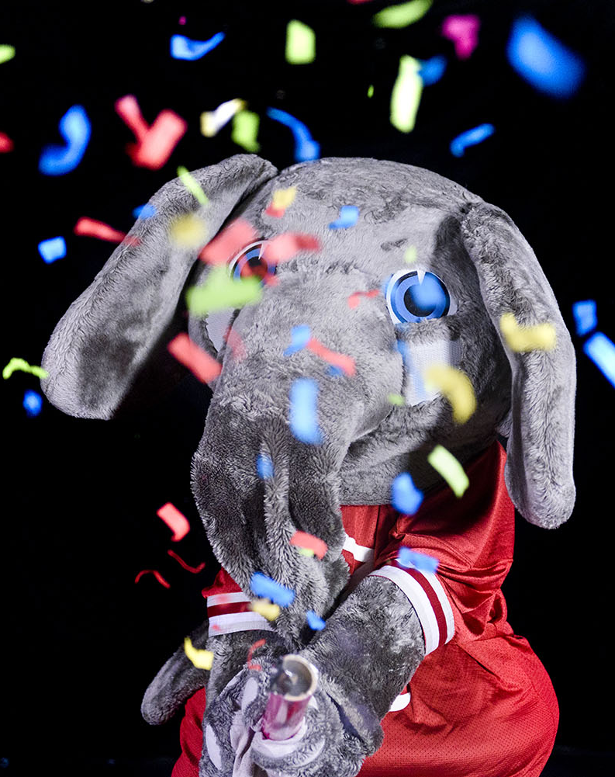
The Future of Alt Text Is Here
AI Can Write Your Alt Text For You

Slide 45
How many people here have used AI?
How many people here have used AI?
Which AI platforms have you used?
Chat GPT 4 or higher
Google Gemini
Google Bard (which is now Gemini)
Microsoft Copilot
Other?

Slide 46
How many of you have used AI to generate alt text?
And how familiar are you with that process?

Slide 47
How can AI help write alt text?
Some AI platforms can author your alt text for you!
Platforms that can write alt text for you include:
Chat GPT 4 or higher
Gemini
Microsoft Copilot
All you do is:
Upload the image with a standard prompt
Copy/paste the results as the alt text for the image.

Slide 48
Best Practices
Double check/spot check the results that are provided by AI. Even AI makes mistakes.
If you get a processing error or AI stops working, you may need to start a new chat to get it to work again.

Slide 49
AI Prompts
Open and review the AI-Prompts-for-Creating-Alt-Text.DOCX shared with you in the Preconference Reference Materials.
Or, you can access it at via AI Alt Text Workshop Google Drive. URL: https://drive.google.com/drive/folders/1iiItI0-WuAeQMoUPWqG1oApxbxf_NPjr?usp=sharing
Important Note: Keep the conference reference materials or Google Drive folder open in a different tab. You will need this later.
This job aid provides the standard AI prompts we use to generate alt text for various types of images, graphs, and math equations.

Slide 50
Let’s generate alt text together
Download all the images in the Preconference Reference Materials folder. Or, you can access them in the Images folder in AI Alt Text Workshop Google Drive. Or, you can copy the images from the Images [DOCX] in the Images folder in AI Alt Text Workshop Google Drive
Open, don’t download, the Image-1-Share-Your-Results.DOCX in the Share Your Results Folder in the AI Alt Text Workshop Google Drive. URL: https://drive.google.com/drive/folders/1iiItI0-WuAeQMoUPWqG1oApxbxf_NPjr?usp=sharing
We will go through the rest of the image files one by one:
Following the instructions for using AI to generate alt text
Trying all of the examples
Sharing all of the results

Slide 51
Let’s evaluate: How do the AI platforms compare?
Review the results shown for each within each Google Doc.
Share your findings.

Slide 52

Document Accessibility
Let AI Do Document Accessibility For You

Slide 53
Document Accessibility
AI can now automatically make some basic Word documents accessible by uploading the document and the following prompt:
Fix the accessibility of this document making it fully WCAG 2.1 AA compliant, section 508 and 508 Refresh compliant, and Title II compliant. Follow best practices for word document accessibility and send me the accessible Word document. Be sure to make the font Times New Roman, Calibri, Arial, or Veranda (based on the closest font to the original document.) Make sure the font never gets smaller than 12 pt. Also, ensure that all of the color contrast is WCAG 2.1 AA compliant. And, complete the properties section.
Note: You should always check the output and make changes as necessary.

Slide 54
Let’s Let AI Do Document Accessibility for Us
Download all the images in the Preconference Reference Materials folder. Or, you can access them in the Images folder in AI Alt Text Workshop Google Drive. Or, you can copy the images from the Images [DOCX] in the Images folder in AI Alt Text Workshop Google Drive
Open, don’t download, the Image-1-Share-Your-Results.DOCX in the Share Your Results Folder in the AI Alt Text Workshop Google Drive. URL: https://drive.google.com/drive/folders/1iiItI0-WuAeQMoUPWqG1oApxbxf_NPjr?usp=sharing
We will go through the rest of the image files one by one:
Following the instructions for using AI to generate alt text
Trying all of the examples
Sharing all of the results

Slide 55
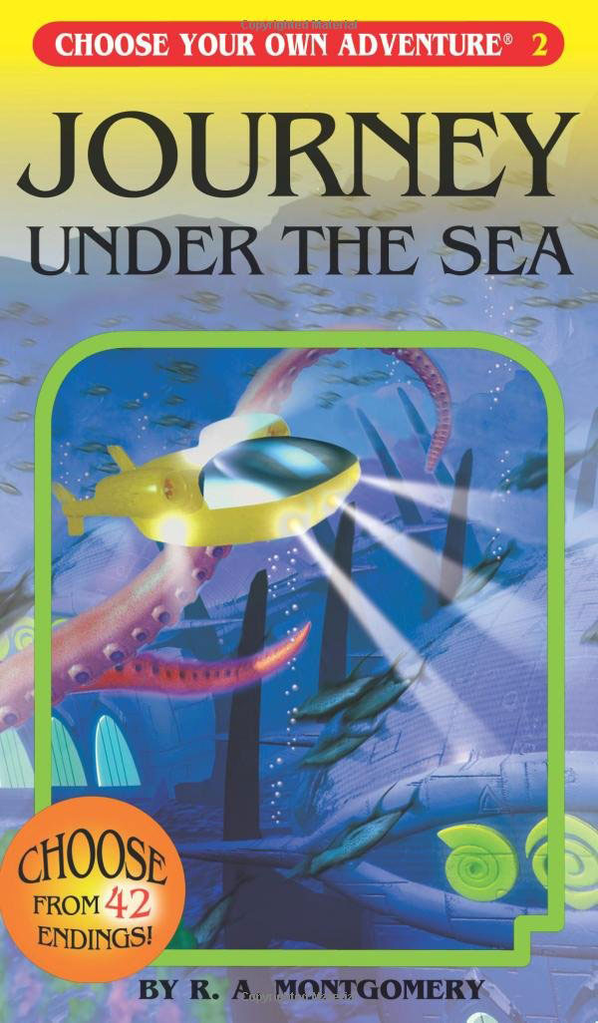
Choose Your Own Adventure
Select your own image and use AI prompts to create alt text.
This Photo by Unknown Author is licensed under CC BY-SA

Slide 56
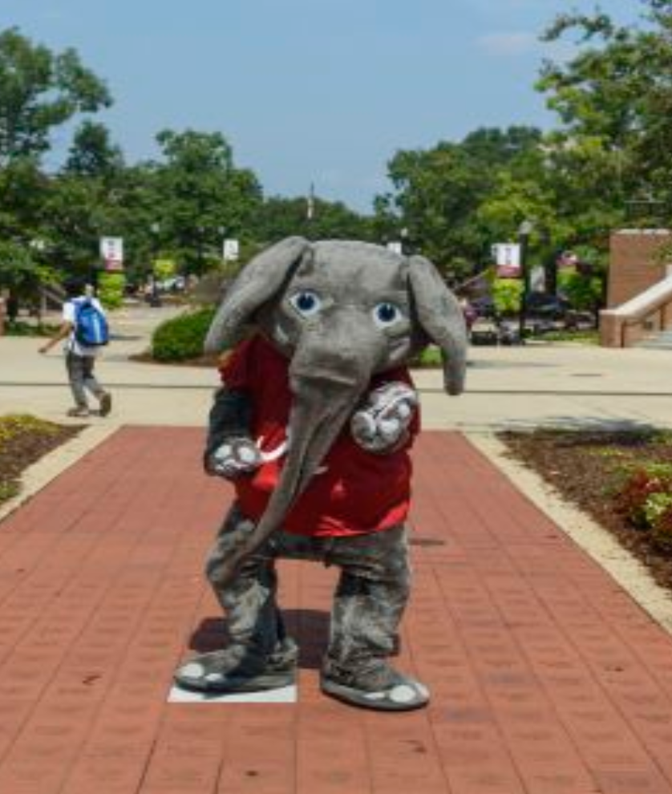
Questions?

Slide 57
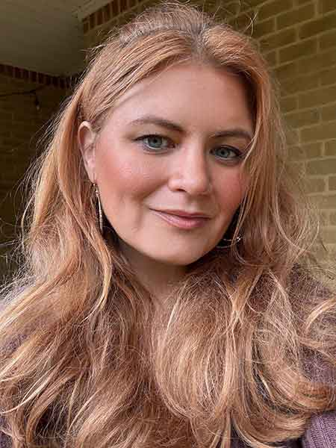

Contact
Kristin Juhrs Kaylor, MA
Senior Accessibility Instructional Designer
The University of Alabama
kjkaylor@ua.edu
205-799-3327

Slide 58

The University of Alabama: Where Legends are Made

