Slide 1

Practicum: Interrogate your images for more impactful alt text and extended descriptions
Laura Ciporen
Accessing Higher Ground
11/20/2025

Slide 2
About me
Laura Ciporen, CPACC. Brooklyn, NY. She
Digital Content Accessibility Manager for McGraw Hill Higher Ed.
100% focused on content accessibility since 2015
Instructional design for 6 years prior
M.A. in Educational Communication and Technology from NYU
I’ve done an intense alt text focus group with real students which helped form some of my thoughts on this topic.

Slide 3

About the Session
At the end of the session, you will have a specific methodology to apply to writing and evaluating image descriptions for educational materials.
One does not simply write alt text.

Slide 4
Example of full image description
Alt text
Extended description
Comparison of opaque, translucent & transparent windows in a wall. A giraffe outside is not seen, partially seen, or completely seen through them.
​​​Opaque: This window is covered with closed shutters; there is no view of anything outside through it at all.
​​Translucent: A hazy view of a giraffe's midsection and front legs is visible through sheer curtains; details are difficult to see, colors are washed out.
​​​Transparent: This uncovered window gives a clear view of the giraffe's head outside.

Slide 5
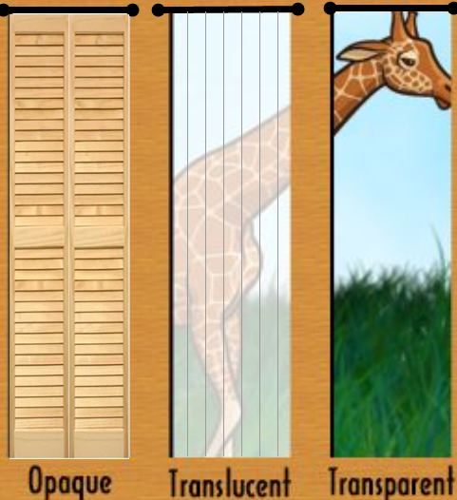
Giraffe image
See extended description for the image on this slide.

Slide 6


Comparison: informational vs. educational content
Informational Content
Educational Content
Telling the user things / provide information (no need to internalize)
Keep user’s interest (voluntary)
Individual; no comparison to others
Helping the user understand things and be able to use them later (user must internalize)
Consequences for not knowing/understanding
Group use; equity of information
Clear aim for what user is supposed to get out of the content
Allowing students to participate in discussion
Assessments vs. content presentations

Slide 7
My THREE image categories for education
Content (informational considers this “non-decorative”)
Directly help students learn the material.
Need full descriptions.
Non-Content (informational considers this “decorative”)
Enhance the experience; contribute something.
If removed, would not impede learning the material.
ALSO need full descriptions.
Decorative
FILLER. You could replace it with a doodle of a flower.
Contain no information at all that isn’t already completely in the text.
The ONLY images that don’t need descriptions.

Slide 8
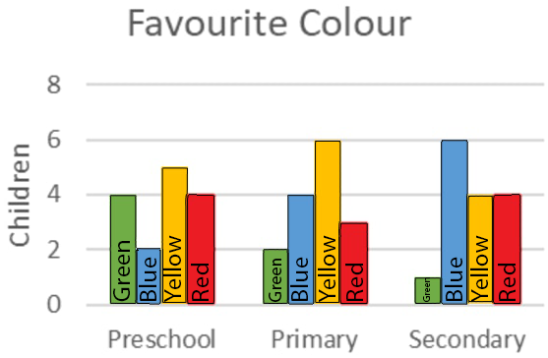
Bar graph: Content image example
Text discusses how children’s favorite colors change over time.

Slide 9
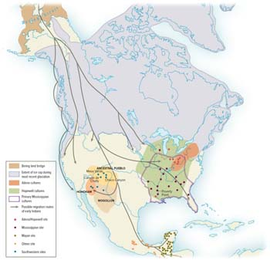
Migration map: Content image example
Text discusses the migration of various North American peoples and where they founded their territories.

Slide 10
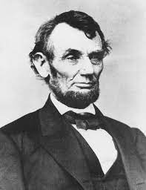
Non-content image example
Why do we include pictures of Abraham Lincoln when we talk about Abraham Lincoln but the only describe the image as being Abraham Lincoln?

Slide 11
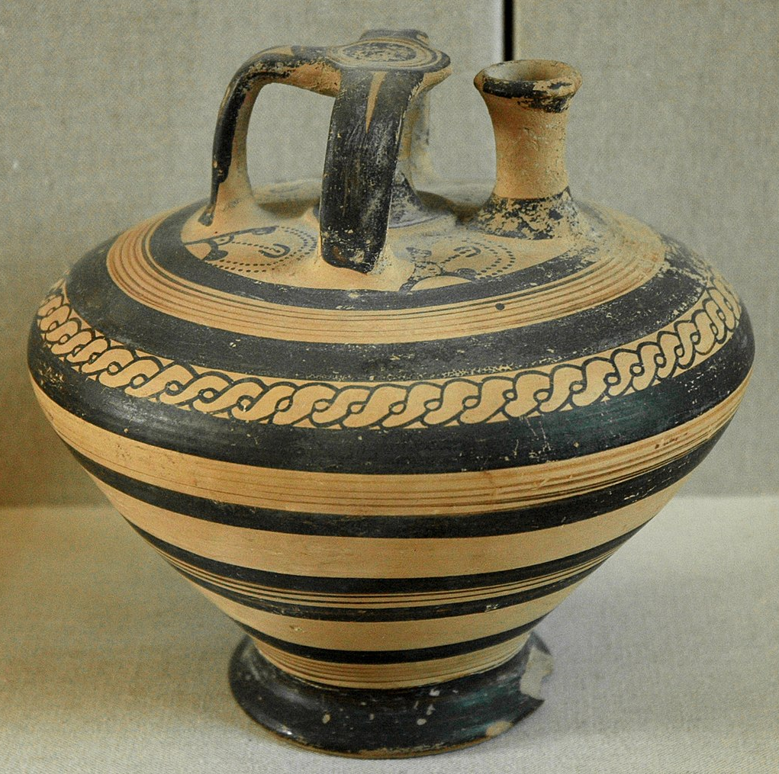
Second non-content image example
History section on Mycenaean excavations mentions only that intricate pottery jars were sometimes found intact.
Mycenaean stirrup jar from Ras Shamra (Ugarit) Syria, 1400–1300 BC

Slide 12
Decorative image example
Educational Content

Slide 13
Generating the description
Ask the following 3 questions.
(Of the person who choose the image, if you can, or yourself if you cannot.)

Slide 14
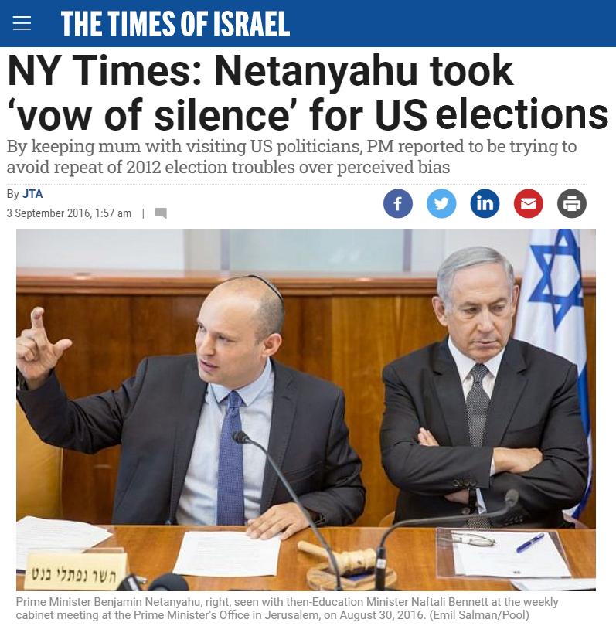
Question 1. Why is THIS image HERE?

Slide 15

WHY is only a 3-letter word
Asking the image decision makers why an image is used.

Slide 16
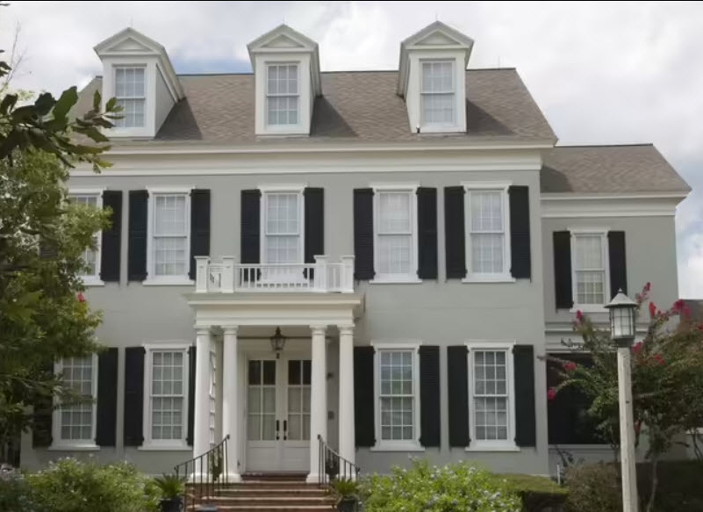
Question 2. How will this image be used in the educational setting?
Which architectural style is this?
Neo-classical
Colonial
Gothic Revival
Federal

Slide 17
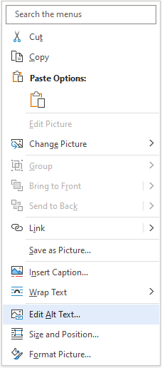
Question 3. What relevant information will the sighted audience get from the image?
To add alt text to an object in Word:
Right-click the object and select Edit alt text.

Slide 18
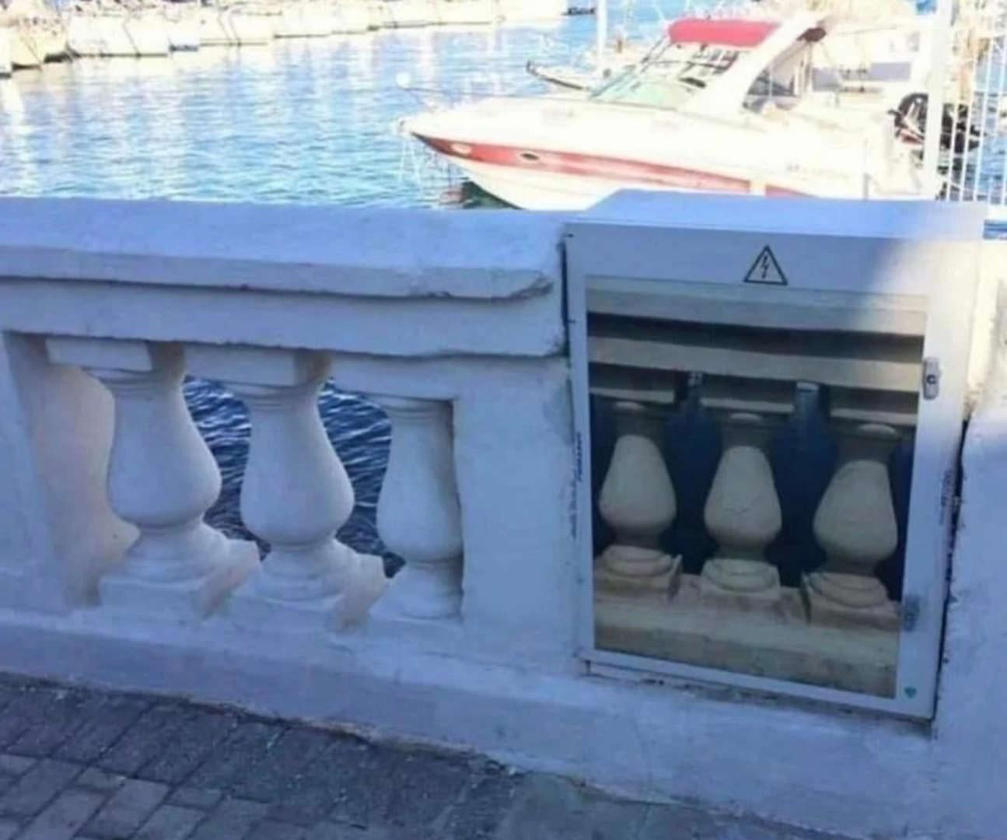
My essential questions for writing VALUABLE image descriptions
WHY is this image here?
How will this image be used in the educational setting?
What relevant information will the sighted audience get from the image?

Slide 19
Make sure you are not writing a caption
Descriptions ARE the image.
Captions are ABOUT the image.
Caption handles who, what, when, where.
Captions share context information that is NOT directly available in the image.
Everyone benefits from captions.

Slide 20
News article image
Caption:
Prime Minister Benjamin Netanyahu, right, seen with then-Education Minister Naftali Bennett at the weekly cabinet meeting at the Prime Minister's Office in Jerusalem, on August 30, 2016.

Slide 21

Caption vs. alt text
A tutor at King Park elementary school helps a student with test prep.
A teacher helps a student with her schoolwork.
An elementary school teacher sits next to a studious girl as he focuses her attention on a section in her textbook.

Slide 22
Flowchart
Jump
Jive
Wail
Description
Circular flow chart. Jump leads to Jive which leads to Wail which leads back to Jump.

Slide 23

Different contexts, different descriptions
If only an idea matters and not the visual representation of that idea, what do we do with this?
Signaling that content is being recycled from earlier lesson: “Recycle.”
About actual recycling: “Recycling symbol.”
But consider: is there a time to describe what the symbol looks like?

Slide 24

Descriptions should not be bland
This image’s purpose is to convey emotion.

Slide 25
Bar graph: Needs data table
Text discusses how children’s favorite colors change over time.

Slide 26

A view of NYC

Slide 27
Longer description and 150-word pure alt text
Tower of blue steel suspension bridge imposes itself at end of empty cobblestone street flanked by 6-story red-brick buildings & parallel-parked cars.
A tower of a blue steel suspension bridge imposes itself at the end of an empty cobblestone street that is flanked by 6-story red-brick buildings lit toward the top by the sun, with a multitude of glinting windows and a single set of fire escapes outlined in black. Both sides of the street are filled with neat lines of dark, parallel-parked cars. One way street signs point away from the bridge and a neon orange scooter fits snugly in front of one line of cars.

Slide 28
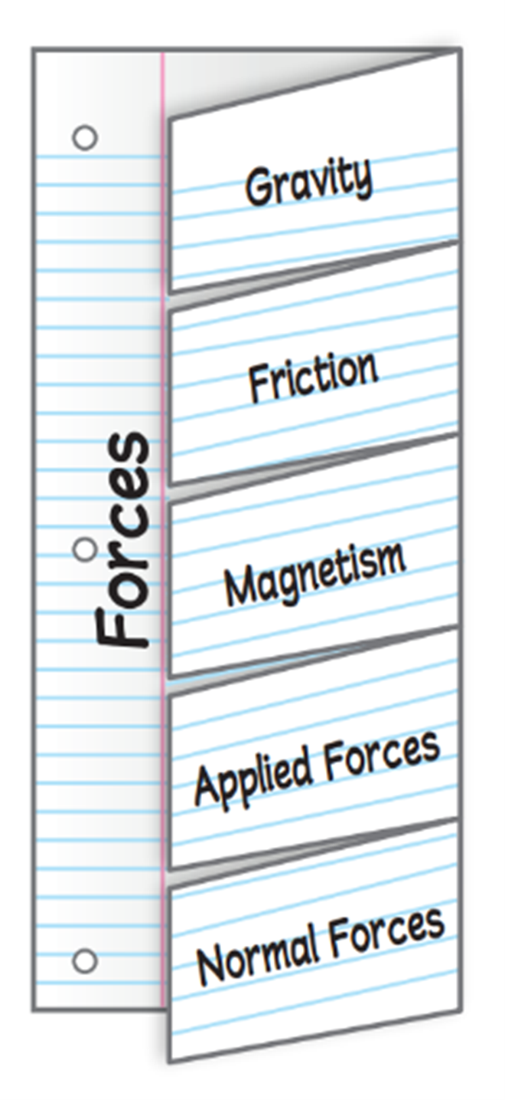
Audience matters!
Use one sheet of notebook paper to make a 5-Tab Foldable. Label the tabs as illustrated. Use the Foldable to identify how forces act on objects. Under the tabs, define terms, list examples, and explain real-world applications.

Slide 29
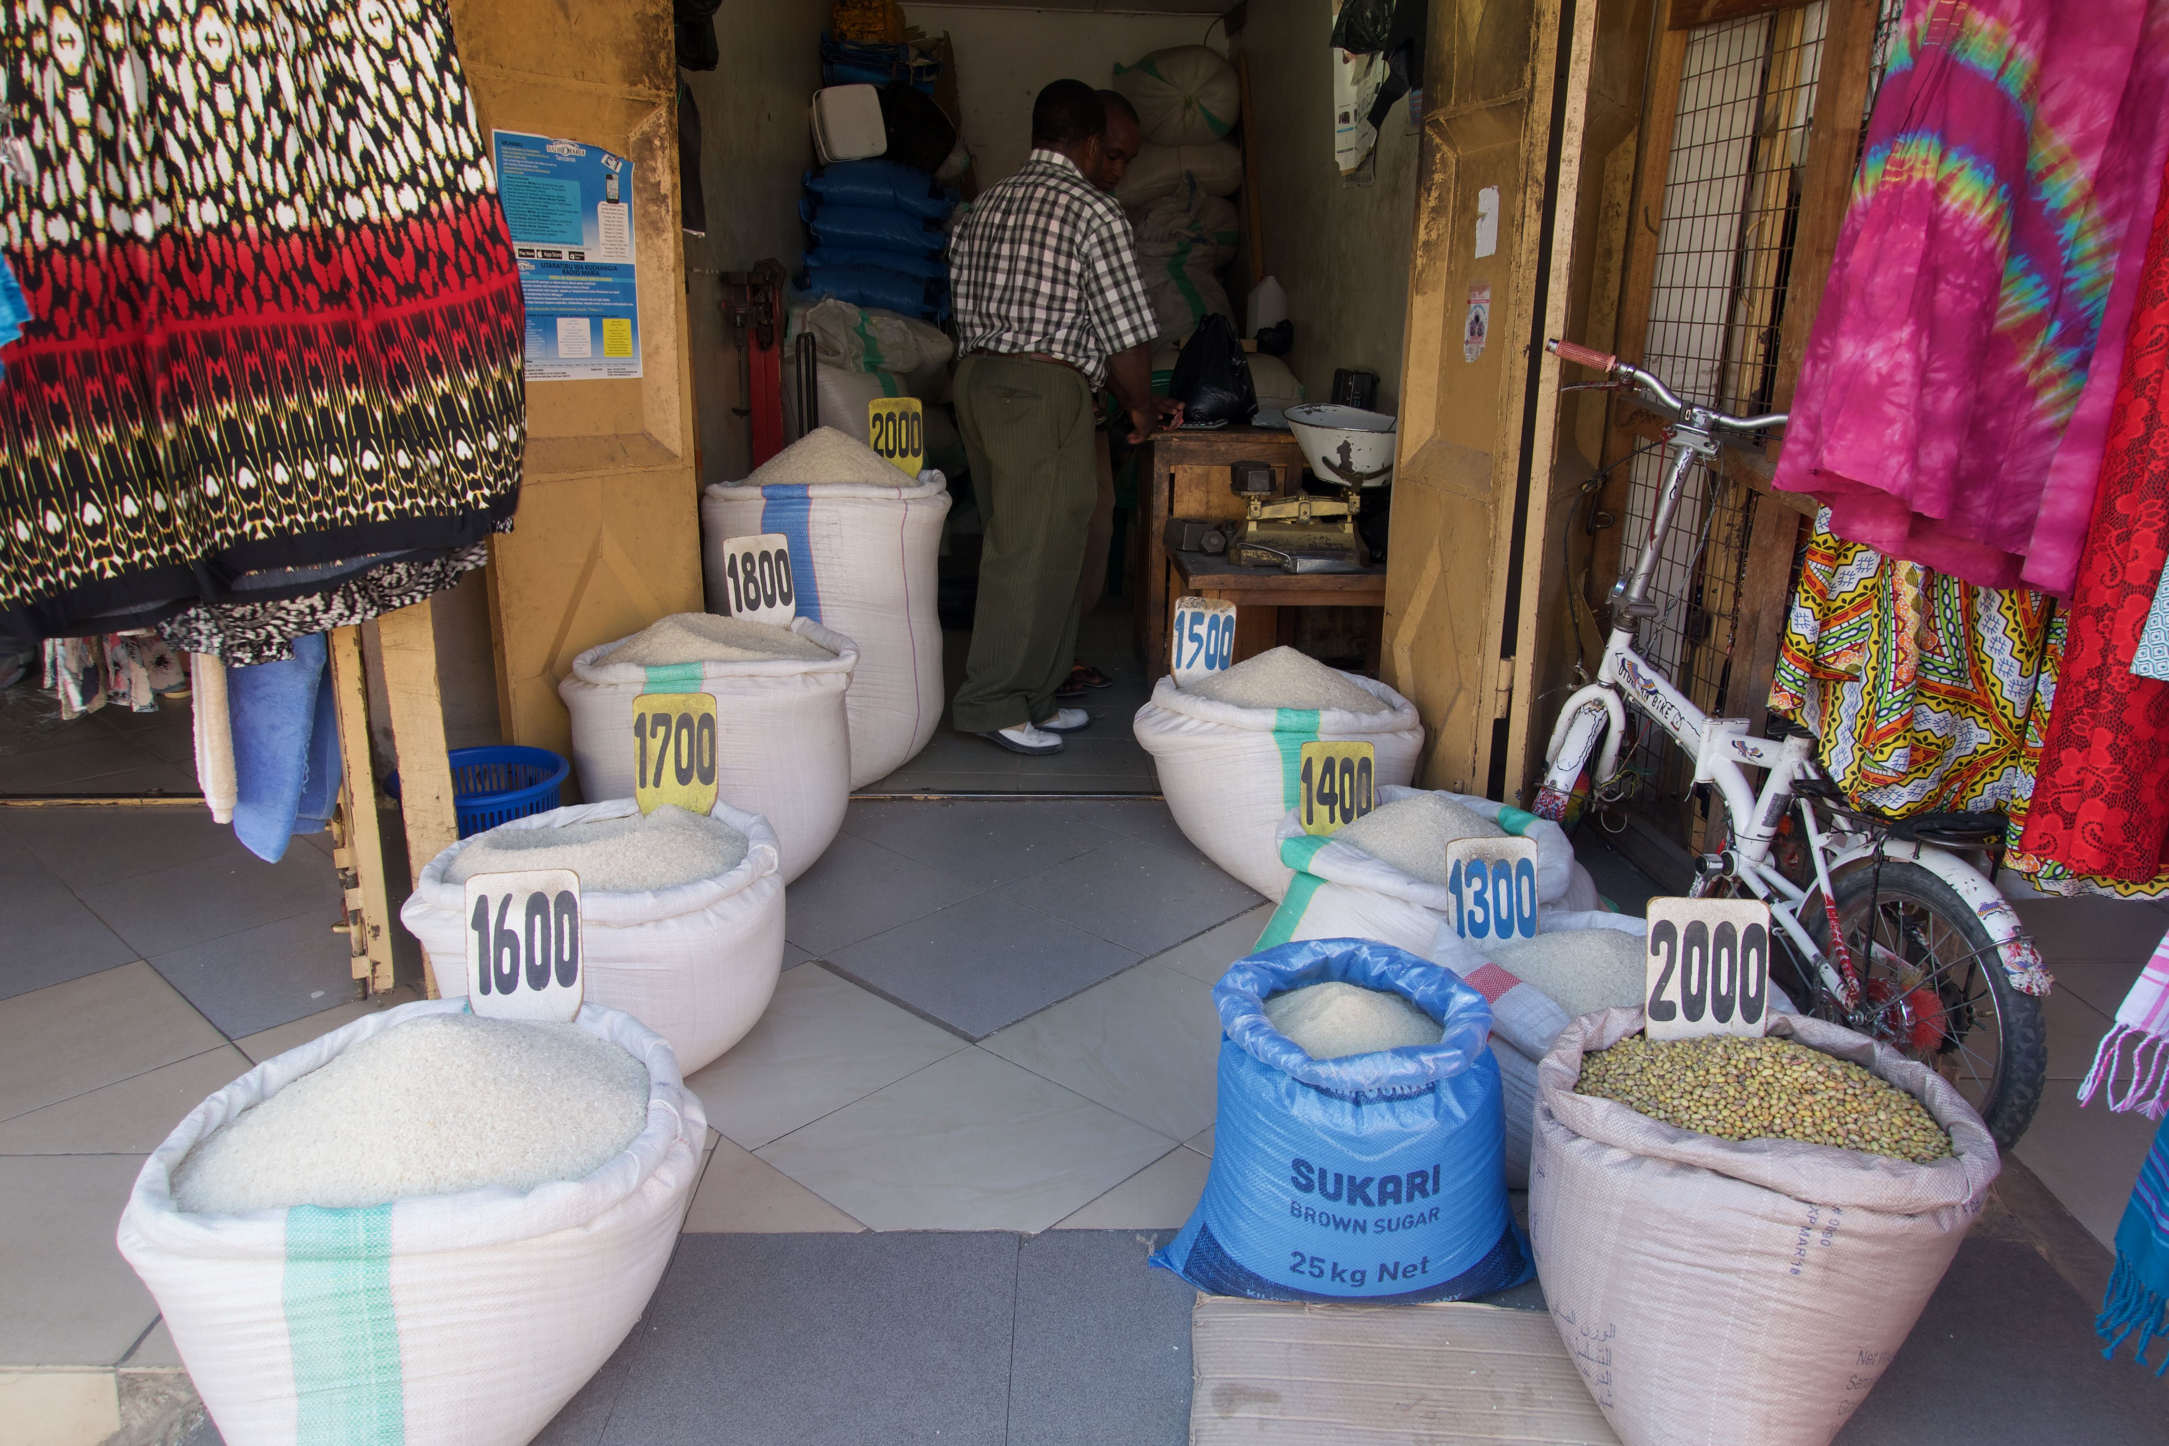
Specialized context plays a role
How would the description of this image be different in a world languages textbook than an economics one?
Selling rice in Iringa, Tanzania. © Laura Ciporen 2016

Slide 30
Summary!
THREE image categories for education
Three essential questions for writing VALUABLE image descriptions
Content: Directly help students learn the material.
Non-Content: Not essential but enhances the experience; contributes something.
Decorative: Meaningless or 100% redundant.
WHY is this image here?
How will this image be used in the educational setting?
What relevant information will the sighted audience get from the image?

Slide 31
Accessibility Content: Extended Descriptions for Images
Note: These slides are hidden from the slideshow but can be accessed by links in some slides with images.

Slide 32
Extended description for slide Giraffe reminder
Return to parent slide.
​​​Opaque: Window is covered with closed shutters, there is no view of the giraffe outside at all.
​​Translucent: A hazy view of the giraffe's midsection through sheer curtains; details are difficult to see, colors are washed out.
​​​Transparent: Clear view of giraffe's head outside.
Return to parent slide.

