Slide 1
Accessing Higher Ground 2025
Cultivating a Thriving Accessibility Champions Program: How the City of Boulder grew an engaged, sustainable network from the ground up

Slide 2
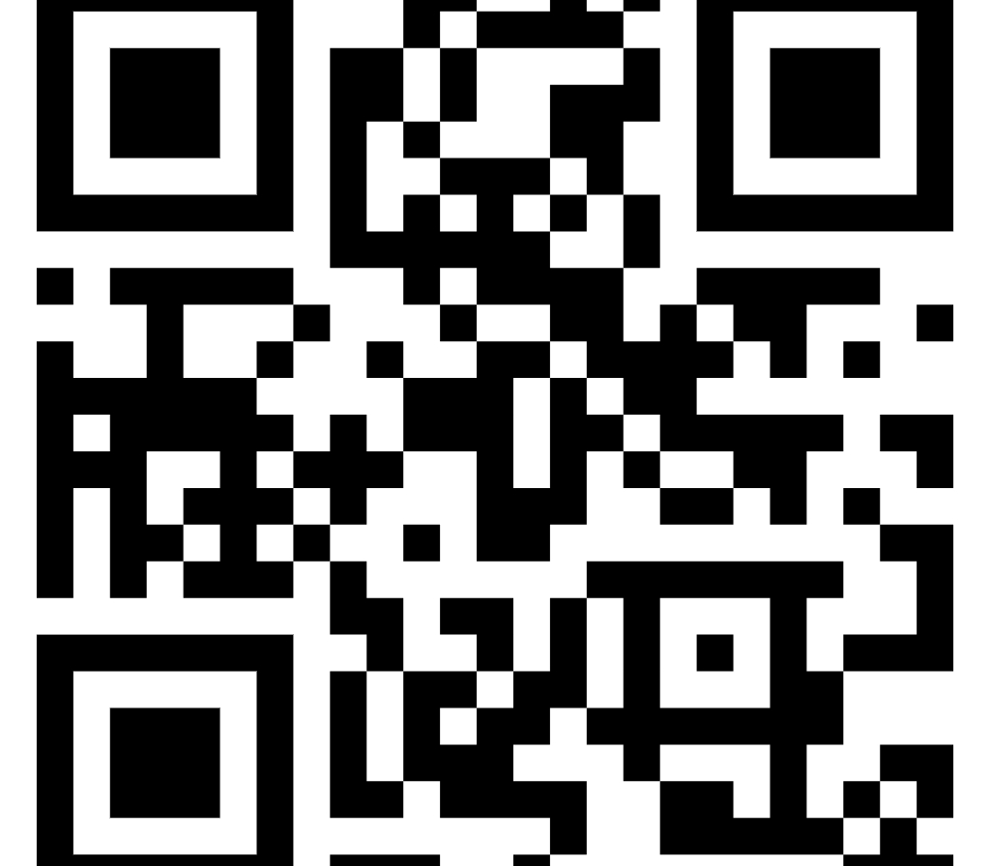
Connect with me!
LinkedIn QR code
Faxonk@bouldercolorado.gov

Slide 3
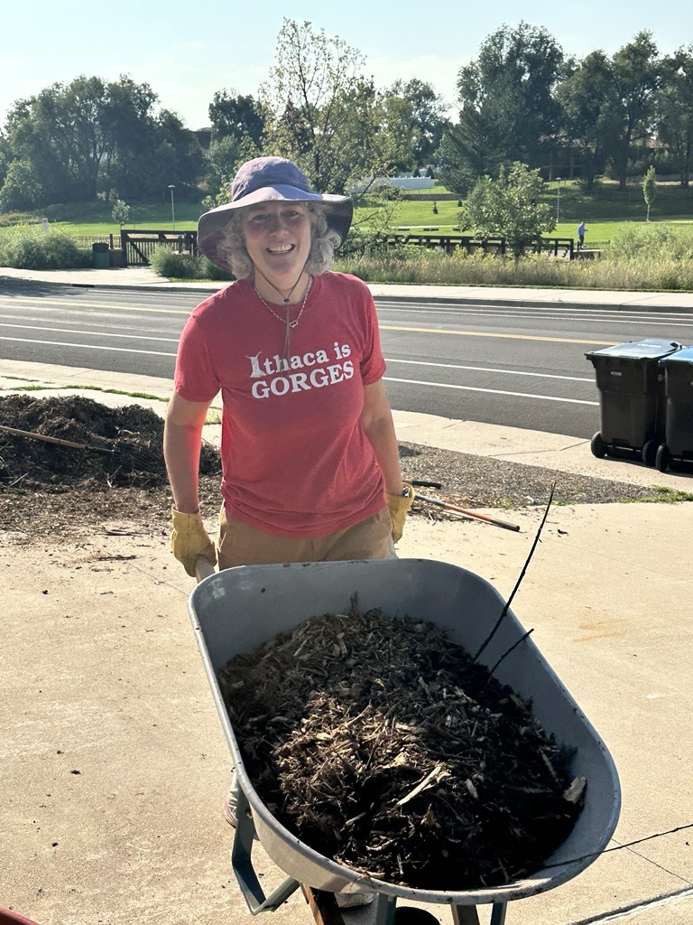
Accessing Higher Ground 2025
Kristine Faxon
Digital Accessibility Program Manager
City of Boulder
...and native plant gardener

Slide 4
Does This Sound Familiar?
You lead accessibility efforts but can’t replicate yourself across every department.
You’re the “accessibility person” — whether or not that’s your job title.
You send great guidance… and never hear back.
You discover inaccessible content after it’s live.
You have 12 departments and 0 consistent process.
You get looped in after procurement signs the contract.
You think, “If only there were more of me…”

Slide 5
Why a Champions Network?
Growing Demand
Limited Capacity
Shared Ownership/Establishes Norms
Sustainable Progress
Sets Expectations and Eases Tension Points
Change Management Support

Slide 6
Make a note...
What is your "why" and "why now" for a Champions Network?

Slide 7
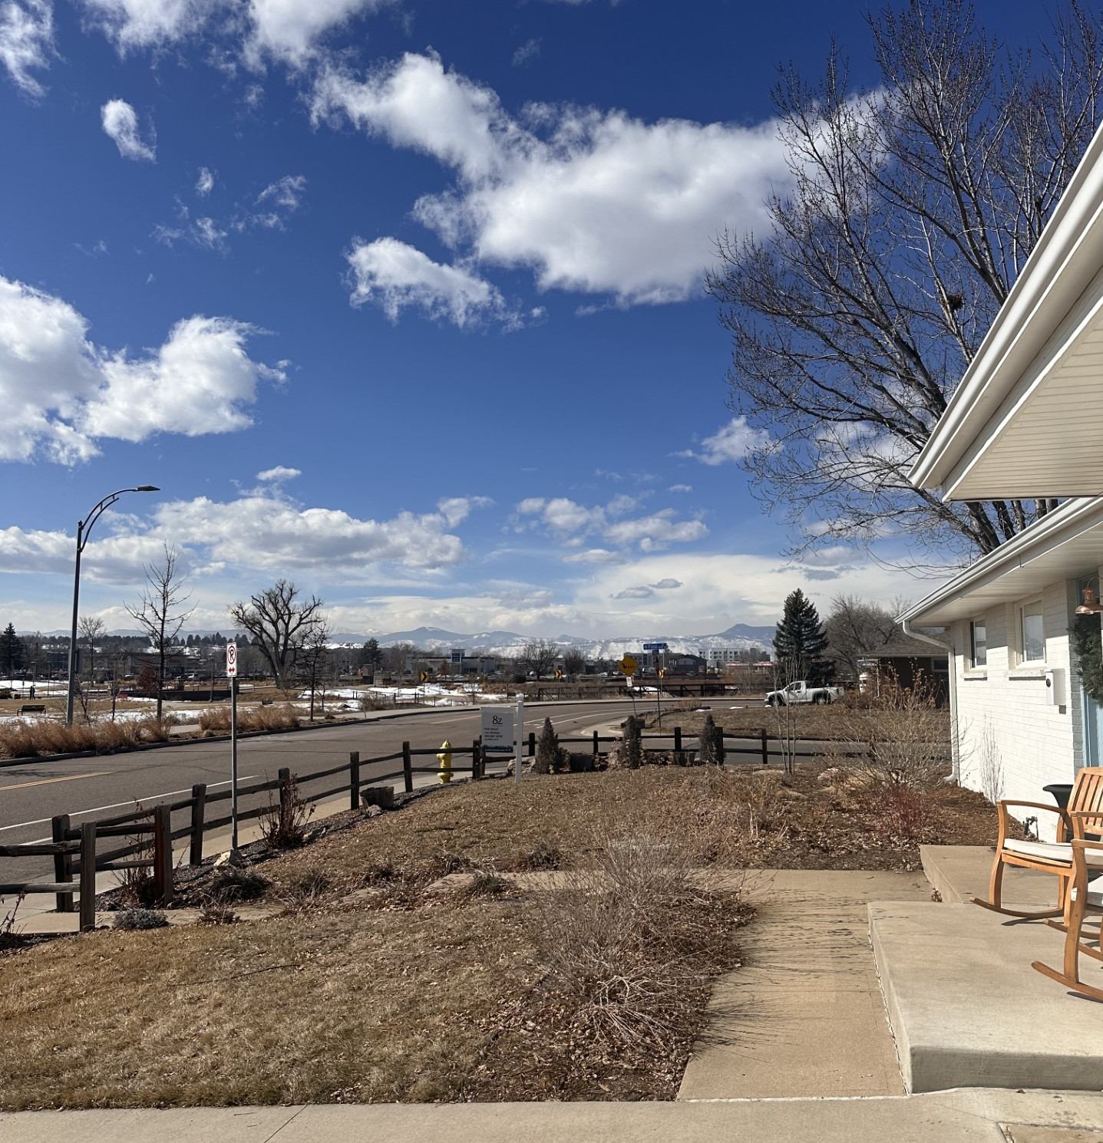
Where do we start?
Starting Out:
Blank Slate

Slide 8

Getting the Right Mix
Two champions per department
Look for: Curious, Communicative, Engaged
Must have: Leadership Support

Slide 9
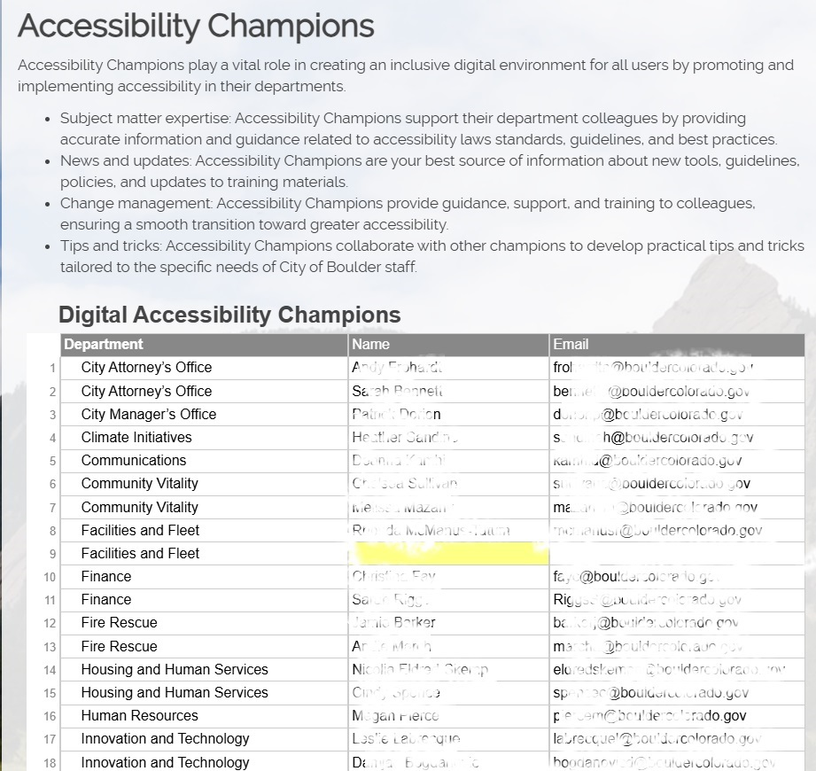
Compiling the Team
Expertise not required
Touch digital content/software

Slide 10
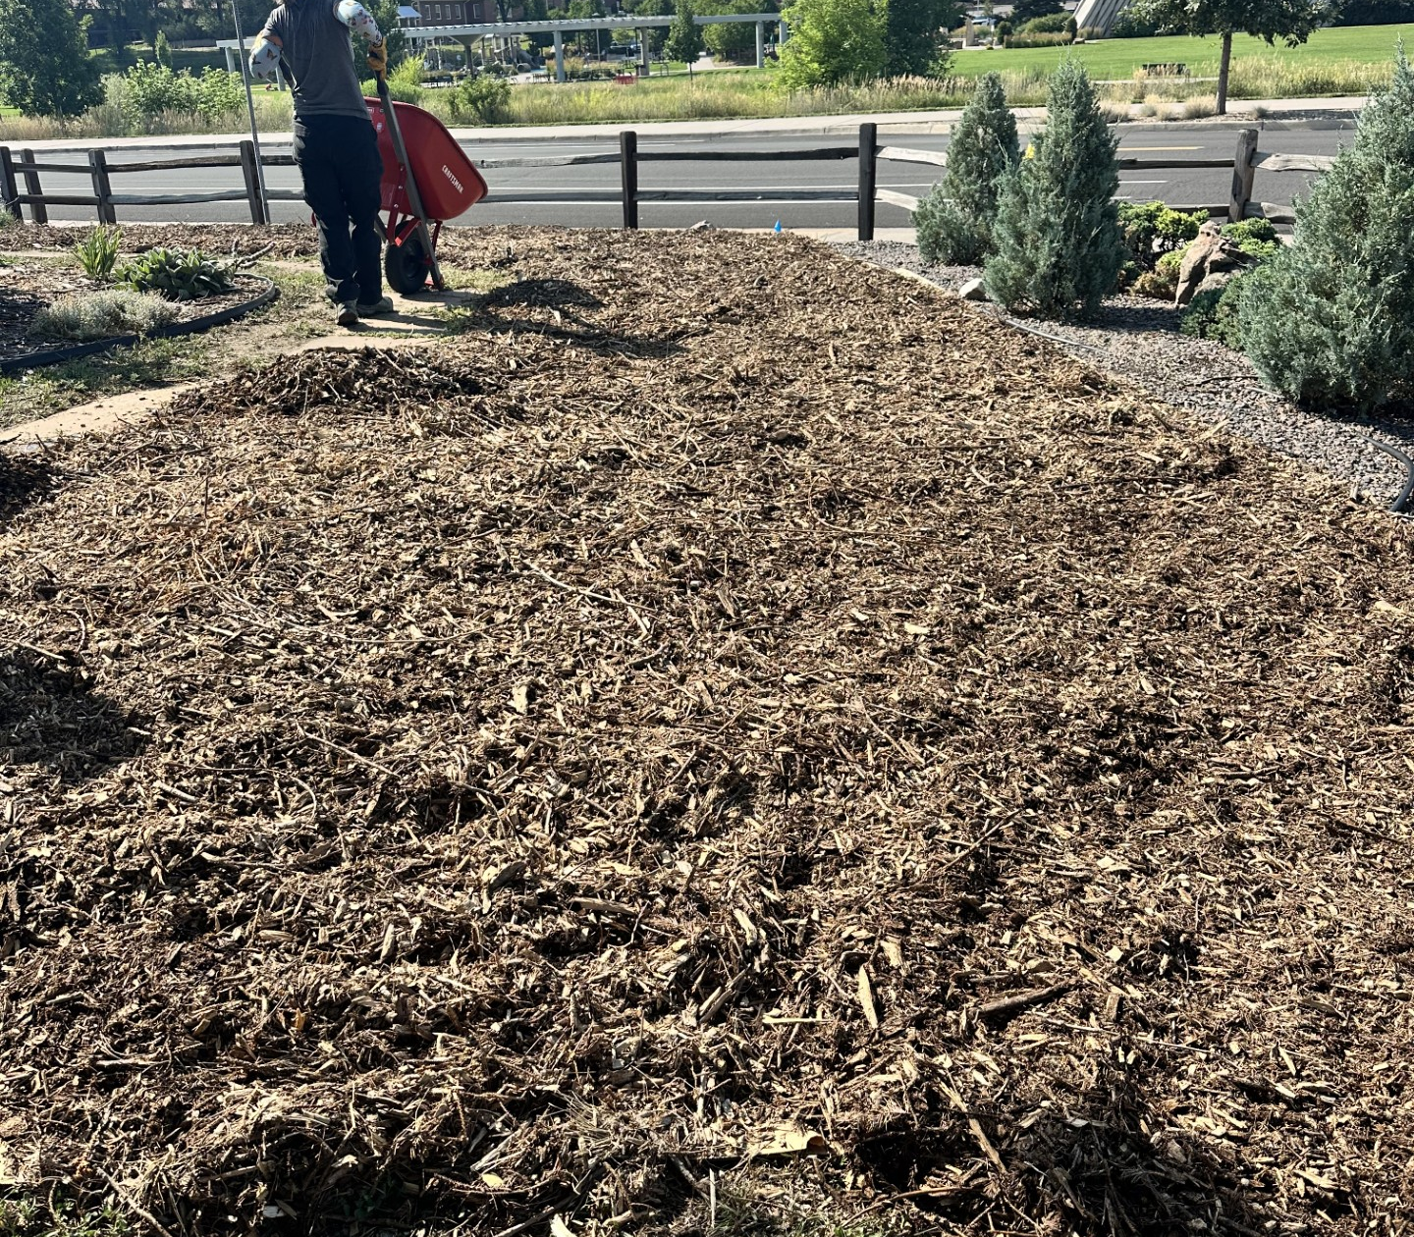
Setting the Foundation
Define shared purpose and success
Role expectations
Time commitment

Slide 11
Understand Continuum
Where on the continuum are champions and where is the organization? Drill down to department

Slide 12
Role Expectations
Advocacy & Coordination
Training & Knowledge Sharing
Content & Software Oversight
Sustainability & Feedback

Slide 13
Further Defining Roles and Boundaries
Connect peers, communicate updates
Escalate issues when needed
Not responsible for technical remediation
Foster cross-department collaboration

Slide 14
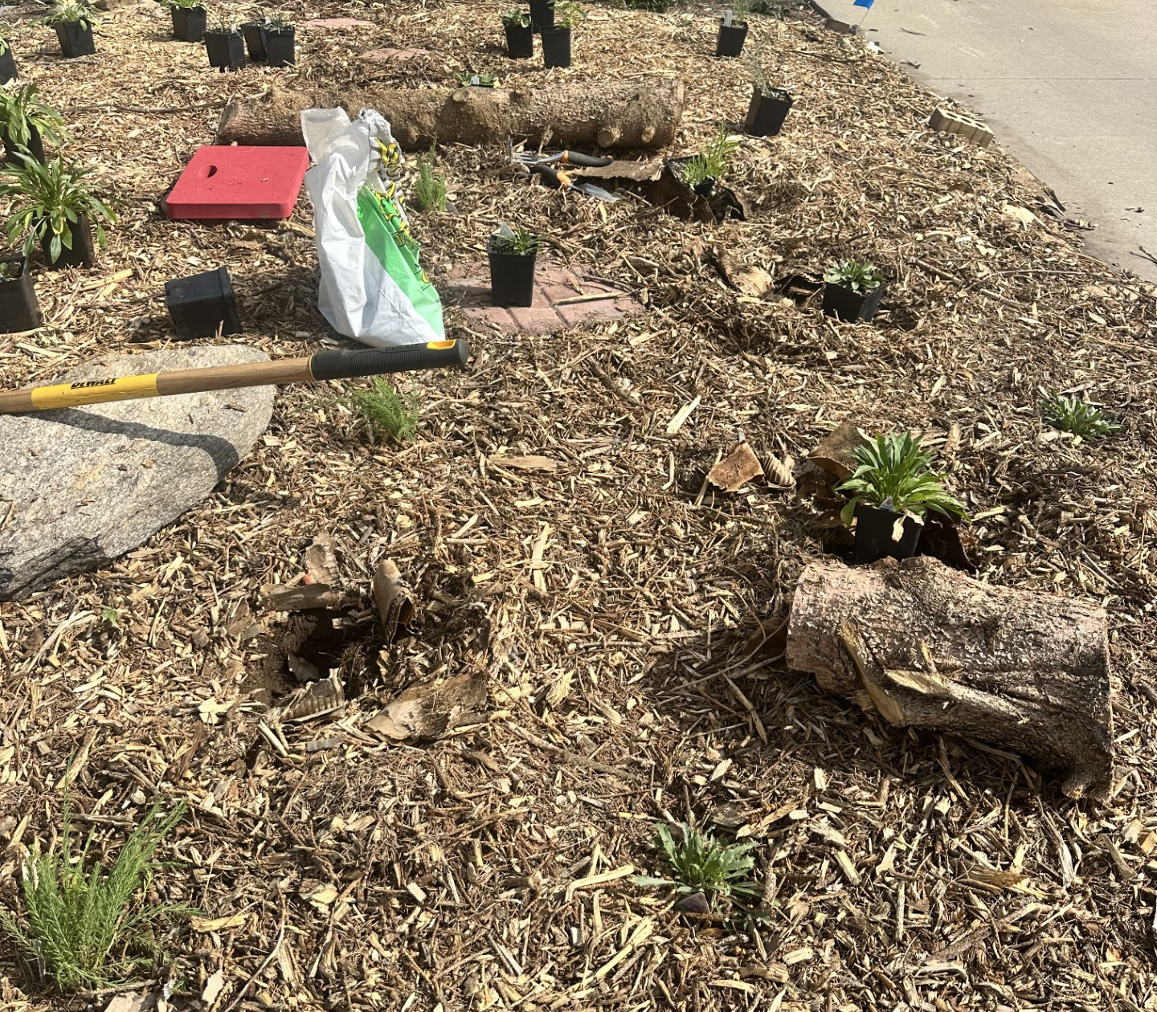
Building Structure
Meeting cadence & content
Toolkit for Champions
Guest speakers

Slide 15
Toolkit Content Types
Program Updates
Legal Updates
Reminders
Reinforce Messaging
Modalities: Emails, Teams Messages, Slides
Built on Sharepoint

Slide 16
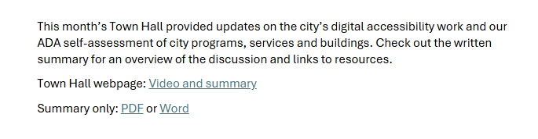
Toolkit Example: Teams and Email

Slide 17
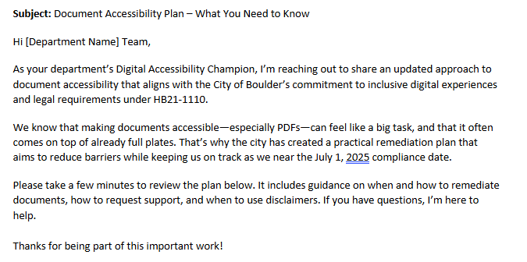
Toolkit Example: Teams and Email

Slide 18
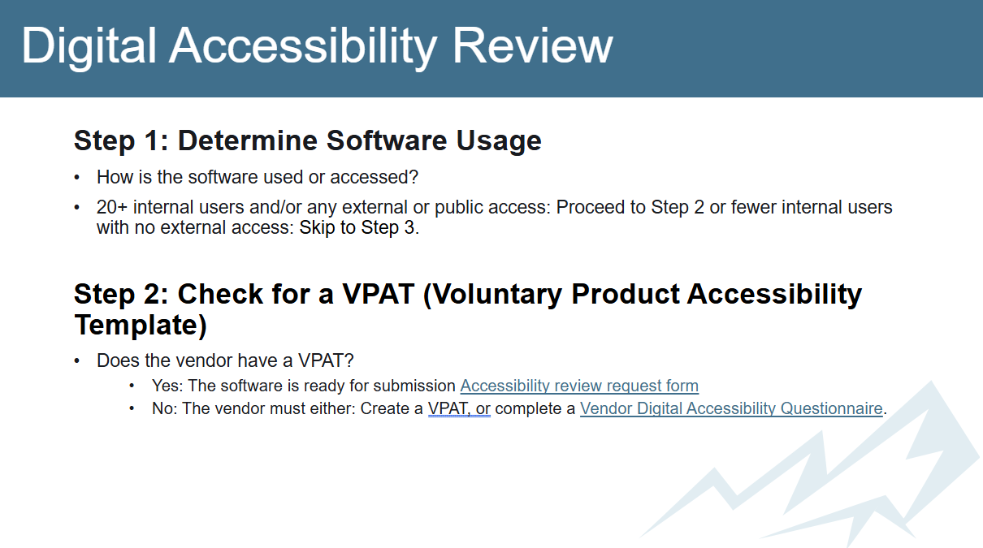
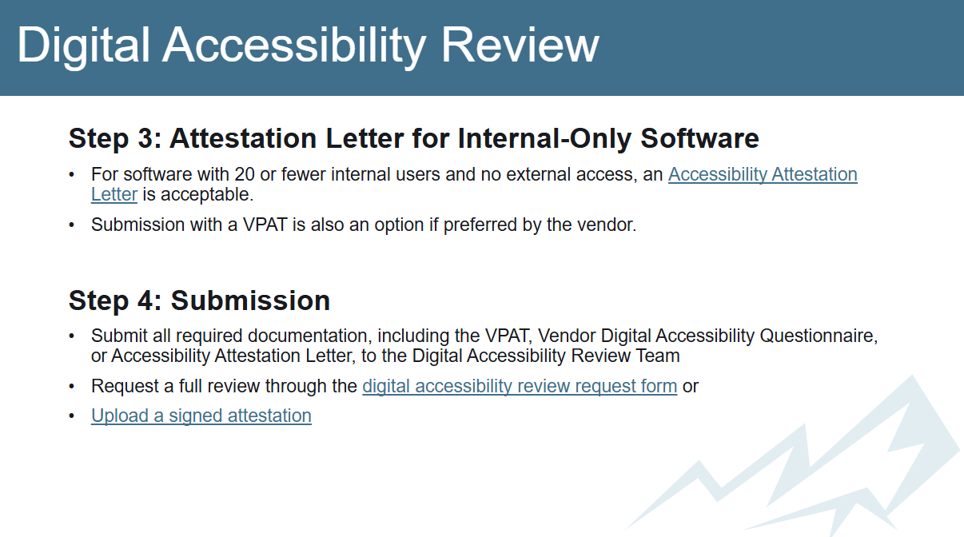
Toolkit Example: Slides

Slide 19
Make a note...
What kind of content would work in your organization?
Teams posts, emails, meeting slides?
Where would you build a toolkit?

Slide 20
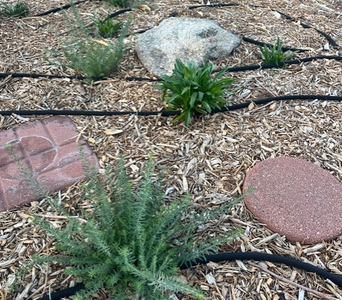
Sustaining the program
Feedback loops
Recognition
Evolve
Maintain purpose

Slide 21
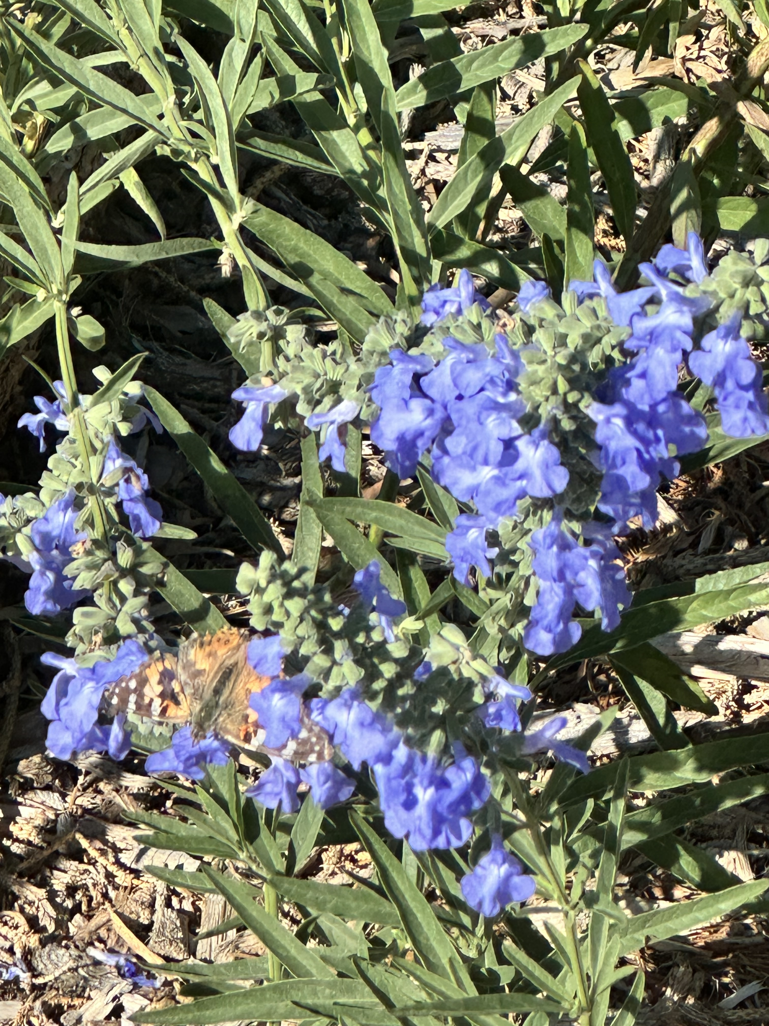
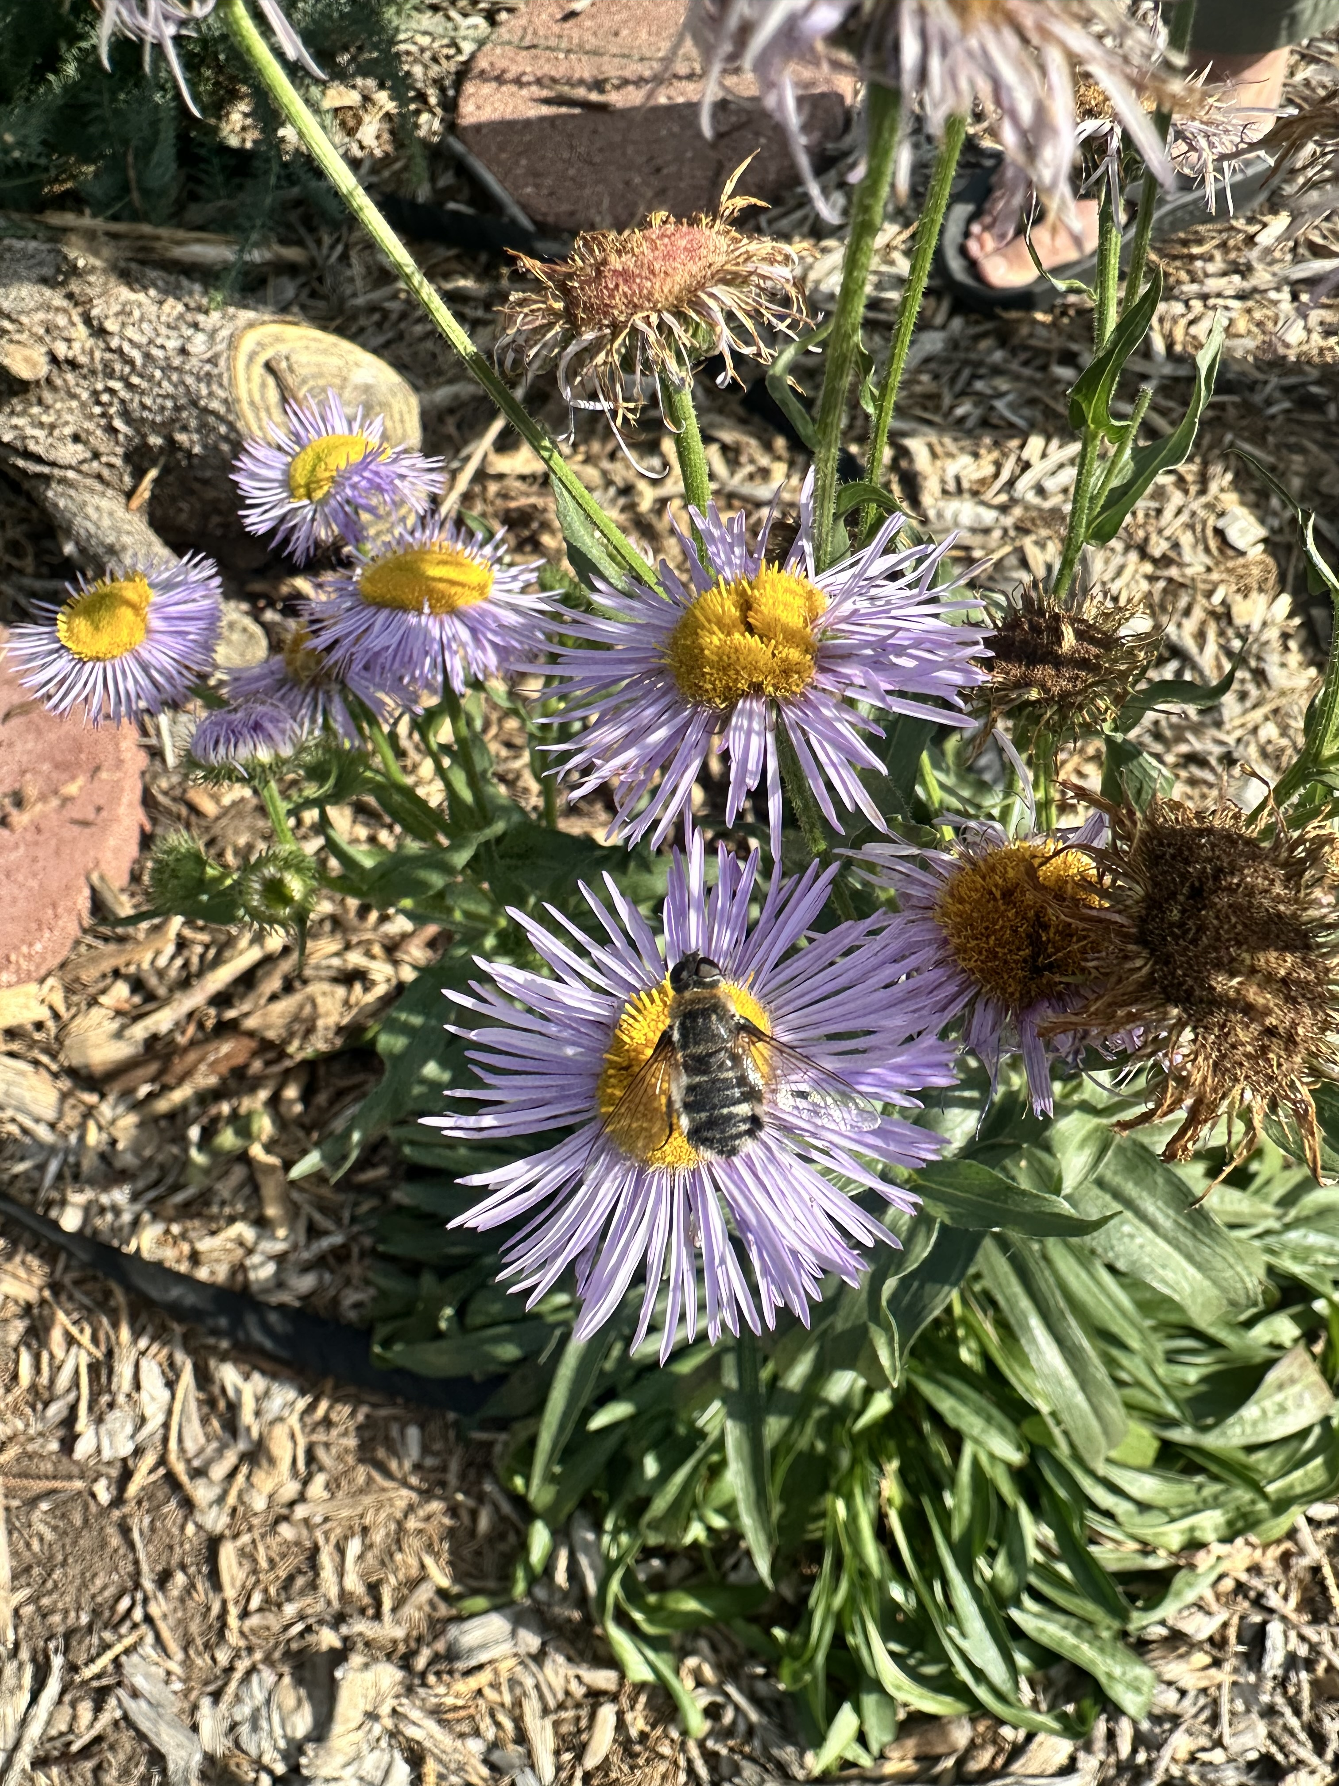
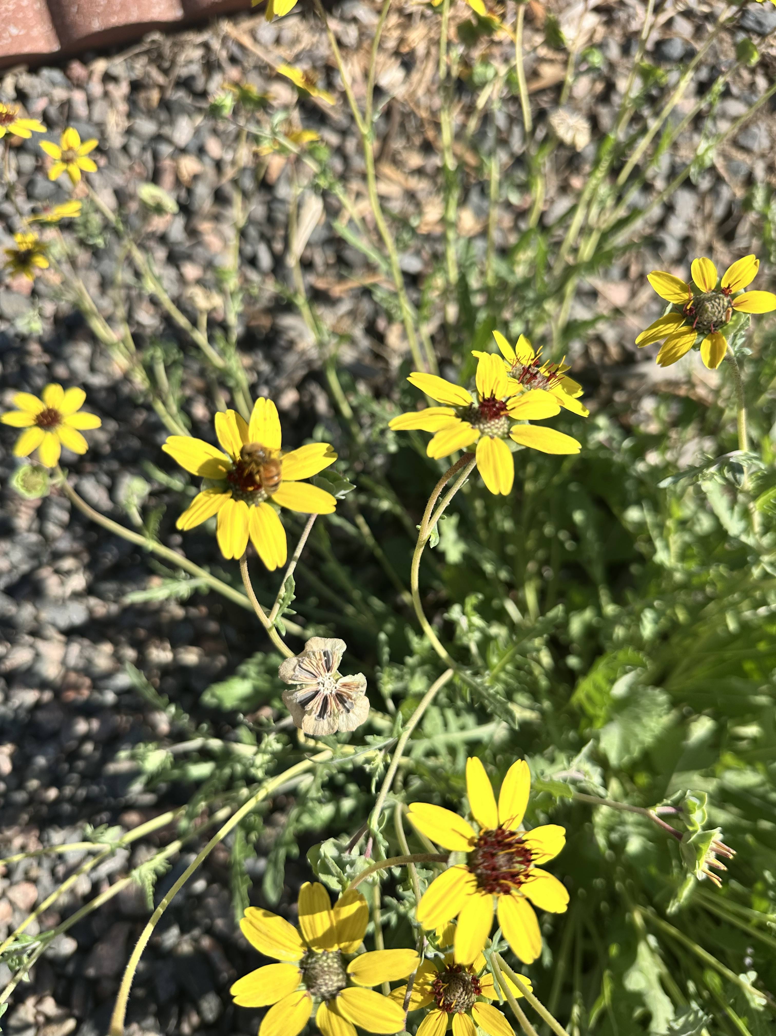
Sustaining the Program

Slide 22
Reflection
What is one small, achievable action you could take in the next month to start building or strengthening your own Accessibility Champions network?

Slide 23
Successes So Far
Built Network
Steady Engagement
Shared Language
Peer Support
Shaping Strategy

Slide 24
Challenges and Lessons Learned
Competing Priorities
Momentum Gaps
Skill Variability
Feedback Loops
Leadership Support

Slide 25
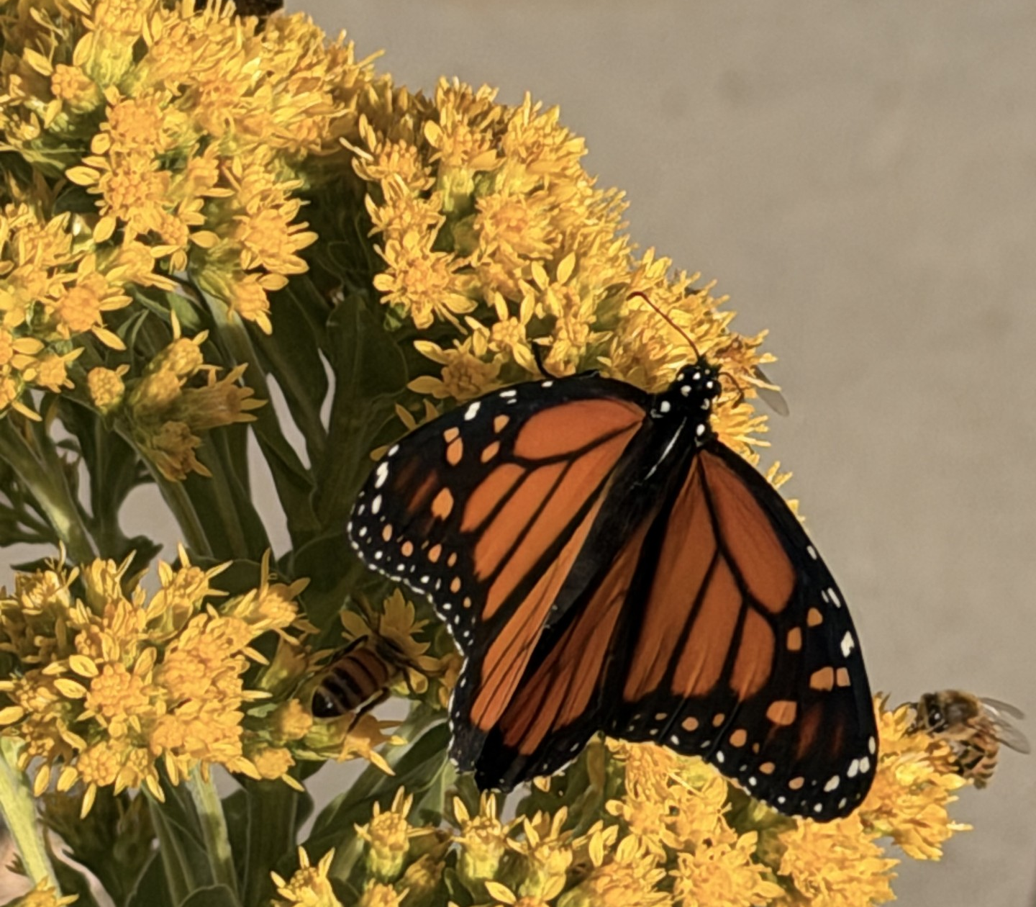
Key Takeaways
Scale accessibility
Sustain engagement
Long-term success

Slide 26
Connect with me!
LinkedIn QR code
Faxonk@bouldercolorado.gov

