Slide 1
AI for Accessibility
Using AI to Empower Creators and Users

Slide 2
Who is Converge Accessibility?

Slide 3

Who is Converge Accessibility? (Jeff)
Jeff Singleton

Slide 4

Who is Converge Accessibility? (Ken)
Jeff Singleton
Ken Nakata

Slide 5
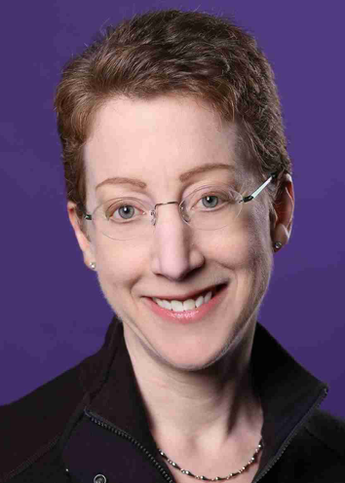
Who is Converge Accessibility? (Laura)
Jeff Singleton
Ken Nakata
Laura Ruby

Slide 6
Our Services
Web Site Reviews
Mobile Apps
Hardware & Software
Accessibility Complaints
ADA, Accessibility, & Procurement Policies,
Self-Evaluations, etc.

Slide 7

Our Services (continued)
Web Site Reviews
Mobile Apps
Hardware & Software
Accessibility Complaints
ADA, Accessibility, & Procurement Policies

Slide 8
What is Digital Accessibility?
Digital accessibility means that any website, document, application, or other content channel is accessible to everyone, including people with disabilities.
Whether it’s a website, mobile app, online course, PowerPoint presentation, or social media platform, everyone should be able to access and engage regardless of their abilities.

Slide 9

What is AI?
Artificial Intelligence enables computers and machines to simulate human intelligence and problem-solving to complete tasks that typically require human intervention and oversight.
AI can be trained, programmed, and designed to complete a wide variety of tasks!

Slide 10
Different Types of AI
Large Language Models: Chat GPT, Gemini, and Copilot
Others: Weak AI, Strong AI, Natural Language Processors, Computer Vision, Reactive Machines, and so much more!

Slide 11
Examples!
Using AI to Empower Creators and Users

Slide 12
Scenario #1 – Making the Inaccessible Accessible
Students can import inaccessible materials into AI models to get accessible versions or content from them.
Example - An inaccessible price list uploaded to Gemini

Slide 13

Image of Price List

Slide 14
Scenario #2 – Help with Accommodations
Brainstorming accommodations or alternatives to traditional materials.
When we feel stuck or out of ideas, AI can help us develop ideas that could work!
Reviewing materials for accessibility and getting guidance on how to improve them.

Slide 15
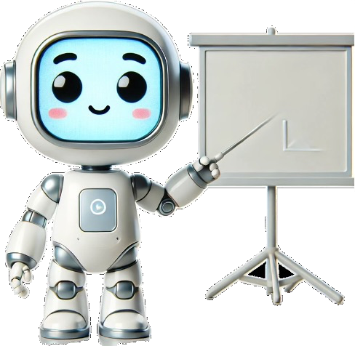
Scenario #3 – Train Your Own Model
Train your own generative models with your content, materials, tone, style, professional level, rules/limitations, and even correctness.
This might be a more secure, safe, and reliable approach to AI in a learning environment.

Slide 16

Thank you!
Jeff Singleton
jeffrey.singleton@convergeaccessibility.com

