Slide 1


Title II Readiness in Action: Key Findings and Insights from Accessibility Pilot Program
Charles LaPierre, Principal Accessibility and Content Quality Architect, Benetech
Phillip Turner, Web and Apple Administrator,
Haywood Community College
Darrin Evans, Director Virtual Learning Community (VLC),
WakeTech Community College

Slide 2
Agenda
⚖️ The Challenge: Why Title II makes accessibility urgent.
💡 Our Solution: Introducing the BASE program.
🔬 The Pilot: A look inside our real-world testing.
🗣️ A Partner's Story: The journey with Haywood CC
📈 Key Findings: What the data revealed.
✅ Actionable Takeaways: Strategies you can use today.
❓ Q&A & Next Steps: Your questions and how to get started.
Notes:
Darrin

Slide 3
The Challenge: A Perfect Storm for Education
The Need for Proactive Accessibility is Urgent
⚖️ New Title II Regulations: Clear expectations and deadlines are now in place.
🎓 Student Success at Risk: Digital barriers directly impact learning, retention, and equity.
⚠️ High Institutional Risk: Proactive strategies avoid costly fixes and legal challenges.
Are you prepared?
Notes:
Speaker: Darrin Evans. Darrin can speak powerfully to the "why" from an institutional and system-wide perspective, framing the problem for the audience.

Slide 4

Our Solution: The BASE Framework
A Proactive Framework for Accessibility
  Maturity model: An informative framework to help organizations assess and improve accessibility policies, processes, and outcomes
  Digital assessment: Review your organization’s websites and digital documents to ensure they meet industry accessibility standards
  Professional development: Support your team’s growth and learning to help reinforce accessibility best practices
Notes:
Speaker: Charles LaPierre, can introduce BASE, its mission, and its core components. Explain that it’s not just a one-time audit but a holistic program designed to build lasting capacity.

Slide 5
The Pilot Program at a Glance
Testing with Four Diverse Partners
      One Community College
      One Private College
      Two K-12 Districts
What:
      Assess: Maturity & Digital Assessments
      Train: Custom Workshops
      Plan: Actionable Roadmaps
Notes:
Speaker: Charles LaPierre.
To ensure our BASE framework was effective and adaptable, we put it to the test in the real world with four distinct educational partners: a community college, a private college, and two K-12 districts. This diversity was crucial to prove the model works across different environments.
For each partner, we followed a consistent three-step process: We started with comprehensive Assessments to understand their unique starting point. Then, we delivered customized Training to build skills. Finally, we collaborated to create a Plan—an actionable roadmap for their accessibility journey."

Slide 6
Maturity Model Overview
The maturity model develops an informative framework to help organizations assess and improve accessibility policies, processes, and outcomes
Developed from the W3C maturity model and tailored to educational institutions
Comprised of 7 dimensions covering communications, culture, procurement, and more with over 70 proof points

Slide 7
Maturity Model: Learnings
Post-secondary pilots show a clear lead in formalizing their accessibility efforts
K-12 partners demonstrated the most significant growth, showing a strong capacity for rapid improvement.
All pilot partners achieved double-digit point increases, validating the effectiveness of the BASE framework.
Organization | Score Before Recommendations | Score After Recommendations | Score Increase
College #1 | 59% | 70% | +11%
College #2 | 27% | 39% | +12%
K-12 #1 | 14% | 39% | +25%
K-12 #2 | 1% | 18% | +17%
Notes:
Charles
So, the first key area we assessed was overall institutional readiness using our Accessibility Maturity Model. This slide shows the powerful impact of the BASE program in a nutshell.
On this table, you can see the scores for each of our four pilot partners, both before we started and after they began implementing our initial recommendations.
You'll immediately notice two key trends. First, our post-secondary partners started with a stronger foundation. College #1, for instance, was already at 59%. This shows they had some formalized accessibility efforts in place.
But what's really exciting is the story on the K-12 side. They started at a much earlier stage—one at just 1%—but look at their growth. K-12 #1 jumped an incredible 25 percentage points. This demonstrates a huge capacity for rapid improvement when you have a clear roadmap.
And that brings us to the most important takeaway, which is our final bullet point: every single one of our partners achieved a double-digit increase in their score.
This is the core validation of our framework. It proves that no matter where your institution is on its accessibility journey, the BASE program provides a clear path to significant and measurable improvement

Slide 8
Maturity Model: Areas of Strength
Two proofpoints in the Support dimension stand out, with three of the four pilot schools having achieved a status of "Integrate" or "Optimize":
Written policy on requesting and providing student accommodations: Three of the four schools have a well-established, written policy for how students can request and receive accommodations
Support for students with disabilities to use assistive technology: A majority of the schools provide adequate support for students to use their own assistive technology to perform assigned tasks
Notes:
Charles:
Before we dive into the gaps, it's crucial to highlight where our pilot partners were already strong.
We consistently found that institutions have well-established foundations in direct student support.
Three of the four had clear, written policies for student accommodations, and a majority provided excellent support for students using their own assistive technology.

Slide 9
Maturity Model: Areas of Weakness
All pilots report “inactive” for the following areas:
No digital accessibility code of conduct
No Employee Resource Group (ERG) for employees with disabilities
No product and project focus groups of employees with and without disabilities
No ongoing ICT procurement training for staff
Notes:
Charles:
This slide shows one of our most significant learnings. Across all four very different partners, we saw the exact same gaps in foundational processes. Every single one lacked a formal digital accessibility code of conduct, employee resource groups, and, critically, an ongoing training process for staff involved in purchasing technology.
This shows a systemic challenge that BASE is designed to address.

Slide 10
Quick Wins for Maturity
Low-Hanging Fruit for Immediate Impact
📄 Publish an Accessibility Statement (We have a template!)
🛒 Add A11y to Vendor Contracts (We provide the language!)
🌐 Create a Central A11y Webpage (A one-stop-shop for resources.)
Notes:
Speaker: Charles LaPierre.
So, after seeing those common weaknesses, the natural question is 'Where do we start?' The great news is that addressing these gaps doesn't have to be overwhelming.
We've identified three 'Quick Wins'—high-impact steps that any institution can take right away. These are foundational pieces that we provide templates and guidance for as part of the BASE program.

Slide 11
Digital Assessment: Overview
Review an organization’s websites and digital documents to ensure they meet industry accessibility standards
On average, we checked 40 webpages and 10 documents (mainly PDFs and some spreadsheets) per pilot
Notes:
Charles

Slide 12
Findings 2: Top 5 Digital Barriers
The Most Common Issues We Found
    Missing Alt Text
    Poor Color Contrast
    Wrong or Missing Headings
    Vague Links ("Click Here")
    Inaccessible PDFs
The Good News: All of these are fixable with basic training.
Notes:
Speaker: Charles LaPierre.
When we assessed the actual websites and documents, a clear pattern of five issues emerged everywhere. We consistently found missing alt text, poor color contrast, improper headings, vague links, and inaccessible PDFs.
But here’s the most important takeaway on this slide: these are all solvable problems. They aren't complex coding issues; they are fundamental barriers that can be fixed and prevented with basic training, which is incredibly empowering.

Slide 13
Findings: Most Barriers Have a Significant Impact
The vast majority of issues found (653 of 667) were of Serious or Medium severity.
This means the barriers are not just compliance issues; they directly prevent students from accessing course materials, navigating websites, and participating fully in their education.
Organization | WCAG A | WCAG AA | WCAG Total | Serious Issues | Medium Issues | Low Issues | Total Issues
College #1 | 11 | 8 | 19 | 95 | 71 | 7 | 173
College #2 | 17 | 10 | 27 | 90 | 27 | 4 | 121
K-12 #1 | 9 | 14 | 23 | 34 | 112 | 1 | 147
K-12 #2 | 15 | 9 | 24 | 76 | 148 | 2 | 226
Total | 52 | 41 | 93 | 295 | 358 | 14 | 667
Notes:
Charles
Now let's look at the results of our digital assessments. This table shows the breakdown of accessibility issues we found on the main websites of our pilot partners.
What's immediately striking is that these aren't minor issues. Across the board, the problems we found were overwhelmingly categorized as Serious or Medium severity. To be clear, a 'Serious' issue is something like a missing form label that completely prevents a screen reader user from submitting an application. A 'Medium' issue might be poor color contrast that makes text unreadable for a student with low vision.
Out of almost 700 issues, only 14 were low-impact. This is the most critical takeaway from our technical work: the accessibility barriers we found are directly and significantly impacting the student experience, preventing them from learning and engaging on an equal basis.

Slide 14
Web Barriers: A Deeper Analysis
College websites had more serious issues, often related to key user interface components like color contrast and keyboard accessibility.
K-12 websites had more medium issues, typically stemming from systemic problems in their templates or page structure.
Despite these differences, missing or improper alt text was a universal barrier across all pilot partners.
Notes:
Charles

Slide 15
Document Findings: Universal Barriers
Both K-12 and post-secondary institutions face the same fundamental document accessibility challenges.
Common barriers preventing access include:
Broken Reading Order: Untagged content makes documents confusing or unreadable for screen readers.
Incomprehensible Tables: Missing header information means data in tables cannot be understood.
Meaningless Images: A lack of alt text makes images invisible to users with visual impairments.
Poor Navigation: Incorrect or missing heading structures prevent users from easily moving through the document.
Incorrect Pronunciation: Missing language tags can cause screen readers to mispronounce text.
Notes:
Charles
When we turned our attention from websites to documents—like PDFs and Word files uploaded to the LMS—we found something striking.
Unlike the web, where we saw different patterns between K-12 and higher ed, the problems with documents were almost identical everywhere.
This is a universal challenge.
The barriers we found were fundamental. We're talking about untagged content, which results in a broken reading order where a screen reader might jump from the first paragraph to the last. We found countless incomprehensible data tables because the headers weren't defined.
And just like on the web, meaningless images due to missing alt text were everywhere.
These aren't minor issues. They are critical barriers that prevent students from being able to access and understand essential course materials."

Slide 16
Professional Development
Building a Culture of Inclusion
Assessments tell you what the problems are. Professional development is how you solve them for the long term.
Moves Beyond Compliance to a Culture of Inclusion. Accessibility becomes a shared institutional value, not just a technical checklist.
Empowers Every Employee to be an Accessibility Champion. We provide the practical, role-based skills needed to create accessible content from the start.
Shifts from Reactive Fixes to Proactive Design. Training is the most effective way to prevent new barriers, saving time and resources while creating a better experience for everyone.
Notes:
Darrin Evans
"So, we've shown you the data on the maturity gaps and the common digital barriers. But a report alone doesn't create change. This is why professional development is the heart of the BASE program.
Our entire approach is built on three core beliefs.
First, we believe in moving beyond simple compliance to create a true culture of inclusion. An audit can tell you if you're meeting a standard, but training helps your staff understand why it matters, turning it into a shared value.
Second, we work to empower every employee to be an accessibility champion. This isn't about blaming people for past mistakes. It's about giving your faculty, your web team, and your procurement staff the practical skills they need to feel confident creating accessible content right from the start.
Finally, and this is crucial for sustainability, our training shifts the institution from making reactive fixes to using proactive design. It is always more effective to build something accessibly in the first place. Training is the single best investment you can make to prevent new barriers, which ultimately saves significant time and resources.
Ultimately, our assessments identify the challenges, but it's the investment in your people that creates lasting, positive change."

Slide 17
Partner Story: Haywood Community College
The Journey from Awareness to Action
The Challenge: We had awareness that improvement was needed but needed guidance identifying a starting point and prioritizing our focus.
The Outcome: We came away with a plan for remediation and guidance on not only what problems to fix but specific instruction on how to fix them.
"The BASE program gave us the specific data and skills we needed to move forward confidently."
- Phillip Turner
Notes:
Speaker: Phillip Turner.
This is the crucial "voice of the customer." Phillip should speak authentically about his experience. He makes the data real by sharing the human side of the journey—the initial challenges, the process, and the feeling of empowerment and clarity afterward. His story validates the entire program.
We had awareness that improvement was needed but needed guidance identifying a starting point and prioritizing our focus.
Tools provided helped to guide the process of discovery
Expert over view to identify major roadblocks so time isn’t spent fixing problems that are more like annoyances
Outside expert voice to lend weight to words
Came away with a plan for remediation and guidance on not only what problems to fix but specific instruction on how to fix them
Web site report: location, guideline, severity, - beyond automated checker included descriptions, user impact, code snippet from actual page, screenshot, recommended fix

Slide 18
The Big Picture: Why This Matters
Building a Culture of Inclusion
🛡️ Proactive Strategy > Reactive Fixes
        Be prepared for Title II and beyond.
🧑‍🤝‍🧑 Benefits All Students
        Good design and accessibility create a better experience for everyone.
💡 Fosters Innovation
        An inclusive mindset drives creative solutions.
Notes:
Speaker: Darrin Evans.
Darrin zooms out to the 30,000-foot view. He connects Charles's data and Phillip's story to the larger institutional and systemic imperatives he introduced at the beginning. He champions the "why"—why this work is critical beyond just compliance.

Slide 19
Your First 3 Steps
What You Can Do Next Week
1️⃣ Start the Conversation:
        Schedule a meeting with campus stakeholders.
2️⃣ Run a Quick Assessment:
        Use a free tool (like WAVE / Axe by deque) on your homepage.
3️⃣ Find Your Policy:
        Does one exist? If not, start the draft.
Notes:
Speaker: Darrin Evans. You bring it back to the audience, giving them a clear, non-intimidating call to action. The goal is to empower them to leave the room and do something tangible immediately. This makes the presentation memorable and useful.

Slide 20
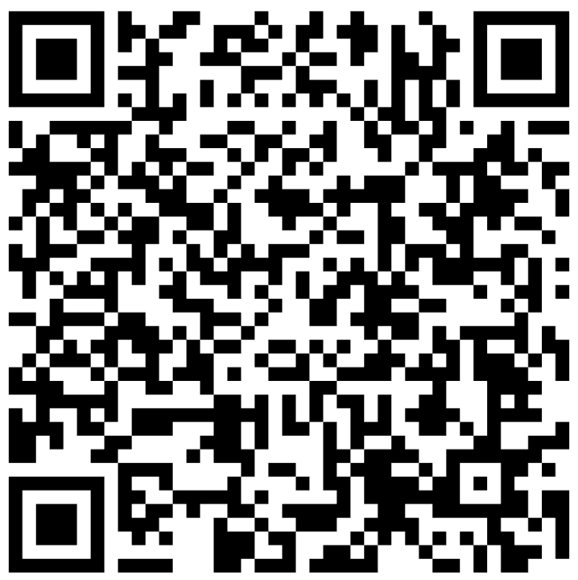
Join the Movement:
Become a BASE Early Adopter
Scan QR Code to get More Information and Sign up!
https://benetech.org/about/base/
Notes:
Speaker: Charles LaPierre.
This is the direct "ask." You clearly present the opportunity for the audience to engage further. State the value proposition (discount, community) and create a sense of timely opportunity.
*** NOTE THIS URL needs to be still updated

Slide 21

Thank You & Q&A
Questions?
Charles LaPierre: charlesl@benetech.org
Phillip Turner: pturner@haywood.edu
Darrin Evans: daevans3@waketech.edu
Notes:
Speakers: All three.

