Slide 1
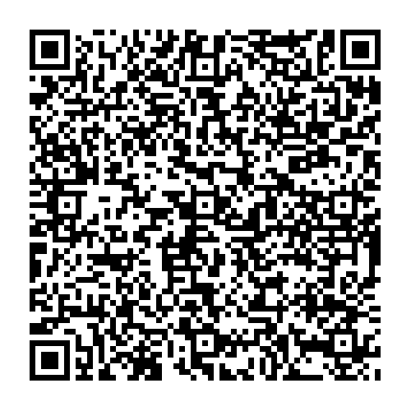
Holding the Weight of Accessibility, Together
https://bit.ly/htwa2025

Slide 2

Agenda
Introduction
Get into the weight
10:00–10:10 AM Break
Finish the weight component
Move forward
11 – 11:10 AM Break
Sustain our work
Closing

Slide 3

Introduction
We are not therapists, but we are realists. This work is hard.
Today is about connecting with peers, reflecting together, and finding small, steady wins that help us keep going.

Slide 4
Framing the Space
This session is intended to be a collaborative space.
We will have time for individual reflection, sharing with a partner or at your table, and whole group discussion.

Slide 5


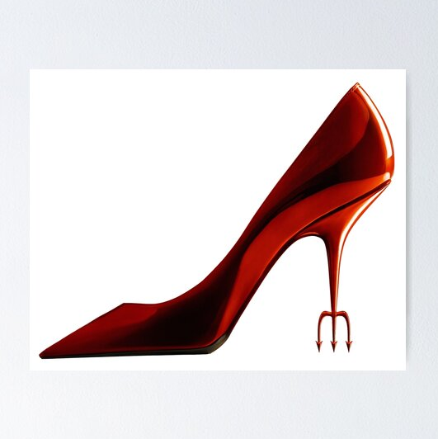
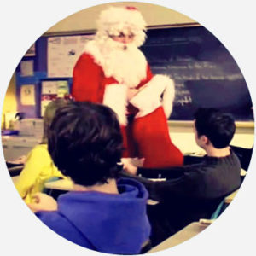
Ground rules (in movie quotes)
“The first rule of Fight Club is: you do not talk about Fight Club.”
“No capes!”
“By all means, move at a glacial pace.”
“You go, Glen Coco!”
What’s said in the room, stays in the room
Reflections can be helpful, but no fixing
But really…it is okay to take a breath and allow some silence before speaking
Let every voice be heard and support who is speaking

Slide 6
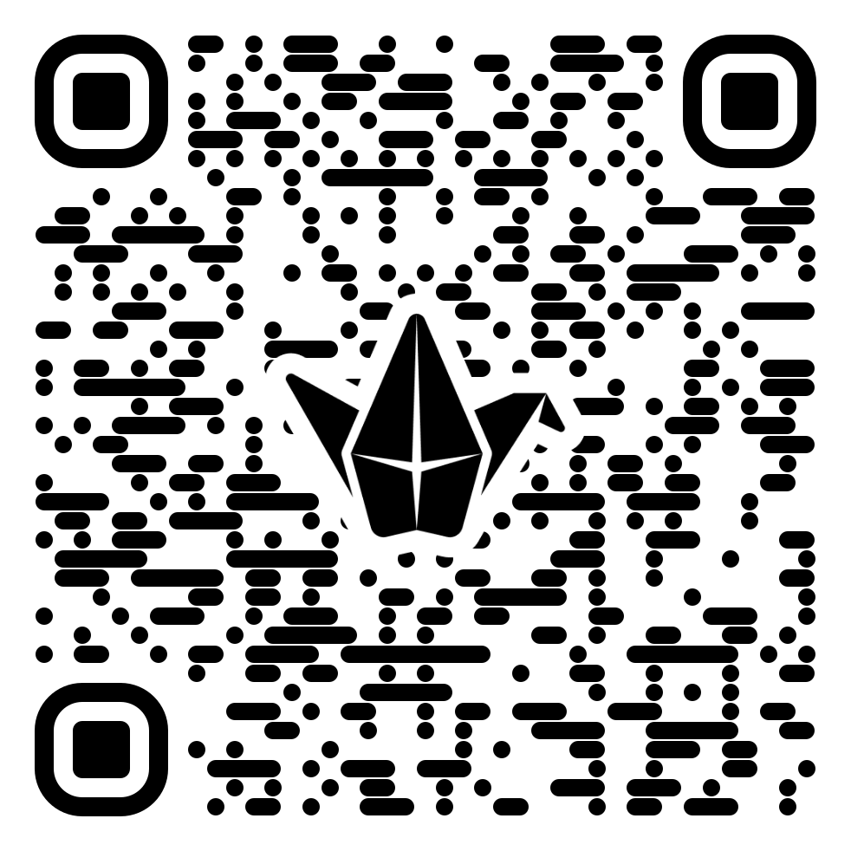
Group check-in activity 1
Digital sticky note activity:
If your work week had a title, what would it be? (It can be a movie, song, TV show, or from scratch.)
Padlet: bit.ly/AHG25htwa

Slide 7
Naming the Weight
Our roles are often multi-faceted and require us to wear “many hats.”
We are also often alone or one of a few on our campuses.

Slide 8
Invisible Work
Invisible work includes, emotional labor, organizational tasks, mentoring, and other behind-the-scenes efforts that contribute to the smooth functioning of individuals, families, and organizations.
The invisible labor of accessibility professionals: juggling roles, emotional toll, under-recognition, etc.

Slide 9
Group check-in activity 2
Digital sticky note activity:
What invisible work is quietly sitting on your shoulders lately?
Padlet: bit.ly/AHG25htwa
Small group breakout (3–4 people):
Share what resonated or surprised you
Large group debrief:
Key themes

Slide 10

Break Time 10:00–10:10 AM

Slide 11
Unspoken Truths
By naming what you’re feeling, you build awareness, reduce reactivity, and open space for action.

Slide 12
Group check-in activity 3
Digital sticky note activity:
What’s something about doing this work that you rarely say out loud?
When you think of burnout, what does it look or feel like for you?
Padlet: bit.ly/AHG25htwa

Slide 13
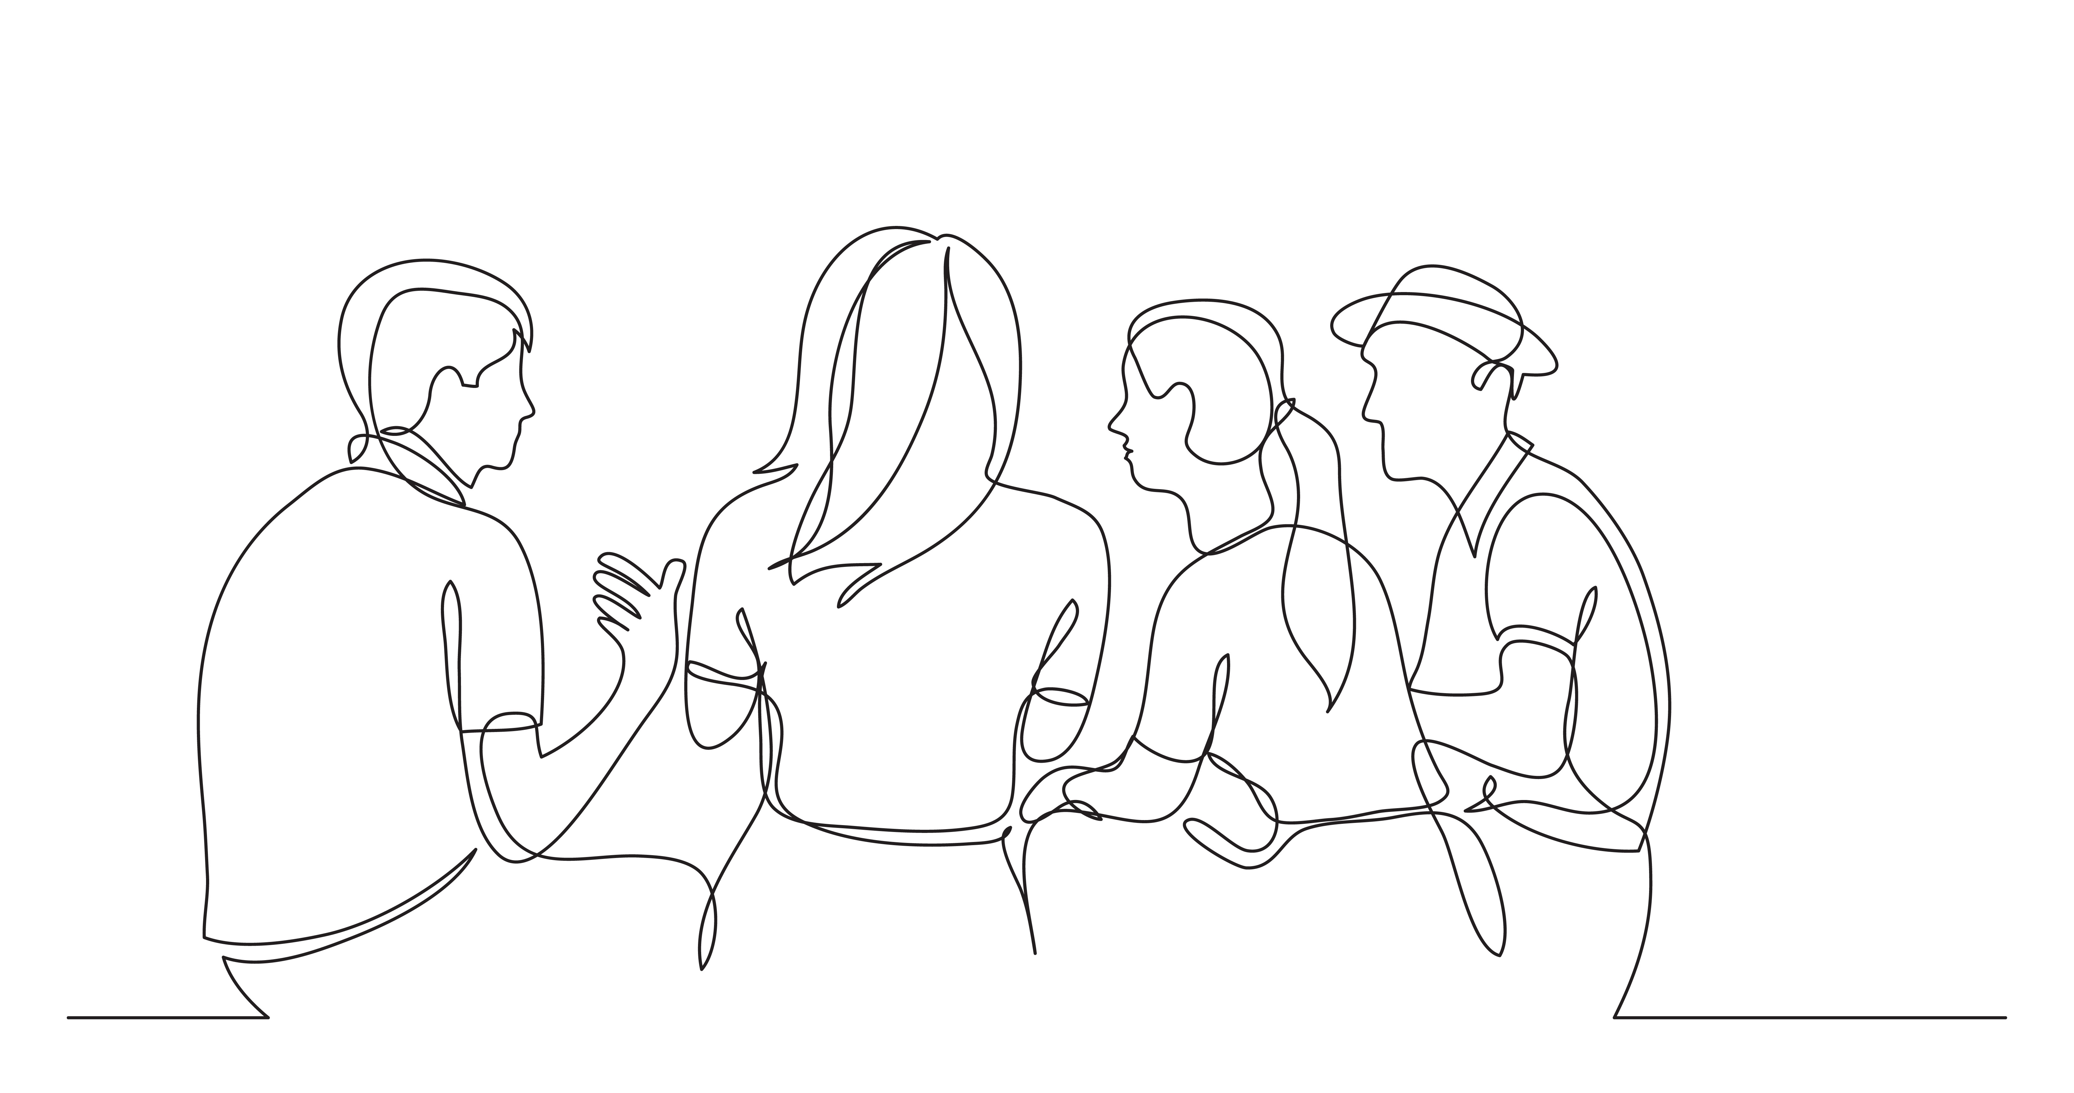
A Path Forward…
Sharing personal stories and experiences
Make the invisible, visible

Slide 14
Celebrating the Brilliant
This next moment is for pride, laughter, and remembering our impact.

Slide 15
Group check-in activity 4
Digital sticky note activity:
What’s a win, big or small that reminded you why you do this work?
Padlet: bit.ly/AHG25htwa
Small group breakout (3–4 people):
Share wins or moments of joy/pride
What do these moments teach us about impact?
Large group debrief:
We are brilliant because…

Slide 16
Break Time 11:00 –11:10 AM

Slide 17
Sustaining the Work
Together we will gather ideas and practices that make this work sustainable.

Slide 18
Group check-in activity 5
Digital sticky note activity:
What boundaries or practices help you keep going?
What’s one (doable) thing that would make your accessibility work feel lighter?
What would you tell someone new to this work?
Padlet: bit.ly/AHG25htwa

Slide 19
Group check-in activity 6
Digital sticky note activity:
Choose one word you’re leaving with
Padlet: bit.ly/AHG25htwa
Large group debrief:
Our suggestions for making this work more sustainable…
(Optional) Invitation to stay connected and make some conference buddies

Slide 20
Closing
We build access together, one choice, one course, one conversation at a time.
Thank you for being part of this effort and for helping make it brighter.

