Slide 1

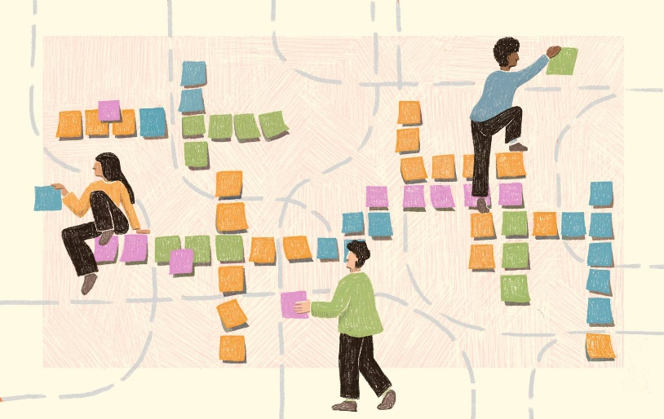

From Process To Practice:
Evolving Course Reviews and Strengthening Faculty Ownership of Accessibility
RaLynn McGuire | Vanessa Garza

Slide 2
Agenda
Welcome
Where We Started
Evolution of the Course Review Process
Faculty Partnership & Ownership
Sustaining the Momentum
Takeaways

Slide 3
Welcome
Location:
UT San Antonio
University Size:
42k+ Students
4k Faculty
Instructional Designers Reach Per Semester:
Course Building Team: 4-5 faculty members
Consult team: Over 100 faculty members
Accessibility work is most sustainable when:
shared,
relationship-driven, and
embedded into everyday teaching.

Slide 4

Question about current practices…
What practices are in place to review course accessibility where you work?

Slide 5
Where We Started
Early Approach:
Reviews were checklist-based and conducted post-course development.
Faculty perceived reviews as “compliance checks” rather than learning opportunities.
Challenges:
Late timing = limited impact.
Faculty overwhelm and defensiveness.
Missed opportunities to build understanding and trust.

Slide 6
Question about barriers…
What barriers have you encountered when trying to engage faculty in accessibility work?

Slide 7
Goals of the Course Review Process
To weave accessibility earlier in design and revision cycles.
Work alongside instructional designers and faculty rather than after the fact.

Slide 8
Evolution of the Course Review Process
Introduced staged reviews:
module 1 prototype review,
monthly consultation with IDDs,
final review
Reframed feedback tone from “audit” to “collaboration.”
Used accessible exemplars and short demos during consultations.

Slide 9

Results
Greater faculty and IDD understanding and engagement.
Increased accessibility scores.
Proactive faculty requests for feedback.

Slide 10
Faculty Partnership & Ownership
Faculty Champions:
Strategies for Building Trust:
Culture Shift:
Identify and engage faculty who model accessible practices.
Encourage peer sharing.
Start with affirmation.
Be transparent about goals and impact.
Co-create solutions rather than prescribing fixes.
Some faculty begin to see accessibility as good teaching, not extra work.
More faculty requesting accessibility feedback unprompted.

Slide 11

Sustaining the Momentum
Recognition & Positive Reinforcement:
Plans for a faculty recognition initiative
Public acknowledgment and storytelling to normalize accessibility as success.
Future Directions:
Integrating accessibility expectations into course development templates.
Strengthening collaboration with college-level partners.
Expanding professional development opportunities.

Slide 12
Takeaways
Key Takeaways:
Start small, build relationships, and embed accessibility into regular workflows.
Positive reinforcement drives engagement.
Shared ownership fosters sustained progress.
Call to Action:
What one relationship could you strengthen to embed accessibility more deeply at your institution?

Slide 13
Questions?
Thank you!
DigitalAccessibility@utsa.edu

