Slide 1

Expanding your Assistive Technology Supports to Include Employees with Disabilities
Michelle Brodsky Med, OTR/L, she/her
Assistive Technology Resource Center
Colorado State University
Accessing Higher Ground 2025

Slide 2
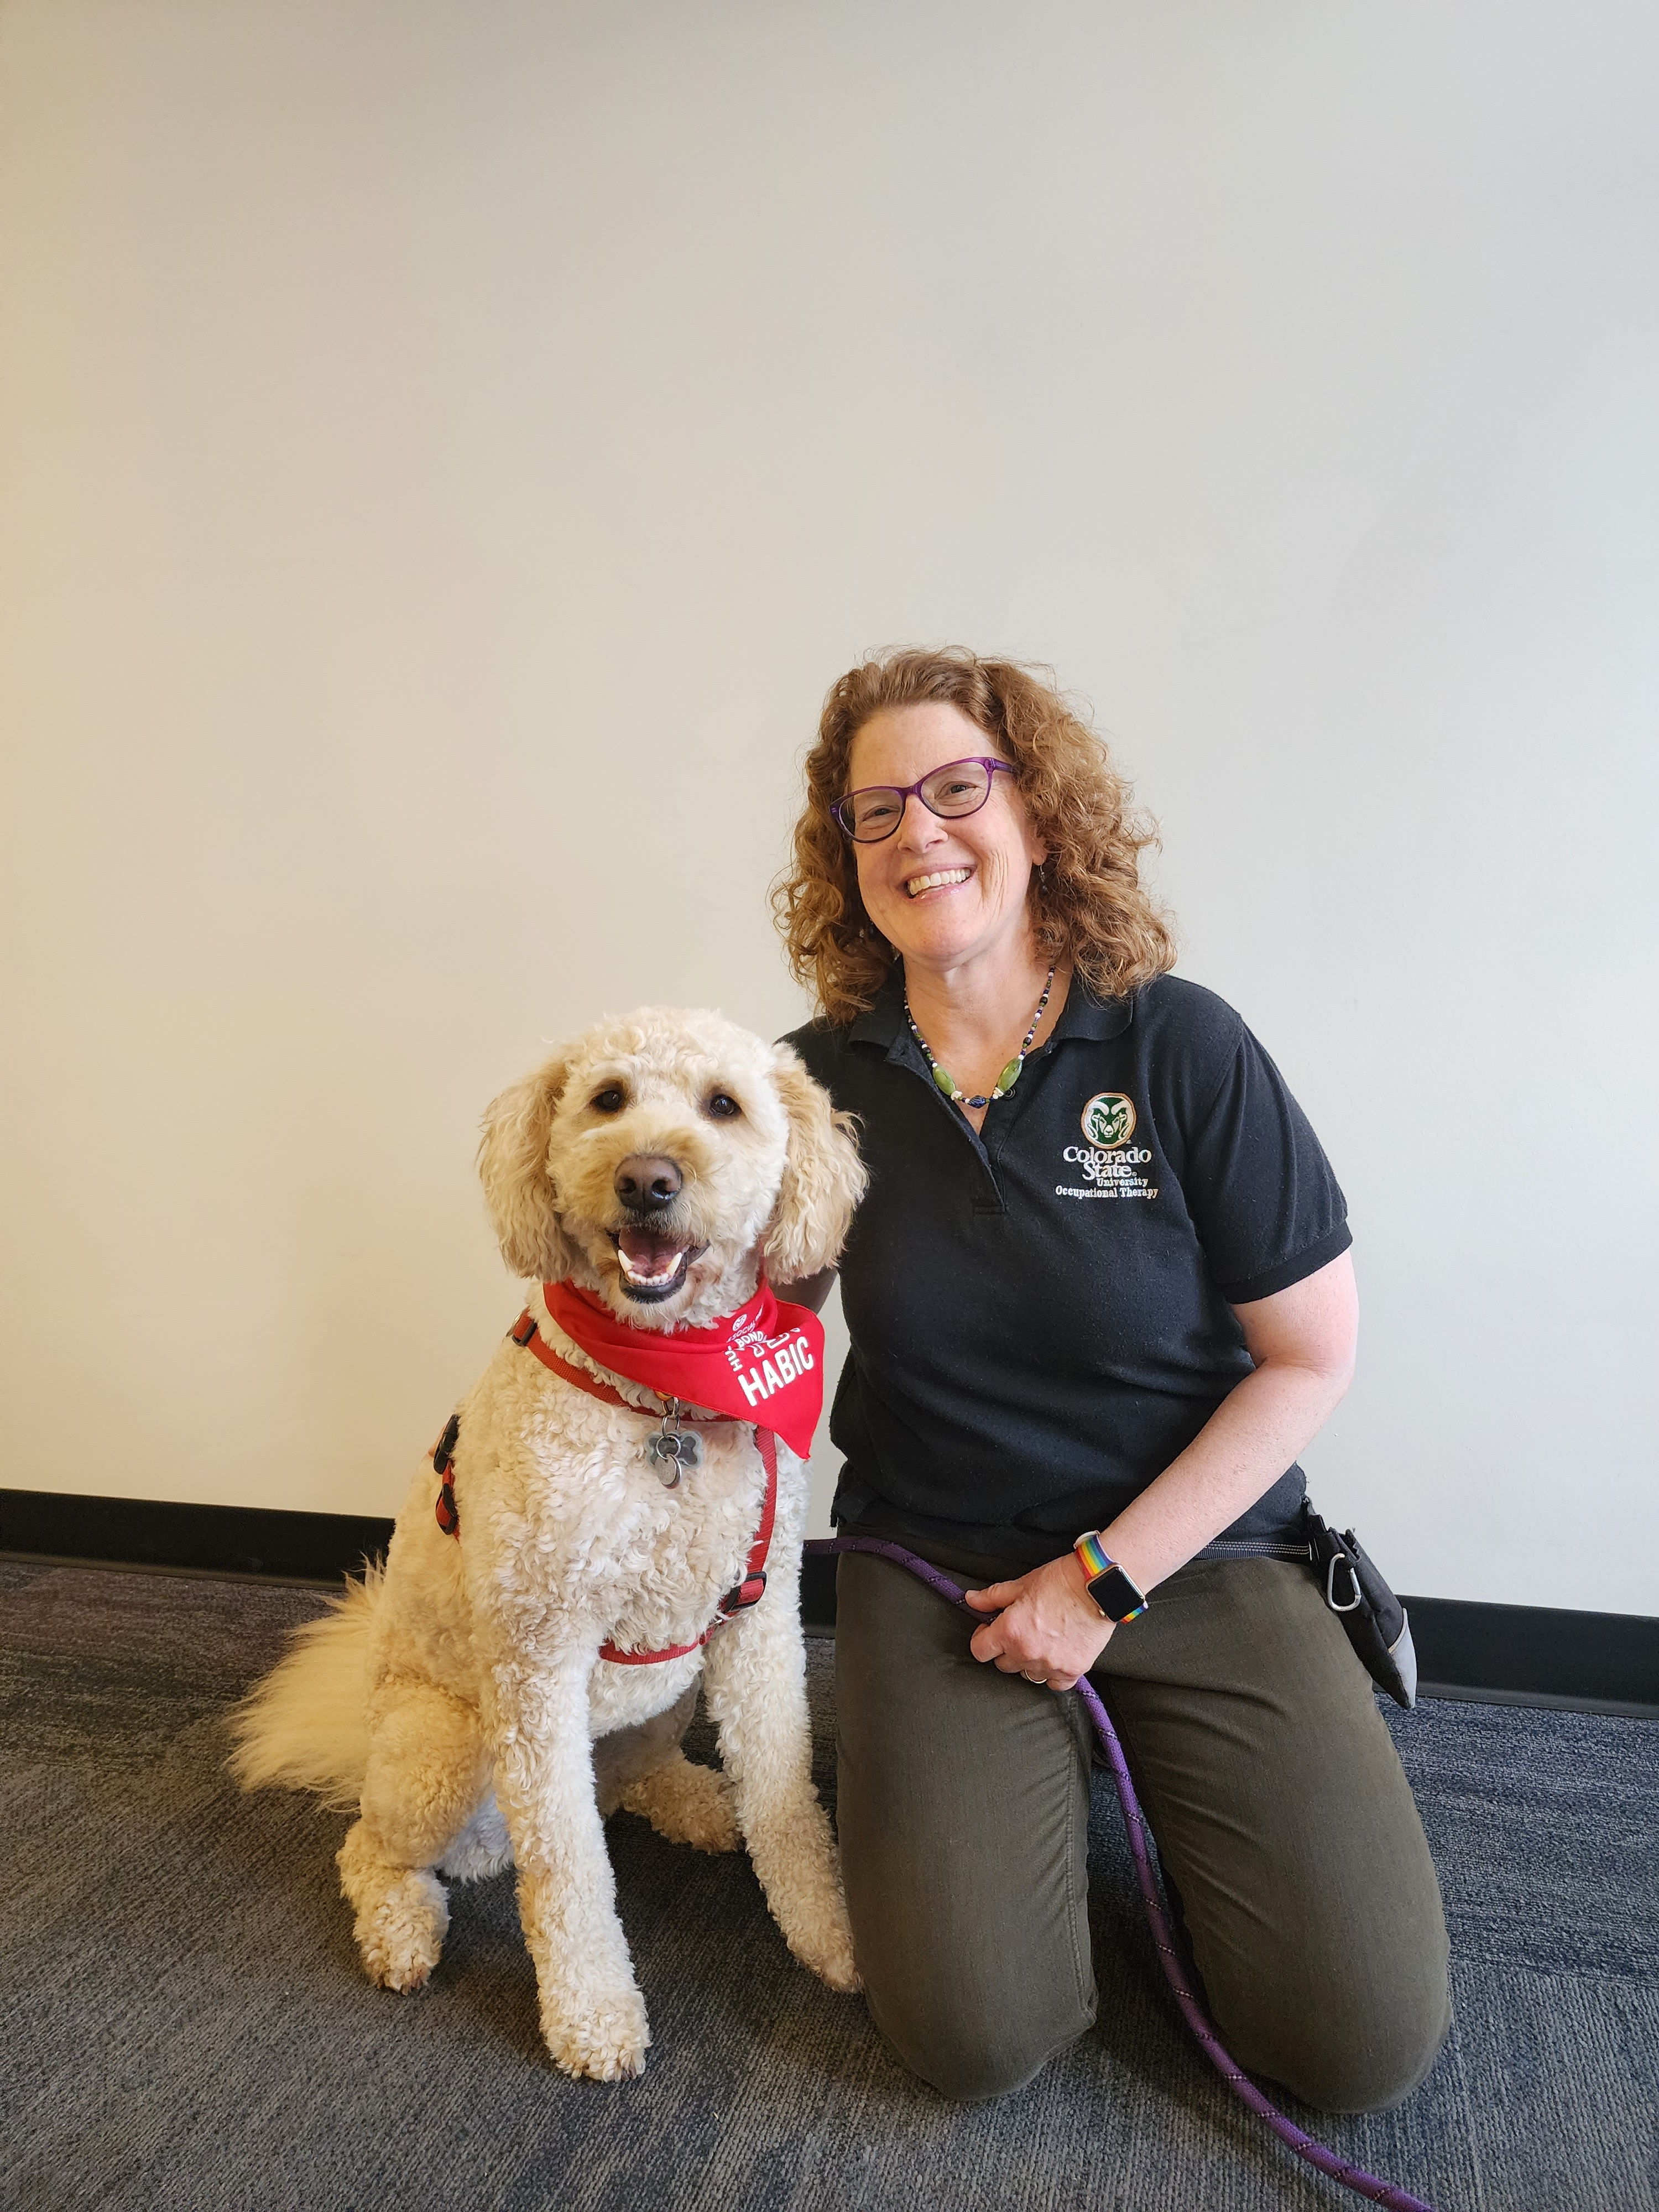

Introductions
Who am I?
Who are you?
Why are we here?

Slide 3
Objectives
Learn how Colorado State University has developed a successful AT support model for employees
Understand the ATRC’s service model for employees
Find out how the ATRC measures success with employees
Know where to turn for more resources to support employees with disabilities

Slide 4

Colorado State University (CSU)
A Public, Land-grant University
Institutional Profile
  34,218 total students
  7,500+ faculty and staff
  4300+ online students
8 colleges
Located in Ft. Collins, Colorado

Slide 5
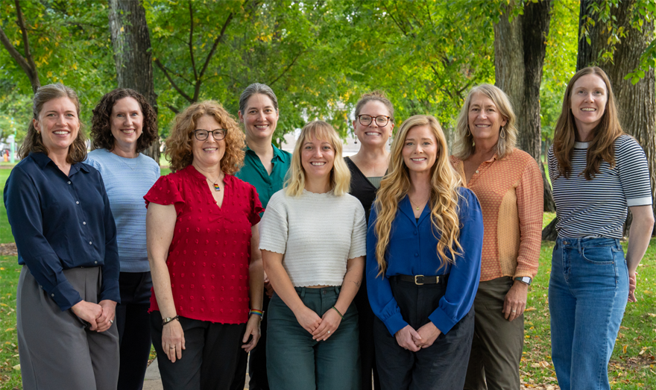
The Assistive Technology Resource Center
Serves students and employees with disabilities
Housed within the CSU Center for Accessibility
Collaborates with the Department of OT
Works closely with other campus inclusion programs
Serves over 600 students/year
4 OT service providers, Director, Admin, IT, GTA
Research

Slide 6
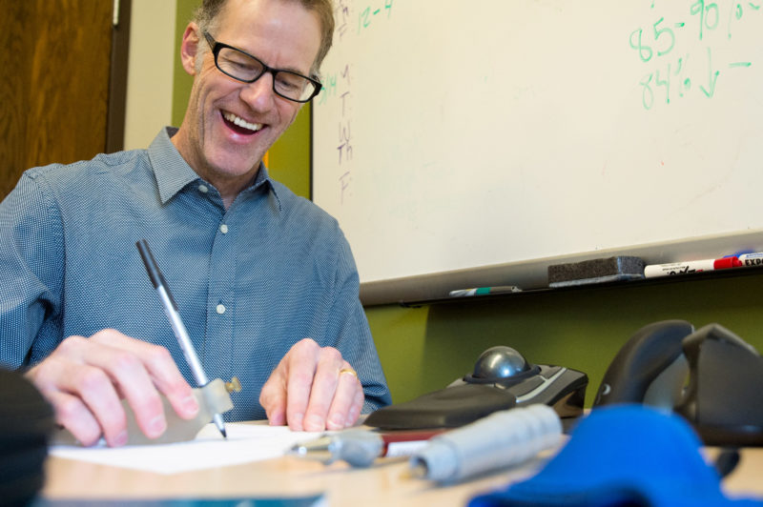
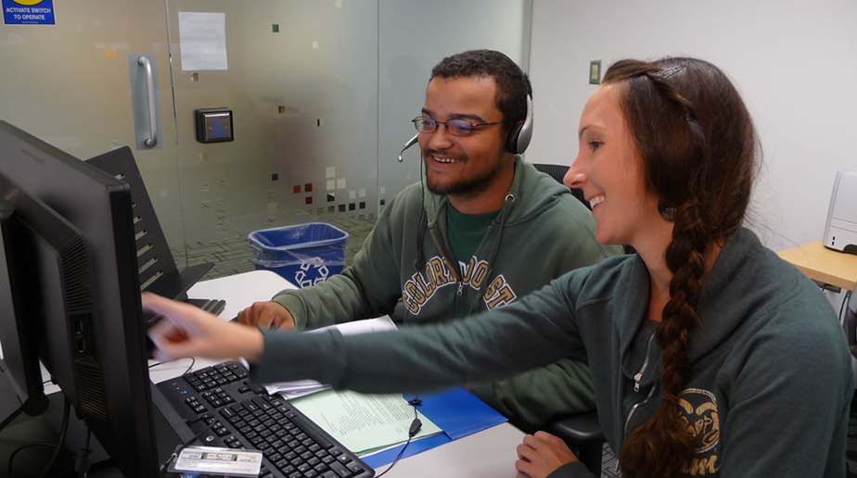
The ATRC
Ensures equitable access to technology and electronic information for students and employees with disabilities by fostering a technological climate that is inclusive and welcoming to a diversity of learners and workers
and
Works to ensure that CSU students and employees are aware of and can access assistive & mainstream technology options, through consultation, education and advocacy

Slide 7
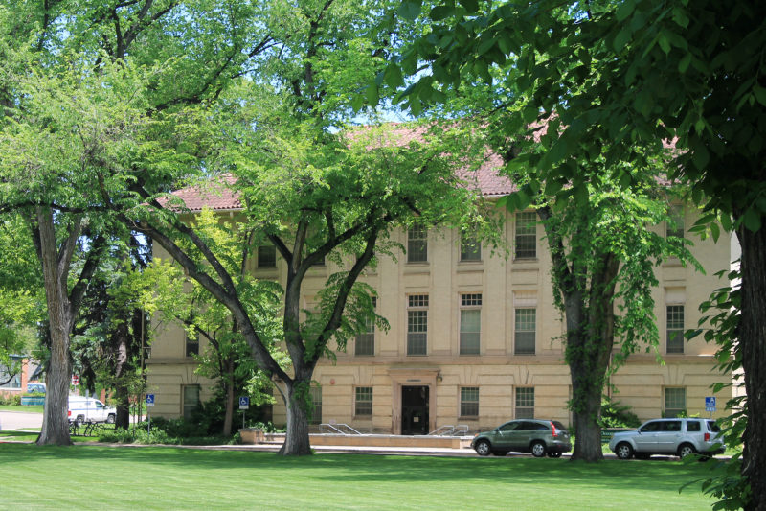
ATRC
Employee Services

Slide 8

History
2010 The environment was ripe!
ATRC started getting requests from employees. ATRC partnered with OEO for Disability and Employment Month
Steering Committee: Director of OEO/ADA coordinator, key campus administrators
The Proposal
Committee saw the need, approved the proposal and funded a position to work with employees!
2019 Employee Loan Closet
Funding: Fringe Account
Future We hope to fold more supports for employees into the CSU Accessibility Center

Slide 9
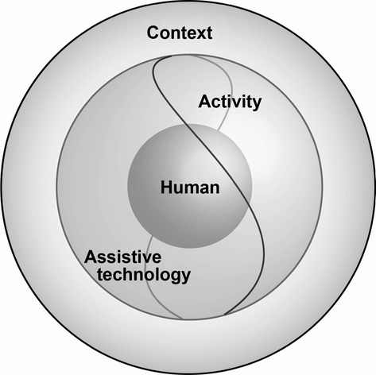
OT Values & Process
Best Practice
Research shows that finding the right match leads to adoption of AT (Cook, Polgar & Encarnacao, 2025)
HAAT model (Human/Activity/Assistive Technology)
Client-centered, strengths-based, social model
Building therapeutic rapport

Slide 10
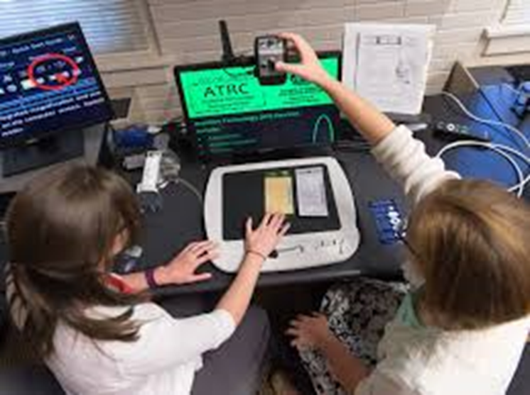
Common Diagnoses
ADHD
Anxiety/Depression
Autism
TBI
POTS
PTSD
Learning Disabilities
Neurological Disorders
Orthopedic Conditions
Low Vision

Slide 11
Differences Between Supporting Students and Employees
Environment
Job Tasks
Funding
Longevity

Slide 12

Process
Referral- OEO or self
Authorization document
Initial meeting
Assessment and Training
AT Recommendations
Wrap-up

Slide 13
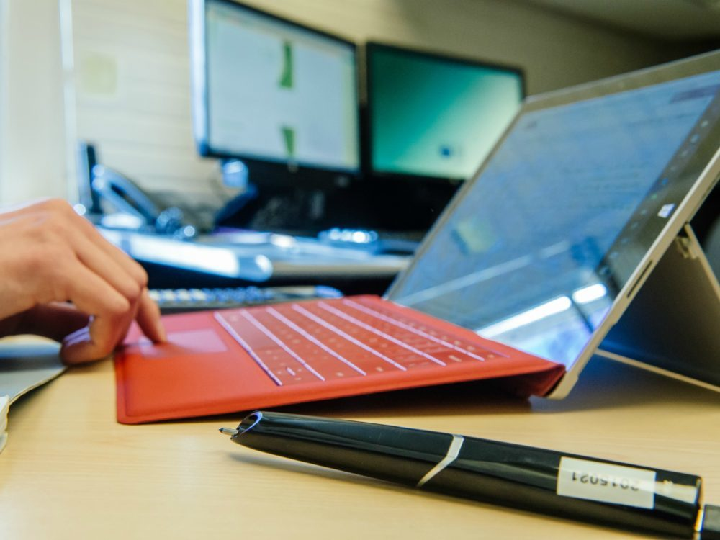
Documentation
ATRC database
Referrals, authorizations
Communications
Initial Meeting, Progress Notes
Loans
Outcome Measures (COPM)

Slide 14

Outcome Measures
COPM
  Pre and Post
  Importance
  Performance
  Satisfaction
Employee Feedback Survey
  Improve our services
  Justify funding
  Research data to support use of assistive technology in higher education

Slide 15

Outreach and Collaborations
HR-Benefits Fairs
ADA compliance/Office of Equal Opportunity
Ergonomic Evaluations and Resources
Center for Community Partnerships
Employee Assistance Program
Commitment to Campus
CARE Program

Slide 16

Case Studies

Slide 17

Case Study: Pat
Job Title: Assistant Dean of Business
Referral: OEO
Disability: TBI due to bike accident
Barriers: headaches, brain fog, short term memory difficulties
Job Tasks: Note-taking, writing/reading emails, writing proposals
Environment: Private office in academic building, fluorescent lighting
Equipment: MacBook Air laptop, external keyboard and mouse
Recommended AT: Built-in text to speech (Outlook Immersive Reader), built-in dictation (Microsoft Word Dictate), headset with microphone, notetaking software (Microsoft Teams Premium), lamps or light filters, task management apps (Microsoft Todo), display settings

Slide 18
Case Study: Max
Job Title: Student Healthcare Administrative Assistant
Referral: Self
Disability: ADHD, PTSD
Barriers: difficulty with focus, organization, time management
Job Tasks: scheduling, managing student workers, filing
Environment: busy shared front desk area
Equipment: HP laptop with built in trackpad
Recommended AT: Calendar with color coding and reminders, mindfulness apps, task management app, timers, Goblin Tools, OneNote

Slide 19


Questions?

Slide 20
Additional Resources
ATRC Website (atrc.colostate.edu)
Accessibility by Design Website (accessibility.colostate.edu)
ATRC Employee Services (https://www.chhs.colostate.edu/atrc/employee-services/)
Job Accommodation Network (https://askjan.org/)
Yang-Tan Institute (https://www.ilr.cornell.edu/yti)

Slide 21
Thank you!
michelle.brodsky@colostate.edu

