Slide 1

Empowering Students, Transforming Systems: A Student-Led Model for Digital Accessibility in Higher Education
Carey Applegate, PhD, CPACC

Slide 2

Institutional Context
Mid-sized public regional university in Illinois
Rural campus
Enrollment: 4364 (Fall 2025)
Student demographics
23% first generation
16.4% international students
44% online
56% on ground/blended
60% full-time

Slide 3
Digital Accessibility Remediation Team (DART): who we are
Student accessibility team
Focus since 2017: remediating digital content for courses and administrative units
Faculty- and staff-facing
“Grow your own” model
2025: 70+ team members w/ a wide variety of majors
Hourly undergraduate and graduate students
Roughly 85% international students & 90% graduate students
1 graduate assistant
Post-graduation opportunities
Funding source: a portion of student fees

Slide 4
DART: what we value (1)
ODA’s Guiding principles:
Digital accessibility is a civil right.
Digital accessibility must be proactive.
Digital accessibility teams must live by their values.

Slide 5
DART: what we value (2)
Proactive accessibility
Universal Design for Learning
Remote, hybrid, on-the-ground
Flexible DART space(s) and resources
Training approaches
Distributed leadership
ODA leadership team
Digital Accessibility Leadership Team and working groups
DART differentiation of roles
Ethical accountability
Long-term commitment
Spot-checking systems
Trusted testers, including people w/disabilities
“kind and direct”
proactive accessibility
ethical accountability
distributed leadership

Slide 6
Ethical accountability: collaborating with campus
Long-term commitment
Spot-checking systems
“Kind and direct”
Campus collaborations
DART project manager
Embedded DART pro
Assess readiness/inventory
Microtrainings
Resources
Dig Acc processes
Web content
Apps and software
Online course content
Doc archives
Admin docs

Slide 7

Proactive accessibility: engaging students from the jump
Recruit and pay students instead of hiring remediation contractors
Train UIS students with valuable market skills
Designed to appeal to student groups that often have difficulty finding work: disabled students, student athletes, international students
Build on students’ strengths and interests
Pay according to role and skills

Slide 8

Distributed leadership: structuring our team(s)
Differentiation of roles on team
ODA leadership team
Campus-wide Digital Accessibility Leadership Team and working groups
Coursework
Training

Slide 9
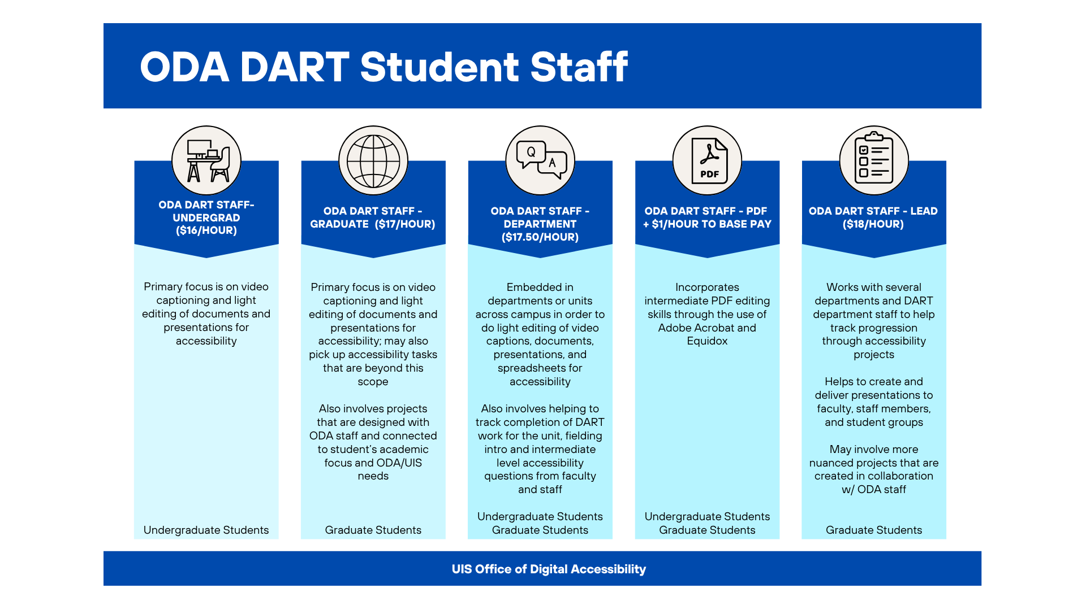
Distributed leadership: team roles

Slide 10
Distributed leadership: team structure
DART Coordinator
Specialty Teams
Quality Assurance
Web & Digital Strategy
Online Courses
Multimedia
PDFs/MS Office
Department Outreach Teams
Green
Orange
Black
White
Brown
ODA Leadership

Slide 11
Day-to-Day DART
In-person hours
Digital sign in/sign out system
5-10 hours/week
DART Office
Remote hours
Processes
Document Queue & Box Folders
Video Queue & Kaltura
Project & Team Queues (ex: library, sprints, COLRS, etc.)

Slide 12
What Are Department “Sprints”?
Holistic, wraparound services to help departments become accessible before April 24, 2026 Title II deadline
Trainings and workshops
Consultations, one-on-one coaching
Digital accessibility remediation and project management
Embedded DART staff to help remediate documents, videos, websites
Software/app/third-party content VPAT reviews
Accessibility resources
Sustainability planning
For academic units: collaborative course reviews for accessibility

Slide 13
Department Outreach Staff
Kickoff meeting, midpoint check-in, final meeting with department reps
Point of Contact for departments to answer questions
Some departments may request on-site hours
Assisting with training for departments on request
Pulling content from courses and/or websites
Remediating content in microteam folders
Each team will have their own microteam sheet/queue and Box folder
Day-to-day work: Team Project Management Sheet/Queue
Box folder: Sprint Folders, then by microteam
Return content back to courses and/or websites

Slide 14
Questions & Discussion

