Slide 1
Accessibility testing for everyone - Getting started
November 18, 2025
Becky Gibson & Bruno Torquato

Slide 2


Who we are
Becky Gibson
Bruno Torquato
Lead Accessibility Specialist
Becky.Gibson@ukg.com
becky@weba11y.com
Senior Accessibility Specialist
Bruno.Torquato@ukg.com
BrunoLovesAccessibility@gmail.com

Slide 3

Agenda
Why should I test?
WCAG brief overview
Automated testing
Manual testing
Alternative text
Keyboard & focus
Zoom, reflow, & text spacing
Heading structure
Color vision
Media & moving content
Recording your findings
Screen readers

Slide 4
Why should I test?

Slide 5

Raise Awareness
Image by Gordon Johnson from Pixabay

Slide 6
The WebAIM Million 2025
“Across the one million home pages, 50,960,288 distinct accessibility errors were detected—an average of 51 errors per page.”
The number of detected errors decreased 10.3% since the 2024 analysis which found 56.8 errors/page.
Detected via WebAIM WAVE tool (web accessibility evaluation tool)
WebAIM Million results

Slide 7

Create Understanding
You don’t know what you don’t know
Give people an ‘Aha’ moment
Enlist accessibility allies
Image by Mohamed Hassan from Pixabay

Slide 8
WCAG Overview

Slide 9
W.C.A.G.
Web Content Accessibility Guidelines
De-facto standard for digital accessibility throughout the world
Created by World Wide Web Consortium (W3C)
Current version is WCAG 2.2 published in October 2023
Used by businesses, governments, and public entities

Slide 10


WCAG 2.2 Structure
4 Principles
13 Guidelines
86 Success Criteria
4 Principles
13 Guidelines
WCAG 2.2
86 Success Criteria

Slide 11
WCAG 2.2 Structure Diagram
4
Principles
13
Guidelines
85
Success Criteria
WCAG
U
R
O
P

Slide 12

Four Principles of Accessibility - POUR
Perceivable
Operable
Understandable
Robust

Slide 13

1. Perceivable
Users must be able to perceive the site in some way using one or more senses. 4 Guidelines:
Text Alternatives 1 success criterion
Time-based Media 9 success criteria
Adaptable 6 success criteria
Distinguishable 13 success criteria

Slide 14
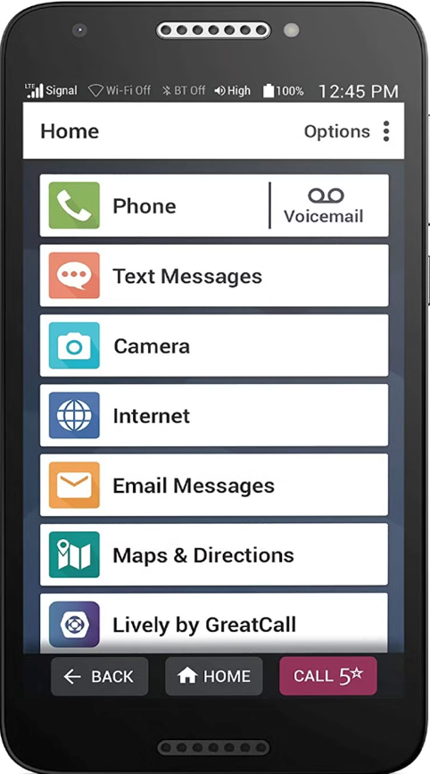
2. Operable
Users must be able to control and navigate interactive elements. 5 Guidelines:
Keyboard accessible 4 success criteria
Enough Time 6 success criteria
Seizures & Physical Reactions 3 success criteria
Navigable 13 success criteria
Input Modalities 8 success criteria

Slide 15

3. Understandable
Users must be able to control and navigate interactive elements. 3 Guidelines:
Readable 6 success criteria
Predictable 6 success criteria
Input Assistance 9 success criteria

Slide 16

4. Robust
Content must be robust enough that it can be interpreted by a wide variety of browsers and assistive technologies now and into the future. 1 Guideline:
Compatible 3 success criteria

Slide 17

Success Criteria
Are testable statements
Address various accessibility needs
Vision / Color
Auditory
Mobility
Cognitive
Specification provides documentation for each
Understanding
How to Meet

Slide 18
3 Levels of Accessibility Support & # of Success Criteria
AAA
(good to have)
31​
AA
(must have)
24
A
(minimum)
31
Most software vendors target Level AA

Slide 19
Targeting level AA means supporting both levels A and AA
AA
(must have)
+
24
= 55 total criteria
A
(minimum)
31

Slide 20
Automated Testing

Slide 21

Automated testing, at a glance
Uses software tools to detect issues in UI, rather than manually using the UI to find those issues
Why use it?
Detects issues early: They're easier and cheaper to fix than if they're discovered later (e.g. during customer escalations)
Very fast: Tests can be run quickly across a lot of code
Eliminate some of the most common issues: Low-hanging fruit like missing alt attributes are reliably found
Empowers engineers: Frees up engineers to focus on more nuanced issues
Notes:
Axe from Deque is the industry standard for accessibility testing
Two products we recommend for testing: axe-core and axe Devtools
Axe DevTools is a free Chrome browser extension that is system agnostic
You can find it in the chrome webstore and I will share a link to it w this powerpoint
Once it’s installed, you can access it from the inspector panel
Axe-core is the accessibility testing API
Axe-core is open source
Available on github
Axe-core and axe devtools test the product against the same rules
60 rules cover WCAG 2.1 AA
28 best practice rules: Rules that do not necessarily conform to WCAG success criterion but are industry accepted practices that improve the user experience
7 experimental rules (disabled by default)
The benefit of using axe-core is that specific rules can be disabled.
This is especially useful for rules around color contrast

Slide 22

Recommended automated testing tools: axe-core & axe DevTools
Deque’s axe is the industry standard. Both versions are free
axe-core
Open source testing API for engineers
Available as Github project: axe-core
Set up as a part of the build process
axe DevTools
Free browser extension for anyone
Has paid features that you don't have to use
Available in Chrome, Firefox, & Edge
Runs from the browser inspector
Notes:
Axe from Deque is the industry standard for accessibility testing
Two products we recommend for testing: axe-core and axe Devtools
Axe DevTools is a free Chrome browser extension that is system agnostic
You can find it in the chrome webstore and I will share a link to it w this powerpoint
Once it’s installed, you can access it from the inspector panel
Axe-core is the accessibility testing API
Axe-core is open source
Available on github
Axe-core and axe devtools test the product against the same rules
60 rules cover WCAG 2.1 AA
28 best practice rules: Rules that do not necessarily conform to WCAG success criterion but are industry accepted practices that improve the user experience
7 experimental rules (disabled by default)
The benefit of using axe-core is that specific rules can be disabled.
This is especially useful for rules around color contrast

Slide 23
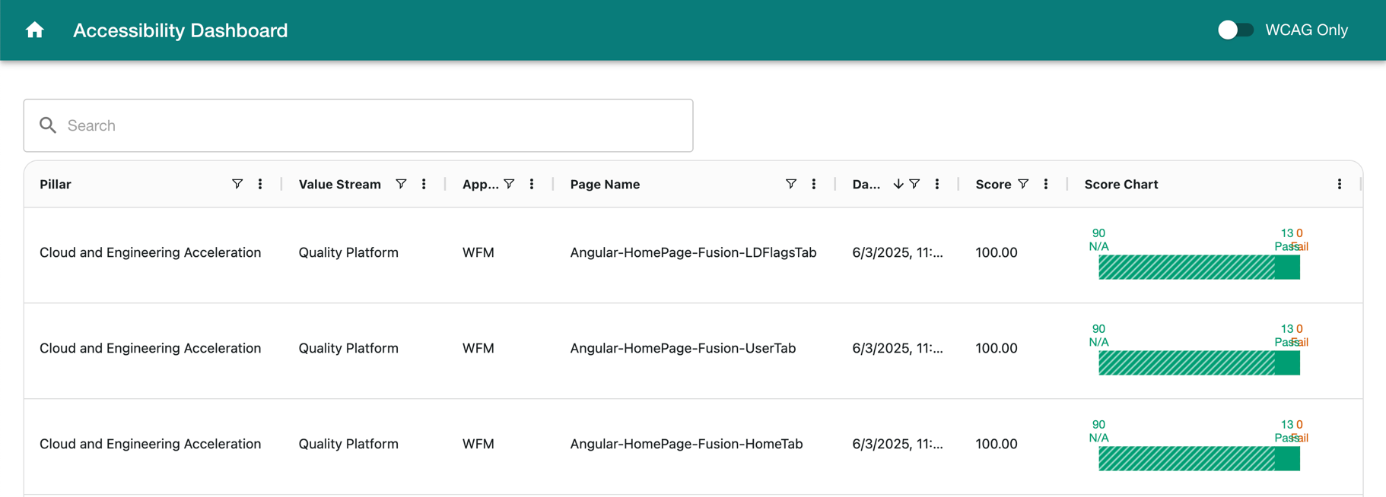
Benefits of axe-core automated testing
Can run automatically every time engineers build, no extra steps once it’s set up
Can feed into a Dashboard and generate reports for monitoring and tracking over time
Notes:
Axe from Deque is the industry standard for accessibility testing
Two products we recommend for testing: axe-core and axe Devtools
Axe DevTools is a free Chrome browser extension that is system agnostic
You can find it in the chrome webstore and I will share a link to it w this powerpoint
Once it’s installed, you can access it from the inspector panel
Axe-core is the accessibility testing API
Axe-core is open source
Available on github
Axe-core and axe devtools test the product against the same rules
60 rules cover WCAG 2.1 AA
28 best practice rules: Rules that do not necessarily conform to WCAG success criterion but are industry accepted practices that improve the user experience
7 experimental rules (disabled by default)
The benefit of using axe-core is that specific rules can be disabled.
This is especially useful for rules around color contrast

Slide 24
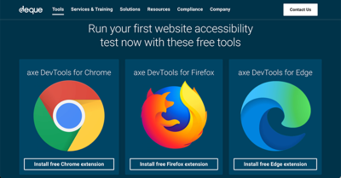

axe DevTools: How to install and use
To install:
See the axe web page for installation links to each browser’s extension
To use:
Inspect your web page (Developer mode)
Navigate to the axe DevTools Tab
Click on “Full Page Scan”
Make sure to use this option!
Other options require a subscription

Slide 25
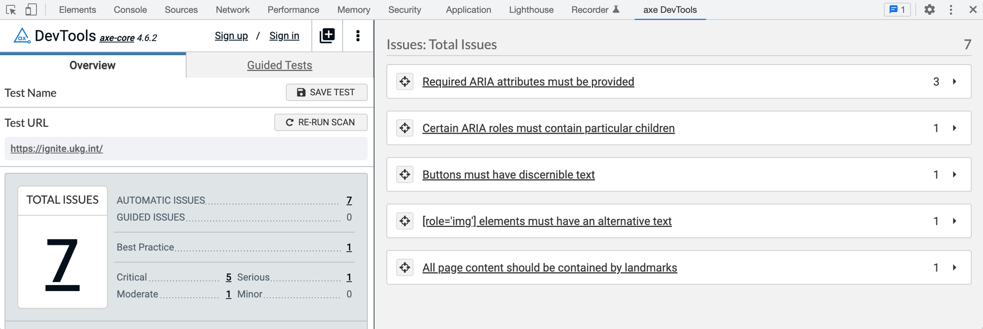
axe DevTools: Understanding Results

Slide 26
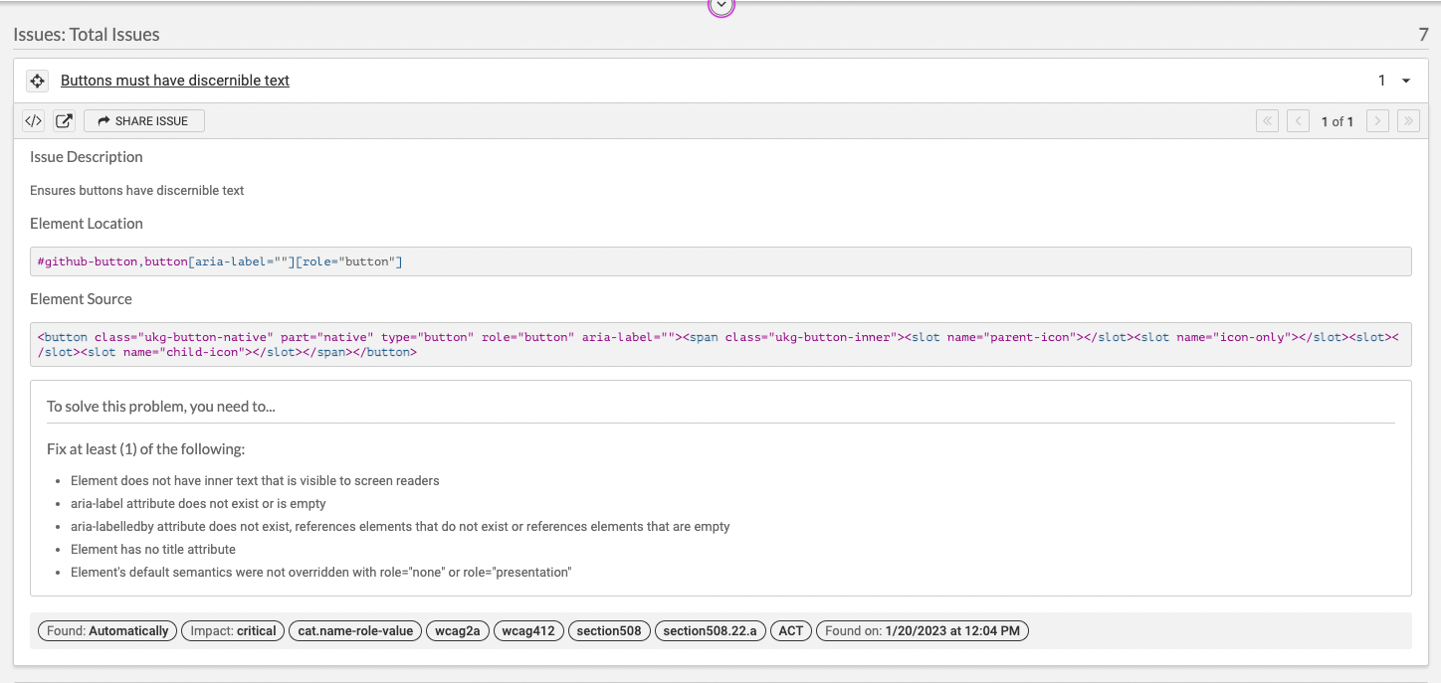
axe DevTools: Understanding Results 2

Slide 27
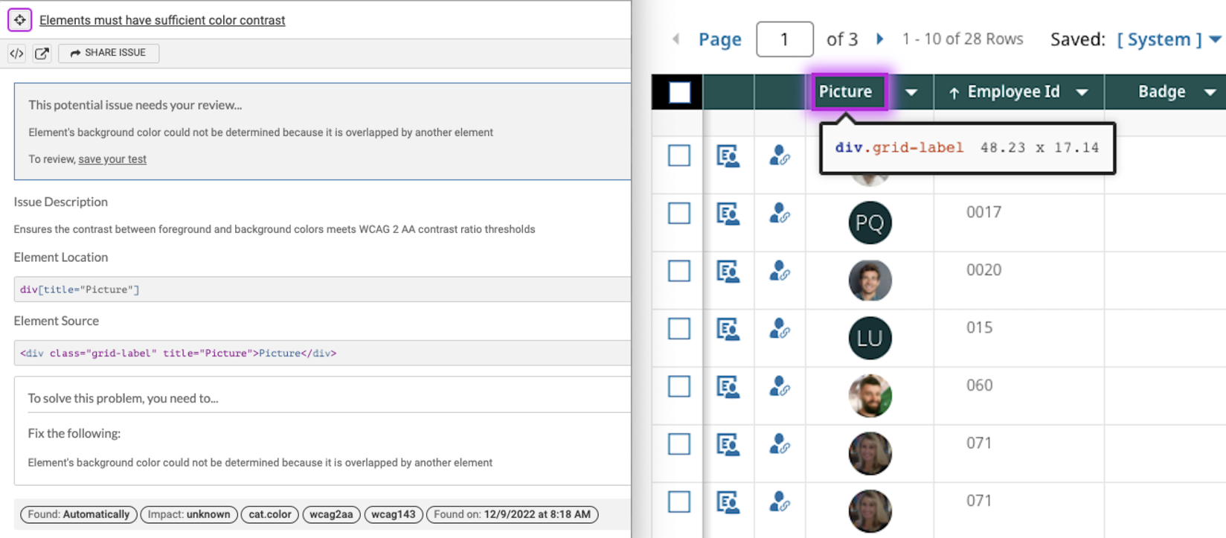
axe DevTools: Color contrast “Potential issue”
Notes:
Automated testing tools cannot always determine color contrast, specifically when there are overlapping elements
If we were to take the results from a browser scan without reviewing them,

Slide 28
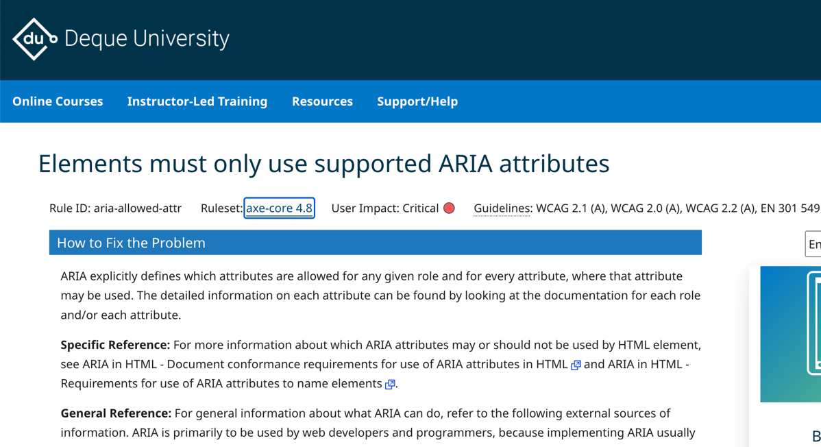
Deque University Resources
Axe DevTools provides links to Deque University, where you can learn more about each specific issue it found.
Notes:
Automated testing tools cannot always determine color contrast, specifically when there are overlapping elements
If we were to take the results from a browser scan without reviewing them,

Slide 29
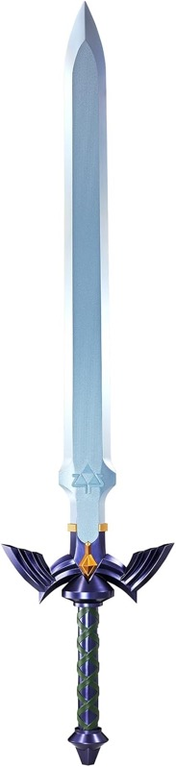
Automated Testing is a double-edged sword
Pros
Low effort
High speed
Low cost (free)
Can find up to 40% of issues
Cons
Not very smart (yet)
Not context-aware
Occasional “false positives”
Misses at least 60% of issues
Make sure to supplement it with manual testing

Slide 30
Try it yourself

Slide 31
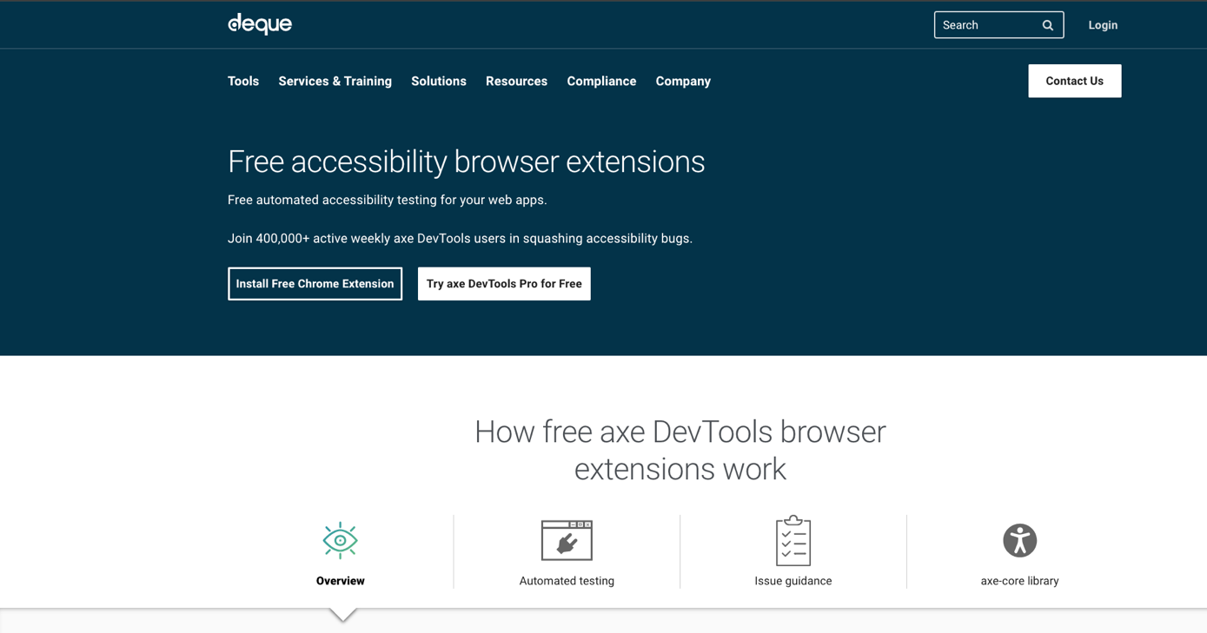
Install the Axe extension
https://www.deque.com/axe/browser-extensions/

Slide 32
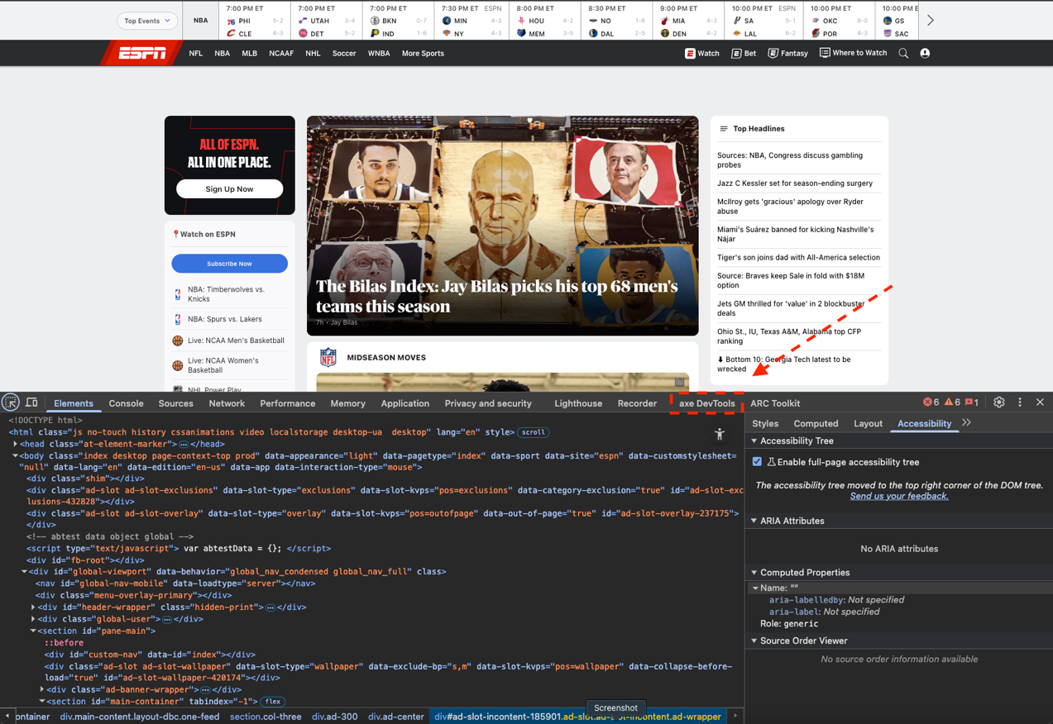
Navigate to espn.com
Select three dot menu in upper right
More tools > developer tools
OR right click on page and select inspect

Slide 33
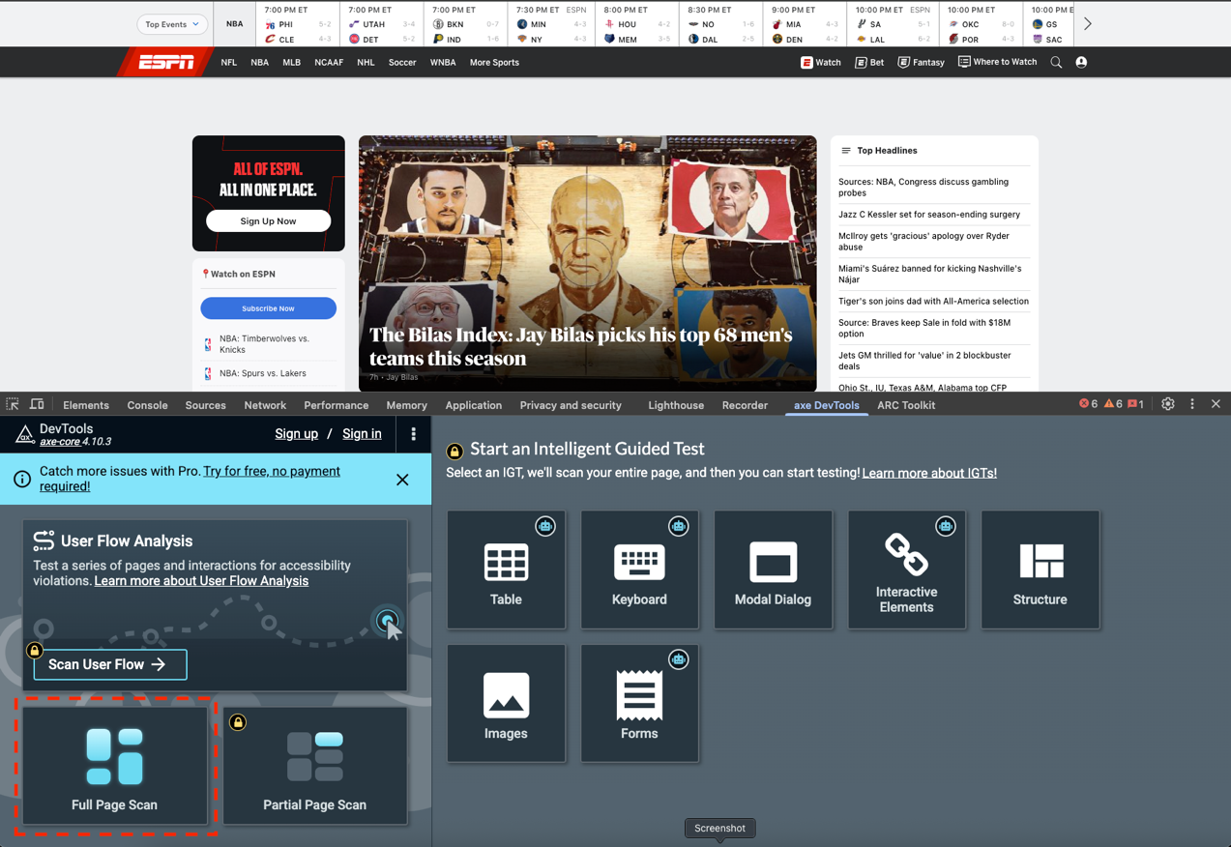
Start full page scan
You may have to scroll down to see that option

Slide 34
Live demo
Notes:
Talk through various issues

Slide 35
Manual Testing

Slide 36

Manual Testing
Manual testing validates the WCAG criteria that cannot be tested by automation.
Alternative Text
Keyboard
Browser Zoom & Reflow
Text Spacing
Color Contrast
Color Alone
Media
Notes:
The second approach to accessibility testing is Manual Testing.
The largest component of manual testing is keyboard testing.
Manual testing confirms that the product can be used by people with disabilities like limited mobility; color blindness; is a way to confirm that the product is usable When manual testing, you are confirming that the product can be

Slide 37
Alternative Text

Slide 38
Images may need alternative text
Alternative text is important for
Screen readers
Images turned off / low band width
Automated tests check for the presence of alternative text, but can’t verify it is correct
Images that convey meaning need alternative text
Images that are just decorative, must be ignored

Slide 39

Images and alt attribute
Today’s weather:
If an image conveys meaning, the alt attribute must exist and have a descriptive value.
<p>Today’s weather: <img src=”sun.png” alt=“sunny”></p>
<p>Today’s weather: <img src=”sun.png” alt=“sunny”></p>

Slide 40
Decorative Images and alt attribute
Today’s weather:
SUNNY!
If an image is decorative the alt attribute must exist and be empty.
<p>Today’s weather: SUNNY! <img src=”sun.png” alt></p>
Can also us alt=“”
<p>Today’s weather: <img src=”sun.png” alt=“sunny”></p>

Slide 41
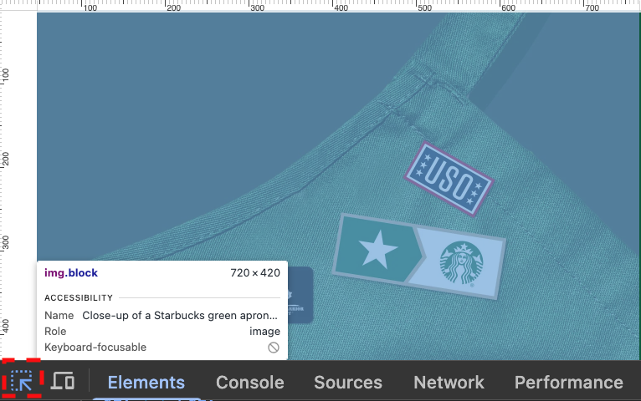
Checking alt text for image elements
Use axe
Identifies img elements with no alt attribute
Use inspect
Select and element to inspect (upper left corner)
Hover over an image and view information
Use a bookmarklet
SVGs will be encountered and tested during screen reader testing

Slide 42
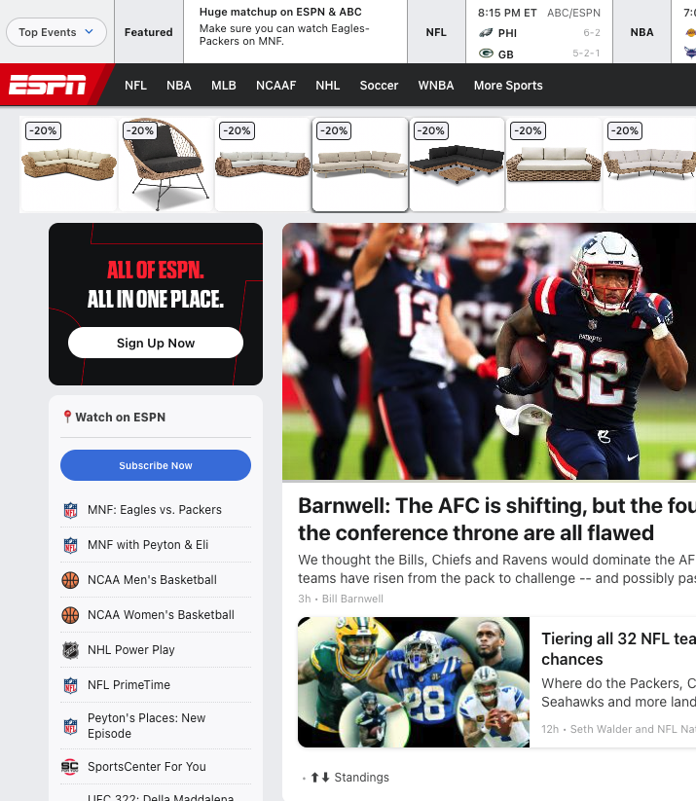
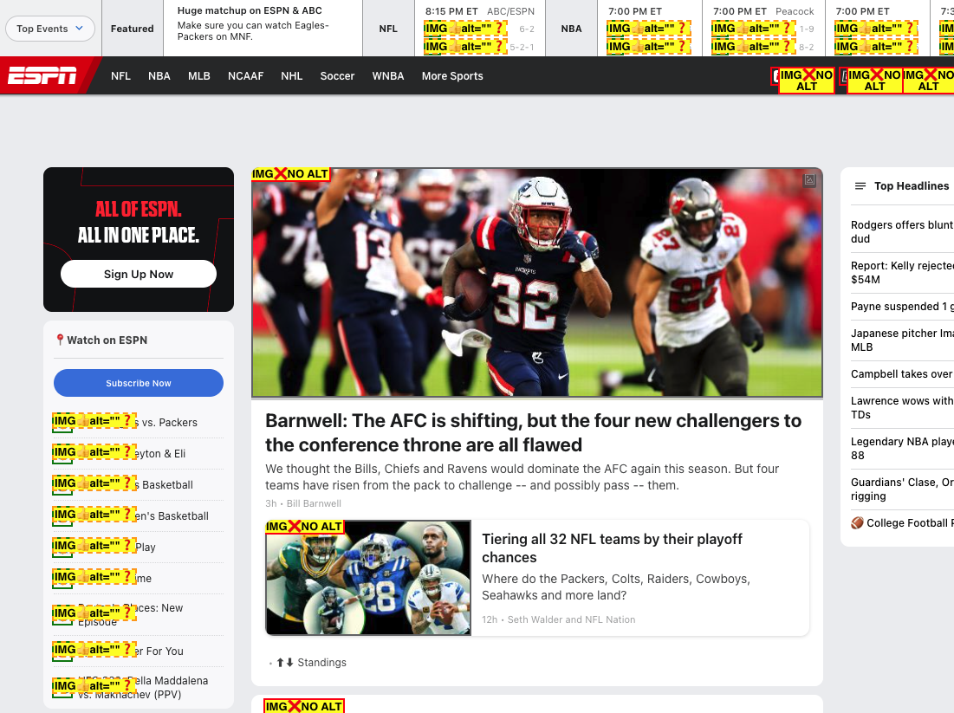
Bookmarklet example

Slide 43
Keyboard Testing (No special tools needed)

Slide 44
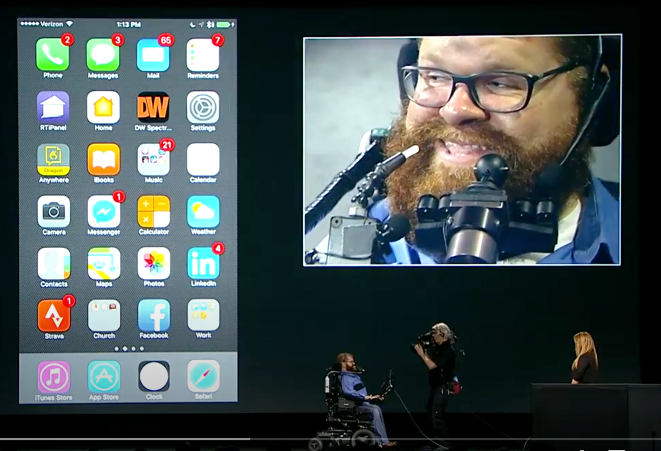
Not everyone uses a mouse
Apple Switch Control Video

Slide 45
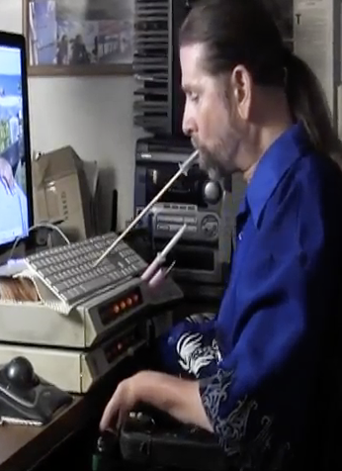
WCAG criteria you can test with a keyboard
2.1.1 Keyboard
Standard keyboard commands
Dialog focus trap
Popup dismissal
2.1.1 No Keyboard Trap
2.4.1 Bypass Blocks (skip link)
2.4.3 Focus Order
2.4.7 Focus Visible
2.4.11 Focus Not Obscured (minimum)

Slide 46

Manual Testing: Keyboard Checks 1
Ensure all content is operable using only the keyboard, no cheating with the mouse or touch:
Navigate to all actionable elements
Non-actionable elements are not navigable by keyboard
Navigation order is logical, meaning it follows natural reading order: Left to right, top to bottom
Top level navigation elements can be skipped from the top of the screen
Notes:
All interactive elements are focusable
There is a clear focus indicator on all active elements
Elements are operable using standard keyboard commands
Focus can move into and out of elements (not trapped)
Elements appear in a logical navigation order
Focusing on an element does not trigger any context change (like opening a new page)

Slide 47

Manual Testing: Keyboard Checks 2
Interactive elements have visible focus indicators with good contrast
All scrolling areas can be scrolled by a keyboard
All interactive elements can be interacted with
Components use standard keyboard commands (see W3C Patterns for expected commands)
Notes:
All interactive elements are focusable
There is a clear focus indicator on all active elements
Elements are operable using standard keyboard commands
Focus can move into and out of elements (not trapped)
Elements appear in a logical navigation order
Focusing on an element does not trigger any context change (like opening a new page)

Slide 48
Manual Testing: Keyboard
Components must be operable using standard keyboard commands
Keyboard Command | Action
Tab | Navigates to next focusable element
Shift + Tab | Navigates to prior focusable element
Enter | Activates element in focus (link, button, dropdown menu option)
Spacebar | Activates element in focus (button, checkbox)
Escape | Closes/collapses dialogs, menus, dropdowns
Arrow Keys | Navigates specific element options (radio buttons, dropdown menus, menu bars, tab panels)
Notes:
Ensure all content is operable using only the keyboard
Content should also follow standard keyboard interaction patterns (meaning semantic buttons are operable using both the spacebar and the enter key)
For more complex components, reference the W3C’s ARIA Authoring Practices Guide for expected interactions

Slide 49
Keyboard & Focus Demo

Slide 50
Keyboard & Focus Examples
Disclaimer: These examples are not meant to shame these companies. They are offered as examples of common accessibility problems you can find and report.

Slide 51

Missing Visible Focus
Article.com
Polyandbark.com
MaryKay
Image by Z RAINEY from Pixabay.
Notes:
MaryKay has focus, it is just hard to see.

Slide 52
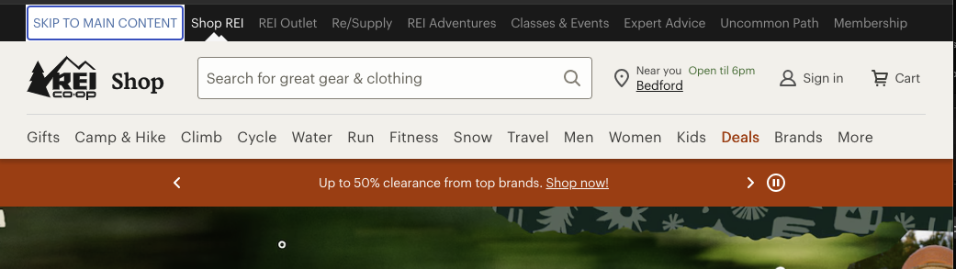
Missing or Broken Skip Link
King Arthur Baking
Sephora
ESPN
Notes:
King Arthur baking - skip to main, when invoke via space (which is wrong for a link) scrolls page but doesn’t move focus; It looks to be coded correctly;
Sephora. - no skip to main link at all

Slide 53
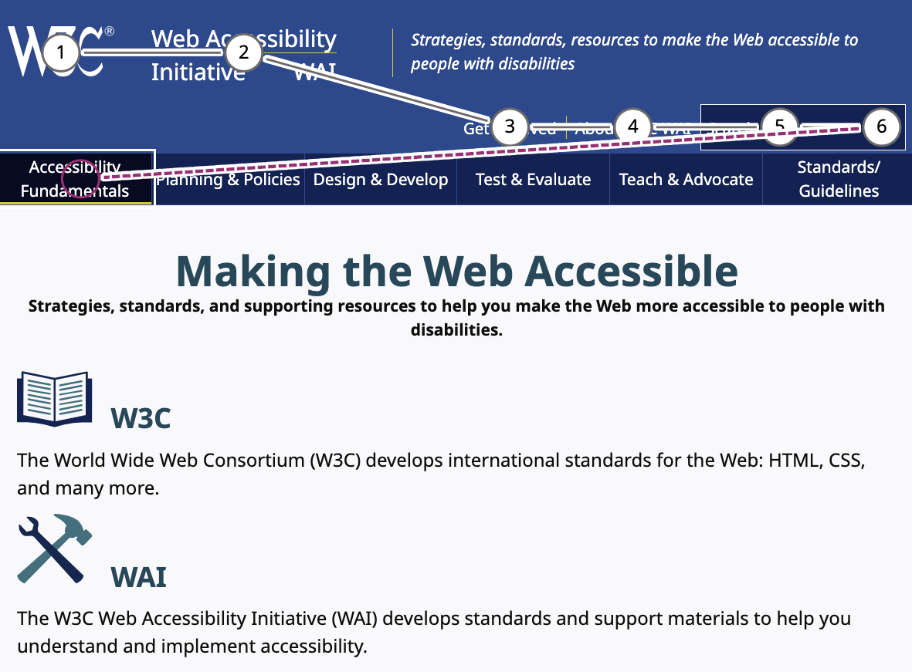
Focus Order
Tiki Pets
Can use MS Accessibility Insights Tab order to record focus order.
Notes:
Tiki pets, first tab stop takes you to bottom of the page for email address. Next page takes you back up, skip to main is like King Arthur, scrolls the page but doesn’t move focus.

Slide 54

Missing Keyboard Support
See’s Candies
Notes:
See’s – can’t build a box,

Slide 55

Focus Obscured
Food52
Image by Alex from Pixabay
Notes:
Food25 – Once tab into search field, popup opens, can’t get rid of it by tabbing up or pressing escape. Have to tab out of it, then to menu, focus will go behind the menu.

Slide 56

Popups & Dialogs
Drgabriellelyon
Cookie acceptance popups
Image by digital designer from Pixabay
Notes:
Drgabrielllyon – can’t get keyboard focus into the dialog to dismiss, doesn’t dismiss with escape, if set focus via mouse, doesn’t trap keyboard focus

Slide 57
Zoom and Reflow Testing (No special tools needed)

Slide 58
Manual Testing: Zoom & Reflow
Test zoom and reflow to confirm product meets WCAG 1.4.4 (AA) and 1.4.10 (AA).
These are not just the “mobile” versions!
At 200% zoom (640 x 512 px) and
at 400% zoom (320 x 256 px), confirm that:
Text is larger
No content or functionality is missing
Wide, or multi column layouts collapse into one column
Horizontal scrolling is not required*
Starting Viewport:
1280px wide
1024px high
Browser zoom controls:
Mac: Command +/-
PC: Control +/-
*There are some exceptions to the scrolling requirement, such as tables and diagrams
Notes:
Specifically address WCAG 1.4.4 – Resize Text (AA) and 1.4.10 – Reflow (AA)
400% zoom when viewport is 1280px wide and 1024px high is equivalent to 320px width and 256px height

Slide 59
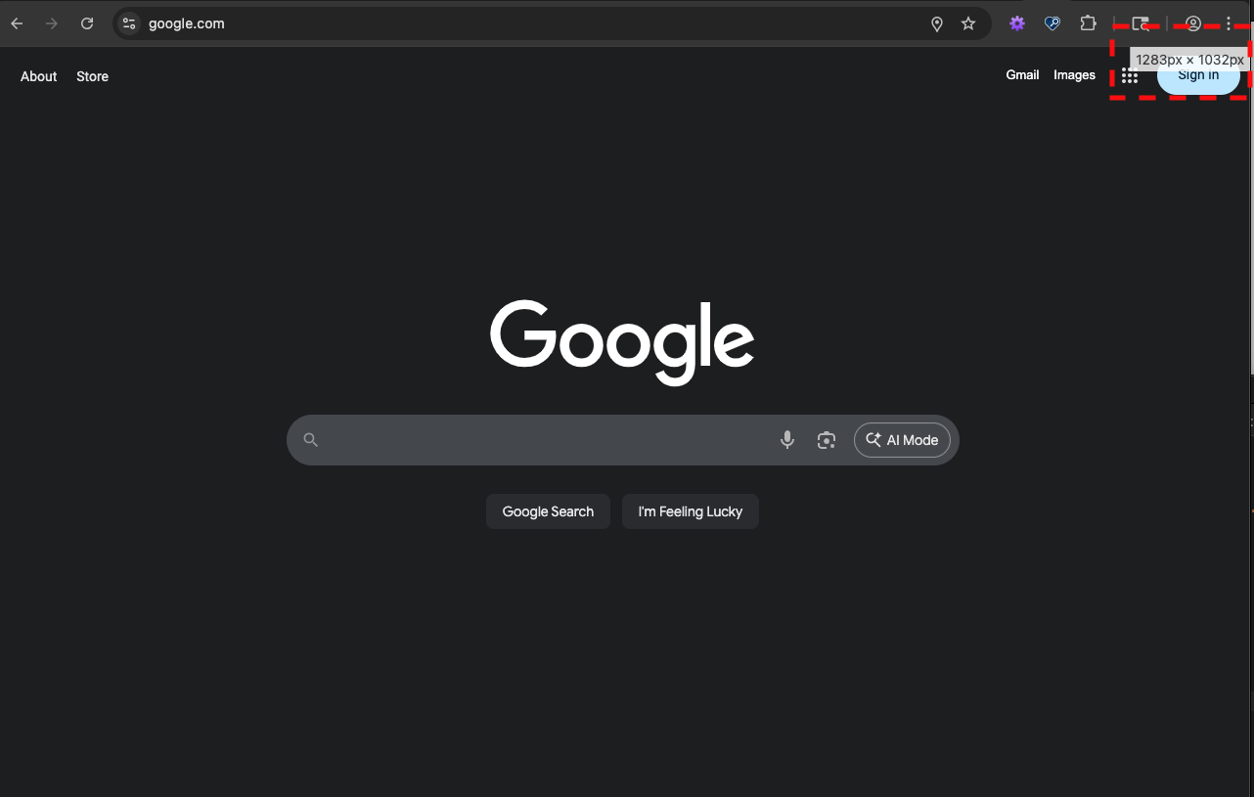
Testing Zoom
Open Chrome/Firefox inspect
Set the inspect tools into a separate window
Resize the main window and note size in upper right
Starting Viewport:
1280px wide
1024px high
Browser zoom controls:
Mac: Command +/-
PC: Control +/-
Reset: control/command + 0

Slide 60
Zoom and Reflow Demo
Notes:
Use avon.com

Slide 61

Text Sizing & Reflow
Partylite
Image by Adina Voicu from Pixabay
Notes:
Partylite – when zoom or resize the browser there are sticky headings

Slide 62
Text Spacing Testing

Slide 63


Manual Testing: Text Spacing
Test text spacing to confirm product meets WCAG 1.4.12 (AA)
Change text styles:
Line height (line spacing) to at least 1.5 times the font size
Spacing following paragraphs to at least 2 times the font size
Letter spacing (tracking) to at least 0.12 times the font size
Word spacing to at least 0.16 times the font size
UK Dept. of Education Bookmarklet sets these all for you, thankfully!
Confirm the following:
All content and functionality remain the same
No instances of overlapping text
Vertical and horizontal texts are not cut off
Notes:
Text spacing is criteria 1.4.12 (AA) in WCAG
It is a confirmation that when the text styles are changed, the content and functionality remain the same
Text styling can be changed either through manual CSS manipulation or using a bookmarklet

Slide 64
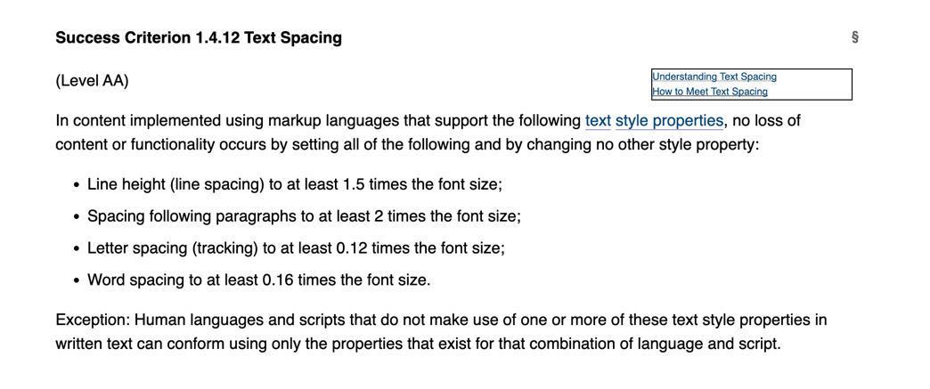
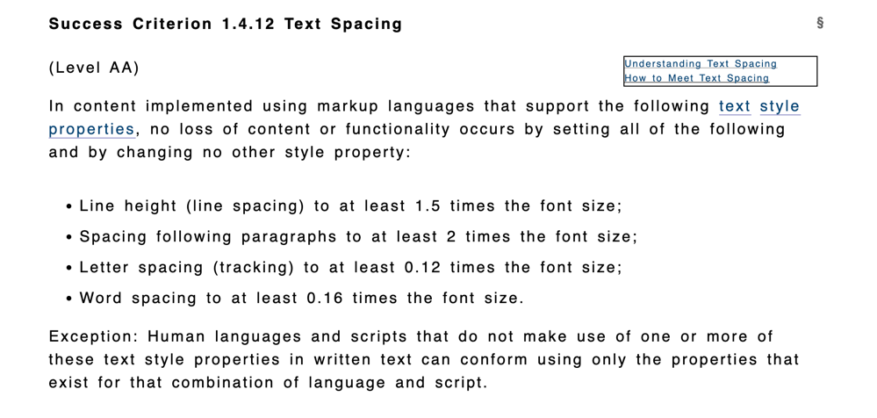
Manual Testing: Text Spacing Example
Before:
After:

Slide 65
Text Spacing Demo
Notes:
Use espn.com

Slide 66
Heading Structure Testing

Slide 67
Manual Testing: Heading Structure
Headings should be nested to show the hierarchy of the information on the page.
The styling of the headings does not always correspond to their hierarchy – the heading level can be separated from the styling so that the nesting is correct.
Tools:
Headings Bookmarklet (Paul J Adam)
h123
H1 – Pay Details
H2 – Pay Summary
H2 – Pay Breakdown
H3 – Earnings
H3 – Deductions
H3 – Taxes
H4 – State
H4 - Federal
Notes:
CNN – just uses H2
Purina.com – good structure but discuss the H1 – does it make sense?
Bbc.com – multiple h1s

Slide 68
Heading Structure Demo

Slide 69
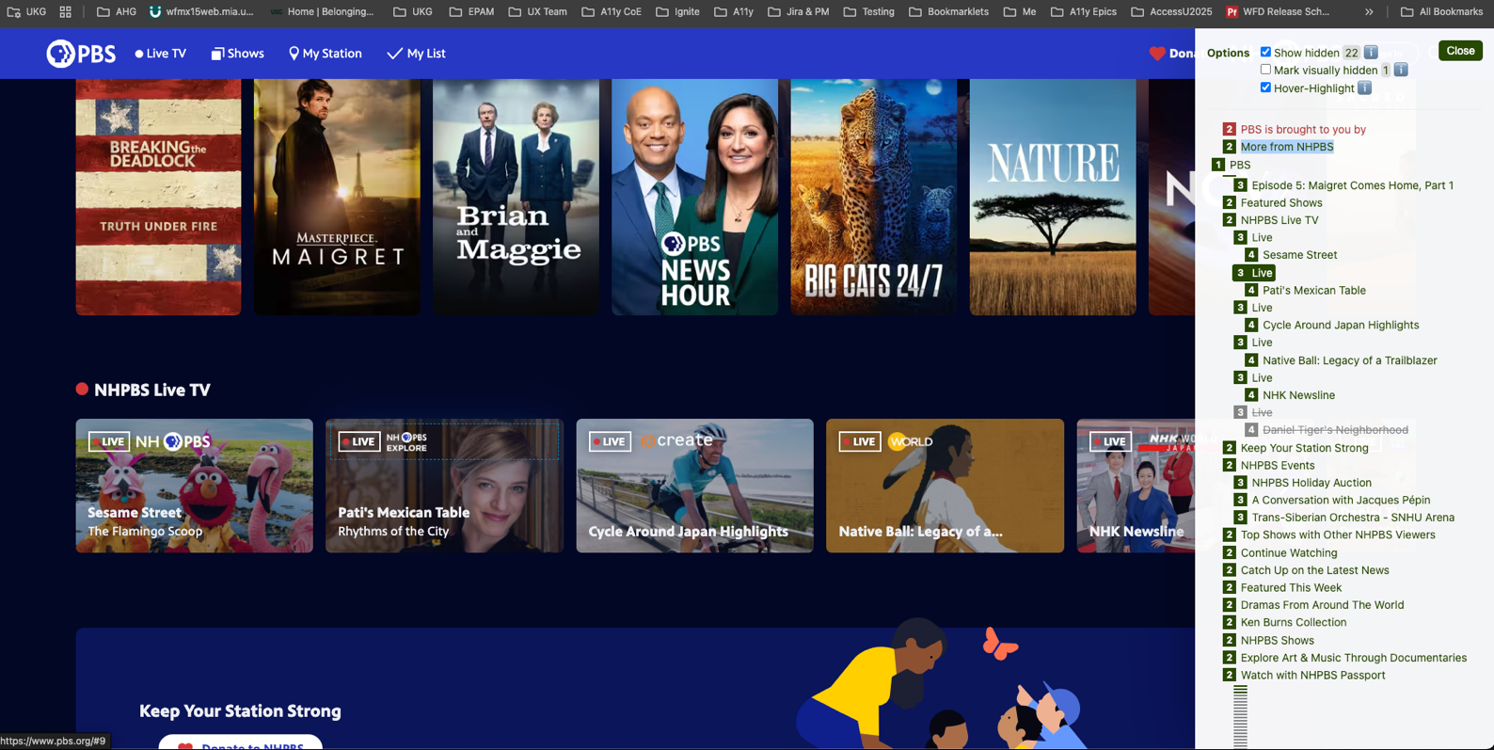
H123 Example
Notes:
Pbs.org– some hidden headings; No need for each Live in middle section to be headings. Discuss that should not use headings for just styling.

Slide 70
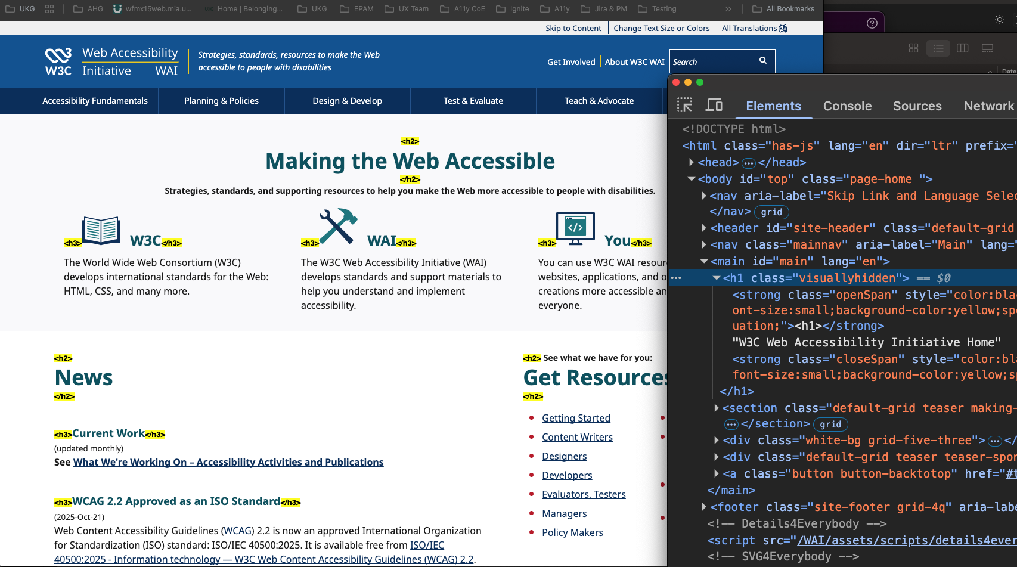
Headings Bookmarklet Example
Notes:
Gives and inline visual representation
W3c.org/wai – no visual H1??

Slide 71
Contrast Testing

Slide 72
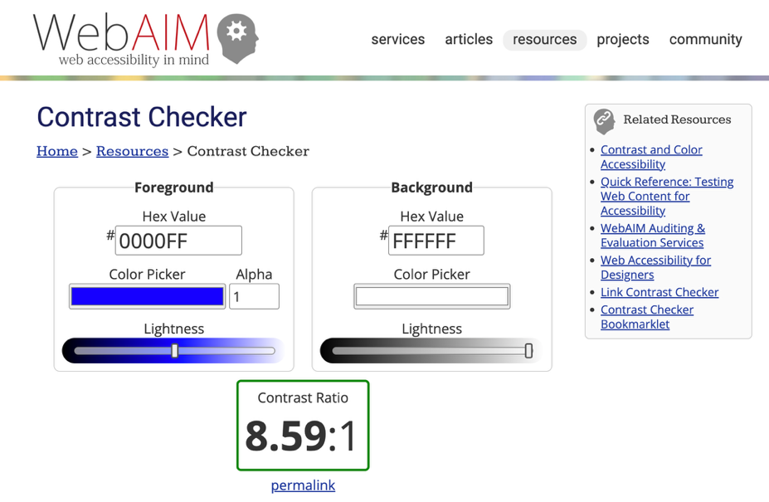
Manual Testing: Contrast
Confirm that:
Text has contrast ratio of at least 4.5:1 (for WCAG 1.4.3)
Non-decorative graphics have a contrast ratio of at least 3:1 (for WCAG 1.4.11)
Testing Tools:
axe (for text)
TPGi Color Contrast Analyzer (Win, Mac)
WebAIM Contrast Checker (Web)
Notes:
A way to test if content uses color alone to convey information
Windows: Settings > Ease of Access > Display > High Contrast
Mac: System Preferences > Accessibility > Display > Color Filters

Slide 73
Contrast Demo
Notes:
https://www.sweetpawsrescue.org/

Slide 74

Contrast
Suzanne Collins
Growth Lab

Slide 75
Use of Color Testing

Slide 76
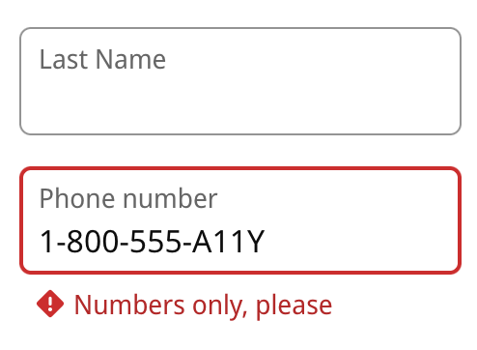
Manual Testing: Color Alone
To Satisfy WCAG 1.4.1 We need to make sure that:
Any colors that are used to convey an important meaning are reinforced by other means
E.g. red outline to show a field in error is reinforced by an icon
Testing Tools:
Color Oracle (Win, Mac, Linux)
Notes:
A way to test if content uses color alone to convey information
Windows: Settings > Ease of Access > Display > High Contrast
Mac: System Preferences > Accessibility > Display > Color Filters

Slide 77
Color & Vision

Slide 78

Color & Vision Items
1.3.3 Sensory Characteristics
1.4.1 Use of Color
1.4.4 Resize Text
1.4.5 Images of Text
1.4.10 Reflow
Text over images
These generally need a color test tool
1.4.3 Contrast (minimum)
1.4.11 Non-text contrast
Image by Clker-Free-Vector-Images from Pixabay

Slide 79
Color & Vision Examples
Disclaimer: These examples are not meant to shame these companies. They are offered as examples of common accessibility problems you can find and report.

Slide 80
Color Alone Demo

Slide 81
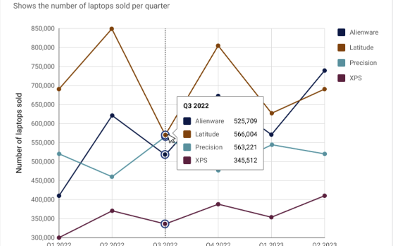
Use of Color Alone - charts
How to improve
Use different symbols for data points
Different line styles
More distinct colors
Keyboard navigation

Slide 82

Use of Color Alone
Yale School of Art
Notes:
Yale school of art – scroll down to calendar, colored bars represent the event type

Slide 83
Media

Slide 84

Media Items
1.2.1 Audio-only and Video-only (Prerecorded)
1.2.2 Captions (prerecorded)
1.2.3 Audio Description or Media Alternative (Prerecorded)
1.2.4 Captions (Live)
1.2.5 Audio Description or Media Alternative (Live)
1.4.2 Audio Control
Image by Samuel1983 from Pixabay

Slide 85
Media Examples
Disclaimer: These examples are not meant to shame these companies. They are offered as examples of common accessibility problems you can find and report.

Slide 86

Missing Transcript or Captions
Global Parts Company
Citizens LinkedIn Post
Commune
Image by Gerd Altmann from Pixabay
Notes:
Global parts company – video with no captions
Video only post with no transcript
Commune – podcast has no transcript

Slide 87
Moving Content

Slide 88

Moving Content - 2.2.2 Pause, Stop, Hide
Must be able to pause, stop, hide, or change the update frequency of:
Moving, Blinking, Scrolling
Starts automatically
Lasts for more than 5 seconds
Presented in parallel with other content
Auto-updating content
Starts Automatically
Presented in parallel with other content
Image by Eva Schmidseder from Pixabay

Slide 89
Moving Content Examples
Disclaimer: These examples are not meant to shame these companies. They are offered as examples of common accessibility problems you can find and report.

Slide 90

Examples of Moving Content
Shopbop
Function Health
Growth Lab
Fabio Formato (warning excessive movement)
Notes:
Shopbop – moving content with no way to stop. Also have to tab through ALL of the carousel items to move forward on the page. Good point about discussing carousels
Function Health – Video is moving in the backgound, can’t start it via keyboard – the player controls aren’t available to stop it until it is started. Moving banner of reviews and review sources.
Growth lab / Atlas of economic complexity – constantly moving video, graphs also move

Slide 91
Error Handling

Slide 92
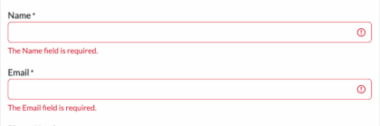
How are errors presented?
Check for use of color alone
Add “Error” or icon
Describe the error
Invalid date – Not specific
Invalid start date – better
Provide instructions to fix
Invalid start date, use mm/dd/yy
Notes:
Ask how this example could be better? Is this first name, last name, or full name? Should we include the email format (most people know it)?

Slide 93
Recording your findings
People can’t fix a problem they don’t know about

Slide 94
Keep it simple
Start with High level categorization - POUR
Non-text content – alt text
Color & Vision
Contrast, color alone, Moving, Blinking, Scrolling
Text sizing, text spacing, reflow/zoom
Multimedia captions & transcripts
Keyboard, visible focus, focus order
Moving content

Slide 95
Info to provide
Brief description
Can’t activate the submit button
Priority
P1 (see next page)
Where it occurs
Page name and/or url
Sign up for newsletter
Steps to reproduce
Enter email, tab to submit button, press enter – nothing happens
Environment & tools used
Keyboard / Chrome
Why it is a problem
User can’t submit form
Screen capture if appropriate
WCAG violation if known
2.1.1 Keyboard

Slide 96
Priority suggestions
P1 – prevents the user from completing a task
Interactive element doesn’t work with the keyboard
No visible focus
Text truncated when reflow or change text size
P2 – an issue but there is a work around
Focus not trapped within a dialog
Incorrect heading level
P3 – inconvenience
Keyboard focus on non-interactive element
Decorative images have alt text

Slide 97
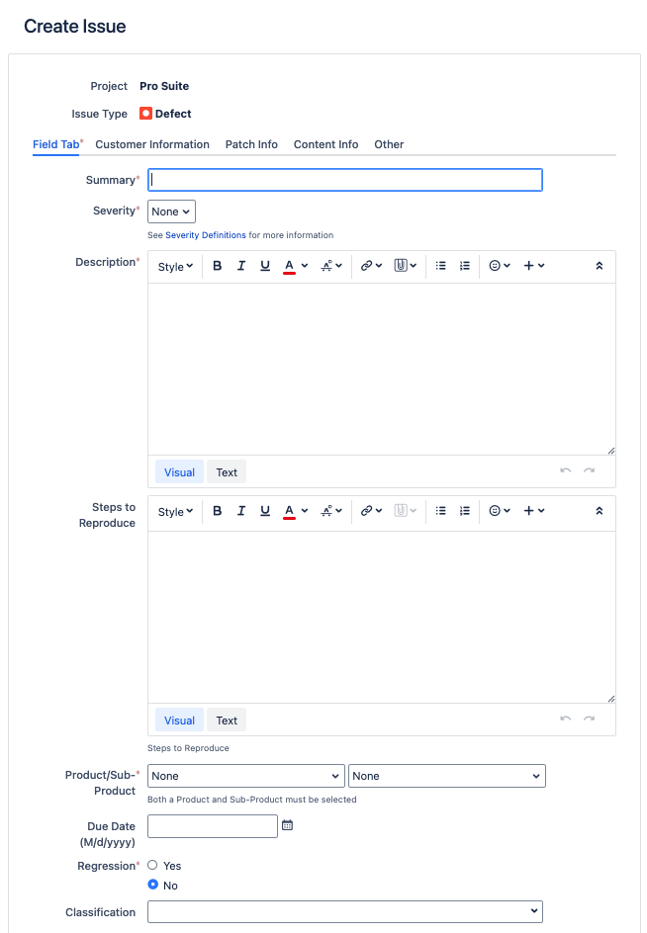
How to record
Established bug / issue tracker
Will likely dictate the information provided
Spreadsheet
Sortable
Can be tedious to work with
Word document
Not sortable

Slide 98
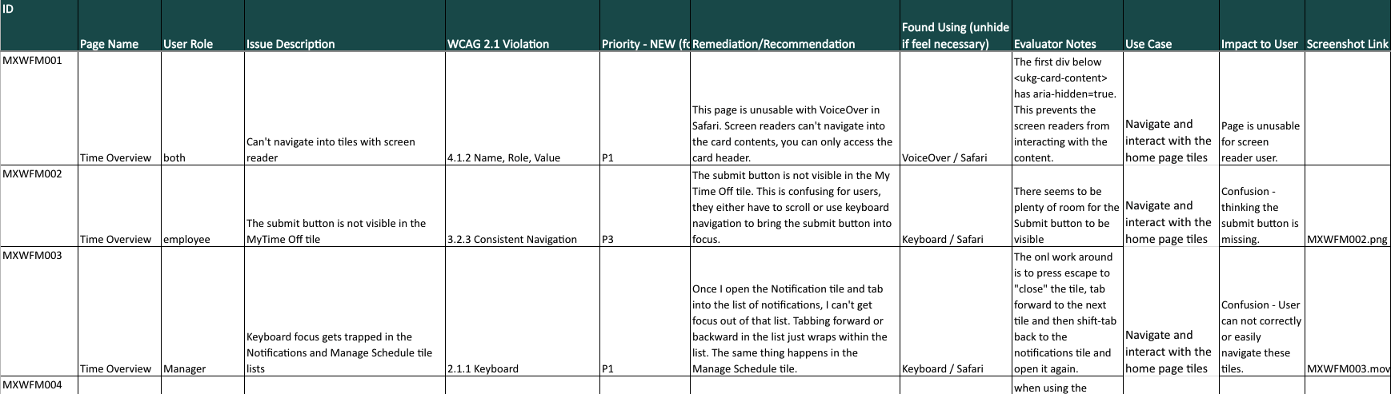
Spreadsheet example

Slide 99
Summary
Why should I test?
WCAG brief overview
Automated testing
Manual testing
Alternative text
Keyboard & focus
Zoom, reflow, & text spacing
Heading structure
Color vision
Media & moving content
Recording your findings
More to come … screen readers!

Slide 100
Questions?

