Slide 1
Accessibility testing for everyone:
Getting started with screen readers
November 18, 2025
Becky Gibson & Bruno Torquato

Slide 2
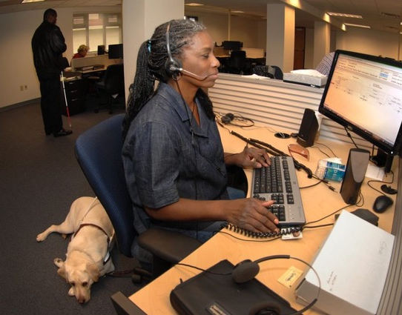
Agenda
Who uses screen readers
Screen reader browser pairings
Browse/focus mode
Basic testing techniques
JAWS
  Basic keys and navigation
  Demo
NVDA
  Basic keys and navigation
  Demo
VoiceOver
  Basic keys and navigation
  Demo
Table Navigation

Slide 3
Who uses screen readers?
People who are:
Blind
Low-vision
Process information better auditorily
People with learning disabilities
And probably more

Slide 4

Recommended screen reader & browser pairs
Screen Reader | Browser | Platform
JAWS (Job Access with Speech) | Chrome | Windows
NVDA (Non-Visual Desktop Access) | Firefox | Windows
VoiceOver | Safari | iOS and MacOS
TalkBack | Chrome | Android

Slide 5

Browse Mode
Reading a tangible book
  Reads everything on the page, including non-interactive content
  Natural reading order (left to right, top to bottom in US)
JAWS refers to this as virtual PC cursor on
NVDA refers to browse mode
VoiceOver – VO + arrow key navigation

Slide 6
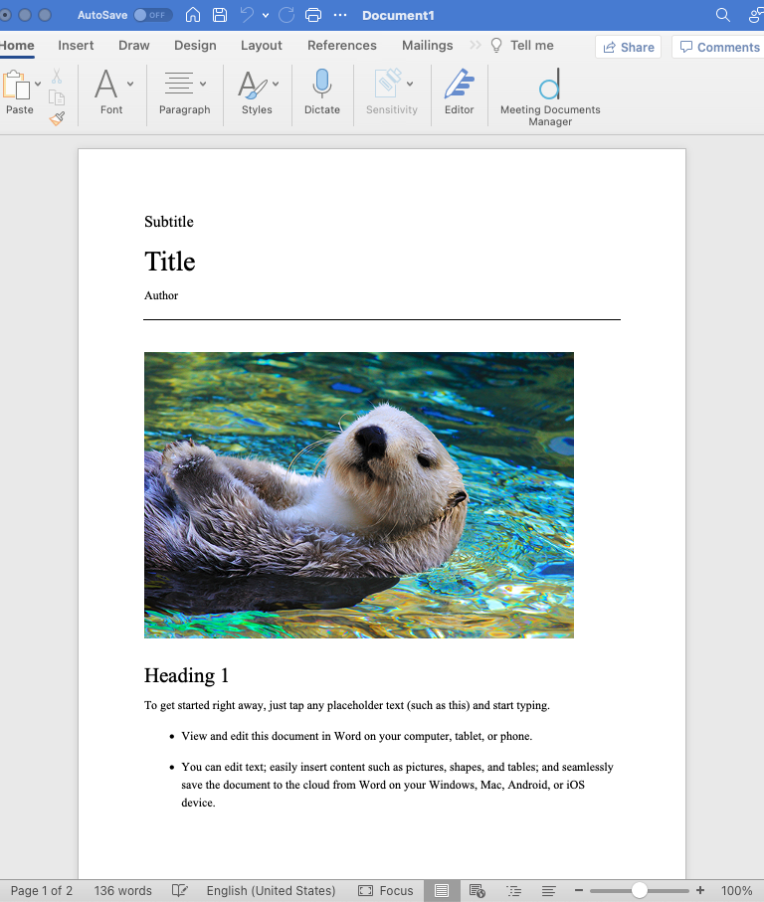
Focus/Forms Mode
Like Editing a Word Document
  Access interactive components only
  Make changes
JAWS refers to as Virtual PC cursor off
NVDA refers to a Focus mode
VoiceOver tab key navigation
Use tab/shift+tab to navigate
Non-interactive content should not be reached with the tab key

Slide 7
Basic Testing
(JAWS and NVDA only) Use browse mode and focus mode
Listen for:
  Labels are announced, unique, and correctly associated to form fields
  Correct roles for components and any children
  Dialog title is announced
    Can’t arrow out of modal dialogs in browse mode
    Keyboard focus is trapped in focus mode (you should have caught this with keyboard testing ;)
Reading order makes sense in both browse and focus modes
List headings and check hierarchy

Slide 8
Screen reader cheat sheets
Deque has screen reader guides one-page Quick Reference guides
JAWS
NVDA
VoiceOver MacOS
VoiceOver iOS
Talkback on Android

Slide 9
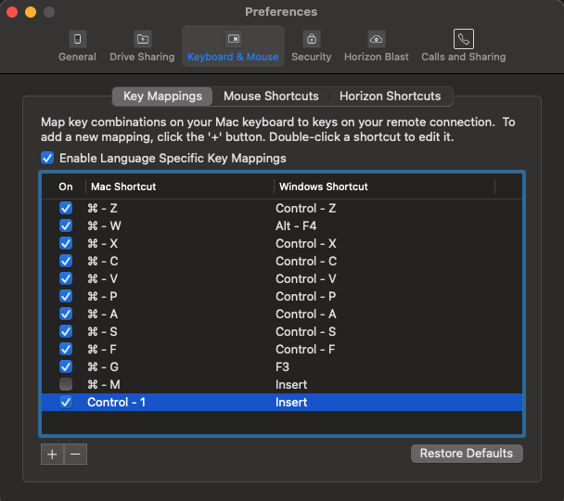
Testing JAWS & NVDA on a Mac
Use a “Virtual Machine”
  Install virtualization software, like: VMWare Fusion (free), Parallels (paid), or UTM (free)
  Download Windows 11 ISO disk image (x64)
  Create a new virtual machine and use your ISO to install Windows on it
  Install JAWS/NVDA in your virtual machine
  Recommended: configure a shortcut key for the “insert” key or use a full USB keyboard with a numpad

Slide 10
JAWS

Slide 11

About JAWS
Job Access With Speech
Paid screen reader developed by Freedom Scientific
Most widely used desktop screen reader
Most compatible with Chrome
Expensive

Slide 12
JAWS – Navigation Basics
Keyboard Command | Action
JAWS + J | Display JAWS menu
Control | Pause current announcement
JAWS + Down Arrow | Continue announcement
JAWS + Space + S | Turn off speech mode
JAWS + Z | Turn on Virtual PC Cursor (Browse Mode)
JAWS + F4 | Exit JAWS
In desktop layout, Insert is the JAWS modifier key (referenced in keyboard commands as JAWS) by default. The JAWS modifier can be used in conjunction with other keys to quickly navigate.

Slide 13
JAWS – Browse Mode (Virtual PC Cursor On) Navigation
Keyboard Command | Action
Tab | Navigate to next focusable element
Up/Down Arrow | Read previous/next line
Enter | Activate a button or link
H | Move to next heading
L | Move to next list
F | Move to next form element
T | Move to next table
Control + Alt + Up/Down Arrow | Within table, move to cell above/below
Control + Alt + Left/Right Arrow | Within table, move to cell to left/right

Slide 14
JAWS – Forms Mode (Virtual PC Cursor Off) Navigation
Keyboard Command | Action
Enter | Enter Forms mode
+ (plus key) | Exit Forms mode
Spacebar | Select/deselect checkbox
Alt + Down Arrow | Expand combo box/menu
Up/Down Arrow | Navigate radio buttons, menu options

Slide 15
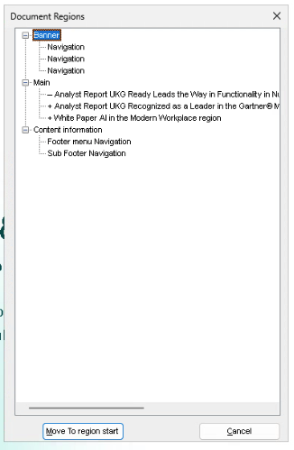
JAWS – View Item Lists
Keyboard Command | Action
JAWS + F6 | Display list of Headings,
JAWS + F7 | Display a list of Links
JAWS + Ctrl + R | Display a list of landmarks

Slide 16
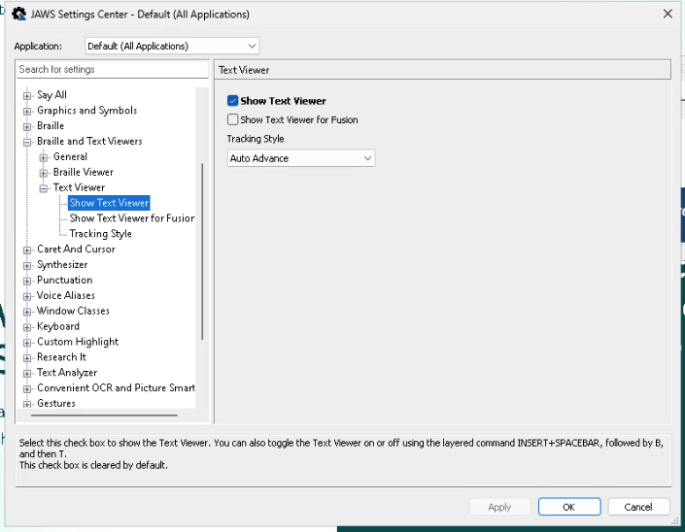
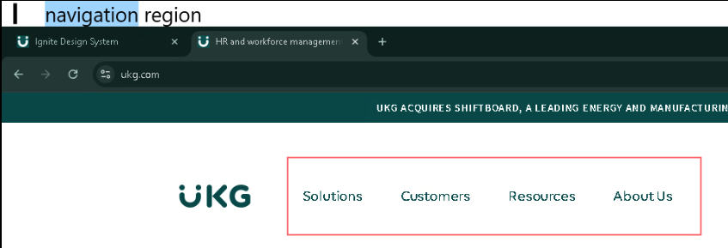
JAWS – View Text Viewer
JAWS + J > Utilities > Settings Center > Braille and Text Viewer > Text Viewer > Show Text Viewer
Check Show Text Viewer

Slide 17
JAWS Demo – What to Listen For
Navigating Tables
The user must be able to navigate in all 4 directions and read each cell in the table
The screen reader should announce column headers when navigating left/right
The screen reader should announce row headers when navigating up/down
It should also orient the user about where in the table they are
Some screen readers orient with more info than others (e.g. just "Row 4" compared to “Column 2 of 5, Row 4 of 10” )

Slide 18
Demo: JAWS

Slide 19
NVDA

Slide 20

About NVDA
Non-Visual Desktop Access
From non-profit NV Access
Free, open-source screen reader for Windows
Developed by 2 blind engineers
Translated into 55 languages by volunteers
Compatible with Chrome and Firefox

Slide 21
NVDA – Navigation Basics
Keyboard Command | Action
Control + Alt + N | Start/Restart NVDA
NVDA + Q | Quit NVDA
NVDA + N | Open NVDA Menu
Control | Pause current announcement
Mute/Unmute Speech | NVDA + S
NVDA + Space | Toggle between browse and focus mode
Insert (also known as the NVDA key) is the NVDA modifier key. Some keyboard shortcuts require the NVDA key in conjunction with other keys. Caps Lock can also be configured as the modifier key.

Slide 22
NVDA – Browse Mode Navigation
NVDA automatically switches between Browse and Focus modes, but the user can switch modes using Insert + Spacebar.
Keyboard Command | Action
Tab | Navigate to next focusable element
Up/Down Arrow | Navigate to previous/next element
Enter | Activate a button or link
H | Move to next heading
L | Move to next list
K | Move to next link
T | Move to next table
Control + Alt + Up/Down Arrow | Within table, move to cell above/below
Control + Alt + Left/Right Arrow | Within table, move to cell to left/right

Slide 23
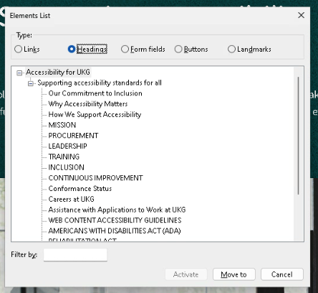
NVDA – display a list of elements
NVDA + F7
Displays a list of:
  Links
  Headings
  Form Fields
  Buttons
  Landmarks

Slide 24
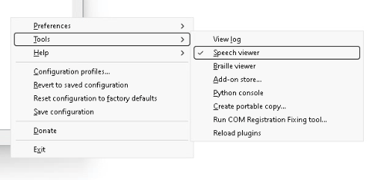
NVDA Helpful Settings
Turn on speech viewer
  NVDA + N > Tools > Speech Viewer
Announce browse/focus mode
Turn off "clickable" announcement

Slide 25
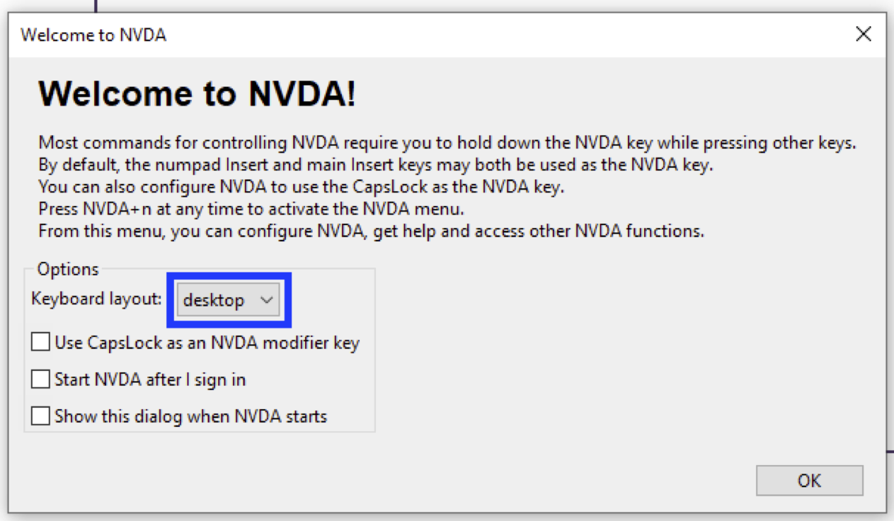
NVDA – Desktop Mode Keyboard Layout
We recommend using NVDA’s “desktop” layout with the insert key:
Most documentation and guidance about how to use NVDA assumes desktop mode
CapsLock as a modifier key does not work reliably on our VDI testing environments

Slide 26
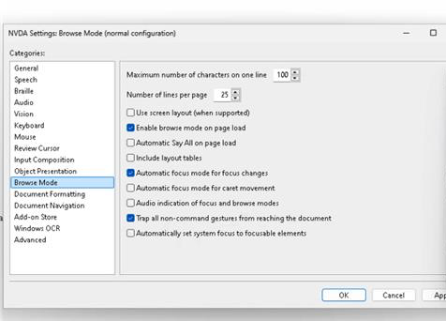
NVDA – Text Announce Browse / Focus Mode
NVDA + N > Preferences > Settings > Browse Mode
Uncheck Audio indication of browse and focus modes

Slide 27
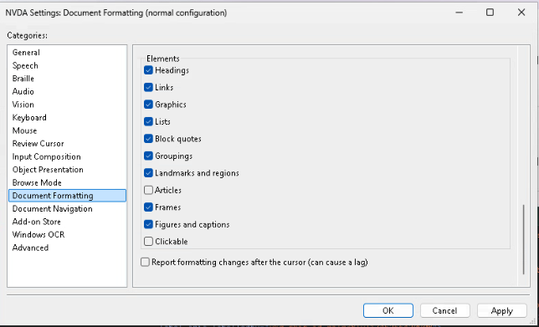
NVDA - Turn off “clickable” announcement
NVDA + N > Preferences > Settings > Document Formatting
Uncheck Clickable

Slide 28
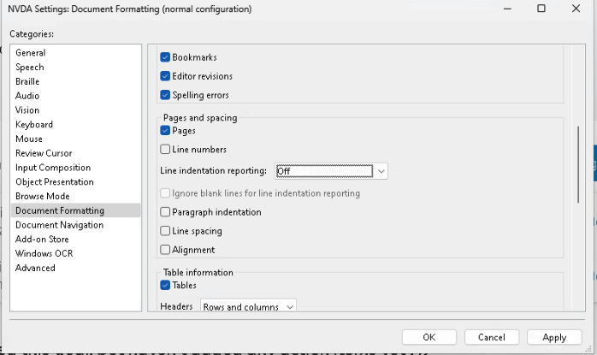
NVDA - Turn off indent announcement
NVDA + N > Preferences > Settings > Document Formatting
Set Line indent reporting to none
This eliminates beeps between some items and announcement of “no indent”.

Slide 29
NVDA Demo – What to Listen For
Navigating Tabs
In Browse Mode
  The name and tab role
  The selected tab is announced as “selected”
In Focus Mode
  Upon entering the tab list – “tab control”
  The current tab name and role and “selected” (tab focus should go to the selected tab)
  The tab position within the total list – “x of y” example: “tab 1 of seven”
  (maybe) The tab panel name when the user navigates into it

Slide 30
Demo: NVDA

Slide 31
VoiceOver

Slide 32
About VoiceOver
Apple's proprietary screen reader
Built into MacOS and iOS
Most compatible with Safari
  Can be used with Chrome (may have issues/unexpected interactions)
Can have a learning curve if you're used to JAWS/NVDA

Slide 33
Important Commands
To turn on/off:
System Settings > Accessibility > VoiceOver
Command + F5
To pause/restart reading:
Control

Slide 34
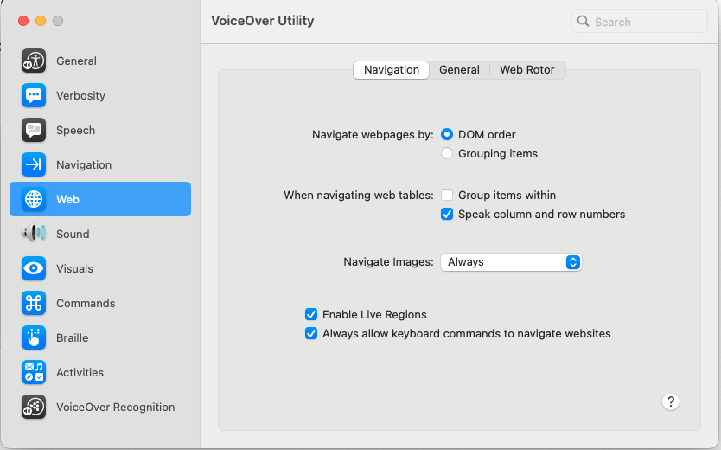
Web Navigation Settings
Notes:
Set navigate webpages to DOM order
Speak column and row numbers (you can eventually turn this off – this setting will create double readouts of some cells)
Enable live regions

Slide 35
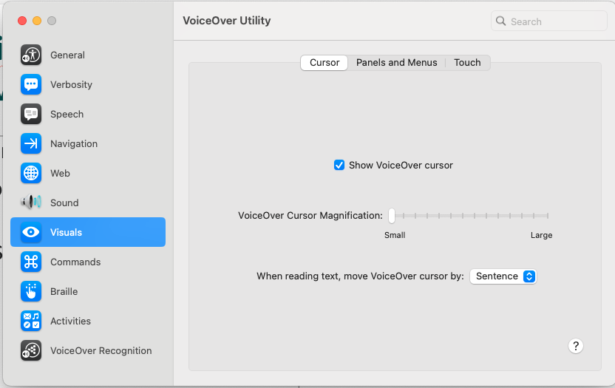
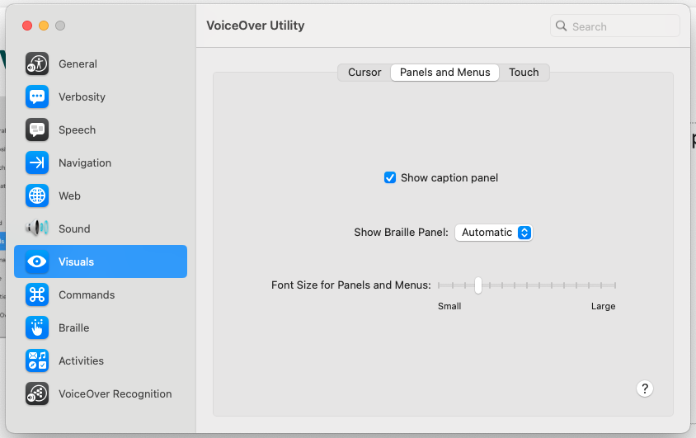
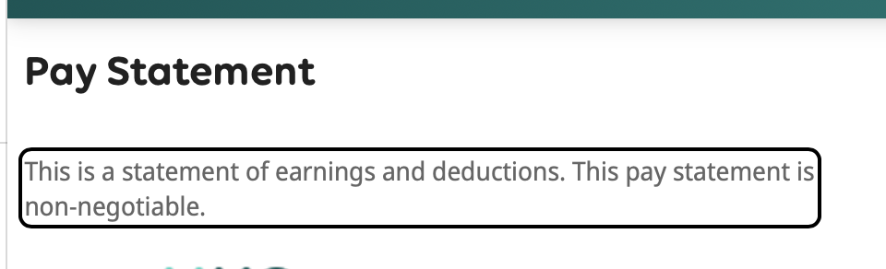
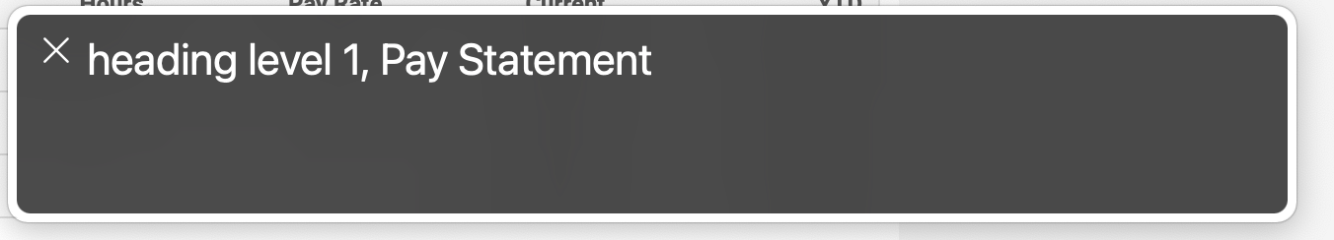
Visual Settings
The Show VoiceOver cursor and caption panel settings are checked by default.

Slide 36
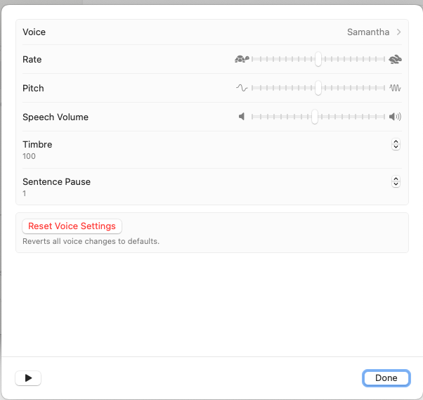
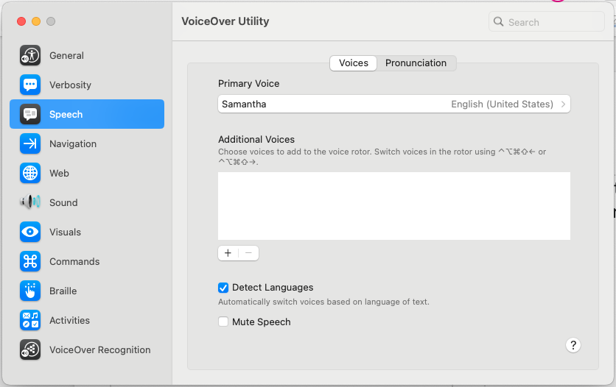
Mute Speech or Adjust Speaking Rate
System Settings > Accessibility > VoiceOver Utility > Speech

Slide 37
VO Navigation Basics
Control + Option (often referenced as the VO key) is the VoiceOver modifier. The modifier key is used in conjunction with other keys to enter VoiceOver commands.
The VO modifier can be tweaked in the VoiceOver Utility menu. Caps lock works very well, and so does the right option key
Keyboard Command | Action
VO + Left/Right Arrow | Read previous/next item
VO + Space | Activate link or form control
VO + Shift + Up/Down Arrow | Enter/exit elements (iFrames, menus, dialogs)
VO + Command + H | Go to next heading
VO + Command + T | Go to next table
VO + Command + J | Go to next form element
VO + U | Open VO rotor
VO + Arrow Keys | Navigate table cells

Slide 38
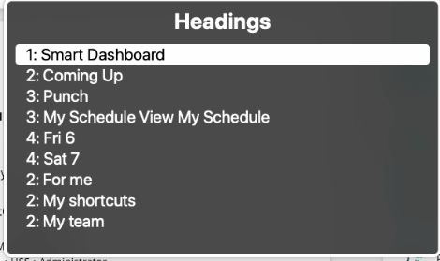
The Rotor – List View
Keyboard Command | Action
VO + U | Opens VO rotor
Left/Right Arrow | Navigate to previous/next rotor list
Up/Down Arrow | Navigate within rotor list
Enter/Space | Select option from rotor list (will close rotor)
Escape | Close rotor without selection
The VO rotor can quickly navigate to common elements. Items can be added to the rotor menu within VoiceOver Utility > Web > Web Rotor.

Slide 39
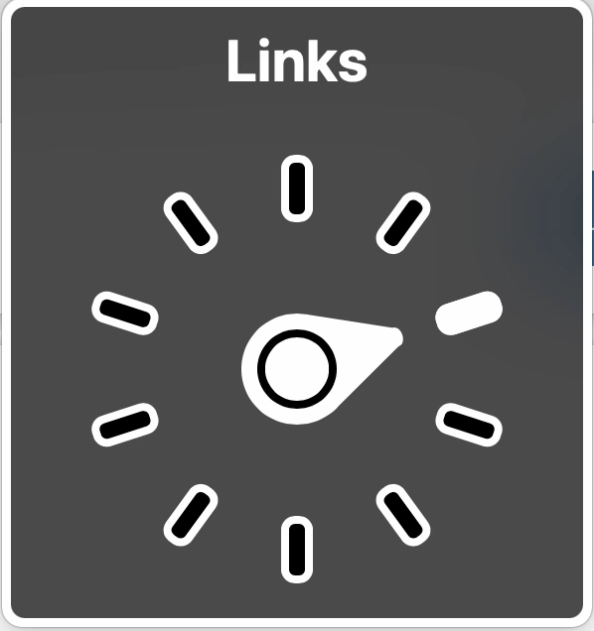
The Rotor – Quick Access Keys
To open/change setting: Control + Option + Command + Left or Right Arrow
To navigate by selected setting: Control + Option + Command + Up or Down Arrow

Slide 40
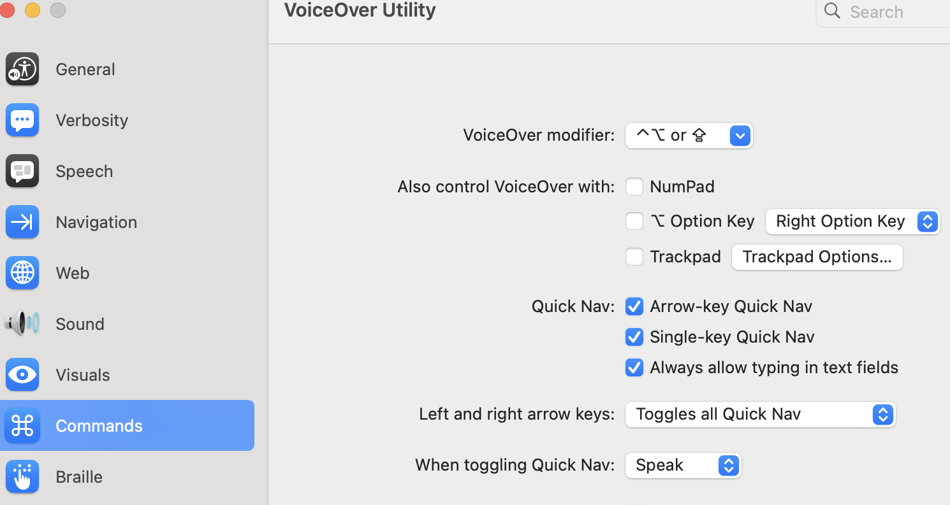
Quick Nav
Changes the keyboard commands to not need the VO modifier for basic tasks. Makes it easier to use VO with one hand, similar to JAWS & NVDA.
Sometimes, it can get activated on accident. If VO is not working like expected, check this.
Keyboard Command | Action
VO + Q | Single-key quick nav on/off
VO + Shift + Q | Arrow-key quick nav on/off
Left + Right Arrow | Quick nav on/off (configurable)

Slide 41
VoiceOver Demo – What to listen for
Navigating Accordions and Menus
Accordions
Control to activate accordion is a button (& sometimes a heading)
Button announces as expanded or collapsed
Content within the expanded section is labelled by the accordion's name
Menu
Button that invokes it includes "menu popup" announcement
Items in the menu announce as "menu item”
Closing the menu should place the user’s keyboard focus (and screen reader cursor) back on the button

Slide 42
Demo: VoiceOver

Slide 43
Mobile Screen Readers:
VoiceOver (iOS)
Talkback (Android)

Slide 44
About Mobile Screen Readers
Built into the operating system
Change how the touch screen works. User can:
  Move their finger across the whole screen and hear what they are touching in real time
  Navigate through all the elements in order by swiping
  Jump through different categories (links, headings, etc)
Clicking an item requires a double tap after selecting
Can pair with a physical keyboard or braille display

Slide 45
Turning the screen reader on and off in settings
iOS VoiceOver:
Settings > Accessibility > VoiceOver
Toggle VoiceOver on/off
Or invoke Siri and say, “turn on VoiceOver” or, “turn off VoiceOver”
Android TalkBack:
Settings > Accessibility > TalkBack > Use TalkBack:
Toggle Talkback on/off
Gemini or Google Assistant can sometimes help with this, but try on your device. Support varies

Slide 46
Turning the screen reader on and off: shortcuts
If you’re going to do a lot of testing on the device, this will come in handy!
iOS VoiceOver:
Settings > Accessibility > Accessibility Shortcut > check VoiceOver
Triple-tap your home or power button
If you have other accessibility commands on this shortcut, you will see a menu first
Android TalkBack:
Settings > Accessibility > TalkBack > TalkBack Shortcut > Volume keys > check Volume keys
Press both volume keys at the same time and hold them briefly

Slide 47
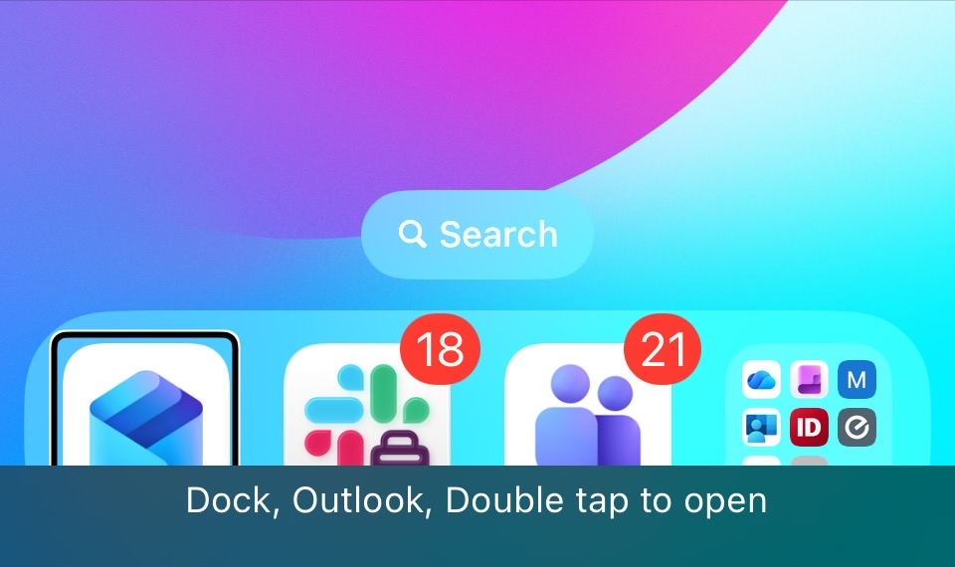
Visual Settings – showing the captions
Show the text of what the screen reader is saying. Useful for showing bugs in screenshots, or for testing silently
iOS VoiceOver:
Settings > Accessibility > VoiceOver > Caption Panel
Toggle Caption panel on
Android TalkBack:
Already set up by default!

Slide 48
Mobile Touch Navigation Basics
VoiceOver Command | TalkBack Command | Action
Touch anything |  | Highlight that item
Swipe left |  | Highlight previous item
Swipe right |  | Highlight next item
Double tap |  | Click currently highlighted item
2-finger “Z”: Right, left, right | 1-finger “backwards L”: Down, left | Dismiss dialog or go back

Slide 49
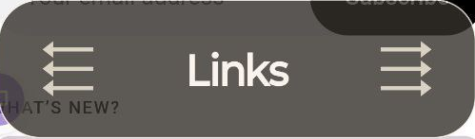
Skip around by category: Rotor/Reading control
VoiceOver Command |  | TalkBack Command | Action
2-finger rotate, counter-clockwise | 3 finger swipe left |  | Switch to previous category
2-finger rotate, clockwise | 3 finger swipe right |  | Switch to next category
Swipe up |  |  | Highlight previous item in category
Swipe down |  |  | Highlight next item in category

Slide 50
Demo:
Mobile Screen Readers

Slide 51
Table Navigation

Slide 52
What exactly is a Table?
2-dimensional grid of data (or controls)
Contains rows & columns of cells & headers
Not every grid is a table, only tabular data, where:
  Rows have consistent meaning horizontally
  Columns have consistent meaning vertically
  Both are labeled by their respective headers
Headers → ↓ | Column ↓ | Column ↓ | Column ↓ | Column ↓
Row → | Cell | Cell | Cell | Cell
Row → | Cell | Cell | Cell | Cell
Row → | Cell | Cell | Cell | Cell
Row → | Cell | Cell | Cell | Cell
Row → | Cell | Cell | Cell | Cell

Slide 53
Navigating within a table
The user must be able to navigate in all 4 directions and read each cell in the table
The screen reader should announce column headers when navigating left/right
The screen reader should announce row headers when navigating up/down
It should also orient the user about where in the table they are
Some screen readers orient with more info than others (e.g. just "Row 4" compared to “Column 2 of 5, Row 4 of 10” )

Slide 54
Table navigation for each screen reader
 | Next Row | Previous Row | Next Column | Previous column
JAWS (keyboard) | Ctrl + Alt + down arrow | Ctrl + Alt + up arrow | Ctrl + Alt + right arrow | Ctrl + Alt + left arrow
NVDA (keyboard) | Ctrl + Alt + down arrow | Ctrl + Alt + up arrow | Ctrl + Alt + right arrow | Ctrl + Alt + left arrow
VoiceOver (keyboard) | VO + down arrow | VO + up arrow | VO + right arrow | VO + left arrow
VoiceOver (touch)* | Swipe down* | Swipe up* | Swipe right | Swipe Left
* VoiceOver (touch) users need to set their Rotor to "Rows” to navigate table rows

Slide 55

Your Next Steps
If you haven't yet, set up the screen readers on your machines
Practice using a screen reader
  Test your websites & your favorite websites
  Use ARIA Authoring Practices Guide (APG) patterns for reference.

Slide 56
Questions?

