Slide 1
Web Accessibility Legal Update 2025
Ken Nakata
Principal
Converge Accessibility LLC

Slide 2
Presenter: Ken Nakata
Former Attorney, Disability Rights Section, U.S. Department of Justice
Principal, Converge Accessibility LLC

Slide 3
Overview of Web Accessibility Laws

Slide 4
Quick Summary of Relevant Laws
 | FEDERAL LAWS |  |  |  | STATE LAWS
Type of Entity | ADA Title II | ADA Title III | Section 508 | Section 504 | Unruh Act and Similar State Laws | HB21-1110 and Similar State Laws
State or Local Government Entity | Covered | Not Covered | Not covered under Federal 508 but may have local 508-like duties | Covered if recipient of federal funding. Duties similar to ADA Title II | Not Covered | Covered if in Colorado
Private Sector | Not Covered | Covered |  |  | Covered if in California | Not Covered

Slide 5
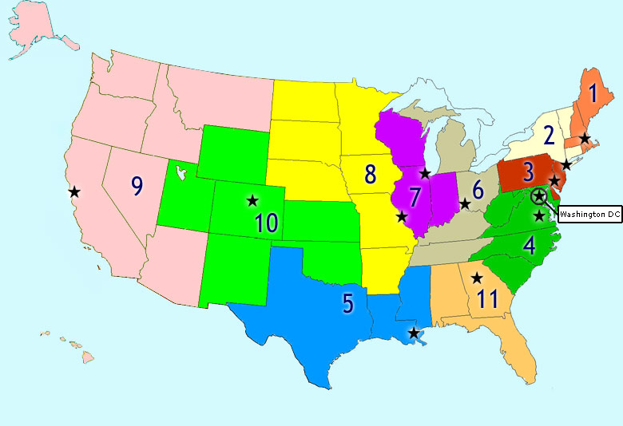
Private Sector– ADA
ADA Title III covers “places of public accommodation.”
Courts differ on whether websites are places of public accommodation.
  Place doesn’t matter (1st and 7th Circuits)
  Nexus Circuits (3rd, 6th, 9th, and 11th Circuits)
  Split Circuits (2nd and 3rd Circuits)

Slide 6

Private Sector – California’s Unruh Act and DPA
Broader than ADA
No nexus requirement but must show “intent” to sue purely online entities.
ADA violations are automatically Unruh violations.
Much bigger damages ($4,000 per violation). Remember Target and $6 million settlement.

Slide 7
Public Sector -- ADA
Websites always ”covered” by ADA Title II (e.g., Martin v MARTA) under ”effective communication” and general non-discrimination and program access but didn’t have clear standards.
New Title II web accessibility regulation now requires WCAG 2.1 A/AA conformance by April 24, 2026/2027.
  General defenses only undue burden, fundamental alteration, and minimal impact.
  Specific exceptions in § 35.201
    Archived web content
    Preexisting conventional electronic documents
    Content posted by a third party
    Individualized, password-protected or otherwise secured conventional electronic documents
    Preexisting social media posts

Slide 8
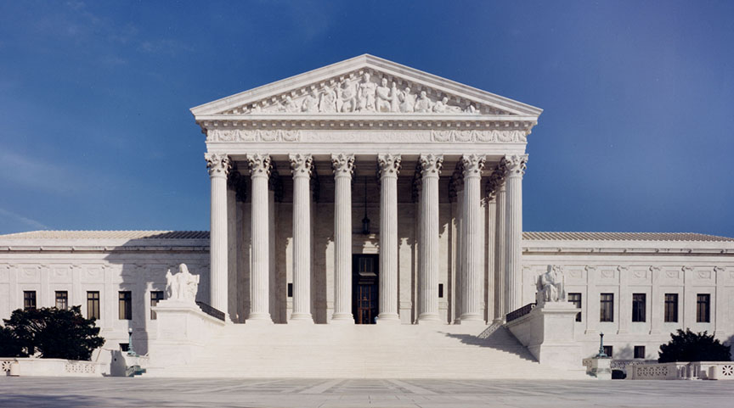
Current Reality: Supreme Court after Chevron
Supreme Court after Loper Bright Enterprises v. Raimondo (U.S. 2024).
Title II likely safe as Congress expressly delegated rulemaking to DOJ … but didn’t tell them to create standards for website.
Notes:
KEN

Slide 9
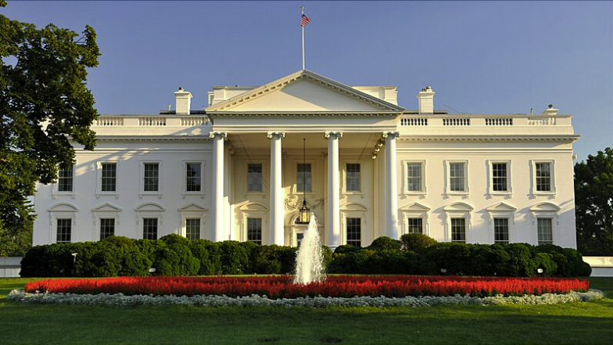
Current Reality: Second Trump Administration
  Department of Energy attempt to rescind Section 504 new construction and alterations regulation
American Council on Education (and EDUCAUSE) letter requesting delay in Title II web accessibility implementation
Significant staff cuts in both the Department of Education OCR and Department of Justice Civil Rights
Notes:
KEN

Slide 10

Predictions
Accessibility regulations will likely stay in place
Less federal enforcement except potentially against “blue” states
Likely increase in private advocacy
Don’t expect a flood of litigation on day one
Notes:
KEN

Slide 11

Public Sector – Colorado HB21-1110
Requires WCAG 2.1 A/AA compliance for all Colorado government entities by July 2025.
Imposes liquidated damages of $3,500 per violation.
Early vendor responses in Colorado are impressive. This makes Title II compliance far easier for everyone.
Other states are stepping up on digital accessibility.

Slide 12
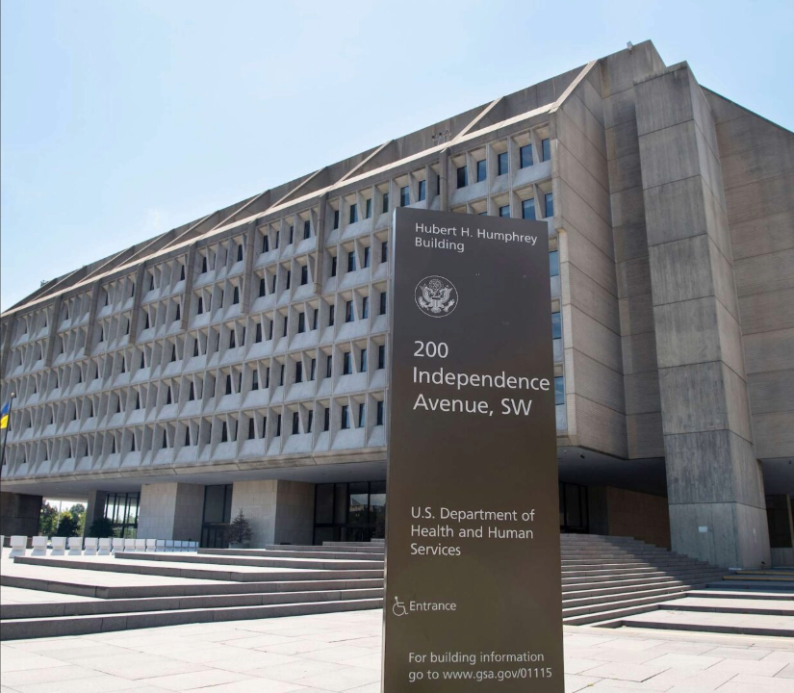
Section 504: Web Accessibility and Federal Funding
New HHS Regulation requires WCAG 2.1 A/AA conformance and has a huge reach.
May 10, 2026 (if more than 15 employees) and 2027 otherwise
Combined with Civil Rights Restoration Act means most colleges and universities need to meet WCAG even if they are private sector.
Texas v. Becerra, No. 24-CV-00225 (N.D. Tex. 2024)
Why isn’t everyone more concerned about this?!

Slide 13
Section 508: Web Accessibility & Procurement
Section 508 only applies to federal agencies.
Many states have their own Section 508-like requirements (e.g. CA Govt Code § 7405).
Other states and organizations have Section 508-like policies (e.g., WA Accessibility Policy USER-01, formerly 188).
Applies to all ICT developed, procured, maintained, or used by agencies.
Enforcement is typically limited to procurements.
Not really a civil rights law. Goal is creating accessible infrastructure and leveraging market forces to encourage accessibility by manufacturers and vendors through procurement process.

Slide 14
Some Real-Life Scenarios from Court Cases

Slide 15
Real-Life Scenarios and Questions
Can an organization just post a phone number or email address and not make their site accessible?
Can an organization be sued for content they don’t control or own?
Can an organization be sued by someone who has no interest in being a customer?
Can an organization be sued if they just settled another lawsuit?
Can an organization be sued in a court that is thousands of miles away?

Slide 16
Wrapping Up

Slide 17
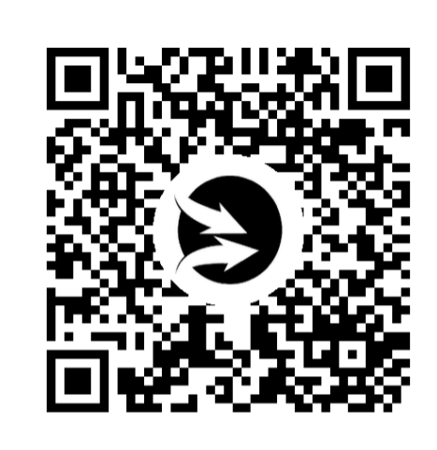
Quick Survey
Possible new offering in the higher education and Title II accessibility area.

Slide 18

Wrapping Up
Converge Accessibility
  Strategic planning and policies
  Digital accessibility workshop
  Customizable training videos
Reach out offline anytime!
  ken.nakata@convergeaccessibility.com
  https://calendly.com/ken-nakata/30min

