Slide 1
Preparing for and Meeting the New ADA Title II Web Accessibility Regulation
Ken Nakata
Principal
Converge Accessibility LLC

Slide 2
Presenter: Ken Nakata
Former Attorney, Disability Rights Section, U.S. Department of Justice
Principal, Converge Accessibility LLC

Slide 3
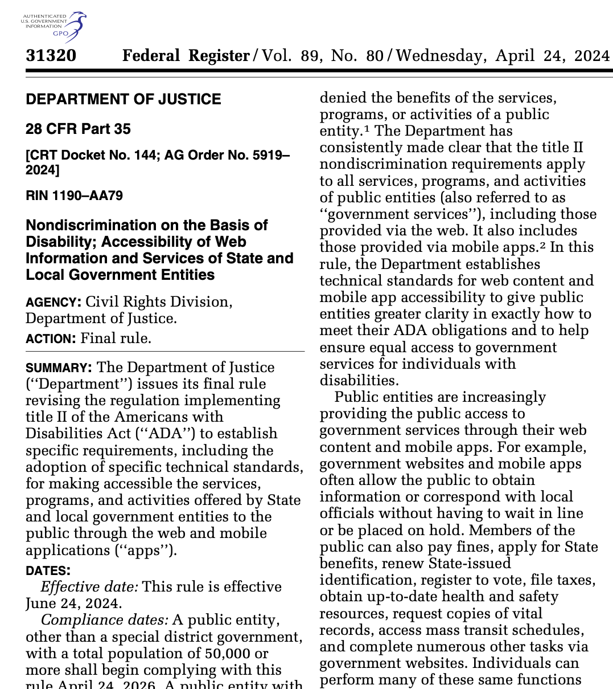
Overview of the New DOJ Title II Web Accessibility Regulation
Full WCAG 2.1 A/AA compliance required unless undue burden or fundamental alteration
Hint: we’ll come back to undue burden
Deadline:
April 24, 2026 (state and local governments 50,000+)
April 24, 2027 (smaller local governments and special districts)
Five Exceptions
Archived web content
Preexisting conventional electronic documents
Content posted by a third party
Individualized, password-protected or otherwise secured conventional electronic documents
Pre-existing social media posts

Slide 4

Core Accessibility Team
Core team includes (at a minimum):
IT Department
Legal
ADA Coordinator
Procurement
Reduces friction and promotes organization-wide buy-in

Slide 5

Importance of a Plan
Need for a High-Level Conceptual Plan
Recognizes new rule creates different types of challenges
Game plan for each type of challenge
Sets plans for
Existing websites and web applications
Existing documents and PDFs
New websites and web applications
New documents and PDFs
Supports Undue Burden Defense
Helps defend against undue financial or administrative burden
Varying from the plan may impose additional burdens
Support with Appropriate Training

Slide 6
Four Biggest Challenges Addressed in Plan
Challenge 1: Existing websites and web applications
Challenge 2: Existing documents and PDFs
Challenge 3: New websites and web applications
Challenge 4: New documents and PDFs

Slide 7
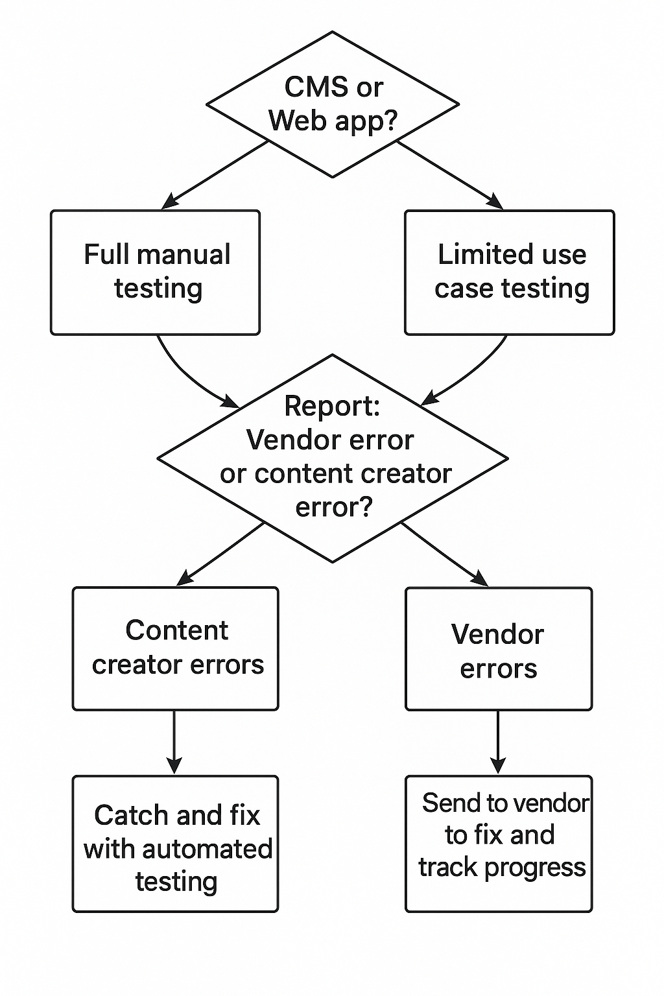
Challenge 1: Existing Websites and Web Applications
CMS systems are tested more rigorously because the CMS:
Offer more templates and components,
Are essential for daily operations
Separating issues due to vendor is key for having vendors correct those errors.

Slide 8
Challenge 1: Existing Websites and Web Applications

Slide 9

Challenge 2: Existing PDFs
Don’t panic!
Limit scope:
Actively used in programs, services and activities
Mark others has “archive” or “legacy”
Shop around
Set budget and plan

Slide 10
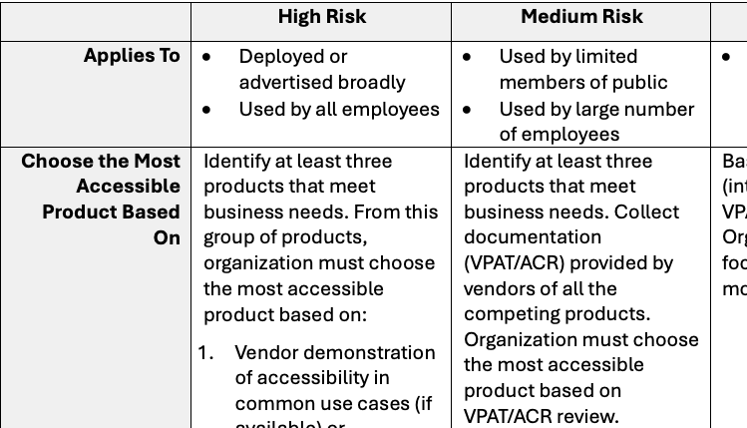
Challenge 3: New Websites and Web Applications
Risk Matrix for IT Systems. Categorizes IT systems based on risk
High risk: public systems and internal systems with high usage
Low risk: one-off purchases for single users
Proof Requirements for IT Systems
High risk: vendor demonstration and/or third-party audit
Low risk: VPAT or ACR
Approval and Documentation
Supports undue burden determinations

Slide 11
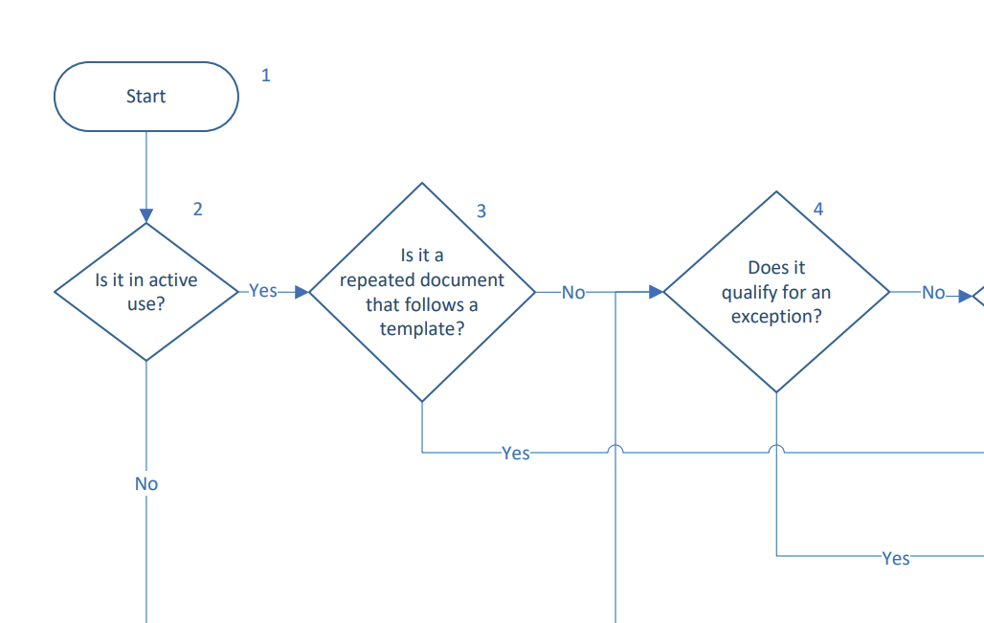
Challenge 4: New Document Accessibility
Understand exceptions and ADA rule
Understand different technologies
Factor in practicality and risk
Best solution:
Basic flowchart then
Cross-functional flowchart

Slide 12
Challenge 4: New Document Accessibility

Slide 13
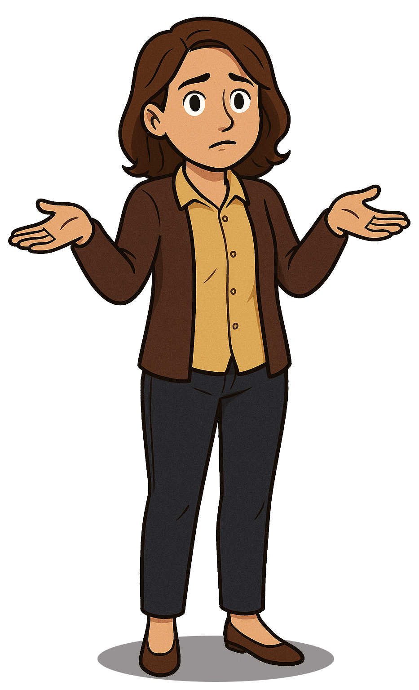
Meeting ADA Title II is not a Technical Problem
WCAG compliance is a technical problem but virtually impossible.
ADA compliance is relatively straightforward but is a people and strategy problem.
Planning and the right processes need to leverage, support, and document available defenses.
Good processes make life far simpler.

Slide 14
Advantages to Working with Converge
“Aligning accessibility with privacy and security makes it easier for us to achieve all three requirements... I doubt any consultant other than Converge could have made this possible.”
Nikki Rosecrans
Manager
Information Security and Compliance
Arapahoe County

Slide 15
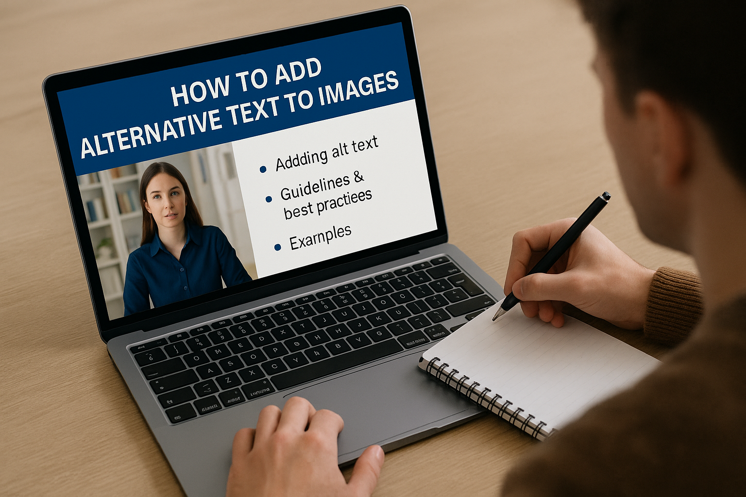
Training
Training should cover:
General Introductory Training
Content Creation Training
IT Deployment and Procurement Training

Slide 16
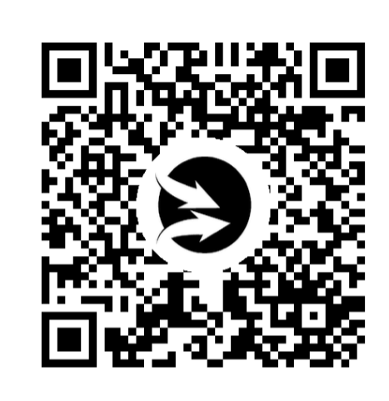
Quick Survey
Possible new offering in the higher education and Title II accessibility area.

Slide 17

Wrapping Up
Meeting the new DOJ rules
Importance of planning
Create repeatable processes
Converge Accessibility
Strategic planning
Digital Accessibility Workshop
More in-depth review of same topics
Optional document templates
Customizable training videos
Reach out offline anytime!
ken.nakata@convergeaccessibility.com
https://calendly.com/ken-nakata/30min

