Slide 1
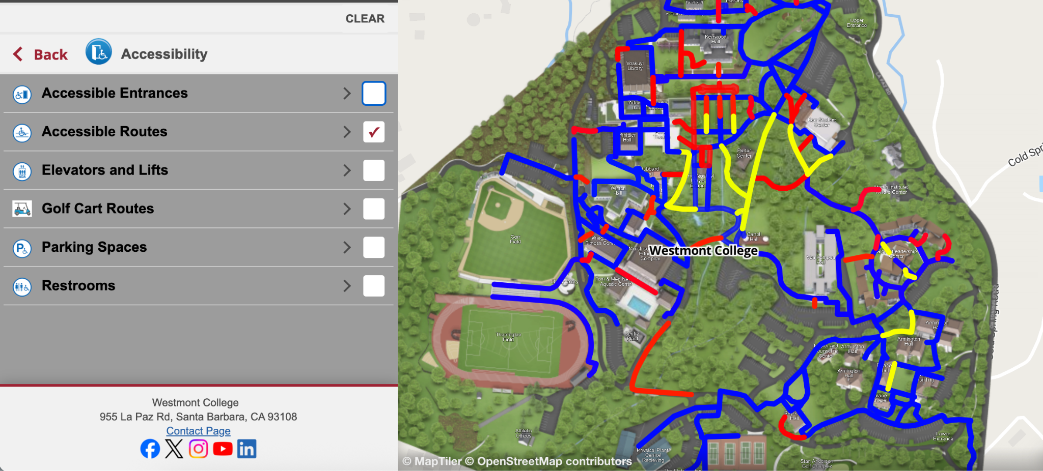
Finding a Path to Belonging with Accessible Maps
Abigail Bradshaw, Assistant Director of Westmont College’s Accessibility Resource Office
Julianna Goldring, Director of Marketing, Concept3D
Notes:
Welcome!

Slide 2
AGENDA
Introductions
Legal Landscape
Why Accessibility Matters
Initial Roadblocks
Roadmap & Case Study
The Destination
Takeaways
Questions
Notes:
Roadmap

Slide 3
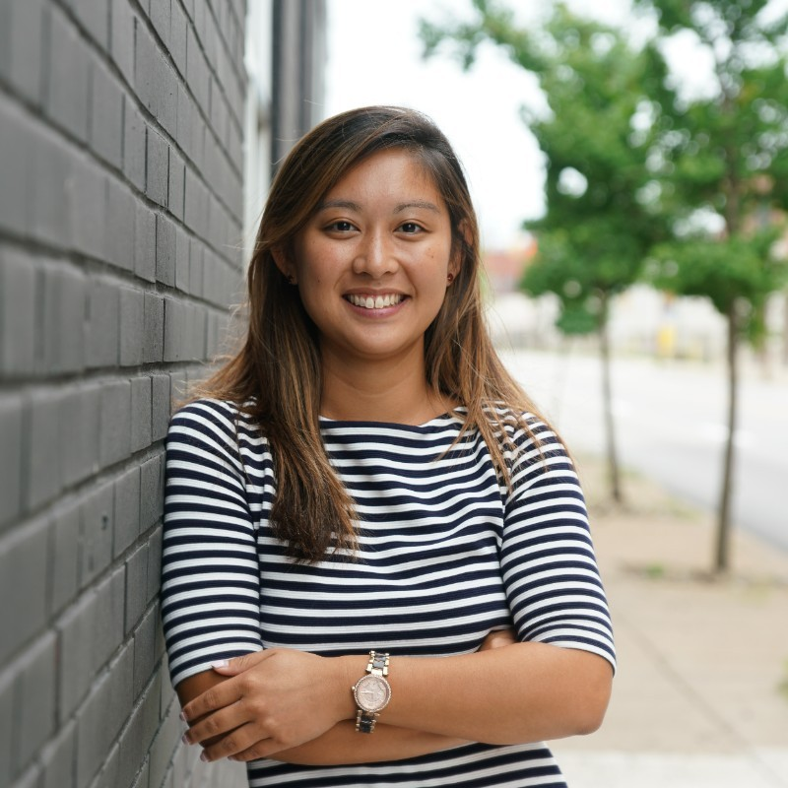
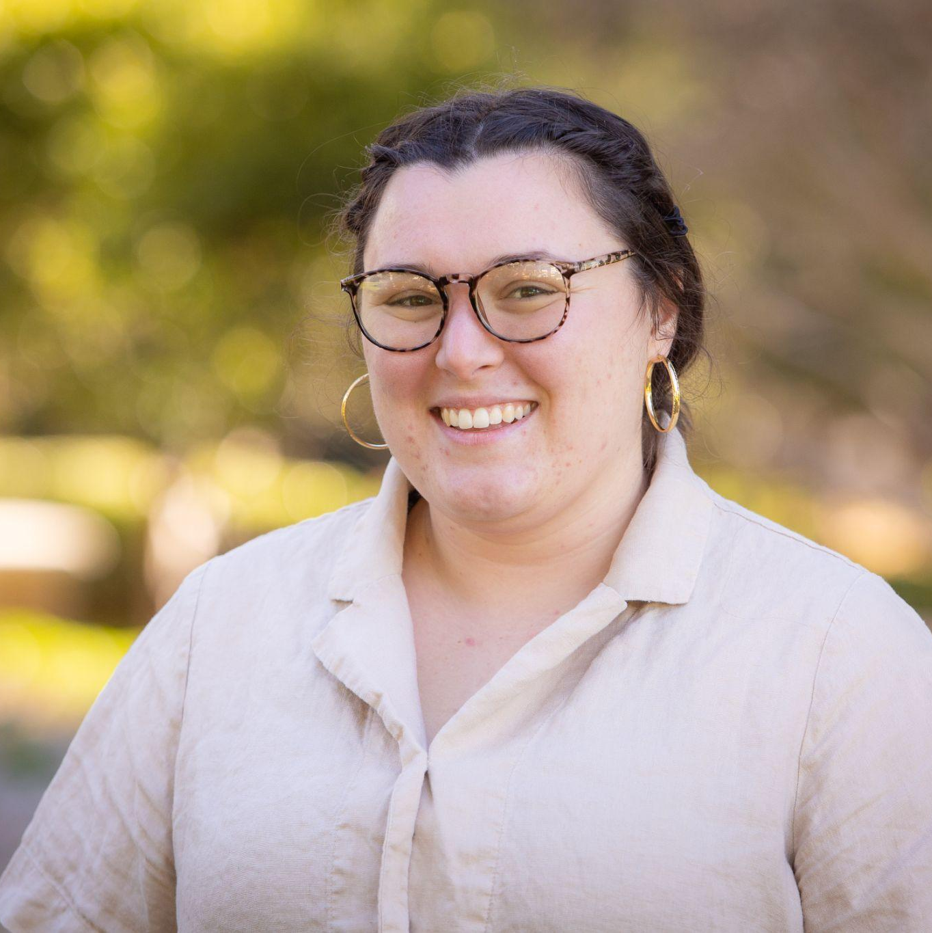
Introductions
Julianna X. Goldring
Director of Marketing
Concept3D
Abigail Bradshaw
Assistant Director of the
Accessibility Resource Office
Westmont College
Notes:
Intros

Slide 4

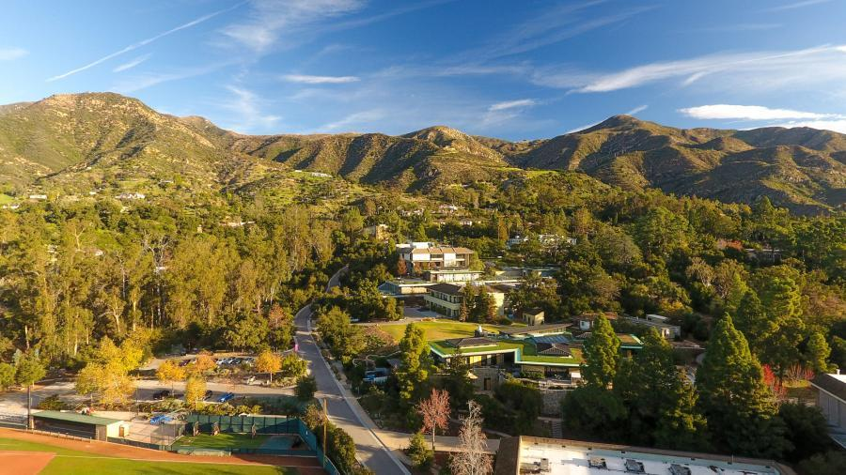
About Westmont College
Notes:
Small Christian liberal arts college in SB, CA (1300 ish). Primarily undergraduate, with several post bac programs including nursing
Faith based has motivated our accessibility work
Physical context: Campus is on the side of a mountain
Founded in 1937, so lots of historical buildings (we also have extra layers of working within the Montecito community/conditional use permit)
About 18% of the student body is registered with our office- FTE 2.3. I am a Westmont alum who received services as well!

Slide 5


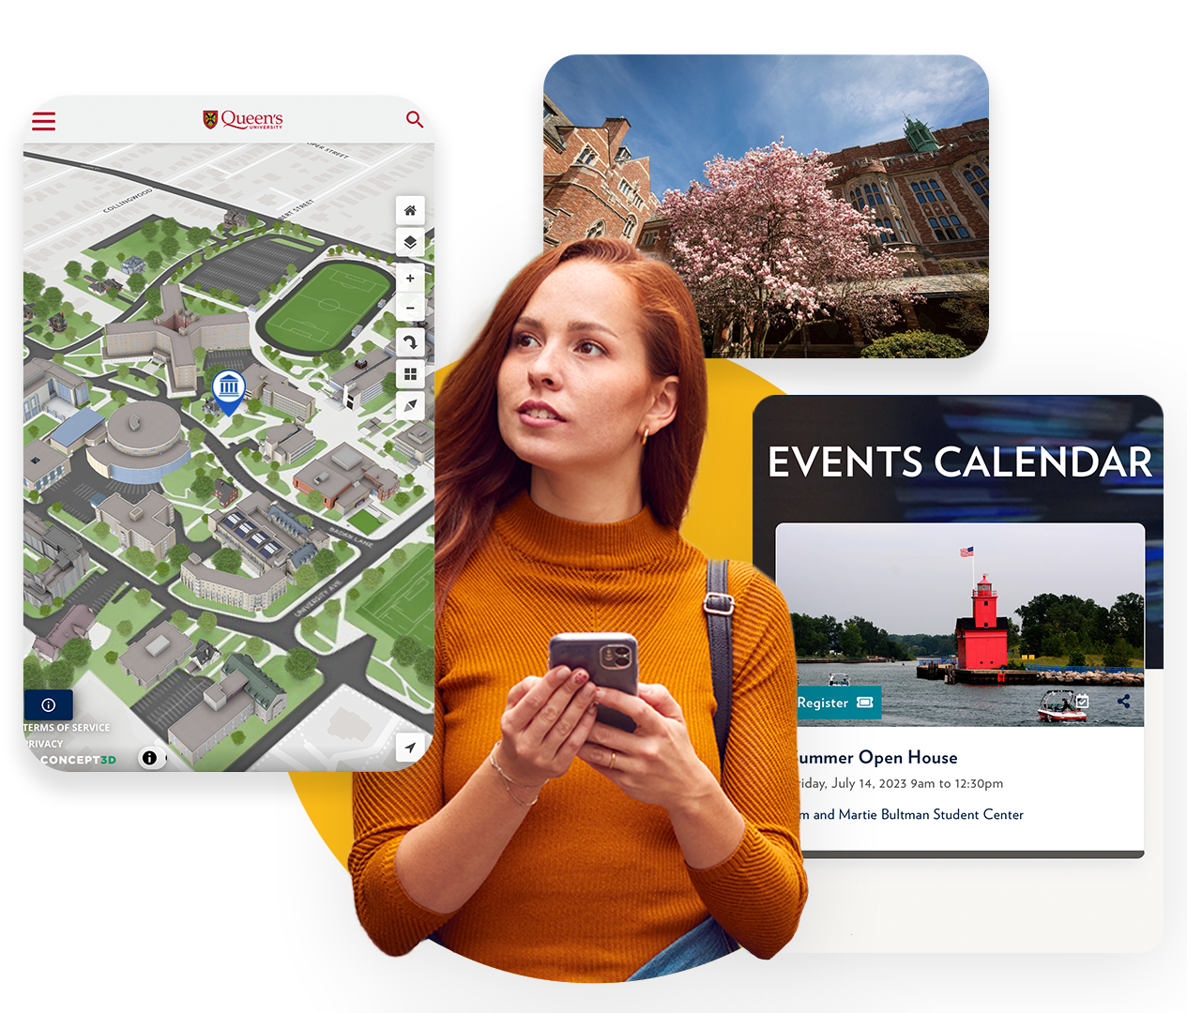







About Concept3D
Empowering Higher Ed with Digital-First Solutions
Enhance Campus Navigation, Communication, Recruitment and Event Management
WHO WE SUPPORT
OUR SOLUTIONS
Marketing
Interactive Maps
Admissions
Localist Events
Student Engagement
360º Tours
Room Reservations
We champion accessibility best practices and advocate for inclusive marketing and recruitment
Notes:
Concept3D was founded in 2006, which means we have almost 2 decades of experience serving Higher Ed institutions. Our platform really caters to the entire student lifecycle, starting with sparking interest amongst prospective students, to engaging inquiries in the pipeline, and enhancing student retention by growing community all the way through graduation.
We’re an industry leading accessible platform embrace a digital-first, inclusive approach to marketing and recruitment. We are proud to share that 4 million students engage with our platform every year and we’re currently working with over 700 campuses, some of which I hope are here today in addition to Dallas College who we’re co-presening with .
Also a fun new product announcement we are excited to share is that our platform is now AI powered and can streamline some of the more manual intensive aspects of writing building descriptions.

Slide 6

The Legal Landscape

Slide 7

Disability in Higher Ed
In Higher Ed - 19.6% of post-secondary students in the United States identify as having a disability
19.6%
Source: National Center for Education Statistics
Notes:
With all of this said roughly 19.6% of post-secondary students in the United states identify as having a disability of some. This is roughly 1 in 5 students and represents a significant piece of the population, some sources have even said this number could actually be slightly higher due to some people having a disability but maybe not identifying as having a disability.

Slide 8

NEW Department of Justice Ruling for
Title II of the ADA - April 2024
What the ruling says:
All web and mobile app content must meet WCAG 2.1 Level AA
Compliance deadlines:
  Greater than 50,000 persons April 2026
  Less than 50,000 persons by April 2027
  *this is not student body size
Notes:
In April 2024, DOJ issued a new ruling for Title II of the Americans with Disabilities Act around web and app accessibility requirements. The ruling stated that all content must meet WCAG 2.1 Level AA standards by either April 2026 or April 2027 depending on the size of the locality in which you are located. While 2026 may seem far away, it’s good to take a proactive approach to reaching compliance so the date doesn’t sneak up on you. I’ve worked with several schools that have mentioned their jumpstart to accessibility initiatives actually came years ago when complaints and even a potential lawsuit was threatened. Leading with accessibility is not just the right thing to do for your students but it also keeps you clear of legal ramifications that can be costly, timely and spooky.

Slide 9

The Destination: Equal Access + Belonging
Universal Design
Independence and personal agency
Enrollment & Retention
Notes:
*students/community members first impressions= culture of belonging!

Slide 10
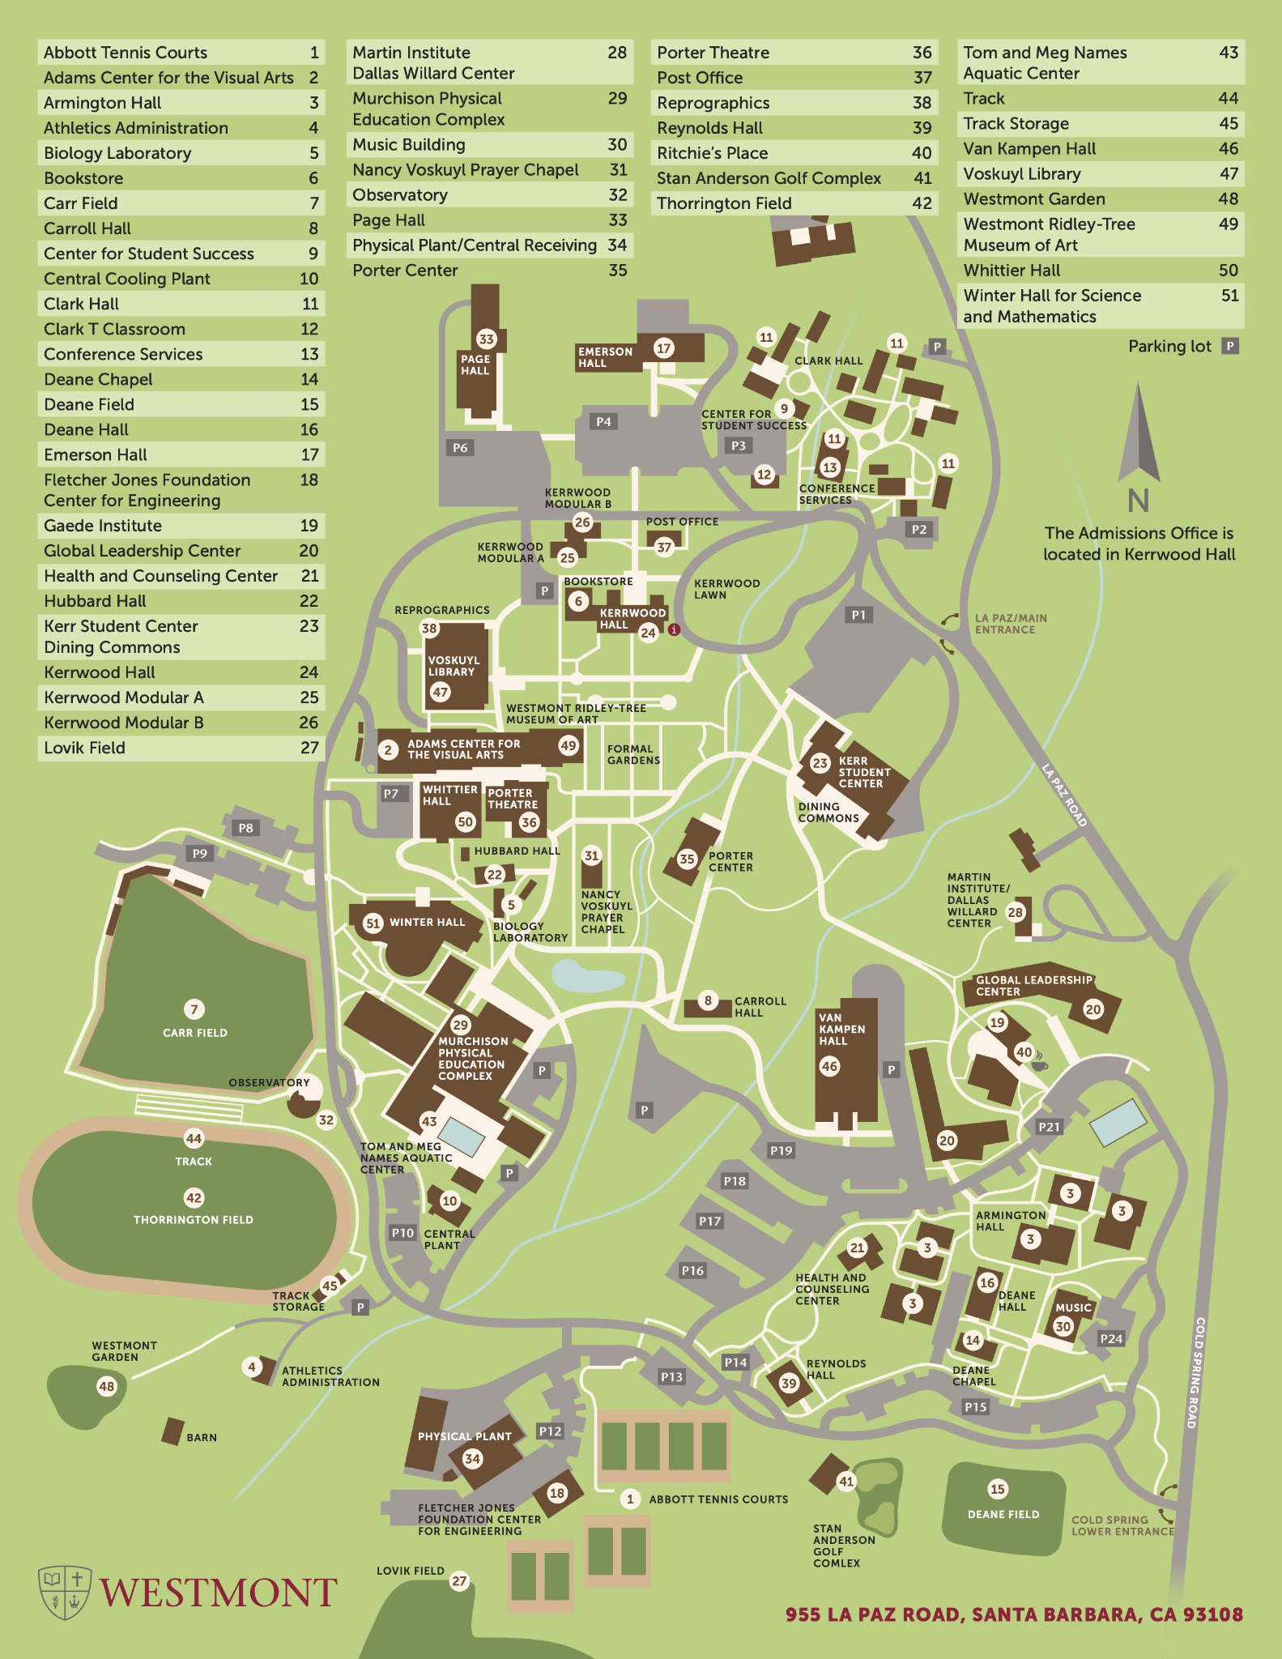
The Roadblocks
Maps are built as inherently visual
Screen reader compatibility
Accessible routes and features not notated
What if maps could be used by everyone?
Notes:
Problem
Catalyst for change (individually working with students and guests on where to go)

Slide 11
What happens to the visitor experience if:
No accessible wayfinding exists
ADA compliant locations are not marked
PDF map isn’t compatible with screen readers
Your institution sets the stage for a non-inclusive environment that leads to reputational damage, lawsuits, a negative impression and lost revenue
A Detailed Story of Risk
Notes:
We know disability exists all around us, we know people care about it, now let’s take a moment to think about what the risk is if we ignore it. Think about your student’s experience and how it would be impacted if no accessible wayfinding exists, ADA compliant locations aren’t marked, or your PDF map isn’t compatible with screen readers
Has anyone experienced a consequence of inaccessible practices in their experience hosting events on campus?

Slide 12
Accessibility Roadmap & Westmont Case Study
Leadership
Buy In
Secure Funding
Testing
Evaluate Vendors
Implementation
Feedback & Continuous Improvement

Slide 13
Accessibility Roadmap: Leadership Buy-In
Accessibility initiatives must stem from top-down leadership
Why this step is crucial:
Sets the standard for campus-wide accountability: responsibility doesn’t just fall on accessibility teams
Institutional Reputation: Visible commitment from leadership positions the institution as a leader in equity and inclusion and gains public trust
Legal Ramifications: Reducing legal risks and financial damages in the form of lawsuits
Notes:
Westmont:
IT, Enrollment/Marketing, Institutional Resilience,

Slide 14
Accessibility Roadmap: Secure Funding
  Identify which departments can share funding resources
    Facilities
    Public safety
    Admissions
    Marketing
    Accessibility and Student Services
Notes:
Westmont: Had already had this software when program began! If/when we can do wayfinding, we hope to divide costs between departments

Slide 15
Accessibility Roadmap: Testing
Whenever possible, include first-hand perspectives in your testing processes (people with disabilities)
Free tools online to help audit your digital platforms:
Axe DevTools
Digital Accessibility Toolkit
Notes:
Westmont: Braille Institute, Golf cart testing, using map with our community!

Slide 16
Accessibility Roadmap: Vendor Evaluation
What to Look For:
Procurement language
Vendor questionnaires
Review of VPAT® reports
Continuous improvement models
Be Wary Of:
100% fully accessible promises
Notes:
Westmont: reviewing Concept3D’s accessibility standards, actually testing the software against the claims

Slide 17
Accessibility Roadmap: Implementation
  Create a plan with measurable KPIs and stick to them
  Involve cross-functional teams early
  Offer training to staff
  Get tools up and running
Notes:
This was a 9 month-ish process for Westmont to just implement the accessibility features/routes.
ID all features, draw routes, etc., pictures, descriptions, etc.
Disseminating information (campus safety, admissions, etc.)

Slide 18
Westmont Map Live Demo: Implementation

Slide 19

Pit Stops & Construction: Are we there yet?
Feedback & Continuous Improvement
  Offer avenues for users to provide continuous feedback
    Surveys
    Integrated feedback forms
    Lines of open communication in-person
  Create a plan for conveying feedback to the right stakeholders
  Input annual review processes for incorporating feedback
  Keep track of compliance requirements
  Treat it as a first draft: delegate & prioritize updates
Notes:
Westmont updates: ongoing updates to campus, adding photos, etc.

Slide 20

Takeaways From The Journey
Importance of accessible venders
There is almost always a way to make it accessible!
Stakeholders are essential

Slide 21

Questions & Open Floor
Ask away!

