Slide 1


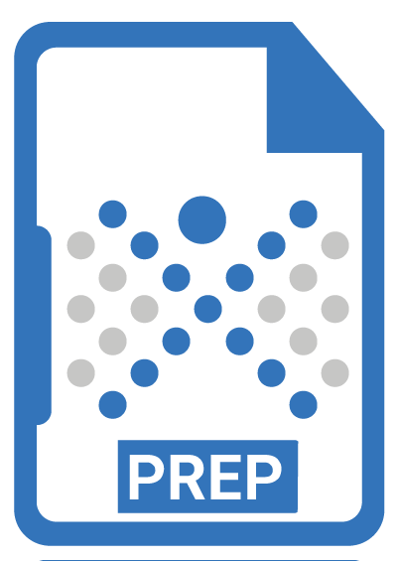
Best Approaches to Scaling PDF
Remediation: Higher Education PDF
Accessibility Success Stories
(Date - Nov 19, 2025)

Slide 2

About Presenters
Vijayshree (VJ) Vethantham,
SVP, Growth & Strategy,
Continual Engine

Slide 3
About Continual Engine
Award-winning AI technology company specializing in digital accessibility
PDF/
Documents
End-to-end solutions for education, finance, healthcare, and municipalities
Diverse Digital Content
Videos
Proprietary AI-powered tools + human expertise for accuracy and efficiency
High-quality results delivered with significant cost savings
Websites
Images

Slide 4

About the Session
Higher education institutions struggle to make learning materials accessible (syllabi to complex STEM content)
Manual remediation is slow; semi-automated tools produce inconsistent results.
This session explores scalable approaches and real-world success stories from leading HEIs, introducing Document Remediation 3.0 and hybrid automation-expert workflows.

Slide 5
Key Points Attendees Will Learn
Multiple remediation strategies, from fully automated to human expert-assisted approaches.
How PREP detects accessibility issues early with screen reader previews and real-time checks.
How leading institutions remediated thousands of STEM and non-STEM documents, faster and more cost-effectively.

Slide 6

Challenges in Higher Education Accessibility
Thousands of course materials each semester
Complex STEM content hard to tag manually
Multiple departments, varied workflows
Limited staff and inconsistent tool outputs
Compliance pressure under ADA Title II
Centralized or outsourced remediation often too slow or costly

Slide 7
Why PREP Stands Out: Remediation 3.0
Automates remediation at speed and scale with consistent quality
Handles complex tagging, tables, and image descriptions seamlessly
In-built accessibility checker
Unique screen reader preview for real-world validation
Seamless LMS integrations (Canvas, D2L Brightspace, etc.)
Flexible user access & customizable deployment options

Slide 8

Use Case 1
A leading college based in Colorado, wanted to embed accessibility within their daily workflows.
The goal: Decentralize remediation while keeping compliance and quality consistent.
1
They needed a solution that departments could adopt easily and independently - without adding complexity or workload.

Slide 9

Integrating PREP into Higher Education Workflows
Minimal learning - ideal for non-specialists.
Easy integration with existing workflows like Canvas
Automation of 90%+ tagging tasks, including headings, lists, tables, and reading order.
Admin capabilities to help users to create new accounts, manage access
Supports both ad-hoc & large-scale remediation needs.
▶ Watch Demo

Slide 10

Integrations PREP Provides
Seamless Integration with LMS like Canvas, D2L Brightspace, Okta, CivicPlus & More
Instructors remediate course files directly in the LMS.
Auto-tagged files returned instantly to course folders.
Minimizes disruption to teaching workflows.
Notes:
Seamless Integration with LMS like Canvas, D2L Brightspace, Okta, CivicPlus & More
Instructors remediate course files directly in the LMS.
Auto-tagged files returned instantly to course folders.
Minimizes disruption to teaching workflows.
PREP supports integration with any LMS or document repository through its open architecture, allowing direct document uploads from your system into the platform.

Slide 11

The PREP Impact
Departments gained autonomy and speed without losing consistency.
Accessible PDFs in minutes, not weeks, accelerating accessibility campus-wide.
PREP’s design helped achieve sustainable, scalable accessibility across all departments.

Slide 12
Use Case 2
A leading college of Virginia with limited accessibility expertise and budget.
Goal: Make course materials accessible to all students while keeping costs low.
They needed a scalable, cost-effective document remediation solution that multiple users can access without exceeding license limits.
2
Notes:
Use Case 1: Colorado Mountain College <<no naming of clients>>
Challenge:
With limited funds but ambitious accessibility goals, Colorado Mountain College faced a significant gap in both budget and in-house knowledge around document accessibility.
Solution:
Continual Engine implemented a low concurrent–high non-concurrent license model (1:10 ratio from our regular 1:5) to maximize access while keeping costs low. To optimize seat usage, the system was configured so that:
Admins can manually log out inactive users after 2–3 days.
Users are automatically logged out after 24 hours of inactivity. This ensured that available licenses were always in active use.
Training & Adoption:
PREP’s standard six-session training program was customized into a more beginner-friendly sessions focused on the fundamentals of document accessibility. Continual Engine also developed custom marketing materials explaining what accessible documents are and why they matter, helping drive awareness and adoption across the institution.
PREP Training Course was also listed in client’s internal training resource hub to spread awareness, ease access and esure adoption

Slide 13
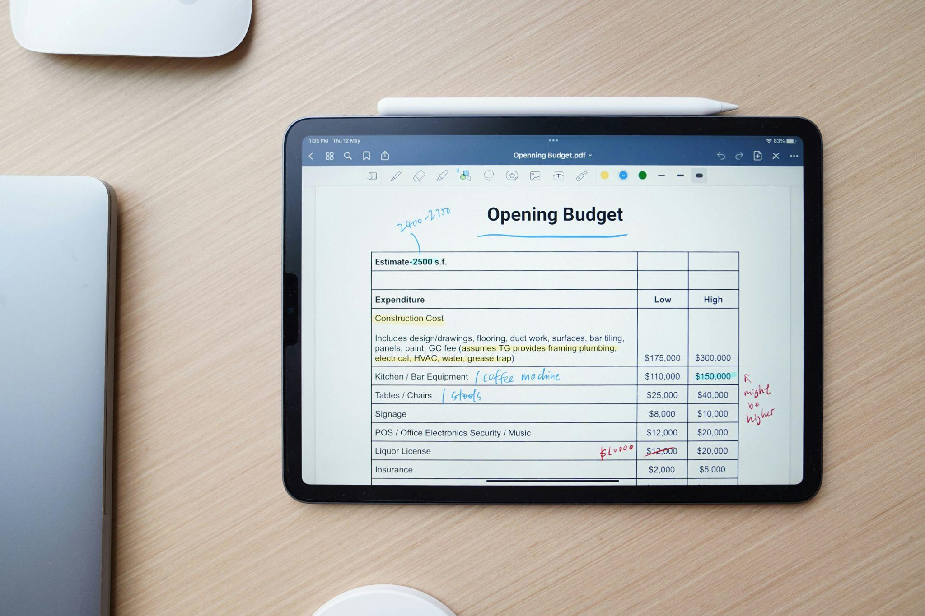
How PREP Scaled Accessibility Within Budget
Implemented a low concurrent–high non-concurrent license setup (1:10 vs. 1:5).
Allowed many users to access PREP while controlling active sessions.
Smart Usage Management
Admin logout (2–3 days inactivity)
Auto-logout (24 hrs) ensured active license use
▶ Watch Demo

Slide 14
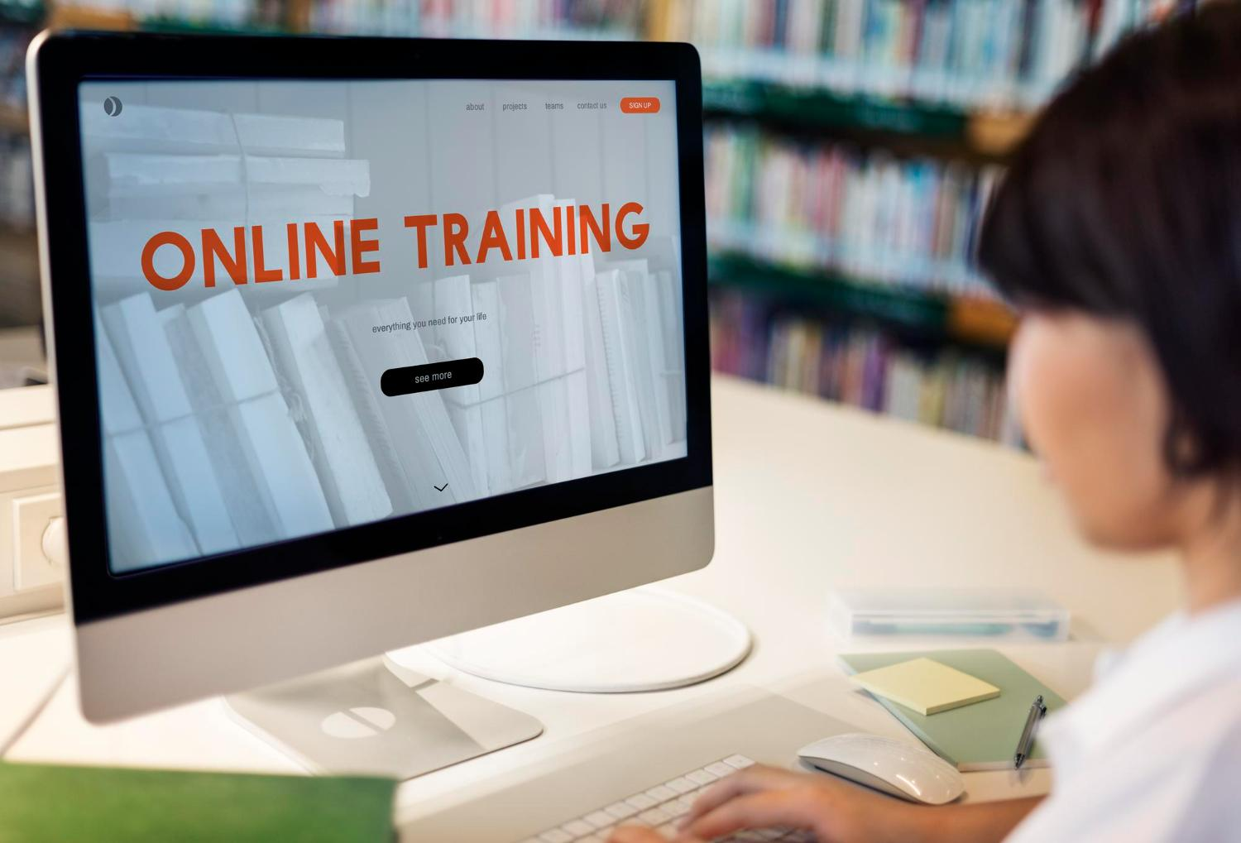
Training & Awareness
PREP’s six-session course simplified into beginner-friendly modules.
Internal materials explained accessibility fundamentals.
PREP course listed in the institution’s training hub.

Slide 15

The PREP Impact
Optimized license use - reduced overall cost.
Enabled more users to work on remediation without added licenses.
The college achieved its accessibility goals faster and more affordably, building long-term capability across its teams
Improved understanding of accessibility across departments.
Increased engagement with PREP’s tools & training.

Slide 16
Use Case 3
A leading U.S. university’s accessibility team needed a scalable, efficient way to remediate large volumes of complex documents, including tables, formulas, lists, and visuals, while ensuring accuracy and compliance without expanding their team.
Goal: Simplify and accelerate large-scale accessibility remediation while maintaining quality and compliance across departments.
3

Slide 17

How PREP Simplified Accessibility
Automated bulk tagging for fast, scalable remediation.
Handles complex tables, lists, & structures.
Automated image descriptions for all visual types.
Centralized tracking and license management.
Unified SSO portals for seamless collaboration.
Screen Reader Preview for issue detection.
▶ Watch Demo

Slide 18
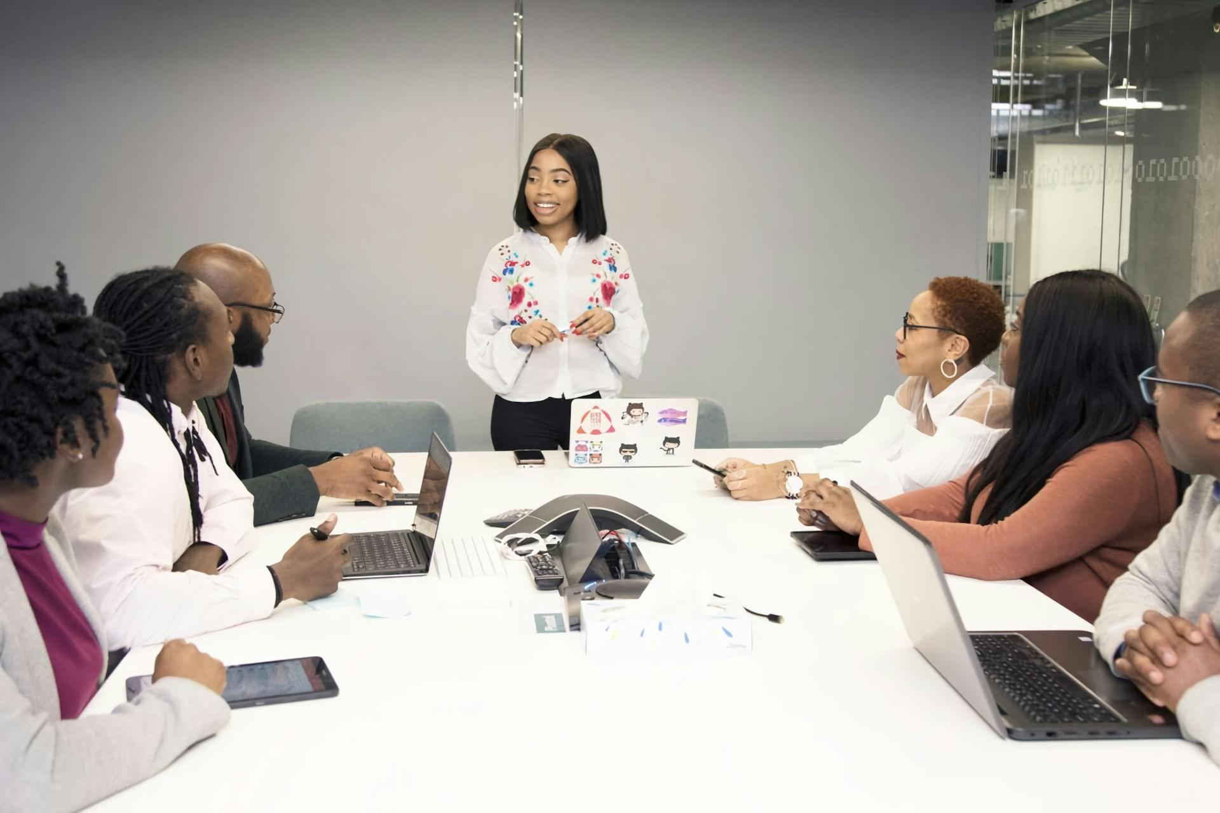
The PREP Impact
Turnaround time reduced from days to hours.
Maintained accuracy & compliance at scale.
Improved accessibility for complex academic content.
Centralized visibility with flexible license management.
Enabled departments to manage accessibility independently.
Enhanced screen reader experience for end-users.

Slide 19

ADA Title II and Higher Education Institutions (HEI)
Requires HEI to make all programs and digital content accessible.
Equal access under ADA and Section 504.
How PREP Supports Compliance
Scales remediation across departments with AI + expert review.
Ensures WCAG and PDF/UA standards.
Backed by ISO 27001 and SOC 2 certified infrastructure

Slide 20
Q&A

Slide 21
Thank You!
Vijayshree (VJ) Vethantham
vijayshree.vethantham@continualengine.com

