Slide 1

Accessibility Experiences of Developing Sage Campus
Platform and Content
Notes:
Lorenzo

Slide 2

Agenda
We will discuss and advise on the process of testing, identifying accessibility issues, and then remediating those issues on Sage Campus, an already built online platform that hosts courses for higher education.
Presenter Introductions and Company Information
The Accessibility History of Campus
Testing Campus and the Results
Remediation Decisions and Process
Future Plans
Notes:
Lorenzo

Slide 3
Presenter Introductions and Company Information
Notes:
Lorenzo

Slide 4
Who We Are
Melissa Kingon, Online Course Developer, Campus Melissa is the Online Course Developer at Sage Campus, where she specializes in creating accessible online courses, managing production timelines, and ensuring top-quality content. Her background in education means she is well-versed in various learning theories and has honed skills in visual design and project management. She is originally from Johannesburg, South Africa, and now lives in the UK with her husband and two beloved cats. In her free time, she enjoys baking and crafting. Lorenzo Milani, UX Specialist, Sage
Lorenzo is a UX Specialist originally from Italy, now based in London. The bulk of his work is on digital accessibility, with a focus on design, training, and testing, but his role also encompasses work around analytics and information architecture.
Notes:
Follow names

Slide 5
Who We Are (continued)
Lorna Notsch, Senior Content Management Analyst, Sage
Lorna lives in Washington, DC, and has worked for Sage Publishing for more than 20 years, with a focus on digital accessibility for the last 13. She is a Department of Homeland Security Trusted Tester and an IAAP Certified Professional in Web Accessibility. When not working, she loves to take advantage of all the amazing cultural opportunities DC offers. She also loves to travel, read, and mother her houseplants.
Crista Earl, Principal Accessibility Consultant, Tech for All (TFA)
Crista is a senior member of the Tech for All (TFA) consulting team, leading non-visual accessibility evaluations of software, website, mobile, and integrated hardware and software products. She brings over 30 years of experience in design, development, and testing of accessible information and communication technology. Crista has helped organizations in a variety of industries, including higher education, finance, and publishing. In her previous role as Director of Web Operations for the American Foundation for the Blind (AFB), Crista oversaw a team of developers, database administrators, content managers, and social media professionals to develop and expand several accessible websites and software applications.
Notes:
Follow names

Slide 6
Who Is Tech For All?
Since 2001, Tech for All (TFA) has been at the forefront of solving the most complex software and hardware inclusion challenges. We are pioneers who contributed to the creation of Section 508 of the Rehabilitation Amendment Act of 1998.
Today, we continue to help organizations identify the applicable standards for their products or services. We provide the technical assessments and guidance necessary to achieve a truly accessible experience for all users.
Notes:
Crista

Slide 7
Who Is Sage?
Sage is an independent academic publisher that publishes books, journals, and other resources in a variety of subject areas, with a focus on the social and behavioral sciences.
Founded in 1965 by Sara Miller McCune with a single journal, Sage now publishes more than a thousand and is the fifth largest journal publisher in the world.
Sage also publishes other materials including textbooks, business cases, datasets, videos, and online courses.
Notes:
Lorna

Slide 8
Accessibility at Sage: Internally
Sage began its journey in digital accessibility in 2013 and has since:
Conducted extensive internal education and training sessions, including an accessibility “bootcamp”.
Formed a company-wide voluntary Accessibility Working Group (AWG).
Begun product testing with individuals with disabilities.
Incorporated accessibility maturity as part of a user experience scorecard.
Begun assessing the accessibility of our internal systems.
Notes:
Lorna

Slide 9
Accessibility at Sage: External-Facing
Introduced closed captioning and audio descriptions for most of our products.
Partnered with TFA.
Created VPATs for most of external-facing products.
Received ASPIRE accreditation for the accessibility statements of four Sage products.
Joined the Accessible Book Consortium’s Charter for Accessible Publishing.
Joined the Publishing Accessible Action Group’s Accessible Publishing Charter.
Received certification from Benetech’s Global Certified Accessible program.
Notes:
Lorna

Slide 10
The Accessibility History of Sage Campus
Notes:
Lorenzo

Slide 11
What Is Sage Campus?
Online learning platform.
Designed to support research and data skills development across higher education and academic institutions.
Offers self-paced, interactive courses focused on core competencies such as data literacy, research methods, critical thinking, and academic writing.
Geared toward those building foundational or advanced skills in areas like qualitative and quantitative analysis, coding for research, and navigating the scholarly publishing process.
Notes:
Lorenzo

Slide 12
What Is Sage Campus? (continued)
Courses created by subject matter experts and instructional designers.
Focus is on engaging, inclusive content aligned with academic standards.
Content is modular, allowing institutions to integrate it into curricula or offer it as supplemental learning.
Additionally, Sage Campus supports institutional goals around digital literacy and research excellence.
Notes:
Lorenzo

Slide 13
First Steps
Launched by Sage in October 2019
Initially prioritised launch schedule over accessibility
Has since collaborated with a11y team to have the product evaluated by Tech For All (TFA)
Notes:
Lorenzo

Slide 14
Initial Accessibility Evaluation
First VPAT created internally in January 2020.
Issues broken into two distinct categories:
Platform
The site that hosts the content
Content
The courses & supplementary materials
Notes:
Lorenzo

Slide 15
Platform Work Prioritised
Advantages
Challenges
Low-hanging fruit
Implementing semantic changes
Could recommend existing accessible patterns from other platforms.
Easily tested
Covid!
Limited resources: one external, dedicated developer and no dedicated content overseer. Lengthened timeline.
Built from scratch, few re-usable components at the time.
Distinction between platform and content ownership wasn’t always clear-cut.
Platform work is now better integrated into the wider business as usual (BAU) product process.
Notes:
Lorenzo

Slide 16
Accessibility Remediation Timeline
Part 1
2023: Internal audit and plan of action.
2024: Accessibility remediation work.
Part 2
2025: TFA audit.
2026: Planned accessibility remediation work.
Notes:
Mel

Slide 17
Part 1: Campus Internal Accessibility Work — Internal Audit
Components not compatible with assistive tech.
Lack of ARIA labels.
Colour contrast issues.
Inaccessible PDFs.
Not all videos had transcripts.
Notes:
Mel

Slide 18
Part 1: Campus Internal Accessibility Work — Action Plan
Accessibility remediation project and theme redesign in 2024.
Changes applied to existing courses and used new knowledge to inform decisions around Collection 2 redesign.
Evolve authoring tool.
Notes:
Mel

Slide 19
Part 1: Campus Internal Accessibility Work — Activity Remediation
Removed:
Drag and Drop/Card Drop
Infographics
Ordering
Sorting
Games
Slides
Replaced with:
Matching
Multiple Choice Questions
Tabs
Accordions
Hot Graphics

Slide 20
Part 1: Campus Internal Accessibility Work — Remediation by the Numbers
36 courses:
85 Drag and Drop reworked into either Matching or Multiple Choice Questions.
200 Slide components replaced by Tabs or Accordions.
160 Open Input questions have had ARIA labels added.
38 Hot Graphic components have had ARIA labels added to each hotspot.

Slide 21
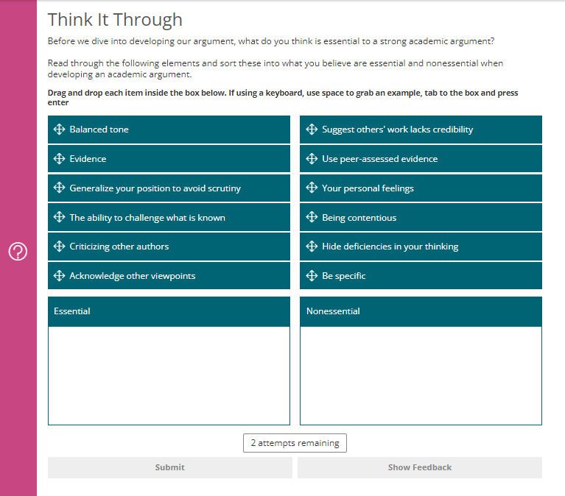
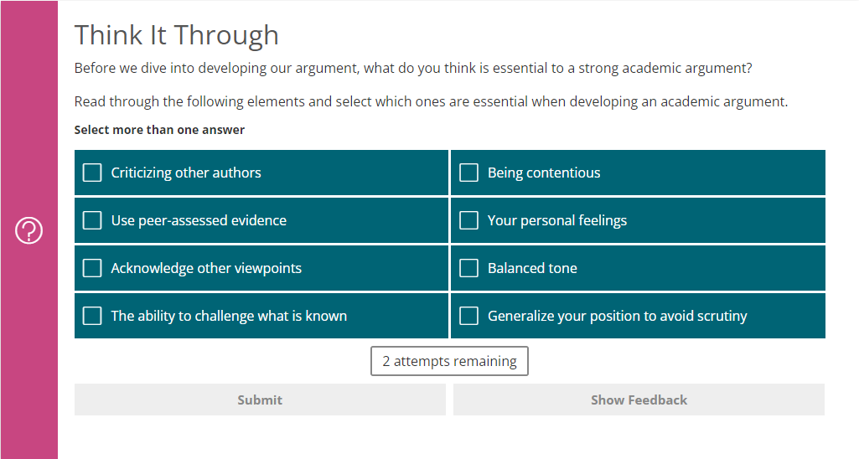
Part 1: Campus Internal Accessibility Work — Activity Remediation
Drag and Drop before
Multiple Choice Question after
Notes:
Mel

Slide 22
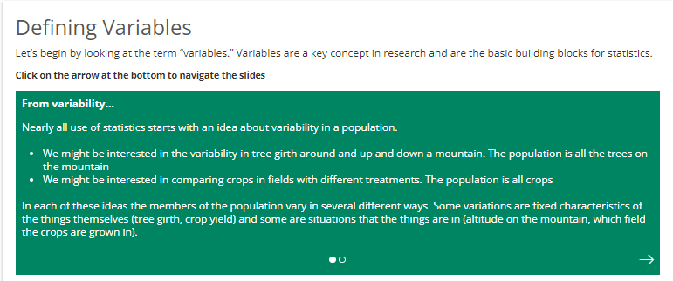
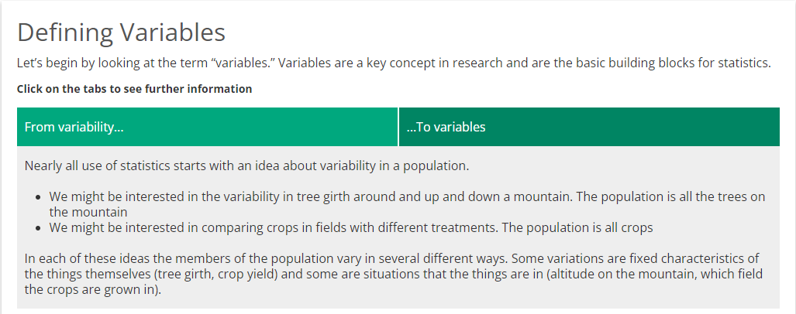
Part 1: Campus Internal Accessibility Work — Activity Remediation (cont'd)
Slides before
Tabs after
Notes:
Mel

Slide 23
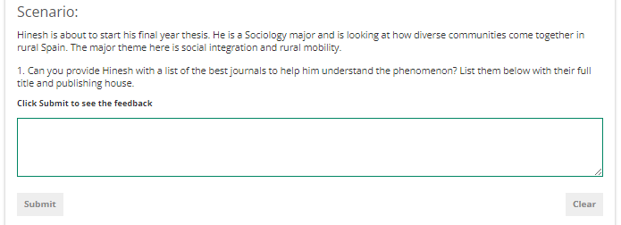
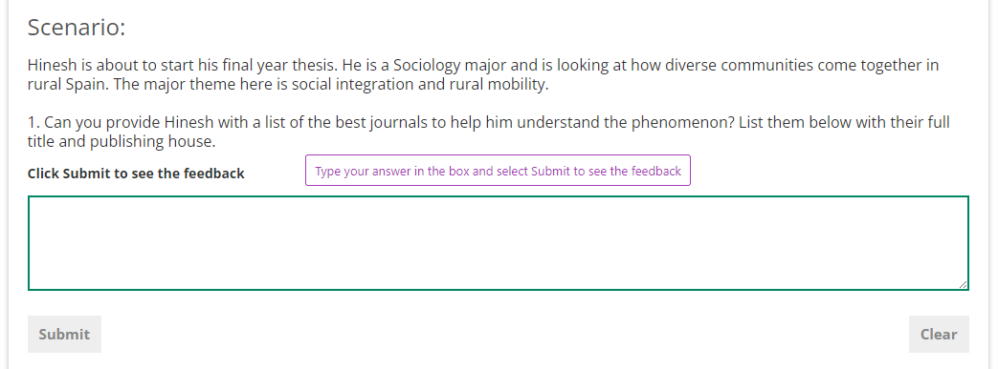
Part 1: Campus Internal Accessibility Work — Input Field Remediation
Open Input before
With ARIA label after

Slide 24
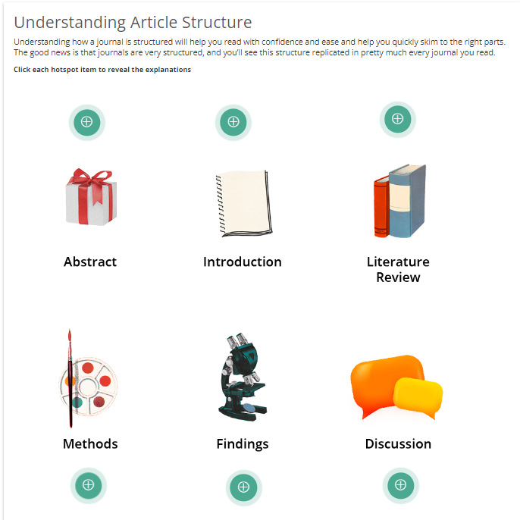
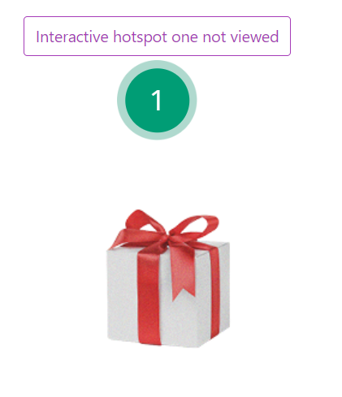
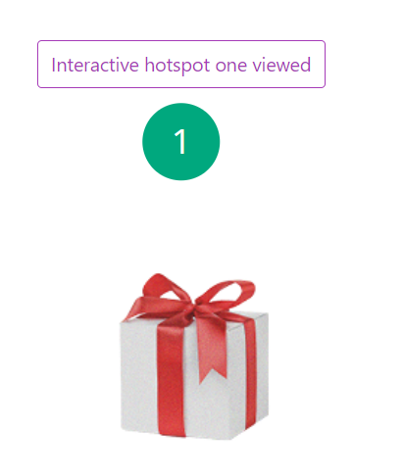
Part 1: Campus Internal Accessibility Work — Hot Graphics Remediation
Hot Graphic with hotspot icons before
With numbered hotspots and ARIA labels after

Slide 25
Part 1: Campus Internal Accessibility Work Completed
Replaced non-compatible components.
Fixed colour contrast issues.
Provided transcripts for all videos.
Remediated and replaced hundreds of PDFs.
Added or remediated ARIA labels on interactive elements.

Slide 26



Part 1: Campus Internal Accessibility Work — Achievements
Improved keyboard accessibility
Improved screen reader experience
Improved experience for all learners

Slide 27
Part 1: Campus Internal Accessibility Work — Approach
Start!
Collaboration
Growth mindset
Intentional approach
Still work to be done
Celebrate!

Slide 28
Tech for All: Testing Sage Campus and the Results
Notes:
Lorenzo

Slide 29
Testing Campus – Methodology
The accessibility assessment was comprised of the following steps:
A sighted accessibility expert conducted an overall technical analysis to identify issues of technical compliance that would affect mobility impaired, deaf/hearing impaired, and low vision users. The evaluator inspected each screen using Google Chrome browser with the Wave and aXe toolbars. Code analysis was conducted using browser Developer Tools.
Keyboard accessibility analysis (for mobility and physically impaired users) was conducted by attempting to thoroughly navigate the Web Application through the keyboard, without using a mouse, using the Google Chrome browser.
For deaf and hard of hearing users, any audio content was assessed for proper captioning.
Notes:
Crista

Slide 30
Testing Campus – Methodology (cont’d)
The accessibility assessment was comprised of the following steps:
The accessibility for low vision users was evaluated three ways: (1) using the screen magnification, palette, and contrast controls provided by the operating systems; (2) using the font resizing capability offered by the browser, and (3) using Color Contrast Analyzer version 2.2.
An evaluator who is legally blind conducted the screen reader testing. The goal was to identify accessibility barriers that are likely to be experienced by users who are blind. The evaluator worked through the Web Application using the JAWS and NVDA screen readers with Google Chrome.
Any usability issues for users with disabilities encountered during the accessibility assessments in Steps I-V were noted for subsequent mention.
Notes:
Crista

Slide 31
Testing Campus – Criteria
WCAG 2.2 AA.
Chrome browser.
JAWS and NVDA screen reader.
Tested representative pages and functionalities across site.
Notes:
Crista

Slide 32

Testing Campus – Demo
Notes:
Crista

Slide 33
Content Accessibility Remediation Plan for 2026
Notes:
Lorenzo

Slide 34
Accessibility Remediation Timeline
Part 1
2023: Internal audit and plan of action.
2024: Accessibility remediation work.
Part 2
2025: TFA audit.
2026: Planned accessibility remediation work.

Slide 35
Part 2: Campus Accessibility Work
Content plan for 2026.
Not able to provide platform plan yet.
3 top-up courses launching in Q1 will have these improvements included.

Slide 36
Part 2: Campus Accessibility Work — Post-TFA Evaluation Plan
Future accessibility work planned for 2026 after TFA evaluation:
Disable pulse animation on Flowcharts, Hints, Hot Graphics, Dialog.
Add ARIA label to Flowchart button.
Improve ARIA labels on Hot Graphics.
Add additional heading to Tabs.
PDF tab order.
Add title attribute to iFrame videos.
Remove radio buttons from Branching.
Fix Feedback headings and make all in-line.
Improve ARIA labels on course progress menu.
Isolated cases.
Notes:
Mel

Slide 37
Part 2: What About the Platform?
Reminder
Platform work is now better integrated into the wider business as usual (BAU) product process.
2026 platform prioritisation will be balanced alongside content work and accessibility development on Sage other product platforms.
Notes:
Lorenzo

Slide 38
Impact on User Groups and How to Build Accessibly
Notes:
Crista

Slide 39
When to Start Thinking about Accessibility
From the start—even in the earliest discussions— consider how users of assistive technologies and alternative approaches to content may interact with your product.
Notes:
Crista

Slide 40
How to Build Accessibly
Consider that the content creation tool has tremendous impact on the end product’s accessibility.
Consider how much autonomy you have in adjusting the tool’s defaults and settings.
Notes:
Crista

Slide 41
Questions?
Contact information:
melissa.kingon@sagepub.co.uk
lorenzo.milani@sagepub.co.uk
lorna.notsch@sagepub.com
cearl@tfaconsulting.com
Notes:
Crista/All

