Slide 1
Helping Everyone Check the Box
Making Forms Accessible for People with Cognitive Disabilities
Jonathan Katz-Ouziel, Opossum House Accessibility
AHG Accessing Higher Ground
November 20, 2025

Slide 2

Agenda
Today, we will discuss:
Common issues that make forms inaccessible for people with cognitive disabilities
Eight methods you can use to make your forms more usable
Broad approaches that support form accessibility
Please hold questions until the end.
This presentation is not:
A complete legal guide
A discussion of HTML and ARIA - this is “form” as colloquially used

Slide 3

About Me
Accessibility professional with over a decade of experience
  Specialized in digital accessibility, cognitive accessibility, and service/program accessibility
  Published research and work on cognitive access, dementia, and restrooms
Independent consultant - Opossum House Accessibility
  Prior work for NYC, Montgomery County, Prince George’s County, and Department of Labor
  Prior freelancer experience
  I also work as a consultant with EdPros Digital
Autistic/OCD
I have worked on, quite literally, hundreds of forms

Slide 4

Introduction
Forms are everywhere in higher education, from application onwards
  Often first experience students have with many forms, or many types of forms
  Gateway to services and opportunities
  Need for print and electronic versions
Many students, staff, and community members with cognitive disabilities face specific barriers on forms
These barriers can be addressed through streamlined solutions
Improvements often make forms easier to complete accurately for all users

Slide 5
Who here has found a form so frustrating that they needed to stop filling it out?

Slide 6

What is cognitive disability?
Any condition that affects thinking, learning, perception, or information processing, usually rooted in brain structure or brain chemistry
Common examples include: autism, ADHD, traumatic brain injury, dyslexia and dyscalculia, intellectual disabilities, memory disabilities, and sensory processing disorders
Needs and ways of doing things vary significantly
Neurodiversity and neurodivergence are one way of thinking about cognitive disability

Slide 7

Common access needs for cognitive disability
Limitations in:
Attention and concentration
Executive function
Memory and recall
Perceiving implied content
Processing information
Social interaction
Understanding words or numbers
(Based on Accessible Community’s useable framework)

Slide 8
Scenario walkthrough:
changing your major

Slide 9

Common barriers on forms
Too complex
Too much information on one page/form
Layout is hard to navigate
Language is too complex
Asking for too much information
Limited flexibility and lack of support to avoid errors
Lack of ways for users to seek help

Slide 10

Methods we will discuss
Keep forms simple
Tell users why
Give tips
Create clear content
Help people remember
Help users avoid errors
Offer human help
And some additional considerations

Slide 11
Tell me about a form you found frustrating, complicated, and potentially useless

Slide 12

Keep forms simple
Avoid PDFs where possible
  Some examples on this deck are from PDFs
  Printable copies may be needed
Keep directions plain, but detailed enough to follow
Use simple and consistent visual layouts
  Avoid visual clutter, including crowded lines
  Group related form fields together
  Separate areas with blank space

Slide 13

Tell users why
Explain the purpose of the form at the beginning
  Users should understand what the form will achieve
  Users should know if there are legal, financial, or academic consequences
Let people know about any privacy and data collection
  You may need to use legally required language
  Use as plain language as possible
Offer additional information on an appendix or separate page
  Only offer the needed context

Slide 14
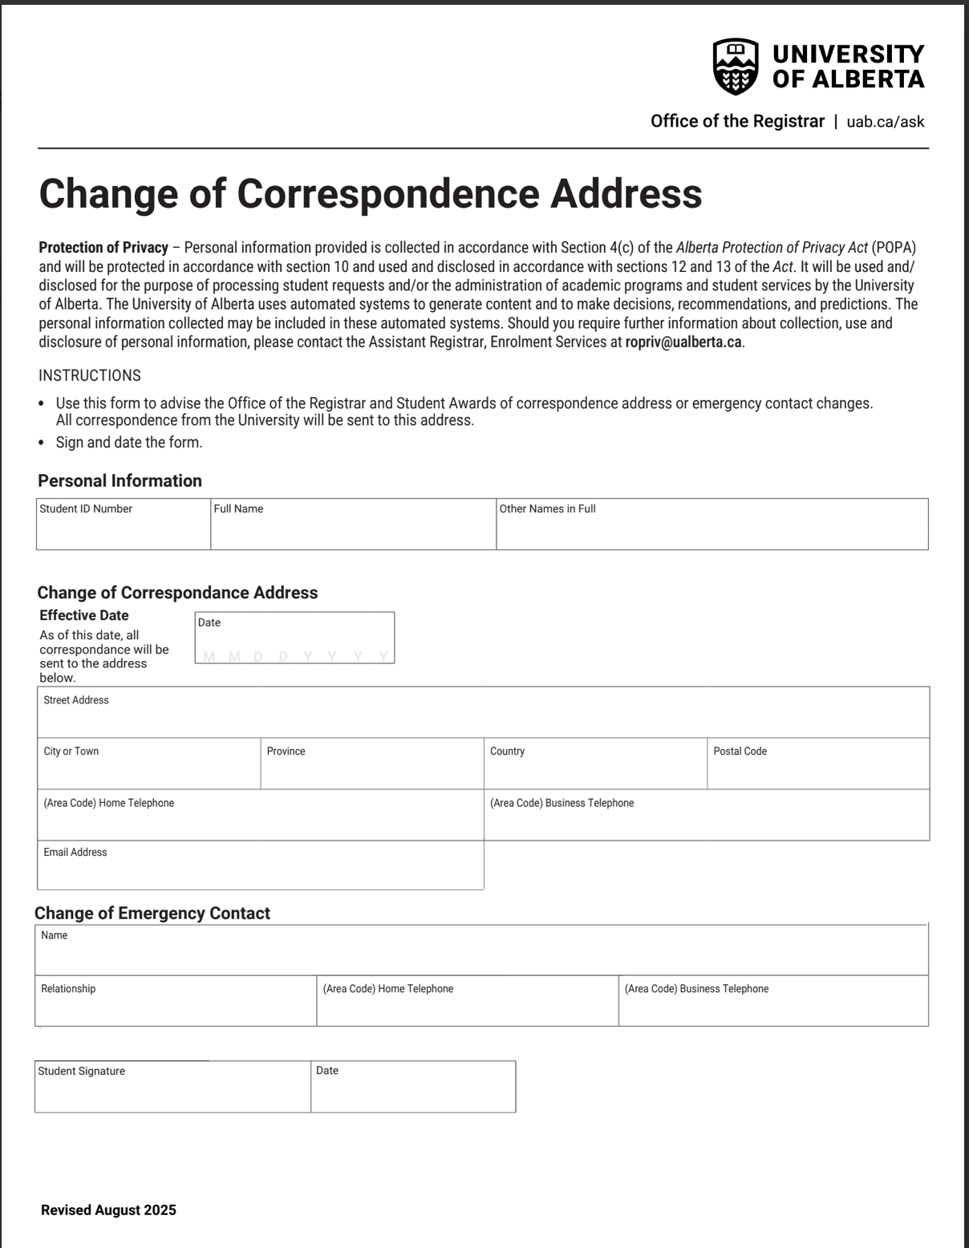
Example of a simple form that says why
From: University of Alberta
PDF version of the form

Slide 15

Give tips
Offer tips to help people:
  Remember things
  Provide correct information
  Give the most appropriate information
Tips can provide directions or examples
  Directions: write your birth date in a month-day-year format
  Examples: 09-12-1991 or September 12, 1991
Keep tips plain language
Try to keep users on the form

Slide 16
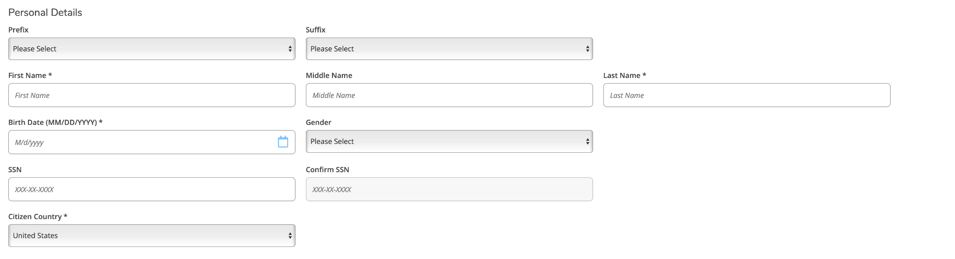
Example of tips - and a cognitive access issue
From: Howard Community College (Columbia, MD)

Slide 17

Create clear content
Use plain language (8th grade reading level)
Avoid jargon where possible
  Specific language is sometimes needed
  Jargon depends on context - e.g. common campus terms
Use contrasting colors
Use bold and italics sparingly
Avoid all-caps
Use sans-serif fonts

Slide 18

Help people remember
Many neurodivergent people cannot recall things on the spot
Others have trouble recalling
“No timing” WCAG requirements
Only ask for the information you need
Use tips to offer hints
  “Your passport number is in the top right corner”
  Refer to prior slide
Allow for auto-fill and copy-paste
  Use HTML over PDF for this reason (and others)

Slide 19
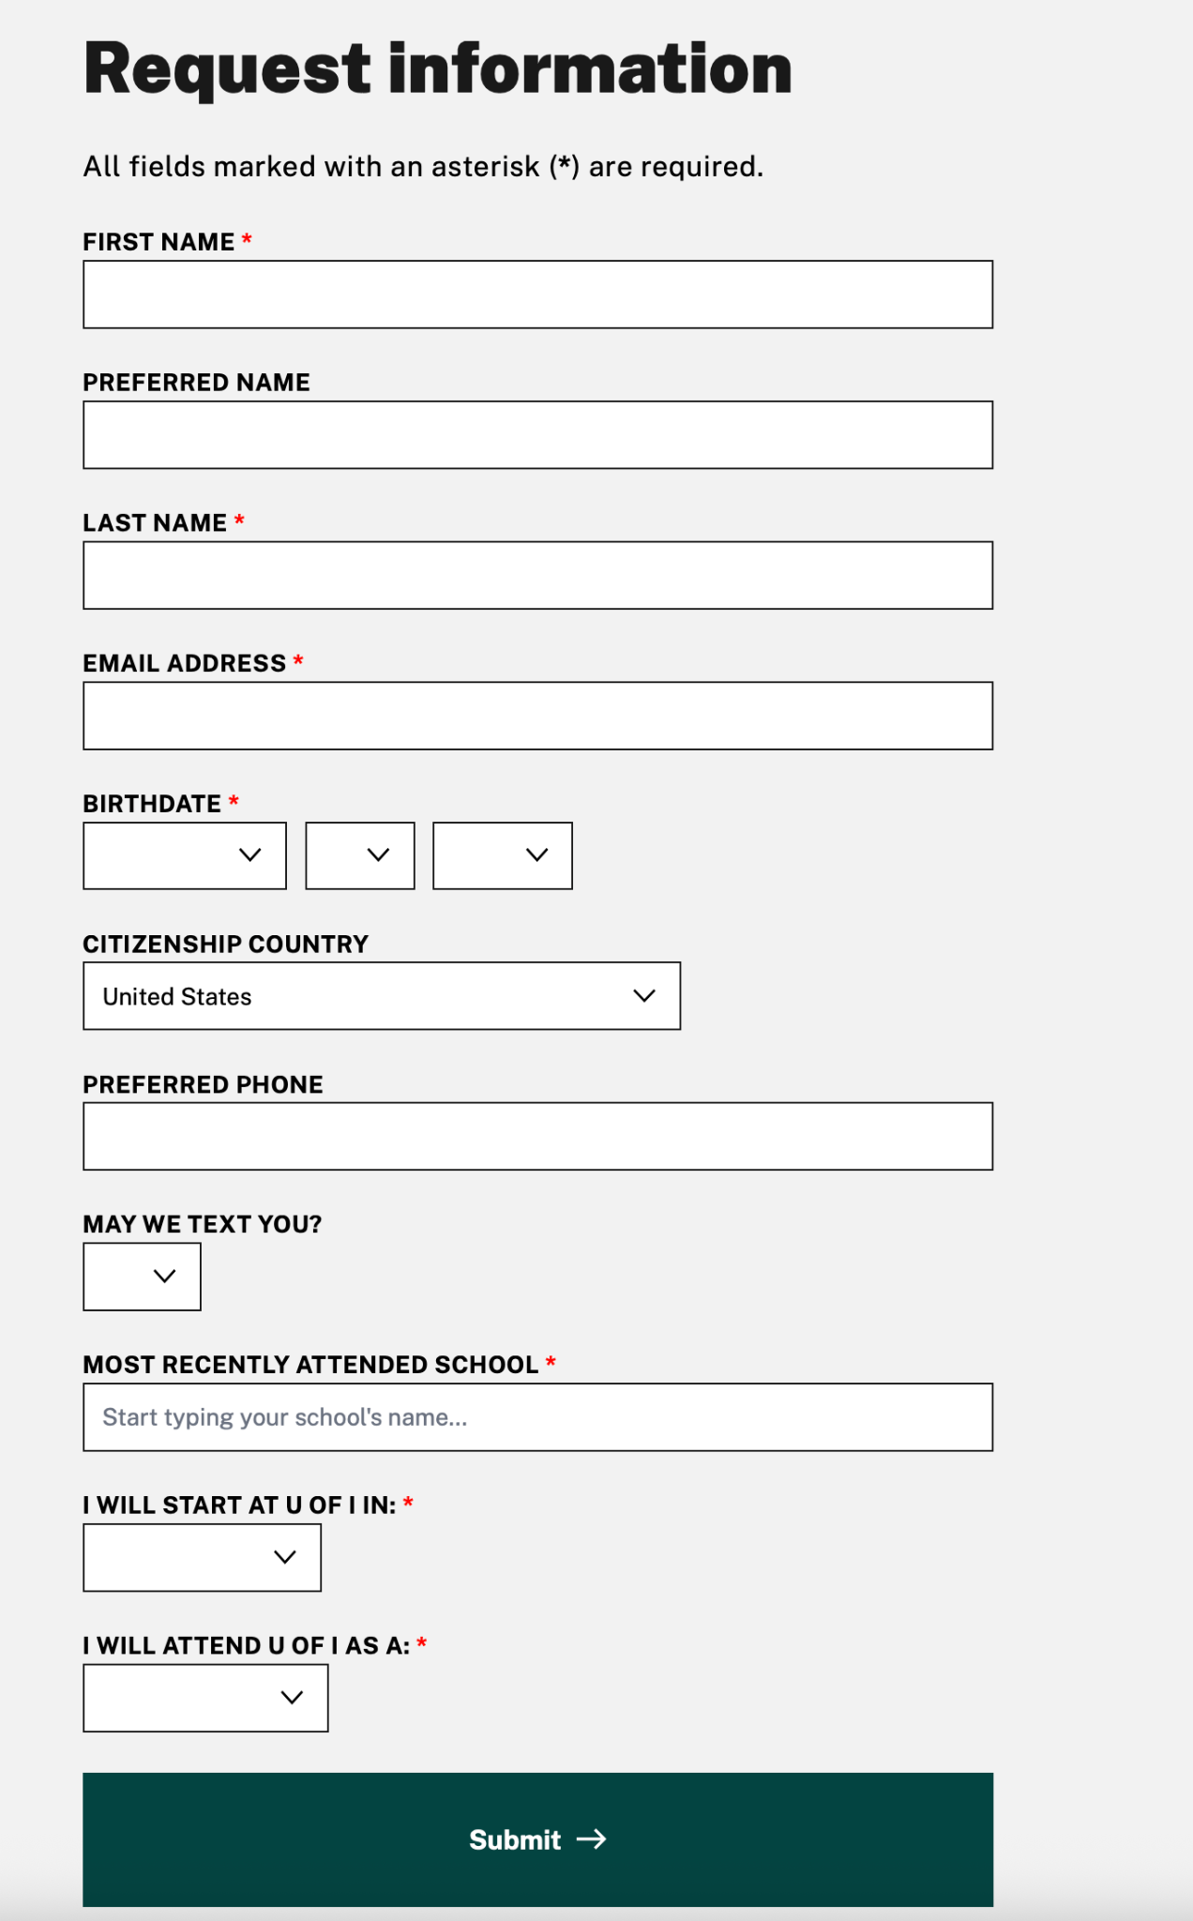
Example of clear content with recall help
From: University of Idaho

Slide 20

Help users avoid errors
Give tips on how to complete the form
Give examples of information you are looking for
Anticipate common errors and include relevant information
  For remaking forms - review common mistakes
  You can often guess off of other forms
Screen questions with current students and staff - ask for feedback
Make it easy to find human help (more to come)

Slide 21
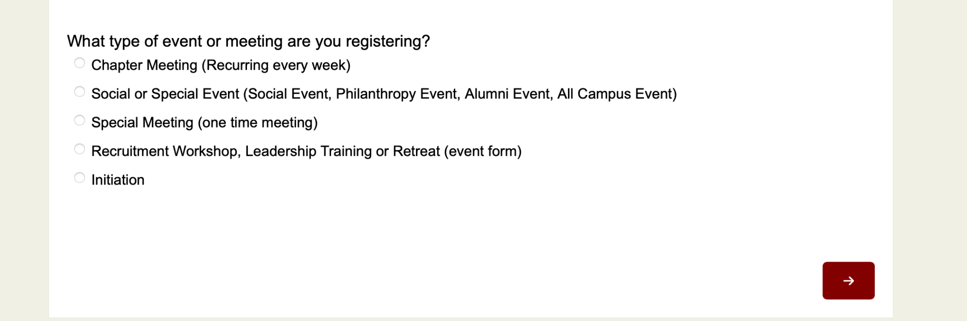
Example of helping avoid errors
From: Washington College (Chestertown, MD)

Slide 22
Who here has said “representative” on an automated customer service line?

Slide 23

Offer human help
Have a feedback method that is simple and easy to find
  Example: “Email this person/Text this number”
  Repeat as needed and more!
Focus on human help
  AI chatbots both ineffective and inaccessible
  Particular AI barriers for people with cognitive disabilities
  FAQs rarely address specific access needs
Have a system or protocol for human help

Slide 24
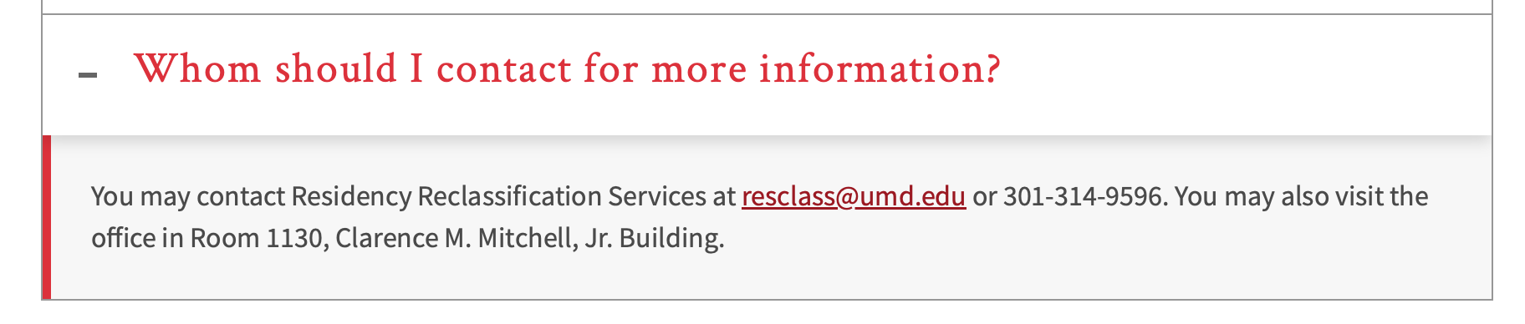

Example of human help
From: University of Maryland - College Park, Office of the Registrar

Slide 25

Additional Considerations
Use dropdowns sparingly
Allow for text/open-ended answers where possible
Confirm receipt or submission
Have a non-PDF form when possible
  PDFs can be helpful for a printable version
  HTML native forms when possible
One more question to ask…

Slide 26
Ask yourself: do you need a form for this task?

Slide 27
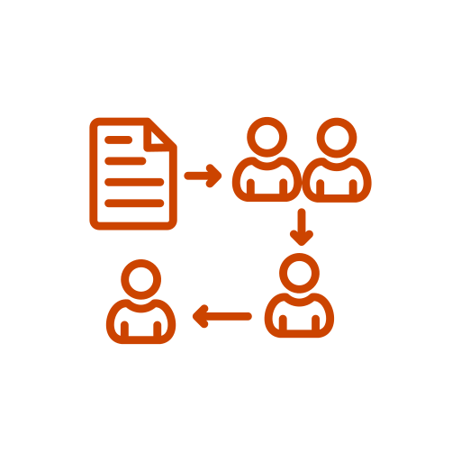
Ways to reduce the number of forms
Reuse/repopulate information on online forms
Offer a way to “add” pre-existing information
  Autocomplete
  Linking student or staff records
  Be mindful of privacy rules
Consolidate processes
Emails, phones, and in-person sign ups
Some role for decision softwares

Slide 28
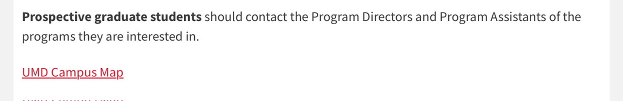
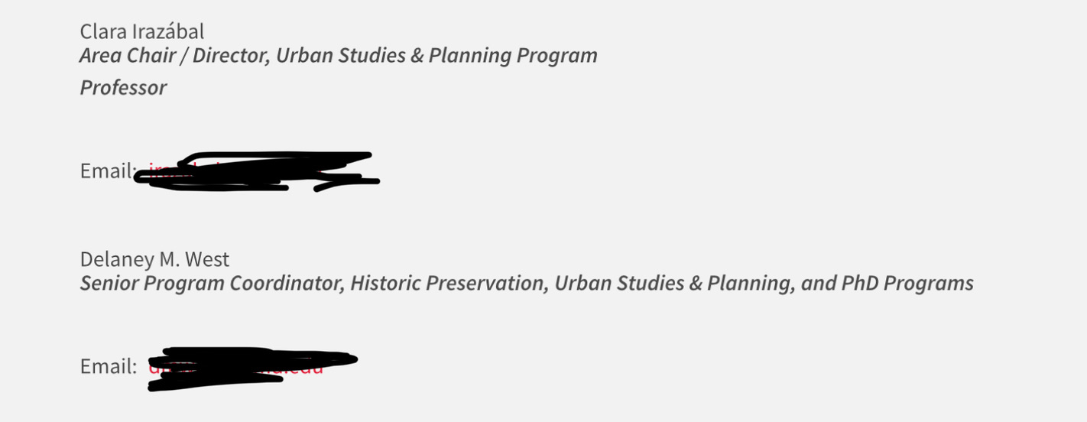
Example of skipping a form
From: University of Maryland - College Park, School of Architecture, Planning, and Preservation

Slide 29
Questions and Answers

Slide 30
Thank you! Stay in touch.
Jonathan@OpossumHouseAccessibility.com

