Slide 1

Optimizing Zoom Interactions and Collaborations
George Joeckel, M.S.

Slide 2


About WebAIM
@ Utah State University | Celebrating our 25th anniversary
Training
Services
Web Accessibility (virtual/f2f)
Document Accessibility (online)
Zoom Accessibility (online | Jan 2025)
Website Evaluations
WAVE Tools Suite
Strategic Consultation
Notes:
Non-profit web accessibility consultancy located at USU
Quick tour webaim.org
Link to WAVE video

Slide 3
Please Note 😁
Zoom is a dynamic platform.
This information is based on
our latest review and testing.

Slide 4

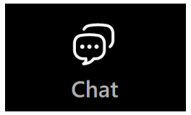
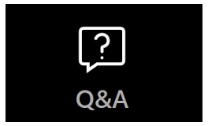
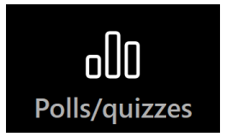

Five Zoom Tools
Reactions
Chat
Q & A
Polls/quizzes
Whiteboards

Slide 5


Two Roles
Participants
Presenter
Notes:
I’ll review some general accessibility issues related to these tools from two perspectives:
participants
Presenter
When I share information for presenters, keep in mind that monitoring these tools is often delegated to one or more people.

Slide 6
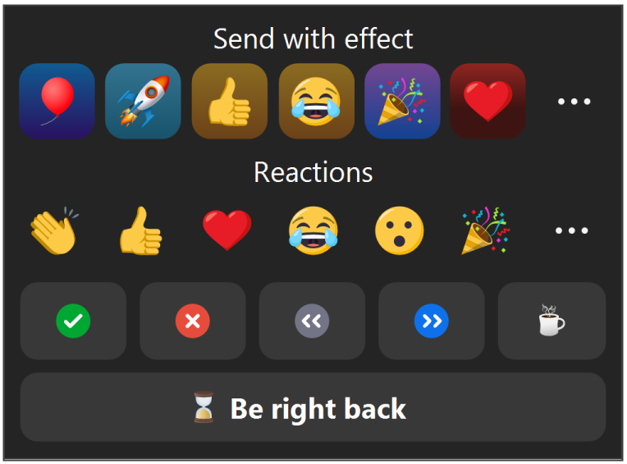
Reactions | participants
NOT presented directly to screen reading software (SRS) users (JAWS, NVDA, Voice Over)
When an SRS user is a Host they are alerted to a raised hand
Notes:
SR users would have to search for reactions in the Participant’s list.
Exception: when a SR user is a host alerted to raised hand.

Slide 7



Reactions | presenter
When appropriate share verbally :
“I see a number of you are clapping your hands for this idea.”
Raised hand does not dismiss automatically
  Open the Participants panel.
  Find the participant in the list.
  Click the “lower hand” button.
Notes:
Determine when appropriate to share verbally.
Be aware that “Raised Hand” does not dismiss automatically.

Slide 8


Chat | participants
A large volume of Chat and/or off-topic messages can distract or overload some users, especially during presentations
SRS users receive an alert for each public Chat message—they may disable these alerts
Notes:
Large volume/off topic can distract or overload some users
SRS users receive an alert for every public Chat message

Slide 9
Chat | presenter
Sharing Chat messages verbally:
  State that you are responding to a Chat message or question.
  Read or summarize the message.
  When appropriate, respond or invite someone to respond.
For high-volume/off-topic messages:
  Share verbal guidelines with participants, OR
  Limit Chat to Hosts and Co-hosts

Slide 10
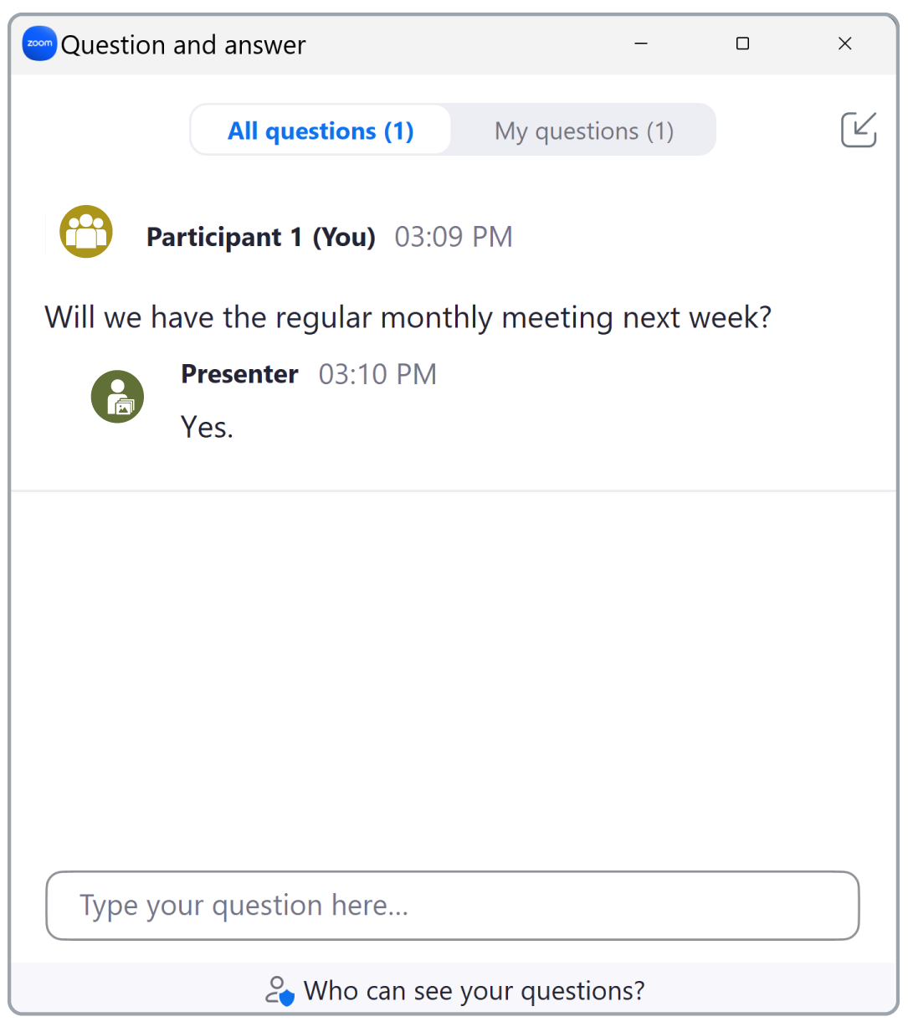
Q & A | participants
Consider also typing verbal answers with detailed info
SRS users are notified when:
  A question is asked
  A public answer is typed in
  A private answer is sent to them
Notes:
Describe Q & A interface
Consider typing verbal answers
SRS notifications
A question is asked
A public answer is typed in
A private answer is sent to them

Slide 11
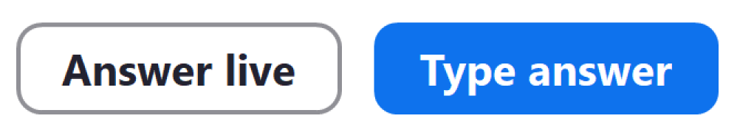

Q & A | presenter
Using “Answer live”
  State that you are responding to Q&A
  Read or summarize the question
  Respond or invite someone to respond
Using “Type answer”
  Type your answer into the text field.
  Optional: check “send privately” to send the answer directly to the participant.

Slide 12
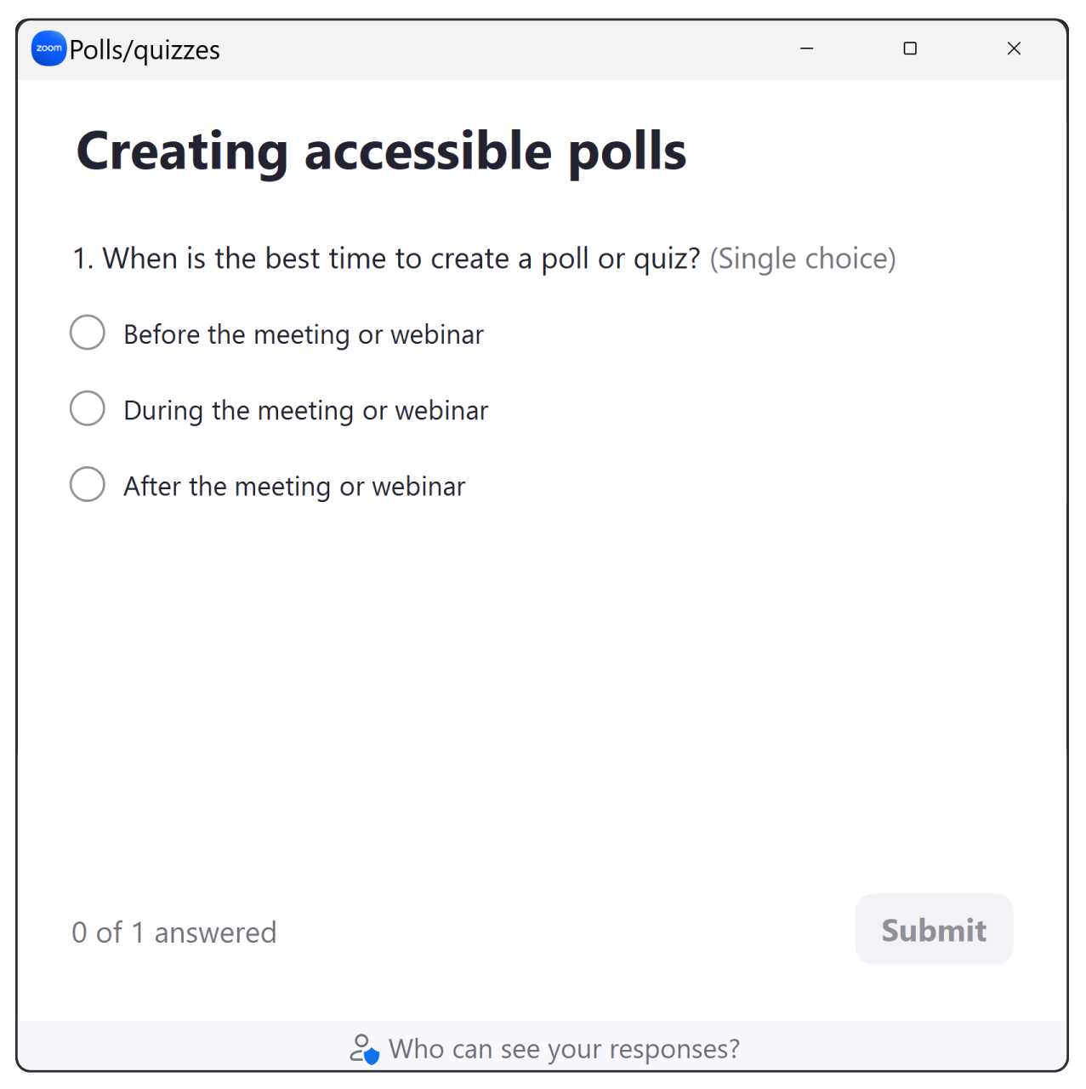
Polls/Quizzes | participants
Participants with cognitive disabilities:
  Use plain language
  Ask succinct questions
  Provide sufficient time to answer
SRS users:
  Notified when a poll is launched
  User interface is keyboard accessible
  Access to visual results may not be accessible
Notes:
Describe poll/quizzes UI
In order to optimize polls for participants with cognitive disabilities
SRS users

Slide 13



Polls/Quizzes | presenter
Provide a summary of the poll when appropriate
Maintain quiet during the poll
Ensure enough time to respond
  Monitor the percentage of participant answers
  “Does anyone need more time?”
Notes:
When you first open the poll, you may want to provide a summary:
The number of questions
The type of questions
The amount of time planned for answering the poll
Mute all mics

Slide 14

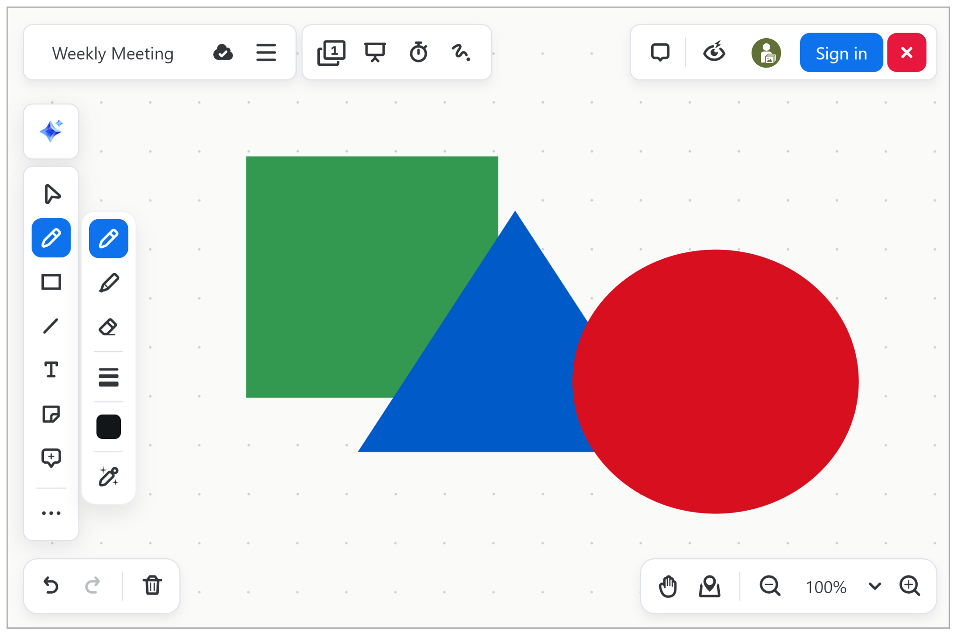

Whiteboards | participants
Keyboard users:
  Add, modify, remove, and move most objects
SRS users:
  Read whiteboard text
  Access some information about an object
  Hard to determine object order/orientation
Pen tool requires touchscreen/mouse

Slide 15

Whiteboards | presenter
When adding visual information, provide an audio description
When others are adding information:
  Ask them to also provide audio descriptions when needed, OR
  Provide them yourself

Slide 16

Questions?

Slide 17
Contact
accessiblezoom@webaim.org

