Slide 1

WCAG Unwrapped:
A People’s Guide to Accessible Digital Experiences
Accessing Higher Ground 2024
Dave D. and Robin E.

Slide 2
What is WCAG truly about?

Slide 3
Agenda
Brief overview of WCAG
The People Perspective
  Personal Technology Experiences Videos
  Connection to WCAG
  Interactive Brainstorming
Closing

Slide 4
Brief Overview of WCAG

Slide 5
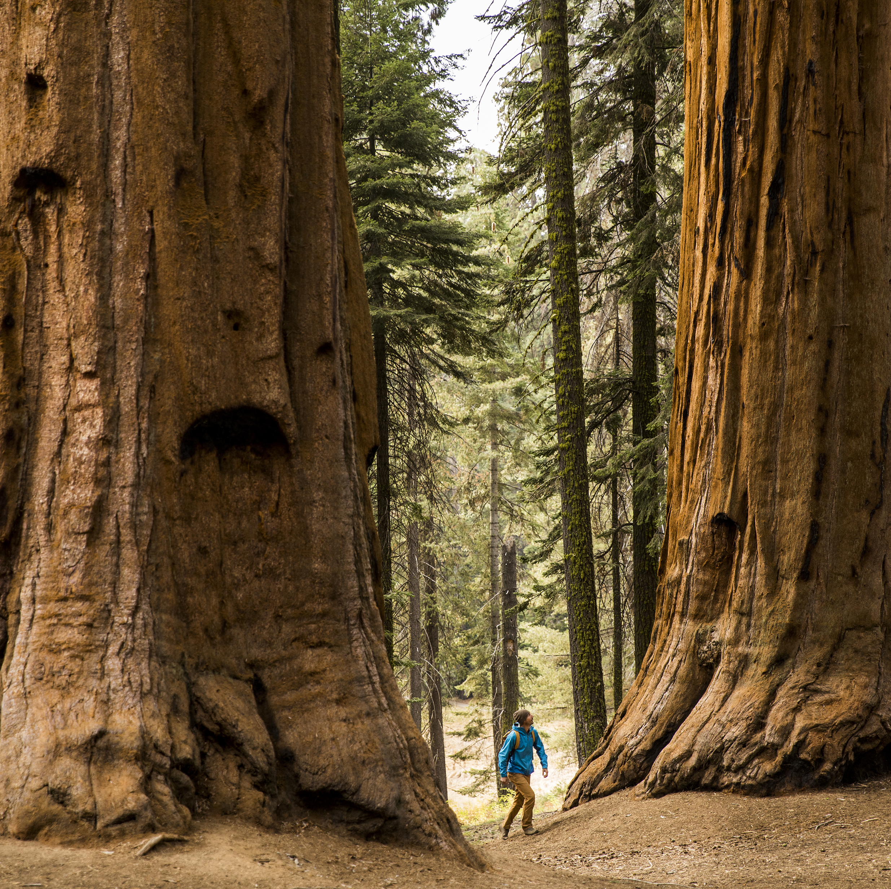
WCAG is huge!
Many guidelines, success criteria, techniques, and failures.

Slide 6

WCAG Principles
Perceivable (1.x.x)
Operable (2.x.x)
Understandable (3.x.x)
Robust (4.x.x)

Slide 7


A Person-First Approach
Knowing people first, WCAG can be more easily “unwrapped”

Slide 8
People Perspectives

Slide 9
Meet Hina

Slide 10
Hina’s Video Shown During Presentation

Slide 11
Hina’s Group Discussion
WCAG unwrapped
  Perceivable, Operable, and Robust
Barriers to access
  Hina’s
  Your students’, clients’, customers’
Solutions?

Slide 12
Unwrapping Unlabeled Buttons
People Experience
WCAG
“…sometimes they make unlabeled buttons.”
Perceivable
  1.1.1 Non-text Content
Operable
  2.5.3 Label in Name
Robust
  4.1.2 Name, Role, Value

Slide 13
Unwrapping Carousels
People Experience
WCAG
“…sometimes the carousel rotates right away, and then you don’t know what just happened.”
Perceivable
  1.3.1 Info and relationships
Operable
  2.1.1 Keyboard
  2.2.2 Pause, Stop Hide

Slide 14
Unwrapping Tables
People Experience
WCAG
“…in tables where his grades and assignments are shown…I can’t understand…which grade is associated to which assignment...the grid is not accessible.”
Perceivable
  1.3.1 Info and Relationships

Slide 15
Meet Jeannie

Slide 16
Jeannie’s Video Shown During Presentation

Slide 17
Jeannie’s Group Discussion
WCAG unwrapped
  Perceivable
Barriers to access
  Jeannie’s
  Your students’, clients’, customers’
Solutions?

Slide 18
Unwrapping Captioning
People Experience
WCAG
“…sometimes the captioning isn’t all that wonderful, and you get some really strange sentences.”
Perceivable
  1.2.2 Captions (Prerecorded)
  1.2.4 Captions (Live)

Slide 19
Unwrapping Interpreting
People Experience
WCAG
“…when I have the interpreter and the captions both, that is amazing…”
Perceivable
  1.2.6 Sign Language (Prerecorded)

Slide 20
Meet Marc

Slide 21
Marc’s Video Shown During Presentation

Slide 22
Marc’s Group Discussion
WCAG unwrapped
  Perceivable, Operable, Robust
Barriers to access
  Marc’s
  Your students’, clients’, customers’
Solutions?

Slide 23
Unwrapping Small Buttons
People Experience
WCAG
“…certain buttons are small. It takes me more time to do things like that if they’re really tiny.”
Operable
  2.5.8: Target Size (Minimum)

Slide 24
Unwrapping Contrast
People Experience
WCAG
“…things that have higher contrast…are easy to read.”
Perceivable
  1.4.3: Contrast (Minimum)
  1.4.6: Contrast (Enhanced)
  1.4.11: Non-Text Contrast

Slide 25
Unwrapping Different Assistive Technology Use
People Experience
WCAG
“Originally I was using a keyboard and mouse…then I found speech recognition...and [then] I found eye gaze.” - Marc
Robust
  Compatible 4.1

Slide 26
Meet Eric

Slide 27
Eric’s Video Shown During Presentation

Slide 28
Eric’s Group Discussion
WCAG unwrapped
  Operable, Robust
Accessible technology stories?
Barriers to access
  Eric’s
  Your students’, clients’, customers’
Solutions?

Slide 29
Unwrapping Speaking Names
People Experience
WCAG
“…some websites I go to, there’s not a single one that has a number associated with it.”
Operable
  2.5.3: Label in Name
Robust
  4.1.2: Name, Role, Value

Slide 30
Unwrapping Multiple Technologies
People Experience
WCAG
“It would be great if…my PC and my iPhone and my iPad, if the websites…were accessible for all those different devices.” - Eric
Robust
  Compatible: 4.1

Slide 31
Meet Kyle

Slide 32
Kyle’s Video Shown During Presentation

Slide 33
Kyle’s Group Discussion
WCAG unwrapped
  Perceivable, Operable, Understandable
Accessible solutions?
  Kyle’s
  Your students’, clients’, customers’

Slide 34
Unwrapping Keyboard
People Experience
WCAG
“I pretty much rely almost entirely on the keyboard.” - Kyle
Operable
  2.1.1: Keyboard

Slide 35
Unwrapping Forms
People Experience
WCAG
“I love forms that let you select information you’ve already entered…” - Kyle
Perceivable
  1.3.5 Identify Input Purpose
Understandable
  3.3.7 Redundant Entry

Slide 36
Meet Alicia

Slide 37
Alicia’s Video Shown During Presentation

Slide 38
Alicia’s Group Discussion
WCAG unwrapped
  Perceivable
Barriers to access
  Alicia’s
  Your students’, clients’, customers’
Solutions?

Slide 39
Unwrapping Text
People Experience
WCAG
“Another thing that I use to help me focus is text-to-speech.”
“If I am really tired or in pain, I will probably skip the [image of text] pin entirely [because text-to-speech won’t read it].”
Perceivable
  1.3.2: Meaningful Sequence
  1.4.5: Images of Text
  1.4.9: Images of Text (No Exception)

Slide 40
Closing
What is WCAG truly about?

Slide 41
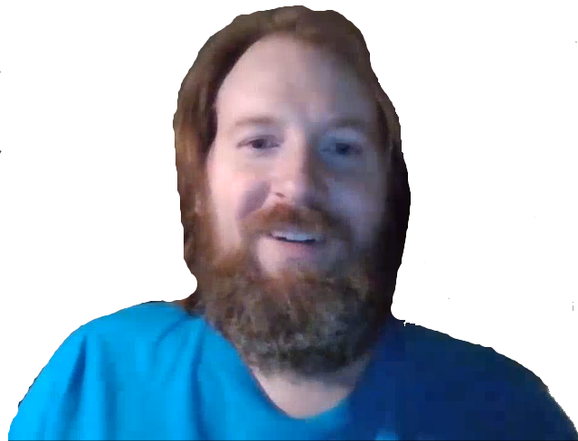
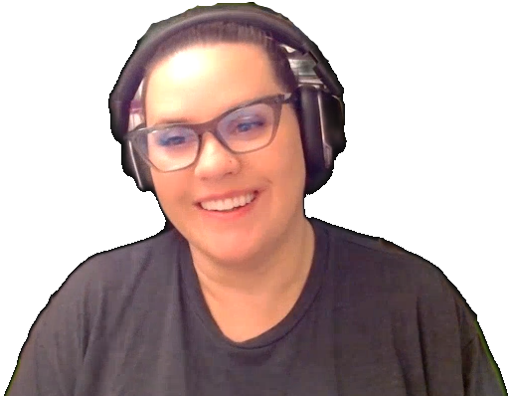
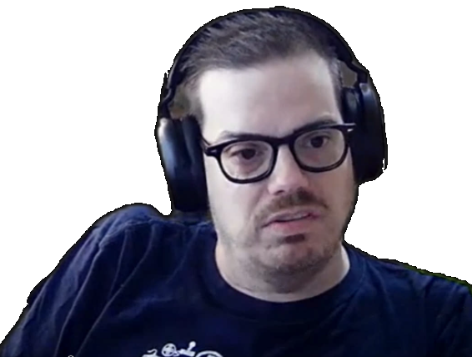
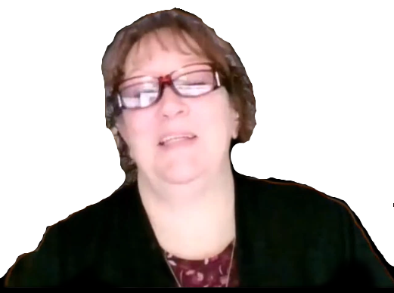

People

Slide 42
Thank you!
Further Questions?
Contact us at AccessibilityWorkRequest@nelnet.net

