Slide 1
Accelerated PDF Remediation with Augmented Classification AI
Accessing Higher Ground
November 15, 2024

Slide 2
Agenda
Session Summary
Introduction
Objectives of this Session

Slide 3
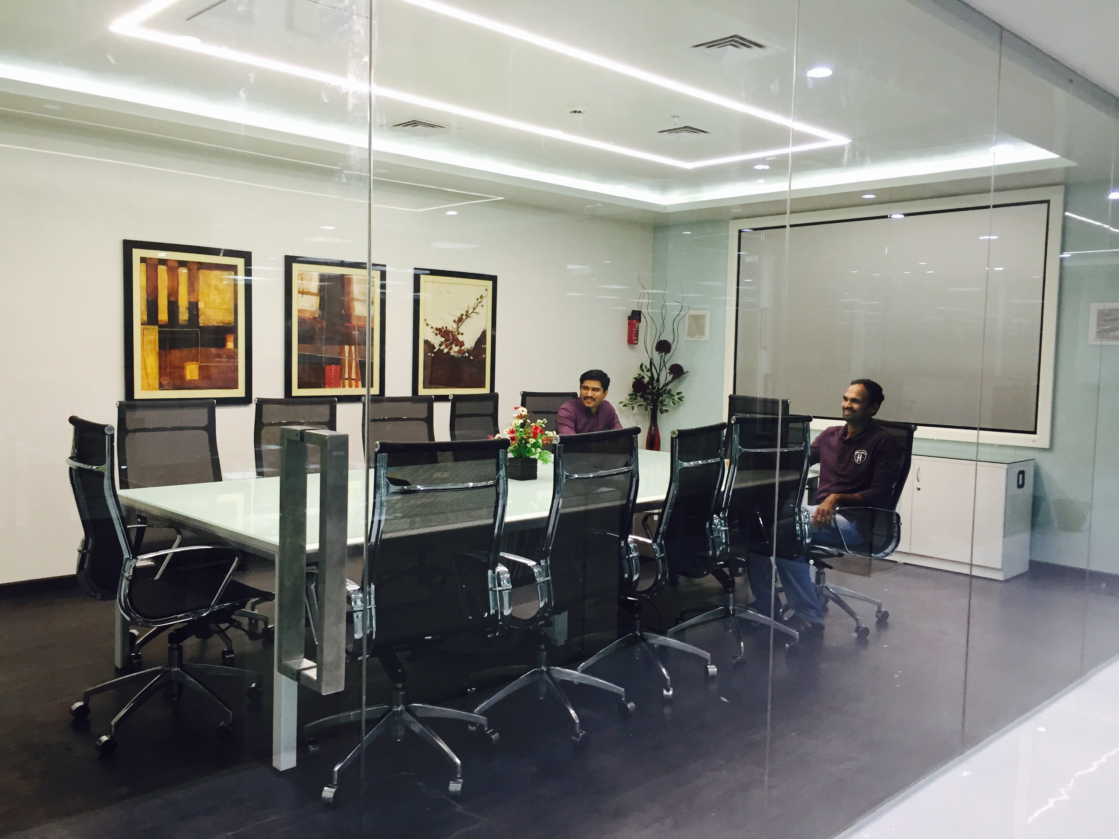
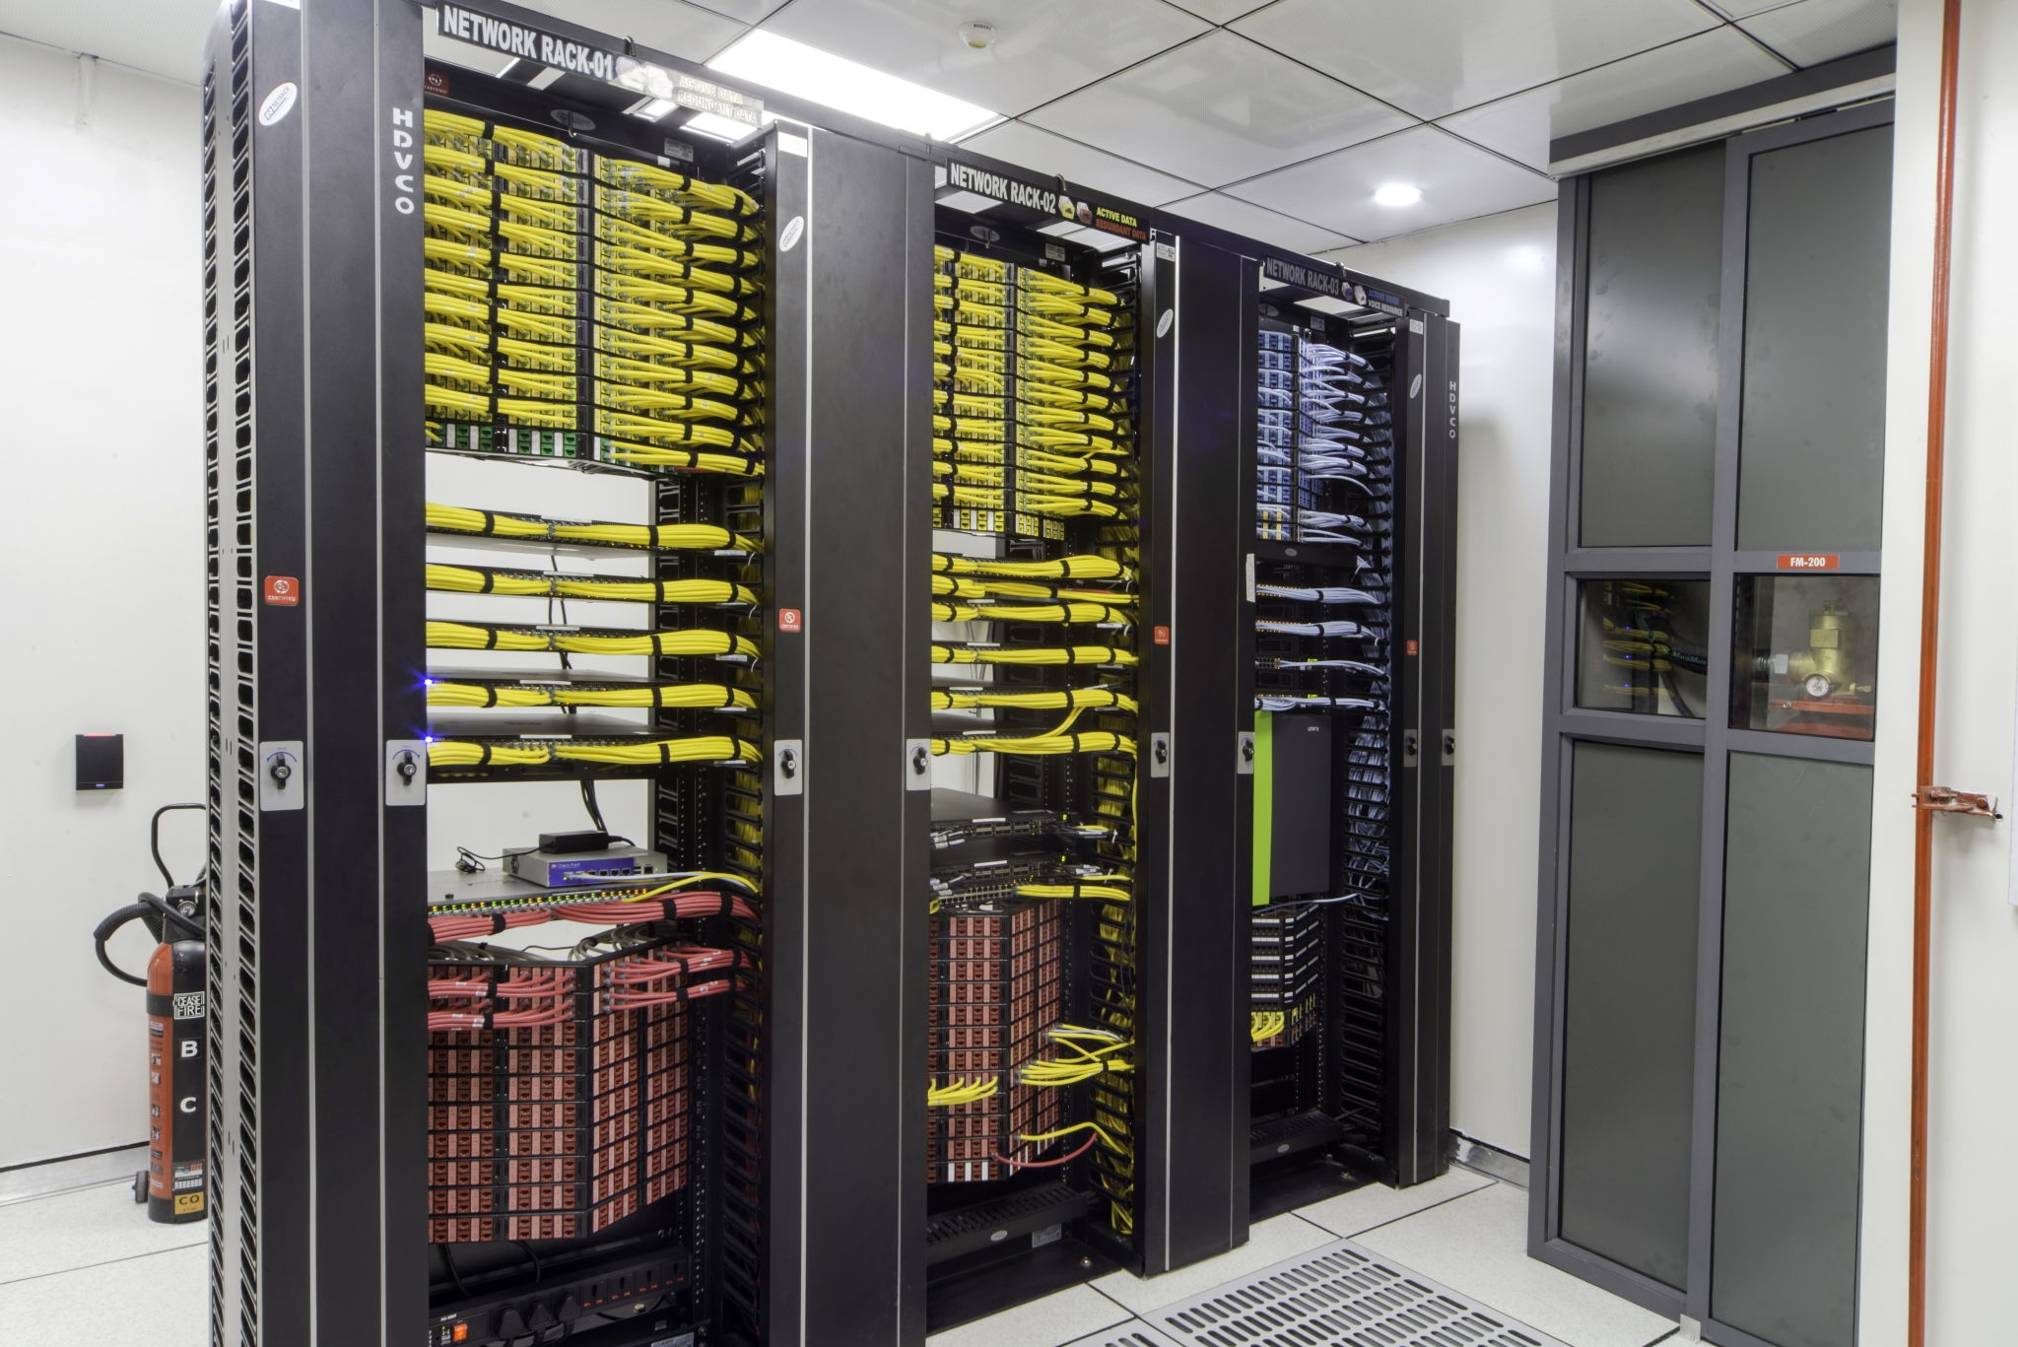
Introduction - Who is Apex?
Apex CoVantage is a leading provider of digital conversion and typesetting services with over 35 years experience working with large national libraries, publishers, U.S. Government agencies, and, private sector clients.
2,000 Global employees
9 Global Offices
Publishing
Pre-press
Accessibility
Content conversion
Cultural Heritage
Libraries
Museums
Archives

Slide 4
Apex Engagement and Thought Leadership
Active Engagement in Professional Organizations
SSP
W3C
NISO
BSIG
IPTC
Apex Blog
Publishing Whitepaper
Multichannel Workflow Design Expertise and Consulting

Slide 5
Services Overview
Book Production
Journal Production
Digital Products
XML
EPUB
TIFF/JPEG2000
PDF
Accessible EPUB/PDF
Software
ADAPT AI
CAPS
CAT AI
GenerATe
PACE
ProTrak
Accessibility
Born Digital
Remediation
Metadata
Creation
Normalization
Enhancement
Tagging
Indexing
Semantic Enrichment
Transcription
Data Labeling

Slide 6
Abstract
AI-facilitated PDF accessibility remediation workflows are discussed.
A Yolov8 classification model running on Python framework was trained to detect objects in PDF and differentiate them for tagging.
The PDF content stream was rendered to XML using three software tools: A subset of Apex’s IZAAC platform for PDF data extraction, Apex’s PDF2XML software, and a toolset for verifying the XML.
Python software was used to integrate object metadata for tagging into the PDF XML content stream.
Python and iTEXT were used to recast the PDF stream without disrupting the presentation or altering the content.
Strengths – Speed (2x Productivity) and reduction of human error
Weaknesses – Models are Gen 1, need to expand model training
Software alone fails to meet all Accessible PDF Checks

Slide 7
Objectives of this session
Address how automation improves accessible product workflows
Workflow design principles
Describe the Classification AI
Defining accessible tagging development break points
Verifying the AI model
XML export
XML markup
Rendering tagged PDF
Verifying the Tagged PDF
Operationalize
ADAPT AI
Documenta11y
IZAAC
Next steps

Slide 8
Design and Workflow Principles
Tools drive high quality/high volume production while taking advantage of human intelligence
Modular
It is not necessary to use all tools in all workflows
Adaptable
Apex will develop solutions for multiple verticals
Configurable
Workflows vary
Customers have unique requirements
Extensible

Slide 9
Workflow Principles
Know your source
Know your target
Exploit objective decision points
Rules definition
Tool selection
Software automation
Use software to focus humans
Quality and Tolerance for Error
Industry standards (ANSI/ASQ Z1.4-2003; WCAG 2.1; PDF/UA)
Bespoke requirements
Criteria setting
Tiered-evaluations

Slide 10
Classification AI
A classification AI is trained to look for patterns and content structures so that they can be labelled.
Labelling creates metadata that can be exploited for tagging.
The classification AI is trained using a curated collection of source PDFs representative of work processed by Apex
Yolov8 computer vision model running on Python framework
For more information on Yolov8: https://yolov8.com/

Slide 11
Results of early model training and detection
Focus on common document structures
Sections
Headings
Paragraphs
Lists
Tables
Images
Within a few weeks, got good results on the above.
Model supported Image PDF and PDF Normal.
Set break point to work on tagging and writing PDF.

Slide 12
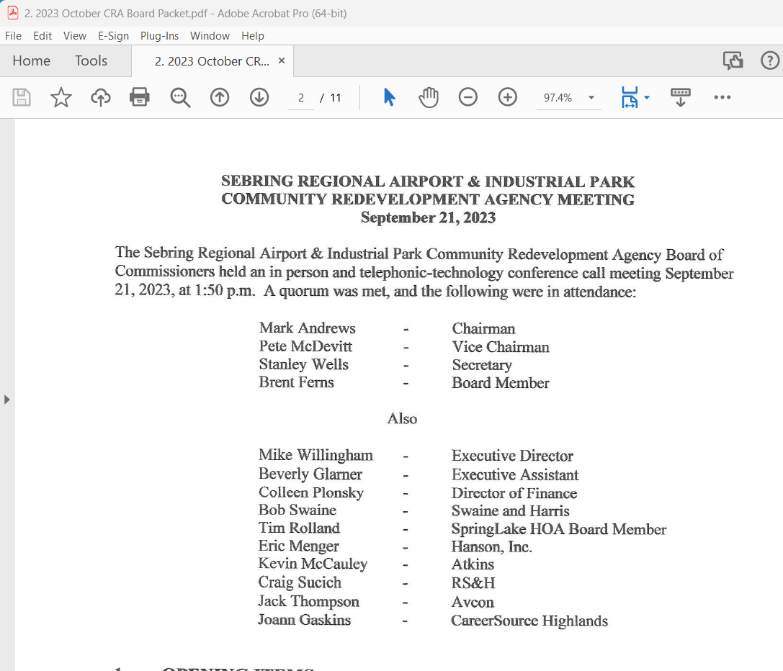
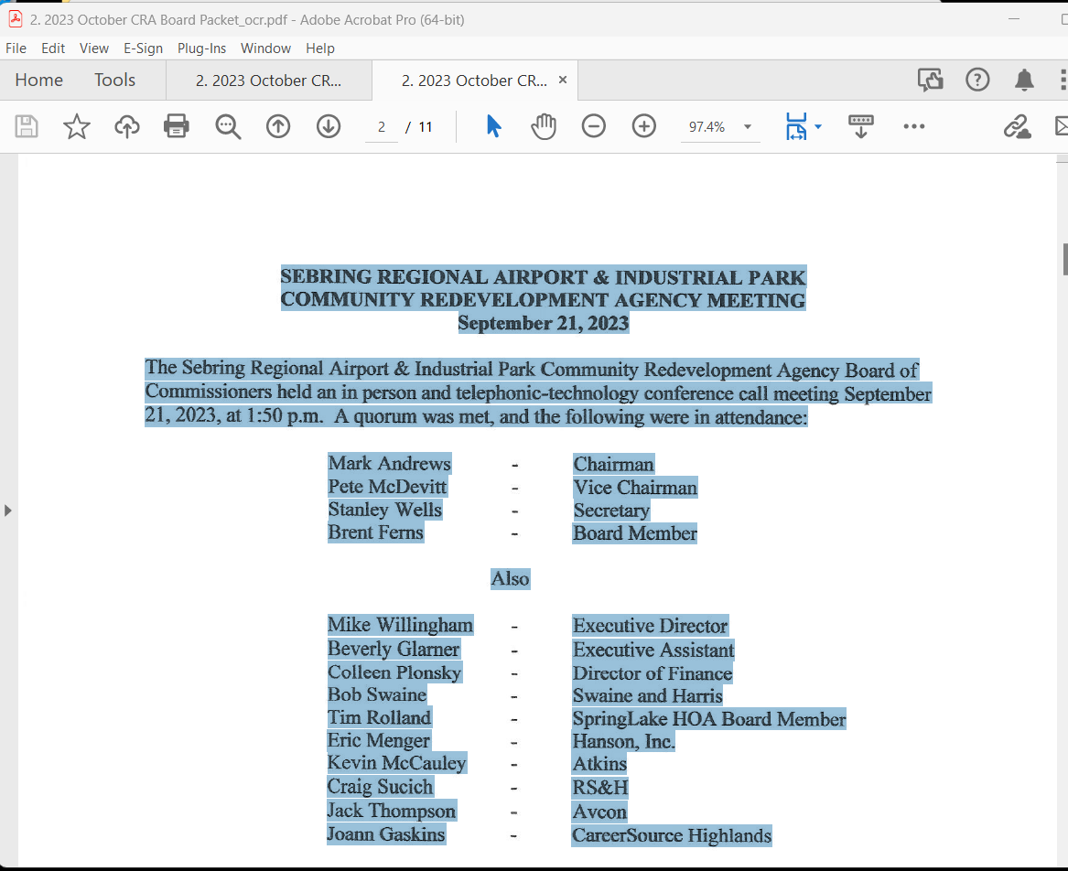
Extracting the content stream for labeling (1)
Image PDF and OCR
IZAAC tools for conversion

Slide 13
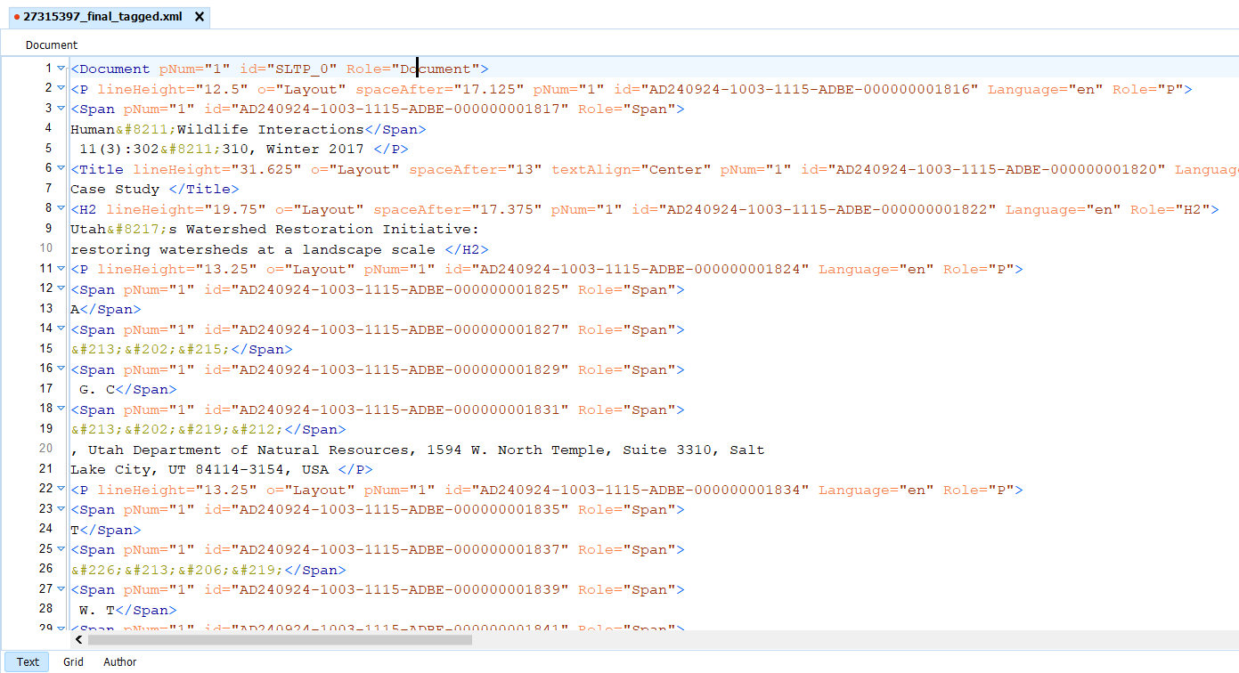
Extracting the content stream for labeling (2)
Yolov8 labels used for locating content in the PDF stream prior to generating XML
PDF2XML

Slide 14
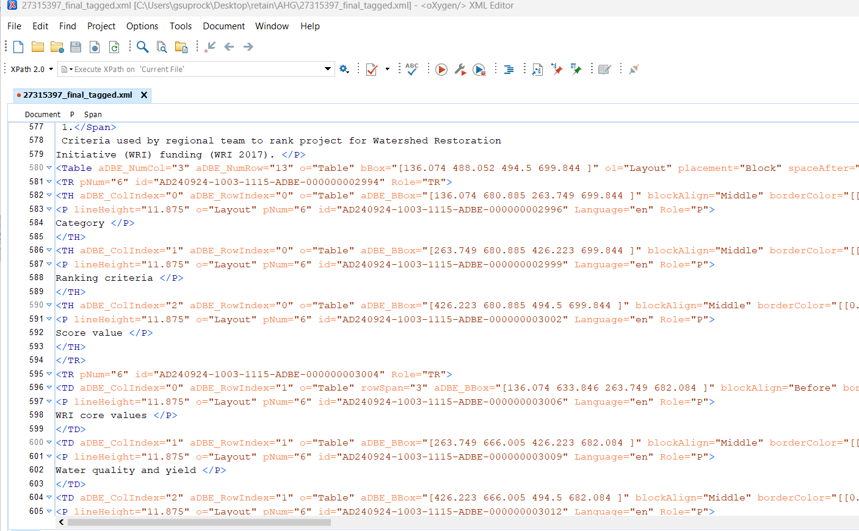
Tagging and Verification

Slide 15
Rendering Tagged PDF
Python and iTEXT were used to recast the PDF stream without disrupting the presentation or altering the content
Lengthy development phase
Character encoding issues
Layered PDFs

Slide 16
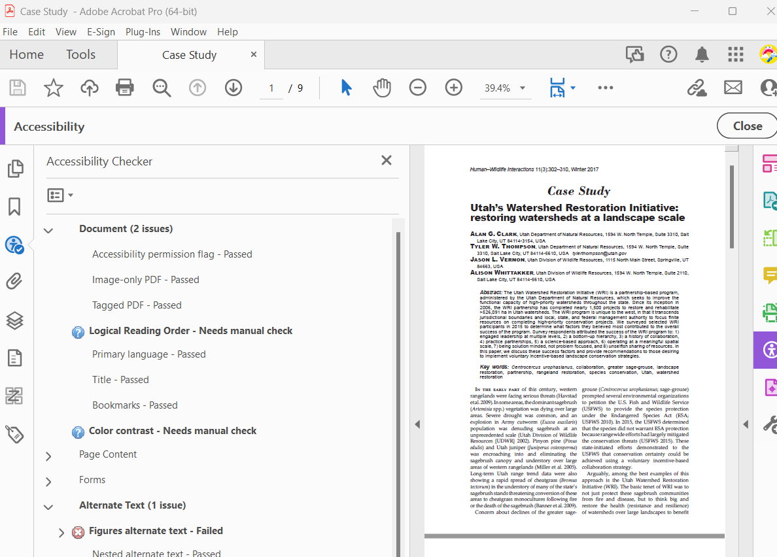
Verifying Tagged PDF
Acrobat Accessibility Checker

Slide 17
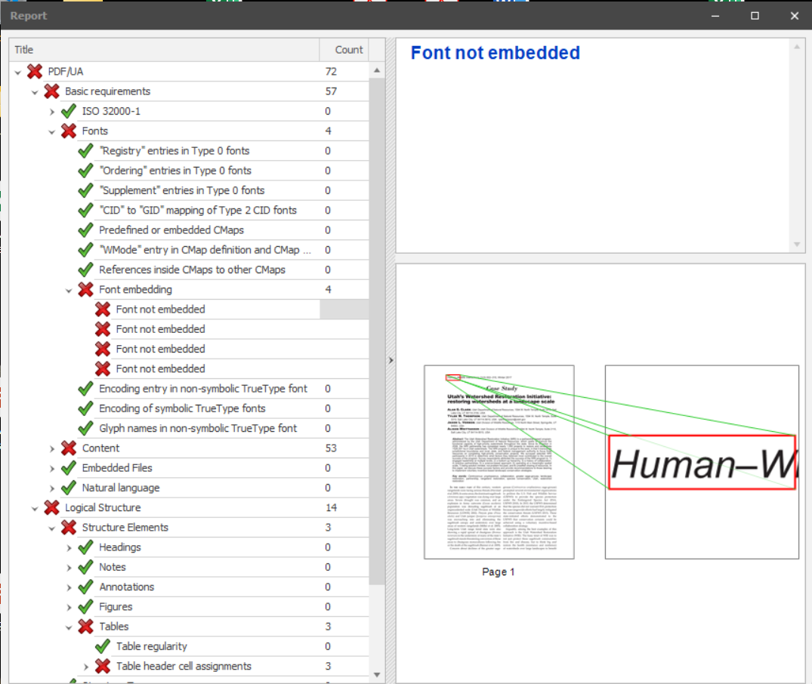
Verifying Tagged PDF
PAC 2021
Used to set development targets

Slide 18
ADAPT AI Demo
Live demo
Web: https://youtu.be/wjWuaR88D1U
Local Video

Slide 19
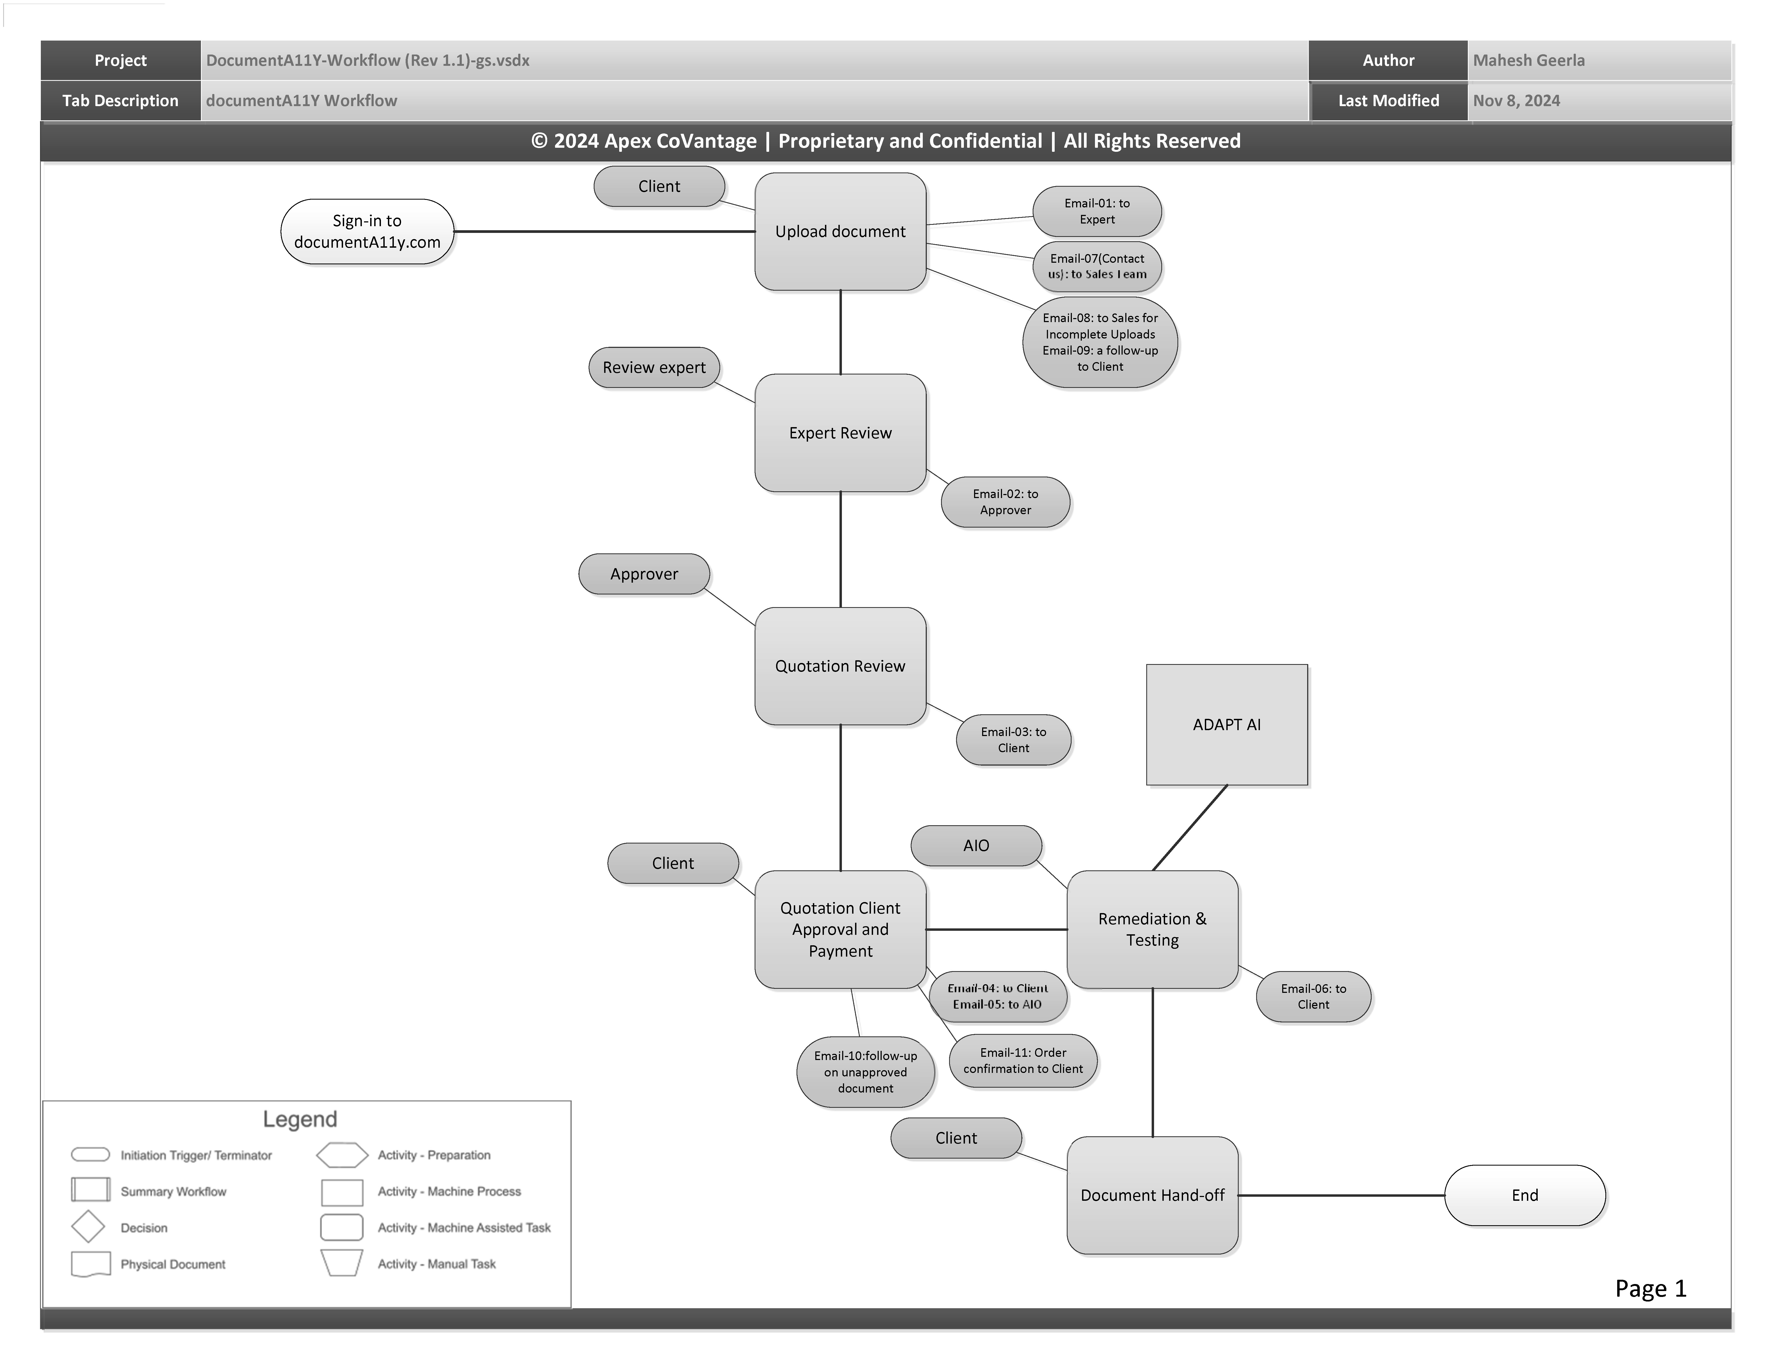
Operationalize: Documenta11y
Documenta11y description
Basic Documenta11y workflow
ADAPT AI underlies current pricing framework
2x faster overall production and QA with ADAPT AI compared with Acrobat alone
For more info on documenta11y: https://documenta11y.com/

Slide 20
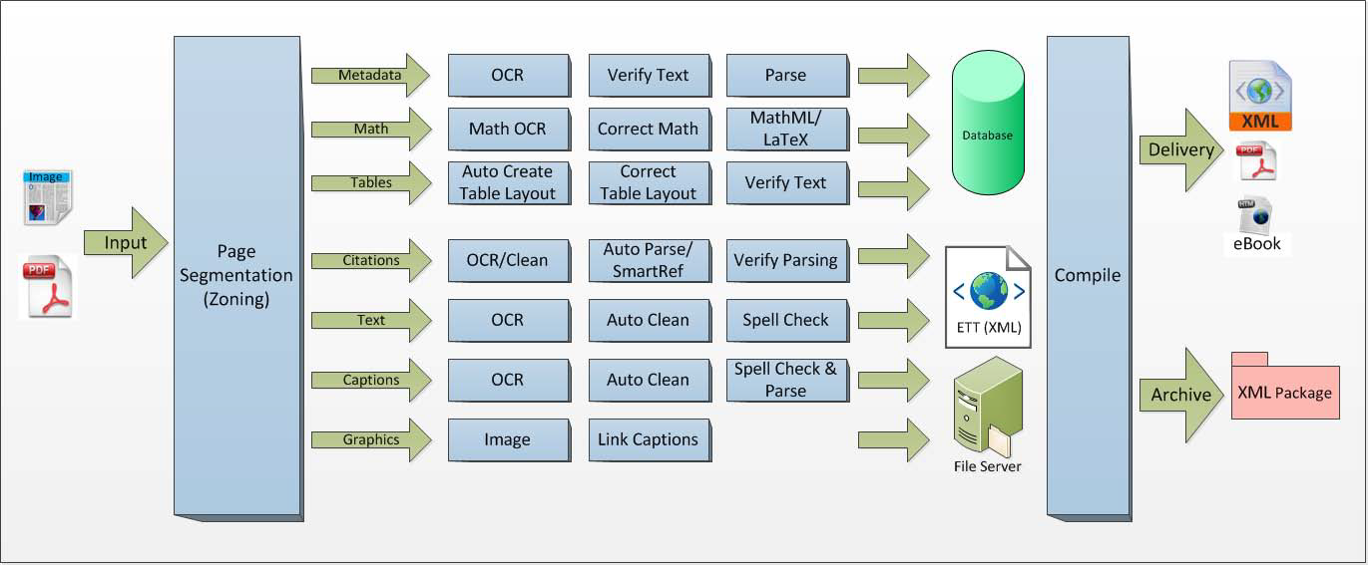
Operationalize: IZAAC
IZAAC = Intelligent Zoning and Algorithmic Conversion System
ADAPT AI inserted as a module
Previously IZAAC created Image over text PDF for Accessible PDF
For more info on IZAAC: https://apexcovantage.com/resources/datasheet-izaac-digitization/

Slide 21
Lessons Learned and Next Steps
Fast
Minimum of 2x productivity improvement for remediation in the current version
Expect more productivity improvements with additional training and enhancements
Modular
Can be integrated into diverse workflows
Front list prepress
On-demand commercial work (documenta11y)
High-volume library or backlist conversions
Requires development team (Solutions Architects and Developers) skilled in large-language models, computer vision, and PDF internal structure.

Slide 22
Lessons Learned and Next Steps
Toolset
Computer Vision Models worked well for basic constructs
Additional training required for more complex inclusions
Ability to label and then write into PDF is now proven
Primary tests used MS Office and InDesign generated PDF Normal, limited Arbortext Advanced Publisher
Integrate alt-text AI tools (Apex generATe tool)
Evaluate options to cure character encoding and font embedding
Testing with complex layered PDFs (magazines)
Develop licensed toolkit

Slide 23
Thank you
Greg Suprock
Head of Solutions Architecture
Apex CoVantage
gsuprock@apexcovantage.com
apexcovantage.com

