Slide 1
Using EPUBs To Retire the PDF
Darrin Evans
VLC Professional Development Center Director
daevans3@waketech.edu
Notes:
Darrin will open and drive the deck

Slide 2
Topics Covered
Introduction to EPUBs
Where to find EPUBs
Demonstrate EPUB Advantages over PDFs
EPUB Workflow
Notes:
Darrin

Slide 3
Just a Thought
I have many things to learn, even – maybe especially – about things I think I already know.
  Teddy Riner

Slide 4
What is an accessible Document?
Well-structured and navigable, including go to print page
Tables are structured and understandable
Text can be resized and personalized
Can support read aloud
Described images
Accessible math?
Notes:
Borrowed from the webinar ‘Publishers face off to prove their accessible EPUB’

Slide 5
What is EPUB
A standard for authoring and distributing digital publications and documents
A format more widely usable than PDFs
You’ve probably read an EPUB… even if you didn’t know it.
Notes:
Darrin

Slide 6

EPUB Advantages
Reflowable and readable on any screen.
Faster, easier, and cheaper to make accessible.
Can display Accessible STEM content via MathML.
Notes:
Darrin

Slide 7

How are EPUBs Built?
Essentially a website that has been compressed into a single file
Relies on web technologies which provide a greater opportunity for accessibility and reflow across multiple devices
Notes:
Joseph

Slide 8
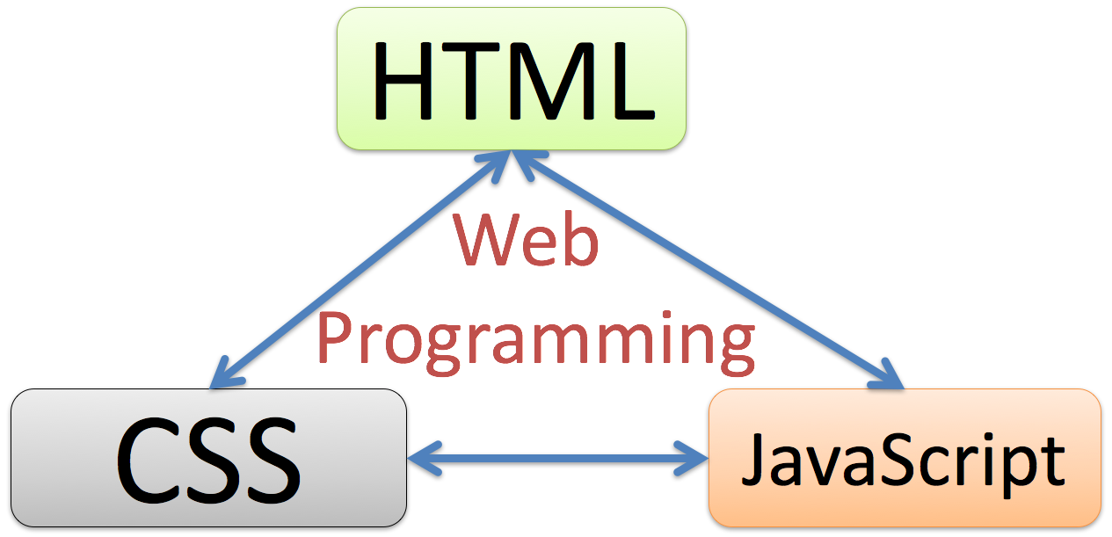
You Don’t Need to be a web developer
EPUB 3 is built on web development technologies, but you don’t need to be a developer to create EPUBs.
Notes:
Joseph
EPUB 3 is built on web technologies, but you don’t have to be a web developer to take advantage of this versatile format. We will look at some simple ways to create EPUBs a bit later that rely on your existing knowledge of Word and your current workflow.

Slide 9

PDF Problems
They simply cannot be made mobile responsive.
There is no way to create accessible STEM content with PDF. It just cannot be done.
They are cumbersome to make accessible.

Slide 10

EPUB Features

Slide 11

Easy EPUB Math

Slide 12
Making an EPUB is getting easier
Free Word to EPUB tool from the DAISY consortium can be used to create EPUBs from an accessible Word document with just a few clicks. Download the free Word to EPUB tool visit the DAISY website. (PC only)
Notes:
Joseph

Slide 13
Garbage In Garbage Out
You must start with a structured accessible Word Document to create an accessible EPUB.
You will need at least one Heading in your Word source document.

Slide 14

Word Accessibility Basics
Use built-in Headings and Styles
Use Table Headers
Add meaningful descriptive hyperlinks
Add Alt Text to Images

Slide 15
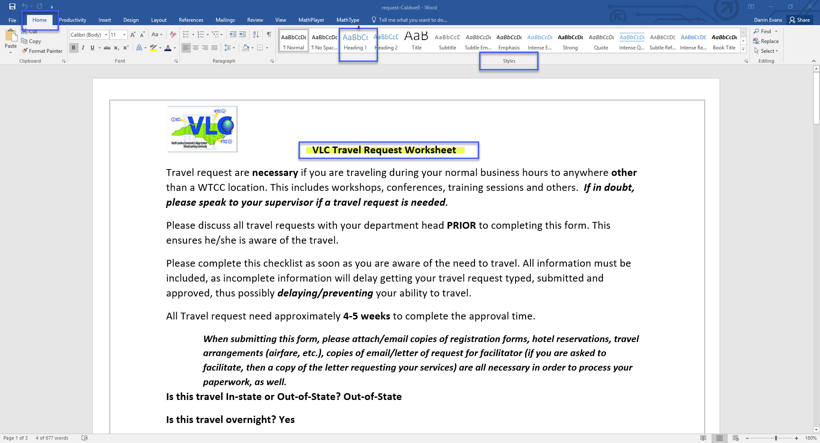
Headings and Styles

Slide 16
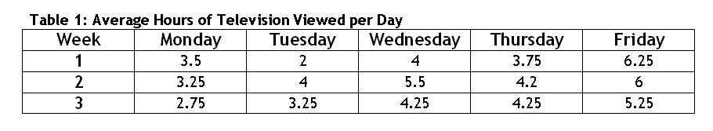
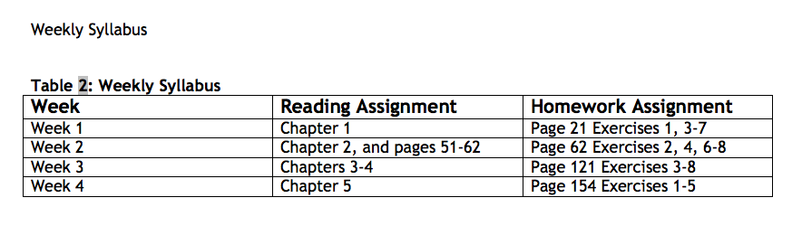
Sample Accessible Tables

Slide 17
Hyperlinks
What will be viewed? (Why is the link provided?)
Make links descriptive and avoid “click here”
Example: Visit the NC Virtual Learning Community.

Slide 18
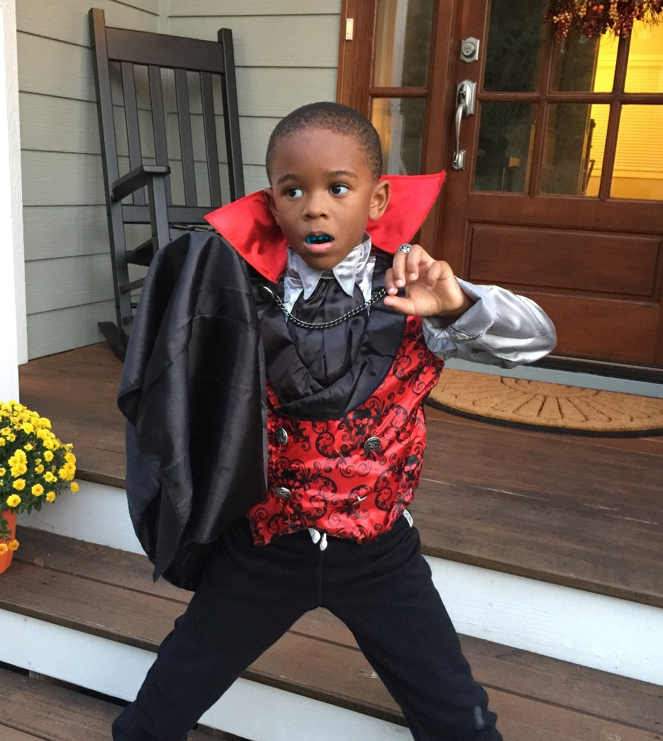
Alt Text is both Art and Science
How would you describe this image?

Slide 19

Alternative Text/Image Descriptions Part 1
Alternative Text Help us with 2 goals:
  It helps make images available to people with visual impairments
  It helps us make sure our images are truly adding value to our content

Slide 20

Alternative text/Image Descriptions Part 2
The Earth to Sky Park in Burnsville North Carolina.

Slide 21
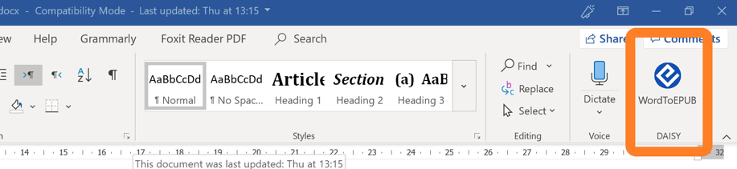
Using WordToEPUB
It is quick and easy to create EPUBs with this free plugin.
Start with an accessible file in Microsoft Word
Check your work with the built-in accessibility checker
Export to EPUB with the free WordToEPUB plugin
Notes:
Joseph

Slide 22

WordToEPUB - Demonstration
Notes:
Darrin will play a short video demonstrating WordToEPUB

Slide 23









I Have An EPUB … Now What?
Read It
Navigation
TOC
Landmarks
Bookmarks
Search
Formatting
Theme
Text Size
Line, Letter & Paragraph Spacing
Display
Features
Annotations
Highlighting
ReadAloud

Slide 24
EPUB Resources [2 of 2]
Dolphin Easy Reader is an EPUB reading application for Windows, Mac, iPad, and Android
Reading app evaluations available at epubtest.org will help you make the best choice for your college.
VitalSource is a provider of EPUB Textbooks
RedShelf is another EPUB Textbook provider
To see a free webinar series on accessible publishing and reading visit the DAISY consortium
Bookshare is an accessible online library for people with print disabilities.
Notes:
Darrin

