Slide 1
Using EPUBs To Retire the PDF
Darrin Evans
VLC Professional Development Center Director
daevans3@waketech.edu
Notes:
Darrin will open and drive the deck

Slide 2
Topics Covered
Introduction to EPUBs
Where to find EPUBs
Demonstrate EPUB Advantages over PDFs
EPUB Workflow
Notes:
Darrin

Slide 3
What is an accessible Document?
Well-structured and navigable, including go to print page
Tables are structured and understandable
Text can be resized and personalized
Can support read aloud
Described images
Accessible math?
Notes:
Borrowed from the webinar ‘Publishers face off to prove their accessible EPUB’

Slide 4
Just a Thought
I have many things to learn, even – maybe especially – about things I think I already know.
  Teddy Riner

Slide 5
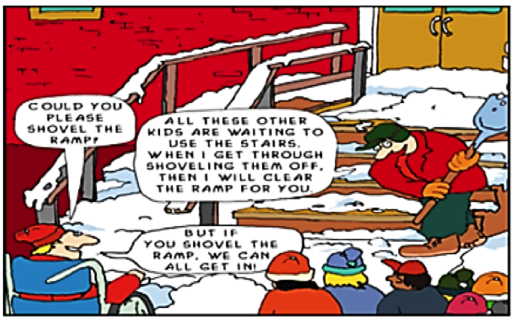
Mindset

Slide 6

PDF Problems
They simply cannot be made mobile responsive.
There is no way to create accessible STEM content with PDF. It just cannot be done.
They are cumbersome to make accessible.

Slide 7

What we looked for
The replacement had to be mobile friendly and easy to make accessible
It had to fit into our existing workflow
It had to have a low learning curve

Slide 8

Enter DASIY
To join the EPUB in Higher Education Working Group email George Kerscher at kerscher@montana.com

Slide 9
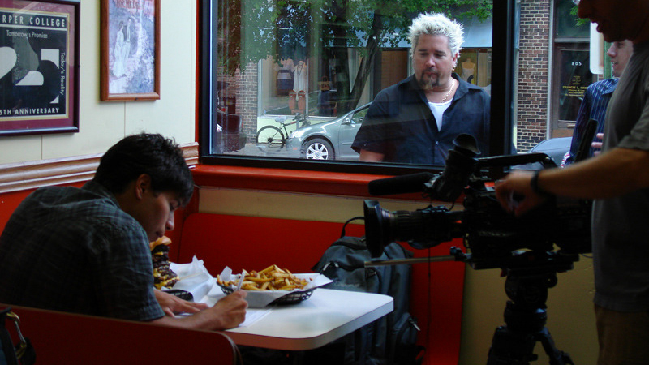
When we found EPUB’s

Slide 10
What is EPUB
A standard for authoring and distributing digital publications and documents
A format more widely usable than PDFs
You’ve probably read an EPUB… even if you didn’t know it.
Notes:
Darrin

Slide 11
Why Users Like EPUBs
Readability: The reflowable nature of EPUB 3 adapts itself to different size displays including cell phones and tablets.
Flexibility/Adaptability: Every reflowable EPUB 3 document can be, with a single click to increase the font size, available in large-print.
Customization: Change background and font colors easily with EPUB
Navigation: excellent opportunities for high level navigation via the table of contents and direct page access.
Notes:
Darrin

Slide 12
Where to find EPUBs
Online bookstores that use EPUB as their primary format include:
Apple’s Book Store
Google Play Books
Providers of EPUB textbooks include:
VitalSource
RedShelf
Notes:
Joseph

Slide 13
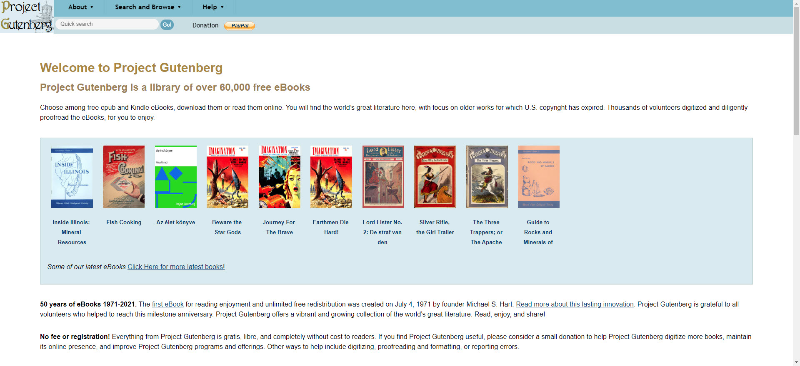
Project Gutenberg
Project Gutenberg is a library of over 60,000 free EPUB books
There are no fees or registration required to search, browse, or download these books.
Notes:
Joseph

Slide 14

How are EPUBs Built?
Essentially a website that has been compressed into a single file
Relies on web technologies which provide a greater opportunity for accessibility and reflow across multiple devices
Notes:
Joseph

Slide 15
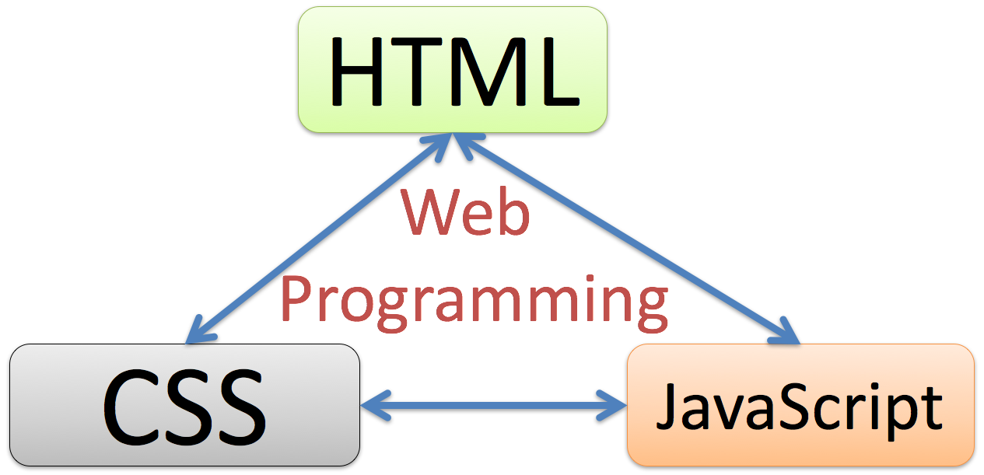
You Don’t Need to be a web developer
EPUB 3 is built on web development technologies, but you don’t need to be a developer to create EPUBs.
Notes:
Joseph
EPUB 3 is built on web technologies, but you don’t have to be a web developer to take advantage of this versatile format. We will look at some simple ways to create EPUBs a bit later that rely on your existing knowledge of Word and your current workflow.

Slide 16

EPUB Advantages
Reflowable and readable on any screen.
Faster, easier, and cheaper to make accessible.
Can display Accessible STEM content via MathML.
Notes:
Darrin

Slide 17

EPUB Features

Slide 18

Easy EPUB Math

Slide 19
Why are we moving away from accessible PDFs?
“PDFs cannot be made mobile responsive. Asking your already impatient users-especially those with only 3G coverage and a small data plan to download an 8MB, two column PDF that requires them to constantly pinch, pull, scroll up, and scroll down just to read the one chunk of content they actually need that’s buried on page 164, is like telling them to suck eggs.”
Dan Craddock @slowburnweb
Notes:
Darrin
I’m going to leave this quote in to highlight the differences in reflow between the 2 platforms. Even with liquid mode PDFs simply aren’t as reflowable. I think the experience Dan describes is one many users have had, and I want to emphasize this point.

Slide 20
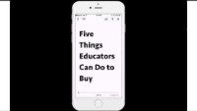
Comparison of PDF and EPUB on Mobile

Slide 21
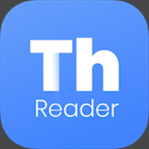
How do I read EPUB’s?
For your PC or Mac, Thorium Reader is great software for reading EPUB’s and it’s free and open source.
Direct Link:
https://www.edrlab.org/software/thorium-reader/

Slide 22
Making an EPUB is getting easier
Free Word to EPUB tool from the DAISY consortium can be used to create EPUBs from an accessible Word document with just a few clicks. Download the free Word to EPUB tool visit the DAISY website. (PC only)
Notes:
Joseph

Slide 23
Garbage In Garbage Out
You must start with a structured accessible Word Document to create an accessible EPUB.
You will need at least one Heading in your Word source document.

Slide 24

Word Accessibility Basics
Use built-in Headings and Styles
Use Table Headers
Add meaningful descriptive hyperlinks
Add Alt Text to Images

Slide 25
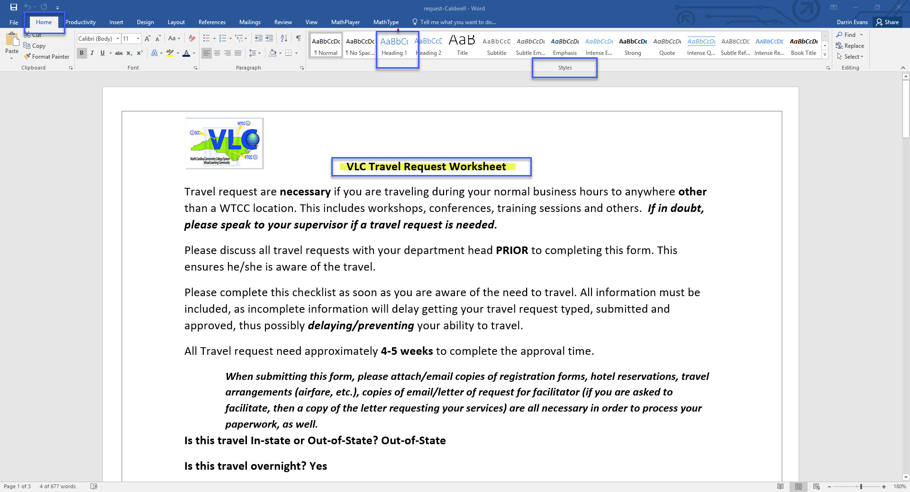
Headings and Styles

Slide 26
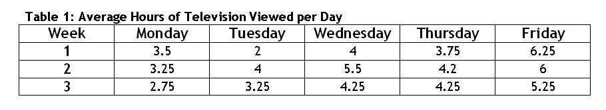
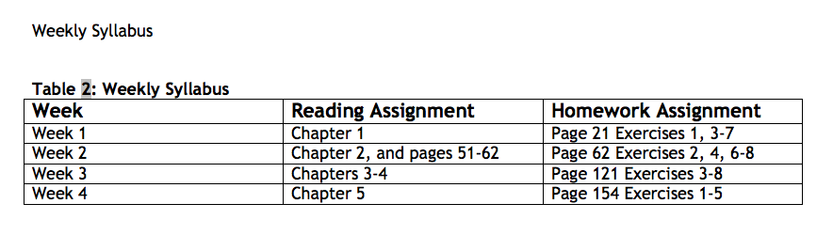
Sample Accessible Tables

Slide 27
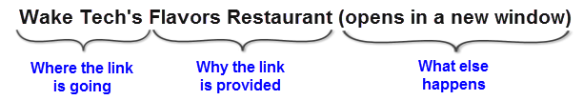
Hyperlinks
Where is the link going?
What will be viewed? (Why is the link provided?)
What happens when the link is clicked?

Slide 28

Alternative Text/Image Descriptions Part 1
Alternative Text Help us with 2 goals:
  It helps make images available to people with visual impairments
  It helps us make sure our images are truly adding value to our content

Slide 29

Alternative text/Image Descriptions Part 2
The Earth to Sky Park in Burnsville North Carolina.

Slide 30
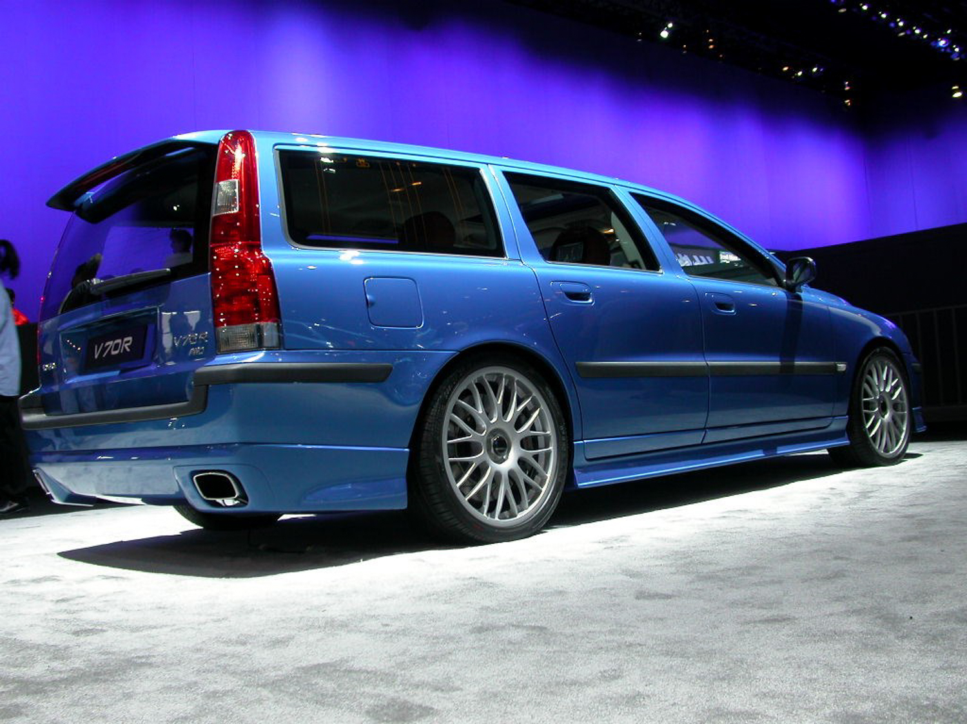
Alternative Text Part 3
Key Points:
  Context is key
  Consider your audience
  Be concise
  Be objective
  General to Specific
  Tone and Language

Slide 31
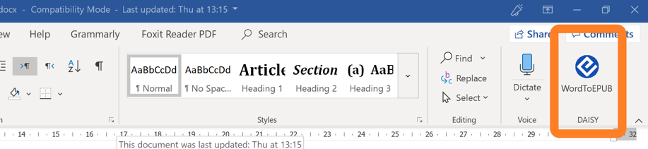
Using WordToEPUB
It is quick and easy to create EPUBs with this free plugin.
Start with an accessible file in Microsoft Word
Check your work with the built-in accessibility checker
Export to EPUB with the free WordToEPUB plugin
Notes:
Joseph

Slide 32

WordToEPUB - Demonstration
Notes:
Darrin will play a short video demonstrating WordToEPUB

Slide 33
EPUB Resources
Free Word to EPUB tool from the DAISY consortium can be used to create EPUBs from an accessible Word document with just a few clicks. To download the free Word to EPUB tool visit the DAISY website.
Read the DAISY Consortium’s white paper on the benefits of EPUB 3
The AEM Center Getting Started with EPUB
Thorium Reader is an EPUB reading application for mac, windows, and linux
The accessibility of an EPUB can be checked using the free Ace by DAISY Accessibility Checker
Notes:
Darrin
Encourage participants to investigate these resources and speak about each one. Tease the word2epub app and build anticipation for the next presentation.

Slide 34
EPUB Resources [2 of 2]
Dolphin Easy Reader is an EPUB reading application for Windows, Mac, iPad, and Android
Reading app evaluations available at epubtest.org will help you make the best choice for your college.
VitalSource is a provider of EPUB Textbooks
RedShelf is another EPUB Textbook provider
To see a free webinar series on accessible publishing and reading visit the DAISY consortium
Bookshare is an accessible online library for people with print disabilities.
Notes:
Darrin

Slide 35

Questions
Notes:
Darrin

