Slide 1
Playing the Long Game: Building an A11y Outreach Ecosystem to Increase Faculty Engagement
Mary-Colleen Jenkins, Terrill Thompson, Mary Mulvihill
UW-IT Accessible Technologies | https://uw.edu/accesstech
Notes:
NOTE: This presentation is shared with a Creative Commons BY-NC-SA License. https://creativecommons.org/licenses/by-nc-sa/4.0/

Slide 2
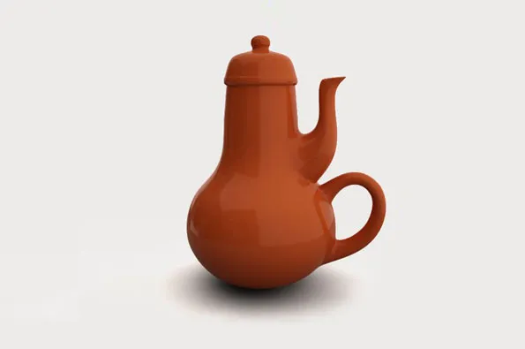
Agenda
Part 1: Past, Present, Future
Part 2: The Long Game -- Creating "Multiple Means" for Engagement
Part 3: The Path Forward – An Outreach Ecosystem
Notes:
Image source: Coffeepot for Masochists created by www.impossibleobjects.com from French artist Jacques Carelman’s 1969 design in Catalogue d’Objets Introuvables. In English, the title is Catalog of Impossible Objects.

Slide 3
Introductions
Name
Affiliation
Role
Number of times attending AHG
On a sticky note:
What do you hope to get out of this session?

Slide 4
Part 1
Digital accessibility at UW
Past
Present
Future
Lessons Learned from a Year of Outreach

Slide 5
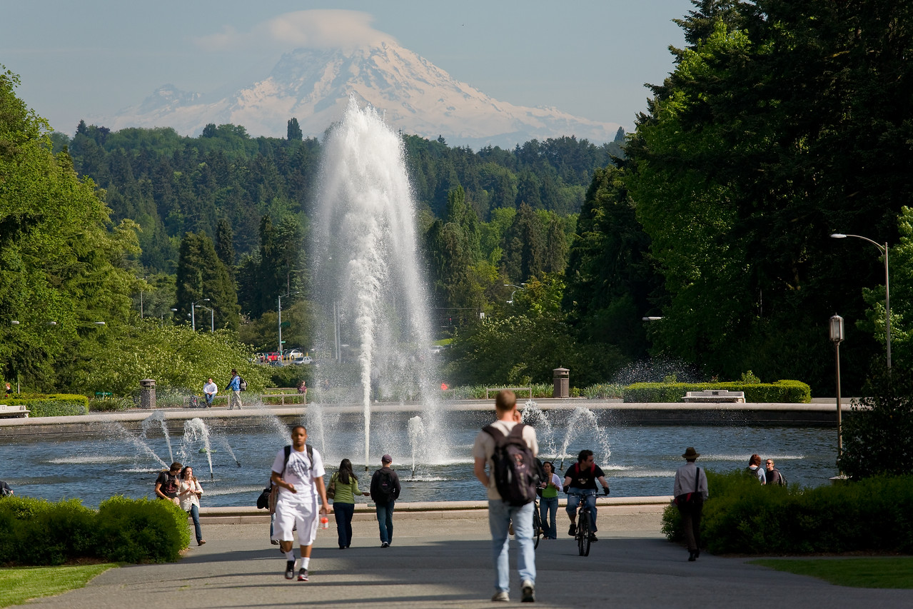
About the University of Washington
Major research university
743 programs on 3 campuses, plus UW Medicine
20 schools & colleges, 846 degree options
11, 941 new students enrolled (Fall 2024)
62, 752 total students across 3 campuses (Fall 2024)
Approximately ~4,000 faculty

Slide 6
Key stakeholder organizations in Digital Accessibility
Disability Resources for Students (DRS)
Disability Services Office (DSO) housed in Human Resources
Office of Compliance (ADA Coordinator)
UW-IT Data & Applications
Accessible Technology Services (ATS)

Slide 7
ATS Organization
Director, Digital Accessibility
Mary Mulvihill
IT Accessibility Team
Terrill Thompson, Manager
DO-IT Center
Scott Bellman, Manager
ATS Operations
Susie Hawkey, Manager

Slide 8
IT Accessibility Team (ITAT)
Web Accessibility Specialist
Document Accessibility Specialist
IT Accessibility Specialist (testing products, working with vendors)
Accessibility Developer
Access Technology Lab manager, Braille production
Student employees – Document remediation, Student Web Accessibility Team (SWAT)
Instruction Accessibility Specialist ***

Slide 9
Grass-roots Approach: Building Community (Past)
AccessibleWeb – Mailman list since the 1990s
350+ subscribers (mostly staff)
Monthly Web Accessibility & Usability Meetup
Up to 40 participants and growing (mostly staff)
IT Accessibility Liaisons
150+ members from across the university (mostly staff)

Slide 10
Top-down Approach (present)
ADA & Accessibility Steering Committee
“President Ana Mari Cauce appointed the ADA & Accessibility Steering Committee in 2020 to provide ongoing strategic oversight and leadership for the University’s work with regard to the University’s efforts to ensure equal opportunity and full participation for all individuals with disabilities. The committee is charged with fostering an institution-wide environment of inclusion and equal access consistent with the University’s mission and values while embracing the mandates of the Americans with Disabilities Act (ADA) and other relevant laws and regulations.”
https://uw.edu/ada/leadership-planning/steering-committee/

Slide 11
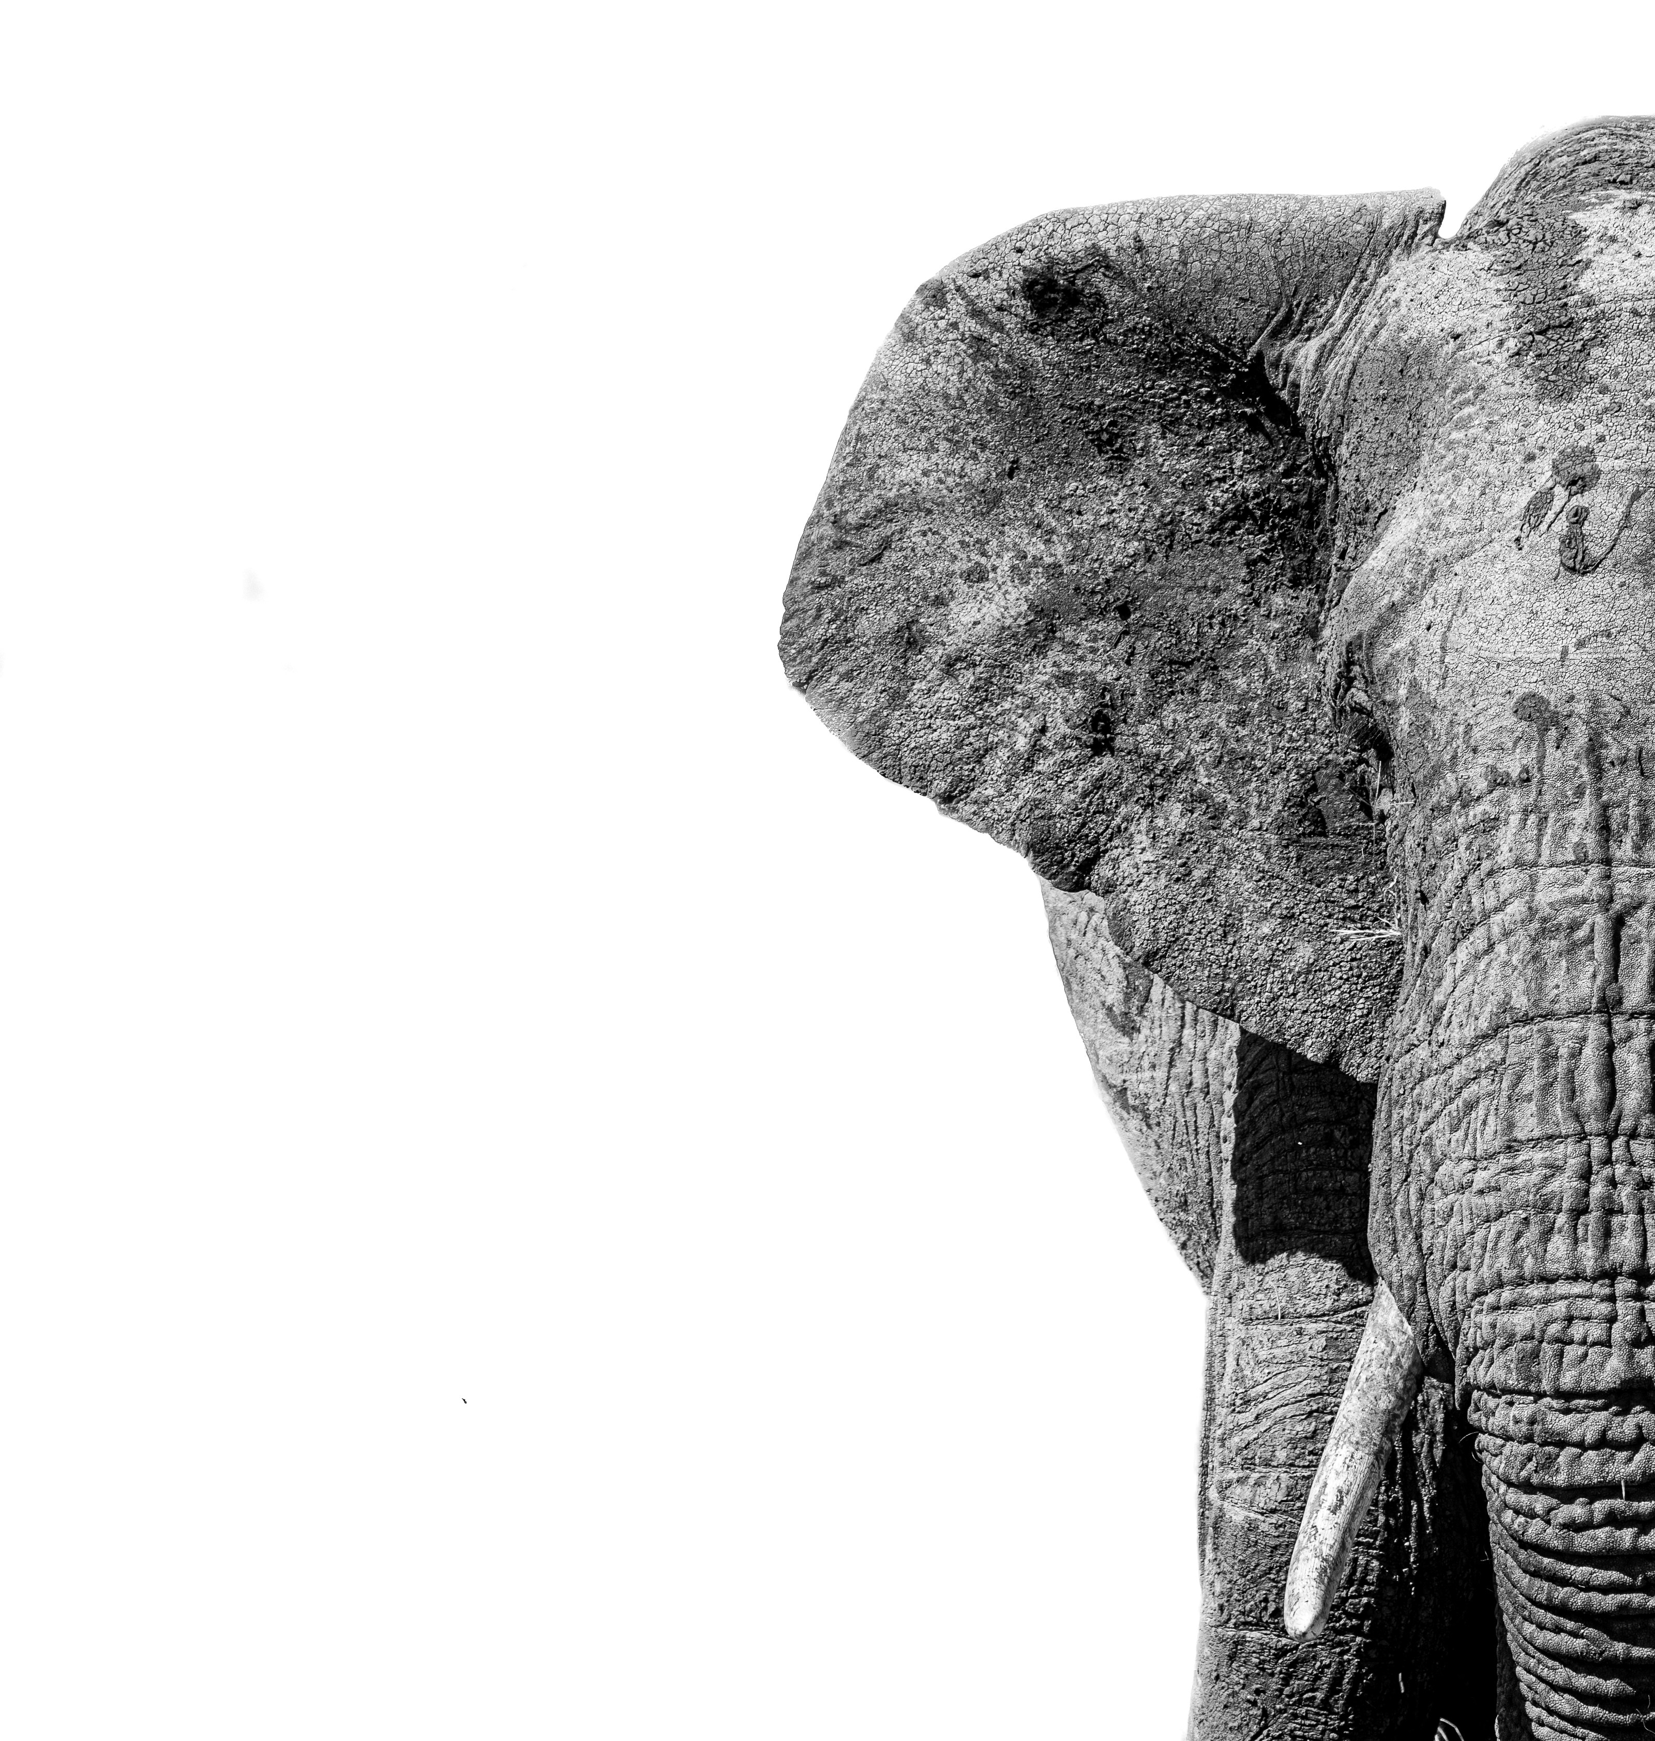
The Elephant in the room
The Department of Justice (DOJ) final rule on web accessibility filed on April 24, 2024, is the elephant in the room.
How do we scale our existing efforts and build new infrastructure to meet this challenge?

Slide 12
Positive Change Responding to the ADA Rule (future)
New staff
Deputy ADA Coordinator for Digital Accessibility
Instruction Accessibility Specialist (from temp to full-time permanent) ***
Lead Digital Accessibility Consultant (in recruitment!)
New tools and services
Domain Discovery Tool (Little Forest)
Enterprise web accessibility checker (DubBot)
PDF remediation tool (Equidox)
Training curriculum (Deque University)
Course materials accessibility tool (Anthology Ally) – Not new, but exploring strategies for increasing adoption
Student Team to help with manual web accessibility evals

Slide 13
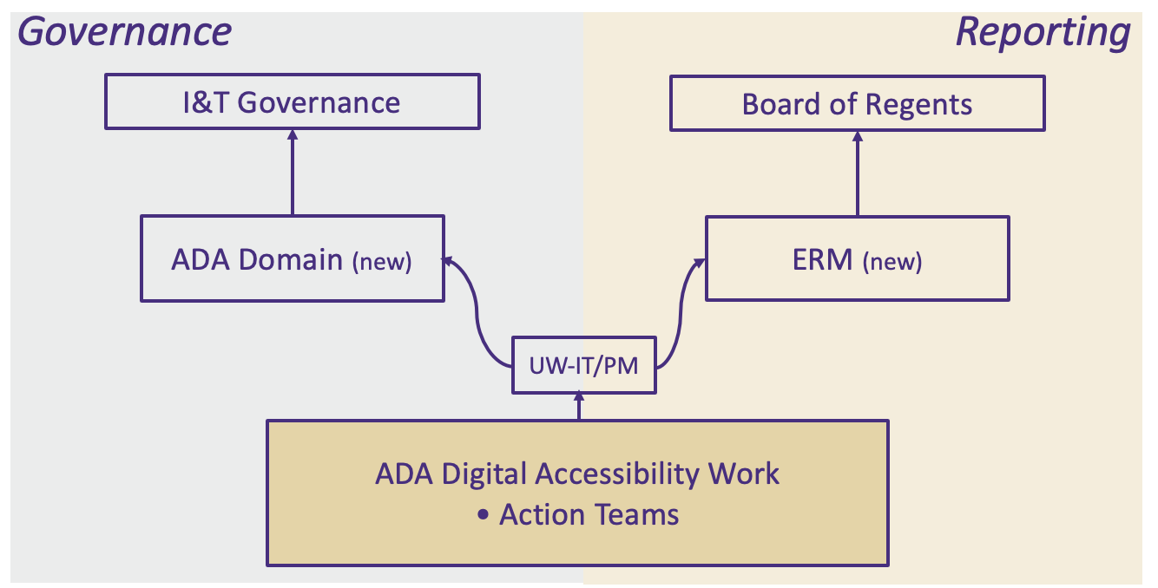
Governance and reporting
Notes:
Task Force
Quarterly meeting of Leadership/decision makers
Coordination Team
Coordinates & gathers feedback from the Action Teams
Current Action Teams
Academic Course Content
Innovation and Research
Procurement
UW Medicine
Web Content and Mobile Apps
Possible Future Teams:
Policy
Training
Transition team to support operationalizing the work

Slide 14
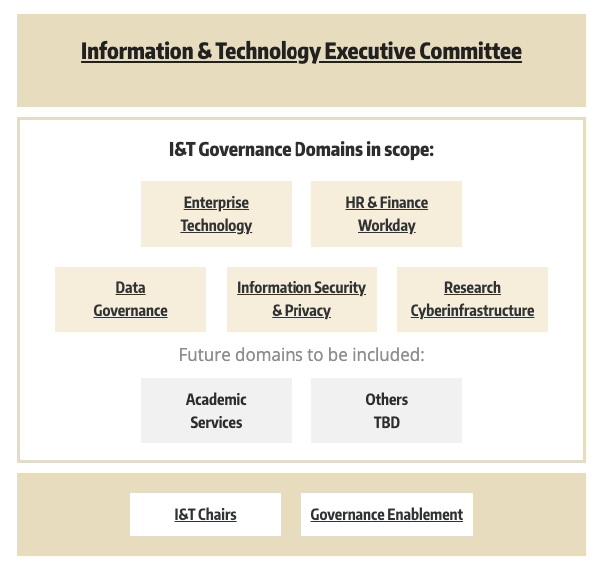
Information & Technology governance
Shared responsibility:
Central IT (UW-IT) responsible for enterprise implementation ​
Compliance responsible for ​policy development and Enterprise Risk Management reporting
Provost’s office responsible for ​faculty engagement
UW-Medicine responsible for ​domain- specific oversight

Slide 15
Action team Structure
Web Content and Mobile Apps
Procurement
Academic Course Content
Innovation and Research
UW Medicine
REFERENCE: ADA Digital Accessibility Task Force
Notes:
Task Force
Quarterly meeting of Leadership/decision makers
Coordination Team
Coordinates & gathers feedback from the Action Teams
Current Action Teams
Academic Course Content
Innovation and Research
Procurement
UW Medicine
Web Content and Mobile Apps
Possible Future Teams:
Policy
Training
Transition team to support operationalizing the work

Slide 16
Action Team Scope
Each Action Team is charged with:
Identifying the risks and resource gaps to meeting the digital accessibility requirements, and the actions needed to address them.
Recommending needed institutional resources and support.
Providing leadership with regular reports and information regarding ongoing work toward institutional process and practice changes.

Slide 17
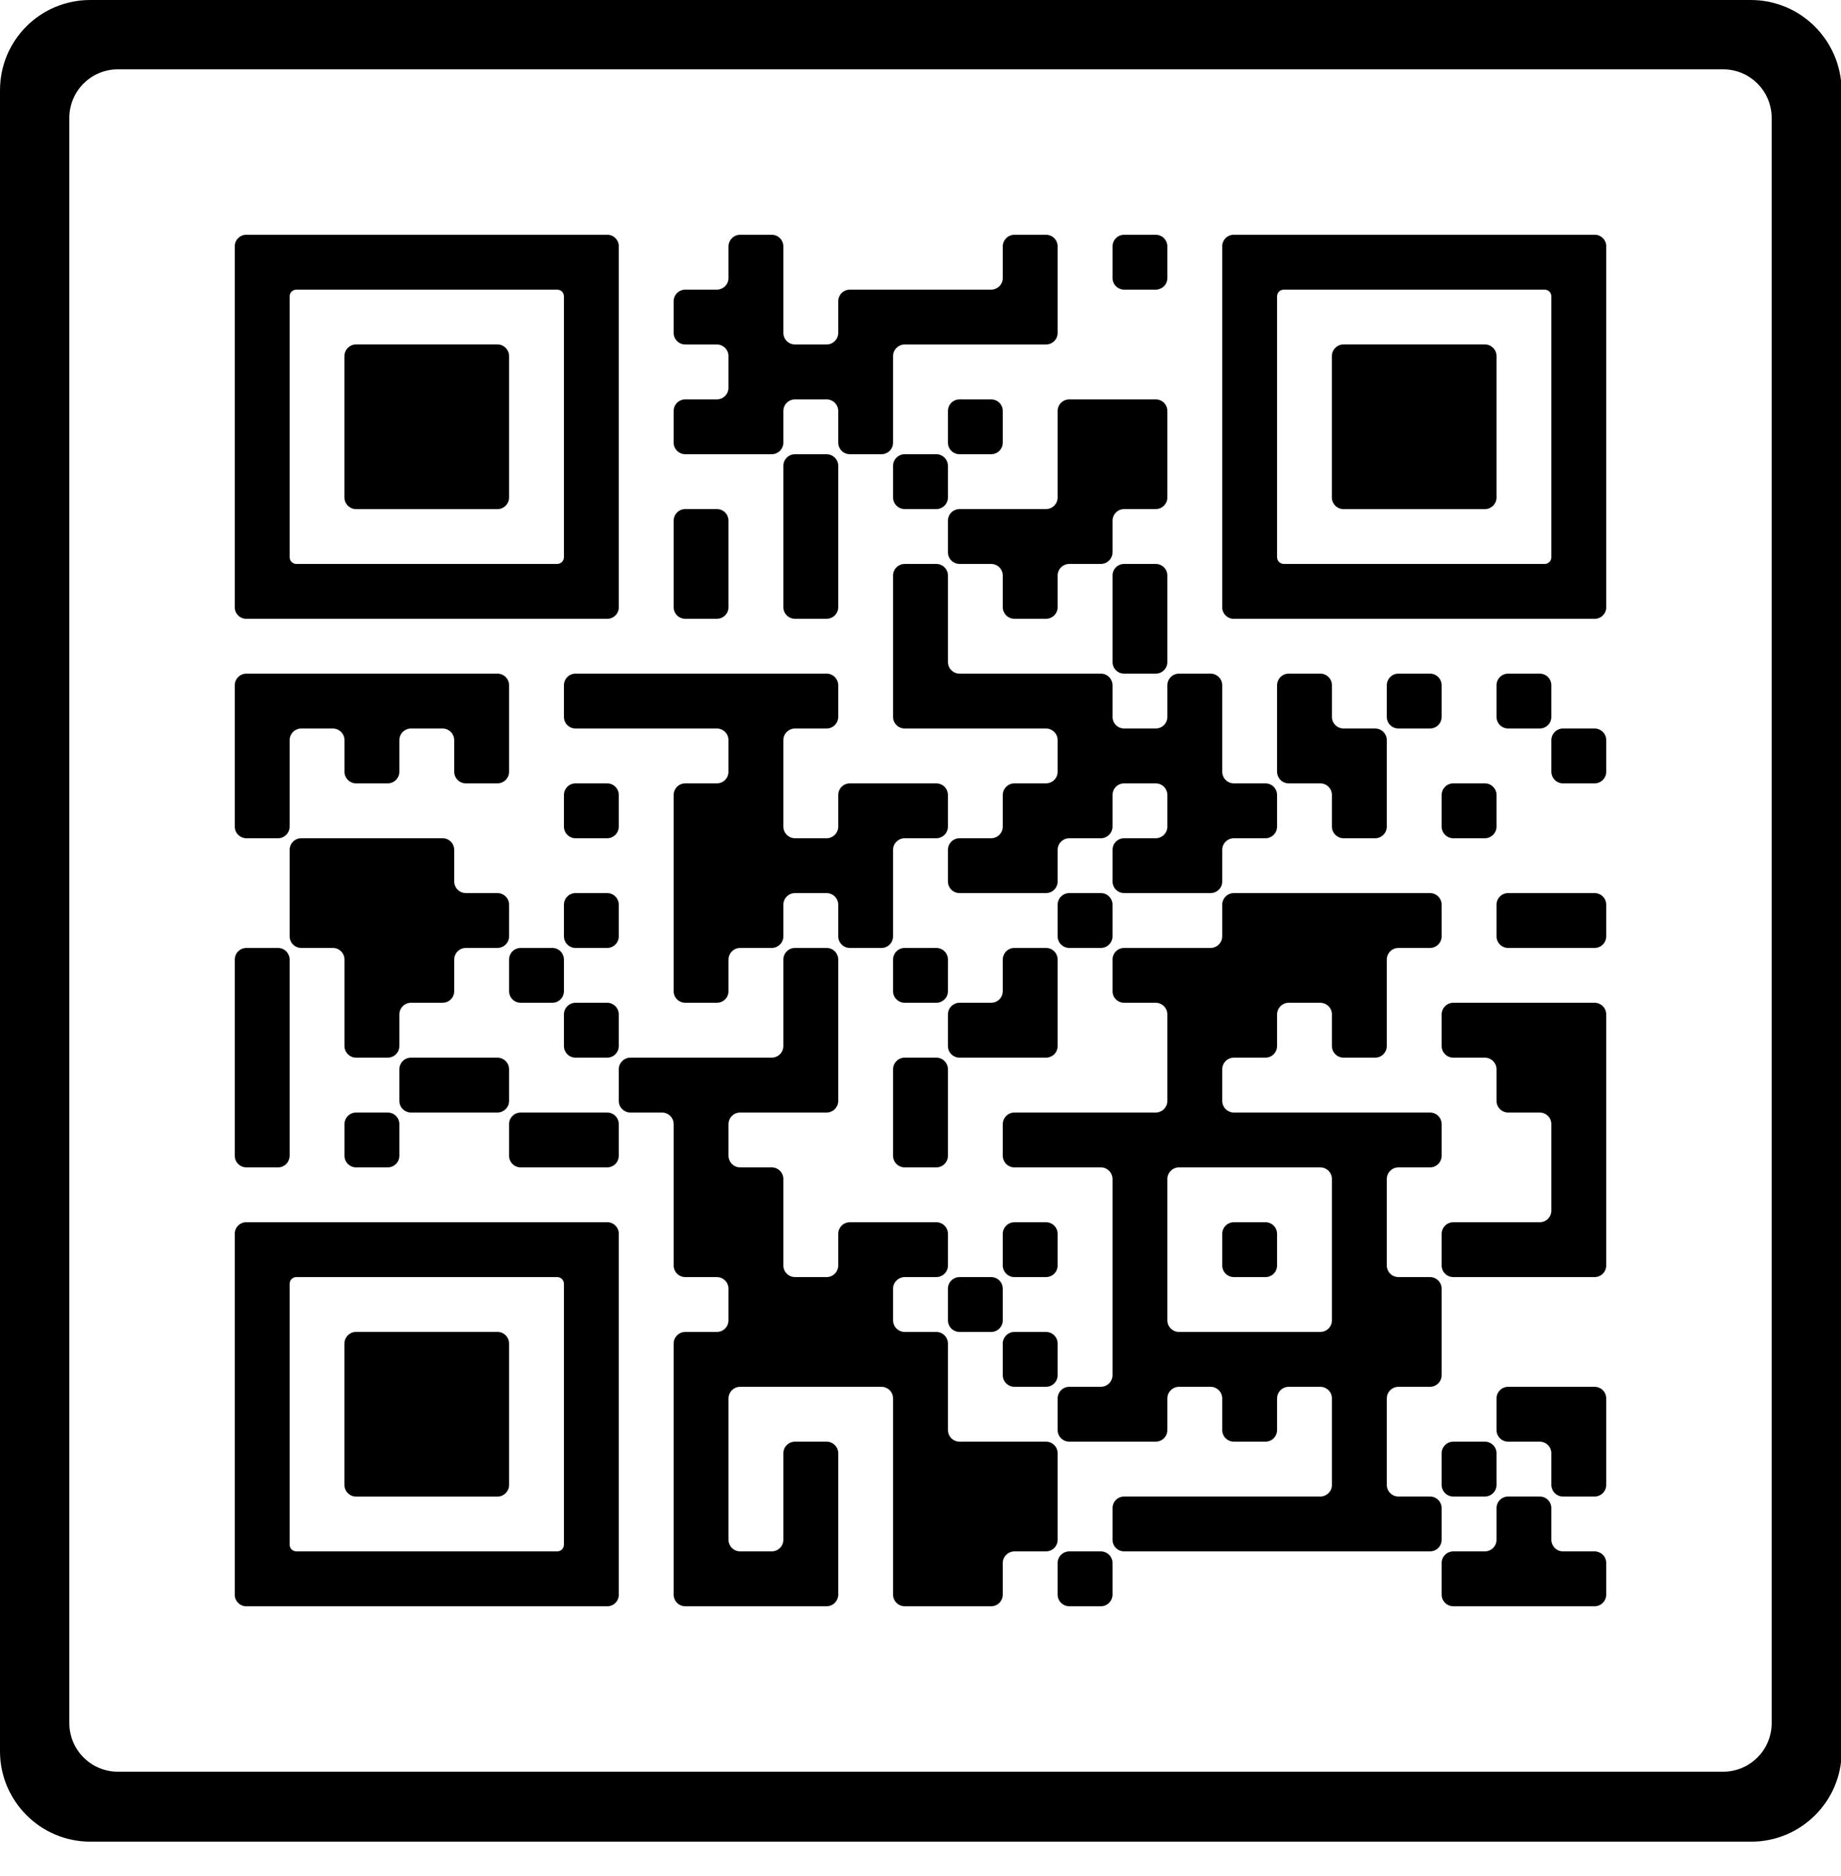
We’re all in this together!
Organizations working to share ideas and resources
ATHEN
AHEAD
EDUCAUSE IT Accessibility Community Group
Big Ten Academic Alliance
TeachAccess
Attendees of this session!
Google Doc for sharing ideas and resources:
https://tinyurl.com/ahg2024-longgame

Slide 18
Questions, Comments, insights?

Slide 19
How does outreach change?
How does faculty outreach change when there is a two-year compliance deadline facing institutions of higher education?
We have a unique opportunity to expand and deepen outreach!

Slide 20
A year of outreach 2022-2023
Observations and Lessons Learned
Disconnect between faculty and resources
Why don’t they seek out/take advantage of resources?
Existing outreach tools too narrow in scope
How to shift to more expansive vision?
Incorporate familiar models
Moving to ecosystem model of outreach/engagement

Slide 21
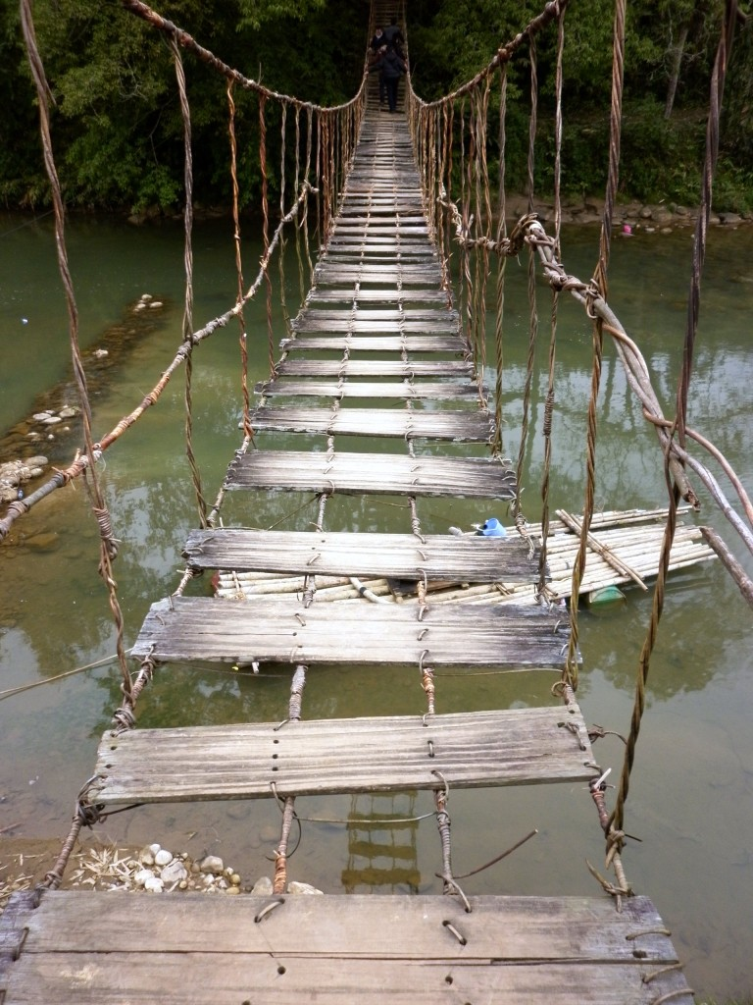
Observations: A year of outreach
Networking with stakeholders and conversations with faculty at all levels revealed 5 key gaps we need to bridge:
Language Gap
Awareness Gap
Knowledge Gap
Resource Gap
Community Gap

Slide 22
Language and Awareness Gaps
Faculty not part of a shared linguistic community
What is digital accessibility?
How is inclusive teaching different from accessibility?
Is accessibility just meeting accommodations?
Faculty not aware of existing accessibility resources
Irony: Many communication channels = dissipated messaging

Slide 23
Knowledge and Resource Gaps
Faculty receive little-to-no accessibility training
Faculty self-select when it comes to optional training
Faculty contend with limited resources
Faculty prioritize tasks they are compensated for

Slide 24
Community Gaps
Not yet a campus-wide conversation to establish a "we're in this together" mindset.
Faculty doing accessibility work often feel they’re working in isolation.
Faculty doing this work are often junior faculty or graduate students and TAs with little support from leadership.

Slide 25
Reflection 1
Does your institution have similar gaps?
How do gaps create challenges for your faculty outreach efforts?
How have you begun to bridge such gaps?
Language Gap
Awareness Gap
Knowledge Gap
Resource Gap
Community Gap

Slide 26
Part 2
The Long Game
The usual tools weren’t enough
Understanding our target audience
Walking the Walk: Applying UDL Principles
Notes:
And being okay with Risking Trial and Error

Slide 27
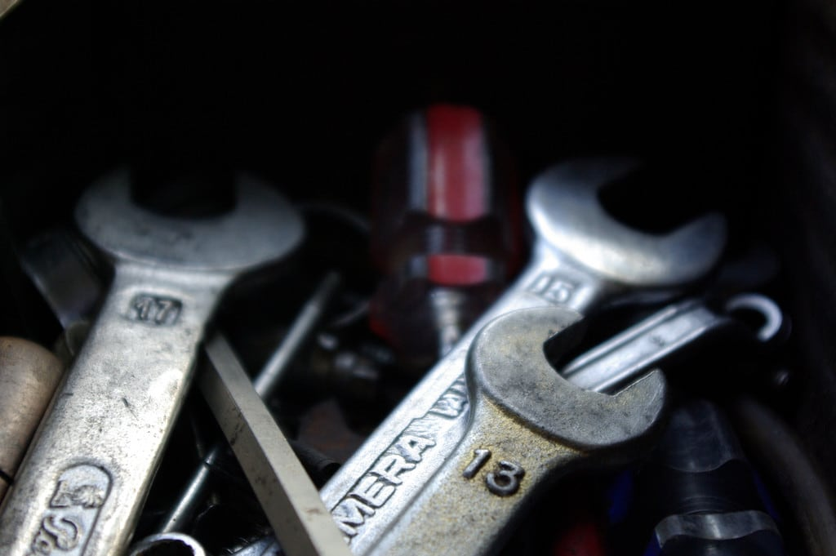
Existing outreach tools
I already had some basic outreach tools:
Offering 1:1 consultations with faculty
Offering more presentations and webinars
Crashing faculty meetings
But something was missing.
I needed something efficient, replicable, sustainable, and interactive. Something that could start bridging these gaps.
Notes:
First new additions to the toolbox:
Creating networking listserv
Hosting Instruction Accessibility Meetups

Slide 28
Understanding our Target Audience
Bridging the Awareness and Knowledge Gaps requires audience analysis.
We need to understand the constraints and pain points that create barriers for faculty in doing accessibility work.

Slide 29
3 Professional Constraints
Lack of Time
The perennial problem
Lack of Awareness and Skills
How much do faculty know or understand about accessibility and Universal Design for Learning (UDL)?
Level of institutional support
Are faculty efforts in building accessible courses encouraged, supported, compensated, and recognized?
The DOJ rule is a benefit here!
Notes:
Three professional constraints come up in literature about faculty development in Universal Design for Learning (UDL) and course accessibility for students with disabilities. The first two constraints – lack of time and lack of awareness -- are universally felt across higher education. Faculty are hyperaware of their time, and this is natural, considering the many responsibilities that come with teaching, research, and service. This is especially true for adjunct faculty.
The third constraint – levels of institutional support – is outside of the realm of our conversation today, but it is the foundational barrier that underlies the first two constraints. The DOJ rules are a benefit here because there is a strong motivation toward compliance. HOWEVER, this can also complicate things. A focus on compliance may undermine true buy-in. It may also create a reactive “fix it for me” remediation focus rather than a proactive skills-building accessibility mindset.

Slide 30
Personal Constraints
Time
Inexperience
Vulnerability
Task paralysis
Perfection at the expense of good
New? Fear of noncompliance
Notes:
The 3 professional constraints we just considered are also impacted by constraints for faculty on a personal level. It is difficult for faculty to be asked to learn new skills, to re-assess elements of a course they’ve spent so much time building, to remediate inaccessible content – even if the fixes are “easy.”
Asking faculty to strengthen accessibility of course material can tap into a personal level of challenge and emotion. There are so many facets to accessibility, that some faculty feel overwhelmed. Some feel guilty – “Have I let students down by not being aware of accessibility challenges?” And so on.
Faculty have typically succeeded in their fields because they started off being talented students. So, seeing the accessibility score in the Ally Course Accessibility Report can feel like a failure. Even a high score of 85% with a green Canvas dial icon can feel like a failure, let alone a red icon with a 0% score on an image easily fixed with alt text.
These personal constraints can stop faculty in their tracks as they try to travel a pathway toward accessibility.

Slide 31
Permanent Structural Barriers
Faculty Code & Governance
Requirements for promotion and merit review do not favor accessibility work
Service requires record-keeping; accessibility work is difficult to quantify
The Academic Time Warp
Feast-or-famine cycles of Academic Time
Input Overload: Information front-loaded at the start of term from multiple campus sources
Notes:
To understand our target audience and build engagement that works with and for them, we need to have a sense of how their promotion structure works and also understand the feast-or-famine cycles of Academic Time. Those of us on 12-month employment cycle are often not aware of term start/end, when common exam times are, when grades are due.

Slide 32
Reflection 2
We often talk about needing to achieve “buy-in” from faculty when it comes to accessibility.
How might an awareness of professional and personal constraints for faculty help us in our messaging to them?
How might an awareness of structural barriers, like the promotion structure or academic time warp, help us in our messaging?

Slide 33
Part 3
Walking the Walk: Integrating Universal Design for Learning (UDL)
The Outreach Ecosystem
Two Pilot Projects
Where do I start?
Notes:
And being okay with Risking Trial and Error

Slide 34
Walking the Walk
Engagement and Universal Design for Learning (UDL)
We encourage faculty to practice inclusive teaching via UDL principles, one of which is offering “multiple means of engagement” for students to engage with, learn, and apply course content.
We need to do the same – apply UDL principles to training and skills building for faculty. One size does not benefit all.

Slide 35
Applying UDL to Engagement
“The design of accessibility training, workshop interactions, and engagement environments to be usable by all instructors, to the greatest extent possible, within an overburdened time schedule, without the need for adaptation or specialized design.”
A design methodology

Slide 36
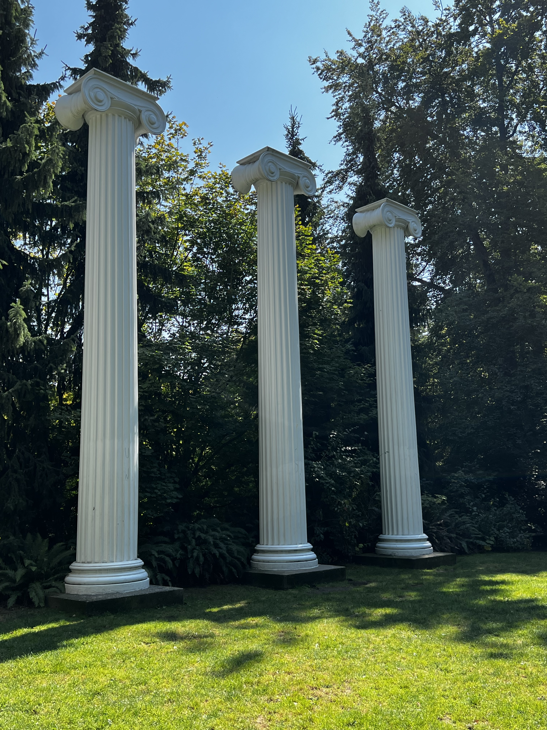
Three pillars of UDL
Multiple Means of Representation
Multiple Means of Engagement
Multiple Means of Action and Expression
Source: The UDL Guidelines. CAST. http://udlguidelines.cast.org
Notes:
UDL is a complex yet adaptable framework for course design and practice – there is no one-size-fits-all UDL practice.
The photo here shows 3 of the 4 cedar columns in UW’s Sylvan Grove. The columns originally supported the UW’s first building, erected in 1861.

Slide 37
The Outreach Ecosystem
Offer Multiple Ways to Engage
Technical Support
Networking & Connection
Meetups & Events
Workshops & Presentations
1:1 Consults
Training platforms

Slide 38
An Ecosystem Mindset...
Focuses on multiple ways for faculty to access and interact with training and resources on Accessibility.
Acknowledges the diversity of our faculty learners and their different ways of developing a workflow.
Helps us to anticipate and proactively design for learners' needs, particularly with overburdened schedules.
Helps build both accessibility awareness and technical skills.
Helps us address the personal and institutional constraints faced by faculty.

Slide 39
Partnerships: a key to success
Build trust and generate interest
Collaborate with internal partners
Customize to the audience
Identify pain points
Ensure relevance
Continue the conversation
Notes:
Unlike other staff units that may have a collective structure around professional development and training, academic units on a decentralized campus like UW vary widely in professional development offerings for faculty, and this is true for tenured and adjunct faculty. Facilitators coming from outside the department for faculty development have to build trust. And partnering with accessibility champions within the department helps to open doors.
Outreach events and trainings need to be relevant to the audience and getting a sense of what conversations are going on and what the pain points are allows us to design a café that best suits the needs of the department we’re working with. Collaboration partnerships help us address what will be most helpful for faculty in that particular department. And those partners can keep the conversation active and alive.

Slide 40
Meet faculty where they are
Literally and Figuratively
“Take your show on the road”
Analyze the audience
Scaffold for different skill sets
Empathize with personal constraints
Prepare for different reactions
Notes:
Being aware of the constraints we already mentioned, partnering with internal allies, and being transparent in our communication with faculty goes a long way toward building a collegial relationship with all participants. It helps them see you as a support who will work with them and for them, rather than someone coming in to impose something on them.

Slide 41
Two Pilot Projects
Both have the qualities I needed – and are adaptable
Accessibility Cafes
Accessibility POP (Progress Over Perfection) Working Groups

Slide 42
Both Models have 4 key characteristics
Efficient: Easy to schedule, organize, and facilitate
Replicable: Content is re-usable and customizable for multiple audiences, easily adapted
Sustainable: One person can do offerings and train others to do them as well
Interactive: Faculty immediately apply what they’re learning to their own materials during the session.
Notes:
How are Accessibility Cafes different?
Learning + Immediate Application = Early success with new skills
Collective conversation with peers that can continue afterwards
Home-base, home-team, community conversation
We can think of Accessibility Cafes as a combination of the best elements of a presentation, office hours, and study hall all rolled into one event.
Accessibility Cafes provide the tool needed my outreach and engagement efforts to support faculty in increasing course accessibility by building awareness and skills.
Offers dedicated space and time for faculty to learn and practice an accessibility skill in a supportive environment
Faculty leave the session able to independently apply their new skills.
Adaptable to myriad topics in accessibility and Universal Design for Learning (UDL)
Easy to organize and facilitate.
Replicable and sustainable

Slide 43
Accessibility Cafe Framework
90-min. guided sessions on a single accessibility topic/skill
20-30 minute introduction to the topic
Emphasize “Progress Over Perfection”
Emphasize skill-building
60-70 minutes work time
Faculty work on what suits their own needs
Spontaneous discussions with peers
Ask questions of one another or facilitator
Notes:
The Accessibility Café Pilot Project seeks to partially address these constraints with an event that offers a safe space and focused time for faculty to be introduced to one focal skill set with time to apply that skill to 1-2 easy fixes, to ask questions, or to explore and plan their next steps.
Here’s a how it works –
Conference room booked for 90 min.
20-30 minute introduction to the topic
60-70 minutes work time – faculty can stay as long as they want to
Facilitator and faculty partner circulate and provide support
An informal, collegial environment is crucial to set the stage for future events to build off of the first one. One-off trainings/workshops may not have long-lasting effects.
NOTE: This model is very flexible and can be molded to suit many purposes.

Slide 44
A key difference in the AC model
Reduces cognitive overload; encourages easy application
“I feel like I have not been to a great talk like [this] for a while, versus other talks where the presenter is cramming too much info in a short period of time, or the content is too complex for people to use.”
Notes:
So often we try to offer faculty ‘everything + the kitchen sink’ when it comes to accessibility, and it’s easy for them to become overwhelmed with all of the options and complexities. This leads to task paralysis, and sometimes even defensiveness. The café model allows faculty to absorb knowledge and apply it in the same space.

Slide 45
Accessibility POP Working Group
Peer-oriented series of working meetings to set and achieve accessibility goals
A cohort of peers commits to a series of 1-hour working meetings over 8-10 weeks
Goal = helping folks learn how to create a sustainable workflow for learning and applying accessibility skills to their course content
15-30-15 structure for meetings
15-min. – Round Robin check-in on previous week’s individual goals
30-min. – Individual working time; opportunity to ask for help
15-min. – Round Robin check-out: What are next week’s goals?
Notes:
Inspiration: Faculty who want to build accessibility into their courses, but can’t figure out the TIME challenge
Question: Can the familiar Writing Accountability Group framework be modified for Accessibility Work?
Goal: Help faculty/staff establish a sustainable accessibility practice that they can apply to their workflow and maintain over time.
Hope: This model can be replicated for future POP groups at UW.

Slide 46
Post-POP Testimonials (1 of 3)
“I'm pleased to realize I'm less intimidated by accessibility.”
--Summer 2024 Cohort

Slide 47
Post-POP Testimonials (2 of 3)
“The dedicated work time was tremendously helpful. And I appreciated the opportunity to learn from others in the group.”
--Summer 2024 Cohort

Slide 48
Post-POP Testimonials (3 of 3)
“The Accessibility POP Groups has been super helpful in terms of motivating me to look more into accessibility, how I can more regularly implement accessibility into my course, and practicing skills related to implementing accessibility so it's not as daunting to do in the future.
“It is also motivating to have a group of peers who are also invested in and care about accessibility, and I know that I can reach out to any of them if I have any questions or want to discuss something in the future.”
--Summer 2024 Cohort

Slide 49
Challenges with both models?
The same constraints and pain points for faculty we spoke about earlier!
We have to creatively counter the deficit mindset – no time, no money, no support – through an ecosystem approach.
And we see, again, the opportunity presented by Title II – more support from leadership for these efforts.

Slide 50
Experiment, don’t overthink it
Benefit of the ecosystem approach?
There are plenty of back ups if you try a new idea!
If you have an idea, run with it. Test it out. Create a workable framework that gets you started, have a purpose behind it, and jump in.
Learn by doing, tweak accordingly.

Slide 51
Where Do I Start?
Networking
Go to the source
Build partnerships
Go to events
Build content
Learn from experimenting

Slide 52
Networking for solo practitioners
Build connections with folks from other schools – we’re here!
Try to develop a collaborative partnerships with staff/faculty in 1-2 departments
Partner with Junior and Teaching faculty who are developing projects
Meet your librarians – they are wonderful allies.
Regional campus?
Depending on system, connect with folks who have a similar role on sister regional campuses.
Tap into any training, networks, connections on central campus.

Slide 53
Reach out to Administrative Staff
They know everything!
They can connect you with faculty and TAs already working on or want to learn more about accessibility.
They know how to navigate the academic time warp.
They have scheduling power -- programming is hard, so if you can fill a slot on short notice, you're doing them a favor.

Slide 54
Build flexible content
Ask partners to clue you in on departmental pain points
Create presentations that can be easily customized to a target audience
Avoid repeating the same presentation to the same audience
Determine depth of content by amount of time you have:
30-min. or less? Introductory content only – maybe 1 skill or example
45-min. is the minimum amount of time for 2-3 general skills
60-min. is perfect for a meetup or basic presentation, allows for Q & A.
90-min. is optimal for interactive workshops

Slide 55
Discussion
What are some tips that have worked for you in your own outreach efforts?

Slide 56
Thank you!

