Slide 1
Navigating Accessibility Through AI: Using the Outcome Thinking Framework
Accessing Higher Ground Conference 2024
JaEun Jemma Ku, PhD, Director of Digital Accessibility
University of Illinois Chicago
Randy D. Colón, PhD student, Disability Studies
University of Illinois Chicago

Slide 2
Jemma’s Reaction to the AI Frenzy
Edvard Munch, “The Scream”, 1893

Slide 3
Agenda
Perspectives on AI – Hype to True Potential
Introduction of the Outcome Thinking Framework
Live Demonstration
Recap and Open Discussion

Slide 4
Key Takeaways
Analyzing AI's potential and limitations for enhancing accessibility in higher education.
Understanding the Outcome Thinking Framework as a tool for guiding AI-driven accessibility initiatives.
Applying actionable strategies to ensure AI accessibility efforts are inclusive, equitable, and impactful.

Slide 5
AI and Accessibility: Navigating the Hype
“Outcome Thinking Framework”
The Hype vs. The Fear
Bridging the Gap
Unlocking True Potential
Efficient and Effective Accessibility Solutions
AI Optimism
Reluctance and Fear
Ethics
Greater Equity and Inclusion
Full context
Cost
Governance

Slide 6
Outcome Thinking Framework
Conceptual foundation, Core principle, Process and Steps

Slide 7
Main Premise
Start by determining desired accessibility outcomes
Assess to what extent AI tools help achieve outcome

Slide 8
Conceptual Foundation
Digital Accessibility Experience
User-centered approach
Practical insight
Outcome-based Evaluation
Define measurable outcomes
Assess based on results
Disability Studies
Center disabled voices
Challenge assumptions
Promote systemic change

Slide 9
Core Principles
User-Centered
Focus on user priorities
Evidence-Based
Based on data and results
Iterative & Collaborative
Ongoing improvement
Systemic Impact
Create long-lasting change

Slide 10
Process
Define Inclusive Strategic Outcomes
Evaluate AI-Powered Accessibility Tools
Implement, Collaborate, Optimize
Drive Equitable Institutional Change

Slide 11
Steps
Define Outcomes
Evaluate AI
Assess capabilities of AI technology to improve accessibility
Implement , Collaborate & Optimize
Develop an inclusive implementation plan that ensures adoption and practical use across the institution
Drive Equitable Institutional Change
Embed accessibility into policies and practices
Engage diverse stakeholders to understand their accessibility needs and priorities
Conduct assessments to identify key areas for improvement
Analyze potential risks and biases to ensure responsible use
Evaluate institution’s capacity to adopt and support AI tools effectively
Test solutions with diverse users, including faculty, staff, and students
Continuously refine based on feedback from all users and stakeholders
Share successes and lessons learned to promote a cultural shift toward accessibility
Align efforts with broader goals for accessibility, diversity, and inclusion
Set clear, measurable goals that focus on user-centered outcomes
Ensure AI tools align with user-centered outcomes

Slide 12
Live Demonstration
AI for Alt Text

Slide 13
Context
Creating alt text for PowerPoint
Exploring the usefulness of popular AI platforms
AltText.ai
Chat GPT
Office's automated alt text generator
MS co-pilot

Slide 14
Generate Outcomes – Why do this at all?
Generate alt text
or ADA Compliance
First Draft or "Weak" Outcome
Ensure all students understand the map’s purpose and message
"Strong" Outcome

Slide 15
1. AltText.ai’s Alt Text
“A U.S. map shows population distribution by state using a color gradient from light yellow (less populated) to dark brown (more populated).”

Slide 16
2. ChatGPT's AltText
“The image shows a color-coded map of the United States, where each state is shaded according to its population. Darker shades of orange represent states with higher populations, while lighter shades represent states with lower populations. The legend at the bottom of the map indicates three population ranges: from approximately 567,826 to 1.8 million, from 1.8 million to 7.18 million, and from 7.18 million to 38.87 million. States such as California, Texas, and Florida are shaded in the darkest orange, indicating the highest populations. States in the Midwest and some in the Mountain West are lighter in color, indicating smaller populations.”

Slide 17
3. Microsoft's Alt Text

Slide 18
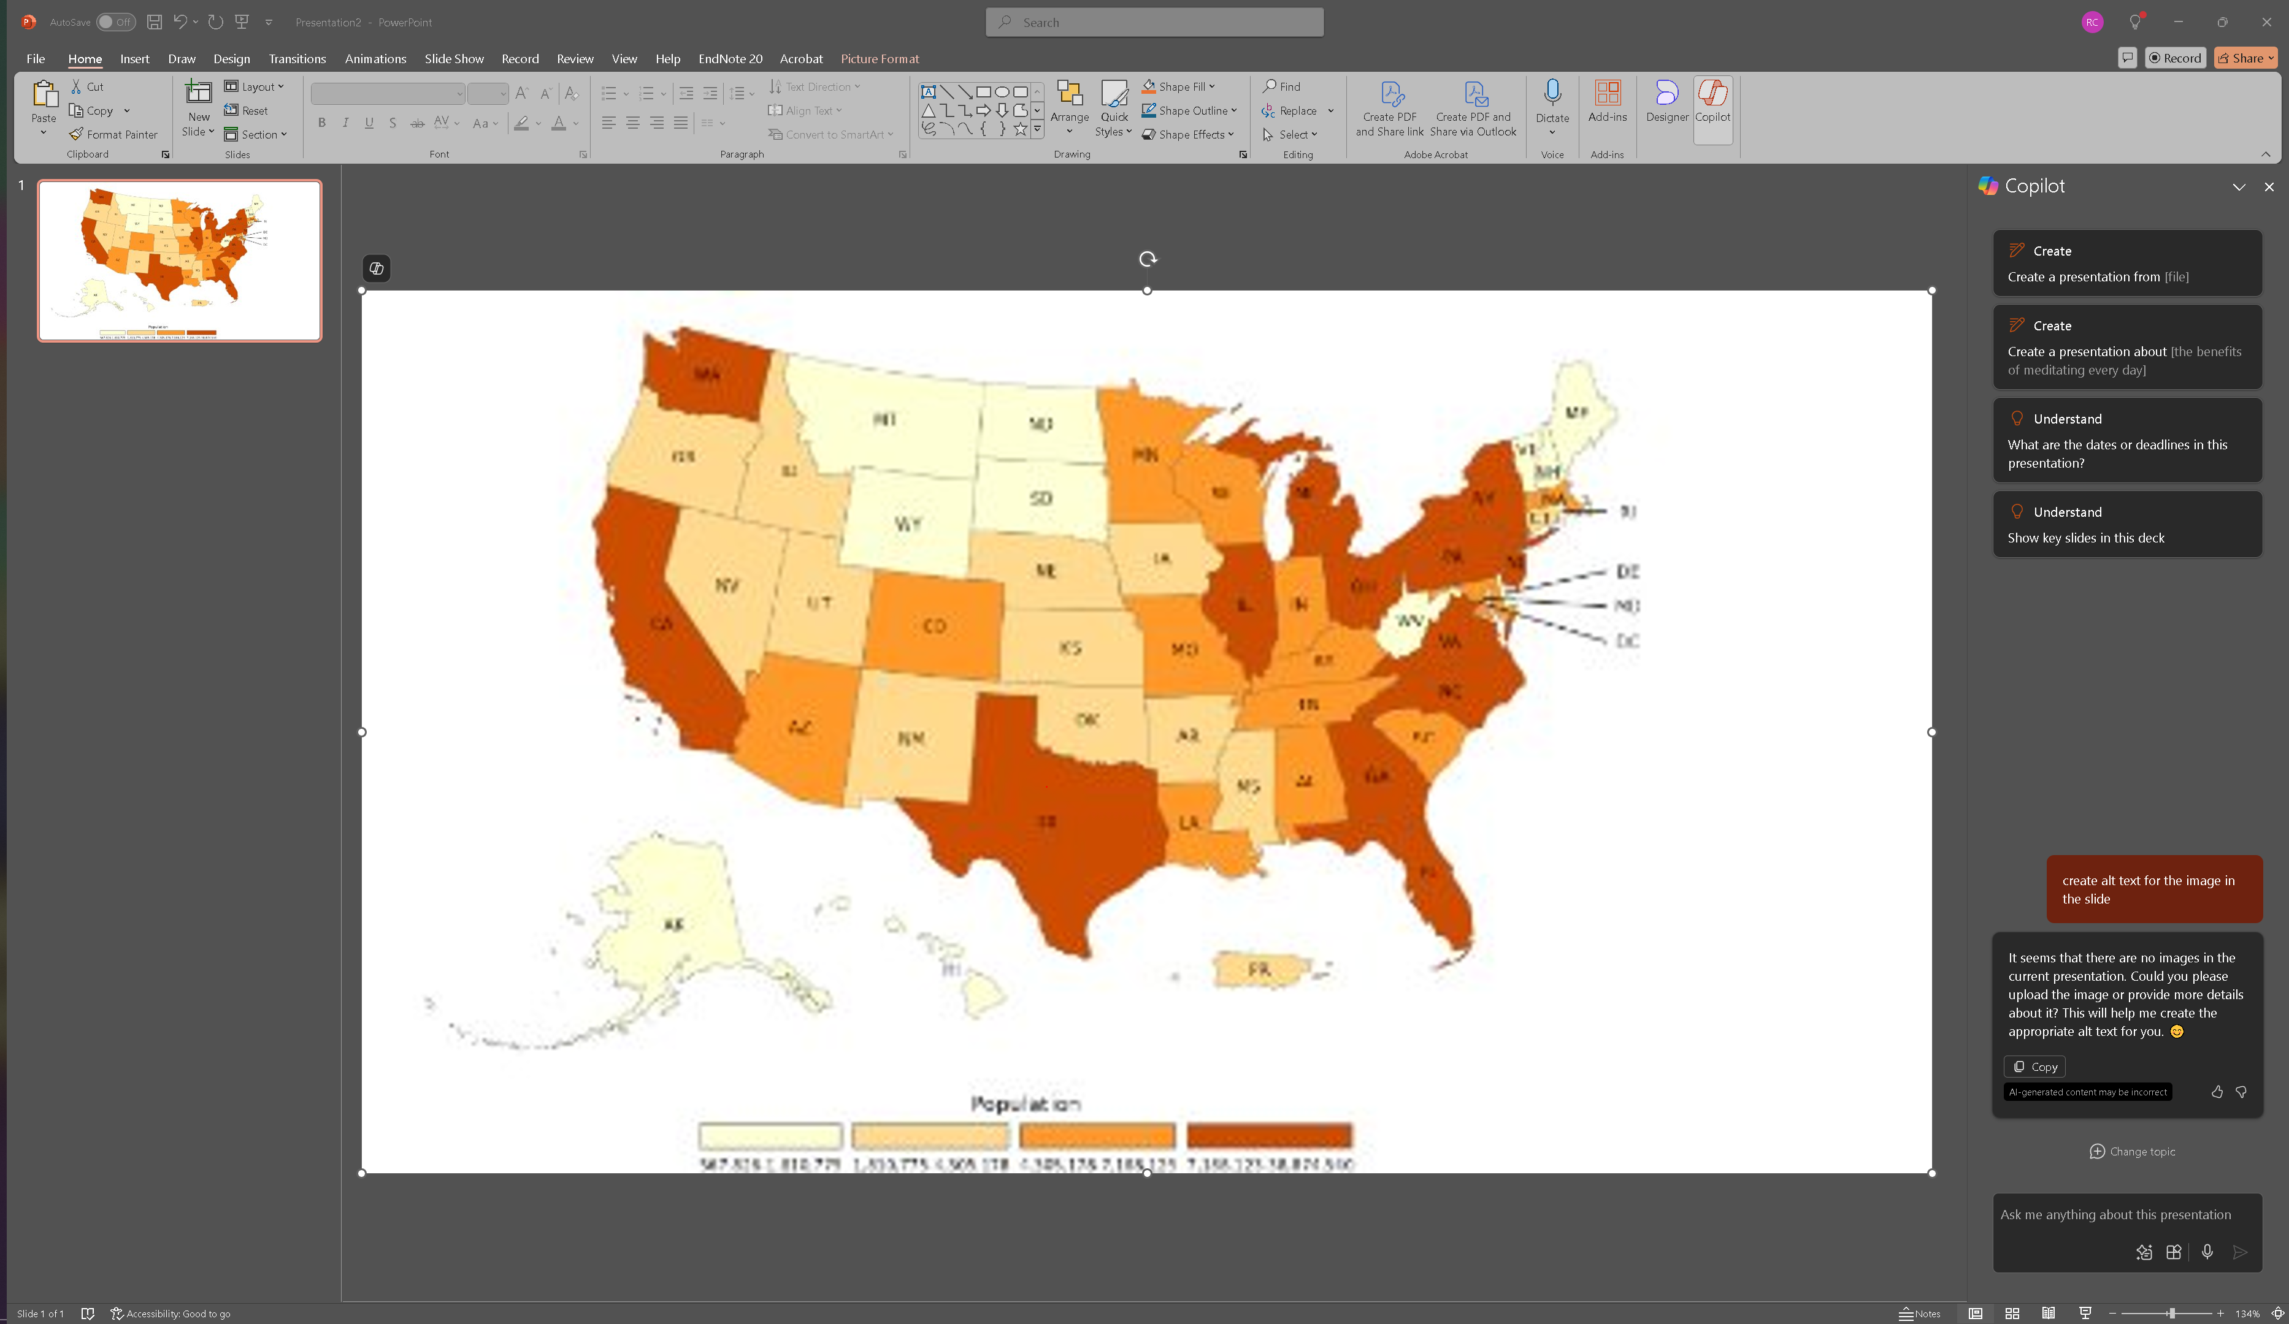
4. Microsoft’s Co-pilot AltText
It seems that there are no images in the current presentation. Could you please upload the image or provide more details about it? This will help me create the appropriate alt text for you. 😊

Slide 19
Vote: Which Alt Text is Best and Why?
Outcome: Ensure all students understand the map’s purpose and message
Option 1: AltText.ai
Option 2: ChatGPT
Option 3: Microsoft

Slide 20
Randy's Pick...with Caveats
ChatGPT ensures student understanding by:
Explaining map’s purpose (population distribution)
Conveying key message (color = population size)
Chat GPT fails to:
Keep text concise
Explain difference between alt text and image description

Slide 21
Determining AI's Role
Strengths: Automation, consistency, and speed
Weaknesses: Lack of context awareness and potential for inaccuracies
Human oversight remains essential for quality control and alignment with learning objectives
Adapt image description based on specific educational goals

Slide 22
Tie to Outcome Thinking Framework
Outcome sets stage for critical approach
Evaluation assesses process and output
Testing offers insight toward ideal AI tool
Sets foundation for adoption and integration

Slide 23
Recap and Discussion
Let's apply, share, and learn!

Slide 24
Recap: Outcome Thinking Framework
3. Process and Steps
Define Inclusive Strategic Outcomes
Evaluate AI-Powered Accessibility Tools
Implement, Collaborate, Optimize
Drive Equitable Institutional Change
2. Core Principles
User-Centered
Evidence-Based
Iterative& Collaborative
Systemic Impact
1. Conceptual Foundation
Digital Accessibility Experience
Outcome-based Evaluation
Disability Studies

Slide 25
How might you implement the Outcome Thinking Framework?
What are some of your current AI-driven accessibility initiatives or What other AI tools are you considering?
1
What outcome do you hope to achieve with those initiatives or tools?
2
How might this framework guide your work and collaboration with users?
3

Slide 26
Thank You
Please feel free to reach out to us if you have any questions.
JaEun Jemma Ku, University of Illinois Chicago jku@uic.edu
Randy D. Colón, University of Illinois Chicago rcolon4@uic.edu

