Slide 1
DIY Braille: How to produce professional braille in-house
(and why you should)
Accessing Higher Ground – November 2024
Em Kribs, Wichita State University

Slide 2

Wichita State University
Public research university in Wichita, KS
Enrollment of 17,700 students
https://www.wichita.edu/

Slide 3
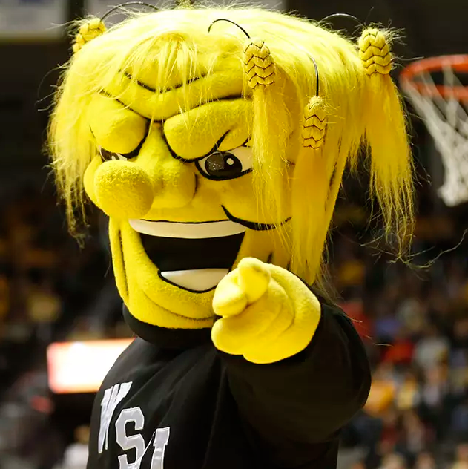
Wichita State University
Yes, this is our real mascot. His name is WuShock, and he’s a “big, bad muscle-bound bundle of wheat”.

Slide 4
Academic Accommodations and Accessibility
Also known as AAA or triple-A
Office in the Media Resources Center at Wichita State University
Built from scratch by Jay Castor
We have graduated three students who used our braille materials
  One is now in medical school, and we still get requests for transcription services when they run into issues
  One of our graduates told us that he had considered leaving WSU due to some uncooperative instructors, but he stayed specifically for the quality of his materials

Slide 5
Some data (1 of 2)
In AY22-23, we transcribed 179 documents across 12 courses for three students
  3,000 pages of print
  7,421 pages of braille
  804 tactile graphics
In AY23-24, we transcribed 366 documents across 20 courses for three students
  4,533 pages of print
  14,976 pages of braille
  2,335 tactile graphics

Slide 6
Some data (2 of 2)
AY24-25:
As of Oct. 11, 2024, we had transcribed 282 documents across 11 courses for three students
  3,372 pages of print
  11,105 pages of braille
  2,928 tactile graphics

Slide 7
Q: But why does Wichita State University have an entire office and four full-time staff dedicated to braille?
A: We got sued.

Slide 8
From the resolution agreement:
“The Complaint alleged that WSU discriminated against her, as a blind student, in violation of Title II of the ADA and Section 504 of the Rehabilitation Act of 1973 by:
using inaccessible electronic and information technology, including: inaccessible class assignments, materials, and tests;
using inaccessible student computer workstations; and
not providing alternative accessible formats of print material, class assignments, and tests in a time and manner that would provide equally effective communication to blind students.”

Slide 9
Alternatives to providing physical braille
These are useful tools, but have drawbacks:
Screen-readable materials
  Relies on materials being correctly formatted
  Heavy demand on working memory
  Can be trickier to navigate than text
  Do not provide students an equitable learning experience
Refreshable braille displays
  Still relies on materials being correctly formatted
  Often quite loud
  Usually cannot display tactile graphics
  Expensive

Slide 10
Why braille and tactile graphics?
Better parity with other students’ learning experiences
Improved subject literacy
Offloads working memory
Tactile graphics provide alternative presentation of information, as well as spatial information

Slide 11
What about contracting out braille? (1 of 2)
Third party braille vendors, while an invaluable resource, have some drawbacks:
Slow and inflexible, often have to account for shipping time
More steps, more people, more opportunities for problems and delays
Requires students to either make do with audio formats for in-class materials OR instructors to have materials ready to go weeks or months ahead of time

Slide 12
What about contracting out braille? (2 of 2)
Vendor may not be sufficiently familiar with subject matter to avoid pitfalls (e.g. a ρ is NOT the same thing as a lowercase p)
Expensive
Lack of QA process and lack of recourse if materials are faulty
Less reusable
  First user may lose or damage materials
  Materials wear out over time, requiring you to pay contractors again
  Tactile graphics cannot be adapted for other uses, such as if a graphic appears in both the textbook and a slide deck

Slide 13
Some math
In spring of 2023, we received a quote from a braille vendor for $40,000 for a single trigonometry textbook.
To extrapolate from there:
Full time undergraduate courseload: 12 credit hours, or four 3-credit classes
If we assume one textbook per class:
4 classes × $40,000 = $160,000 per student per semester
(Probably only $80,000 per student for a summer semester)
This figure does not cover in-class materials like slides, assignments, tests, handouts, etc.

Slide 14
What about AI?
AI is a useful tool with plenty of applications, such as Optical Character Recognition (OCR) and generating image descriptions.
However, at this point we should only be using AI for things where we’re willing and able to check its work, or where correct and accurate output doesn’t matter.
AI cannot think. It is a tool for generating statistically likely outputs. The more obscure the subject, the less likely AI can help.
AI is a tool. You still need humans to wield it.

Slide 15
Starting Costs

Slide 16

Braillo 300 S2 Embosser: $25,000

Slide 17
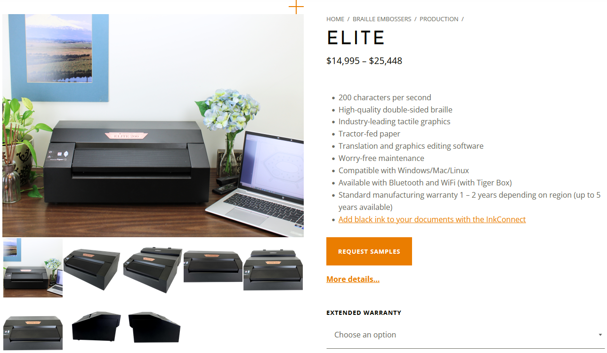
Elite 200 Embosser: $14,995 – $25,448

Slide 18
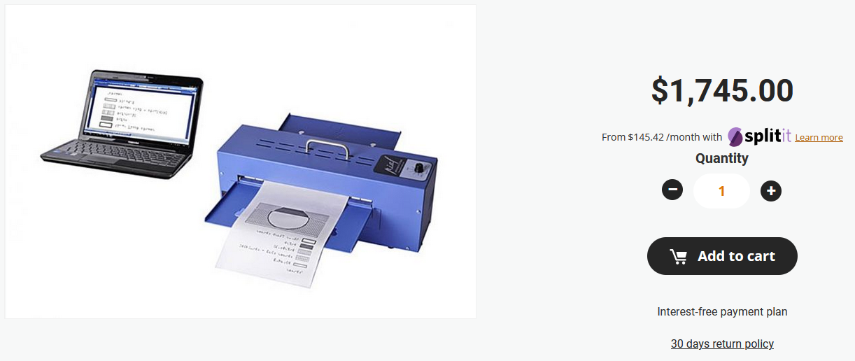
PIAF: $1,745

Slide 19
Starting costs for equipment
Braillo 300 S2 Embosser: $25,000
  https://braillo.com/braillo-300-braille-embosser/
Elite 200 Embosser: $14,995 – $25,448
  https://viewplus.com/product/vp-elite/
PIAF: $1,745
  https://store.humanware.com/hus/piaf-picture-in-a-flash-tactile-graphic-maker.html
Equipment total: $41,740 – $52,193

Slide 20
Software
Duxbury Braille Translator: $695 per user
  https://www.duxburysystems.com/default.asp
  Save your installer!
MathType: $61.95 per user per year
  https://store.wiris.com/en/
  (20% off with email ending in .edu)
Adobe Illustrator or other vector drawing program
Microsoft Word

Slide 21
Supplies
11×11.5” Continuous Feed Braille Paper: $50.99 per 1,000 sheets
  https://americanthermoform.com/product/braille-paper-11x11-5-plain-continuous-sheets/
Tabloid-size Swell Paper: $225 per 100 sheets
  https://americanthermoform.com/product/swell-touch-paper/
11×11.5” Swell Paper: $165 per 100 sheets
  https://americanthermoform.com/product/swell-touch-paper/

Slide 22
Also need
A printer/copier and its requisite supplies
Normal office supplies (desk, computer, etc.)
Staff
Recommended:
Somewhere to put this stuff with great soundproofing or where no one will mind the noise
Hiring a braille user to check your work, especially when first getting started, is invaluable

Slide 23
Staffing Tips (1 of 2)
Experience in higher education, ideally with teaching
Research and critical thinking skills
Cognitive flexibility and/or competence with different perspectives
Criticism competent
  Able to take criticism
  Able to understand criticism and distill out useful information
  Able to incorporate useful information

Slide 24
Staffing Tips (2 of 2)
Technical proficiency
Comfortable with long periods of solitary work (i.e. introverts)
Not intimidated by instructors
  We hire for introverts, but social competence is definitely a plus
Proactive, adaptable, attention to detail
Curious and motivated to learn

Slide 25
Don’t I need to know braille? (1 of 2)
There is a national shortage of braille transcribers, according to Jana Hertz of the National Braille Association. (source: https://www.theoglethorpeecho.com/local-news/high-demand)
Braille can be learned
  Useful for getting started: https://uebonline.org
  National Federation of the Blind and Library of Congress offer braille transcription certification: https://nfb.org/programs-services/braille-certification

Slide 26
Don’t I need to know braille? (2 of 2)
Other braille resources:
  Braille Authority of North America codebooks and guidelines: https://www.brailleauthority.org/publications-area
    Includes Unified English Braille, Nemeth (for math, science, chemistry), music, etc.
Duxbury knows braille, so transcribers need to know when Duxbury is likely to fail
Some useful braille to learn: Numbers, alphabet, Nemeth indicators, transcriber note indicators

Slide 27
The brailling process (1 of 2)
This is highly simplified, but in essence:
Acquire syllabus and materials, create a to-do list with due dates. Start from the nearest deadline and work into the future.
Copy document contents into MS Word BANA template from Duxbury, leaving blank pages for figures and diagrams.
  Document will become linear in this process; sidebars, breakout boxes, etc. will need to be indicated, and you will need to find a sensible location in the text.
Make copies of images (I recommend the snipping tool from Microsoft) and create blank documents in Adobe Illustrator

Slide 28
The brailling process (2 of 2)
Place original images on one layer, then recreate on another layer. Hide the original image’s layer, and make sure any braille text is the correct size.
Translate text into braille using Duxbury and emboss text and tactile graphics
Collate into a single document, which can then be given to the recipient.
Save everything in case of future need. Even when new editions of textbooks come out, you can usually reuse materials.
  Don’t forget to submit a request to distribute to the publisher!

Slide 29
Some tips
Brailling takes time, and that time adds up quickly. Equations, images, tables, and lousy file formats all add to the amount of time you’ll need.
We tell instructors to give us a minimum of two weeks. Even when this is not possible, being ahead of the class allows for more flexibility when urgent situations arise.
For teams with multiple transcribers, people seem to prefer a mix of subjects rather than handling entire courses on their own.

Slide 30
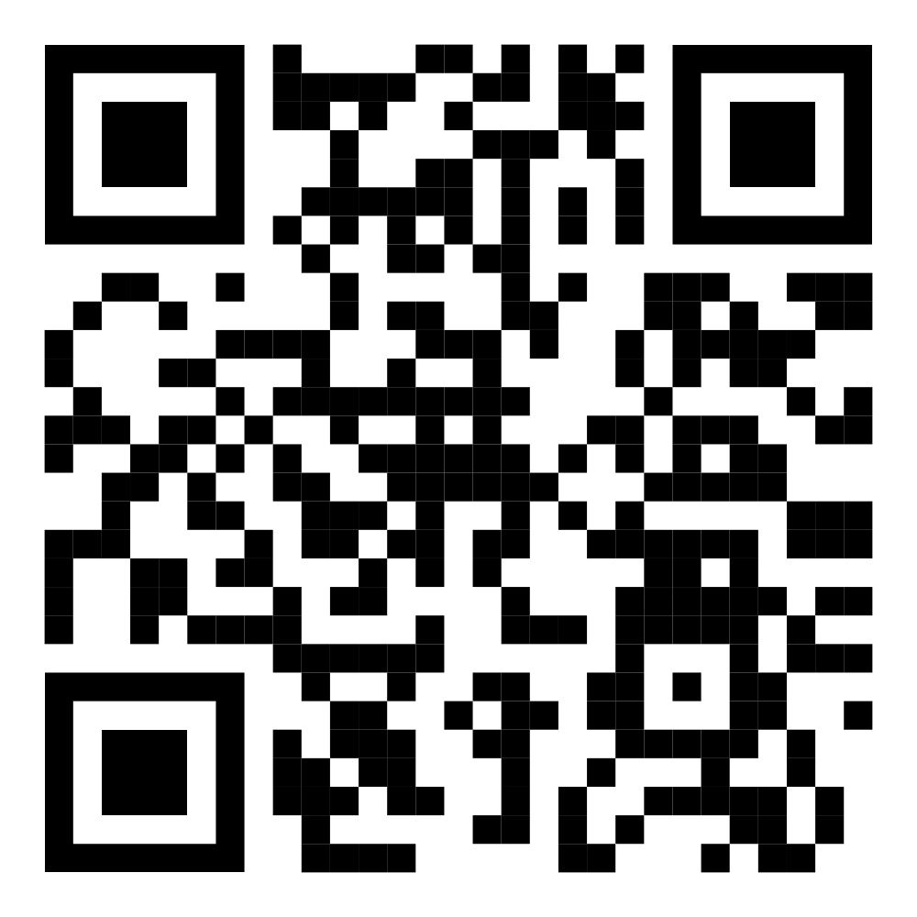
Questions?
Contact Information:
em.kribs@wichita.edu
aaa@wichita.edu
braille@wichita.edu

