Slide 1

Captioning for Inclusive Education Enhancing Accessibility while focusing on Universal Design
Lindsay Cisar,
Senior Account Manager

Slide 2

Session Transcript

Slide 3
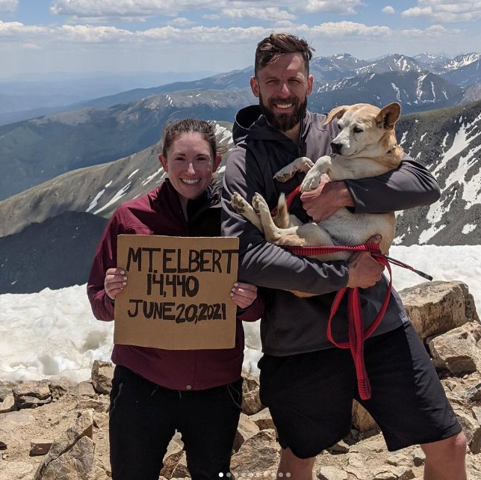
Lindsay Cisar​
Senior Account Manager
Verbit.ai​
She/Her/Hers ​ lindsay.Cisar@verbit.ai

Slide 4
Our mission & vision
Our mission
Make all verbal information and experiences accessible, insightful and useful
Our vision
A world in which all speech can be seamlessly converted into meaningful actions
Notes:
Note the changes to the mission.
Vision, additional options.
A world where spoken and written words are equally valuable
A world where all speech can seamlessly translate to meaningful actions
A world where every spoken word can be captured and used
A future where the path from verbal communication to action keeps getting is minimal
A future where the spoken word is not just heard, but truly understood and utilized to drive innovation, efficiency, and inclusivity in every aspect of life and work
A world where the spoken word and its contextual meaning can be understood by anyone, and its value can be implemented where it is needed
A world where the richness of spoken language, along with its contextual significance, is readily comprehended by all, and where its inherent value seamlessly translates into meaningful action wherever it's required

Slide 5
Captioning and your DEIA Strategic Goals
Diversity
Equity
Inclusion
Students that Most Benefit from Captioning
  First generation students (64.8%)
  Pell-eligible students (65.4%)
  Adult learners (62%)
7.2% higher GPA
with captioning
65% of students in the OSU survey indicated captions help them focus.
27.2% noted captions aid with challenging vocabulary
80% of people who use captions are not deaf or hard of hearing
62.9% respondents said captions helped them retain information.
Students are more confident in engaging
85% are more likely to watch an entire video when captions are available
All cognitive learning styles can
be supported through caption
use.
Research: Linder, Katie, and Mary Ellen Dello Stritto. “A Rising Tide: How Closed Captions Can Benefit All Students”. Educause Review. https://er.educause.edu/articles/2017/8/a-rising-tide-how-closed-captions-can-benefit-all-students. 8/28/2017

Slide 6
ADA Title II Updates
Applies to all public universities.
Requires reasonable accommodations for students with disabilities.
The standards align with WCAG 2.1 AA guidelines.
Mandates the use of auxiliary aids such as captioning
Ensures equal access to academic all programs.
Compliance is required by 2026.
Learn more here: Justice Department sets accessibility requirements for state, local government websites, mobile apps

Slide 7

Common captioning challenges within education
Cost
Accuracy
Scale
Providing accurate captioning for all video content can be expensive, particularly for institutions with limited budgets
Institutions must weigh the cost of captioning along with other accessibility services
Poorly captioned content can mislead or confuse students, impacting learning outcomes.
Free solutions may not always deliver the desired level of accuracy, especially for niche subject matter.
Universities often have vast amounts of video content, from recorded lectures to live events.
Scaling captioning efforts across thousands of hours of content can be difficult without the right technology.
Notes:
There is a need to balance affordability with quality delivery

Slide 8
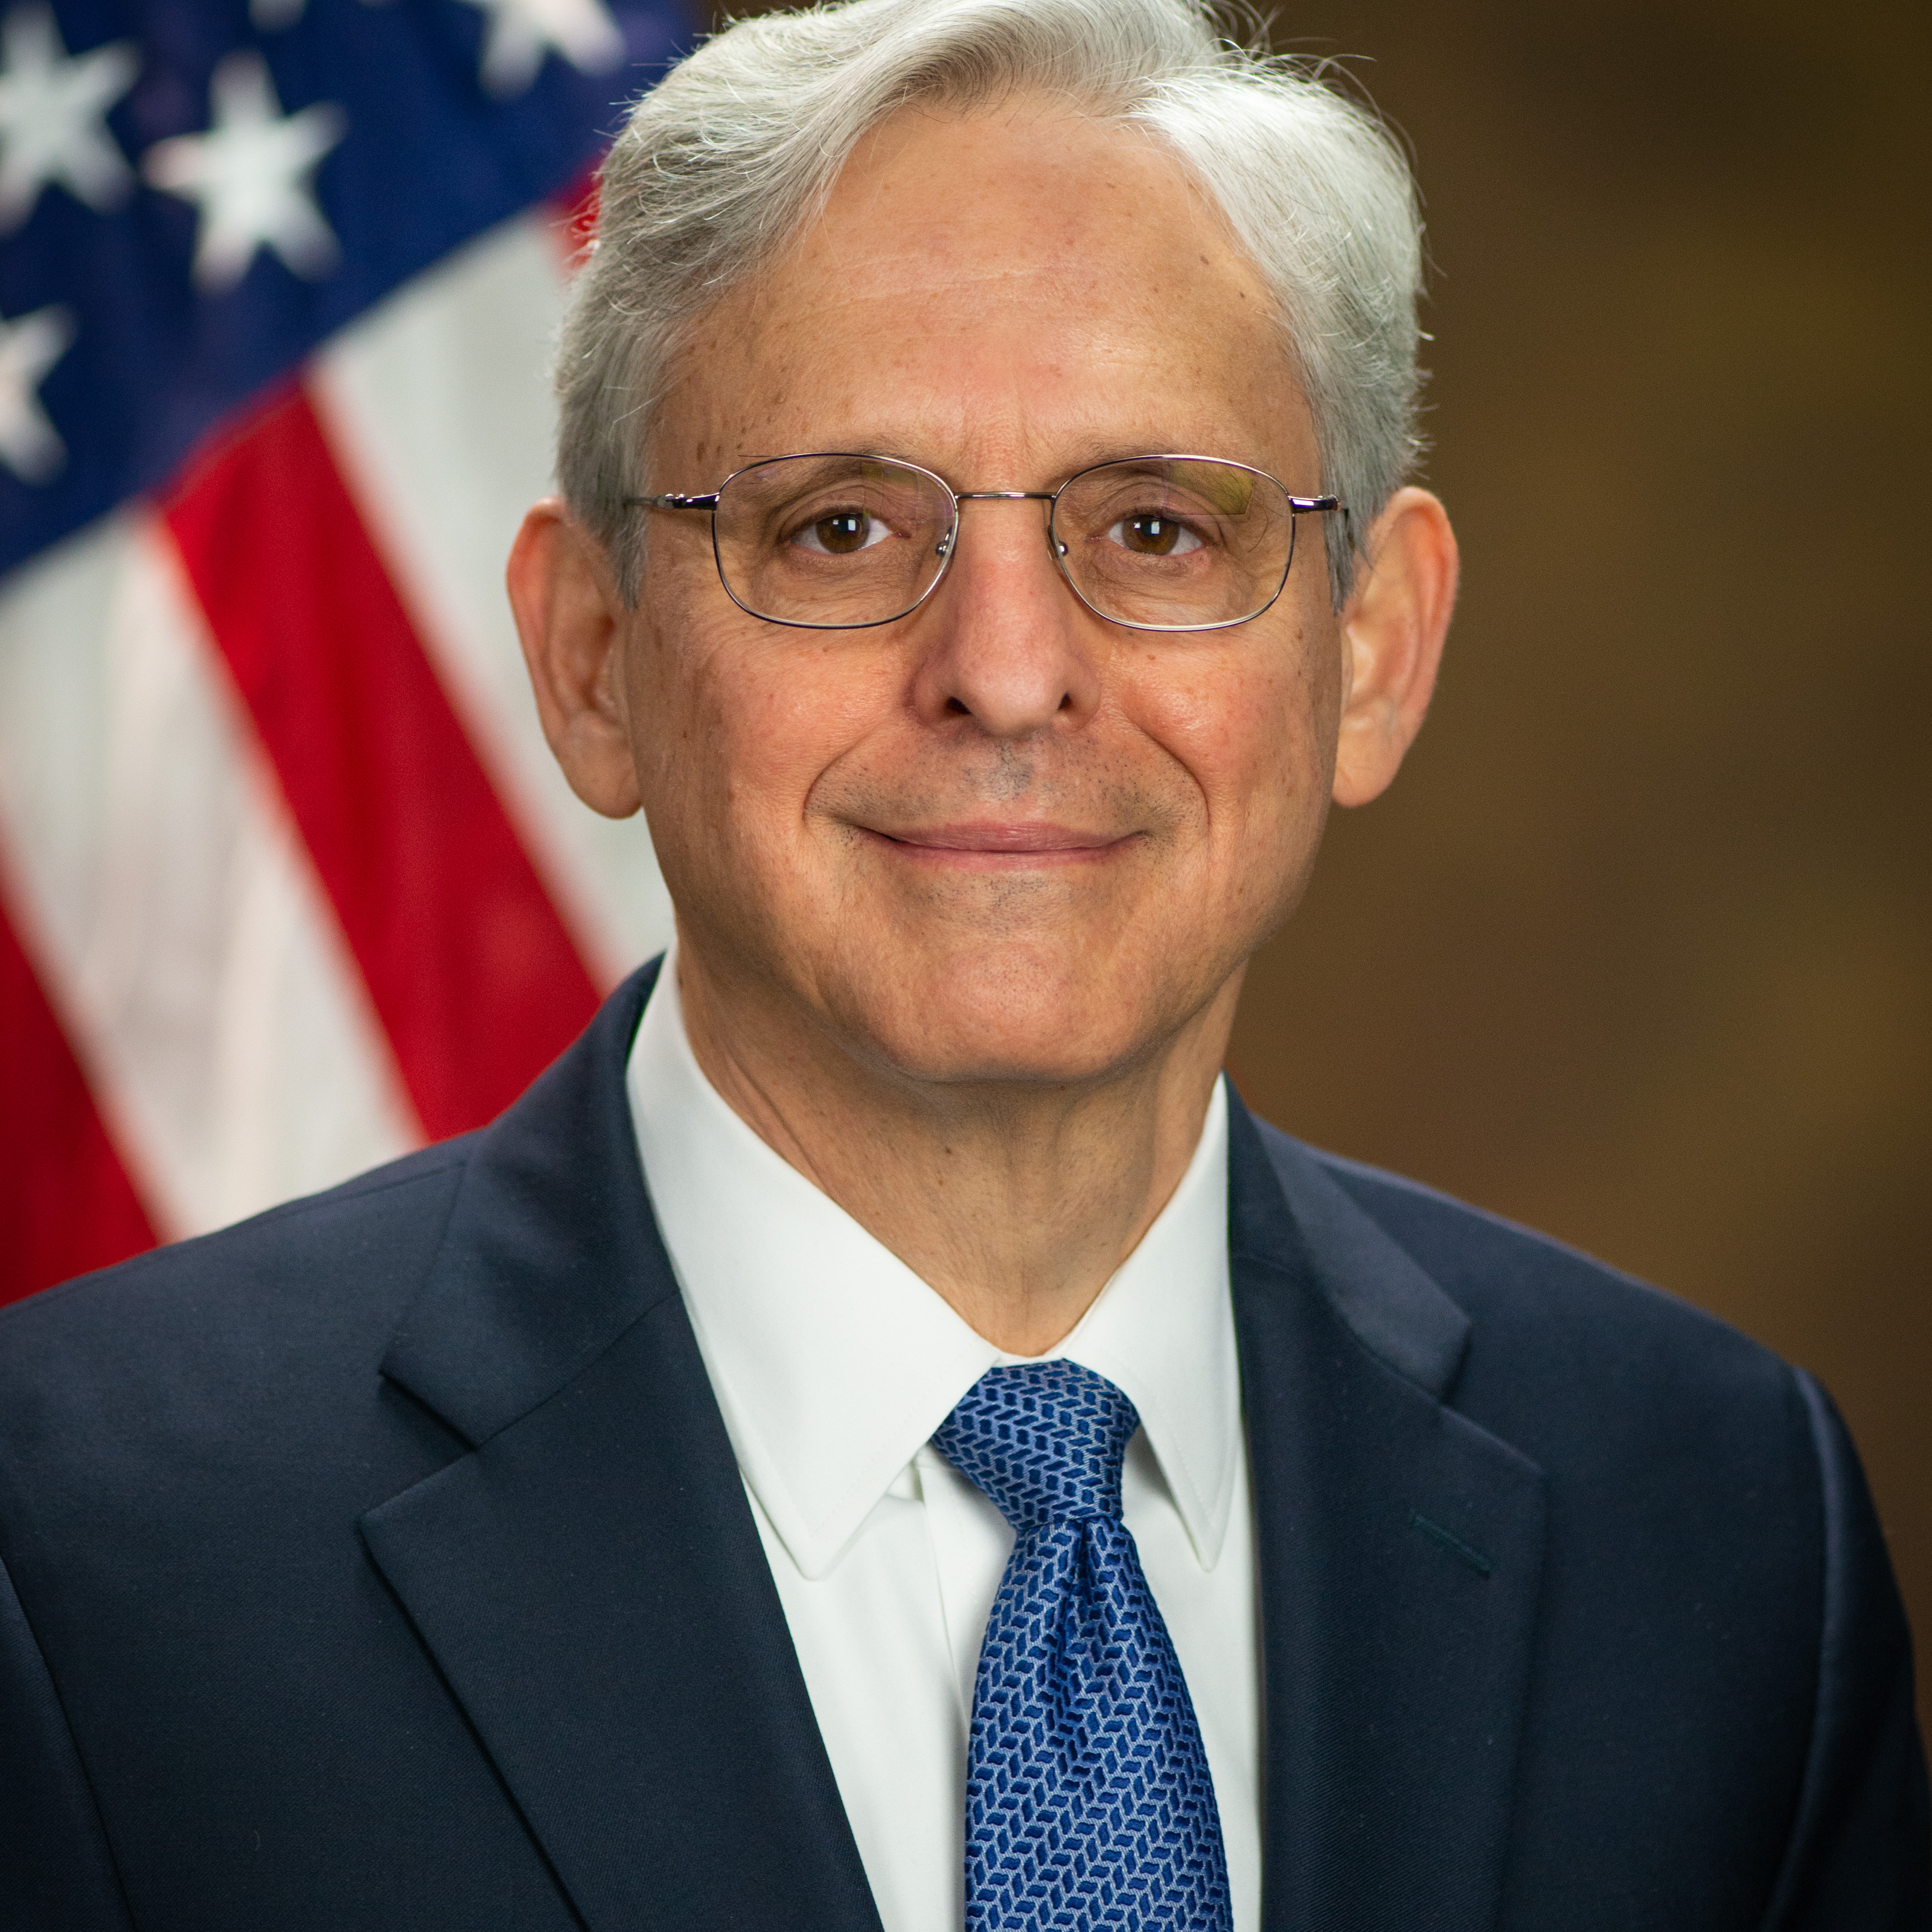
Merrick Garland
United States
Attorney General
“This final rule marks the Justice Department’s latest effort to ensure that no person is denied access to government services, programs, or activities because of a disability […] this rule advances the ADA’s promise of equal participation in society for people with disabilities.”

Slide 9
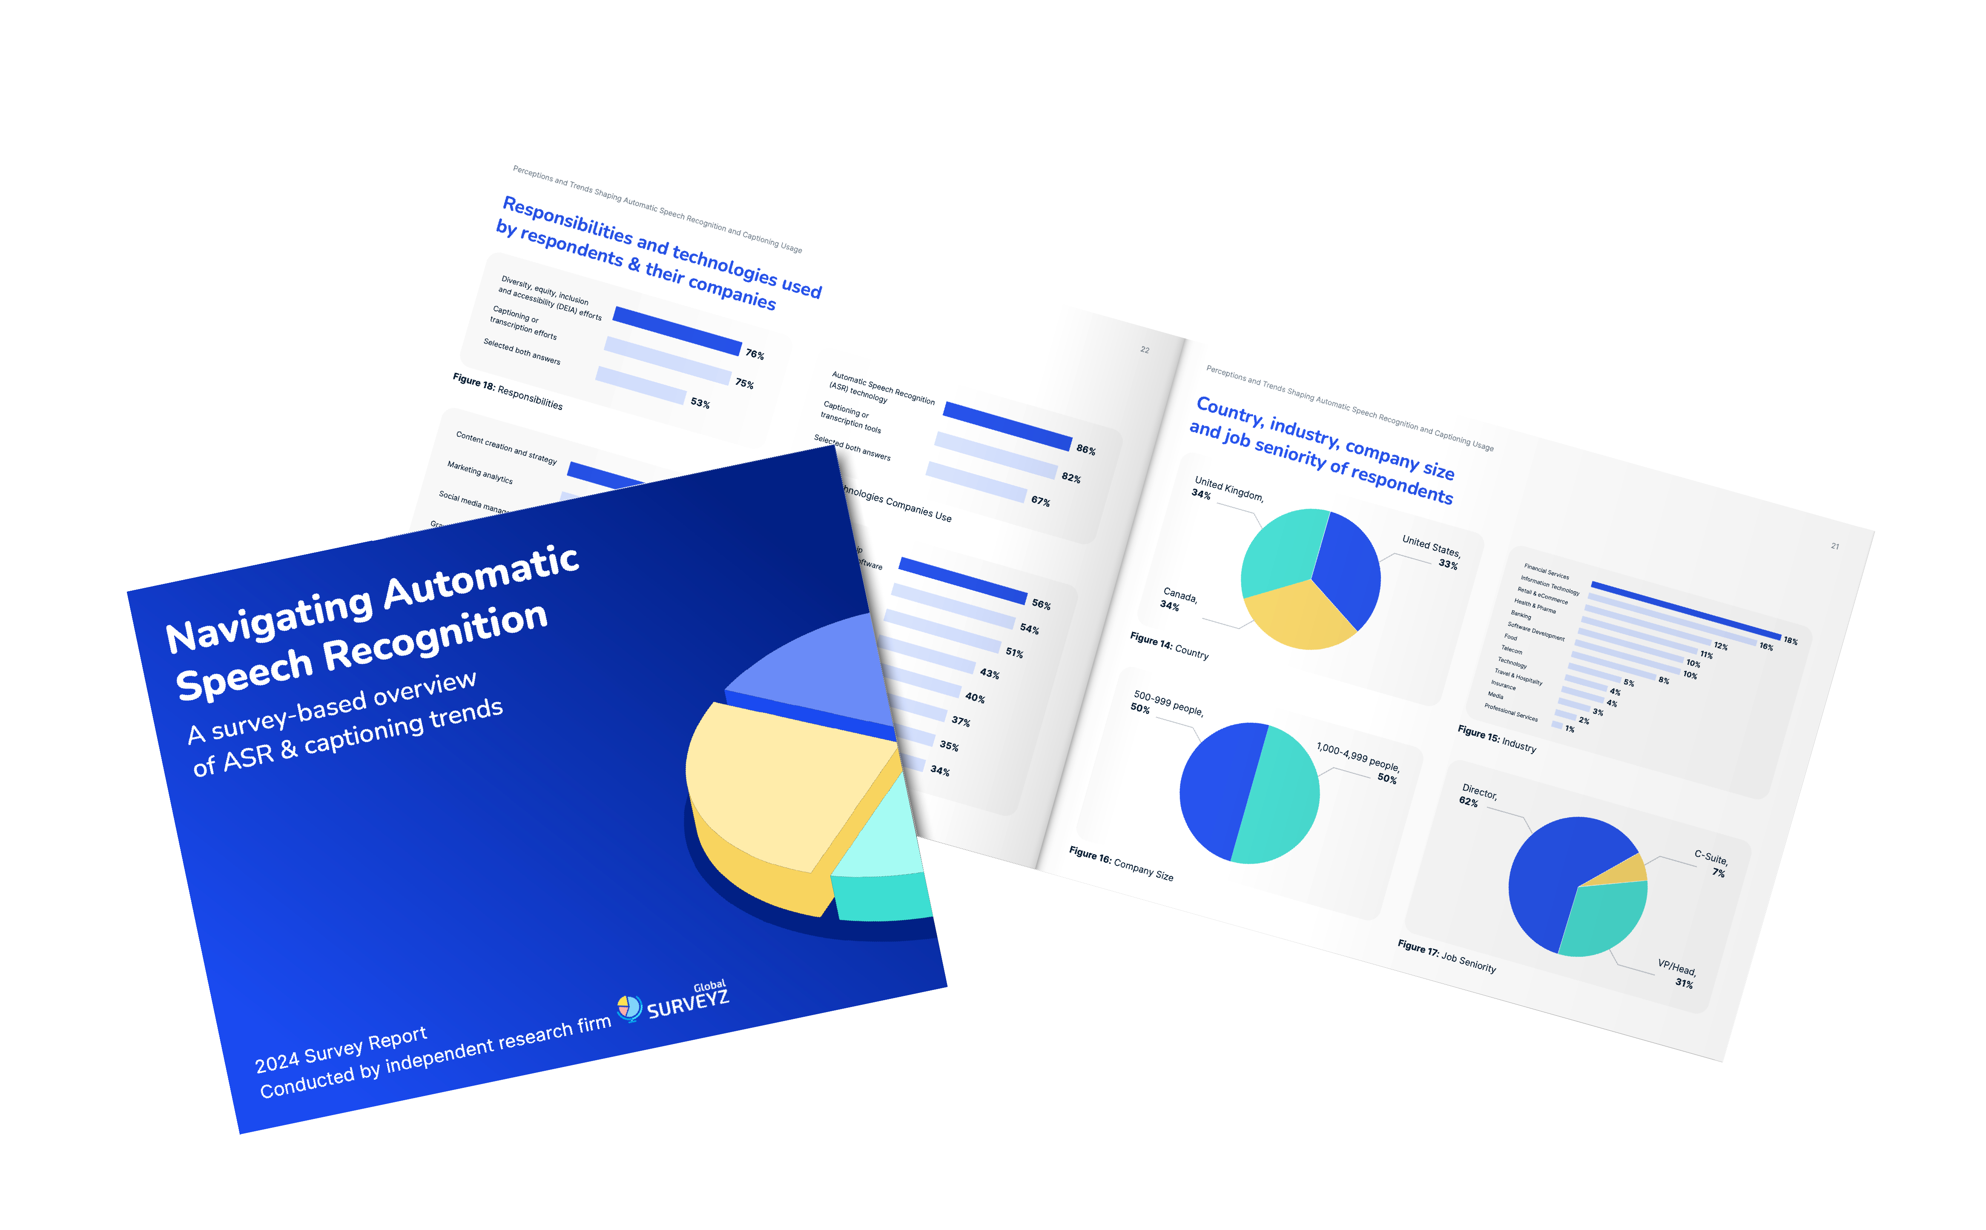
Verbit survey on ASR technologies
Notes:
Now let’s talk about the technology that powers our solutions..
We recently commissioned a survey on the latest captioning trends in the market.
Flood of ASR tools coming to market, many are free and built-in to other software, making them easy to use. However, their accuracy varies and presents some risks.
We sought to explore current attitudes on ASR technologies globally. what are the developments? What are people worried about? What do people expect? Where is this going?

Slide 10

How we commissioned this survey
Location of respondents
33%
US
33%
CA
34%
UK
We recruited Global Surveyz Research
to administer this survey of 200 senior executives (Director+) across industries. Respondents had to be responsible for:
DEIA efforts
Captioning
ASR technologies
Any combination of the above
Organization size where respondents are employed
50%
500-1K employees
50%
1-5K employees
Notes:
Global Surveyz is an independent global research firm

Slide 11
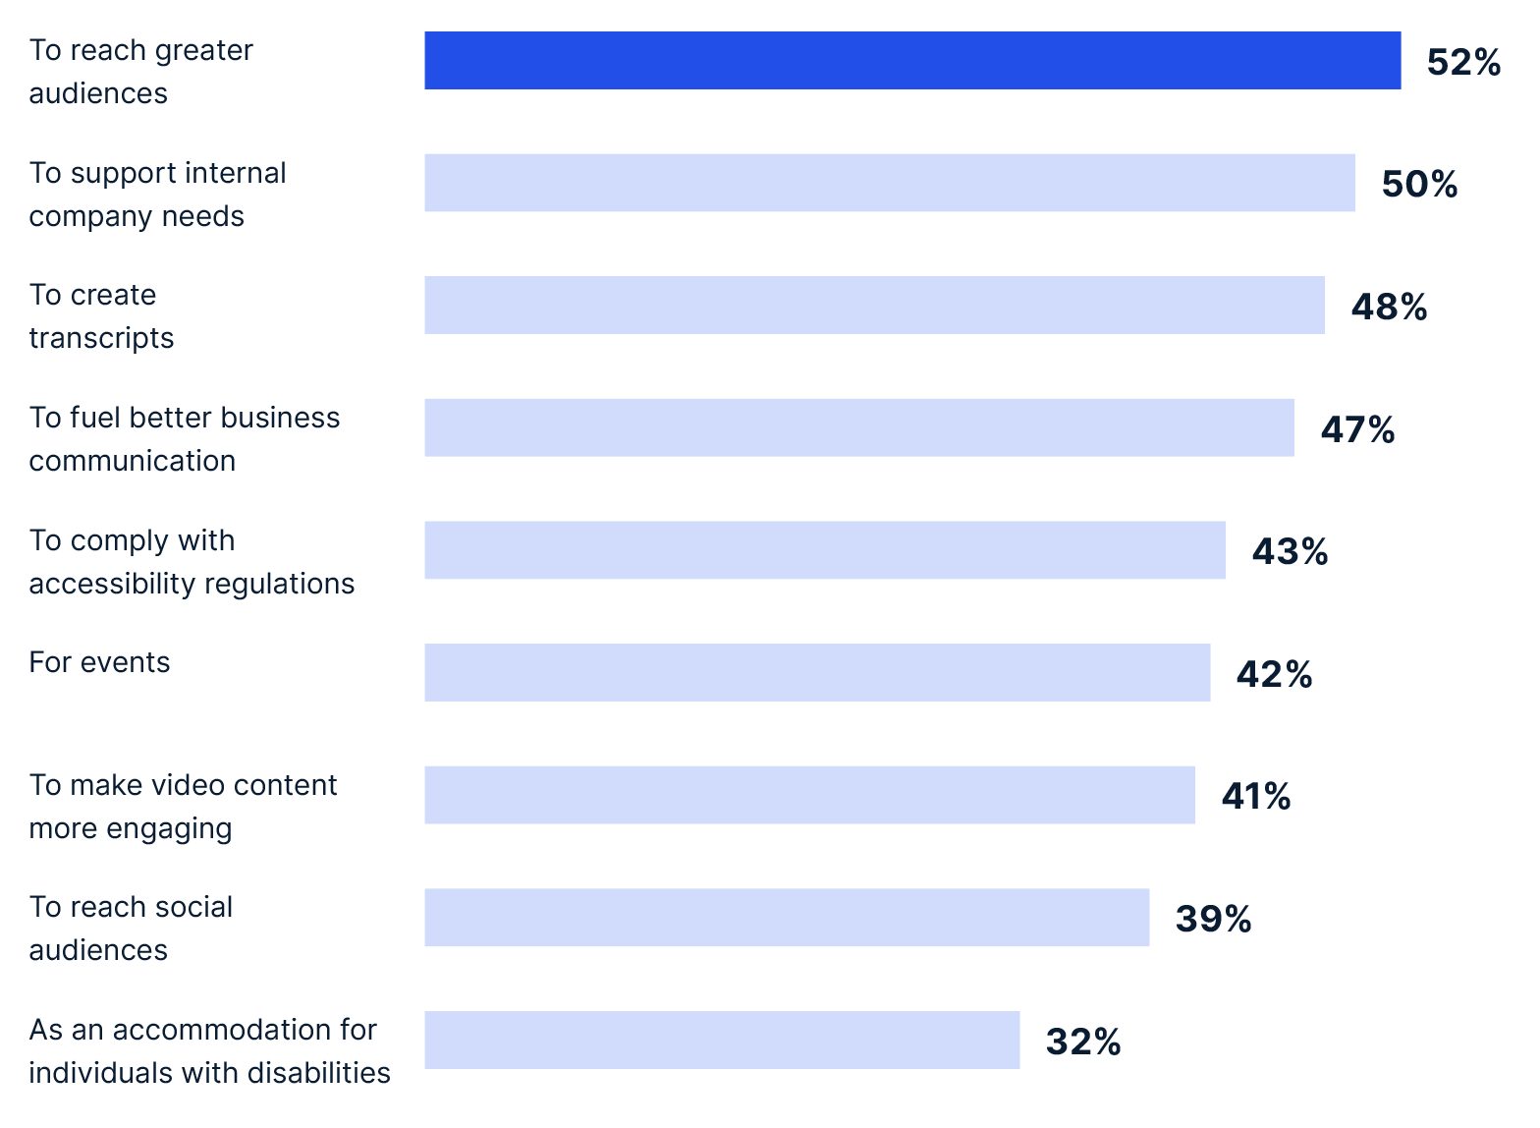
Trend: Gone are the days of captioning or using ASR to 'check a box' for accessibility or regulations
Use Cases for Using ASR or Other Captioning Tools
*Question allowed more than one answer and as a result, percentages add up to more than 100%
Notes:
Companies are finding value in turning to ASR and captioning to improve experiences for everyone, not just something they have to do to check a regulatory box
Broader business use cases exceed:
Doing so to meet accessibility regulations (43%)
Doing so as an accommodation for individuals with disabilities (32%)
David: How do you see the evolution and why? (we've been in this business for a while), easier access to this technology (when hard, expensive only ppl who must have it feel the immediate need, as becomes easier to consume and cheaper, value is clearer, level some free-miums are good enough), increasing reach

Slide 12
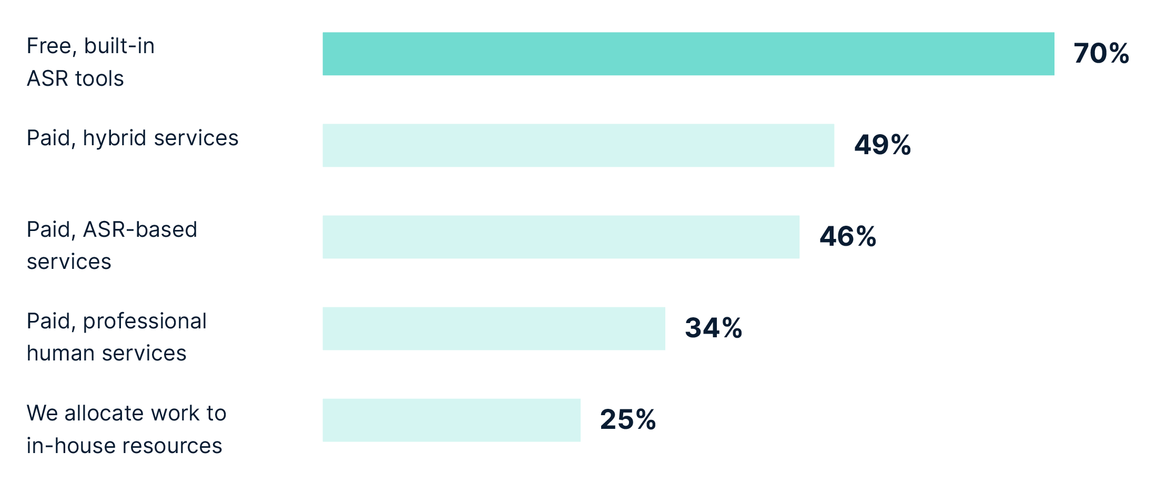
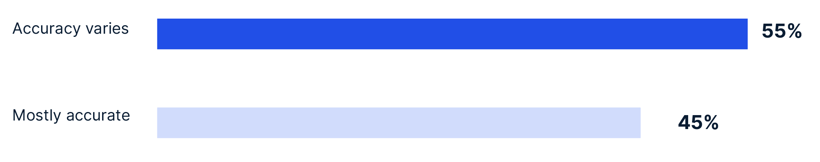
Trend: 70% are using free, built-in ASR tools to caption and transcribe
Tools Companies are Using to Caption and/or Transcribe
*Question allowed more than one answer and as a result, percentages add up to more than 100%
How the 70% of Respondents Using Free, Built-in ASR Tools View Their Accuracy
Notes:
When looking closer at the 70%, we see:
78% are now using it for accessibility regulations
55% using it report that ‘accuracy varies’
Free tools are clearly good enough for certain things and business use cases. What is plain, vanilla generic ASR for? Users have to accept that its accuracy will vary. Where will accuracy vary usually? Accuracy will vary more on places, names and terms versus conversational parts. Where does ASR have a tougher time? Specific audio.
It's important to note that accuracy doesn't just mean names and information spelling, it can mean scores, layout, format, too.

Slide 13
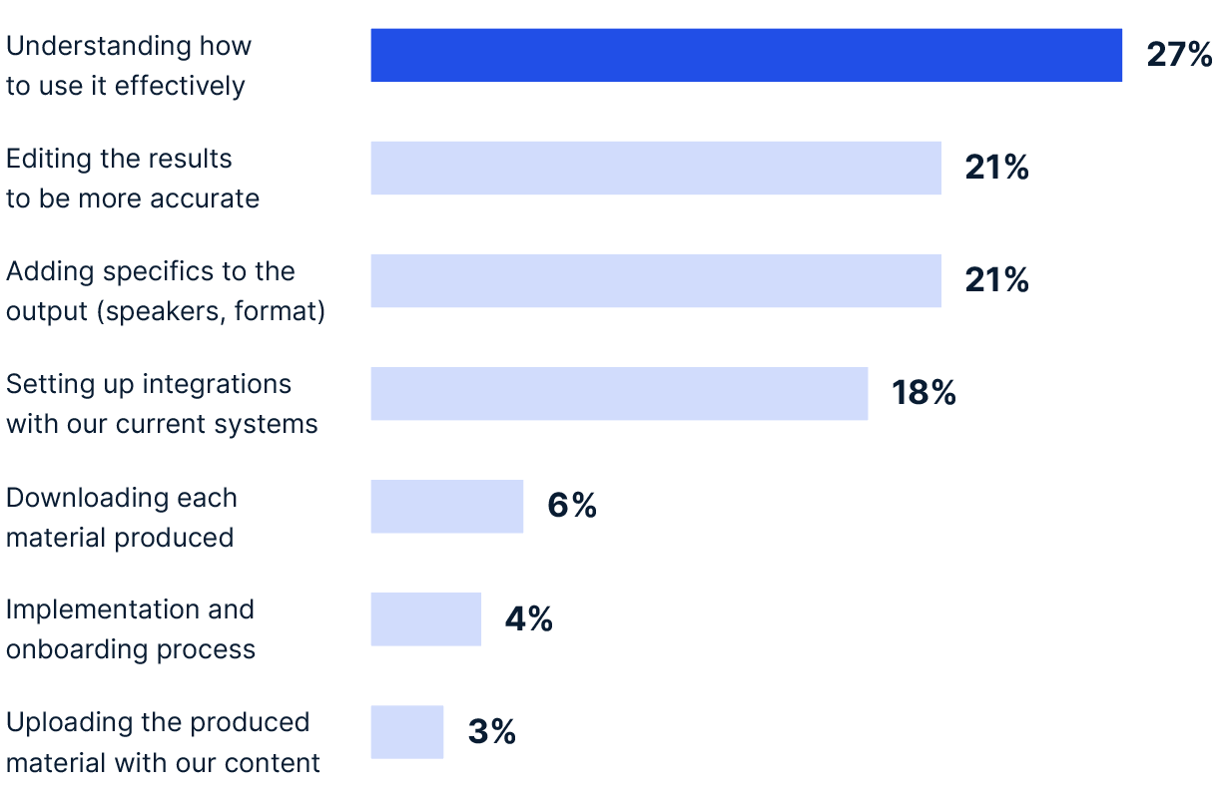
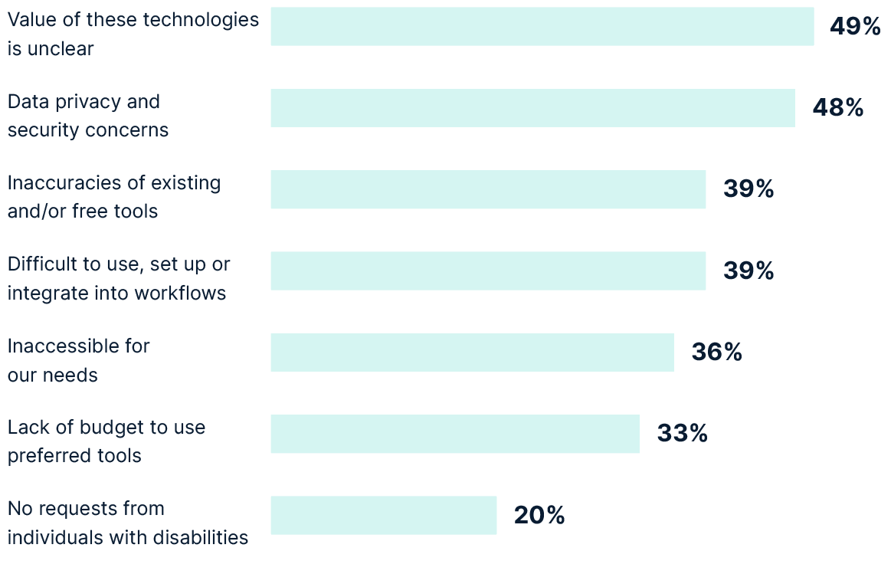
Current ASR & captioning tools aren't intuitive enough and require manual effort
What’s holding people back from increasing their use of captioning and ASR?
What Requires the Most Effort When Using ASR or Captioning and Transcription Tools
*Question allowed more than one answer and as a result, percentages add up
to more than 100%
Top Challenges Preventing Increased Use of ASR Technologies
*Question allowed more than one answer and as a result, percentages add up
to more than 100%
Notes:
GRAPH 1
Although most using it significantly, this is what they're saying is missing for them.
David – is this the next frontier? In paid, you can already get these things. Talk about specific use cases – formatting in legal for example, ppl investing effort now and it can be solved with better existing tools.
There's a lack of understanding, accuracy issues and integrations aren't always easy.
People want something that's easy you use. Sometimes you need certain file types or you need certain integrations being in the workflow. If people can get the work done within their LMS if they're an institution or within platforms like Teams and Zoom where it's embedded in, that can be a gamechanger. You can relate to the hassle of things not being connected and therefore taking more time.
David – what's changing in this world? Will it be solved?
The need for usability is specific – needs to be tailored.
---------------------------------
GRAPH 2
That’s a question that comes up a lot – what you settle on when using a generic ASR. Data privacy should really stand out to you. People have concerns about data privacy when using generic tools, which is a real concern that we at Verbit don’t take lightly. You should measure vendors on how they store your content and what it’s used for. There are ways to deal with privacy the same ways we did before ASR - with private environments and high security built in. When using public, off-the-shelf ASRs, you're giving them the right to inform public models based on info you’re feeding them. With any free tool, you’re playing with your privacy.
Someone using these tools are looking to have it in their day to day life in the systems that they already interact with. If I'm a student or a professor, and most of my time is spent in a learning management system, that's where I would expect these sorts of tools to reside within the learning management system. If I am a lawyer and I'm working in the legal domain, I would expect it to fit my very specific legal formatting needs. It's not just the ASR, it's not just capturing the text, it's about the integrations, and it's about the formatting to meet my business needs. It needs to be easy. It needs to fit my use case. It needs to be in my ecosystem. If I need to spend a lot of time to reformat the output in a specific way so I can submit it later or use it for my certain needs, then it's not going to be as interesting for me to use.
Privacy:
AI companies offer varying levels of privacy and security. Most AI models are trained on public data, so there's little risk. Custom models are created specifically for you and are not accessible to others.
ASR (Automatic Speech Recognition) models use statistical relationships between sounds and text and do not generate new content. This means your private data remains secure with ASR.
Generative AI models can create text based on their training data. For privacy, ensure you use custom models tailored to your needs, not public domain models. Look for vendors that provide secure, custom AI models that aren't accessible in the Cloud.
In summary, ASR captures and transcribes existing speech without generating new content, ensuring privacy. Custom Generative AI models provide tailored, secure solutions for your specific use cases.

Slide 14
5 key takeaways from the survey
5 key takeaways from the survey
There's a great need for improved accuracy in ASR tools
67% are captioning at least half of their audio and video content
The use of ASR to improve business outcomes exceeds accessibility use cases
Companies are seeking more customization beyond what current ASR tools offer
49% of companies expect to increase their investment in ASR and captioning technologies
Notes:
1 Accuracy is clearly a pain point among users
2 The demand and understanding of the importance of captioning is growing!
3 We’re seeing a shift from legal/accessibility needs to greater use cases and benefits in making experiences more inclusive
4 Customization is key for users and many existing ASRs don’t offer that – for accessibility there are certain measures to keep in mind for example
5 Adoption and usage isn’t slowing down – most will continue their efforts or increase investment in them!
So what does this mean for Verbit?
We are focusing a lot on the capture part, making it much more adaptive to your specific business needs. You can generate Captivate ASR model to fit a very specific sets of use cases, and you will see amazing accuracy and great results. That's already out there, it's already available. We're just increasing the amount of control and flexibility that you have when handling these models. We're moving towards the understand and the apply side of the capture, understand, and apply paradigm. Specifically, we have a great example with legal now. We have released a legal real time. We're able to capture in a real time live deposition, the actual discussion, the transcript, and suggest follow up questions, we're working hard now on the apply part, generating insights from a specific legal conversation, things that can assist the lawyer, really give them superpowers right in real time of a live deposition.

Slide 15
Technology designed for education
Notes:
Now let’s talk about the technology that powers our solutions

Slide 16
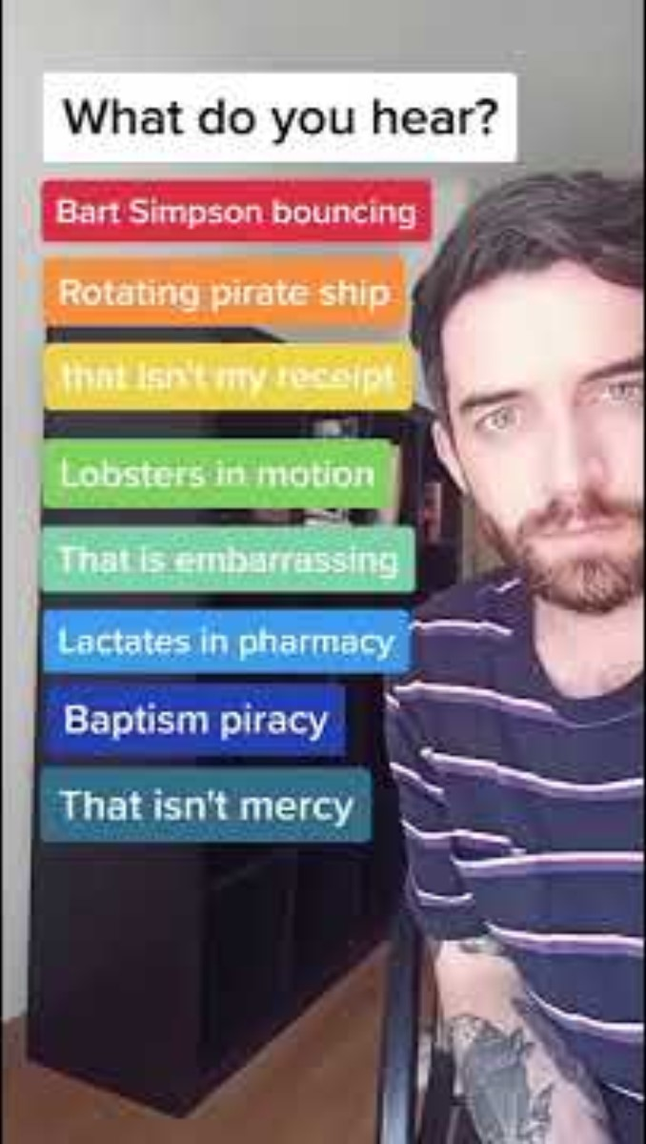
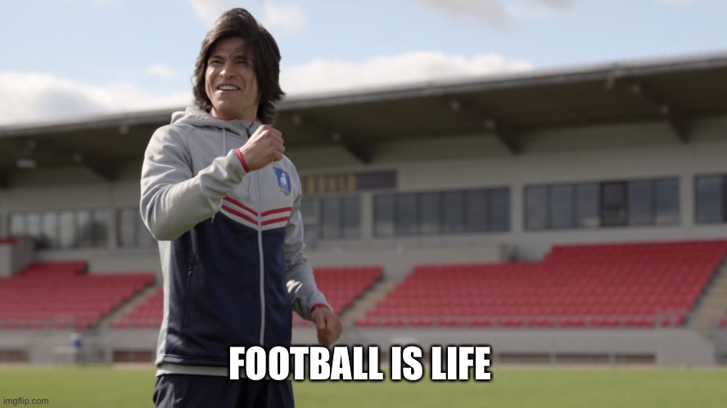
Quick audience drill
What did you hear?
Notes:
I think when you put your mind to it, you can hear everything that we put on that list. This is part of the challenge that we have with ASR, as this example shows how there can be many interpretations to words being spoken or chanted. However, using a trained, customizable ASR like Verbit's allows for you to feed information that will help it to detect the correct subject matter based on other content, not something generic ASRs will perform well at.

Slide 17
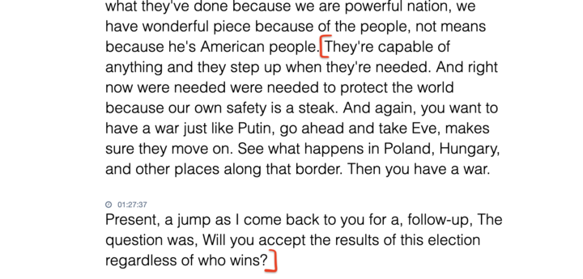
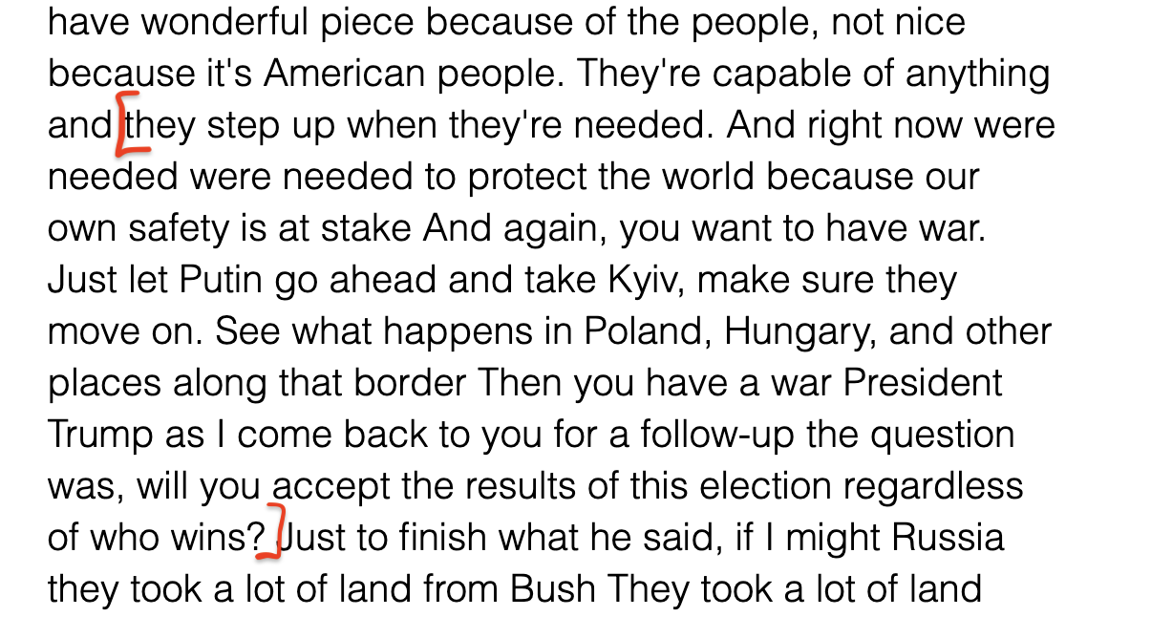

See the difference between a generic ASR and customized ASR in action
Notes:
What's the difference between uploading a list of terms and other types of communication?
Well, so I have an example maybe of a generic model and an adaptive model, so if we want to jump to the next one, I'll use one of the specific examples that's there to prove the point of what a adaptive model will produce versus a generic one for a word that could have been added in a dynamic dictionary. There's a small audio recording there. You can run. This is from the debate that we had between Trump and Biden.
Let's take even the first one. You can pause that. Just that first example I think will drive them as he term. The word Stake appears in any model and you could have even decided to upload it as part of a dynamic dictionary, but when you create a model that is adapted for the use case of news, the combination at stake will appear significantly more times or President Trump in this example is yet another combination will appear again in multiple sentences as part of the context, places like Kyiv even though it found take E, so Kyiv might have appeared, but when it is part of a model that has all the context, you will get much higher accuracy. Much more so than just adding a list of dictionary or glossary to a generic model.
How does this work? How would you prep for a debate?
First is you get hours of trained context. You make sure that it has the full set of audio and the correct transcript for that. You get all the common combinations. You try and identify even as a speaker the types of words that they might be mispronouncing. If I know that there's going to be a presidential debate, I know that President Trump says a few things in a certain way. Biden says other things in a different way where a model can be customized to those two specific speakers, a set of specific terms and words that a generic engine might mispronounce or type mistakenly. We can even control the masking of it so that when you own the model, you adapt it, you customize it for the specific use case, you're going to get very high quality results.
Are there still situations where a human would be more accurate than ASR or are we at that stage in the evolution of the technology where I would actually prefer to use technology over human?
I would say it's not black and white. I think when you have people that are speaking on top of each other, a model would need to choose a single voice. It's harder for it to control. I'm assuming not everyone has their own multichannel. Not their own channel of audio feed, so there are areas where an ASR engine might struggle with a little bit more or less, but again a lot of it has to do with the type of content, how much you invested in customizing the model for that type of environment, level of noise, accent and so on. When you do that, it gives a really good run for its money.

Slide 18
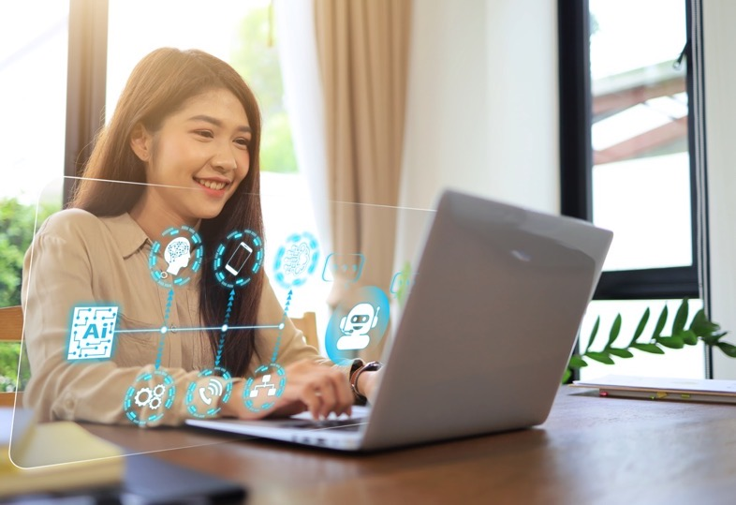


Verbit’s ASR, CaptivateTM
In response to the survey data & need for customization and better accuracy

Slide 19

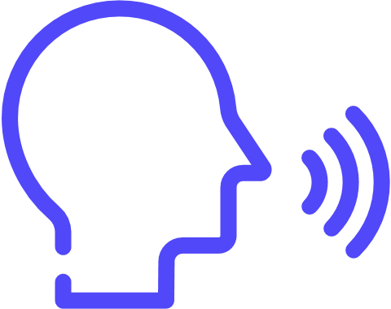

: Our automatic speech recognition technology
Capture
Proprietary ASR
Domain specific
Customer specific
Bespoke
Automatic speech recognition
Choose from a variety of models, depending on the use case
Dynamic domain dictionaryTM
Continuous domain specific updates
  Pre-session
  Dynamically within a session
  Dedicated models
  Term boosting
    Proactive research
    Automated integration
    Customer input
    Biased models
    Formatting
Further customization of any part of the process with Verbit's internal development and research teams
Notes:
Our capture technology is made up of layers and we apply one or more layers depending on the customer and the use case

Slide 20
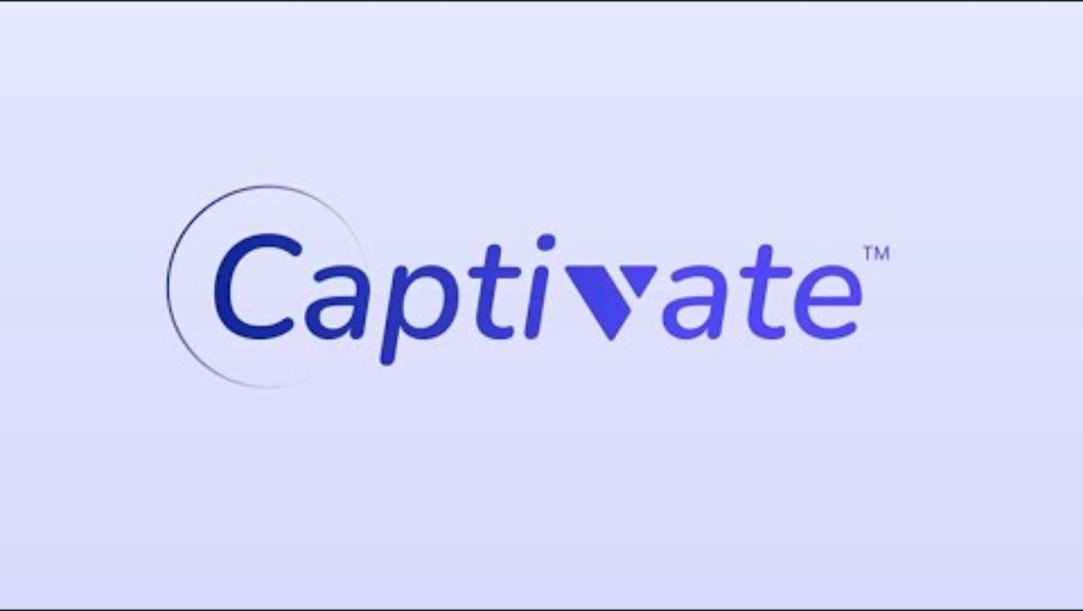
Introducing the latest customizable capture technology
See how Verbit CaptivateTM works
Watch Now

Slide 21


Universal Design for Learning

Slide 22



Our solutions offer institutions three stages of verbal intelligence
Capture
Understand
Apply
Document
your words
Derive insights
from your words
Put your
words to work
Speech recognition
Speech insights
Workflow integrations
Notes:
Components

Slide 23
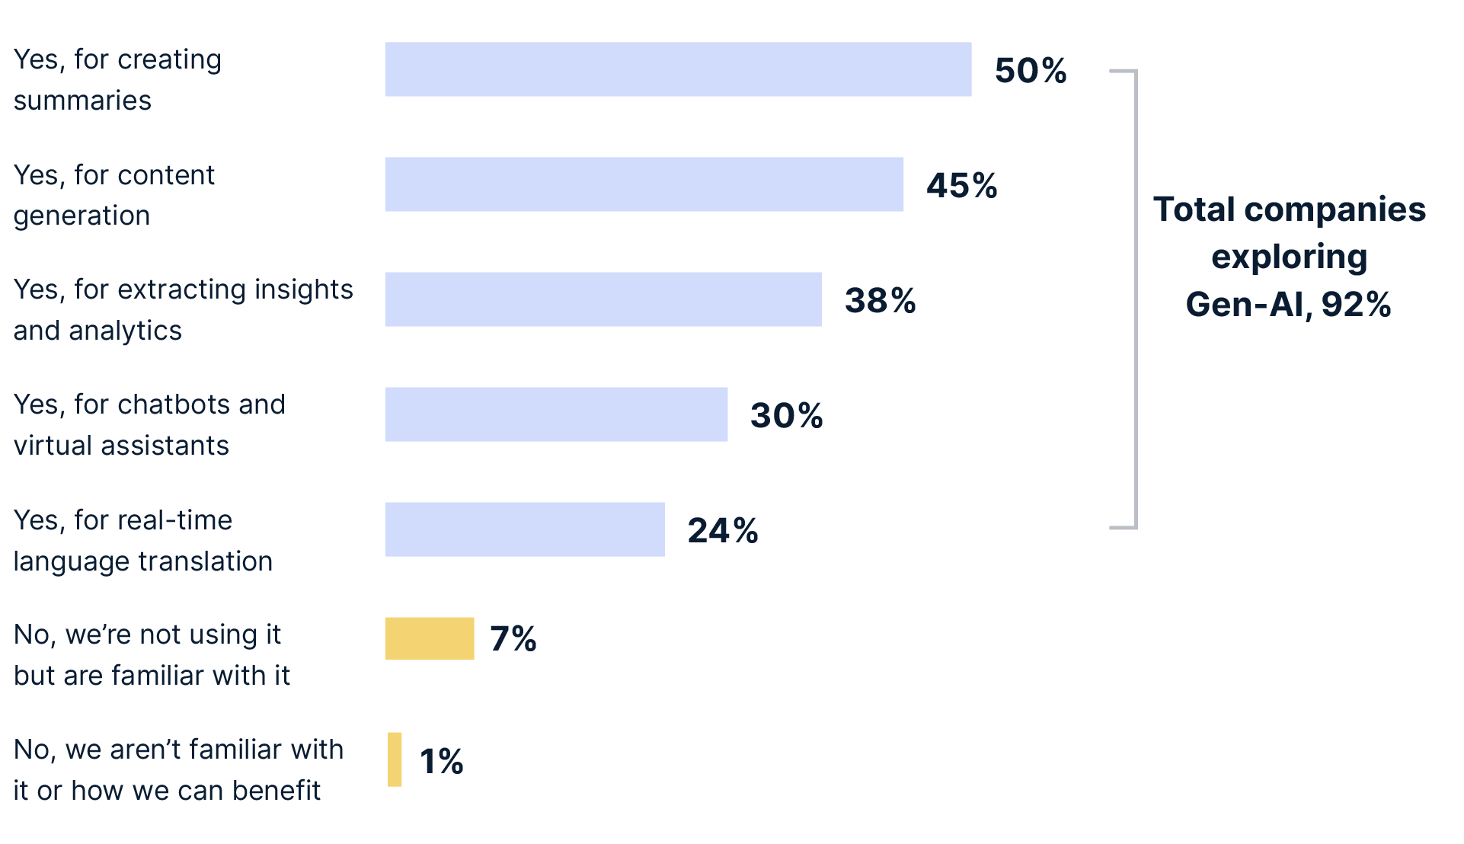
Trend: Majority are adopting Generative AI (92%)
Companies Exploring the Use of Generative AI
*Question allowed for more than one answer and as a result, percentages add up to more than 100%
Notes:
ASR has become widely adopting, now experiencing Gen AI boom, majority of companies have tested it out
Gen AI as a pre-rec to be used to pulls insights and gain from conversations being recorded.
With access to text, companies are getting more out of the verbal interactions they're having.
Many are finding value in complementing the audio and video they're capturing with Gen AI tools. They're extracting more information from these insights and saving time.
David: What is the future? Mainly being used for productivity – if actions taking based on convo, they'll looking for tools to automate that. ASR+GEN AI together allow you to do that. Capture, Understand, Apply

Slide 24




Gen V features
Understand
is our Generative AI tool. It offers institutions incredible
AI-based insights to make their transcripts actionable.
Gen.V can be used to help students and faculty:
Generate
summaries
Create
quizzes
Segment chapters
Suggest
titles
Provide
keywords
Notes:
Gen.V is applicable to both post-production and live transcription. The prompts can be used for live transcripts in real-time once the transcript reaches 500 words.
Additional features:
Craft headlines: Automatically create headlines to give students bite-sized overviews of courses and videos
Produce keywords: Instantly receive a list of important keywords to easily navigate key themes and ideas from your transcript's content

Slide 25

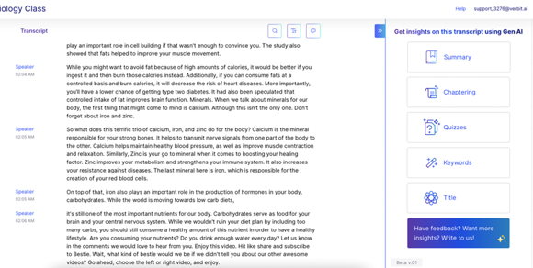
Gen V demo
transcript insights can be accessed directly from the platform with one click
Understand
Watch the demo video
Notes:
Watch the demo video: https://youtu.be/EA1Jc7o7a0c

Slide 26
Verbit Unlimited
Complete accessibility support at an annual price
Predictable budgeting
Make financial planning easier with Verbit's subscription plan that offers institutions with upfront pricing
Packaged solutions
Get everything you need in one place – captioning, transcription, audio description and more
Accessibility at scale
Reliable solutions that support compliance needs for evolving ADA and Title II requirements
Tools for greater student success
Enhance engagement and learning outcomes for those with reported and unreported disabilities, international and ESL students, among others
Notes:
Pricing depends on your school’s FTE

Slide 27


Verbit Unlimited
What’s included in the plan:
Features & tools included:
Advanced Verbit platform capabilities
Gen.V - Gen AI based transcript insights
Integrations with LMS, cloud storage and video platforms
Industry standard output formats
Verbit's proprietary Smart Player for better engagement & video accessibility
SSO
Access to live support desk
Includes:
Unlimited Academic Live captioning, powered by CaptivateTM (English or Spanish)
Unlimited Academic Post-Production captioning, powered by CaptivateTM (48 hr turnaround time, English or Spanish)*
Unlimited Verbit Translate (machine translation in up to 2 additional languages)
Verbit Describe – extended audio description (2 hrs)
Paid add-ons
Special discounted pricing for additional or custom services
*Academic Post-Production is unlimited for students in the current academic year who have requested accessibility accommodations​

Slide 28
Thank you

