Slide 1
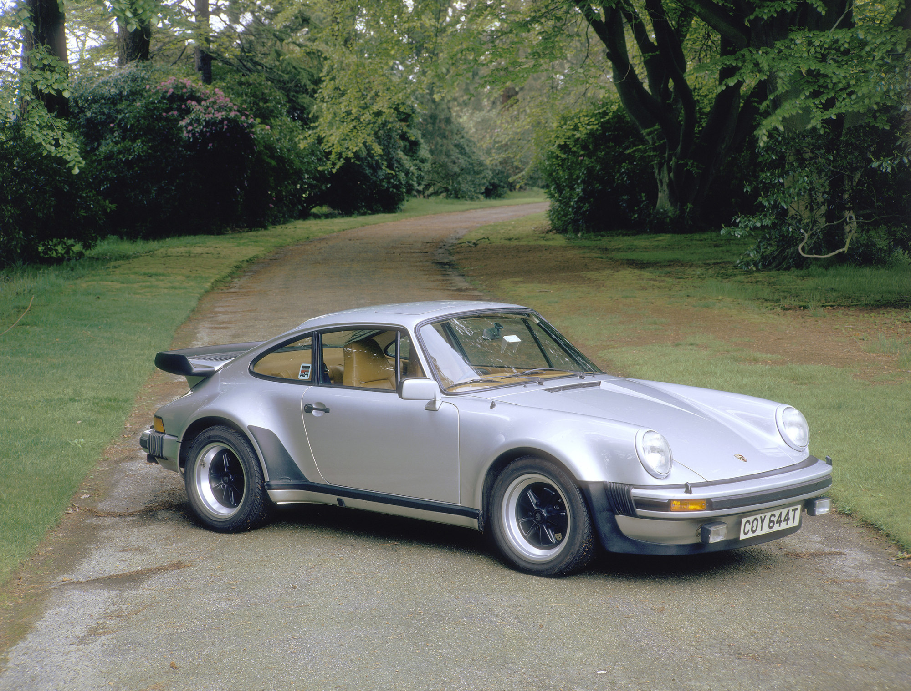
Why THIS image HERE?
Writing meaningful image descriptions for education and beyond
Laura Ciporen
Accessing Higher Ground
11/12/2024

Slide 2
About me
Laura Ciporen, CPACC. Brooklyn, NY. She/Her
Digital Content Accessibility Manager for McGraw Hill Higher Ed.
100% focused on content accessibility since 2015
Instructional design for 6 years prior
M.A. in Educational Communication and Technology from NYU

Slide 3
About the Session
At the end of the session, you will have a specific methodology to apply to writing and evaluating image descriptions for educational materials.
Important considerations for image descriptions in education.
Thought process for creating descriptions: presentation and practice.
I will talk a lot for the first third before we fully start workshopping.
Don’t worry about being “wrong” we are here to learn, not show off knowledge we already have. I am not judgmental.

Slide 4
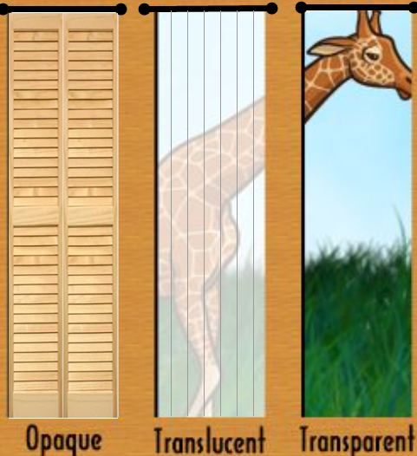
Some background
Let’s make sure we’re all on the same page about image descriptions.

Slide 5
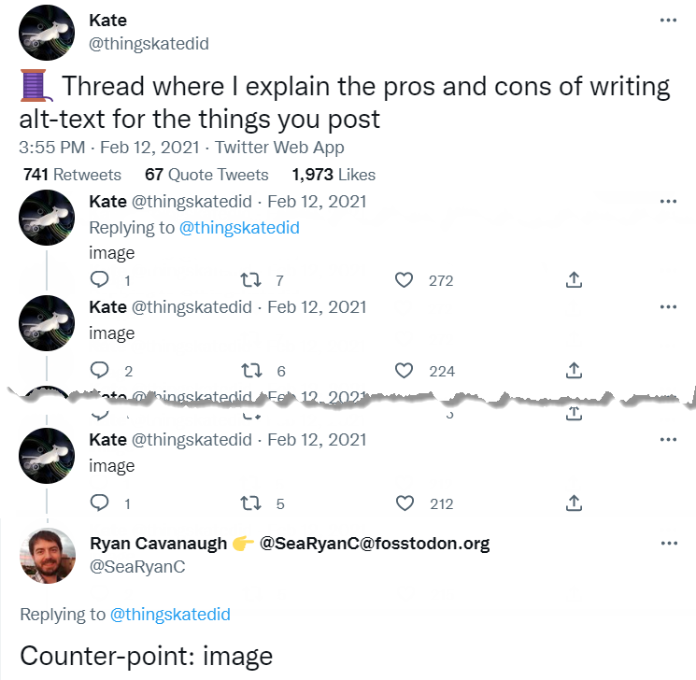
Image descriptions are content, treat them as such
Accessibility is not a numbers game, it’s an impact game.

Slide 6

What does a good image description do?
Conveys in text the same information that an image conveys visually.
Image descriptions are about meaning and emotion, NOT visual representation.
One does not simply write alt text.

Slide 7
Two parts to an image description
Alt text (text alternative)
Extended description
This is what assistive technology automatically says when it gets to an image and what users see if an image fails to load.
Like glancing at the image. You can’t help but get this information. It should be the most obvious and important information in the image.
​​​Like studying the image. You have to decide to do it (description may be elsewhere on the page or accessed via a link etc.). There are a lot of details.
Not always necessary.
Accompanies but DOES NOT REPLACE alt text.

Slide 8
Example of full image description
Alt text
Extended description
Comparison of opaque, translucent, transparent. ​￼​Wall with ​​3 windows through which parts of a giraffe are not seen, partially seen, or completely seen.
​​​Opaque: Window is covered with closed shutters, there is no view of the giraffe outside at all.
​​Translucent: A hazy view of the giraffe's midsection through sheer curtains; details are difficult to see, colors are washed out.
​​​Transparent: Clear view of giraffe's head outside.

Slide 9
Giraffe reminder
See extended description for the image on this slide.

Slide 10
Just alt text? Or alt text & extended description?
Alt text alone is fine when…
Extended descriptions when…
There is no technological way to add extended description (such as social media).
You’re sure you can say everything relevant in about 150 characters, including spaces and punctuation. (Or your definition of acceptable character count.)
You’re struggling to fit everything into your defined alt text character count.
There’s obvious information plus less obvious.
There are details which might be relevant OR INTERESTING but aren’t 100% necessary.

Slide 11

Image descriptions are not captions
Captions are ABOUT the image.
Descriptions ARE the image.

Slide 12
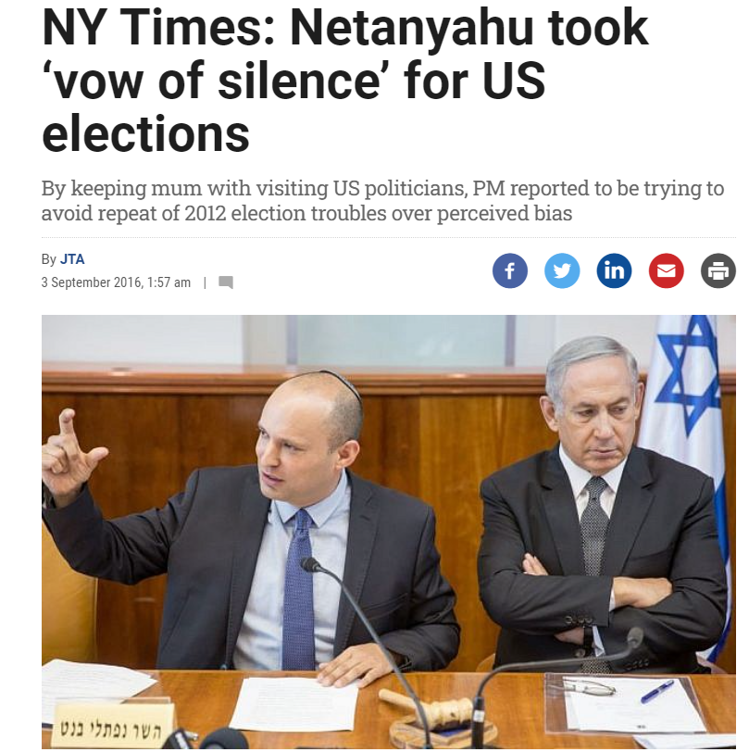
Function of captions
Title / Identifier
Explanation / Setting the scene
Provide information about the image
What’s in the caption may not be directly evident in the image
Available and useful to everyone
Supplement to, not replacement for the image
Prime Minister Benjamin Netanyahu, right, seen with then-Education Minister Naftali Bennett at the weekly cabinet meeting at the Prime Minister's Office in Jerusalem, on August 30, 2016. (Emil Salman/Pool)

Slide 13

Art caption example: like museum plaques
Ugo Rondinone, Erstermärzzweitausendundeinundzwanzig, 2021. Watercolor on canvas in artist’s frame. 78 ¾ x 118 1/8 (200 x 300 cm).

Slide 14
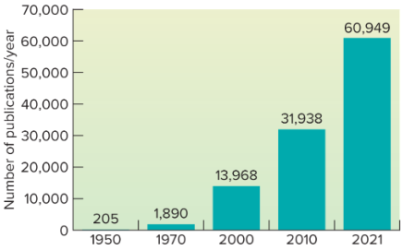
Evaluate: Caption or alt text (description)?
Bar chart illustrates the growth of scientific publications in exercise physiology from 1950 to 2021.

Slide 15

What makes a good description?
Image descriptions should NOT actually describe images.
They should convey their information, meaning and personality.

Slide 16
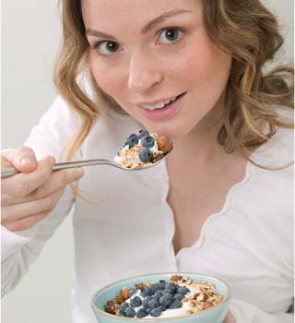
Photo: describing vs. conveying info example
Visual Description
Young woman slightly smiles as she makes full eye contact with the viewer. She holds a spoonful of granola, milk, nuts, and blueberries almost to her mouth, tipping the spoon slightly toward the viewer. Her other hand holds a light blue bowl with the rest of her granola.
Conveying Information
Young woman happily eating granola with milk, berries, and nuts.

Slide 17
Flowchart: describing vs. conveying info example
Visual Description
Jump
Jive
Wail
Three red circles create the points of a triangle. In between each is a thick purple arrow pointing from one circle to the next in a clockwise order. The top circle reads “Jump,” the lower right circle reads “Jive,” the lower left circle reads “Wail.”
Conveying Information
Circular flow chart. Jump leads to Jive which leads to Wail which leads back to Jump.

Slide 18


Try it:
Describe visually vs. convey information

Slide 19

Exceptions: sometimes appearance IS important
If only an idea matters and not the visual representation of that idea, what do we do with this?
Signaling that content is being recycled from earlier lesson: “Recycle.”
About actual recycling: “Recycling symbol.”
But consider: is there a time to describe what the symbol looks like?

Slide 20

Why the emphasis on “educational” alt text?
What makes us so special?

Slide 21


Comparison: informational vs. educational content
Informational Content
Educational Content
Telling the user things / provide information
Keep user’s interest (voluntary)
Individual; no comparison to others
Helping the user understand things and be able to use them later
Consequences for not knowing/understanding
Group use; equity of information
Clear aim for what user is supposed to get out of the content
Allowing students to participate in discussion
Assessments vs. content presentations

Slide 22
My THREE image categories for education
Content (informational considers this “non-decorative”)
  Directly help students learn the material.
  Need full descriptions.
Non-Content (informational considers this “decorative”)
  Enhance the experience; contribute something.
  If removed, would not impede learning the material.
  ALSO need full descriptions.
Decorative
  FILLER. You could replace it with a doodle of a flower.
  Contain no information at all that isn’t already completely in the text.
  The ONLY images that don’t need descriptions.

Slide 23
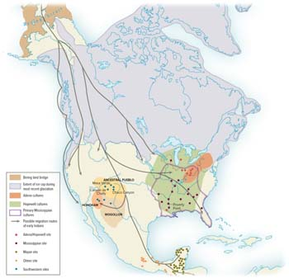
Content image example
Text discusses the migration of various North American peoples and where they founded their territories.

Slide 24
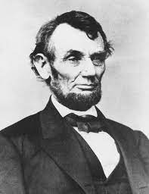
Non-content image example
Why do we include pictures of Abraham Lincoln when we talk about Abraham Lincoln but the only describe the image as being Abraham Lincoln?

Slide 25
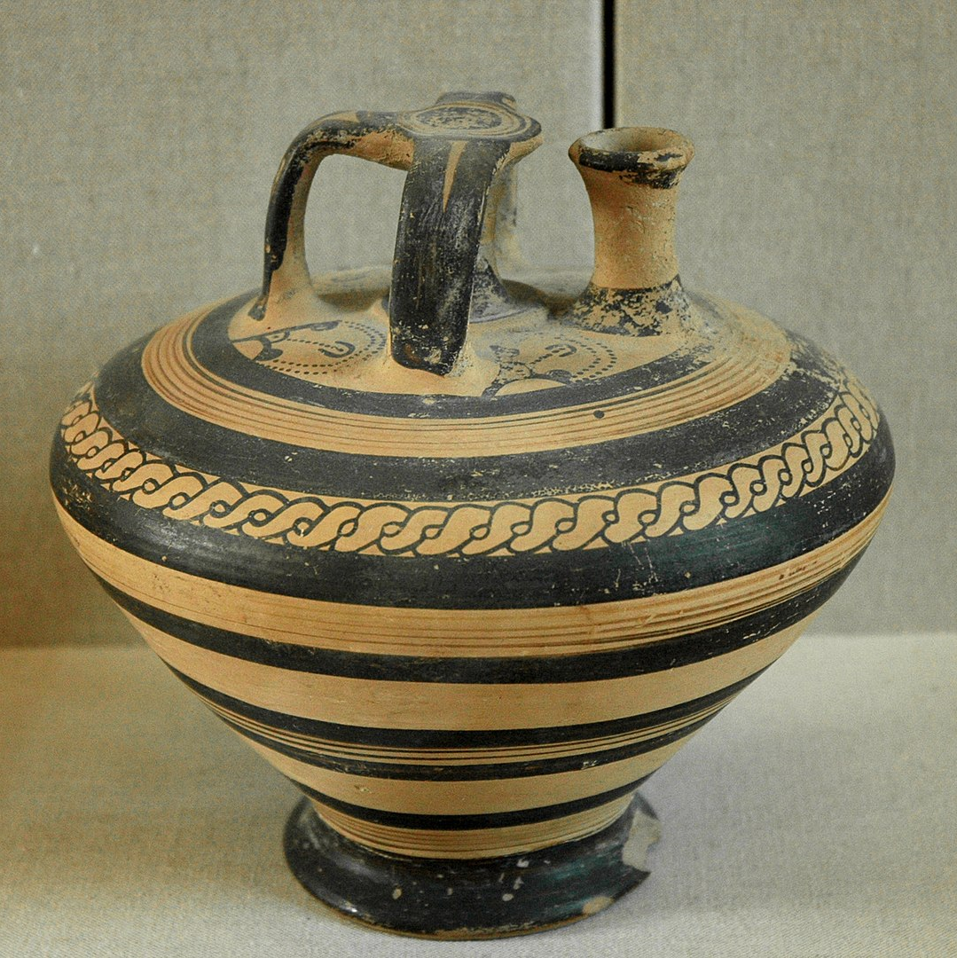
Second non-content image example
History section on Mycenaean excavations mentions only that intricate pottery jars were sometimes found intact.
Description:
An ancient-looking jar made of yellow-brown ceramic with black stripes and one stripe drawn to look woven. The overall shape is a cone with a flat bottom. At the top is a spout that sticks straight up and a handle that arcs parallel to the spout and has one half arc opposite the spout. The flat portion of the top has intricate motifs, possibly of creatures, drawn primarily in dots.
Mycenaean stirrup jar from Ras Shamra (Ugarit) Syria, 1400–1300 BC

Slide 26
Decorative image example
Educational Content

Slide 27

Evidence for the importance of non-content images
Smith, B. D., & Elifson, J. M. (1986). Do Pictures Make a Difference in College Textbooks? Reading Horizons: A Journal of Literacy and Language Arts, 26 (4).
"Including pictures, such as those of people, buildings, artifacts and landscapes in college history text material does not seem to increase a college student's comprehension of the material, even when the pictures have been selected because they support the main ideas of the text.”
“Student preference proved to be overwhelmingly in favor of pictures. Of the 145 students, 119 chose the passage with pictures, while only 26 chose the passage without pictures. The passage with pictures was preferred by 82% of the students.”

Slide 28

Anecdotes for importance of non-content images
User study: 8 SR users read 3 versions of 3 readings:
Which level of descriptions did you prefer, and why?
The screen reader users wanted the highest level of description…and more.
“This was my favorite version by far. I finally got the descriptions of the pictures I just had a feeling I was missing. This is great, because for an E-Book on nutrition you want those images in the mind as you read along.”
“Finally! I've gained some extra context that I didn't even know was missing. The descriptions of the image content itself really added to my understanding of what the captions were referring to.”

Slide 29

Anecdotes continued….
User study: 3 sighted students read the same content.
Didn’t spend much time on the images; mainly only glanced at them.
Wanted them there, just like the 1986 study.

Slide 30
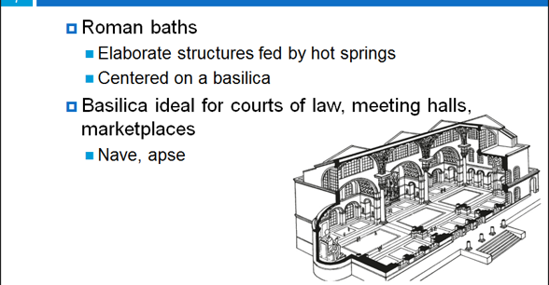
Evaluate: PPT slide image category

Slide 31
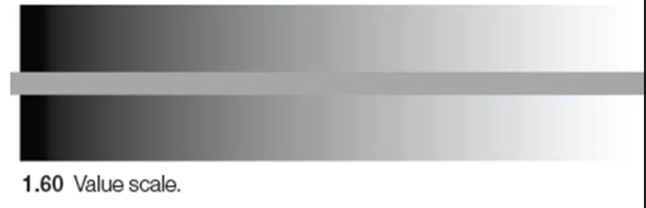
Evaluate: Textbook image category
“Value refers to the relative lightness or darkness of a surface. The word relative is significant. The lightness or darkness of a shape is largely determined by its surroundings. For example, on a white surface, a gray square seems stable and imposing (1.59A). The same gray square has less visual weight and seems luminous when it is surrounded by a black ground (1.59B). A value scale further demonstrates the importance of context (1.60). The solid gray line appears luminous when it is placed on a black background. As it crosses over the middle grays and into the white area, it seems to darken.”

Slide 32
Generating the description
Ask the following questions.
(Of the person who choose the image, if you can, or yourself if you cannot.)

Slide 33
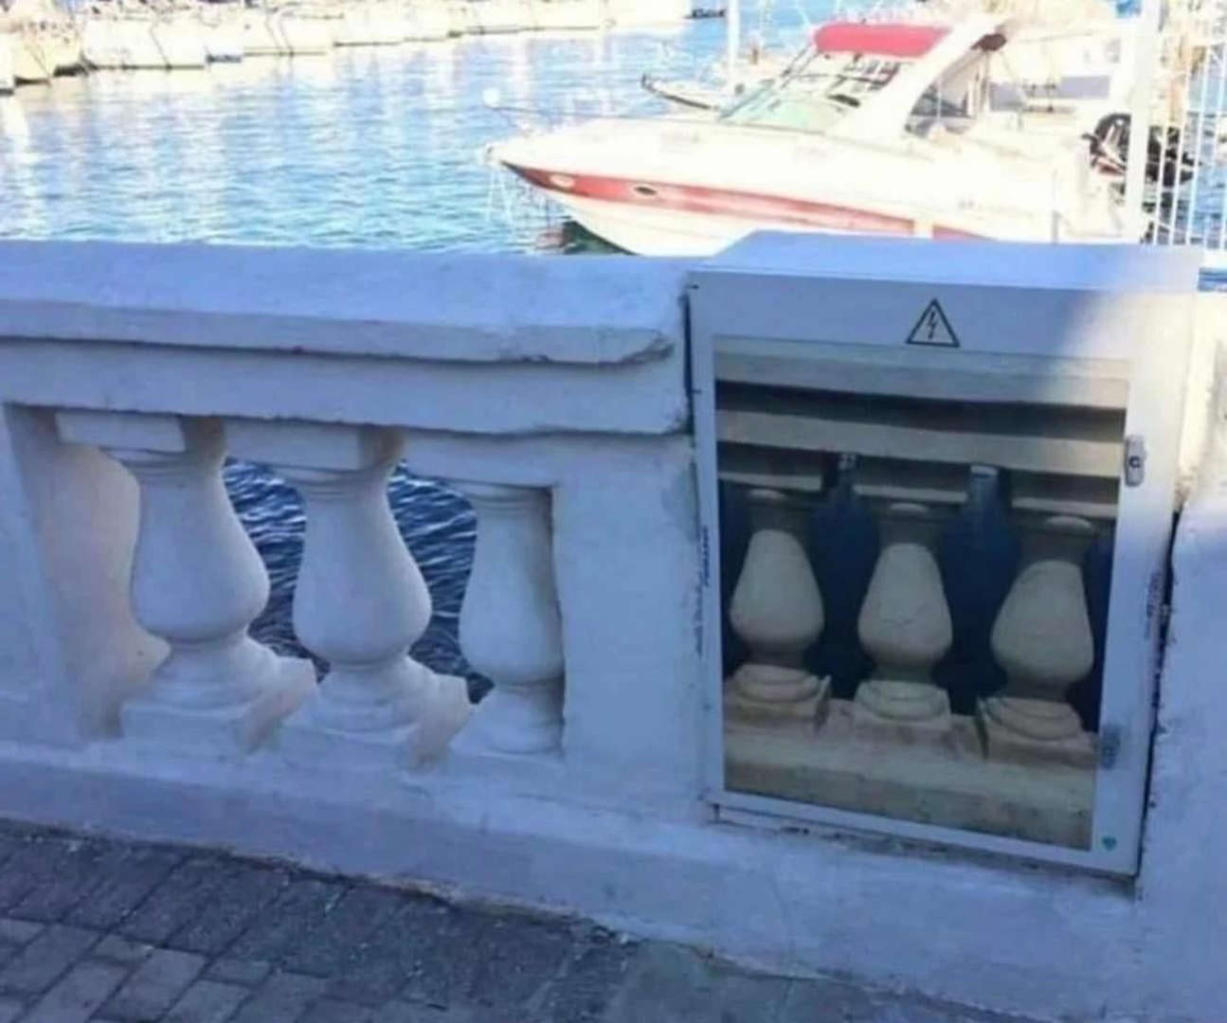
My essential questions for image descriptions
WHY is this image here?
What relevant information will the sighted audience get from the image?
How will this image be used in the educational setting?

Slide 34

WHY is only a
3-letter word
Asking the image decision makers why an image is used.

Slide 35

When do you need a subject matter expert?
When reading the context around the image is not enough.

Slide 36

Sometimes, be wary of SMEs
A dark night sky glows a vivid blue in the upper two-thirds of the image with dark clouds and tiny dots of stars scattered across the sky. Just off center to the right a single tent glows yellow from a lamp inside, illuminating the surrounding area with warm orange light in a sea of almost complete darkness….

Slide 37

Write about the image, not the topic
Ask yourself
"Where is that information in the image?“
“How do I know that?”
Also be wary of this in AI-generated descriptions.

Slide 38


Evaluate: Decorative, non-content, content?

Slide 39
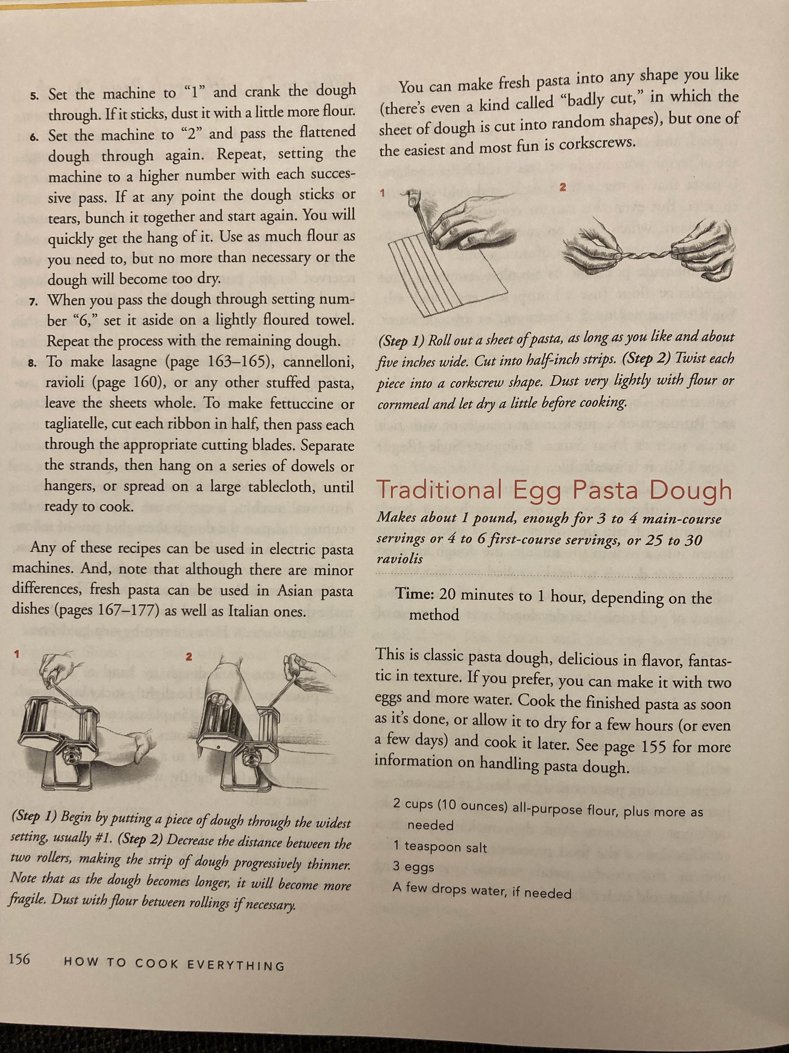
Your turn to answer the questions!

Slide 40
Question 1: WHY is this image here?
Is it content, non-content, or decorative?
Why does this place in the cookbook need an image?
What does this representation of the concept have that others do not?
(Step 1) Begin by putting a piece of dough through the widest setting, usually #1.
(Step 2) Decrease the distance between the two rollers, making the strip of dough progressively thinner. Note that as the dough becomes longer, it will become more fragile. Dust with flour between rollings if necessary. (How to Cook Everything, p. 156 - how to make pasta using a pasta machine.)

Slide 41
Question 2: What relevant information will the sighted audience get from the image?
What is this image saying that the surrounding text is not?
Evoked emotions are sometimes “relevant information.”
Remember your audience: what would THEY, get out of looking at this image?
  Note: This is not necessarily what the person who chose the image WANTS people to get out of it.
Immediately obvious or most important information = alt text. Further details = extended description
(Step 1) Begin by putting a piece of dough through the widest setting, usually #1.
(Step 2) Decrease the distance between the two rollers, making the strip of dough progressively thinner. Note that as the dough becomes longer, it will become more fragile. Dust with flour between rollings if necessary. (How to Cook Everything, p. 156 - how to make pasta using a pasta machine)

Slide 42
Question 3: How will this image be used in the educational setting?
Learning the material?
  Info that supports, explains, or adds to the surrounding content.
Discussion?
  What non-essential info might a classmate bring up or the instructor ask about?
Assessment?
  Don’t give away the answer!
  Provide the opportunity to get the answer wrong.
(Step 1) Begin by putting a piece of dough through the widest setting, usually #1.
(Step 2) Decrease the distance between the two rollers, making the strip of dough progressively thinner. Note that as the dough becomes longer, it will become more fragile. Dust with flour between rollings if necessary. (How to Cook Everything, p. 156 - how to make pasta using a pasta machine)

Slide 43
♫ After these messages we’ll be right back! ♫ (ding!)
Let’s take a 10-minute break then we’ll start the more active portion of the session.

Slide 44

Let’s try it!

Slide 45
Evaluate: How is this alt text?
Digital alarm clock showing seven am.
Analog clock showing six fifty-three & thirty seconds.

Slide 46
Context matters!
WHY is this image here?
What relevant information will the sighted audience get from the image?
How will this image be used in the educational setting?

Slide 47
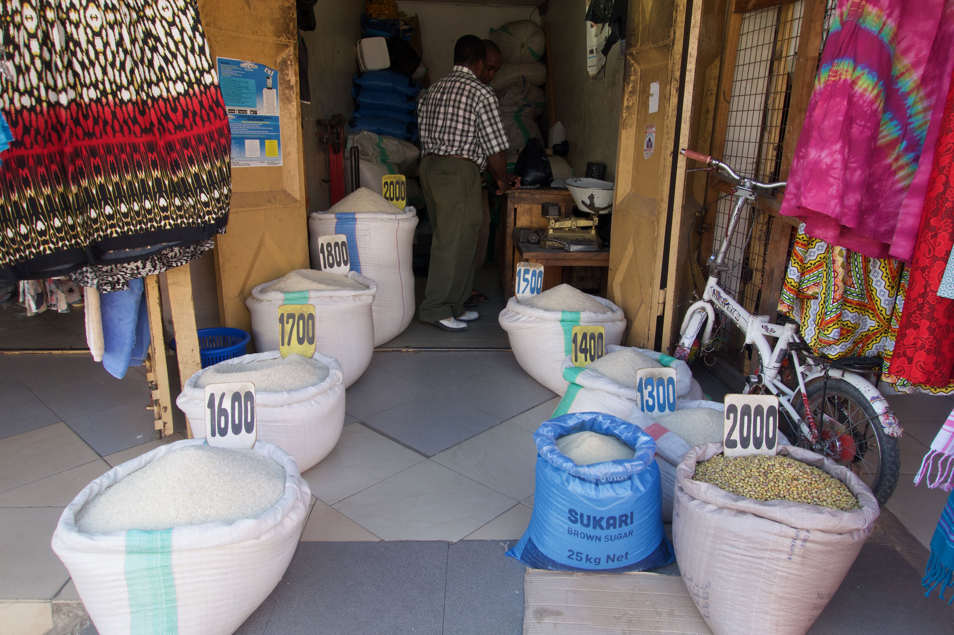
Context matters again
WHY is this image here?
What relevant information will the sighted audience get from the image?
How will this image be used in the educational setting?
Selling rice in Iringa, Tanzania. © Laura Ciporen 2016

Slide 48
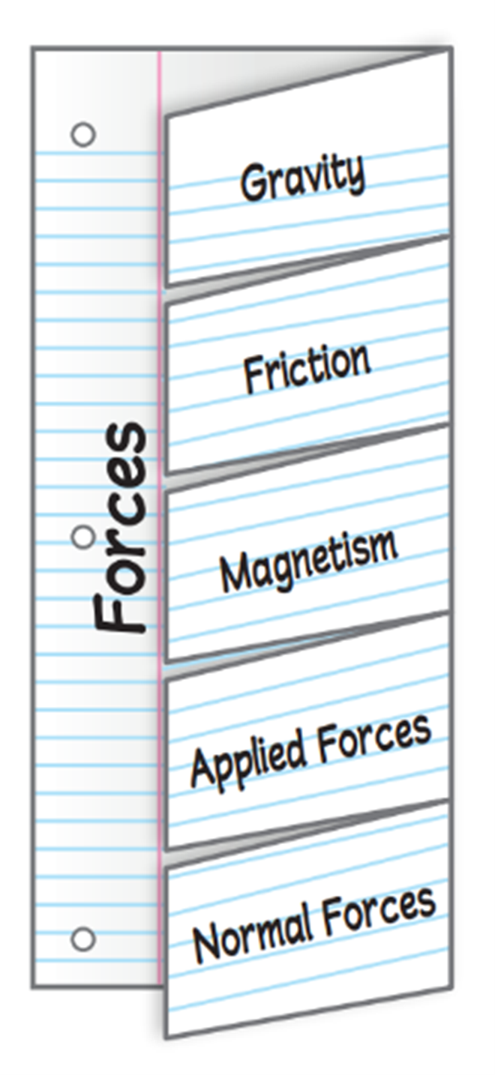
Audience matters!
Text that the image accompanies:
Use one sheet of notebook paper to make a 5-Tab Foldable. Label the tabs as illustrated. Use the Foldable to identify how forces act on objects. Under the tabs, define terms, list examples, and explain real-world applications.

Slide 49
Purpose matters, too!
Text that the image accompanies:
Use one sheet of notebook paper to make a 5-Tab Foldable. Label the tabs as illustrated. Use the Foldable to identify how forces act on objects. Under the tabs, define terms, list examples, and explain real-world applications.

Slide 50
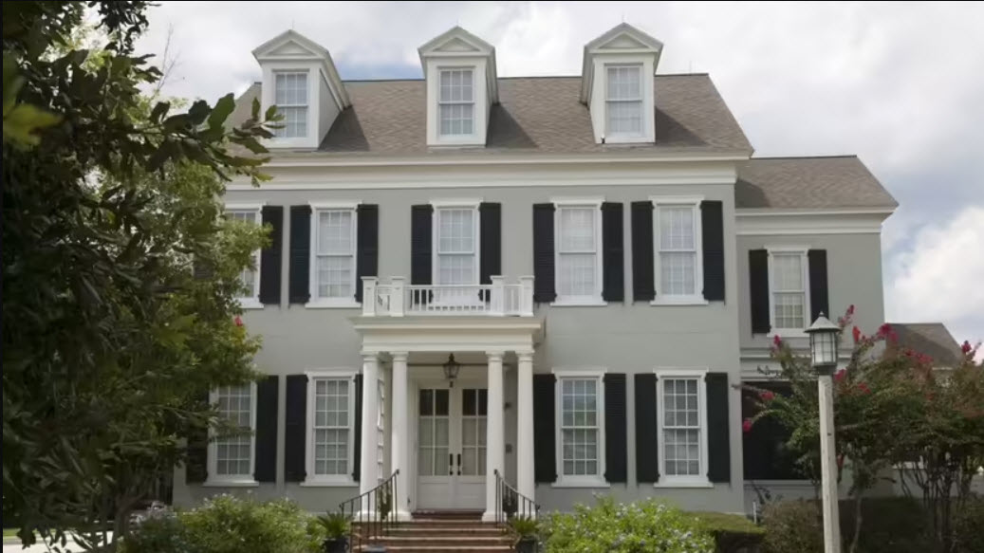
Purpose matters!
Which architectural style is this?
Neo-classical
Colonial
Gothic Revival
Georgian

Slide 51
Structure matters!
Start with an overview / summary where applicable.
Move from general to specific at every level of the description.
Order the elements of a description the same way each time for ease of comparison.
Relate the parts of the image to each other or a common reference point.
Organize descriptions of the parts of an image logically.

Slide 52
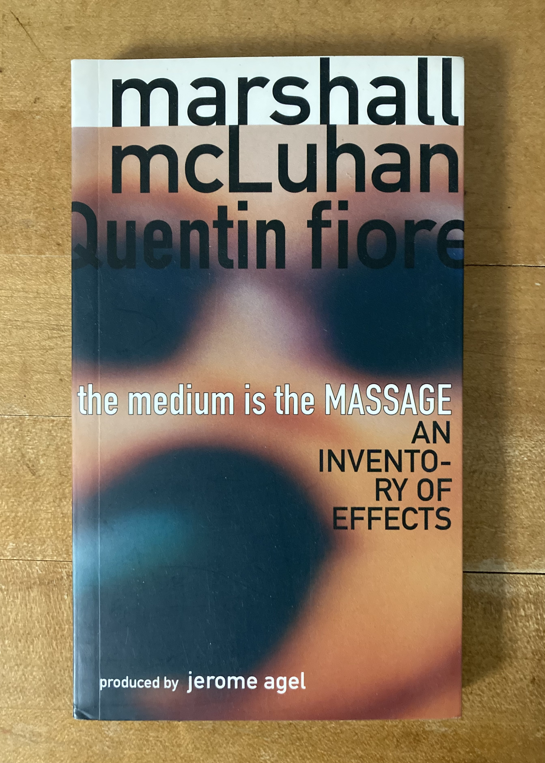
Style of image does NOT always matter
Only mention the format of the image if the format tells you something about the image. Examples:
Photo of: (only if one would expect an illustration)
Illustration of: (only if one would expect a photo)
Archival photo: (usually)
Black and white drawing: (usually)
Cartoon: / Comic strip: (always)
Bar chart: / Line graph: (always)
*
* True story: I studied this book in grad school and until I put this slide together I thought the title was “the medium is the MESSAGE.” I kept it in anyway because it still makes a related point.

Slide 53
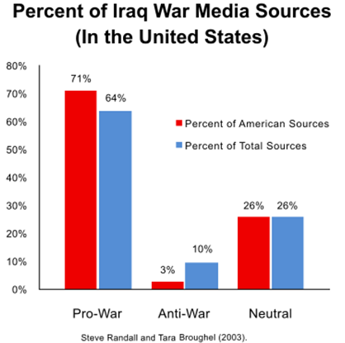
Image Description (alt) Comparison
Alt option 1: Bar chart comparing percentages of Iraq war media sources in categories of pro-war anti-war and neutral.
Alt option 2: Bar chart comparing the pro-Iraq war, anti-war, or neutral sentiments expressed in American media versus total media sources.

Slide 54
Evaluate: Extended description needed?
Caption:
Analysis of media coverage during the Iraq war was by no means universally objective. In fact, it's clear that coverage was overall pro-war with American news sources being slightly more pro-war than sources from outside the US. Neutral coverage came in at 26%, while a minority of sources were determined to be anti-war. Only 3% of American sources fell into that category.

Slide 55
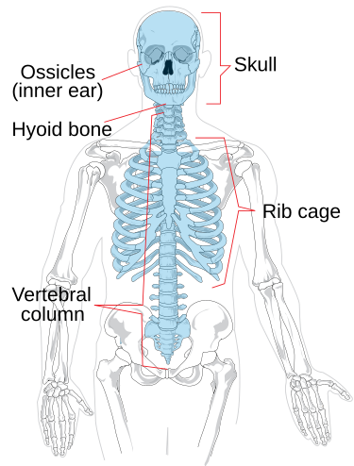
Find the issue with this alt text
Labeled drawing of axial skeleton of human. Shows skull, ossicles (inner ear), hyoid bone, rib cage, vertebral column. Other bones less visible.
Figure 3.6 Human Skeleton.

Slide 56
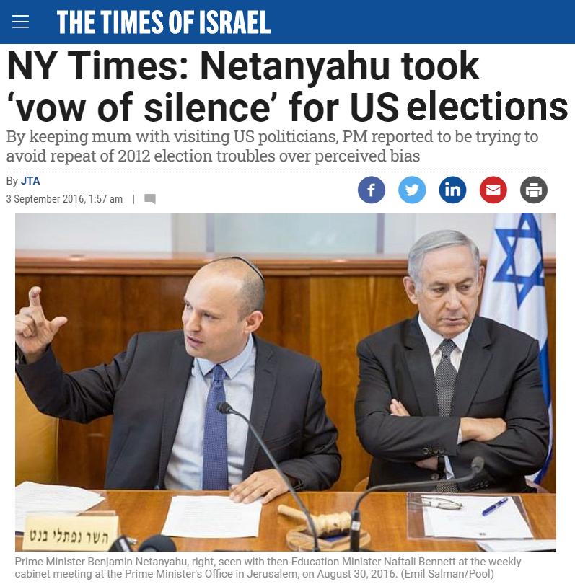
Write some quick alt text
Caption:
Prime Minister Benjamin Netanyahu, right, seen with then-Education Minister Naftali Bennett at the weekly cabinet meeting at the Prime Minister's Office in Jerusalem, on August 30, 2016.

Slide 57
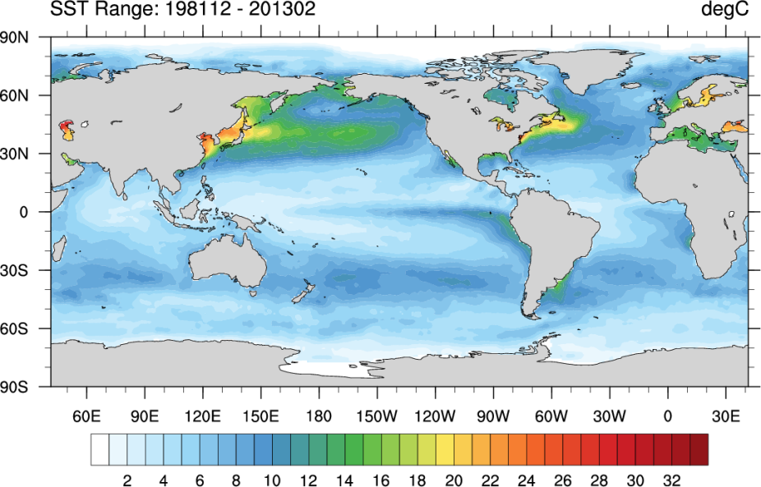
Evan’s ocean temps

Slide 58
Type and purpose of image: Special considerations
Special considerations for different kinds of information and different modes of conveying it.
(When workshopping; we will brainstorm information, not refine the descriptions.)

Slide 59

Poor image choices
If you can impact image choice: make sure the images are describable.

Slide 60
Art
See if descriptions are available from a museum etc.
Very often needs a subject matter expert’s input, especially for appropriate terminology.
Use more poetic, descriptive adjectives.
Overview should include setting, subject, action.
Include color, shapes, feeling.
What is visually striking?
What about the image is related to the surrounding text and learning topic?

Slide 61
Assessments
Use words that don’t give away the answer.
If it’s a multipart question, like labeling, don’t name in one description another part that needs identifying.
Look to the distractors: Why / how will sighted students get this wrong?
Features of the image: Why / how will sighted students get this right?

Slide 62
Charts and Graphs
Structure
Summary & details
Identify type of chart/graph.
X by Y axes, if not already clear from the title.
Summarize core / most visually obvious info.
Specify axes, units, increments.
Details.
Include data table where technologically possible.
  If data are approximate, state that.
  Order rows by most logical for students.
What does the visual representation make clear that just presenting the data in a table wouldn’t?
Trends / Shape – Use descriptive (and SME-approved) adjectives.
Comparisons.
Things coming together or diverging.
Outliers.

Slide 63
Compare / Contrast
All very similar
Very different
Describe common parts of 1st image then point out how it is unique
For all others, say “same as first except…”
Describe attributes in same order
Use comparative language

Slide 64
Flowcharts
Call it out as a flow chart.
Start with overview of structure / relationships.
If the structure is complex, mention how you will be describing it.
Base description on most important or direct route.
Separate notes about each step clearly from step itself.
Use nested lists.
State what the arrows mean, not that they are arrows.

Slide 65
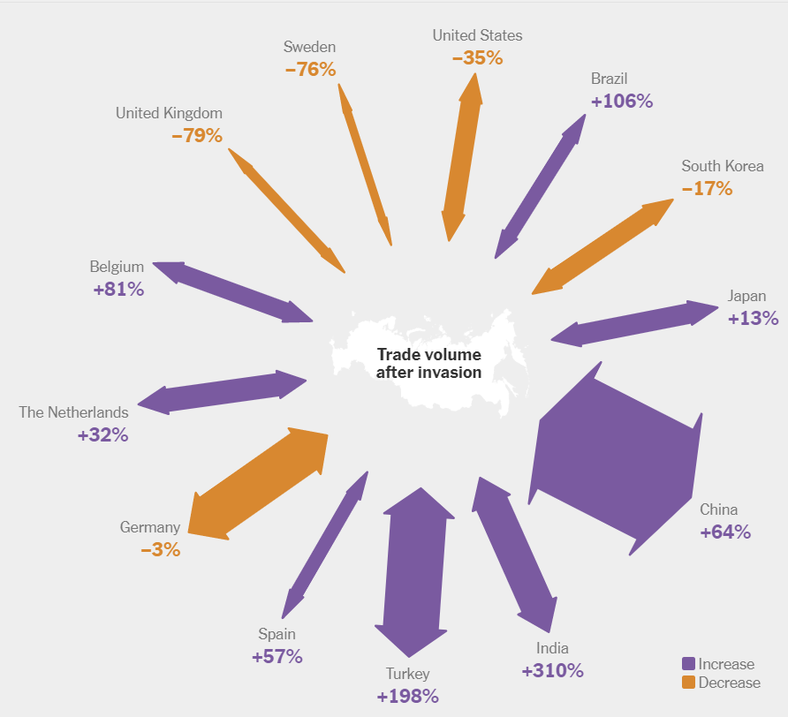

Infographics: Text with Pictures or Data Representation?

Slide 66
Infographics as Representations of Data
Identify it as an infographic
What about the data is the infographic highlighting?
Treat it like a chart or graph
Is it definitely clear what the infographic visually represents?
Does the format of the infographic matter in the context?

Slide 67
Labeled parts
Mention the fact that the image is labeled and how many parts are labeled.
Refer to exactly how the parts are labeled.
Describe in a logical order.
Refer back to previously described labeled areas to explain connections
Describe relative locations of each part.

Slide 68
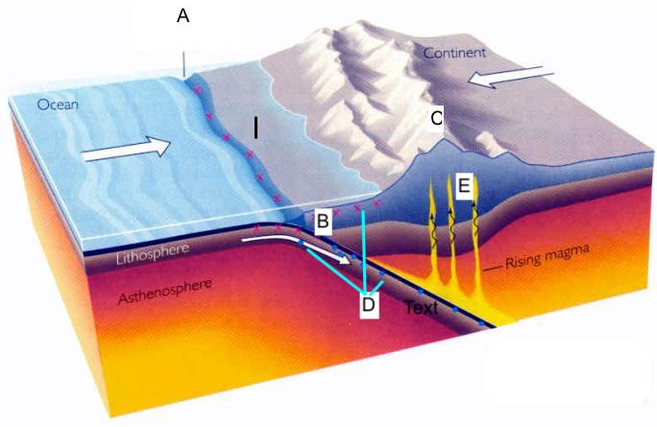
Evan’s plate tectonics

Slide 69

Logos and icons
Logos
Logo: [Company].
  Would you ever describe a logo?
Icons
Does it matter that it is a visual representation (Icon: Reading)
Would just the words be enough (Reading)?

Slide 70
Maps
Alt
Region, types of features, summary of what it shows that’s relevant. Clearly state if full list is not included.
Extended
Key locations, features.
Relationships.
If map will later be used in assessments, describe areas in relation to each other, and with shapes and prominent features etc.; anything that doesn’t just rely on the names of all the areas.

Slide 71
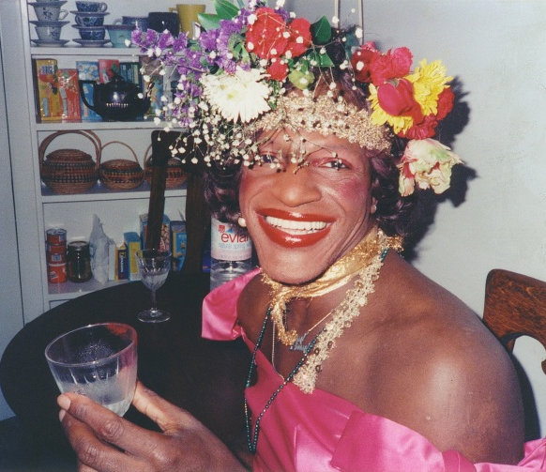
People (very tricky!)
IF describing apparent race, ethnicity, age, gender ALWAYS do it.
Young, White Men Are Not the Default Humans.
Real people: Ask them to describe themselves and start there.
Stock photography:
Look into wording the group uses for themselves.
See if keywords help.
Use sources from the community.
Marsha P. Johnson, queer rights activist.

Slide 72
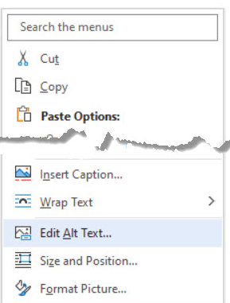
Screenshots
Right-click the object and select Edit alt text.

Slide 73
Considerations for screenshots
What part of the instructions SPECIFICALLY is the screenshot demonstrating?
Where might people get confused in following just the text?
How much context is needed?
What part of the interface are you sure your users know? Are you really sure?

Slide 74
Accessibility Content:
Extended Descriptions for Images
Note: These slides are hidden from the slideshow but can be accessed by links in some slides with images.

Slide 75
Extended description for slide Giraffe reminder
Return to parent slide.
​​​Opaque: Window is covered with closed shutters, there is no view of the giraffe outside at all.
​​Translucent: A hazy view of the giraffe's midsection through sheer curtains; details are difficult to see, colors are washed out.
​​​Transparent: Clear view of giraffe's head outside.
Return to parent slide.

