Slide 1
Writing educational alt text to support the WHY of learning
Laura Ciporen
Accessing Higher Ground
11/14/2024

Slide 2
About me
Laura Ciporen, CPACC. Brooklyn, NY. She/Her
Digital Content Accessibility Manager for McGraw Hill Higher Ed.
100% focused on content accessibility since 2015
Instructional design for 6 years prior
M.A. in Educational Communication and Technology from NYU

Slide 3
About the Session
At the end of the session, you will have a specific methodology to apply to writing and evaluating image descriptions for educational materials.
This will be participatory. The audience will be called on.
One does not simply write alt text.

Slide 4
Background concepts to keep in mind
Two parts to a description
Image descriptions are content
What image descriptions are & are not
Educational vs. informational content

Slide 5
Two parts to an image description
Alt text (text alternative)
Extended description
What assistive technology automatically says when it gets to an image and what users see if an image fails to load.
Like glancing at the image. It should be the most obvious and important information in the image.
Try to keep to 150 characters, including spaces and punctuation. (Or your definition of acceptable character count.)
​​​Like studying the image. You have to decide to do it (description may be elsewhere on the page or accessed via a link etc.). There are a lot of details.
Not always necessary. (But usually, for educational materials.)
Accompanies but DOES NOT REPLACE alt text.

Slide 6
Example of full image description
Alt text
Extended description
Comparison of opaque, translucent, transparent. ​￼​Wall with ​​3 windows through which parts of a giraffe are not seen, partially seen, or completely seen.
​​​Opaque: Window is covered with closed shutters, there is no view of the giraffe outside at all.
​​Translucent: A hazy view of the giraffe's midsection through sheer curtains; details are difficult to see, colors are washed out.
​​​Transparent: Clear view of giraffe's head outside.

Slide 7
Giraffe reminder
See extended description for the image on this slide.

Slide 8
Image descriptions ARE content

Slide 9
Accessibility is not a numbers game, it’s an impact game
Image!
Counter-point: image.

Slide 10
What does a good image description do?
Conveys in text the same information that an image conveys visually.
Image descriptions are about meaning and emotion, NOT visual representation.

Slide 11
Image descriptions are not captions
Captions are ABOUT the image.
Descriptions ARE the image.

Slide 12
Function of captions
Title / Identifier
Explanation / Setting the scene
Provide information about the image
What’s in the caption may not be directly evident in the image
Available and useful to everyone
Supplement to, not replacement for the image
Prime Minister Benjamin Netanyahu, right, seen with then-Education Minister Naftali Bennett at the weekly cabinet meeting at the Prime Minister's Office in Jerusalem, on August 30, 2016. (Emil Salman/Pool)

Slide 13
Art caption example: like museum plaques
Ugo Rondinone, Erstermärzzweitausendundeinundzwanzig, 2021. Watercolor on canvas in artist’s frame. 78 ¾ x 118 1/8 (200 x 300 cm).

Slide 14
Quiz 1: Caption or alt text (description)?
Bar graph illustrates the growth of scientific publications in exercise physiology from 1950 to 2021.

Slide 15
What makes a good description?
Image descriptions should convey an image’s information, meaning and personality.
They should not actually describe images.

Slide 16
Flowchart: describing vs. conveying info example
Visual Description
Jump
Jive
Wail
Three red circles create the points of a triangle. In between each is a thick purple arrow pointing from one circle to the next in a clockwise order. The top circle reads “Jump,” the lower right circle reads “Jive,” the lower left circle reads “Wail.”
Conveying Information
Circular flow chart. Jump leads to Jive which leads to Wail which leads back to Jump.

Slide 17
Exceptions: sometimes appearance IS important
If only an idea matters and not the visual representation of that idea, what do we do with this?
Signaling that content is being recycled from earlier lesson: “Recycle.”
About actual recycling: “Recycling symbol.”
But consider: is there a time to describe what the symbol looks like?

Slide 18
Why the emphasis on “educational” alt text?
What makes us so special?

Slide 19
Comparison: informational vs. educational content
Informational Content
Educational Content
Telling the user things / provide information
Keep user’s interest (voluntary)
Individual; no comparison to others
Helping the user understand things and be able to use them later
Consequences for not knowing/understanding
Group use; equity of information
Clear aim for what user is supposed to get out of the content
Allowing students to participate in discussion
Assessments vs. content presentations

Slide 20
My THREE image categories for education
Content (informational considers this “non-decorative”)
Directly help students learn the material.
Need full descriptions.
Non-Content (informational considers this “decorative”)
Enhance the experience; contribute something.
If removed, would not impede learning the material.
ALSO need full descriptions.
Decorative
FILLER. You could replace it with a doodle of a flower.
Contain no information at all that isn’t already completely in the text.
The ONLY images that don’t need descriptions.

Slide 21
Content image example
Text discusses the migration of various North American peoples and where they founded their territories.

Slide 22
Non-content image example
Why do we include pictures of Abraham Lincoln when we talk about Abraham Lincoln but the only describe the image as being Abraham Lincoln?

Slide 23
Decorative image example
Educational Content

Slide 24
Evidence for the importance of non-content images
Smith, B. D., & Elifson, J. M. (1986). Do Pictures Make a Difference in College Textbooks? Reading Horizons: A Journal of Literacy and Language Arts, 26 (4).
"Including pictures, such as those of people, buildings, artifacts and landscapes in college history text material does not seem to increase a college student's comprehension of the material, even when the pictures have been selected because they support the main ideas of the text.”
“Student preference proved to be overwhelmingly in favor of pictures. Of the 145 students, 119 chose the passage with pictures, while only 26 chose the passage without pictures. The passage with pictures was preferred by 82% of the students.”

Slide 25
Anecdotes for importance of non-content images
User study: 8 SR users read 3 versions of 3 readings: Which level of descriptions did you prefer, and why?
The screen reader users wanted the highest level of description…and more.
“This was my favorite version by far. I finally got the descriptions of the pictures I just had a feeling I was missing. This is great, because for an E-Book on nutrition you want those images in the mind as you read along.”
“Finally! I've gained some extra context that I didn't even know was missing. The descriptions of the image content itself really added to my understanding of what the captions were referring to.”

Slide 26
Anecdotes continued….
User study: 3 sighted students read the same content.
Didn’t spend much time on the images; mainly only glanced at them.
Wanted them there, just like the 1986 study.

Slide 27
Generating the description
Ask the following questions.
(Of the person who choose the image, if you can, or yourself if you cannot.)

Slide 28
My essential questions for image descriptions
WHY is this image here?
What relevant information will the sighted audience get from the image?
How will this image be used in the educational setting?

Slide 29
When do you need a subject matter expert?
When reading the context around the image is not enough.
Writing educational alt text to support the WHY of learning | AHG 2024 | Laura Ciporen

Slide 30
WHY is only a 3-letter word
Asking the image decision makers why an image is used.

Slide 31
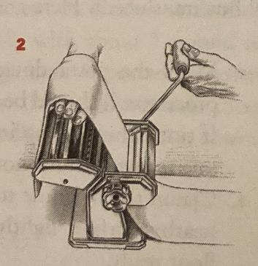
Question 1: Why is this image here?
Is it content, non-content, or decorative?
What does this representation of the concept have that others do not?
If it were removed, what would be lacking?
What does its presence add that text alone does not?
(Step 1) Begin by putting a piece of dough through the widest setting, usually #1.
(Step 2) Decrease the distance between the two rollers, making the strip of dough progressively thinner. Note that as the dough becomes longer, it will become more fragile. Dust with flour between rollings if necessary. (How to Cook Everything, p. 156 - how to make pasta using a pasta machine)

Slide 32
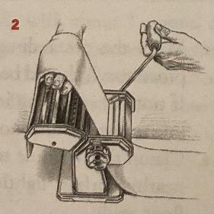
Question 2: What relevant information will the sighted audience get from the image?
What is this image saying that the surrounding text is not?
Evoked emotions are sometimes “relevant information.”
Remember your audience: what would THEY, get out of looking at this image?
Note: This is not necessarily what the person who chose the image WANTS people to get out of it.
Immediately obvious or most important information = alt text. Further details = extended description
(Step 1) Begin by putting a piece of dough through the widest setting, usually #1.
(Step 2) Decrease the distance between the two rollers, making the strip of dough progressively thinner. Note that as the dough becomes longer, it will become more fragile. Dust with flour between rollings if necessary. (How to Cook Everything, p. 156 - how to make pasta using a pasta machine)

Slide 33
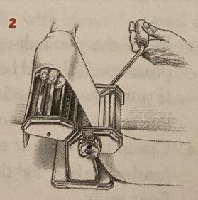
Question 3: How will this image be used in the educational setting?
Learning the material?
Discussion?
Assessment?
(Step 1) Begin by putting a piece of dough through the widest setting, usually #1.
(Step 2) Decrease the distance between the two rollers, making the strip of dough progressively thinner. Note that as the dough becomes longer, it will become more fragile. Dust with flour between rollings if necessary. (How to Cook Everything, p. 156 - how to make pasta using a pasta machine)

Slide 34
Let’s try it!
Writing educational alt text to support the WHY of learning | AHG 2024 | Laura Ciporen

Slide 35
Context matters!
WHY is this image here?
What relevant information will the sighted audience get from the image?
How will this image be used in the educational setting?
Selling rice in Iringa, Tanzania. © Laura Ciporen 2016

Slide 36
Audience matters!
Use one sheet of notebook paper to make a 5-Tab Foldable. Label the tabs as illustrated. Use the Foldable to identify how forces act on objects. Under the tabs, define terms, list examples, and explain real-world applications.

Slide 37
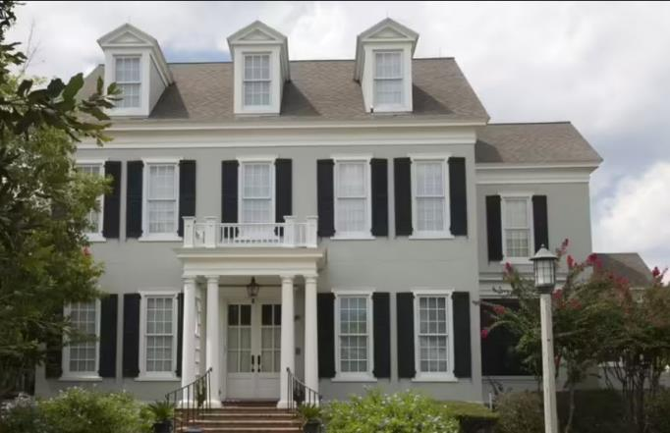
Purpose matters!
Which architectural style is this?
Neo-classical
Colonial
Gothic Revival
Georgian

Slide 38
Questions?
Need to go over anything again?
Writing educational alt text to support the WHY of learning | AHG 2024 | Laura Ciporen

Slide 39
Structure of good image descriptions
Start with an overview / summary where applicable.
Move from general to specific at every level of the description.
Order the elements of a description the same way each time for ease of comparison.
Relate the parts of the image to each other or a common reference point.
Organize descriptions of the parts of an image logically.

Slide 40
Style of image does NOT always matter
Only mention the format of the image if the format tells you something about the image.
Photo of: (only if one would expect an illustration)
Illustration of: (only if one would expect a photo)
Archival photo: (usually)
Black and white drawing: (usually)
Cartoon: / Comic strip: (always)
Bar chart: / Line graph: (always)
*
* True story: I studied this book in grad school and until I put this slide together I thought the title was “the medium is the MESSAGE.” I kept it in anyway because it still makes a related point.

Slide 41
Compare / Contrast
All very similar
Very different
Describe common parts of 1st image then point out how it is unique
For all others, say “same as first except…”
Describe attributes in same order
Use comparative language

Slide 42
Image used as an example / compare & contrast
Text discusses designers’ use of form and function. Quote applying to example:
“Before creating a new line of aquatic gear, designer Bob Evans carefully analyzes the needs of different types of swimmers. The basic Force Fin (9.5A) provides the required maneuverability for snorkeling. He designed the Multi Force Fin (9.5B) as a strength- training device. The Excellerating Force Fin (9.5C) provides the extended power that scuba divers need. For designers such as Evans, the form must fulfill a specific function, or purpose.”

Slide 43
Poor image choices
If you can impact image choice: make sure the images are describable.

Slide 44
Accessibility Content: Extended Descriptions for Images
Note: These slides are hidden from the slideshow but can be accessed by links in some slides with images.

Slide 45
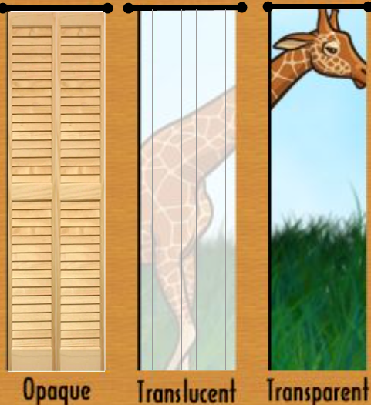
Extended description for slide Giraffe reminder
Return to parent slide.
​​​Opaque: Window is covered with closed shutters, there is no view of the giraffe outside at all.
​​Translucent: A hazy view of the giraffe's midsection through sheer curtains; details are difficult to see, colors are washed out.
​​​Transparent: Clear view of giraffe's head outside.
Return to parent slide.

