Slide 1
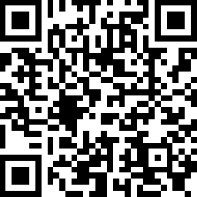
AccessCORPS: A Scalable Approach to Enhancing Higher Education Accessibility and Research
Dr. Bruce Walker, Norah Sinclair, and Bella Martincic
https://accesscorps.gatech.edu

Slide 2
Introduction: The Prevalence
21% of undergraduates and 11% of postbaccalaureate students have cognitive, mobility, and perceptual disabilities (National Center for Education Statistics, 2023)
Lower than the 28% of adults who have these disabilities in the population (Centers for Disease Control and Prevention, 2024)

Slide 3
Introduction: The Need
Accessibility issues include teaching materials.
Materials include…
Document types (pptx, pdf, html, docs)
Use cases (syllabus, exams, lectures, readings, assignments, homework)
Information types (charts, graphs, models, videos, pictures, diagrams, maps, simulations)

Slide 4
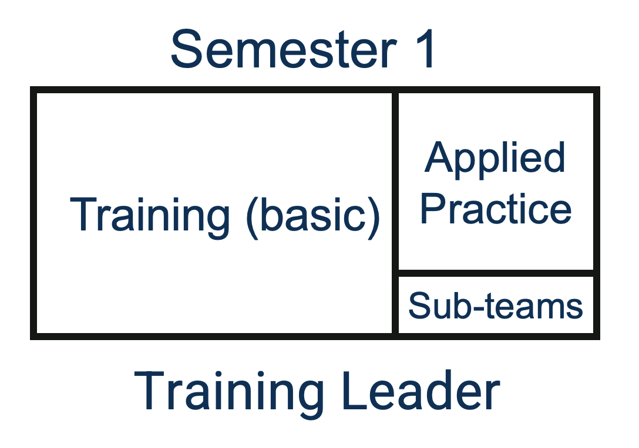
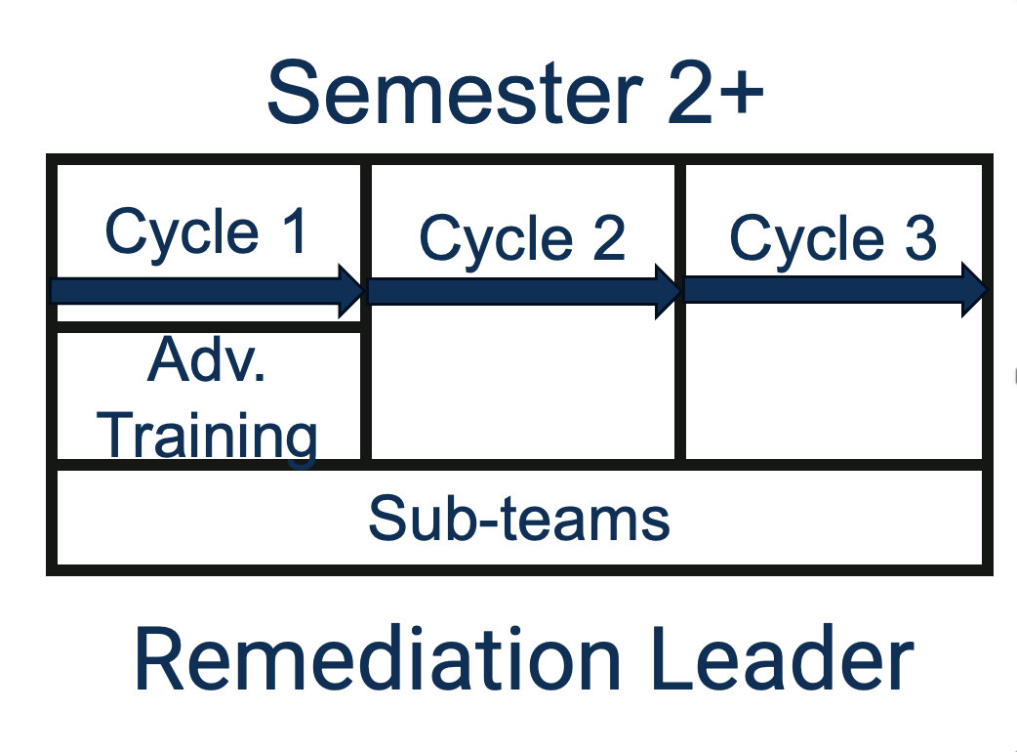
Introduction: Overview of AccessCORPS
Composed of three main components:
Training, Remediation, And More!

Slide 5
Training: Overview and Materials
Rely on Teams, Canvas, and teaching materials made “in-house”

Slide 6
Training: Onboarding Process
One semester long, composed of two parts
2/3 of the semester – training modules and peer reviewing
General accessibility, image description, Word, PowerPoint, and PDF documents
1/3 of the semester – practicing course remediation

Slide 7
Training: Advanced
2+ semesters long
Advanced topics can include equations, graphs, charts, etc.

Slide 8
Remediation: Overview
1) Engagement
2) Organization
3) R1a/b Remediations
4) R2 Remediations
5) Finalize, Summarize, and Return

Slide 9
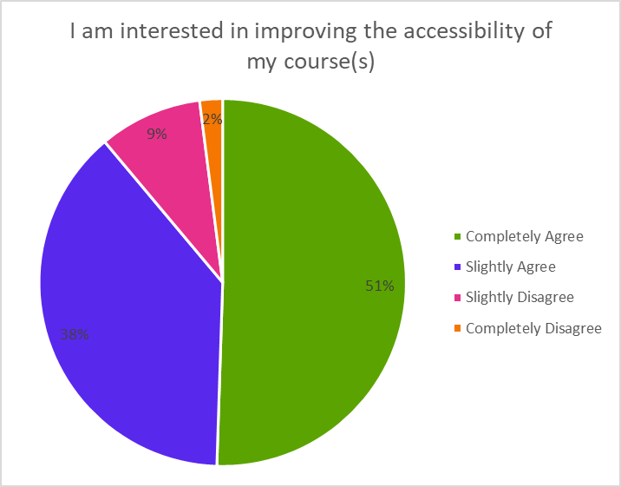
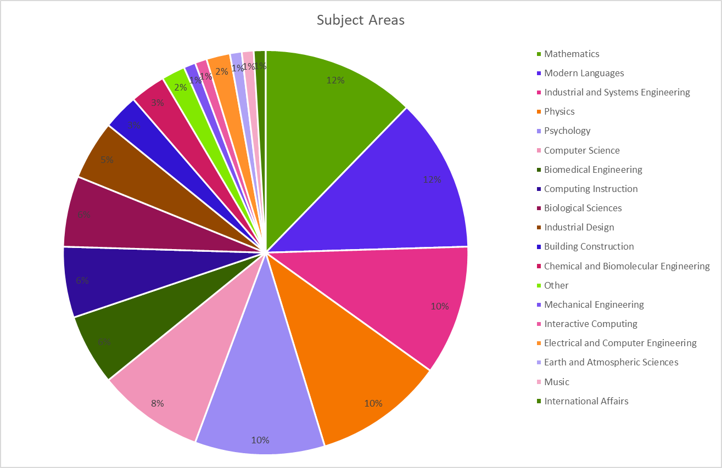
Remediation: Engagement
Course selection process
Lots of positive feedback!
Created by Kristin Purmort and Ethan Kang
Created by Kristin Purmort and Ethan Kang

Slide 10
Remediation: Code of Conduct
Confidentiality of Course Materials
Responsible Access
Use of AccessCORPS Methods and Resources
Non-commercial Use
Commitment to Quality
Material Retention and Deletion

Slide 11
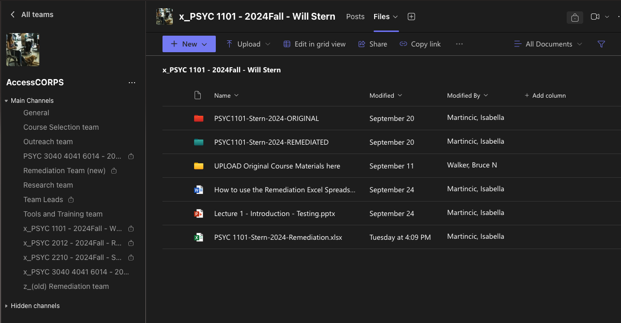
Remediation: Organization 1 of 2
AccessCORPS uses Teams to organize the remediation process

Slide 12
Remediation: Organization 2 of 2

Slide 13
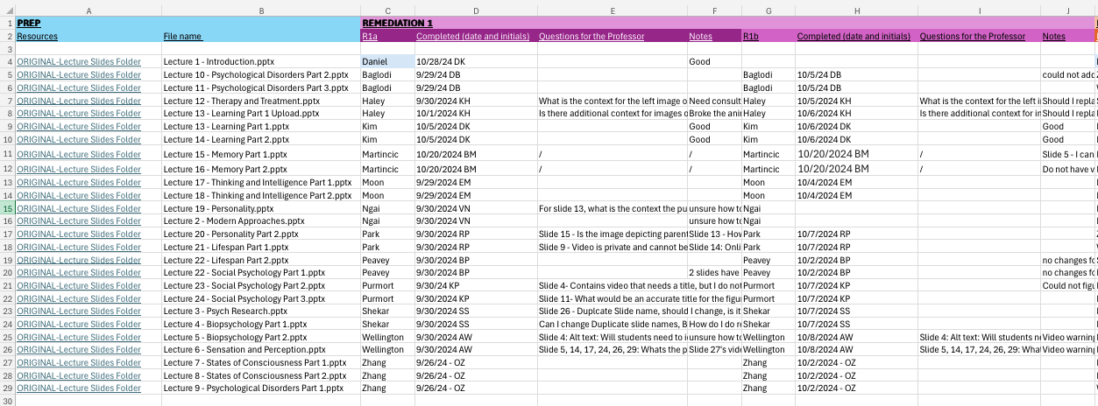
Remediation: R1a/b Remediations

Slide 14
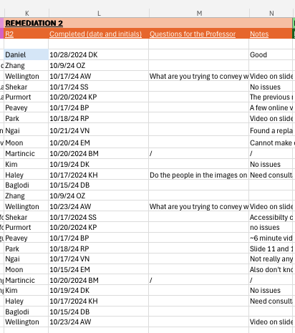
Remediation: R2 Remediations

Slide 15
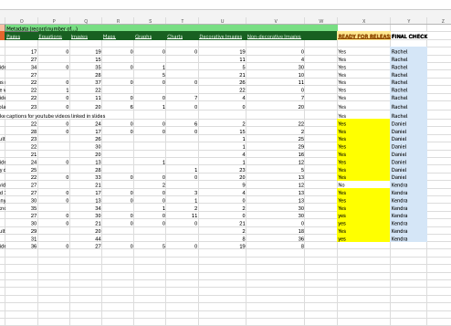
Remediation: Finalize, Summarize, & Return
Finalize all the remediations and collect meta data
Summarize the remediation process for the professor
Return all the finalized materials

Slide 16
Remediation: Scalable Cycles
Utilize task forces
1 month to complete a full course remediation
3-4 courses x number of teams

Slide 17
And More!: Leadership
Graduate/undergraduate leads

Slide 18
And More!: Sub-teams
Research
Outreach
Course selection
Tools & Training

Slide 19
And More!: AccessCORPS Products
Tips and tricks
Content creation
Accessible Templates
Instructor/teaching assistant/administration training
Consultations
Also…gives students transferable skills

Slide 20
Bringing AccessCORPS to You!
AccessCORPS “package” includes...
Comprehensive training materials
Remediation tools for accessibility
Step-by-step organizational setup guide
Additional support materials
On-site assistance for process orientation and consultations
Note: Universities will need to determine logistics and incentives for student participation

Slide 21
Summary

Slide 22
We want to partner with you!

Slide 23
Thank you!

Slide 24
Questions?

Slide 25
Contact Us
Dr. Bruce Walker: bruce.walker@psych.gatech.edu
Bella Martincic: imartincic3@gatech.edu
Norah Sinclair: norah.sinclair@design.gatech.edu
https://accesscorps.gatech.edu

