Slide 1
Building an Accessibility Knowledge Base
macmillanlearning.com

Slide 2
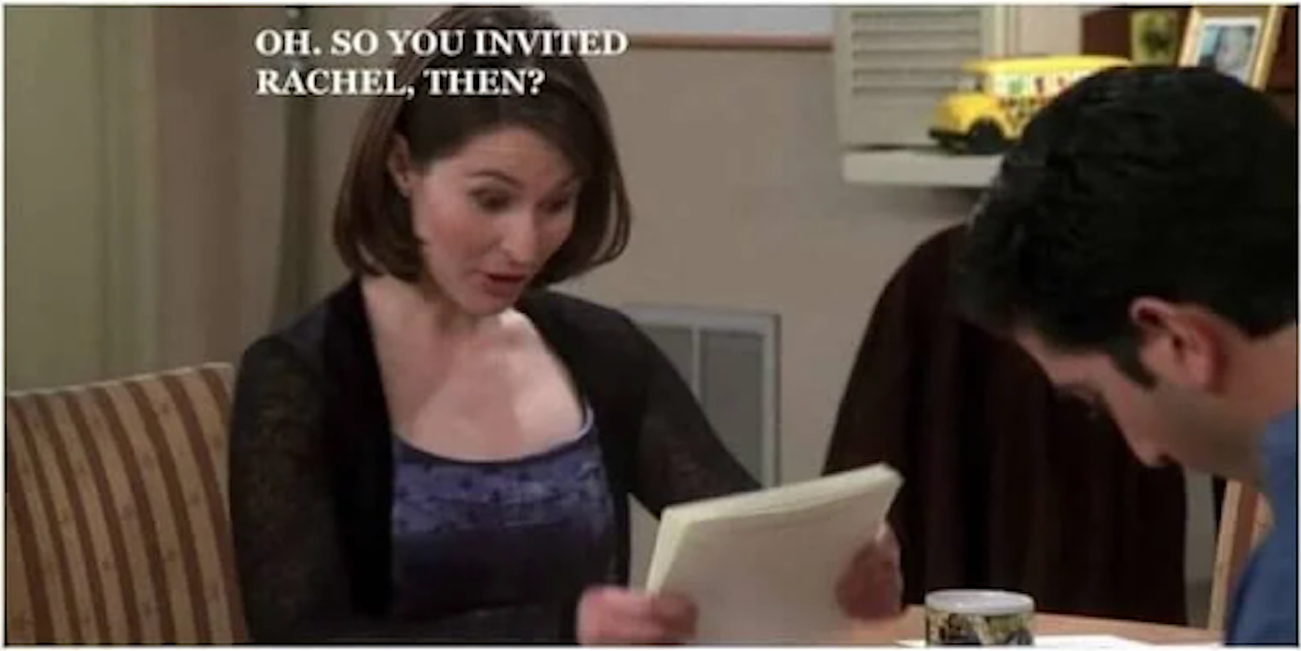
Rachel Comerford
Senior Director Accessibility Outreach and Communications
Macmillan Learning

Slide 3
What You’ll Learn Today
How a knowledge base can support your team and reduce support requests.
Three(ish) steps to building a successful knowledge base.
Strategies for continuous improvement and self-service in accessibility.

Slide 4



Why an Accessibility Knowledge Base
(Or: That Slide Where I Preach to the Choir)
Across various industries, the same challenges exist…
Lack of Time
Lack of People
Lack of Money
A knowledge base provides…
A quick resource for answering questions.
A chance to learn from the questions others ask.
Time to focus on more complex issues.
Supports continuous learning for peers and colleagues.
Reduces repeated support requests.
Offers insights into organizational accessibility progress.
Empowers self-service in accessibility issues.

Slide 5
What a Knowledge Base Can’t Do
So many answers in accessibility are: It Depends
Can’t foresee every question
Address everyone’s needs or preferences for accessing information
Make a fancy cheese plate and pour your wine

Slide 6
Overview of process
1
2
3
Step 1: Kickoff - Finding Existing Resources
Step 2: Research - Understanding Your Audience
Step 3: Development - Customizing for Your Organization

Slide 7
Step 1
Kickoff: Find Existing Resources
Where do you go with your accessibility questions?

Slide 8
Open Resources for Quick Wins
Websites
Shameless plug: www.macmillanlearning.com/accessibility
TeachAccess: https://teachaccess.org/
Job Accommodation Network (JAN): https://askjan.org/
Deque screen reader guides: https://dequeuniversity.com/screenreaders/
Accessibility developer guide: https://www.accessibility-developer-guide.com/
CAST: https://aem.cast.org/
Books
The Accessibility Operations Guidebook by Devon Persig
Demystifying Disability by Emily Ladau
Ask Anything Spaces
A11y Slack: web-a11y.slack.com
Athens listserv: https://www.athenpro.org/listserv/
Why? Quick wins are a way to establish engagement with your user base, establish needs, and get investment.
Notes:
Discuss the importance of quick wins to establish engagement and generate initial usage data.
Examples of useful resources: websites, databases, and new technologies (e.g., AI).

Slide 9
Reducing Support Requests with Self Service
Establishing a centralized location for open resources that you want people to use means you are keeping the focus on what is relevant to your teams needs
This database, while not curated, will reduce overall inquiries allowing for more bandwidth for a deeper dive in your documentation
Getting SOMETHING out there proves to administrators, executives, etc that the work is being done… an incremental step is still a step
The initial database will show you what your audience is making use of and give them a chance to tell you what they need that isn’t there

Slide 10
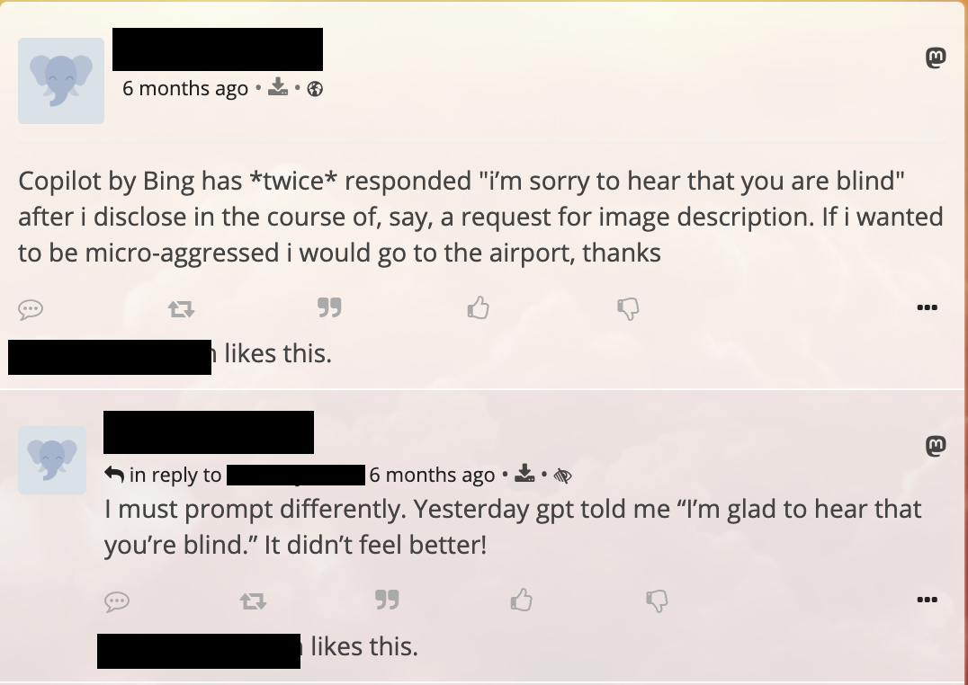
I Know, I Know… You Want to Hear About AI
Yes, AI can help answer your questions
But, AI sounds like an expert even when it has no expertise
If someone with no experience with accessibility gets the wrong answer - they may never know
High risk for hallucination treated as fact
AI is trained on the prejudices of others
I’m not saying it won’t help - but handle with care. AI results require human intervention.

Slide 11
Step 2
Research: Understanding Your Audience
Who is your audience for accessibility documentation?

Slide 12
Identifying and Aligning Needs Across Audiences
Figure out who needs the documentation (and who you need to need the documentation)
  Example: I need a knowledge base for employees to understand how to make their products accessible AND I want a database that will help any user make educational material accessible
Use surveys, open channels for feedback, interviews, and past experiences

Slide 13
Identifying Audiences Avoids Misunderstandings
Hearing from your audience about their needs will tell you a lot about the maturity of the accessibility program
Keep track of common requests and their source so you can make sure the right people get the right information
Remember that your audience breaks down to more specific personas
  For example, my designers have very different color contrast questions than the developers I work with
  Targeted documentation can help in this circumstance

Slide 14
Step 3
Development: Building Custom Resources
What resource formats have your users found helpful?

Slide 15
Creating Customized Documentation
Use the common questions from your audience engagement to decide where to start
Look at the open source materials you gathered - do they meet the common needs? Do you need to add to them? Update them?
How are your users requesting information
  Consider FAQs, How To Guides, video tours, synchronous learning options
Use the customization process to start hitting on specifics from surveys and interviews

Slide 16
Meeting Your Audience Where They Are
Don’t let perfect get in the way of good - Get your audience the help they need and then continue to improve it over time
Encourage feedback for that iterative improvement
Minor updates over time add up to a big difference and tax the existing resources less

Slide 17
Absolutely Not a Surprise Step 4
Promoting Your Knowledge Base
How are you letting your audience know about the knowledge base?

Slide 18
I Hate the Word ‘Socializing’ when Applied to Documentation but Here I Am…
Strategize with colleagues about how to increase awareness of the knowledge base
  Newsletters
  Team/Departmental meetings
  Workshops
  “How-To” sessions (Live and Recorded)

Slide 19
Brainstorm: Ideas for Improving Accessibility Resources
What gaps exist in your current resources
What are your biggest challenges, blockers in development? In Socializing?
What are your ‘FAQs’?

Slide 20
Overview
Step 1: Kickoff - Finding Existing Resources
Step 2: Research - Understanding Your Audience
Step 3: Development - Customizing for Your Organization
Step 4: Promoting Your Knowledge Base
Contribute to our forthcoming knowledge base project!
WebAccessibility@Macmillan.com

Slide 21
Q&A

Slide 22
macmillanlearning.com

