Slide 1
Building Your
Accessibility Dream Team
Identifying Who You Have, Who You Need, and Growing Your Team

Slide 2
A Couple of Things…
Be kind to each other.
All of us are at different points of the same journey.
This looks like:
Not disparaging others for their thoughts and methods.
You will be working together in this session.
We are together for 3 hours. We will be talking and sharing and ranting.
This looks like:
Contributing to our activities and communicating with your table and the group.
Give everyone a chance to speak.
This looks like:
Not dominating the conversations.
When we share, keep your insights under 5 minutes.
Accept if we guide you back to the conversation.
Three hours is a long time.
This looks like:
Doing what you must to to get the most out of this session.

Slide 3
Agenda:
Hour 1
Review Agenda
Quick Introductions
It’s Nice To Meet You!
Begin Brainstorm
What Do Our Teams Do / Need to Do?
Case Study & Trends
Case Studies: What Have Other Universities Done?
Current Trends
Break! (10 minutes)

Slide 4
Agenda:
Hour 2
  Discuss Job Titles
What Are The Roles
  Who Does What?
Let’s Make Connections
  Plan Your Team
Impact!
Make It Personal
Break! (10 Minutes)

Slide 5
Agenda:
Hour 3
Share Your Plan
Share It Out!
How To Make This Happen
Plan Implementation
Final Thoughts
Big Questions

Slide 6
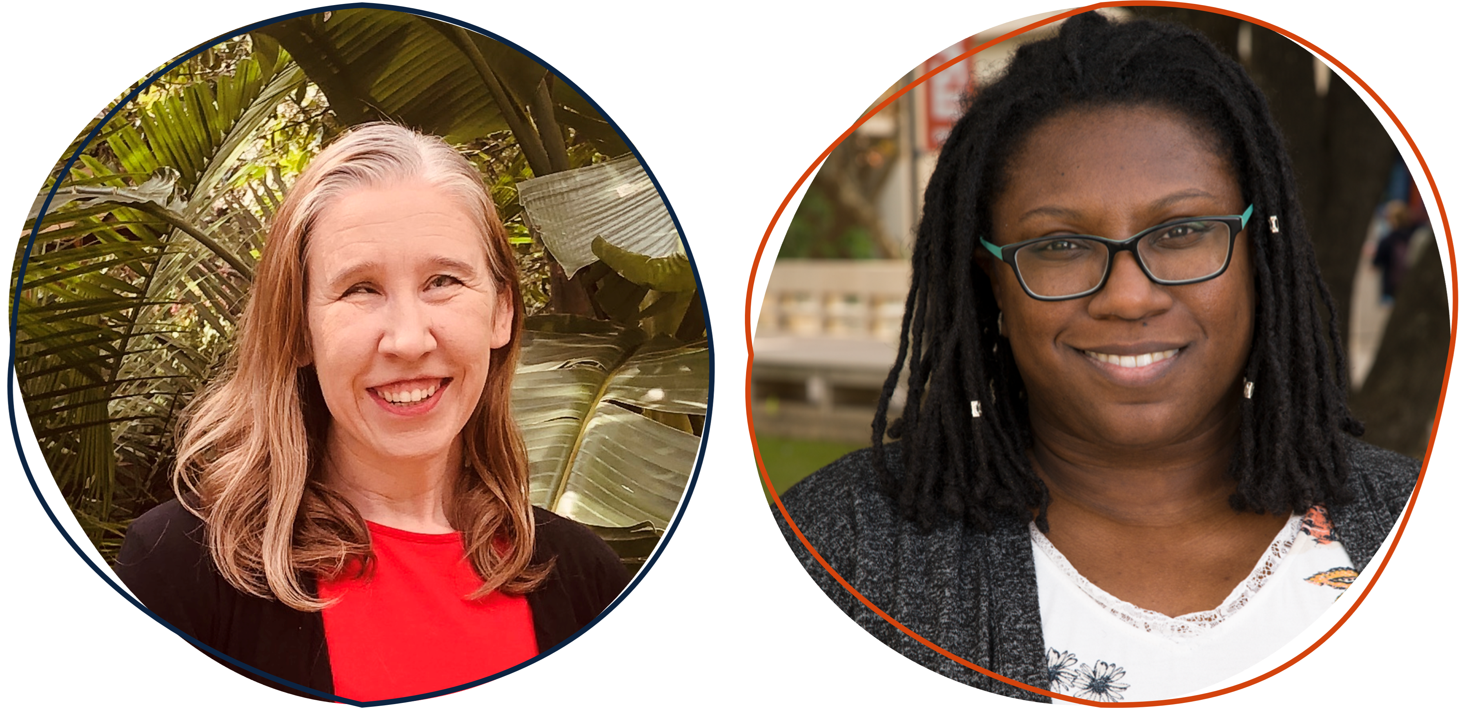
It’s Nice To Meet You!
We are your facilitators for this workshop.
RaLynn McGuire, CPACC, M.A., Doctoral Candidate
Vanessa Garza, M.A.
Lead Accessibility & UDL Specialist
Lecturer College of Education & Human Development
Learning Experience Accessibility Specialist

Slide 7
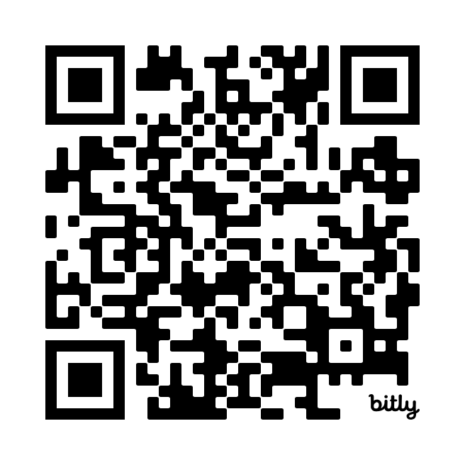
What Do Our Teams Do / Need to Do?
At your table, let's use our shared Google Doc to capture the following:
Celebrate your wins!
    Who is your team? What is currently getting done?
Sound the alarm!
    What’s not currently getting done?
If we could get everything we wanted…
    What would be nice to get done?
Google Doc:
What Do Digital Accessibility Teams Do?
https://bit.ly/AHGPCG2024

Slide 8
Case Studies
What Have Other Universities Done?
University of Washington
Virginia Tech
University of Minnesota

Slide 9
University of Washington
ADA & Accessibility Steering Committee
  ADA Coordinator
  ADA Deputy Coordinator Digital Accessibility
Accessible Technology Group

Slide 10
Virginia Tech
ADA & Accessibility Services
Services for Students with Disabilities
Accessible Technologies

Slide 11
University of Minnesota
Office of Digital Accessibility
  “…the Office for Equity and Diversity (OED) and the Office of Information Technology (OIT) have partnered to establish the Office of Digital Accessibility (ODA).”
ODA Director
Senior Digital Accessibility Analyst; Deputy ADA Coordinator

Slide 12
University of Texas at San Antonio
ADA Coordinator
Web Accessibility / EIRAC
Digital Accessibility Team

Slide 13
Current Trends
Reactions to Title II
Increased hiring
More awareness

Slide 14
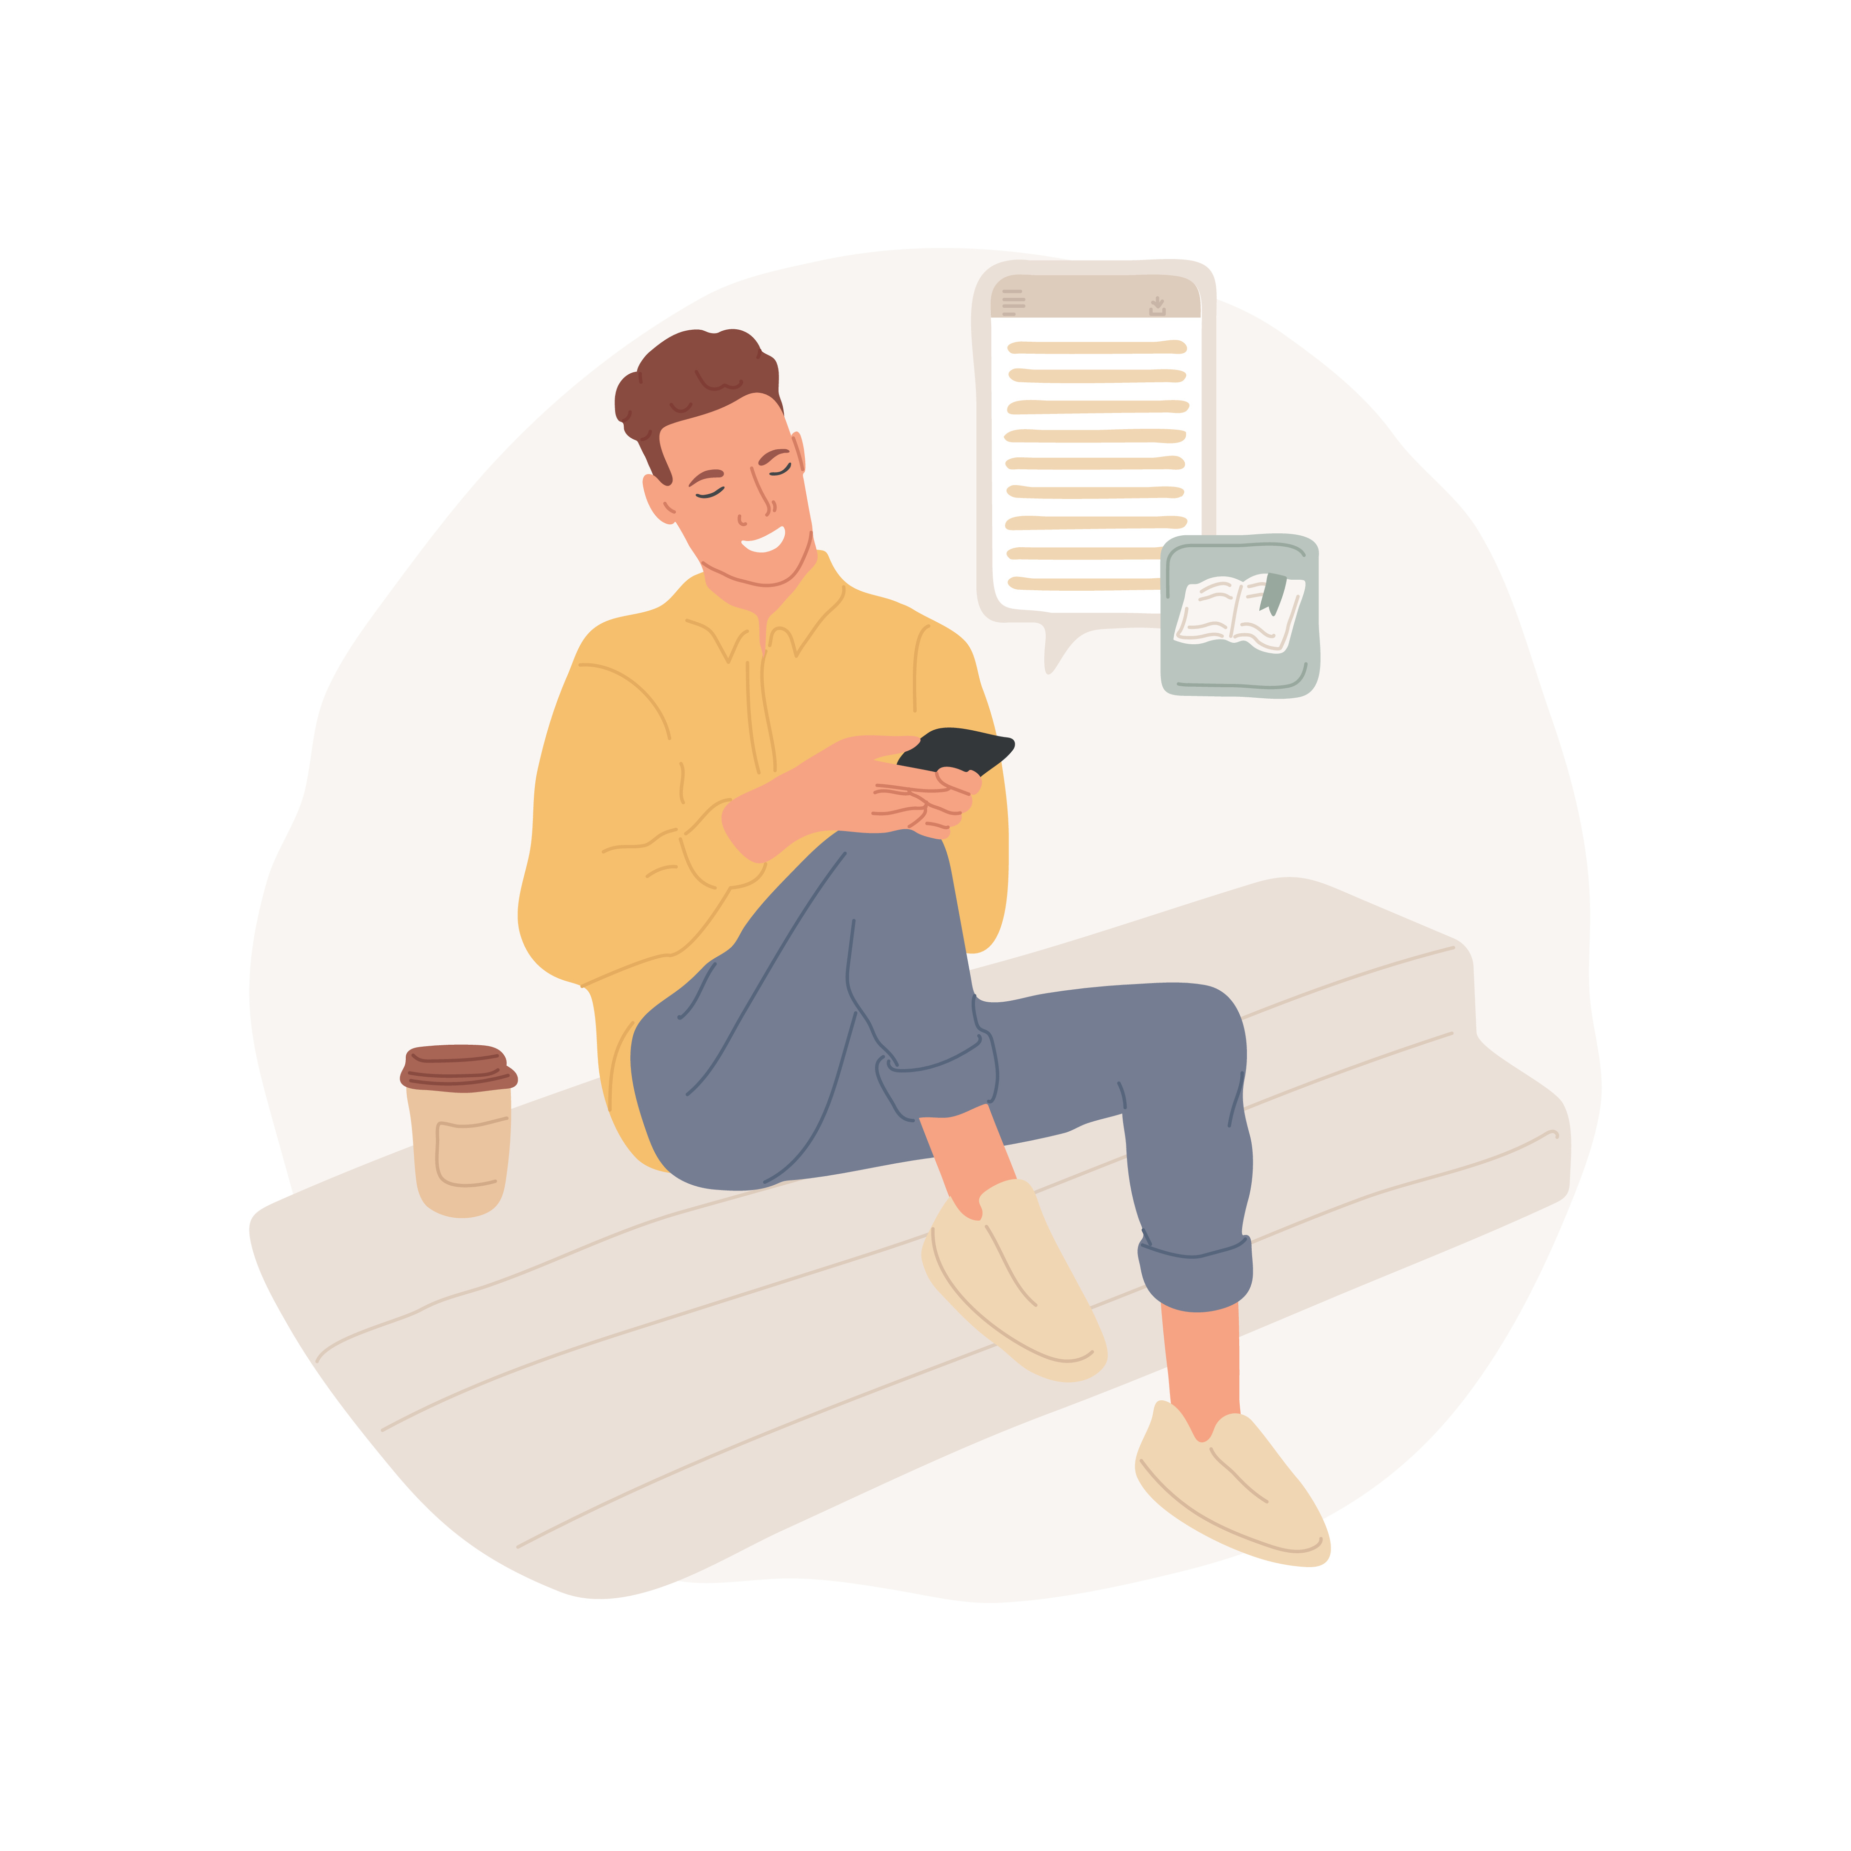
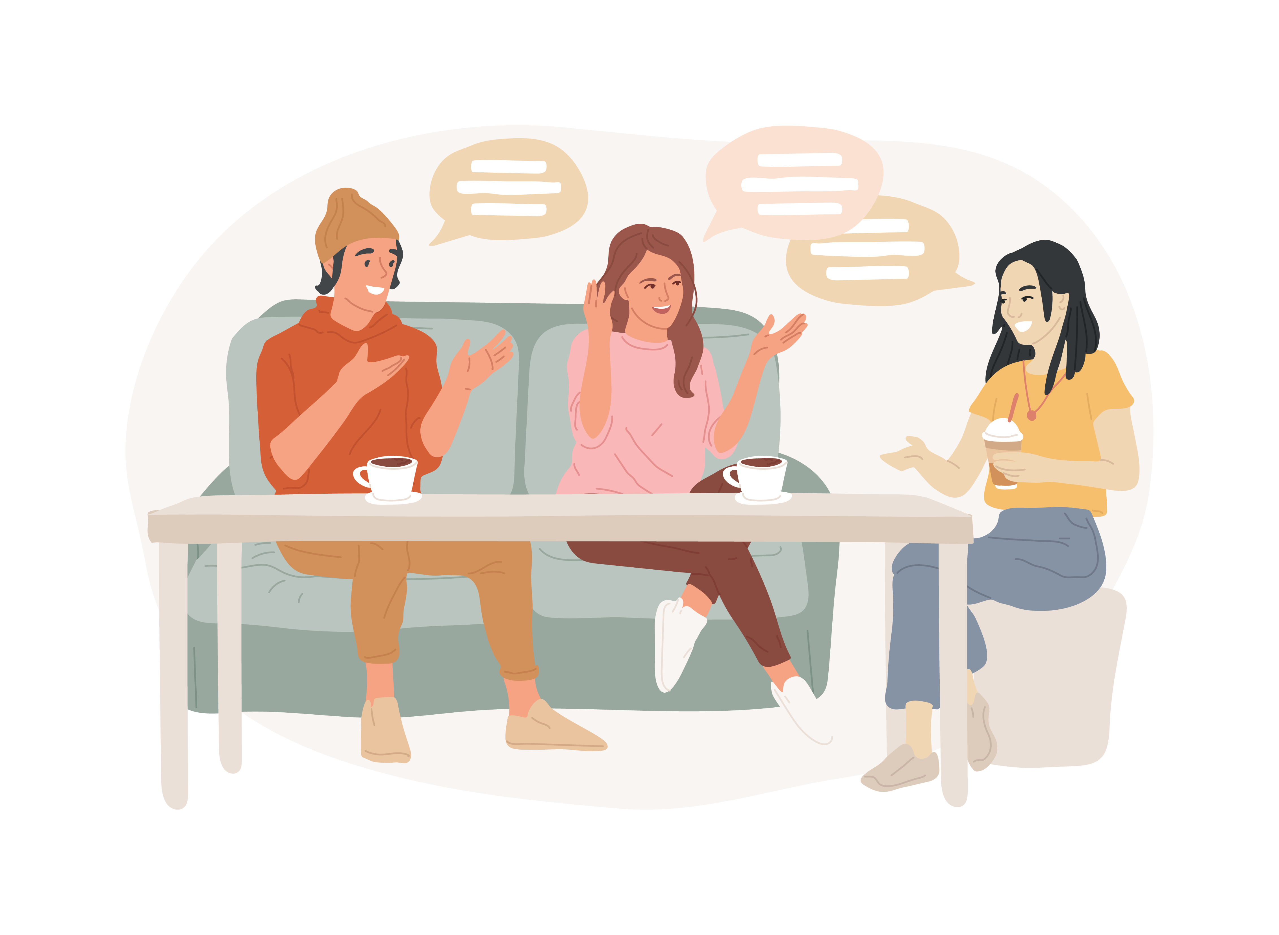
Break Time!
We will meet back in 10 minutes

Slide 15
Hour 2
  Discuss Job Titles
What Are The Roles
  Who Does What?
Let’s Make Connections
  Plan Your Team
Impact!
Make It Personal
Break! (10 Minutes)

Slide 16
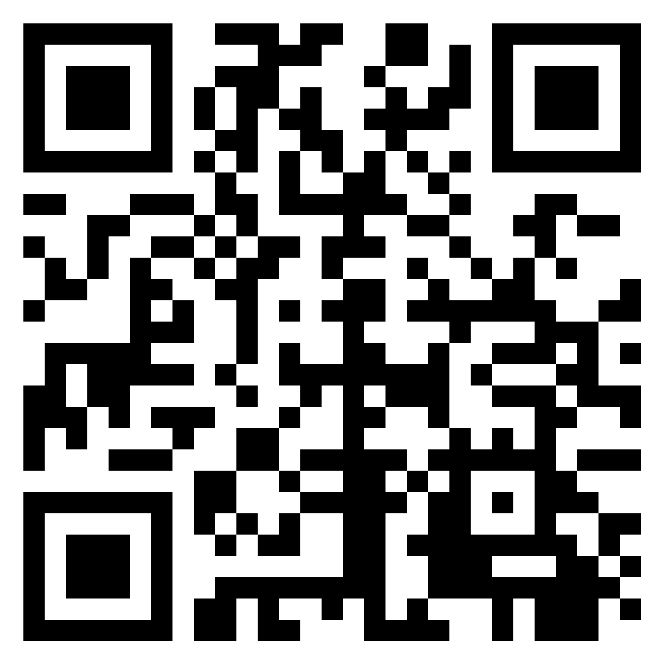
What Are The Roles
At your table:
Discuss what roles need to be added to the Padlet
Elect one or two people at your table to add missing roles to the Padlet
  Don’t worry about having the “perfect” title
Note: We have collected a few roles on the Padlet to start you off.
Padlet: Job Titles / Roles in Digital Accessibility
https://bit.ly/AHGPC2024

Slide 17
Let’s Make Connections
At your table:
Connect our tasks/jobs in our Google Doc with our Job Roles Padlet
Choose two jobs to focus on as a table
Elect one to two people in your group to copy items from the Google doc into the Job Roles Padlet
  Duplication is okay!

Slide 18
Impact!
At your table:
Choose the most impactful role
  This may differ from university to university so please feel free to talk this through as a group but it’s fine if each person chooses a different role
Choose one to two people to share with the group
Our focus will be on your own ideas about how this role could best be situated within the university to best achieve the goals for that role or for the university at large

Slide 19
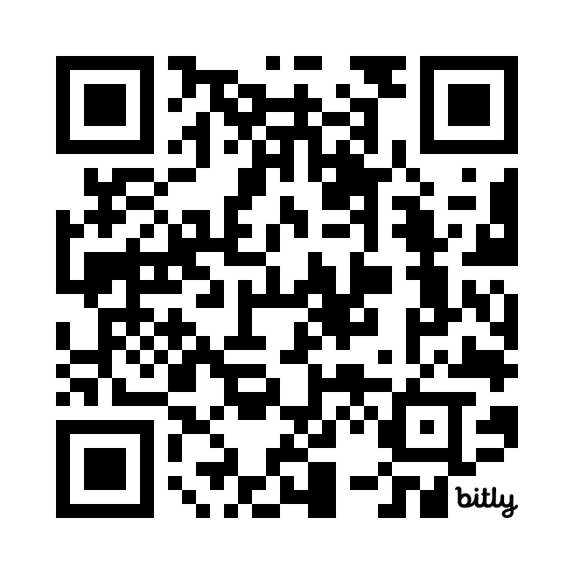
Make It Personal
Use our Google Doc template to:
  Assign tasks to roles for your unique university
  Plan for roles you already have or need to have
We will work on our own plans until break time
After break we will have time for folks to share!
Digital Accessibility Team Planning Template
https://bit.ly/AHGDA2024

Slide 20
Break Time 2!
We will meet back in 10 minutes

Slide 21
Hour 3
Share Your Plan
Share It Out!
How To Make This Happen
Plan Implementation
Final Thoughts
Big Questions

Slide 22
Share It Out!
Share your top 3 roles (if you’d like):
You can share why you chose these roles
Feel free to share any hurdles, wishes, and any other thoughts about your choices.

Slide 23
Plan Implementation
Evidence of Need
  Compliance Data & Legal Risks
  Peer Institution Benchmarks
  Student Retention, Faculty Efficiency, Financial ROI
Strategic Benefits
  Boost Reputation
  Improve Student Experience

Slide 24
Plan Implementation (continued)
Success Stories
  Peer Institution Wins
  Cross-Functional Collaboration
Role Definition
  Key Functions & Impact
  Vision & Growth Potential
Pilot Program Proposal
  Start Small, Scale with Success
  Track Metrics & Accountability

Slide 25
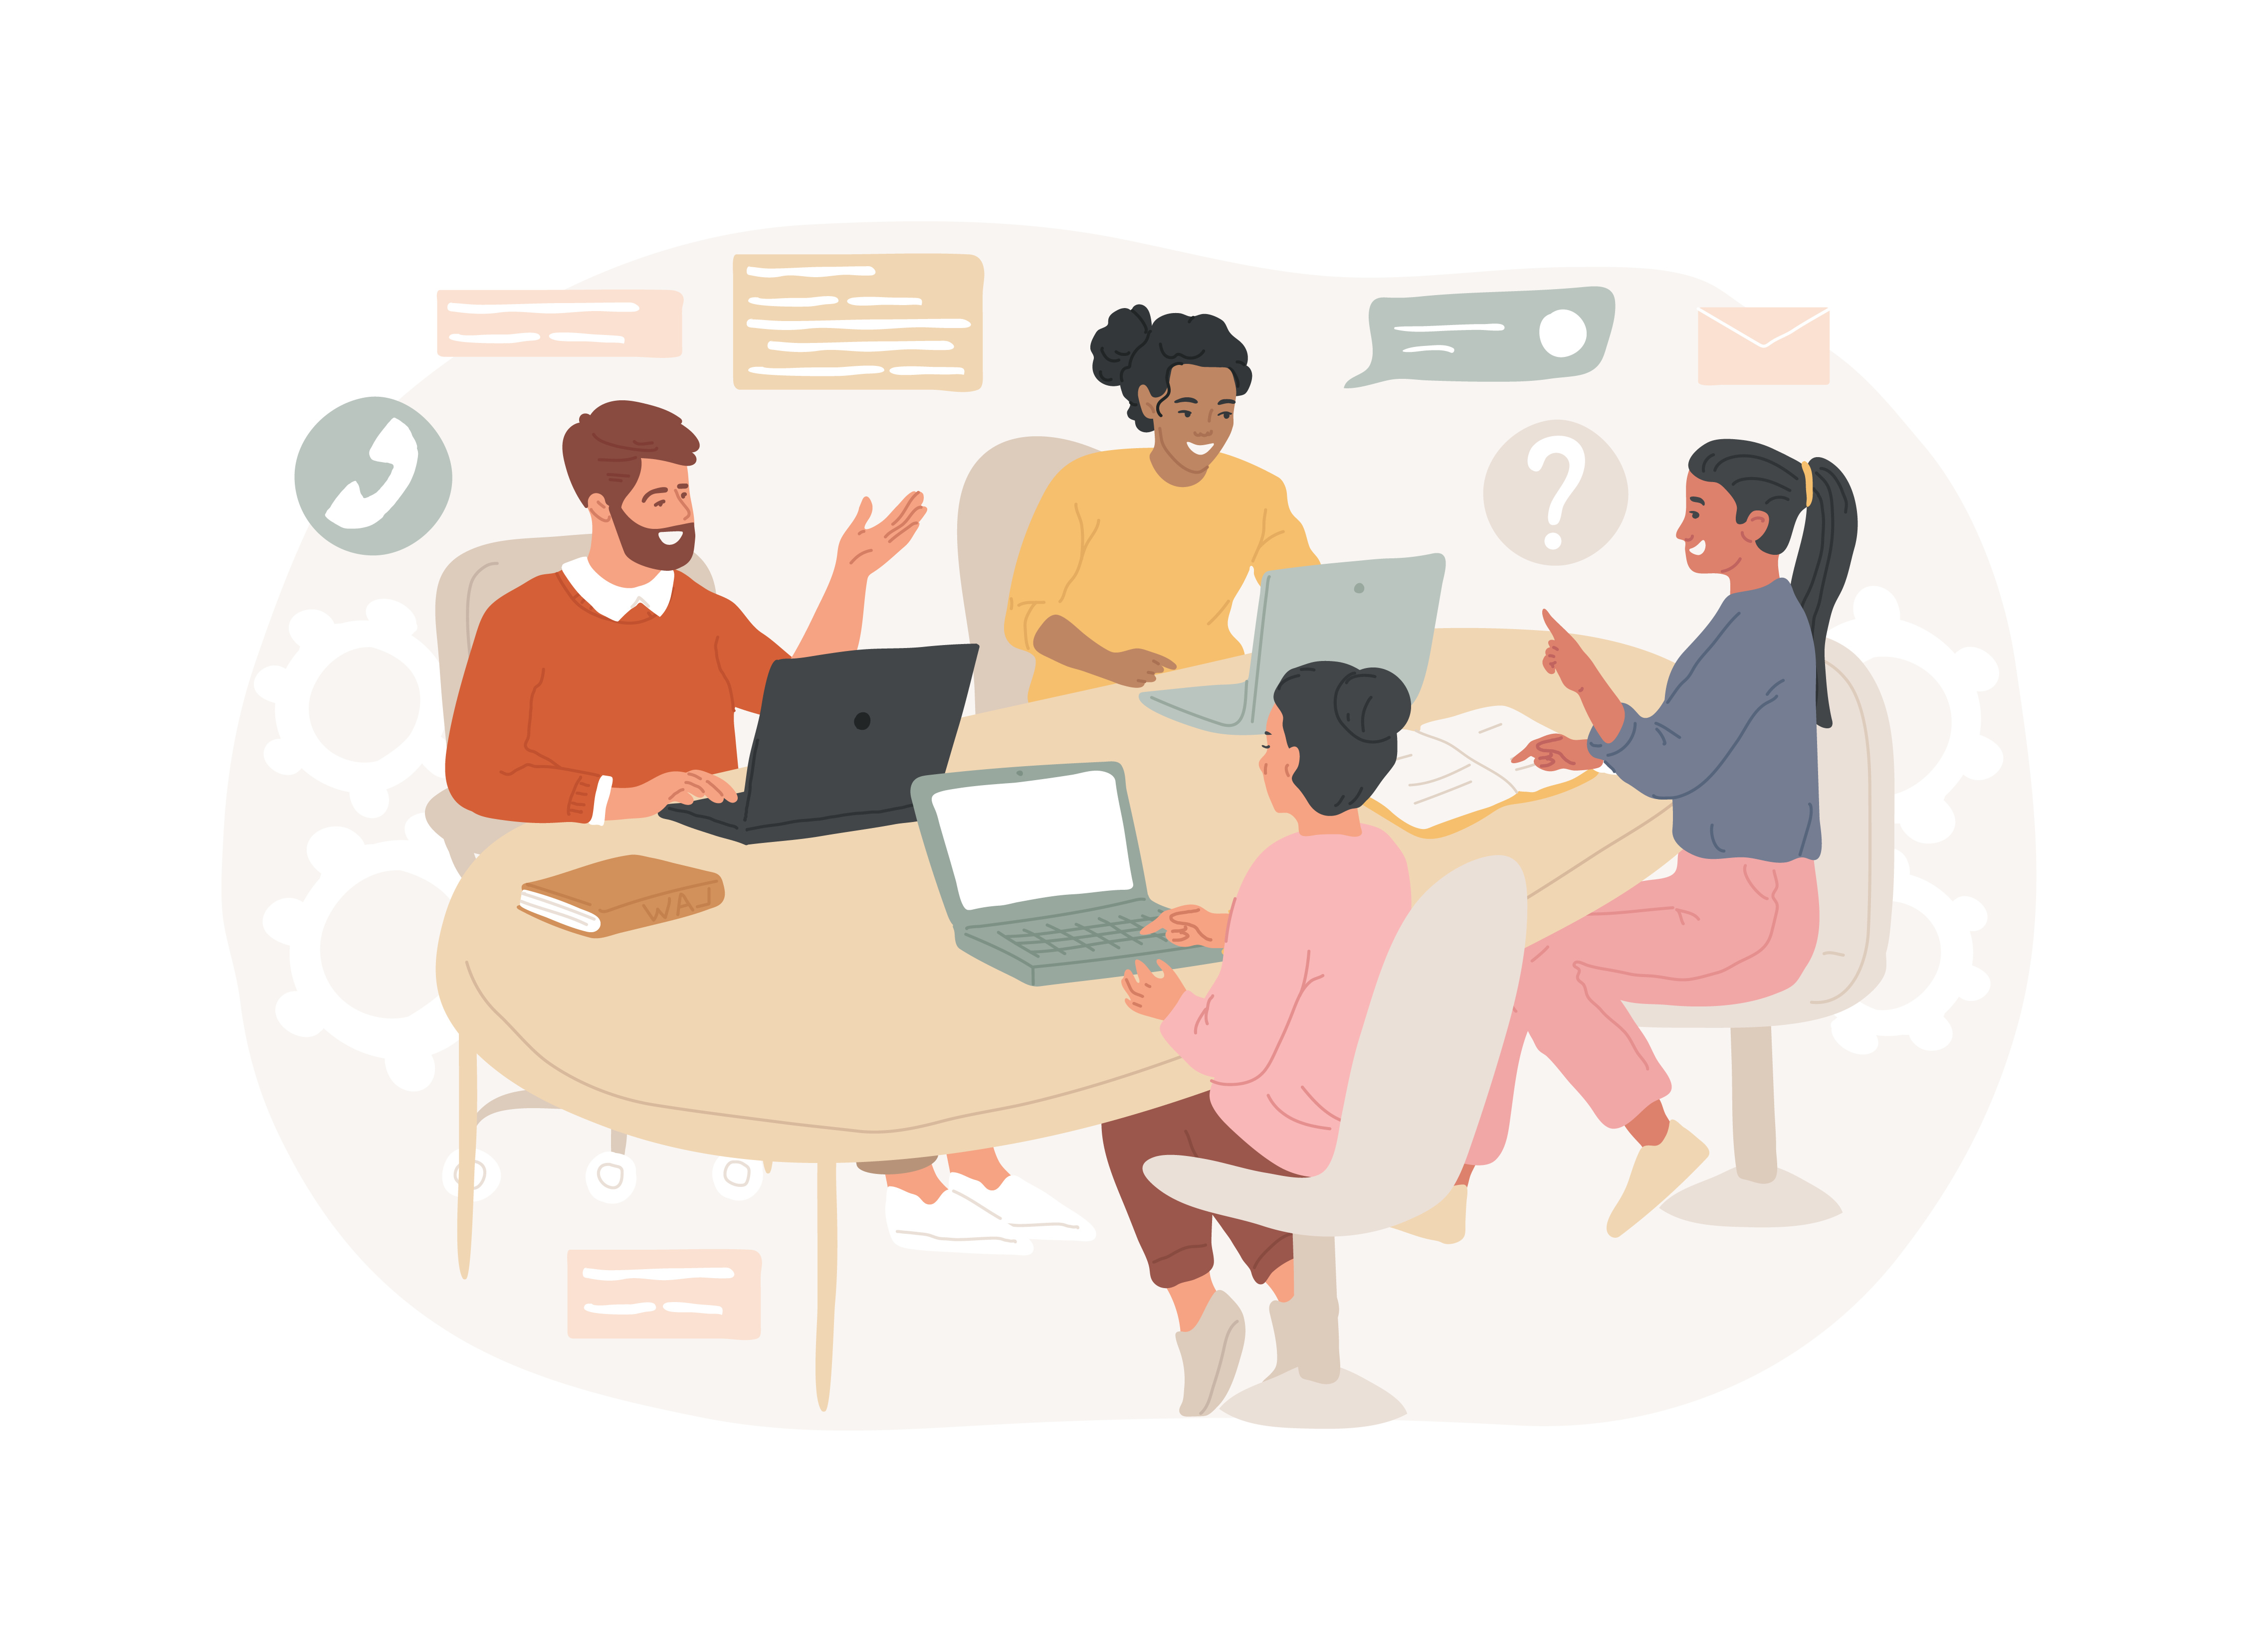
Final Thoughts

Slide 26
Big Questions
What questions came up for you?
Do you have a big question for the group?
What is something you’d like to get more clarity about?
Who is a key contact at your university would you like to connect with?
Is there someone outside your university you can reach out to for guidance?

Slide 27
Have questions for us?
Email us!
DigitalAccessibility@utsa.edu

