Slide 1
Promoting Accessibility Across the California Community Colleges with the Accessibility Capability Maturity Model
Dawn Okinaka Christine Fundell

Slide 2
Agenda
California Community College (CCC) accessibility environment
Accessibility Capability Maturity Model (ACMM) Overview
Creating buy-in for ACMM participation
ACMM Implementation in the CCC

Slide 3
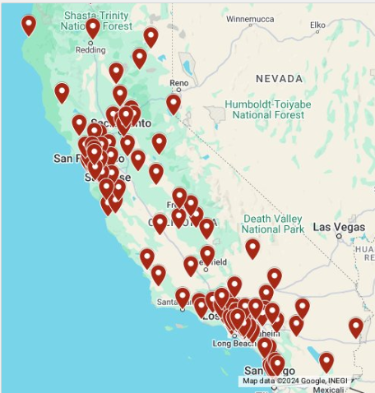
California Community Colleges Background
116 Colleges
73 Districts
1.9 million students
Diverse funding, geography, population
CCC Accessibility Center
Notes:
CCCCO structure

Slide 4
Disclosed Students Receiving Disability Services
Receiving Disability Services Nationally from 2-year Colleges
Receiving Disability Services in CCC
5%
20%
47%
57%
67%
5%
20%
47%
57%
67%
Notes:
https://www.bestcolleges.com/research/students-with-disabilities-higher-education-statistics/#:~:text=The%20same%20ED%20study%20as,accommodations%20after%20r
https://datamart.cccco.edu/services/dsps_status.aspxeporting%20their%20disability.
79,923 students spring 2024

Slide 5
Shifting the CCC Focus
Accommodation
Reactive
Cultural Shift
ACMM Implementation
Accessibility
Proactive
May be expensive
College-wide effort
Equitable, timely access
Individualized
Not customized
Training

Slide 6
Capability Maturity Model
Plan
Implement
Assess/ reassess
Process improvement
Building capacity
Notes:
D 5-8

Slide 7
CCC Accessibility Capability Maturity Model
Changes reactive to proactive accessibility
Allows flexibility to reach goals
Incorporates accessibility into processes
Reduces risk of complaint/settlement
Aligns with Title II Updates
Adds student responsibilities for content creation
Aligns with other systemwide efforts
Notes:
A tool that:
Assesses current effectiveness and capabilities of an organization
Supports identification of gaps between current capabilities and the next level of maturity
Supports plans for next steps to improve the organization’s performance over time
Uses status levels to capture the organization’s maturity for each milestone
Drive the college, district, and system toward accessibility
Respect individuality/uniqueness of each of the colleges
Align with Vision 2030’s objectives of equity in support, access, and success
Establish a plan that will proactively address Office of Civil Rights (OCR) settlement requirements in a manageable timeline based on campus resources
Reduce risk of a complaint and settlement

Slide 8
ACMM Goals and areas
Governance
Educational Materials and Technology
Web
Digital Content
Monitoring and Remediation
Design and Development
Content Contributors
Documents, Marketing, Video and Audio
Online, hybrid, flex, in-person classes
Student Services
Employee Services
Student clubs/organizations
Leadership, planning, documentation
ICT Procurement
Training
Culture
Equally Effective Alternate Access
Communications
Events
Onboarding
Organizational Integration and Alignment
Pre-Purchase
Evaluation
Procurement Processes
Role-based

Slide 9
Participation Strategy
Notes:
C 9-14

Slide 10
Opt-In Approach
Participation
Marketing
Systemwide presentations
College/District specific presentations
Meeting with Vice Chancellors/Vice Presidents
Logistics

Slide 11
Visit Commitments
College/District
CCC Accessibility Center
Travel and time
Train, generate assessment and report
Provide additional resources
Executive sponsor
Coordinate visit and meetings
Internal communication
Messaging to teams

Slide 12
Training for Decision-Makers
Focus on the “what and why” of accessibility
Identify opportunities to incorporate accessibility into existing processes
Align accessibility with existing college/district priorities
Align with other systemwide efforts, Section 508, & ADA Title II changes
Cultural shift for equity and success
Notes:
In-depth review of concepts related to goals and milestones
How to incorporate into existing processes
Targeted at decision-makers
Resources and examples

Slide 13
Assessment
Small groups based on goal
May have different attendees than training
ACMM team facilitates discussions and take notes
ACMM team reviews provided documentation
Collaborative, not punitive
Set starting point
Plan for progress
Do not review individual courses or content
Notes:
Concurrent sessions
This is about setting a starting point and a plan to improve. We are not expecting everything to have been done.
Governance, Planning, Onboarding, EEAAPs
Web
Educational Materials and Technology
Digital Content
Marketing, Communications, Events
ICT Procurement

Slide 14
ACMM Engagement
Commitment (onsite visit date confirmed)
2 weeks prior to onsite visit: Zoom Kickoff (90 minutes)
Onsite Training (4 hours)
Onsite Assessment (1.5-3 hours)
1 week post-visit: Zoom Open House (1 hour)
1 month post-visit:
Zoom meeting to review assessment (up to 1 hour)

Slide 15
Assessments, Not Audits
Audit
Assessment
Rigorous evaluation
Verify compliance to specific standards
Only identify gaps or areas where improvement is needed
More flexible approach
Analyze processes
Aims to identify potential areas of improvement
Identify successes
Notes:
D 15-21

Slide 16
Reporting progress
ACMM Report
Status levels mapped
Detailed baseline assessment worksheet
High-level recommendations
Data collected

Slide 17
Long-Term Commitments
CCC Accessibility Center
College/District
Provide guidance
Generate annual report
Additional online training
Iterative improvements
ACMM planning and implementation efforts
Provide evidence for annual report

Slide 18
Progress Over Perfection
Progress is an attainable annual goal
Allows learning from mistakes
Allows for flexibility when the unexpected happens
Focuses on what is working
Iterative improvements:
Easy wins
Training
High risk areas

Slide 19
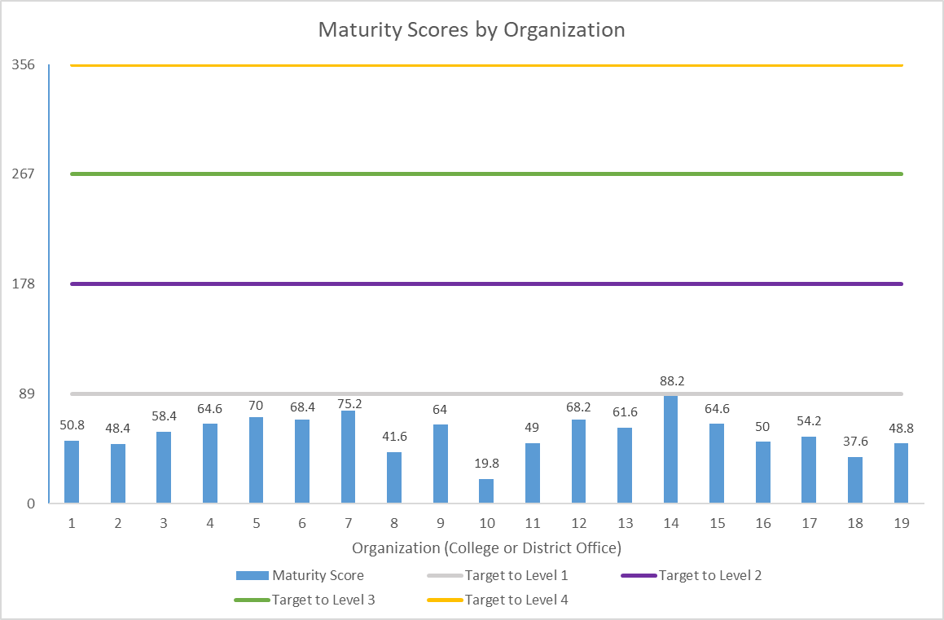
Visual of Baseline Maturity Scores Pilot

Slide 20
ACMM Participants

Slide 21
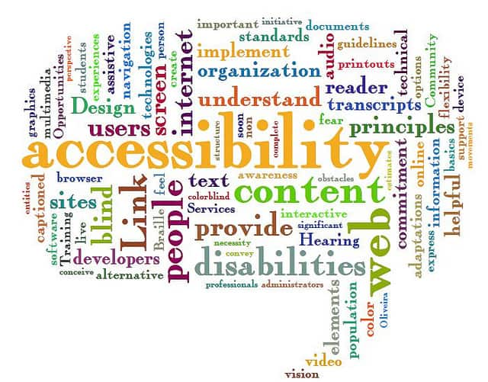
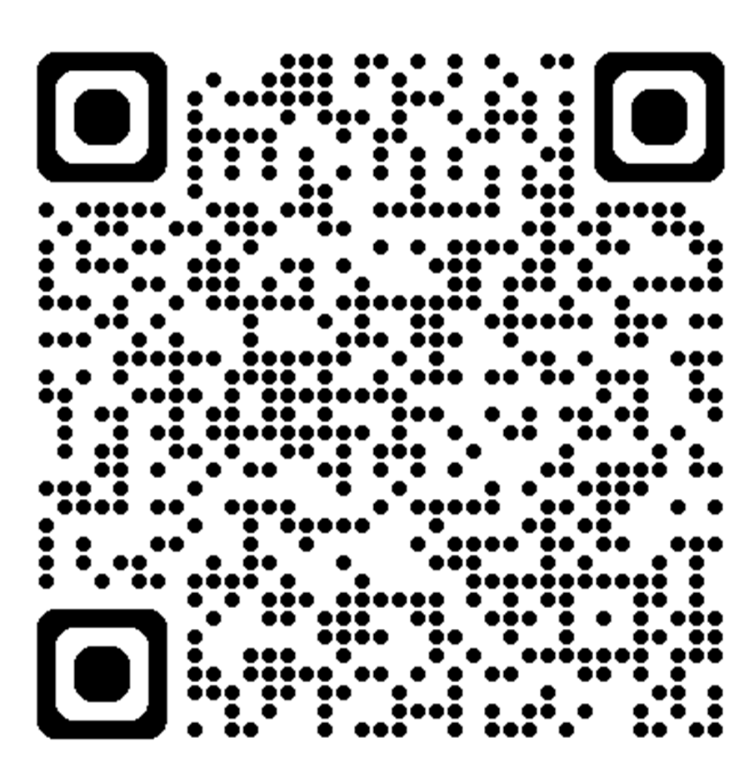
Questions?
accessibility@ccctechcenter.org
acmm@ccctechcenter.org
https://cccaccessibility.org/acmm

