Slide 1
I Have An EPUB … Now What?
Read It
Navigation
TOC
Landmarks
Bookmarks
Search
Formatting
Theme
Text Size
Line, Letter & Paragraph Spacing
Display
Features
Annotations
Highlighting
ReadAloud

Slide 2
Reading Systems
Adobe Digital Editions
Amazon Kindle
Thorium
VitalSource Bookshelf
Colibrio Reader
Redshelf
Apple iBooks

Slide 3
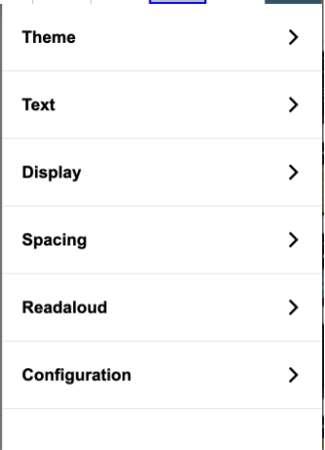
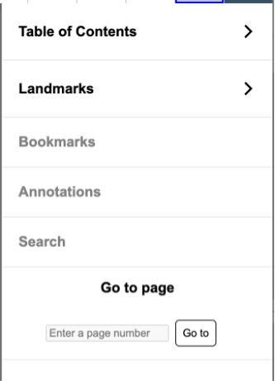
Thorium
Navigation
Formatting
Features
ReadAloud

Slide 4
I Have An EPUB … Now What?
Edit It
File Structure
container.xml
content.opf
content files (xhtml)
fonts, css, etc.
Tools
ACE by Daisy
Compress/
Explode
XML Editor
Remediate
Where & how the Magic Happens.

Slide 5
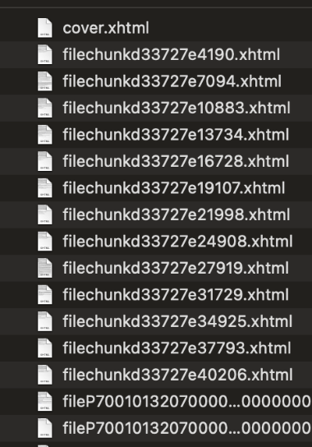
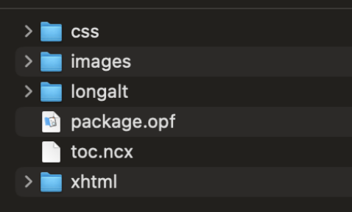
Digging in

Slide 6
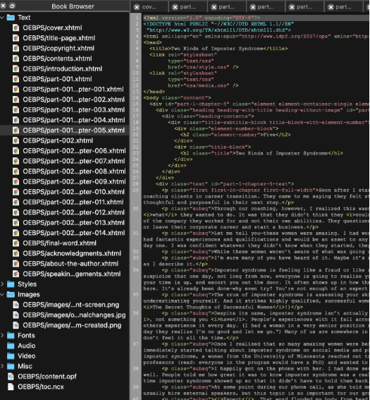
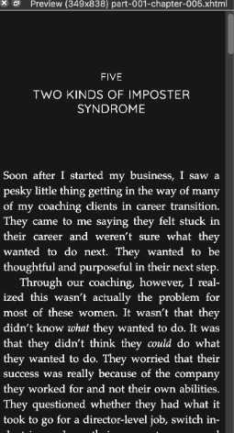
Explode and Go!
Search
Edit Content
Add Metadata
Add Alt Text

Slide 7
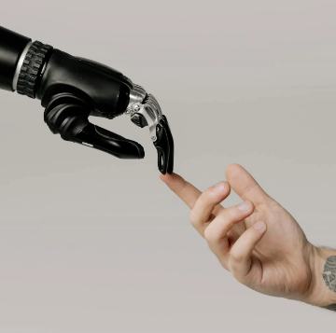
WHO/WHAT IS SMARTER?
AI OR HI?

Slide 8
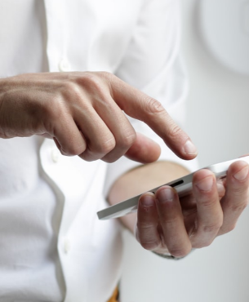
REMEDIATING INACCESSIBLE CONTENT
Remediation required
Writing alt text
Fix color contrast
Reorder headers
Table & Table Images
Math Images
Writing captioning for video
What else?
How to remediate
Creating Alt Text
Contrast tools
Tag tables
Create MathML
Video captioning
Digital Solutions
AI
WebAIM Contrast Checker
IDEA

Slide 9
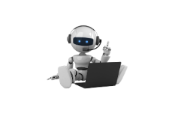
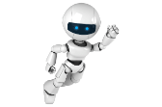
WHO, WHAT & HOW?
Human
Intelligence
Artificial Intelligence
Large Language Models
(LLMs)

Slide 10
Large Language Models
Turing-NLG by
Microsoft
Gemini, LaMDA by Google
Claude by Anthropic
Machine Translation
Text summarization
Question answering
Creative text generation
ChatGPT
3,3.5,4
by OpenAI
LLaMA 2
OPT
by Meta

Slide 11
Break Into Groups.
The
Challenge
You will be shown 4 images for
2 minutes each.
Measuring Your Alt Text Skills
Work with your team to craft the best text alternatives you can for each image.
Compare and contract with Human Intelligence and Artificial Intelligence.

Slide 12
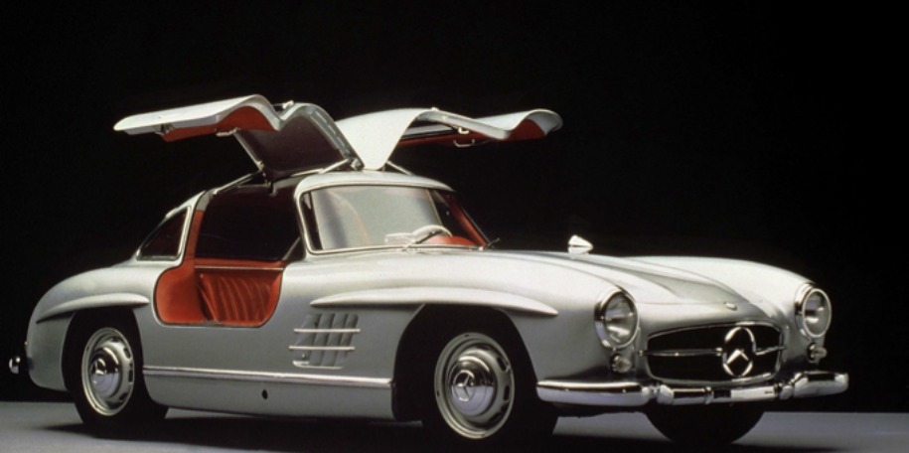
Example 1

Slide 13
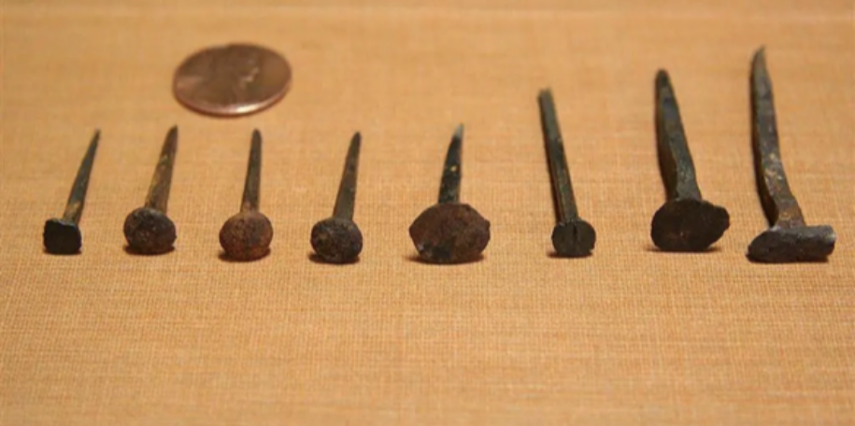
Example 2

Slide 14
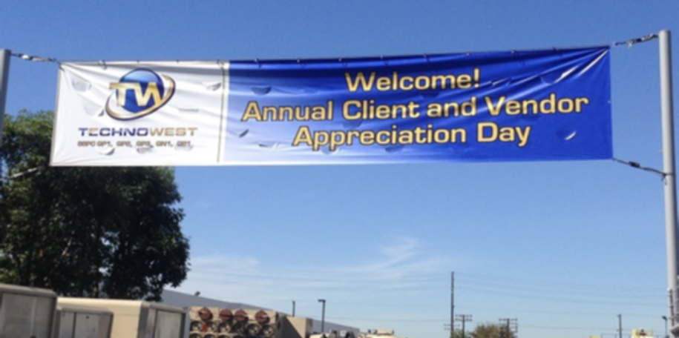
Example 3

Slide 15
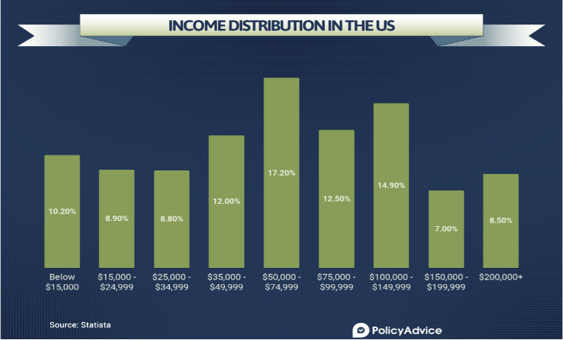
Example 4

Slide 16
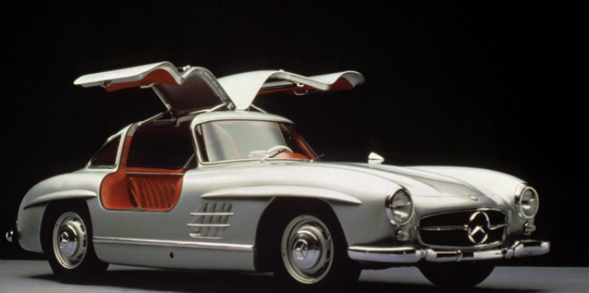
alt="Tire, Wheel, Mode of transport, Automotive design, Vehicle, Transport, Automotive exterior, Car, Fender, Classic car, " title="Tire, Wheel, Mode of transport, Automotive design, Vehicle, Transport, Automotive exterior, Car, Fender, Classic car, "
https://www.townandcountrymag.com/leisure/sporting/news/g2165/best-vintage-cars/
Example 1

Slide 17
alt=“Nails with penny”
https://www.harpgallery.com/blog/the-humble-nail-a-key-to-unlock-the-past/
Example 2

Slide 18
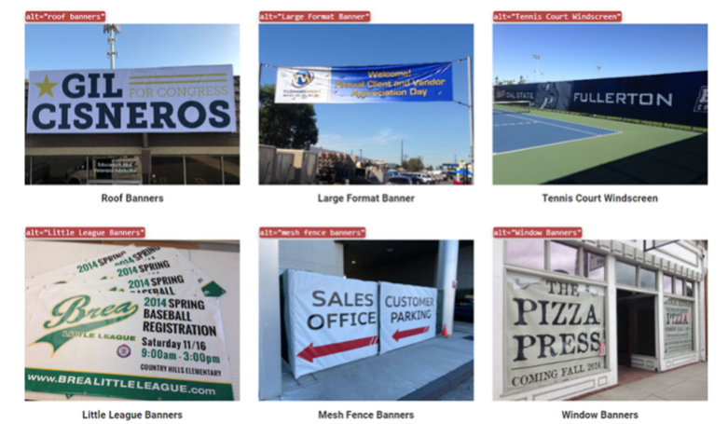
alt=“Large format Banner”
https://superiorsignsandgraphics.com/products_services/banners/
Example 3

Slide 19
alt=“Chart showing the income distribution in the US”
https://policyadvice.net/insurance/insights/average-american-income/
Example 4

Slide 20
IDEA
Content Ingestion
IDEA ingests various digital content formats, including ePubs.
Metrics Analysis
Provides basic metrics such as image and page counts.
Compliance Check
Reviews content for WCAG and other accessibility standards compliance.
Alt Text Generation
Automatically generates alt text for images, with manual editing options.

Slide 21
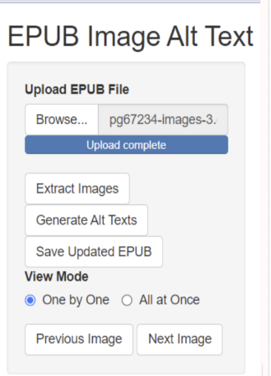
Uploading Digital Content
Select File
Choose the digital content file from your device.
Upload
Click the upload button to send the file to IDEA.
Process
IDEA analyzes and prepares the content for accessibility enhancement.

Slide 22
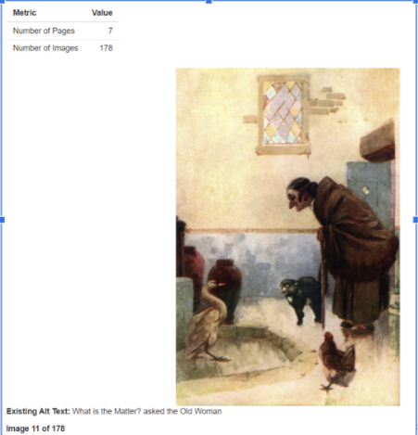
Image Extraction
Image Detection
IDEA scans the content to identify all the images.
Extraction
Images are extracted and prepared for alt text addition.
Generation
Alt text can be added manual or auto-generated.
Alt Text Bypass
Image
Status
Action Required
Image 1
Alt Text Present
None
Image 2
Alt Text Bypassed
Add Alt Text

Slide 23
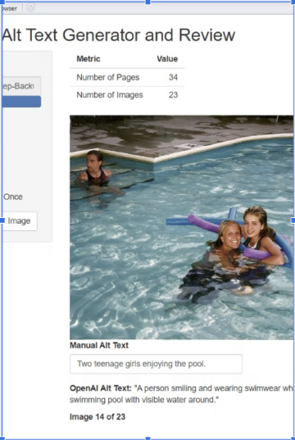
Automatic Alt Text Generation
AI Anaysis
IDEA's AI examines each image to understand its content.
Alt Text Generation
The AI creates a descriptive alt text based on image analysis.
User Review
Users can review and edit the auto-generated alt text if needed.
Saving Updated Digital Content
Review Changes
Users can review all accessibility enhancements made to the document.
Save Updates
IDEA saves the modified content with new alt text and accessibility features.
Download
Users can download the updated, more accessible version of their digital content.

Slide 24
BEWARE
COPYRIGHT!?!?!?
Can we trust it?
Is it the answer to our hopes and dreams?
Can we 100 percent say it’s producing exactly nuts on?
Will AI impact our own Human Intelligence?
It’s still a baby and we’re going to grow with it.

Slide 25
Prepared using
Funded by
os-beyond.com | hello@os-beyond.com

Slide 26
os-beyond.com | hello@os-beyond.com

