Slide 1
Applying Neurodivergent Perspectives to Accessibility Resources
Presenters: Julie Rummings, Rachel Gunderson, Josh Rumpff
Notes:
[Introductions]
Introduce the presentation. Define neurodivergent.

Slide 2
Neurodivergent (ND):
Those who self-ID or diagnosed with…
Attention Deficit and Hyperactivity Disorder (ADHD, ADD)
Autism Spectrum Disorder
Learning disabilities
Auditory Processing Disorder
Mental health diagnoses (e.g., anxiety, depression, OCD, etc.)
Notes:
RG Before teaching this section, here is a link to become familiar with what these are.
https://my.clevelandclinic.org/health/symptoms/23154-neurodivergent#:~:text=The%20term%20%E2%80%9Cneurodivergent%E2%80%9D%20describes%20people,learning%20disabilities%20and%20other%20conditions.

Slide 3
Theme: Including the human perspective

Slide 4
Faculty Interview Clip
Notes:
[Watc
Going with the theme of the presentation today - which is including the human perspective in the design of faculty resource on accessibility - we are going to show you this faculty interview video that Rachel created - giving advice on barrier free learning. Many of these instructors are neurodivergent themselves.

Slide 5
Talk to your neighbors
What is your reaction to this video?

Slide 6
Cornell University
Notes:
We want to start with some background information of where we are coming from. I always find this helpful when I attend a presentation - as each university is different - and knowing where the presenters are coming from puts their presentation in context. On the screen is a photograph of our campus, Cornell, in Ithaca, NY. Specifically it is a photo of the building that our teaching center is located. Ithaca is beautiful and green in the middle of central New York State.

Slide 7
Our University
16,071 undergraduates
2,950 faculty
8 undergraduate colleges/schools
Notes:
As of Fall 2023, we have 16,071 undergraduate students, 2950 faculty, and 8 separate undergraduate college

Slide 8
but we have waterfalls!
Notes:
But, we have beautiful waterfalls! About 150 of them in fact. That’s what we are known for in Ithaca. On the screen is a photograph of a Cornell student in from of Taughannock Falls.
Photo: Tompkins County Convention and Visitors Bureau

Slide 9
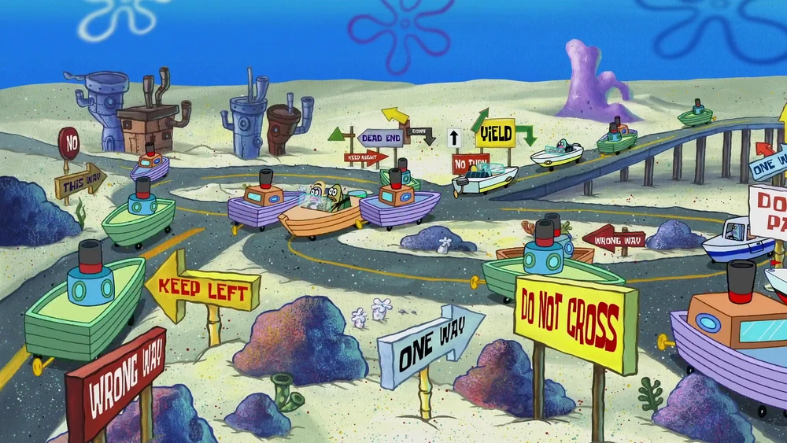
and the roads are complicated,
Notes:
Driving on the roads here in Ithaca is a bit chaotic - we are talking lots of winding, hilly roads, one-way bridges, potholes, and pedestrians everywhere. On the screen is an image of bikibottom’s roads in Spongebob with confusing contradictory signs everywhere, random winding roads, and hills. The hills are bad. We have lots of roads where you go up a steep incline and there is a stop sign at the very top, so you stop at the top of this hill at an angle praying that your breaks will make it through. My mother, who is from a different city a few hours away and isn’t that into nature, came to visit me and the only thing she remembers from the experience is how stressful the roads are. That’s unfortunate.
This is sort of a metaphor for finding resources on accessibility at our campus.

Slide 10
Our Center
2017 year founded
32 total staff, across about…
8 teams or programs
Notes:
We work at the Center for Teaching Innovation, founded in 2017, by combining several units into one. As of right now, we have a total 32 people across all our different teams and programming. Because we were founded by combining different groups together, we are fairly large and our teams focus on different things. We have English language classes for TAs, graduate student workshops, grant award programs for faculty teaching undergraduates using innovation teaching strategies and active learning. We have learning technology support - from Canvas to polling. We have a Innovation Tech Lab where we employ students to help support fun technologies like VR in the classroom. Some of our staff work with faculty on inclusive teaching, accessibility, privacy, etc.

Slide 11
Goals
Consider looking beyond WCAG when developing faculty resources.
Reflect on the evolution of a living faculty resource.
Discuss incorporating faculty and student perspectives.
Come away with a few strategies for removing barriers for neurodivergent learners.

Slide 12
Session Agenda
Where did we begin?
Evolution of an accessibility resource
What’s missing?
Inclusion of neurodivergent perspectives
60-minute session
What’s next for the resource?
Future topics

Slide 13
Session Agenda
Where did we begin?
Evolution of an accessibility resource
60-minute session

Slide 14
CTI Accessibility Guide
Notes:
[Show website - Introduce the resource, the structure]

Slide 15
What is the gap?
Increasing accommodations
No unified process
Lack of self-paced remediation resources

Slide 16
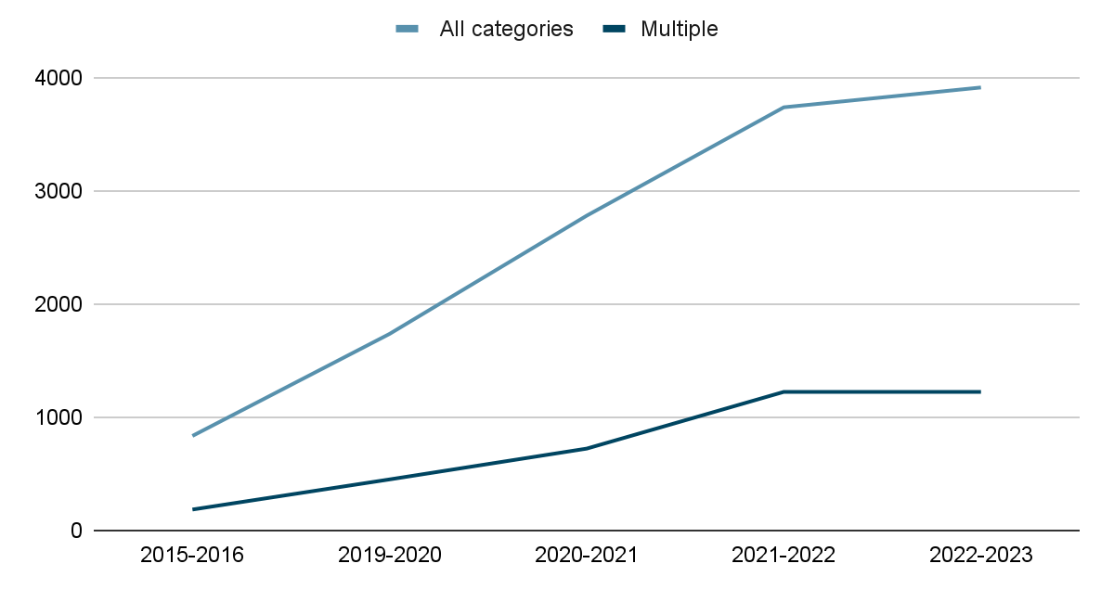
Students with Reported Disabilities
2015-2023
Notes:
As of 2022-2023, we had 3919 students with reported disabilities. On the screen is a line graph showing that the number of students with reported disabilities has increased significantly since 2015. This of course doesn’t included those who didn’t wish to disclose; so, the number of students who may actually need support is much higher.
This also means more accommodations, which has been a topic of discussion at our university and one of the reasons why, about 2 years ago, we set out to talk to our faculty more about accessibility and barrier free learning frameworks and strategies. While some parts of Cornell are doing great with making their courses accessible, others are a little behind. We realized there wasn’t many resources at our campus with information on actual remediation. There are snippets here and there on different topics at different department website, but no central resource.

Slide 17
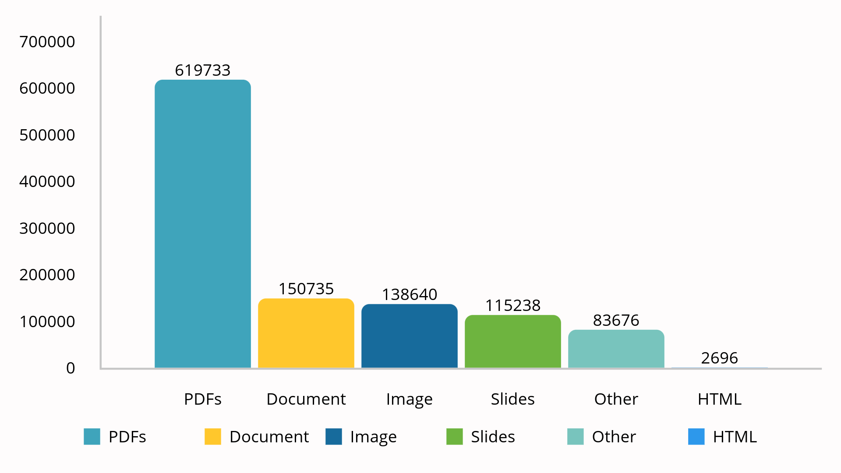
Types of Files in our LMS
2022-2023 (Ally data in Canvas)
Notes:
This is data taken from Ally in our LMS Canvas.
Note that we actually have multiple LMSs and instances of Canvas used on our campus, as we are very siloed and each college does its own thing. But, the instance of Canvas that our center runs is the most popular. [Read data from slide - important!] Note that Ally doesn’t distinguish between published and unpublished materials, and many of our faculty use Canvas as a storage area of old course content unfortunately. So, many of these are just old unpublished materials or duplicates of other files. Even with those notes, it is still clear that documents, images and slides are our most common content types. PDFs being the most common type of document, sadly. This information played into the topics we chose to focus on in our resource.

Slide 18
What was important to us
Light and welcoming design
Keeping it beginner-level, but more in-depth
Referencing WCAG guidelines and UDL
Adding faculty/student perspectives (but this didn’t happen right away)
Notes:
So, we wanted

Slide 19
Messy Spreadsheets
Notes:
So, we set out to create a website for information on remediation. For many months we were in that scary messy spreadsheet development phase. On the screen are screenshots of some of our multi-tab spreadsheets that we used to organize our process. Josh and I were the main developers of the website. Between Josh and I, one person would draft the page, the other would review, and then it would go to some of our other colleagues to review (other IDs), and then finally, to our center’s communication specialist to finalize the language.
During this process, we discussed the idea of having a page on the website that helped to create that human connection with those viewing it. So, we reached out to our fellow instructional designer, Rachel Gunderson, to assist us with creating that page. At the time it was called “Why Accessibility is Important” ? Rachel’s work with one of our associate directors would come into play a bit more as she will share in a couple of minutes.

Slide 20
Released in Phases
Phase 1
Fall 2022
Website launch
First three topics:
Documents
Slides
Canvas
Phase 2
Spring 2023
Feedback edits
More topics:
Video & Audio
Social Media
PDFs
Phase 3
Now
Add videos & quotes
New topics based on needs:
AI & Accessibility
In-Person Teaching
Notes:
We decided to release the resource in phases, with the idea that this would be a living resource that we update and evolve over time. Phase 1 was just launching the website itself and a few topics on the most common resources at our institution - documents, slides, and items created with the Canvas RCE. We would then add topics in Phase 2, apply changes based on feedback, and phase 3 would add even more topics and hopefully videos and faculty quotes. The videos we had in mind were actually like short content videos, not interviews. That came later. Now, the topics for phase 3 didn’t emerge until later - as we develop based on needs of the time. ]For example, AI was becoming a thing at that point - faculty were panicking - and we wanted to create a resource that showcased the many ways AI could actually assist in remediation efforts. So, that became a topic.

Slide 21
Initial Launch Date
Launch Phase 1
Fall 2022
Launch the website and three topics: Documents, Slides, Canvas
Notes:
The original plan was to launch phase 1 in Fall 2022, but things changed.

Slide 22
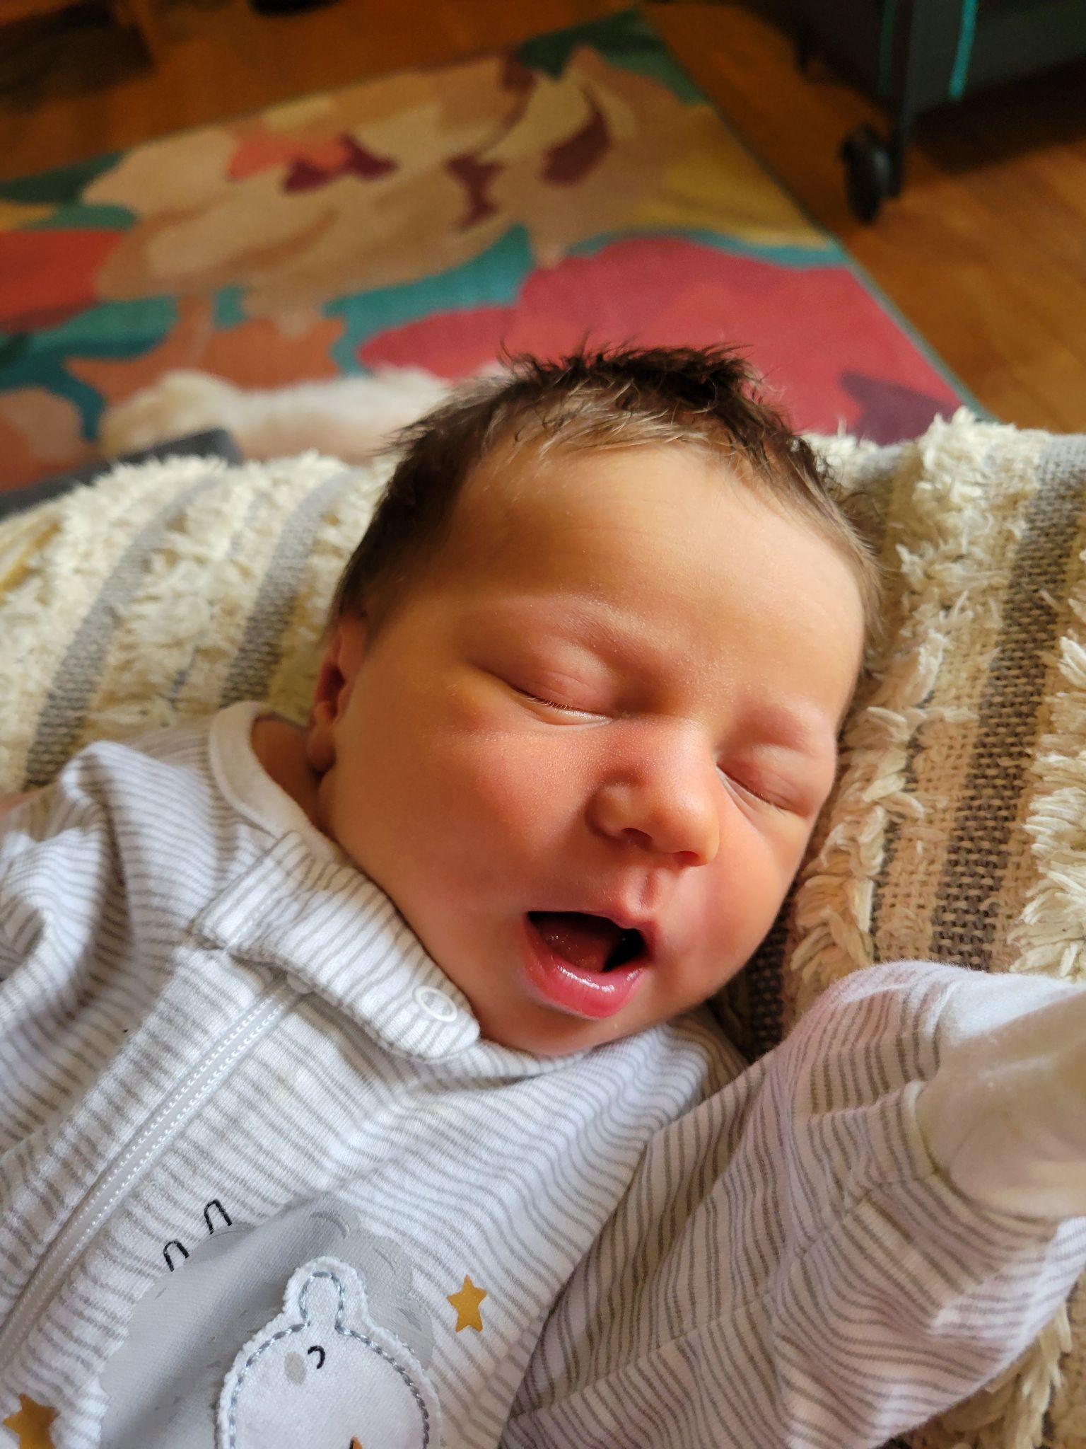
New Launch Date
Launch Phase 1
Fall 2022
Spring 2023
Launch the website and three topics: Documents, Slides, Canvas
Notes:
I had a baby. Yay. There is a photo of her on the screen. That meant I had to take some time off and the launch date changed to Spring 2023.
Adapting while creating the site became a consistent theme for us and would play out in a large way once we launched and had a second to step back and view what we had created in Phase 1.

Slide 23
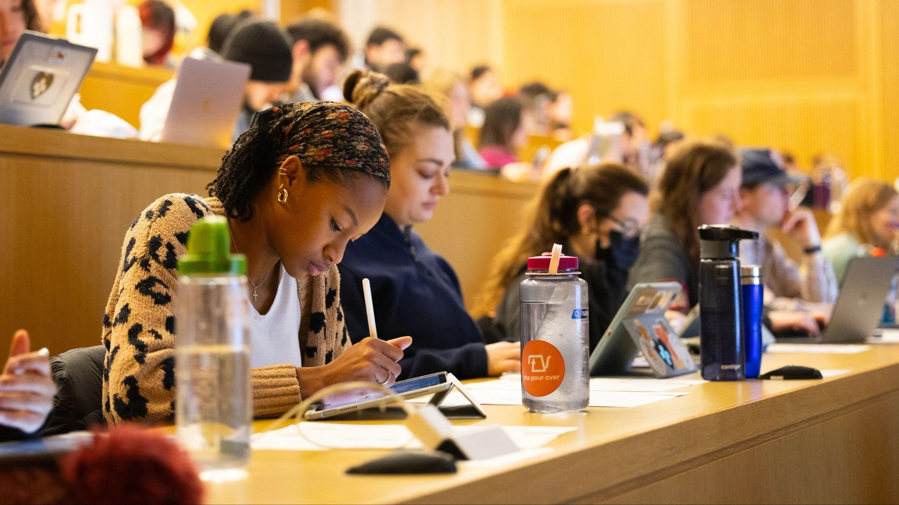
In-person teaching
Notes:
Also, it occurred to us that the majority of courses at Cornell are in fact in-person while using some digital resources in Canvas. We have online courses at Cirbekk, but there are far more in-person classes. This means the majority of the feedback we get from students through our various programming are actually related to the in-person learning experience. So, we definitely needed a resource on physical spaces and classrooms. That became a topic.

Slide 24
Session Agenda
What’s missing?
Inclusion of neurodivergent perspectives
60-minute session

Slide 25
Humanizing the Guide
Notes:
Discuss what will make instructors want to change their behavior when it comes to accessibility. Humanizing the guide

Slide 26
Increase in Neurodivergent Learners
Neurotype | 5 yr change
ADHD | 246%
Autism Spectrum Disorder | 224%

Slide 27
Neurodiversity @Cornell
Notes:
Neurodiversity at Cornell: Learning Strategies Center
SNAC: Student Neurodiversity Alliance at Cornell

Slide 28
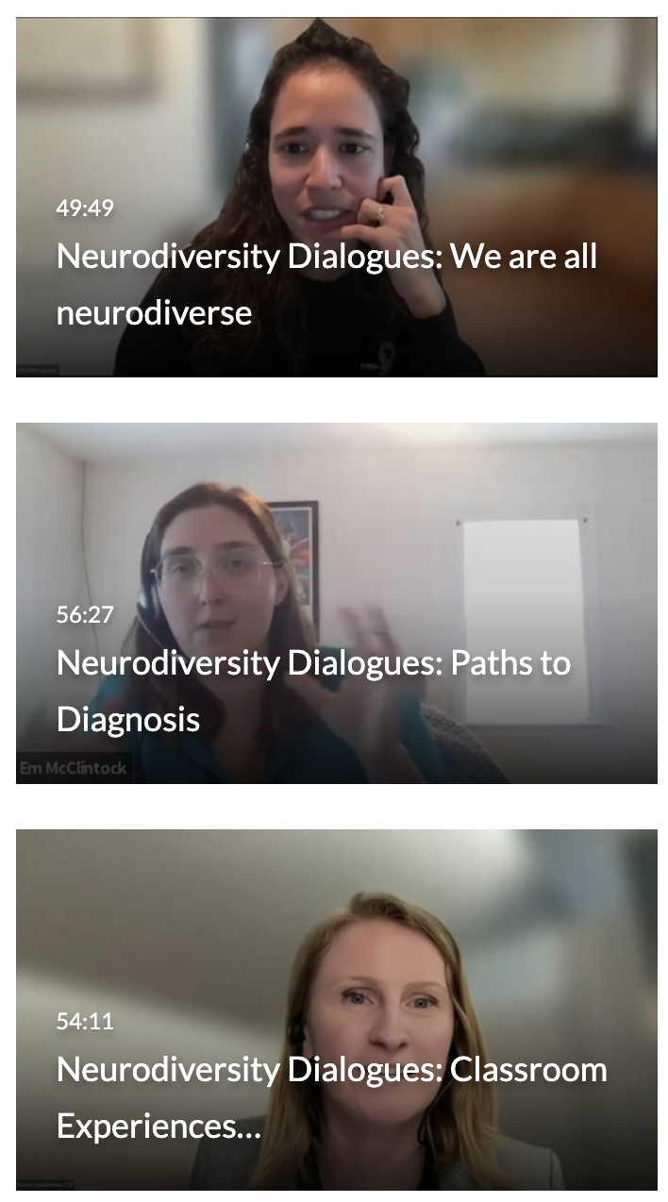
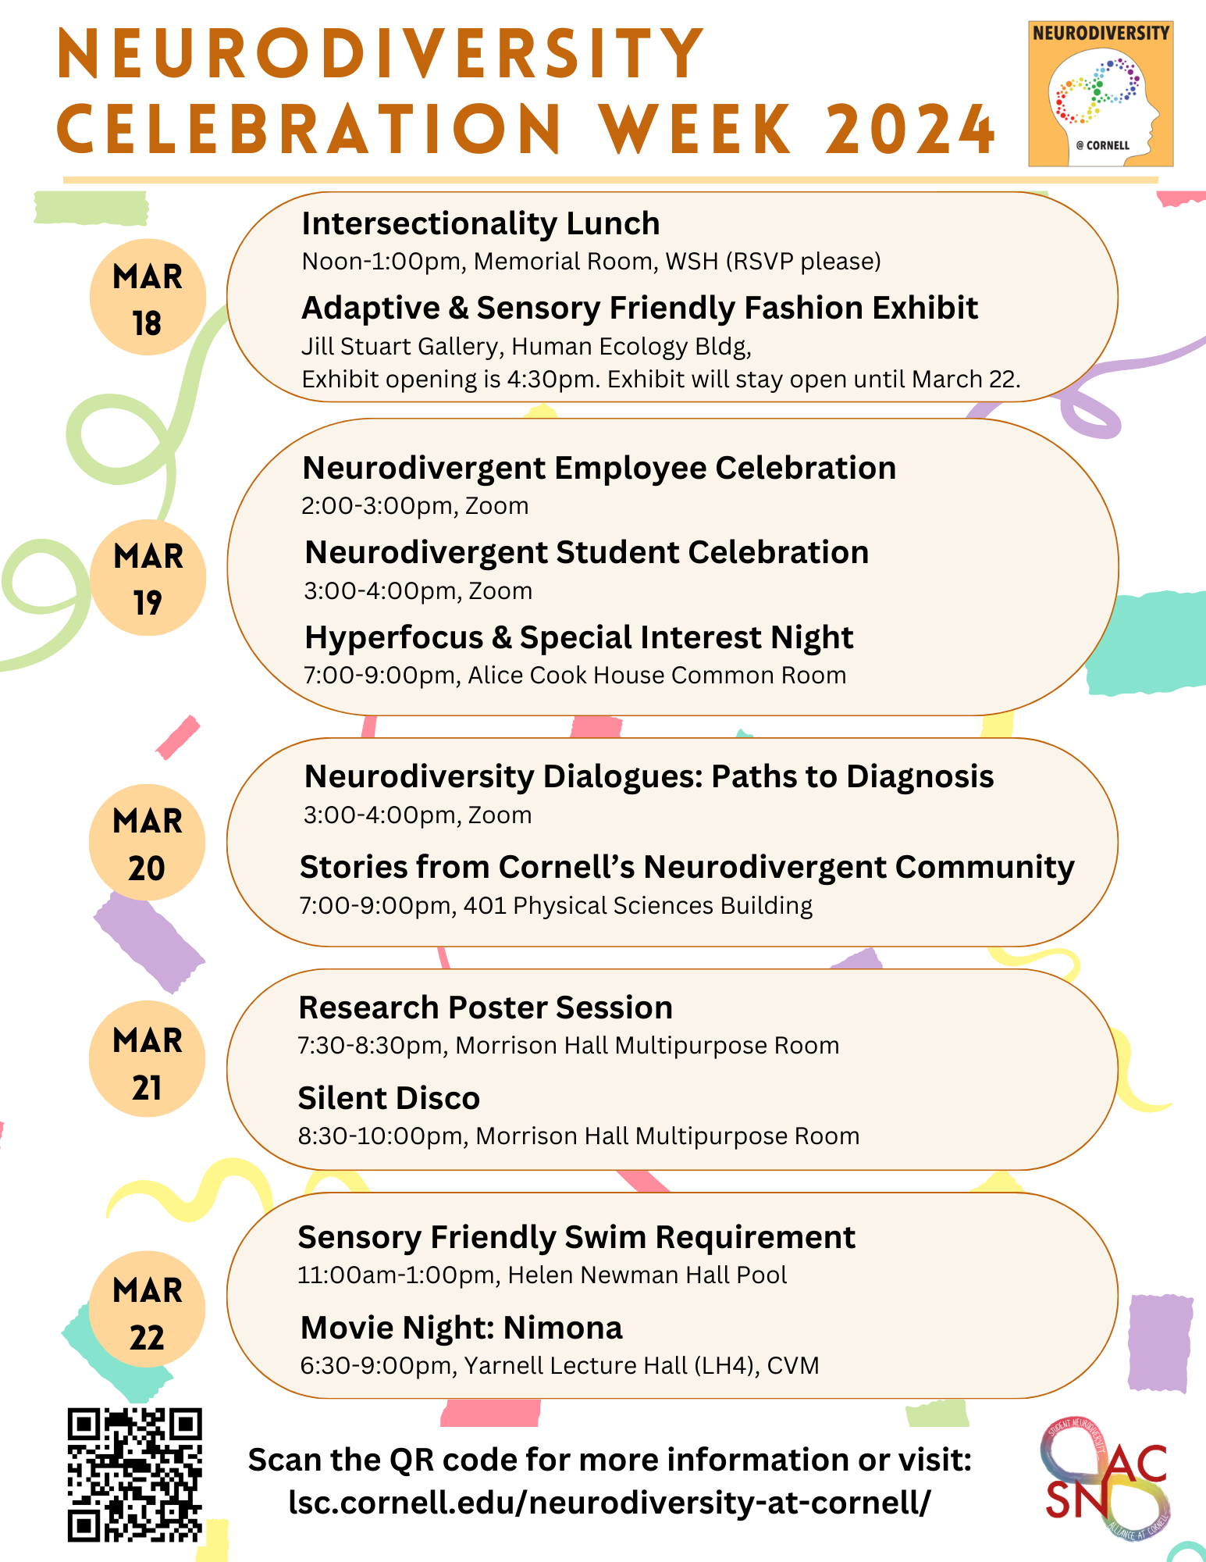
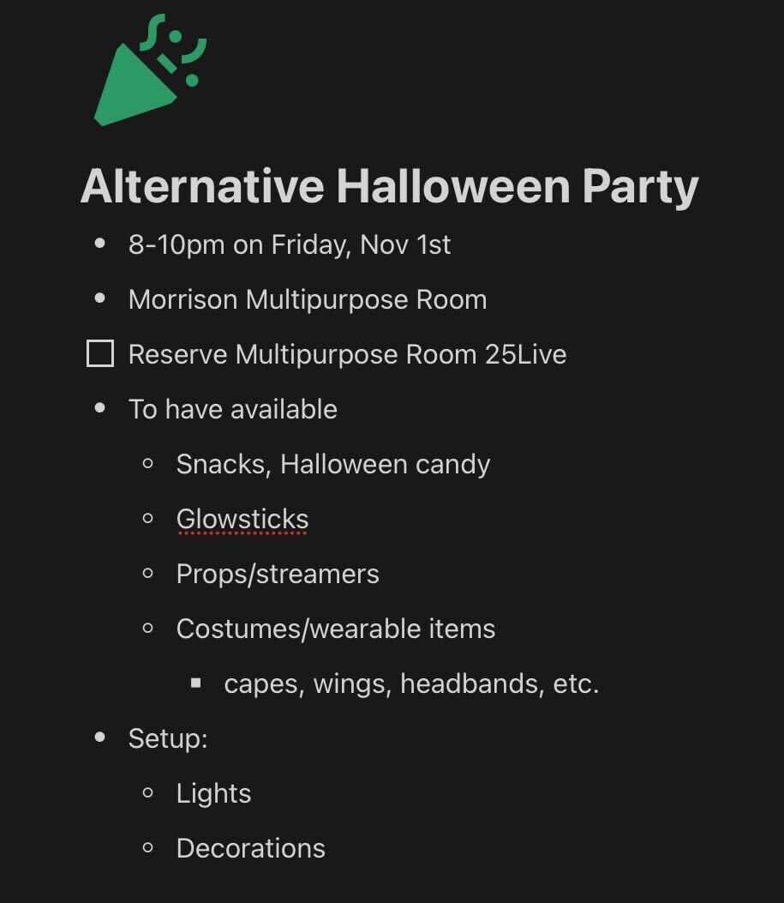
Events at Cornell
Dialogues
Celebration Week
Autism Social Group
Notes:
RG
[Remember to describe each image and mention during the presentation that we are not expecting people to read them.]

Slide 29
Sensory Room (Learning Strategies Center)
Notes:
RG

Slide 30
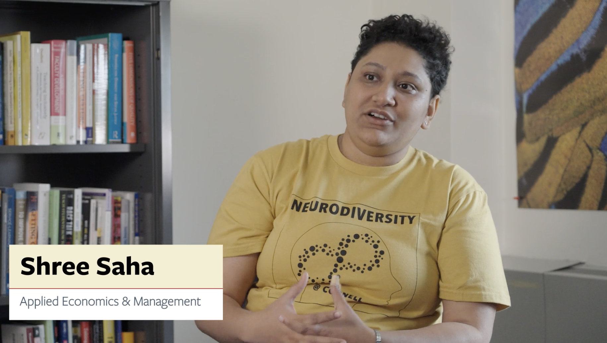
Video #1: Sensory barriers
Notes:
2:51

Slide 31
Strategies from Video #1
Barriers:
Large classes, lots of people talking
Sensory barriers: Loud, sudden noises, crowds, smells
Supportive behaviors:
Honor accommodations
Allow for individual needs (noise cancellation headphones)
Reflect and write: How could you incorporate these strategies into your resources?
Notes:
Shree and Becca 2:51

Slide 32
Video #2: Conveying information
Notes:
Video on “Conveying Information” 3:51

Slide 33
Strategies from Video #2
Barriers:
Instructors writing and talking on the board at the same time
Oral-only instructions
Supportive behaviors:
Access to captions
Written instructions with handouts
Reflect and write: How could you incorporate these strategies into your resources?

Slide 34
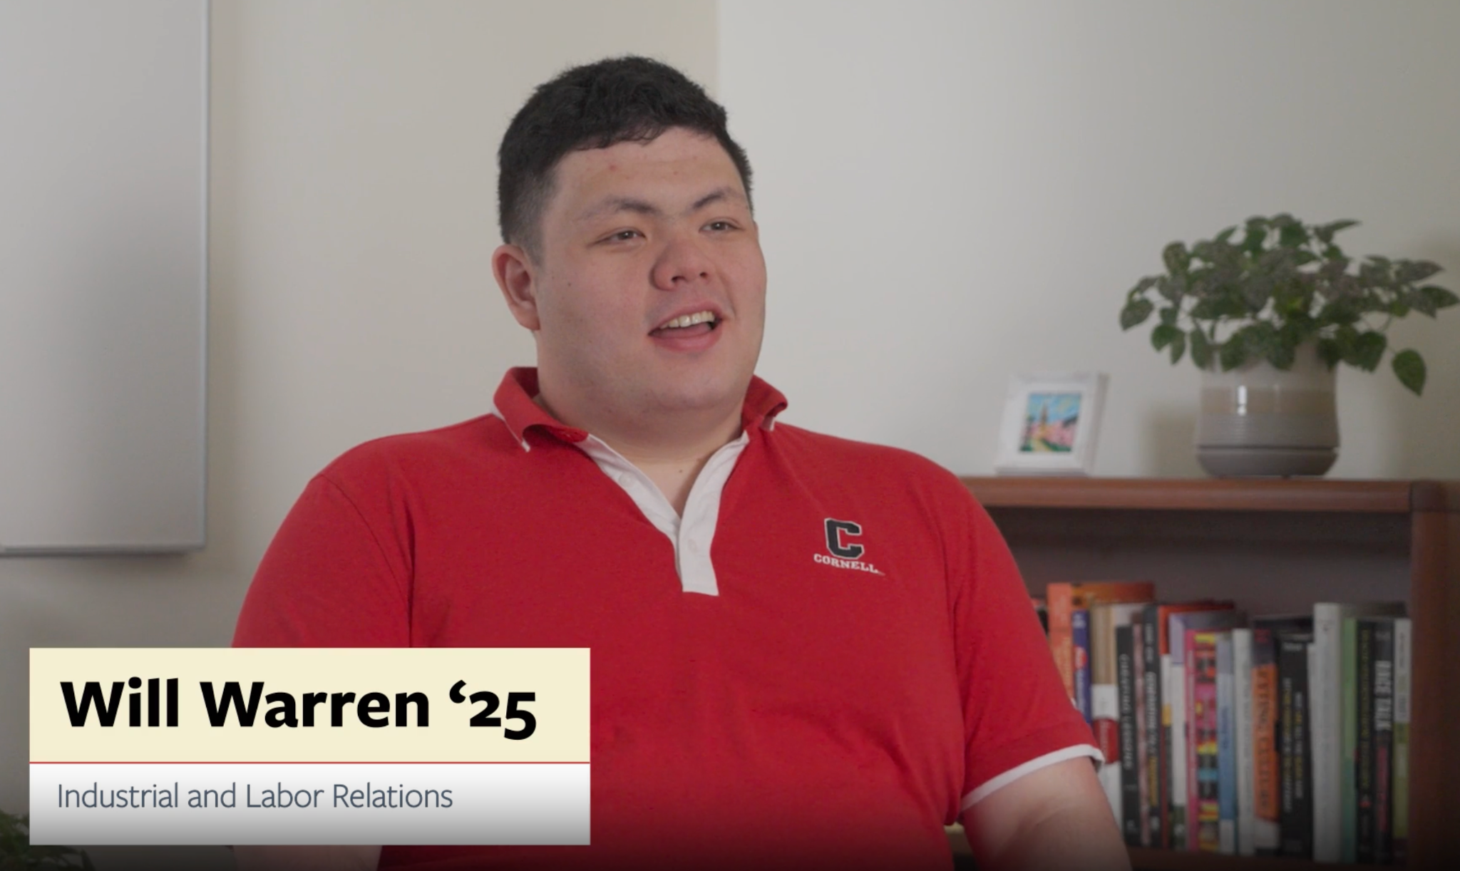
Video #3: Flexible assignments and policies
Notes:
Multiple forms of assessment 1:44

Slide 35
Strategies from Video #3
Barriers:
Learns more slowly
Life events come up
Supportive behaviors:
Flexible policies (due dates, extensions, class activities)
Mental health support
Reflect and write: How could you incorporate these strategies into your resources?

Slide 36
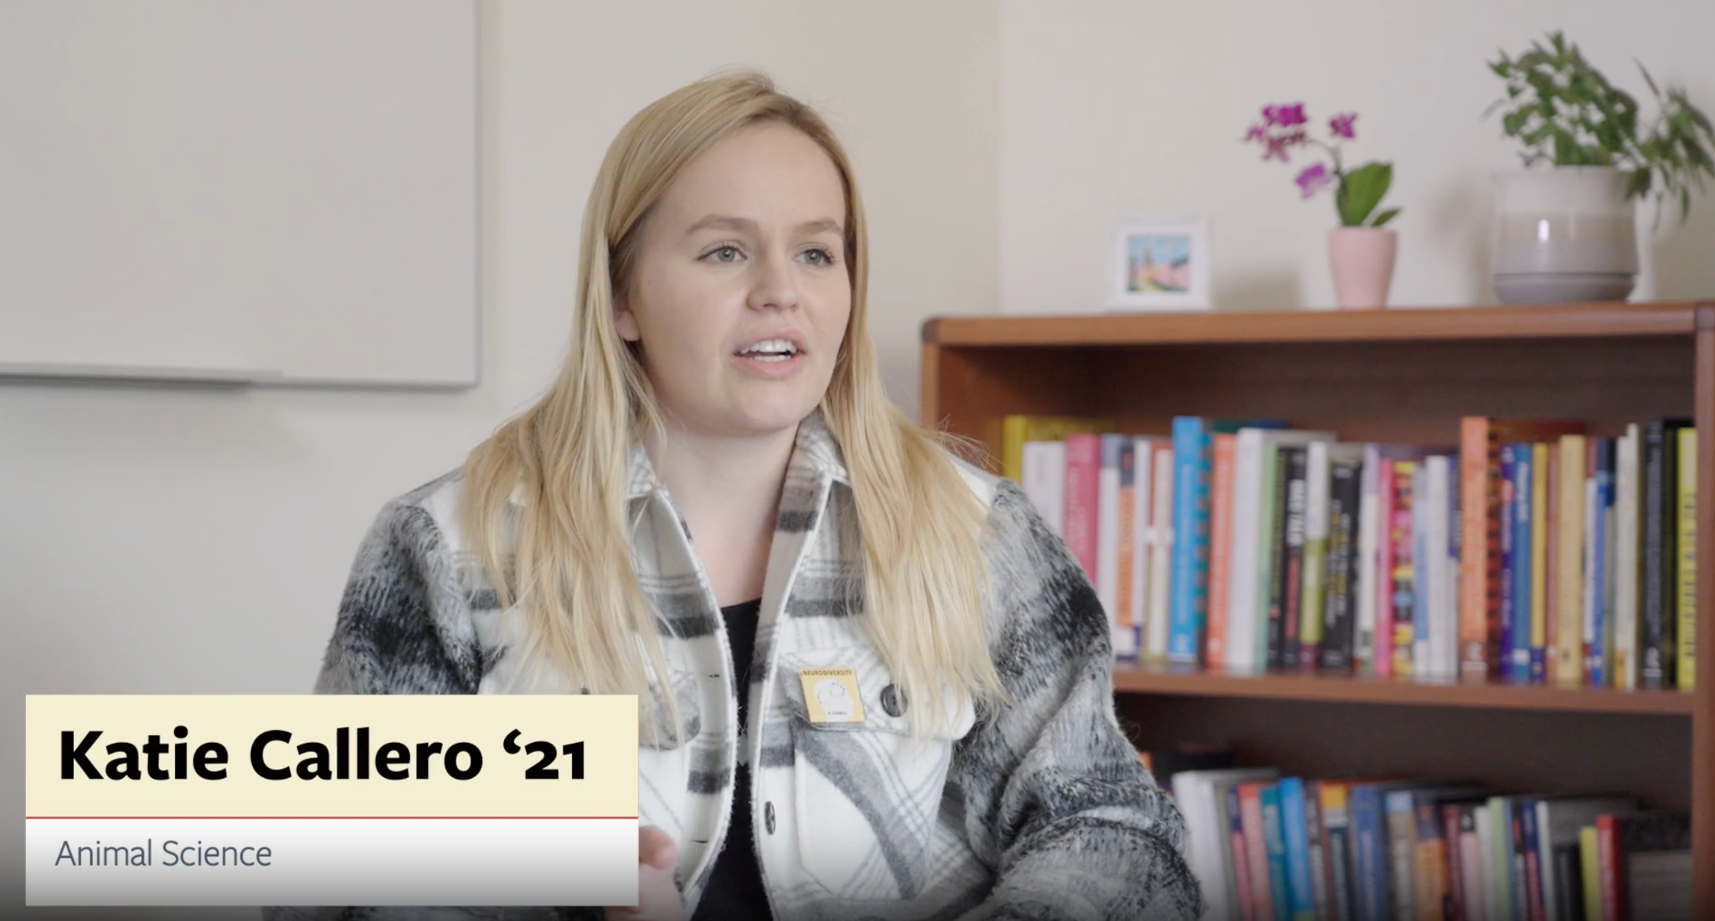
Video #4: Extra time on exams
Notes:
Extra time on exams 3:09

Slide 37
Strategies from Video #4
Barriers:
Stress, pressure, and performance issues due to timed exams
Difficulty focusing on the exam
Supportive behaviors:
Extra time on exams or removing the time requirement
Reflect and write: How could you incorporate these strategies into your resources?

Slide 38
Talk to your neighbor
Share your reflections and other things you have been doing at your institution.
Notes:
Share with your neighbor(s) some of your reflections from the videos, and what you have been doing at your institution.

Slide 39
Session Agenda
What’s next for the resource?
What we’ve learned and future topics
60-minute session

Slide 40
Takeaway: Add the human perspective
Look beyond guidelines
Add the human perspective
Notes:
[Julie will talk about the first; Rachel the second]
Rachel: Instructors are motivated by each other and their students. Student videos seemed like a good behavior opportunity for them to update their courses.
It's also important for the content creators like us to learn about the identities who will be impacted by our resource. The interviews with the ND learners were incredibly helpful in getting it right for the website.
Each person will be different and sometimes the guidelines alone won't cover a person's unique needs. People were taught in different ways and as a result have different needs that won't be necessarily addressed in the WCAG guidelines.

Slide 41
Takeaway: Look beyond Guidelines
Notes:
[Julie will talk about the first; Rachel the second]
Rachel: Instructors are motivated by each other and their students. Student videos seemed like a good behavior opportunity for them to update their courses.
It's also important for the content creators like us to learn about the identities who will be impacted by our resource. The interviews with the ND learners were incredibly helpful in getting it right for the website.
Each person will be different and sometimes the guidelines alone won't cover a person's unique needs. People were taught in different ways and as a result have different needs that won't be necessarily addressed in the WCAG guidelines.

Slide 42
What’s Next?
Apply feedback from one-on-one interviews
Including more student and faculty perspectives through videos and quotes
More inclusive strategies throughout the guide (that are not included in WCAG)
Notes:
RG Before teaching this section, here is a link to become familiar with what these are.
https://my.clevelandclinic.org/health/symptoms/23154-neurodivergent#:~:text=The%20term%20%E2%80%9Cneurodivergent%E2%80%9D%20describes%20people,learning%20disabilities%20and%20other%20conditions.

Slide 43
Thank you!
Rachel Gunderson
rtg54@cornell.edu
Julie Rummings
jar623@cornell.edu
Josh Rumpff
jnr53@cornell.edu
Notes:
Fix this slide

