Slide 1

Harnessing AI and DEI: Innovative Solutions for Overcoming Accessibility Challenges through Captioning

Slide 2
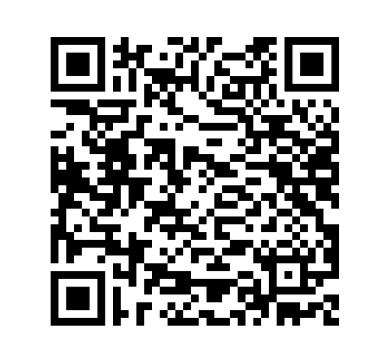
Session Transcript

Slide 3


Session Summary
Explore how Verbit partners with institutions like CSU Northridge to harness AI and tools to conquer accessibility challenges while integrating DEI principles.
This session delves into the transformative power of AI, cultural competence, and cutting-edge tools in addressing accessibility hurdles in educational settings. Gain insights from real-world case studies on navigating and overcoming these challenges to foster an inclusive digital environment for all.
Notes:
Note the changes to the mission.
Vision, additional options.
A world where spoken and written words are equally valuable
A world where all speech can seamlessly translate to meaningful actions
A world where every spoken word can be captured and used
A future where the path from verbal communication to action keeps getting is minimal
A future where the spoken word is not just heard, but truly understood and utilized to drive innovation, efficiency, and inclusivity in every aspect of life and work
A world where the spoken word and its contextual meaning can be understood by anyone, and its value can be implemented where it is needed
A world where the richness of spoken language, along with its contextual significance, is readily comprehended by all, and where its inherent value seamlessly translates into meaningful action wherever it's required

Slide 4

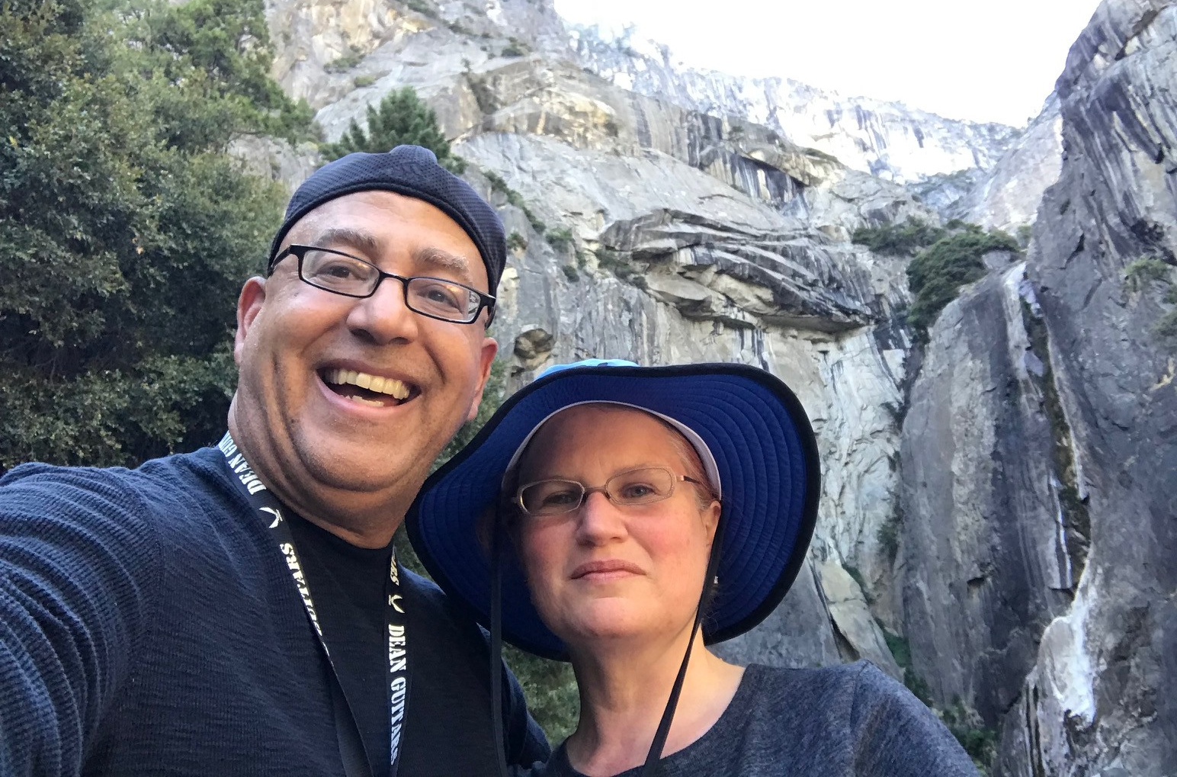
Introductions
Lindsay Cisar
M.A.
Kate Tipton
M.A.
Universal Design Center Program Manager
California State University, Northridge
She/Her/Hers
kathryn.sharron@csun.edu
Senior Account Manager
Verbit.ai
She/Her/Hers
Lindsay.tulloss@verbit.ai

Slide 5
DEI & Accessibility

Slide 6
Why accessibility is a vital part of DEI
Breaks down barriers
Goes beyond disability
Fosters inclusive spaces
.
.
Helps reduce learning barriers that prevent students with disabilities from participating meaningfully.
Accessibility initiatives like captioning support diverse learners, including ESL learners and students with multi-modal learning styles.
Cultivates environments where all students can feel a sense of belonging in the classroom and on campus.

Slide 7
Captioning and your DEIA Strategic Goals
Diversity
Equity
Inclusion
Students that Most Benefit from Captioning
  First generation students (64.8%)
  Pell-eligible students (65.4%)
  Adult learners (62%)
7.2% higher GPA
with captioning
65% of students in the OSU survey indicated captions help them focus.
27.2% noted captions aid with challenging vocabulary
80% of people who use captions are not deaf or hard of hearing
62.9% respondents said captions helped them retain information.
Students are more confident in engaging
80% are more likely to watch an entire video when captions are available
All cognitive learning styles can
be supported through caption
use.
Research: Linder, Katie, and Mary Ellen Dello Stritto. “A Rising Tide: How Closed Captions Can Benefit All Students”. Educause Review. https://er.educause.edu/articles/2017/8/a-rising-tide-how-closed-captions-can-benefit-all-students. 8/28/2017

Slide 8
AI and DEIA Case Study
Notes:
Note the changes to the mission.
Vision, additional options.
A world where spoken and written words are equally valuable
A world where all speech can seamlessly translate to meaningful actions
A world where every spoken word can be captured and used
A future where the path from verbal communication to action keeps getting is minimal
A future where the spoken word is not just heard, but truly understood and utilized to drive innovation, efficiency, and inclusivity in every aspect of life and work
A world where the spoken word and its contextual meaning can be understood by anyone, and its value can be implemented where it is needed
A world where the richness of spoken language, along with its contextual significance, is readily comprehended by all, and where its inherent value seamlessly translates into meaningful action wherever it's required

Slide 9
California State University - Northridge
Student Enrollment
36,848
Location
Los Angeles, CA
Student Accommodation Support
Disability Resources & Educational Services (DRES)
NCOD: Deaf and Hard of Hearing Services
Current AI Policy
Academic Integrity
Wider policy in development
Main Accessibility Hurdles
PDFs
Universal Design Center (UDC)
Dedicated accessibility team

Slide 10
Summary
Cultural and Language Equity in Accessibility
Cultural competency and diversity and inclusion are necessary for accessibility
Language equity is key to anti-racist pedagogy
Advocate for inclusion and expansion
Agreed upon language – no typing out the n-word or any similar words
Global and Cultural Variations in Language
There are many pidgins and creoles that use English words/lexicon, but do not work like English
There are many Englishes around the World
Accessibility should not require additional cultural taxation for Ethnic Studies faculty
Captioning, including audio captions, is hard work! We appreciate their work!

Slide 11
Let’s examine this study
Testifying while black: An experimental study of court reporter accuracy in transcription of African American English.
Jones, Taylor ; Kalbfeld, Jessica Rose ; Hancock, Ryan ; Clark, Robin. Language (Baltimore), 2019-06, Vol.95 (2), p.e216-e252.
40.5% of full utterances were inaccurately transcribed (18-77% accuracy)
31% inaccurately altered the who, what, when, where
Word Error Rate: 82.9% accuracy
Transcriptions are required to be certified at 95-98% accuracy
Source:
Testifying while black news article

Slide 12
Another valuable study
“Our contention so far is that Rachel Jeantel, like AAVE and other vernacular dialect speakers before her, was not properly heard (understood, responded to) in the courtroom that this fundamentally and negatively affected the believability of her testimony in the Zimmerman trial. But similar mishearings occur in other contexts, also with profoundly negative consequences for vernacular speakers” (p. 978). (emphasis mine)
LANGUAGE AND LINGUISTICS ON TRIAL: HEARING RACHEL JEANTEL (AND OTHER VERNACULAR SPEAKERS) IN THE COURTROOM AND BEYOND
Rickford, John R. ; King, Sharese
Language (Baltimore), 2016-12, Vol.92 (4), p.948-988
Rachel Jeantel was the key prosecutorial witness in the George Zimmerman trial

Slide 13
Race and Accent Bias
“But considerable research, much of it summarized in Lindemann & Subtirelu 2013, demonstrates that speech perception and evaluation are significantly influenced by listeners' attitudes, often by biases from factors like race, ethnicity, geography, and social status” (p. 976).
“In one study, students are played a four-minute speech sample recorded by a Ph.D. student, a native speaker of American English from Ohio. When the speaker is represented (through a picture) as Asian rather than Caucasian, he is rated as being much more accented and harder to comprehend, even though raters are evaluating the same native-speaker accent in each case” (p. 976). (emphasis mine).

Slide 14
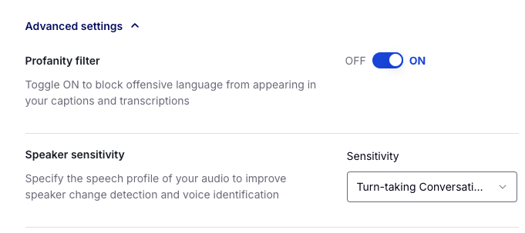
Working with your Captioning Provider to Mitigate Issues
Understand their AI Policy - Example: Verbit’s data policy
Discuss concern regarding your AI comfortability and/or course content
Share your campus community’s AI policy
Ask for specific training to better understand AI
Adjust settings to align with your needs.
AI providers want to hear from you!

Slide 15
Industry Leading
AI Tools
Notes:
Note the changes to the mission.
Vision, additional options.
A world where spoken and written words are equally valuable
A world where all speech can seamlessly translate to meaningful actions
A world where every spoken word can be captured and used
A future where the path from verbal communication to action keeps getting is minimal
A future where the spoken word is not just heard, but truly understood and utilized to drive innovation, efficiency, and inclusivity in every aspect of life and work
A world where the spoken word and its contextual meaning can be understood by anyone, and its value can be implemented where it is needed
A world where the richness of spoken language, along with its contextual significance, is readily comprehended by all, and where its inherent value seamlessly translates into meaningful action wherever it's required

Slide 16
Has your campus adopted Generative AI?
Not at all
Somewhat, but it is case by case
We are discussing AI frequently but have yet to set a campus wide policy
We have a campus wide policy, but are still working to integrate AI in the the classroom experience
We have a set AI policy and we seamless integrate AI tools into our Student’s learning

Slide 17
Gen AI – By the numbers
The study, sponsored by Turnitin, was conducted in September 2023 and included roughly 1,600 students and 1,000 faculty members across more than 600 institutions.
Reich, Justin. "Most Students Outrunning Faculty in AI Use." Inside Higher Ed, 31 Oct. 2023, https://www.insidehighered.com/news/tech-innovation/artificial-intelligence/2023/10/31/most-students-outrunning-faculty-ai-use.

Slide 18
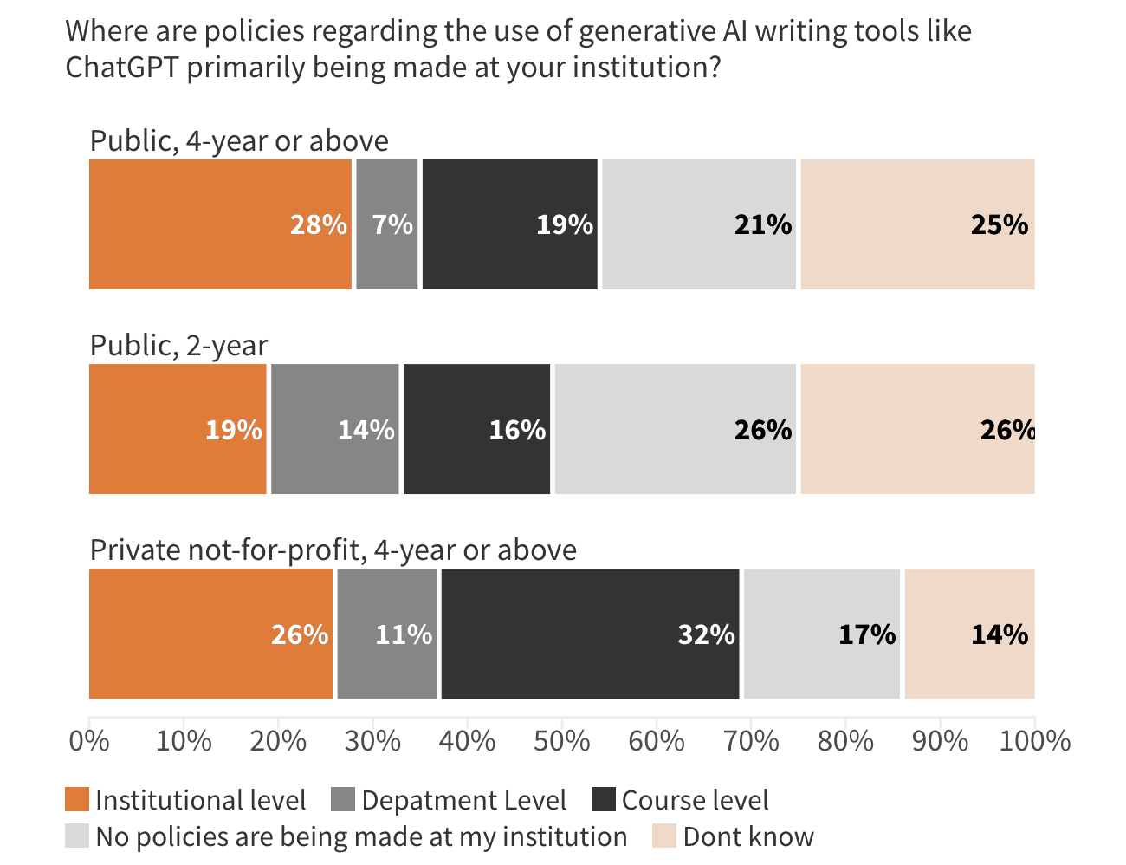
AI Policy-Making
Reich, Justin. "Most Students Outrunning Faculty in AI Use." Inside Higher Ed, 31 Oct. 2023, https://www.insidehighered.com/news/tech-innovation/artificial-intelligence/2023/10/31/most-students-outrunning-faculty-ai-use.

Slide 19

Generative AI and
Universal Design for Learning
UDL Guidelines propose that students are given chooses on how to engage with the course content
Generative AI tools can help as a brainstorming tool
Many students find AI a helpful learning tool
It is important to define the AI policy to the students via the syllabi, so all students are on the same page
“Many instructors are motivated to adopt more inclusive teaching approaches. However, they often find it challenging and time-consuming to identify, create and implement new resources and strategies.”
Onufer, Lindsay. "Teaching at Pitt Using New Methods." University of Pittsburgh, 22 July 2024, https://www.utimes.pitt.edu/news/teaching-pitt-using.
Notes:
Universal Design for Learning (UDL): a set of principles for curriculum development that aims to provide equal learning opportunities for all students, including those with disabilities.

Slide 20
Tips for using AI in the Classroom
Start Small: Integrate AI tools gradually, such as automating administrative tasks or providing personalized feedback. Also review the tools you already have and their new AI features
Focus on Engagement: Use AI to create interactive, adaptive learning experiences that keep students engaged. Work with your AI tool provider to learn more or to attend trainings
Promote Ethical Use: Discuss with students and your campus community the ethical aspects of AI, including privacy, data security, and bias.
Balance AI and Human Touch: Use AI as a supplement to teaching, not a replacement.
Continuous Learning: Stay updated on AI advancements by conencting with colleagues, attending webinars and conferences such as AHEAD!

Slide 21





Gen V features
Understand
is our Generative AI tool. It offers institutions incredible
AI-based insights to make their transcripts actionable.
Gen.V can be used to help students and faculty:
Generate
summaries
Create
quizzes
Segment chapters
Suggest
titles
Provide
keywords
Notes:
Gen.V is applicable to both post-production and live transcription. The prompts can be used for live transcripts in real-time once the transcript reaches 500 words.
Additional features:
Craft headlines: Automatically create headlines to give students bite-sized overviews of courses and videos
Produce keywords: Instantly receive a list of important keywords to easily navigate key themes and ideas from your transcript's content

Slide 22
What Gen AI tool has made a difference in your work or on your campus?

Slide 23
Cautions and Recommendations for using AI

Slide 24
AI Biases - 5 points to keep in mind
1
2
3
Algorithmic Bias
AI systems can perpetuate existing societal biases, affecting marginalized groups, especially in education.
Digital Divide
AI tools often widen the gap for students in underserved communities, particularly those with limited internet access.
Facial Recognition Errors
AI misidentifies people of color more frequently than white individuals, leading to discriminatory outcomes.
4
5
Inclusive AI Development
Encourage diversity in AI development teams to mitigate biases and build equitable tools.
Equitable Classroom Tech
Focus on developing AI solutions that promote fairness, particularly in education.

Slide 25

Disadvantages of using free tools
Inaccurate captions | Inability to learn | Limited integration options | Lack of customization options
Complex, educational topics aren’t suited for free tools, which have trouble understanding accents, speech patterns and specialized terminology. | Free tools typically aren’t complex enough to pick up on speech patterns, accents and other nuances that improve captioning quality over time. | Transcriptions should give you time back – not add extra steps to your workflow. Tools that have built in integrations with platforms such as Kaltura, Panopto and YouTube will save you valuable time. | Many organizations and institutions require specialized formats, caption placements and timing for their video content. Free tools rarely offer these capabilities.

Slide 26
Works Cited
Freeman, Andrew. "Does AI Have a Bias Problem?" National Education Association, https://www.nea.org/nea-today/all-news-articles/does-ai-have-bias-problem#:~:text=Because%20AI%20is%20based%20on,of%20color%2C%E2%80%9D%20Freeman%20says.
Stanford Law School. "How Will AI Impact Racial Disparities in Education?" Stanford Law School News Center, 29 June 2024, https://law.stanford.edu/2024/06/29/how-will-ai-impact-racial-disparities-in-education/.
"How to Prevent AI Bias in University Systems: Best Practices." University Business, https://universitybusiness.com/how-to-prevent-ai-bias-in-university-systems-best-practices/.
"Getting Started with AI in Education." MIT Sloan EdTech, https://mitsloanedtech.mit.edu/ai/teach/getting-started/.
"Embracing Artificial Intelligence in the Classroom." Harvard Graduate School of Education - Usable Knowledge, https://www.gse.harvard.edu/ideas/usable-knowledge/23/07/embracing-artificial-intelligence-classroom.

Slide 27
Thank you

