Slide 1
Fight Climate Change with Digital Accessibility
An introduction to Sustainable Web Design
Jennifer Strickland Senior Accessibility Human-Centered Engineer
2024 Accessing Higher Ground Conference Friday, November 15, 2024, 11:30 AM in Matchless
Approved for Public Release; The author's affiliation with The MITRE Corporation is provided for identification purposes only and is not intended to convey or imply MITRE's concurrence with, or support for, the positions, opinions or viewpoints expressed by the author. Distribution Unlimited. Public Release Case Number 24-3428. © 2024 The MITRE Corporation. All rights reserved.
Notes:
Alt text for background image: a polar bear on a small bit of ice, mirrored in still water on a grey-blue sky day

Slide 2
Who am I?
Hi! I’m Jen Strickland. Designer, Developer, Researcher, Strategist, Policy-wonk-in-training in D.C.
I serve the public interest at The MITRE Corporation as a Senior Accessibility Human-Centered Engineer supporting several U.S. federal agencies.
To support local government, I volunteer with U.S. Digital Response.
I’m a researcher, strategist, designer, and engineer, with a dedication to equitable outcomes for everyone.
I’m a Master’s in Public Administration student at Maxwell School of Citizenship & Public Affairs, Syracuse University.
In 2019 I became an Invited Expert with the Worldwide Web Consortium (W3C) Accessibility Guidelines Working Group. I chair the Equity Community Group and am active on other working groups. If you’re looking to participate with the W3C, please reach out and I’ll help connect you.

Slide 3
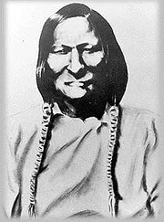
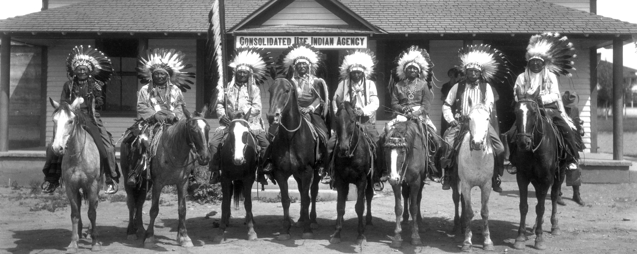
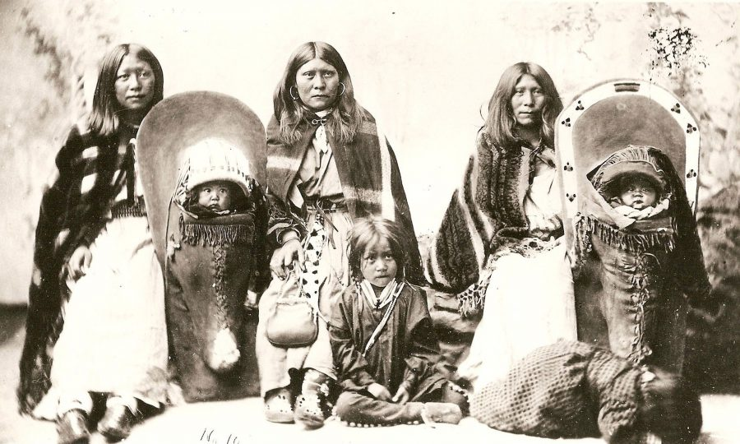
How can we be in good relationship with Indigenous peoples, with non-human beings, with the land and water?
We are on ancestral lands of the:
Arapaho.
Chief Black Coal, one of the most influential Arapaho chiefs, largely kept Arapaho at peace with the U.S. & out of the Great Sioux war of 1876.
Credit: John K. Hillers (Lifetime: Unknown) - Original publication: 1882, USA. Immediate source: Public domain.
Cheyenne.
Chief Black Kettle of the Southern Cheyenne, an advocate of peace among his people.
Source: Public domain.
Ute.
Southern Ute Indian Chiefs at the Consolidated Ute Indian Agency, 1922.
Source: https://www.southernute-nsn.gov/history/ and https://www.familysearch.org/en/wiki/Consolidated_Ute_Indian_Agency_(Colorado)
Notes:
Source: https://native-land.ca
We’re all in communities that owe their very existence to generations from around the world. Those people lent their hopes, dreams, energy, and pains to creating the history we come from. Some were brought against their will, some left homelands in hope of a better life, and some have been on this land for many generations.
We must acknowledge what has been buried. Without that context, we uphold systemic inequities that leave many in lives of suffering. Please take a moment to consider the many legacies of violence, displacement, migration, and settlement that bring us together. And please join us in uncovering such truths and use such truths to guide your work towards equitable outcomes.

Slide 4
Let’s talk about…
The environmental impact of digital services
Environmental justice + intersectionality
How to reduce climate impact with digital accessibility and sustainable web design

Slide 5
The environmental impact of digital services

Slide 6
Each year, the Internet emits
1.6 billion tons
of greenhouse gas emissions.
Moradi, David. (2022). What’s Next for Digital Accessibility, Forbes.com.
Notes:
Alt text for background image: smoke pouring from factory smokestacks against a dark, smoky sky

Slide 7
“If the Internet was a country, it would be the
7th largest polluter.”
— Sustainable Web Manifesto
Notes:
Alt text for background image: wild fire and smoke aerial view
Source: Sustainable Web Manifesto. https://www.sustainablewebmanifesto.com/

Slide 8
AI alone already uses as much energy and water as a small country and is expected to double in the next year.
Source: Calvert, Brian. March 28, 2024. AI already uses as much energy as a small country. It’s only the beginning. Vox. https://www.vox.com/climate/2024/3/28/24111721/climate-ai-tech-energy-demand-rising
Notes:
Source: Calvert, Brian. March 28, 2024. AI already uses as much energy as a small country. It’s only the beginning. Vox.
https://www.vox.com/climate/2024/3/28/24111721/ai-uses-a-lot-of-energy-experts-expect-it-to-double-in-just-a-few-years

Slide 9
“Green software” is a myth.
“The carbon footprint of our gadgets, the Internet, and the systems supporting them account for about 3.7% of global greenhouse emissions, according to some estimates.”
– The BBC
“Every line of code takes energy to execute, energy to write, and likely represents a combination of communications efforts to nail down.” – Sustainability from the Drupal team
It doesn’t have to be!
“Digital technologies now emit 4% of greenhouse gas emissions (GHG), and its energy consumption is increasing by 9% a year.”
– “Climate Crisis: The Unsustainable Use of Online Video” from The Shift Project
Notes:
In 2019 alone, more than 50 million tons of e-waste were produced, a number expected to rise by 8% each year.
The global IT sector electricity demand ranks behind only two countries in the world: China & the U.S.
Sources
https://www.drupal.org/about/sustainability
The communications industry represents 20% of all the world’s electricity.
By 2040, the tech sector is expected to consume 14% of the world’s energy per year.
Griffiths, Sarah. (2020). Why your internet habits are not as clean as you think. BBC.com. https://www.bbc.com/future/article/20200305-why-your-internet-habits-are-not-as-clean-as-you-think
“Climate Crisis: The Unsustainable Use of Online Video”: Our New Report on the Environmental Impact of ICT (Information and Communications Technology) https://theshiftproject.org/en/article/unsustainable-use-online-video/
ESCP Business School. (2021). Reduce your digital carbon footprint to shape a greener future. https://escp.eu/news/reduce-your-digital-carbon-footprint-shape-greener-future
Climate Impact Partners. (2021). The Carbon Footprint of the Internet. Climate Impact Partners. https://www.climateimpact.com/news-insights/insights/infographic-carbon-footprint-internet/
Median desktop page transfer size has increased by 677KB between 2015 and 2019. An increase of over 50%.
Source: HTTP Archive
We're sorry, this seems to be taking longer than usual. The test requires a full load of the page, so the bigger the webpage, the longer it takes.

Slide 10
Why are modern websites slower? [and thereby emitting more greenhouse gas, wearing out devices]
Mostly due to the heavy embedded JavaScript and/or CSS frameworks.
Sites are designed and built for the latest devices and fast bandwidth connections.
The Growth of Web Page Size
803kb
2012
1850kb
2014
2,200kb
2016
2,284kb
2022
Source: KeyCDN.com. (2022). The Growth of Web Page Size.
Notes:
Source
The Growth of Web Page Size, November 18, 2022, https://www.keycdn.com/support/the-growth-of-web-page-size
Also, speaking to the impact of web performance on accessibility, as the slower a site the harder it is for assistive technology to connect to it, if it can at all. https://marcysutton.com/accessibility-and-performance

Slide 11
Environmental justice + intersectionality

Slide 12
Environmental justice is…
the fair treatment and meaningful involvement of all people regardless of race, color, national origin, or income, with respect to the development, implementation, and enforcement of environmental laws, regulations, and policies.
Source: The U.S. Environmental Protection Agency
Notes:
Source: https://www.hhs.gov/civil-rights/for-individuals/special-topics/environmental-justice/index.html
Another example of environmental injustice in nearby Minnesota: Another example of environmental injustice https://prairieisland.org/who-we-are/our-history
What is Environmental Justice?
Environmental Justice is the fair treatment and meaningful involvement of people regardless of race, color, national origin, or income in the development, implementation, and enforcement of environmental laws, regulations, and policies.
Lack of meaningful access to programs and activities can impact health outcomes, especially in communities facing environmental injustice
Background
Executive Order 14008, entitled Tackling the Climate Crisis at Home and Abroad (2021), directs federal agencies to develop programs, policies, and activities to address the disproportionate health, environmental, economic, and climate impacts on disadvantaged communities. As part of President Joe Biden’s whole-of-government approach to confronting the climate crisis, HHS has released its Climate Adaptation and Resilience Plan to bolster resilience of its operations and assets from the accelerating impacts of climate change. Executive Order 14008 Tackling the Climate Crisis at Home and Abroad. January 27, 2021. The White House. https://www.whitehouse.gov/briefing-room/presidential-actions/2021/01/27/executive-order-on-tackling-the-climate-crisis-at-home-and-abroad/
HHS identified five priority actions that will be implemented through its mission, programs, operations, and management of procurement, real property, public lands and waters, and financial programs:
Expand existing climate change-related public health and biomedical research activities;
Improve HHS responses to the climate crisis;
Develop climate-resilient grant policies at HHS;
Workplace optimization and effective space management for climate resilience; and
Promote sustainable and climate resilient operations at HHS facilities.
This plan represents a concerted effort to enhance resilience and adaptation to climate change throughout the activities of HHS. Effective action to build resilience to climate change-related health, economic, and other threats is essential to fulfilling the HHS mission to enhance the health and well-being of all Americans. This list of five adaptation actions is the first step in HHS’s climate resilience efforts, with additional actions to be identified and initiated as the plan is implemented.
HHS is committed to protecting the health and well-being of all Americans by integrating environmental justice and equity into its work to build a safer, healthier future.
Read the full HHS plan - PDF and policy statement - PDF
Learn about the threats of climate change on human health. Explore by topic and region.
HHS has also established an Office of Climate Change and Health Equity that serves as a coordinating body to make this goal a reality.
Executive Order 12898, entitled Federal Actions to Address Environmental Justice in Minority and Low-Income Populations (1994), requires each Federal agency to make achieving environmental justice part of its mission.
The HHS Environmental Justice Strategy and Implementation Plan and annual reports can be found on the Environmental Justice at HHS web page.
OCR’s Involvement in Environmental Justice
Title VI can be used to help ensure that all people can effectively participate in and benefit from federally funded programs and activities. OCR’s Title VI enforcement program is allied with Executive Orders 14008, 12898, the HHS Climate Adaptation and Resilience Plan, and the HHS Environmental Justice Strategy and Implementation Plan.
HHS and Department of Justice Announce Agreement in Environmental Justice Investigation of Alabama Department of Public Health – May 4, 2023The Departments of Justice and Health and Human Services (HHS) announced a historic interim resolution agreement in their environmental justice investigation into the Alabama Department of Public Health and the Lowndes County Health Department (collectively ADPH) in Lowndes County, Alabama. In November 2021, Justice and HHS launched an investigation into whether ADPH’s conduct violates Title VI of the Civil Rights Act of 1964 (Title VI) and Section 1557 of the Affordable Care Act (Section 1557). The nearly 18-month investigation revealed areas of concern in ADPH’s operations and compliance with Title VI and Section 1557. Specifically, the investigation revealed that ADPH’s enforcement of sanitation laws threatened residents of Lowndes County with criminal penalties and even potential property loss for sanitation conditions they did not have the capacity to alleviate. The investigation also revealed that ADPH engaged in a consistent pattern of inaction and/or neglect concerning the health risks associated with raw sewage. The investigation revealed that despite ADPH’s awareness of the issues, and the disproportionate burden and impact placed on Black residents in Lowndes County, it failed to take meaningful actions to remedy these conditions. The interim resolution agreement puts ADPH on a path towards ensuring the development of equitable and safe wastewater disposal and management systems in Lowndes County.
Read the Interim Resolution Agreement - PDF
Read the Press Release
If you believe that you have been discriminated against under Title VI in programs or activities that HHS directly operates or to which HHS provides federal financial assistance, you may file a complaint with OCR. You may file a complaint for yourself or for someone else. Learn more about filing a complaint with OCR.
Learn more about your rights under Title VI - PDF
Visit the U.S. Department of Justice’s Environmental Justice Page
Visit the EPA Environmental Justice Page

Slide 13
The Seventeen Principles of Environmental Justice
Preamble: WE THE PEOPLE OF COLOR, gathered together at this multinational People of Color Environmental Leadership Summit, to begin to build a national and international movement of all peoples of color to fight the destruction and taking of our lands and communities, do hereby re-establish our spiritual interdependence to the sacredness of our Mother Earth; to respect and celebrate each of our cultures, languages, and beliefs about the natural world and our roles in healing ourselves; to insure environmental justice; to promote economic alternatives which would contribute to the development of environmentally safe livelihoods; and, to secure our political, economic, and cultural liberation that has been denied for over 500 years of colonization and oppression, resulting in the poisoning of our communities and land and the genocide of our peoples, do affirm and adopt these Principles of Environmental Justice.
Adopted October 27, 1991, in Washington, D.C.
Source: https://www.ewg.org/news-insights/news/17-principles-environmental-justice

Slide 14
The Seventeen Principles of Environmental Justice (EJ), detailed
Environmental justice affirms the sacredness of Mother Earth, ecological unity and the interdependence of all species, and the right to be free from ecological destruction.
EJ demands that public policy be based on mutual respect and justice for all peoples, free from any form of discrimination or bias.
EJ mandates the right to ethical, balanced and responsible uses of land and renewable resources in the interest of a sustainable planet for humans and other living things.
EJ calls for universal protection from nuclear testing, extraction, production, and disposal of toxic/hazardous wastes and poisons and nuclear testing that threaten the fundamental right to clean air, land, water, and food.
EJ affirms the fundamental right to political, economic, cultural, and environmental self-determination of all peoples.
EJ demands the cessation of the production of all toxins, hazardous wastes, and radioactive materials, and that all past and current producers be held strictly accountable to the people for detoxification and the containment at the point of production.
EJ demands the right to participate as equal partners at every level of decision-making including needs assessment, planning, implementation, enforcement and evaluation.
EJ affirms the right of all workers to a safe and healthy work environment, without being forced to choose between an unsafe livelihood and unemployment. It also affirms the right of those who work at home to be free from environmental hazards.
EJ protects the right of victims of environmental injustice to receive full compensation and reparations for damages as well as quality health care.
EJ considers governmental acts of environmental injustice a violation of international law, the Universal Declaration On Human Rights, and the United Nations Convention on Genocide.
EJ must recognize a special legal and natural relationship of Native Peoples to the U.S. government through treaties, agreements, compacts, and covenants affirming sovereignty and self-determination.
EJ affirms the need for urban and rural ecological policies to clean up and rebuild our cities and rural areas in balance with nature, honoring the cultural integrity of all our communities, and providing fair access for all to the full range of resources.
EJ calls for the strict enforcement of principles of informed consent, and a halt to the testing of experimental reproductive and medical procedures and vaccinations on people of color.
EJ opposes the destructive operations of multi-national corporations.
EJ opposes military occupation, repression and exploitation of lands, peoples and cultures, and other life forms.
EJ calls for the education of present and future generations which emphasizes social and environmental issues, based on our experience and an appreciation of our diverse cultural perspectives.
EJ requires that we, as individuals, make personal and consumer choices to consume as little of Mother Earth's resources and to produce as little waste as possible; and make the conscious decision to challenge and reprioritize our lifestyles to insure the health of the natural world for present and future generations.

Slide 15
Intersectionality One’s lived experience is greater than the sum of their identities.
Notes:
Intersectionality (or intersectional theory) is a term first coined in 1989 by American civil rights advocate and leading scholar of critical race theory, Kimberlé Williams Crenshaw.
It is the study of overlapping or intersecting social identities and related systems of oppression, domination, or discrimination. The theory suggests that—and seeks to examine how—various biological, social and cultural categories such as gender, race, class, ability, sexual orientation, religion, caste, age, nationality and other sectarian axes of identity interact on multiple and often simultaneous levels.
In other words, intersectional theory asserts that people are often disadvantaged by multiple sources of oppression: their race, class, gender identity, sexual orientation, religion, and other identity markers. Intersectionality recognizes that identity markers (e.g. “woman” and “black”) do not exist independently of each other, and that each informs the others, often creating a complex convergence of oppression. (Leigh Chandler)
https://researchguides.library.syr.edu/fys101/intersectionality
https://www.nationaldisabilityinstitute.org/wp-content/uploads/2020/08/race-ethnicity-and-disability-financial-impact.pdf

Slide 16
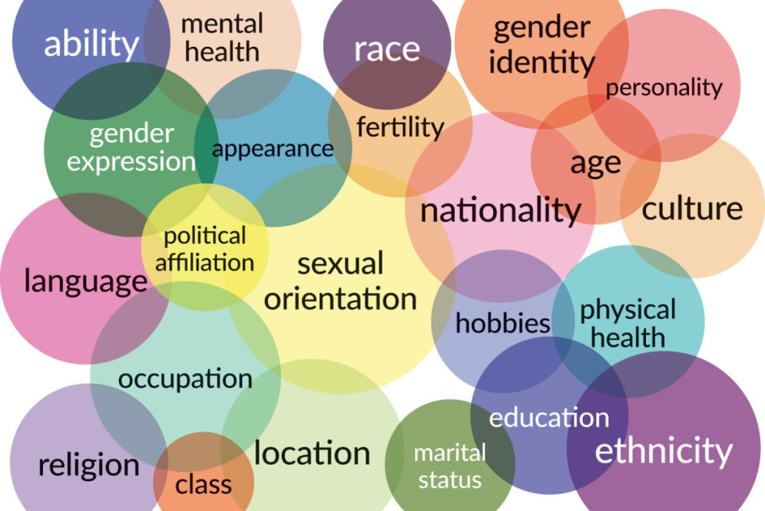
Intersectionality may compound barriers
According to the Center for Intersectional Justice, intersectional identity characteristics may “intersect to create unique dynamics and effects” and may compound barriers to accessing services and impact outcomes.

Slide 17
Household net worth by race / ethnicity and disability status of working-age householder, 2016
Intersectional statistics
There are significant disparities in household net worth by disability status and race.
Black households with a disability have an average net worth of only $1,282.
Latinx households with a disability have a $13,340 average net worth.
In comparison, white households with a disability have a $27,100 average net worth.
Total category shows that regardless of race / ethnicity, people with disabilities have a dramatically lower household net worth.
Source: National Disability Institute Analysis of U.S. Census Bureau. 2019. Survey of Income & Program Participation Microdata, 2014 Panel, Wave 4.
Notes:
Source: National Disability Institute Analysis of U.S. Census Bureau (2019) Survey of Income and Program Participation Microdata, 2014 Panel, Wave 4. https://www.nationaldisabilityinstitute.org/wp-content/uploads/2020/08/race-ethnicity-and-disability-financial-impact.pdf

Slide 18
Race / ethnicity and disability
Intersectionality statistics
Race/Ethnicity | No disability | With disability | % with a disability
American Indian and Alaska Native alone | 3,136,844 | 492,983 | 15.7
Black or African American alone | 39,433,690 | 5,892,163 | 14.9
White alone, not Hispanic or Latino | 189,453,615 | 27,692,494 | 14.6
White alone | 200,003,542 | 28,800,167 | 14.4
Native Hawaiian & Other Pacific Islander alone | 648,525 | 80,808 | 12.5
Two or more races | 41,284,223 | 4,780,216 | 11.6
Hispanic or Latino (of any race) | 62,806,703 | 6,581,811 | 10.5
Some other race alone | 24,217,296 | 2,482,618 | 10.3
Asian alone | 19,585,690 | 1,617,809 | 8.3
328,309,810 people included in this American Community Survey from 2022, representing 13.4% of the civilian non-institutionalized population
Source: U.S. Census Bureau. (2022). American Community Survey 1-Year Estimates (Table S1810).
Notes:
Updated from Andrea Urqueta Alfaro’s work.
https://data.census.gov/table/ACSST1Y2022.S1810?q=S1810:%20Disability%20Characteristics
U.S. Census Bureau, 2022 American Community Survey 1-Year Estimates (Table S1810)

Slide 19
“We can’t save the planet without uplifting the voices of its people, especially those most often unheard.”
Leah Thomas from The Intersectional Environmentalist
Notes:
“For so long, environmental activism has been primarily a white, middle-class issue, far removed from the daily reality of inner-city life. It’s all very well to embrace saving the rain forests and conserving endangered animal species, but such global initiatives don’t even begin to impact communities inhabited by people of color.” - Hazel M. Johnson, Chicago Tribune in 1955. Source: Rudolph, Linda; Harrison, Catherine; Buckley, Laura; North, Savannah. 2018. Climate Change, Health, and Equity: A Guide for Local Health Departments. Oakland, CA, and Washington, DC, Public Health Institute and American Public Health Association. https://www.apha.org/-/media/files/pdf/topics/climate/climate_health_equity.ashx.

Slide 20
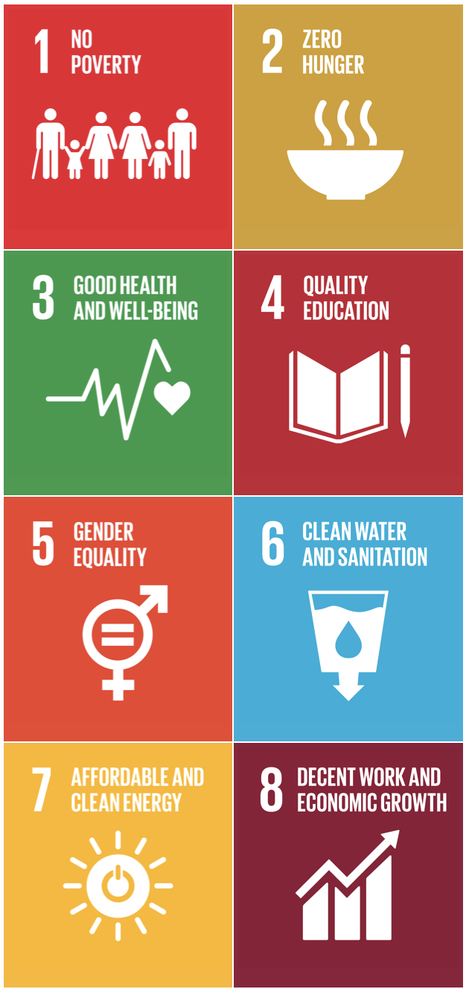
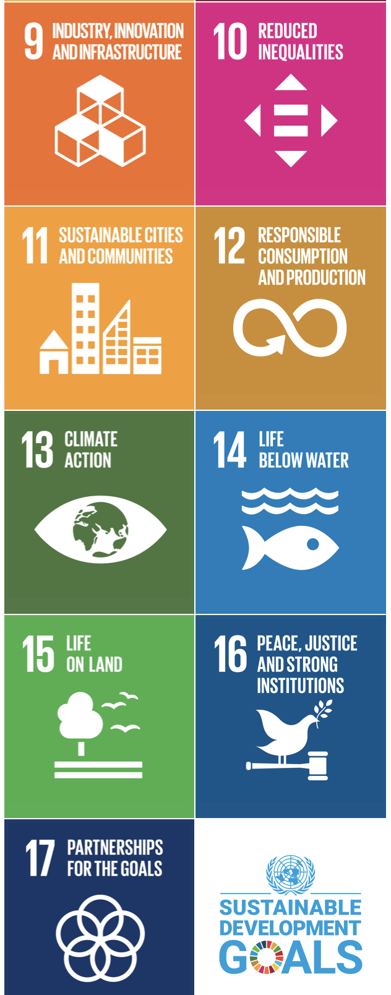
The United Nations Sustainable Development Goals 17 Goals to Transform Our World
The Sustainable Development Goals are a call for action by all countries – poor, rich, and middle-income – to promote prosperity while protecting the planet.
They recognize that ending poverty must go together with strategies to build economic growth and address a range of social needs while tackling climate change and environmental protection, including:
Education
Health
Social protection
Job opportunities
Source: https://www.un.org/sustainabledevelopment/
Notes:
https://www.un.org/sustainabledevelopment/

Slide 21
Fight climate change with digital accessibility & sustainable web design

Slide 22
Accessibility goes together with Sustainable Web Design.
Designers improve accessibility in documents and services, specify progressive design layers, improve user experience through reduced energy usage
Developers architect applications progressively, begin with accessibility, and minimize resource consumption
Strategists assess and reduce your environmental impact as governments document sustainability regulations
Everyone make the case for accessibility and sustainability with data

Slide 23
Sustainable web design and development
thoughtfully considers the impact on our environment. It pairs well with accessibility and usability as each leverage many of the same best practices and standards.
Notes:
Read more https://www.ibm.com/blog/green-coding/

Slide 24
European Union Ecodesign for Sustainable Products Regulations (ESPR)
The framework will allow for the setting of a wide range of requirements, including on:
product durability, reusability, upgradability, and reparability
presence of substances that inhibit circularity
energy and resource efficiency
recycled content
remanufacturing and recycling
carbon and environmental footprints
information requirements, including a Digital Product Passport
Source: https://commission.europa.eu/energy-climate-change-environment
Notes:
Source: https://commission.europa.eu/energy-climate-change-environment/standards-tools-and-labels/products-labelling-rules-and-requirements/sustainable-products/ecodesign-sustainable-products-regulation_en

Slide 25
Chile Framework Law on Climate Change (LMCC) 2022
The goal is to achieve neutrality of greenhouse gas emissions by 2050
Climate change must be considered in projects or activities, require environmental assessment
Regulations of new emission limits to combat climate change, for example, limiting greenhouse gases and/or short-lived emissions from industrial activities or other sources
Establishment of a public registry to record transfers, purchases, and values for a national carbon market to verify reduction/absorption of GHG
System providing access to information and for citizen participation in the climate change area, including ways to promote and include citizen participation in development and updates of climate change management
Implementation of “Green Bonds” to fund projects with a positive impact on the environment or countering climate change
Created an Energy Efficiency Law to achieve carbon neutrality optimizing energy consumption
Notes:
In Chile, the Political Constitution guarantees all people the right to live in a pollution-free environment and, correlatively, declares that it is the state’s duty to ensure that the environment is not affected and to protect the preservation of nature.
Chile is positioned to feel the impacts of climate change and proactively worked to address the environmental concerns.
In 2020, Chile adopted its Framework Law on Climate Change that defines a system that would establish GHG emissions limits to individual or groups of emitting sources and could be implemented either as an ETS or as a tradable performance standard.
Sources
https://www.diariooficial.interior.gob.cl/publicaciones/2022/06/13/43277/01/2142067.pdf
https://icapcarbonaction.com/en/news/chile-publishes-climate-change-framework-law-paving-way-market-based-policy
https://practiceguides.chambers.com/practice-guides/climate-change-regulation-2023/chile/trends-and-developments
https://www.eelaw.cl/files/publication/pdf/2/Guia_Chambers_2019_2da_version_.pdf

Slide 26
United States of America
Executive Order (EO) 14008 Tackling the Climate Crisis at Home and Abroad
EO 14096 Revitalizing Our Nation’s Commitment to Environmental Justice for All
Justice 40 Initiative
Categories of investment
Climate change
Clean energy and energy efficiency
Clean transit
Affordable and sustainable housing
Training and workforce development
Remediation and reduction of legacy pollution
Development of critical clean water and wastewater infrastructure
Source: https://www.whitehouse.gov/environmentaljustice/justice40/
Notes:
To date, none of the regulation explicitly calls out limits on the GHGE of digital services, although the clean energy and energy efficiency as well as the climate change categories do apply.
Source: https://www.whitehouse.gov/environmentaljustice/justice40/

Slide 27
Introducing the W3C Web Sustainability Guidelines (WSG), design and implement digital products and services that put people and the planet first
You
On September 7, 2023, the WSG were launched, best practices based on measurable, evidence-based research; aimed at end-users, web workers, stakeholders, tool authors, educators, and policymakers.
WSG has four major categories:
User Experience Design
Web Development
Hosting, Infrastructure and Systems
Business Strategy And Product Management
See https://w3c.github.io/sustyweb/.
Notes:
The guidelines are in line with the Sustainable Web Manifesto and aligned with GRI Standards to help organizations incorporate digital products and services into broader sustainability reporting initiatives.
WSG guidelines are based on recommendations that have been proved to reduce impacts (even if it can sometimes get more nuances, through impact transfers). BTW, assessing such impacts can prove quite tough because most tools used to assess environmental impacts tend to skip some important metrics and methodology steps (most rely on page weight, number of HTTP requests and DOM size, limited to loading/scrolling on the page). - Laurent Devernay
Most of the impacts come from user devices, not data centers (because we need to consider all steps of the life cycle of these devices and make sure digital services do not reduce their lifespan). - Alexander Dawson
The scope of the WSGs is primarily with web technologies because it’s nearly impossible to tangibly measure the impact of, for example, every user device and the social aspect of ESG relating to people themselves beyond the digital. We know it has an accumulative effect (performance leads to less hardware thrashing not just at the server-side but at the client-side on devices) but the math is based on more variables than we can likely calculate.
The structure of WSG is inspired by WCAG with 93 guidelines and 232 success criteria. Every guideline is supported by evidence and examples with information about the impact it has, the effort involved in implementation, and the specific benefits.
These two adoptions of the WSGs come with case studies that may be of interest:
Team UX (French): Approach (https://www.team-ux.com/demarche-eco-conception/) and Study (https://lowwwcarbon.com/case-study/team-ux/)
Craft Code: https://www.cantankerouscoder.com/p/craft-code-is-up
GRI Standards: The global standards for sustainability impacts
The GRI Standards enable any organization – large or small, private or public – to understand and report on their impacts on the economy, environment and people in a comparable and credible way, thereby increasing transparency on their contribution to sustainable development. In addition to companies, the Standards are highly relevant to many stakeholders - including investors, policymakers, capital markets, and civil society. ​

Slide 28
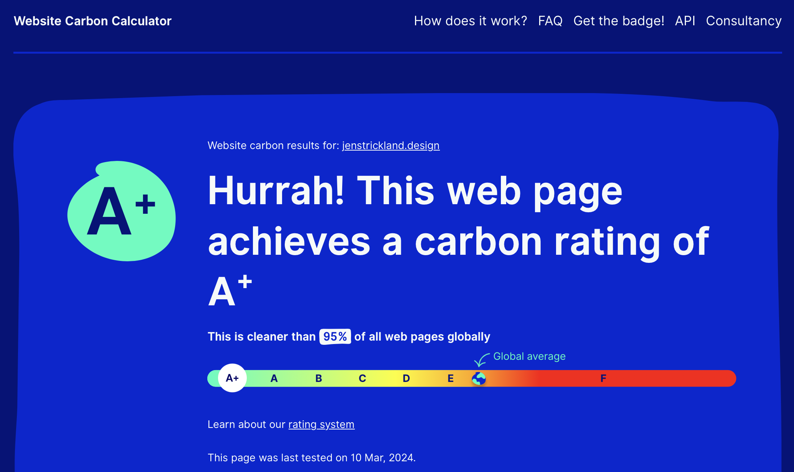
Measure & Monitor
We’re in the early days of this topic, so statistics are scarce.
Tools for checking requirements, especially carbon counts:
Website Carbon Calculator
Beacon
Climate and Economic Justice Screening Tool (CEJST)
To meet the WSG, first meet the W3C Web Content Accessibility Guidelines (WCAG) and Web Performance Guidelines.
WCAG: Deque axe extension
Web Performance: Core Web Vitals
Notes:
Tools
Website Carbon Calculator: https://www.websitecarbon.com
Beacon: https://digitalbeacon.co/
Climate and Economic Justice Screening Tool (CEJST): https://screeningtool.geoplatform.gov/en/#3/33.47/-97.5
Deque axe extension: https://www.deque.com/axe-devtools-accessibility-testing/
Core Web Vitals: https://web.dev/articles/vitals and https://chromewebstore.google.com/detail/web-vitals/ahfhijdlegdabablpippeagghigmibma?pli=1
Sources
WCAG: https://www.w3.org/WAI/WCAG22/quickref/
W3C web performance working group: https://www.w3.org/webperf/

Slide 29
How to Sustainable Web Design Minimize environmental impact
Build websites / apps from scratch so only required code is included. Many “no-code” or frameworks-based websites include unused packaged code, emitting more carbon unnecessarily.
Host website / app on services using renewable energy for power.
Avoid video unless it’s the only method for message.
Minimize all code to not only increase efficiency but improve UX through faster page load, thereby also improving accessibility as assistive tech can connect without barriers.
Optimize images, preferably deliver in SVG/WebP to reduce file sizes.
As part of the progressive enhancement technique all website assets leverage lazy loading to reduce unnecessary resources.
Notes:
Sources
Sabrina Chevannes, “Why Web Designers Need to Think about Sustainable Web Design,” Forbes Business Council, Sep 1, 2022. https://www.forbes.com/sites/forbesbusinesscouncil/2022/09/01/why-web-designers-need-to-think-about-sustainable-web-design/?sh=32ec16f91c86
David Fork, Ross Koningstein, “Engineers: You can disrupt climate change,” IEEE Spectrum, June 28, 2021. https://spectrum.ieee.org/engineers-you-can-disrupt-climate-change
Ismael Velasco, “How many emissions in a gigabyte of data?”, Ismael Velasco.dev, Aug 21, 2022. https://ismaelvelasco.dev/emissions-in-1gb?t=1661099790397
Kathy Pretz, “IEEE's Plan to Help Combat Climate Change,” IEEE Spectrum, May 5, 2022. https://spectrum.ieee.org/ieee-plan-combat-climate-change
Handbook of Sustainable Design of Digital Services. https://gr491.isit-europe.org/en/
“Digital Nations Shared Approach to Sustainable Digital Government,” DIGITAL NATIONS: Leading Digital Governments, November 18, 2021. https://www.leadingdigitalgovs.org/sustainable-government-it
“An image format for the Web,” (2023). Google for Developers. https://developers.google.com/speed/webp

Slide 30
How to Accessibility Beyond Compliance
Accessibility Short How-to
Use a screenreader (Mac comes with Voiceover built-in, Windows with Narrator) to read your work. I always have to do a web search for the keys to use it, because I context switch so much. [Check out: https://dequeuniversity.com/screenreaders/survival-guide]
Documents
Remove empty paragraphs, tabs, and spaces that are used to add white space — these are read to the user in some screen readers and become errors if exported to PDF.
Navigate document headings using the sidebar navigation (Word).
Web Services
Use the Lighthouse extension in Chrome to do a preliminary test for web services. [https://chrome.google.com/webstore/detail/lighthouse/blipmdconlkpinefehnmjammfjpmpbjk] It’s not perfect, but it’s an initial automated read for web performance and accessibility.
The axe extension is more accurate, in my experience. [https://chrome.google.com/webstore/detail/axe-devtools-web-accessib/lhdoppojpmngadmnindnejefpokejbdd]
Section 508 and other regulations define legal standards of accessibility.
Regulations rely on objectively testable standards while many guidelines require subjective expertise to deliver accessible outcomes.
Governance takes time and often is well behind the current best practices and guidelines established by standards bodies like the Worldwide Web Consortium (W3C) Accessibility Guidelines Working Group.
The most inclusive approach is to deliver accessibility beyond compliance: meeting the spirit, not only the letter of the law, employing the expertise of seasoned accessibility experts. Standards don’t guarantee accessibility — there needs to be a culture of accessibility.
Mobile usage skyrocketed over the past decade. WCAG 2.1 & 2.2 add criteria for cognitive considerations & mobile.
I encourage you to use WCAG 2.2, Levels A and AA — and AAA as much as possible. Honor the spirit of Section 508!
This empowers people to access materials in the range of ways they may use. For example:
Plain language ensures content is understandable.
Increased color contrast and touch target sizing and spacing support mobile device users.
Also, PlainLanguage.gov provides guidance on clear writing and meeting the Plain Writing Act.

Slide 31
How to Equitable Design “Equality is equal access, while ‘equity’ is equal outcomes.” — Antoinette Carroll Creative Reaction Lab Founder, President, & CEO
Hire diverse teams
Assess processes, document assumptions, identify risks
Define equity for the team
Identify under-served communities, stakeholders, indicators, data sources
Conduct analysis to identify disparities, barriers
Document & socialize findings, lessons learned
Plan, monitor & measure, re-evaluate regularly
Restore justice and liberation
Source: Freeman, Tammy, and Patterson, Jenine. (2021). A Framework for Assessing Equity in Federal Programs and Policies, Advancing Racial Equity and Support for Underserved Communities Through the Federal Government (EO 13985). The MITRE Corporation, Version 1.0 May 2021.
Notes:
Source
Freeman, Tammy, and Patterson, Jenine. (2021). A Framework for Assessing Equity in Federal Programs and Policies, Advancing Racial Equity and Support for Underserved Communities Through the Federal Government (EO 13985), The MITRE Corporation, Version 1.0 May 2021. https://www.mitre.org/news-insights/publication/framework-assessing-equity-federal-programs-and-policy

Slide 32
How to Responsive Web Design One fluid web service
A technique that delivers one fluid web design which flexibly adapts size dimensions and functionality, increasing usability and access for all devices.
This minimizes resources used to deliver the site, then in turn the amount of energy and effort to maintain.
It is not just stacking items or fitting devices.
Notes:
Responsive web design is one fluid website that flexibly adapts size and functionality of the device, increasing usability and access for all devices. This minimizes resources used to deliver the site, and in turn the amount of energy and effort to maintain it.
Without responsive design, web content might overflow or not use the space available. With the increasing variety in device sizes, responsive web design is considered a best practice.
Sources: Ethan Marcotte. Responsive Web Design. 2010. A List Apart, https://alistapart.com/article/responsive-web-design/. Last accessed September 27, 2022. Animation https://css-tricks.com/the-difference-between-responsive-and-adaptive-design/.

Slide 33
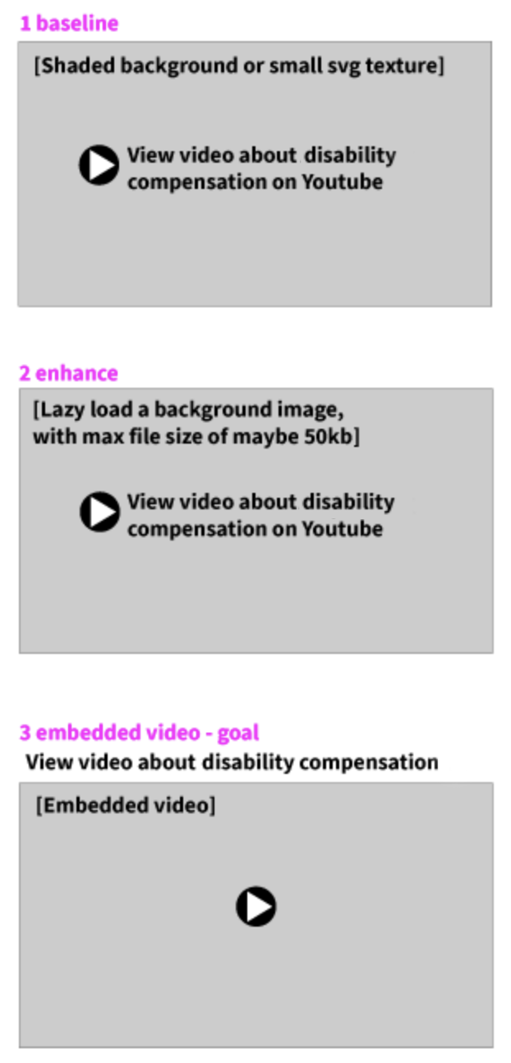
How to Progressive Enhancement Deliver just what’s needed for each person
Example for Basic Video Card
Title
Description
Duration of video
Link to video service in a box with indication of external link
Enhancement 1
Same as above
Poster image of video with alt text
Set dimensions on poster container so that the screen will not shift when image loads
Enhancement 2
Same as above
Embedded video that does not auto-play, only play on user action
Include size of the video
1 baseline experience
The first deliverable would be the linked video title text, as follows, perhaps inside a shaded box created with HTML; the entire box may be clickable.
<a title="Go to video about disability compensation" class="video-link" href="https://www.youtube.com/watch?time_continue=3&amp;v=xE0LzeRgdAk" target="_blank" rel="noopener "> View video about disability compensation <dfn>on Youtube</dfn> </a>
2 enhancement
Next, enhance the experience with a video thumbnail image.
Add an image, after the page loads to fill in a shaded box that is the dimensions of the image.
Another treatment might be to only load the image at a certain width.
Visit Floodsmart.gov and resize your browser. Watch the image of the people be replaced by a textured svg graphic. This uses a tiny vector graphic repeated in the background, and then replaces it with an image at a dimension that we can expect the user has sufficient connectivity.
<a title="Go to video about disability compensation" class="video-link" href="https://www.youtube.com/watch?time_continue=3&amp;v=xE0LzeRgdAk" target="_blank" rel="noopener "> View video about disability compensation <dfn>on Youtube</dfn> <img srcset="disability-compensation-480w.jpg 480w, disability-compensation-800w.jpg 800w" sizes="(max-width: 600px) 480px, 800px" src="disability-compensation-800w.jpg" alt="Director speaking about disability compensation" /> </a>
3 goal enhancement, embedded video(s)
The third option of including an embedded video requires additional technical discovery and depends upon your project’s requirements and constraints.
Identify the key functionality of the feature you want to implement.
Provide this functionality with the simplest technology.
Enhance!
Notes:
Paul Grenier, a11ySlack, WCAG: I did a lot of work researching how best to use the validity API and presented it at A11yTO a few years ago. https://bit.ly/a11yform. My conclusion: don't use it as is. But it can be very useful especially for progressive enhancement.
Progressive Enhancement is not anti-JavaScript: https://saptaks.blog/posts/progressive-enhancement-is-not-anti-js.html

Slide 34
Key Takeaways
Digital Accessibility supports Sustainable Web Design.
You can fight climate change through:
Sustainable Web Design
Accessibility Beyond Compliance
Equitable Practices
Progressive Enhancement
Responsive Web Design
All these techniques support digital accessibility and digital sustainability to reduce environmental harm.

Slide 35
Thank you!
Any questions?
Jennifer Strickland, jstrickland@mitre.org
Tangential MITRE research
Resilient & Efficient Computing: Positioning Industry and Government for the Future
Sustainable computing and simulation: a literature survey
Notes:
MITRE work:
Resilient & Efficient Computing: Positioning Industry and Government for the Future. https://www.mitre.org/news-insights/publication/resilient-efficient-computing-positioning-industry-government-future
Sustainable computing and simulation: a literature survey. https://dl.acm.org/doi/10.5555/3522802.3522854

