Slide 1

Think like an instructional designer: A case study in accessibility training at scale

Slide 2

About Wiley
200+ year-old educational provider serving students, instructors, researchers, adult learners, and corporations
Product portfolio
eBooks & ancillaries
Courseware
Journals
Websites
Software
Mobile applications

Slide 3
1. Where does accessibility (a11y) have an impact?
Communication
The accessibility of all internal and external communications, as well as a11y information that is conveyed to customers.
Knowledge & skills
Ongoing colleague education to build a11y awareness and fill a11y knowledge and skill gaps.
Customer support
Accessibility assistance provided to customers with disabilities.
ICT development lifecycle
Incorporation of web/software/hardware a11y considerations in ICT processes from conception to maintenance & obsolescence.
Personnel
Employee application and retention best practices designed to ensure that all colleagues are supported regardless of ability.
Procurement
A strategic process that concentrates on finding and acquiring accessible products and services.
The attitudes, sensitivity, and behaviors around accessibility, including internal interaction, perception, and decision-making.
Culture
W3C Accessibility Maturity Model

Slide 4



2. What are my instructional design needs?
When do people learn?
How do people learn?
What methods work best?
Professional learning has unique needs.
Flexibility
and timing are important in a professional setting.
Each of us has a specific learning style preference.
A combination
of auditory, visual, verbal, and kinesthetic works best.
Consider what approaches and techniques you should use.
Common methods
include eLearning, instructor-led, microlearning, workshop, etc.

Slide 5
What we did: Learning design & delivery
Static documents
Self-paced courses
Trainings and webinars
Goals
Increase accessibility awareness
Upskill our colleagues
Needs
Support a global workforce
Include a mix of learning styles and methods
Be easily digestible
Ability to update
Measurable

Slide 6


3. How are you going to measure the program?
Qualitative
Measuring success can often be difficult.
You don’t know what you are looking for
You are not set up to capture data properly
It is not clear how the data will translate to work performance
Quantitative

Slide 7
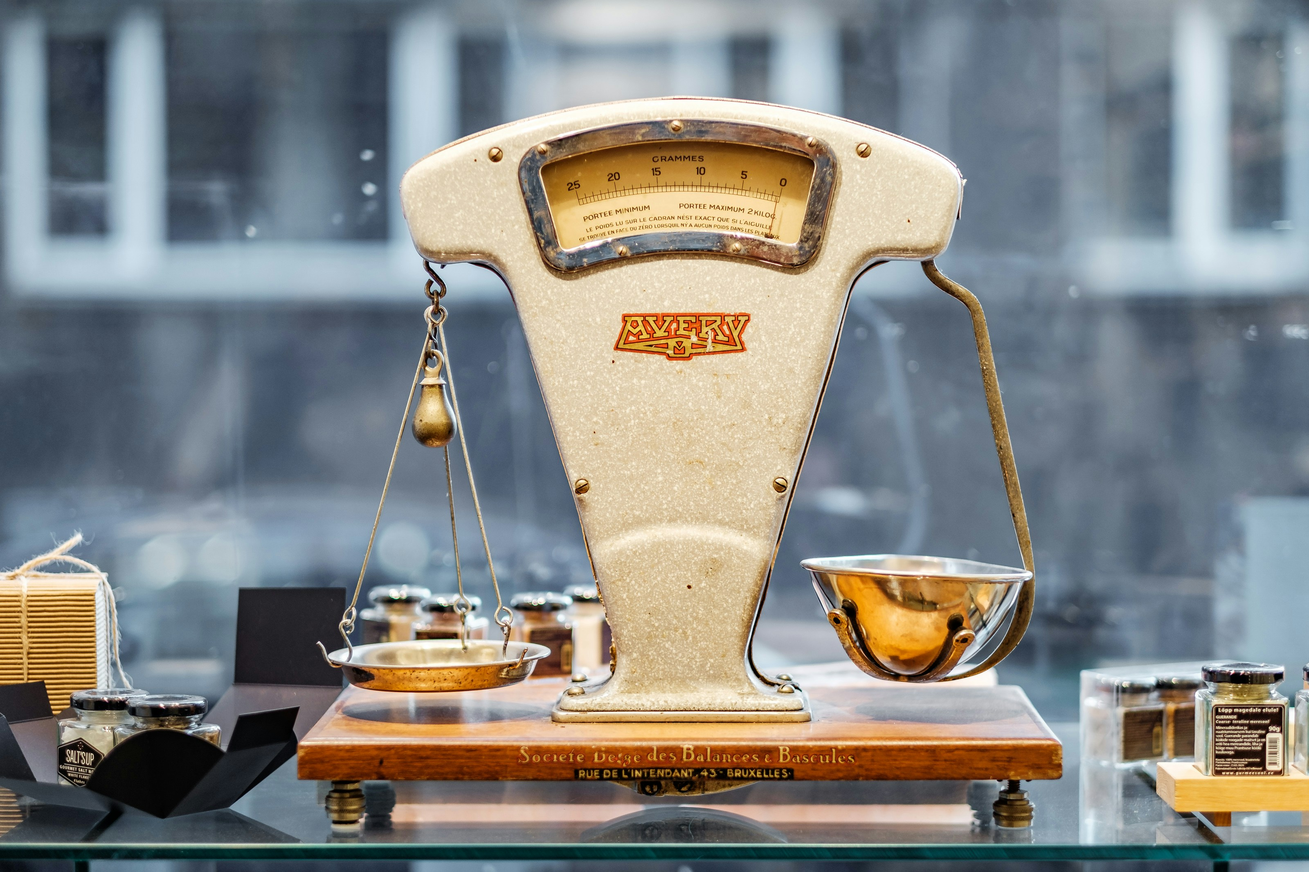
What we did: Measurement
Static documents
  Hosted on Confluence and SharePoint to obtain engagement rates (total views, unique views, time spent, etc.)
Courses
  Hosted in Workday to obtain completed/in-progress rates and identify reporting lines.
  Inclusion of content surveys
Training and webinars
  Attendance rates
Align with:
Product audit results | Correspondence frequency | Overall proliferation of a11y program

Slide 8

4. With whom do you need to partner?
Who will be involved in program development?
Who will be involved in funding the program?

Slide 9
What we did: Partners
Reviewed options
Calculated risk vs. reward
Shopped around proposal
Accessibility partners and our Accessibility Guild to create the content
Colleagues with instructional design experience to test the materials’ learning design
Department stakeholders to review completeness of content
HR for technical checks & planning
Communications team for promotion

Slide 10
5. How are you going to promote it?
Consider how people communicate within your organization
Who
How
When

Slide 11




What we did: Promotional strategy
Multi-level communications plan consisting of
Newsletters
Wire articles
Teams & Viva Engage
Team roadshow
Messages were targeted to the audience and the communications method.
We measured program engagement against promotional messaging.

Slide 12
Program results by the numbers
Program was released on May 18, 2023, to celebrate Global Accessibility Awareness Day (GAAD). ​
640
Colleagues who have completed or accessed courses
3,490
Colleagues who have visited our documents for the first time
9,662
The total number of views our documents have received
1,000
Colleagues who have participated in some form of live training
Rise in colleague engagement
Increased support for born accessible processes
Faster resolutions to existing tech debt

Slide 13

What we learned
How we presented and organized content was appreciated
People want more video
Programs of this nature need a top-down, bottom-up approach
Constant promotion is key
Badging and rewards should be explored
Add into new employee onboarding

Slide 14


Questions
Christina Volpe
Lead, Accessibility Solutions, Wiley
cvolpe@wiley.com
LinkedIn

