Slide 1

Unleashing Potential: Integrating Artificial Intelligence to Elevate Math and STEM Education
Louis Shanafelt
#AHG24

Slide 2




Introduction to today’s speaker
Hello, I’m Louis.
Louis Shanafelt
Senior Product Manager
Texthelp
@LouisShanafelt
Louis@texthelp.com
#AHG24
Notes:
My name is________ and I work for Texthelp.

Slide 3
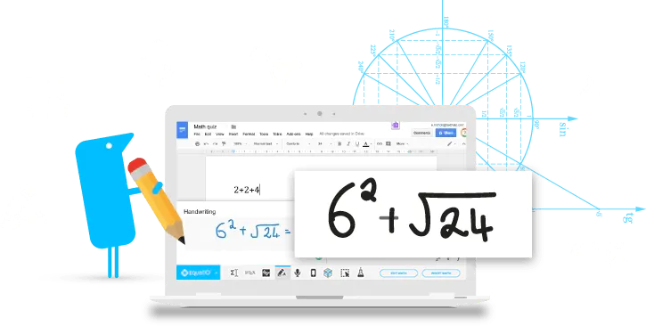


The Equatio Mission Statement
Make Math Digital
Equatio allows you to create equations, formulas, and more, digitally. Helping to make math and STEM classes more accessible and engaging for every student.
#AHG24
Notes:
Equatio: Mission Statement

Slide 4

The Equatio Vision Statement
VISION:
To disrupt how math is both taught and learned.
We do this by making it easy to create digital and accessible math to work with any learning style or environment.
We are the math editor of choice for schools and content creators.
#AHG24
Notes:
Equatio: Vision Statement

Slide 5

One of my favorite Math quotes
People don’t dislike math.
What they dislike is being confused, intimidated, and embarrassed by math.
#AHG24

Slide 6
Math fear & anxiety is a big obstacle in the classroom
Math fear and anxiety is a big obstacle in the classroom…
61.9%
78.7%
Considered math fear / anxiety to be one of the biggest obstacles to student learning in math classrooms.
Talked about their limited time to modify lessons for different needs.
Accessibility issues are still a prime problem in math education (only 16.3% reported materials were fully accessible) - leading to a lack of math engagement.
#AHG24

Slide 7
Digital Math Can Help
Digital Math Can Help
It makes math more accessible and engaging for all learners. But…
44.7%
26.6%
said they only use up to 15 minutes of digital math regularly in their classrooms.
highlighted that their biggest obstacles to implementing more digital math include:
A lack of time to learn new skills
Digital math being a new and scary concept.
#AHG24

Slide 8
The data states that there is great interest in creating digital math
But that doesn't mean there's a lack of educator interest in digital math…
67.4%
79.1%
Believe there is enough scientific evidence to support the transition to digital math and improve the math education for all learners.
See the benefit of digital math for saving grading time with quick and flexible feedback options.
To Check Out the Full Study Click Here!
#AHG24

Slide 9
AI-enhanced assessments can offer dynamic learning paths tailored for student success
Key Point
#AHG24

Slide 10

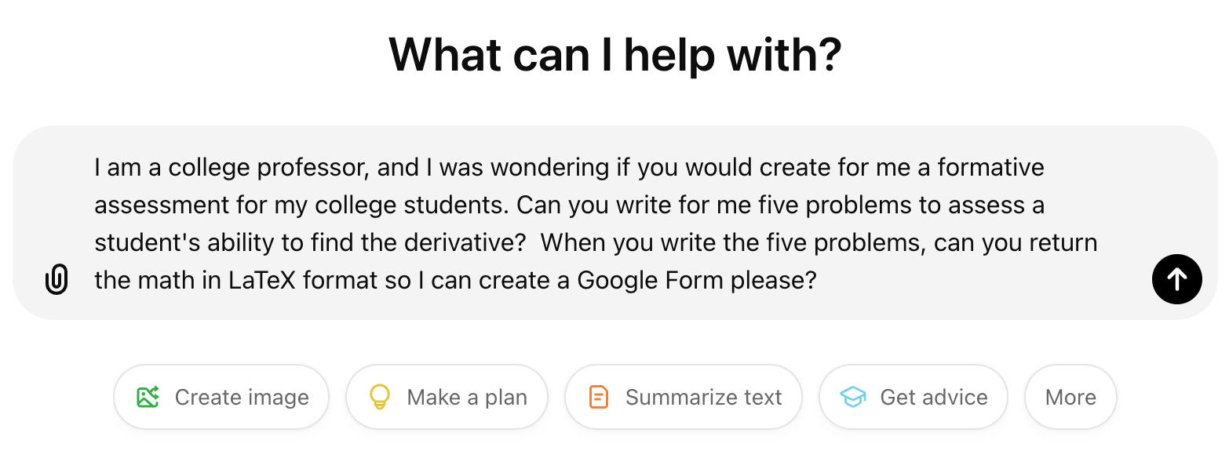
ChatGPT Is There For Help
Ask ChatGPT For Help
Write a prompt but you must be very specific
Considerations: Who you are, What is the topic, What academic level, Quantity of questions, and Format returned
#AHG24

Slide 11
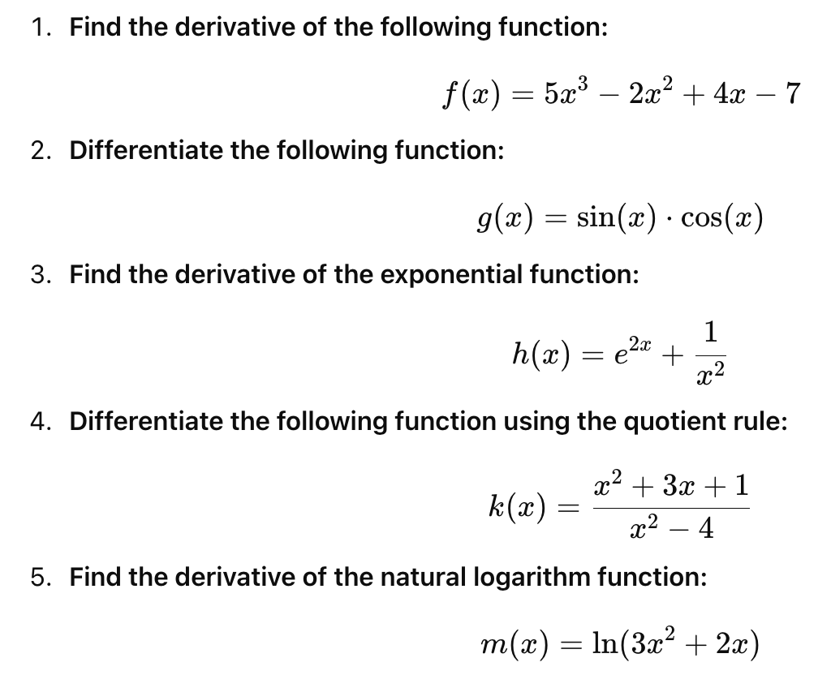
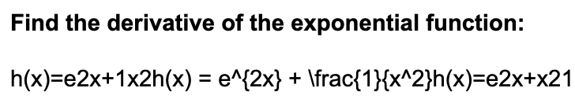
ChatGPT Results
Chat GPT Results
AI can return math problems created by AI and include the directions
At first glance the math doesn’t appear to be in LaTeX but when you click and drag, the content copied when pasted will in fact be LaTeX
#AHG24

Slide 12
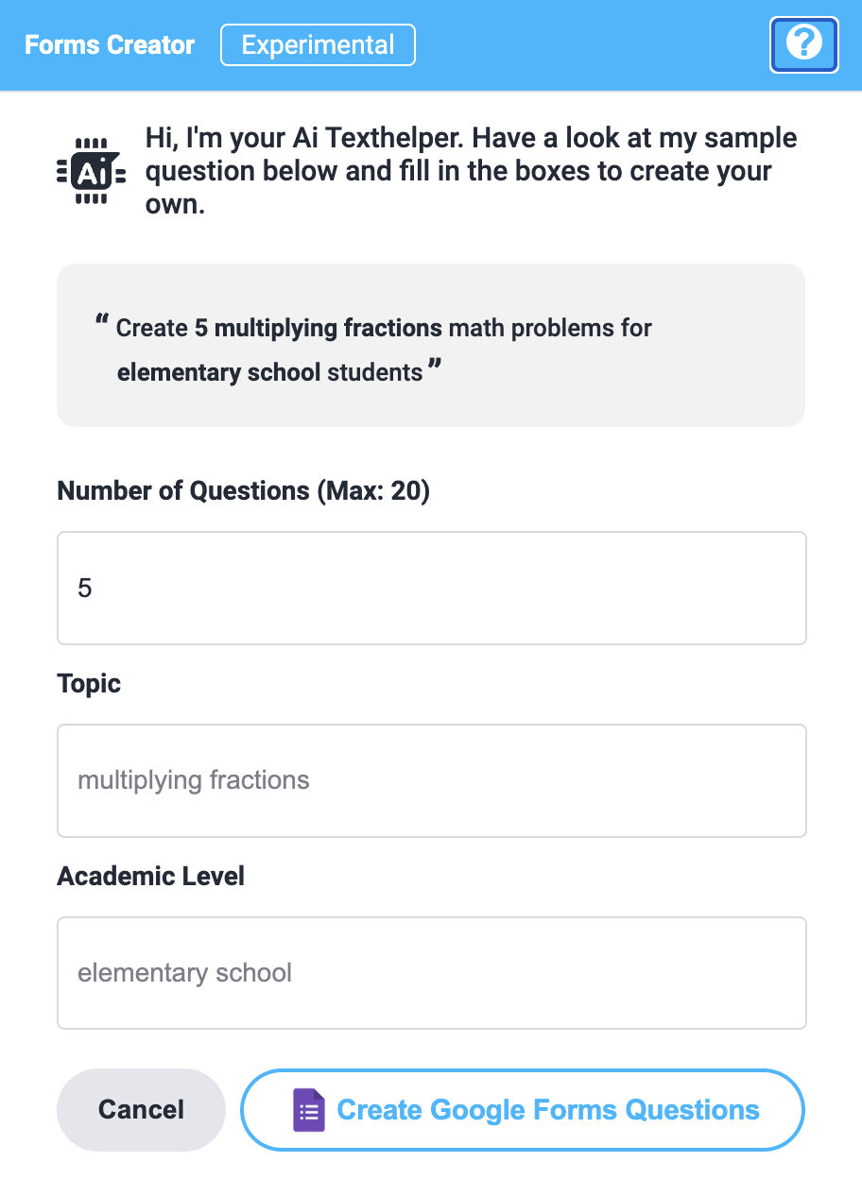
AI Commonly Utilized For Math Problem Solving Assistance
AI Commonly Utilized For Math Problem Solving Assistance
What if a product could leverage AI to build Math quizzes and examinations
Live demo
#AHG24

Slide 13
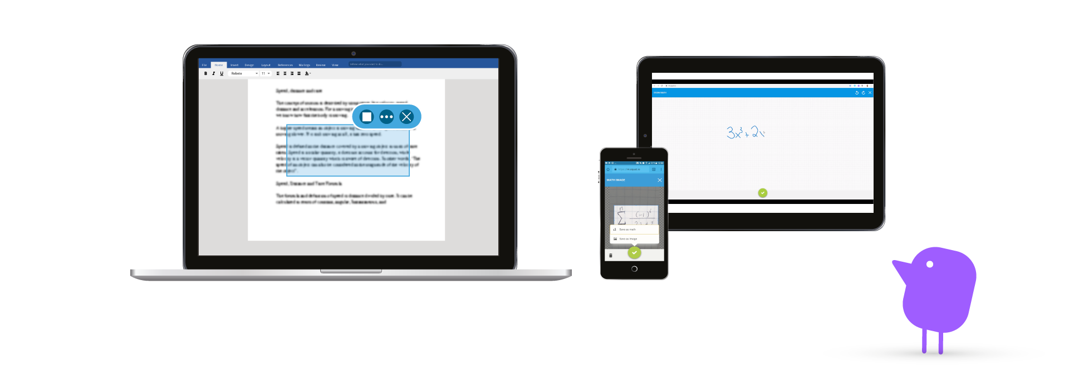
Let’s Look At A Live Demo
Demo Time
#AHG24

Slide 14
AI simplifies math worksheet creation, offering tailored problems, saving time, & enhancing learning outcomes
Key Point
#AHG24

Slide 15
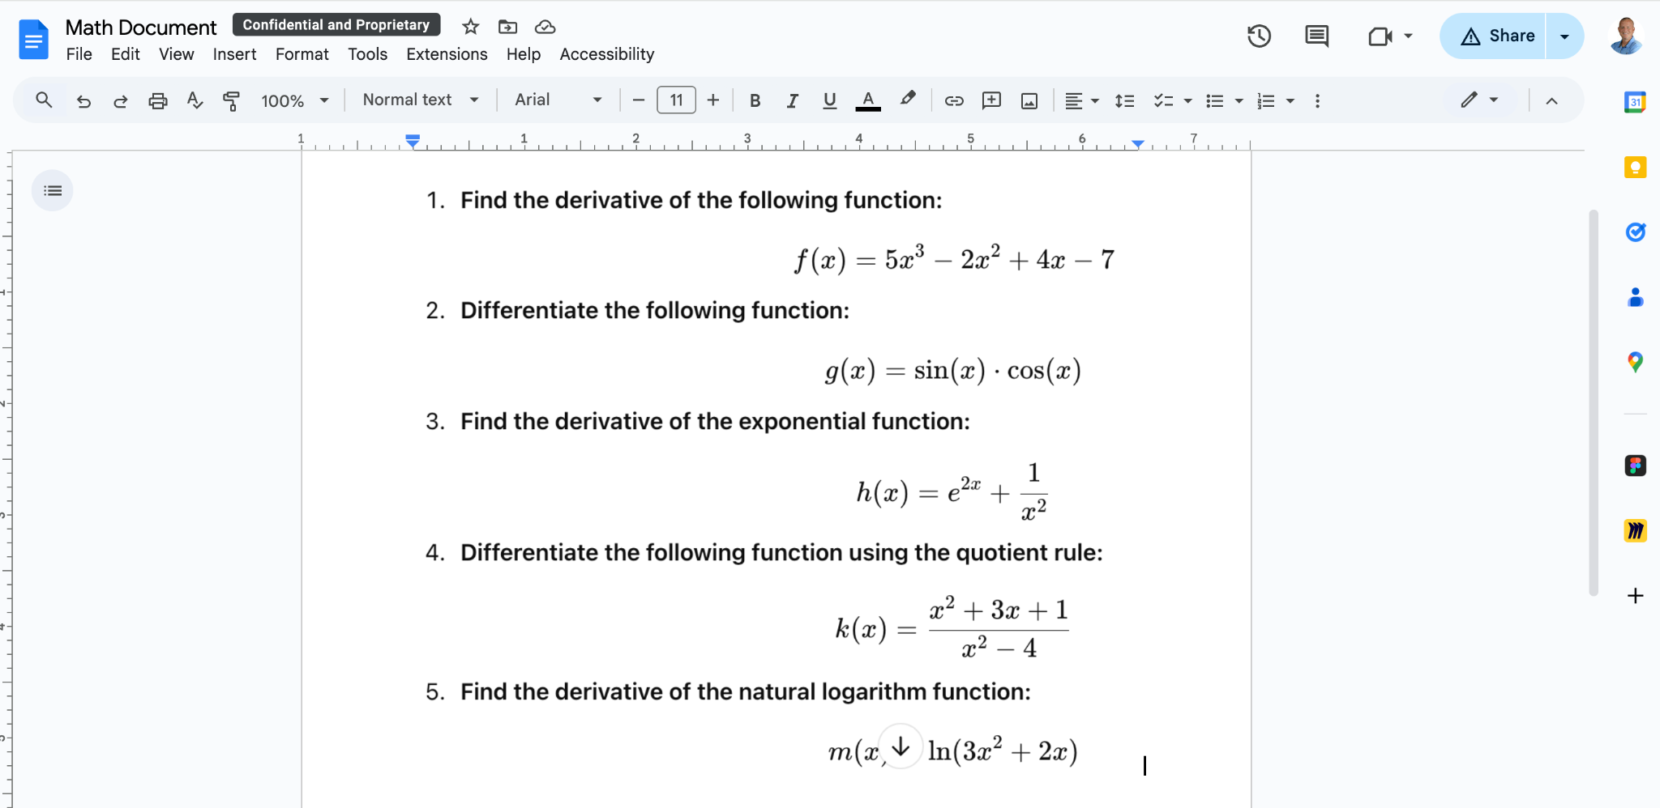
ChatGPT To The Rescue Again
Again, ChatGPT Can Help
Write a prompt & be very specific
Use ChatGPT to create problems that can be added to Docs, PDFs, Word, & more
#AHG24

Slide 16
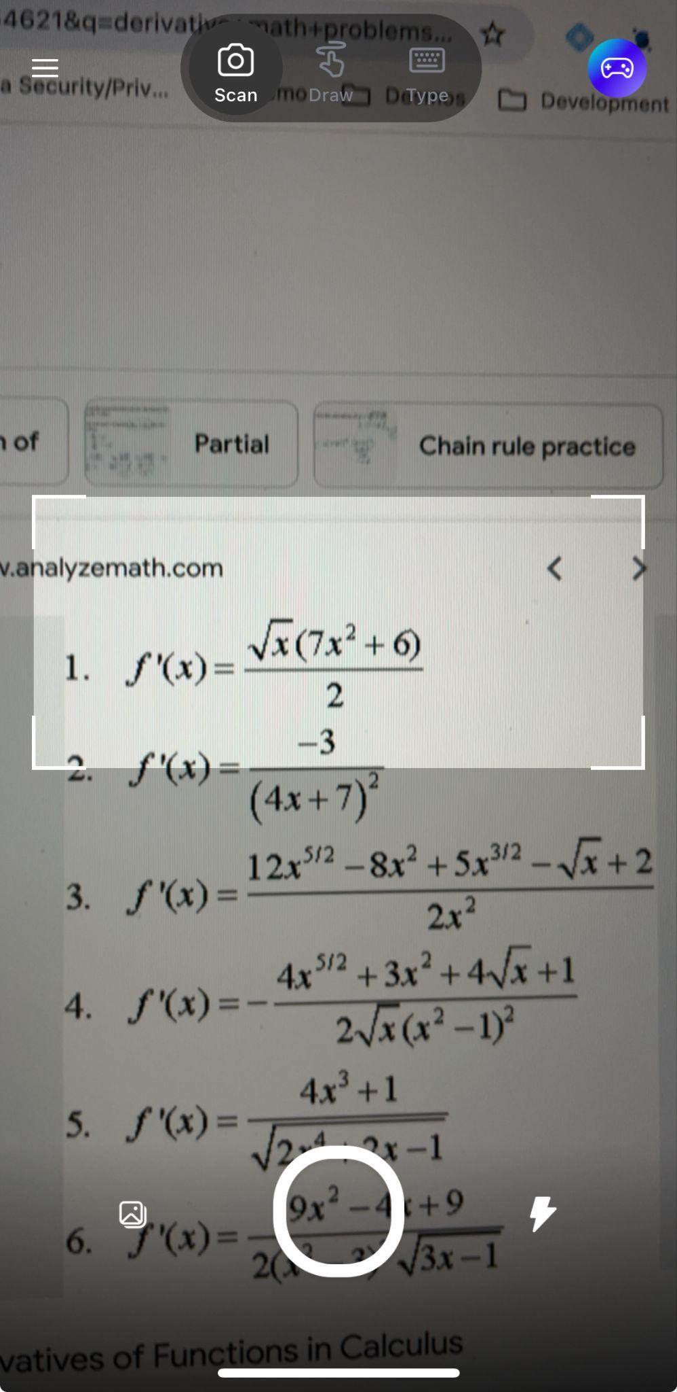
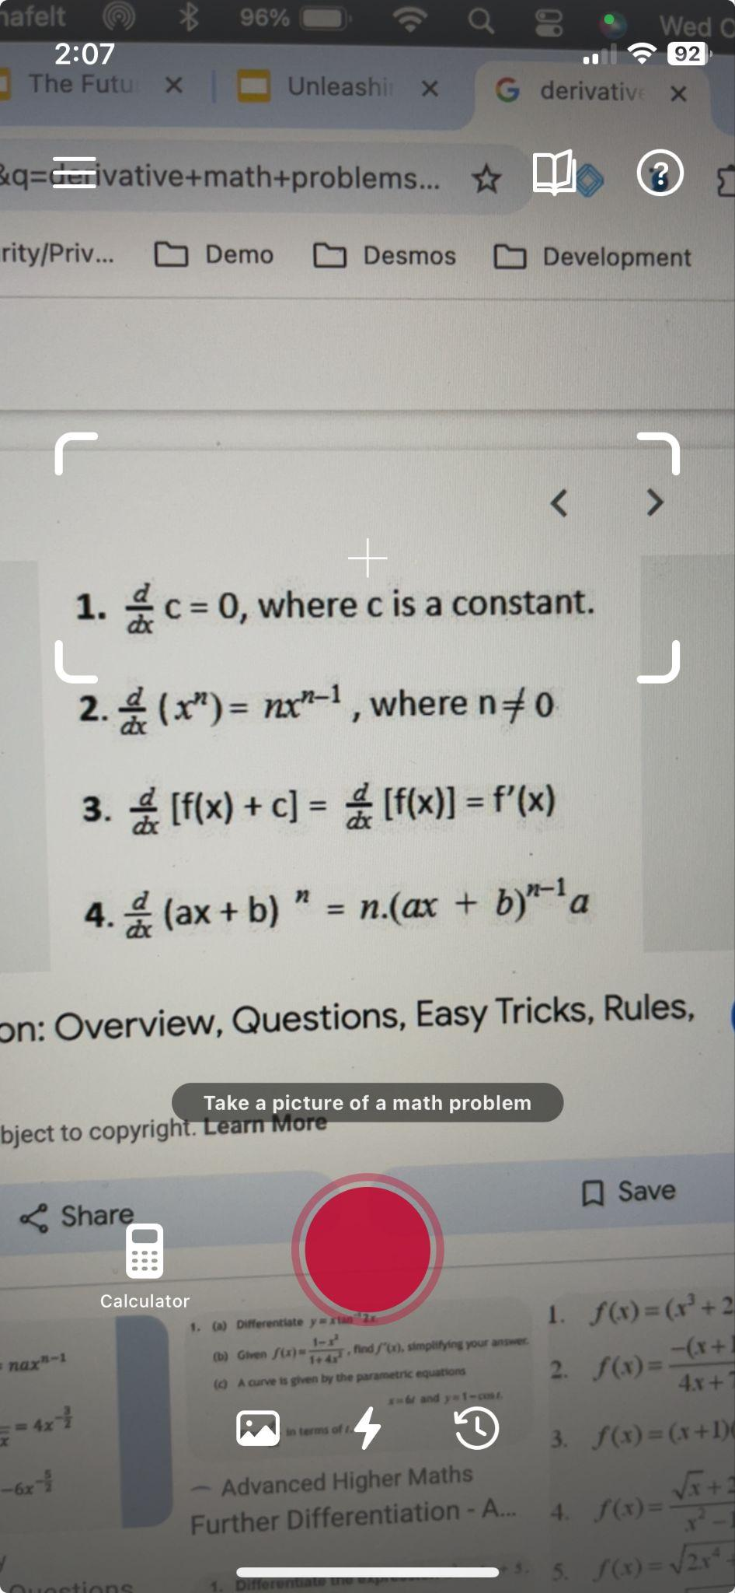
Using AI As A Math Tutor
Using AI As A Math Tutor
Can AI Enhance Learning Outcomes?
What Is Available In The Market Today?
  Microsoft Math Solver App
  Photomath
#AHG24

Slide 17
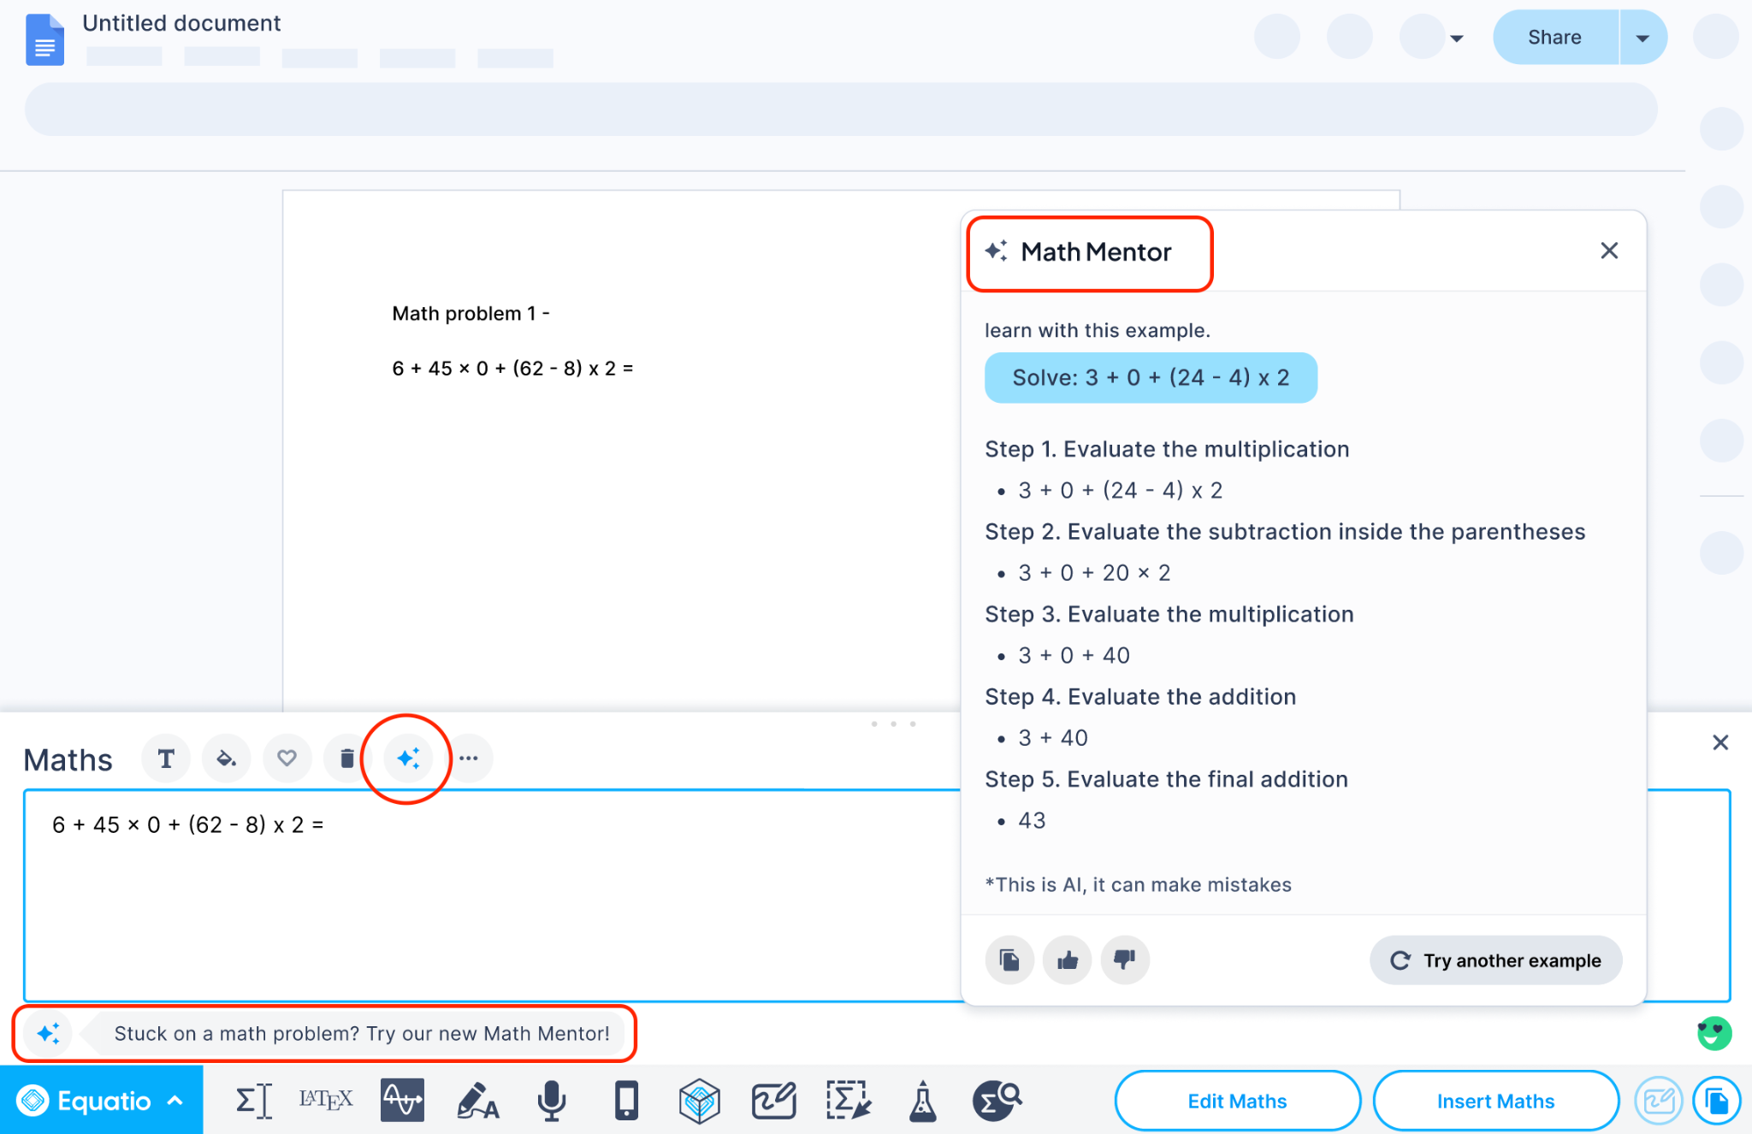
Stop Using Programs Designed To Give Kids Answers
Dare To Be Different
Stop giving students an easy out
Point, click, solve, & solution
Instead, scan the math, let AI return a similar problem, and walk the learner through the proper steps & teach them how to solve for success
#AHG24

Slide 18
Demo Time
Demo Time
#AHG24

Slide 19
Students & faculty can streamline math problem solving by inserting LaTeX into AI to bolster comprehension
Key Point
#AHG24

Slide 20
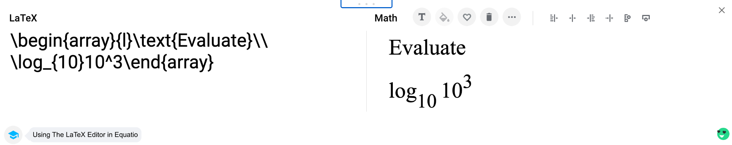
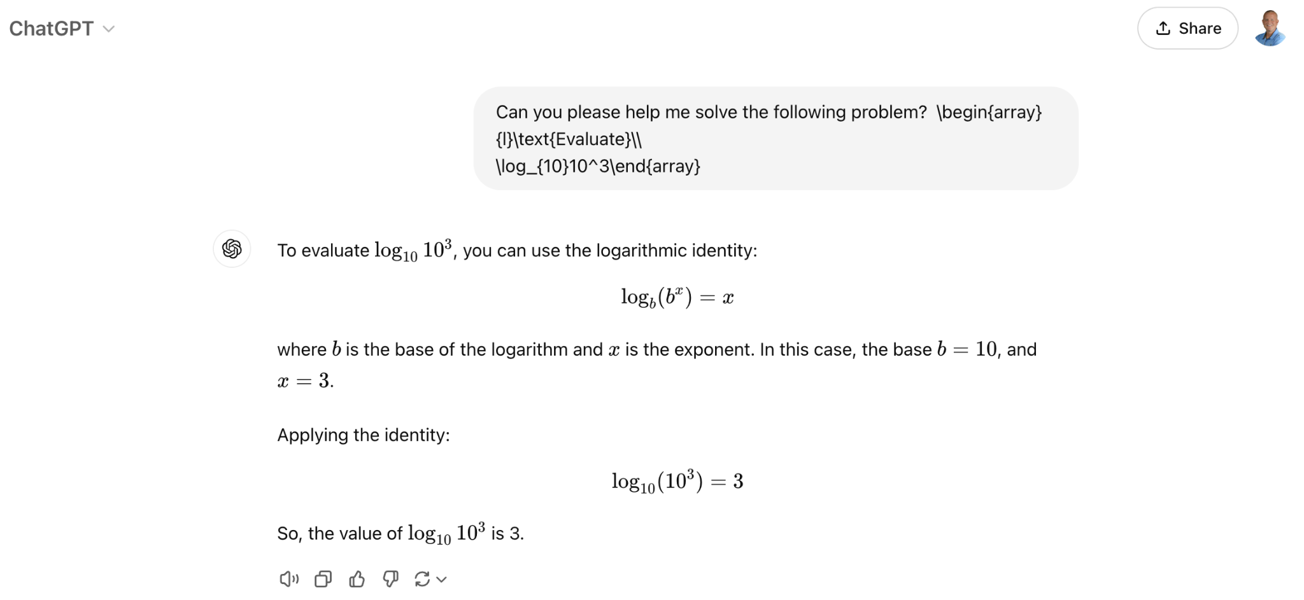
Increasing Comprehension By Using LaTeX
Increase Math Comprehension By Using LaTeX
Can your math tool return to you LaTex
If so, you can copy that LaTex and paste it into ChatGPT & ask for assistance in helping to solve the problem
#AHG24

Slide 21
Demo time again
Demo Time
#AHG24

Slide 22

Feedback or Questions
Feedback or questions?
#AHG24

Slide 23
Thank You!
Louis Shanafelt
Senior Product Manager
Email: l.shanafelt@texthelp.com
X: @LouisShanafelt
#AHG24

