Slide 1
Captioning Your Content: Creating a Sustainable System
Megan Cox Caption Program Coordinator

Slide 2
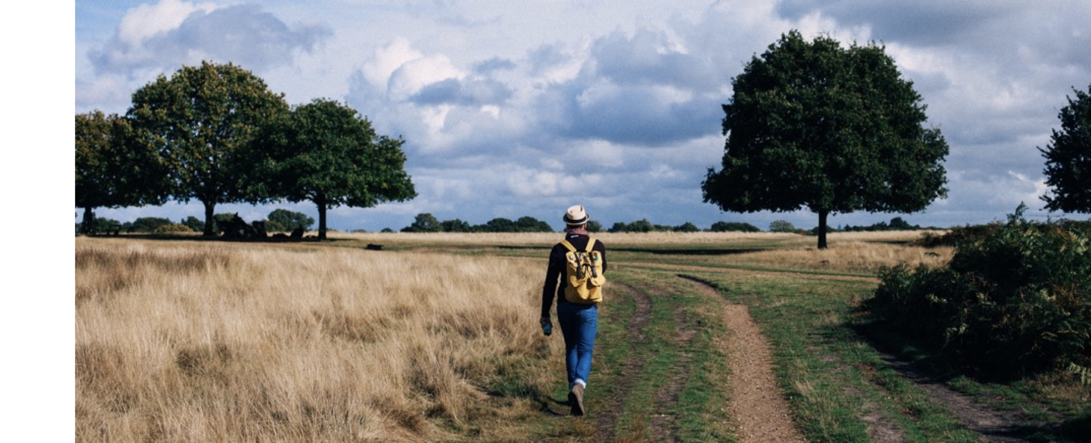
Where We Started

Slide 3
Our Story
Total Videos
Captioned Videos

Slide 4
Gather Information
Find Video Content
Official Lists
Website Information
YouTube
Inventory
Essential Information

Slide 5
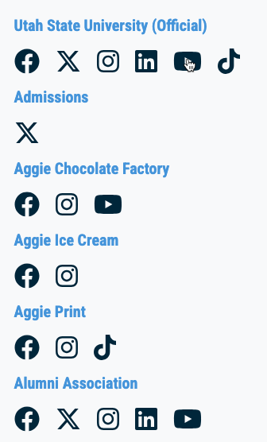
Official Lists
Social Media Directories
Marketing and Communications
That one person who seems to know everything…

Slide 6
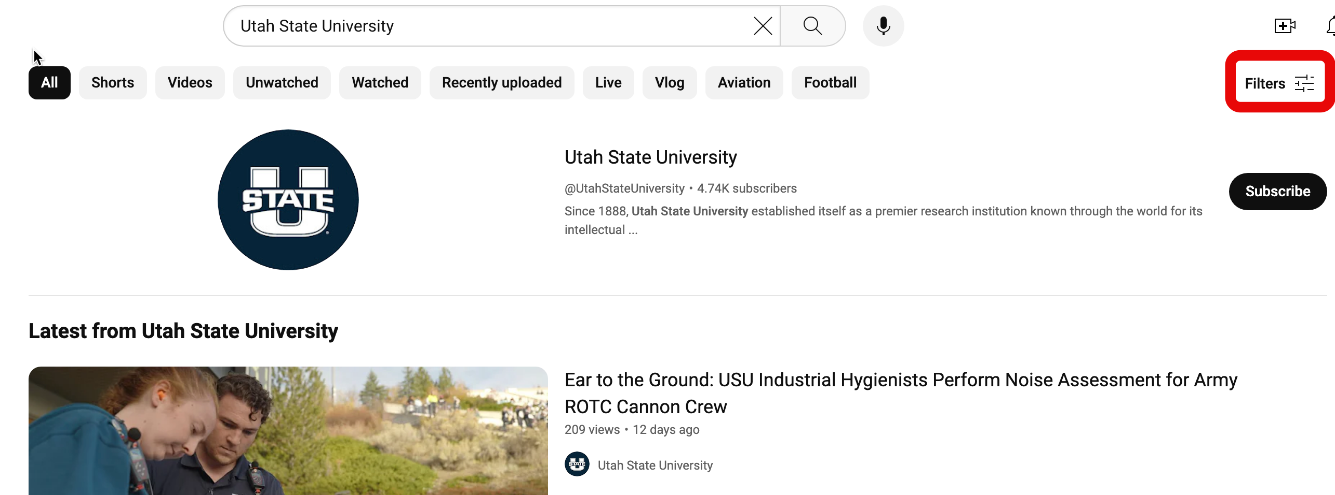
YouTube Channel Search

Slide 7
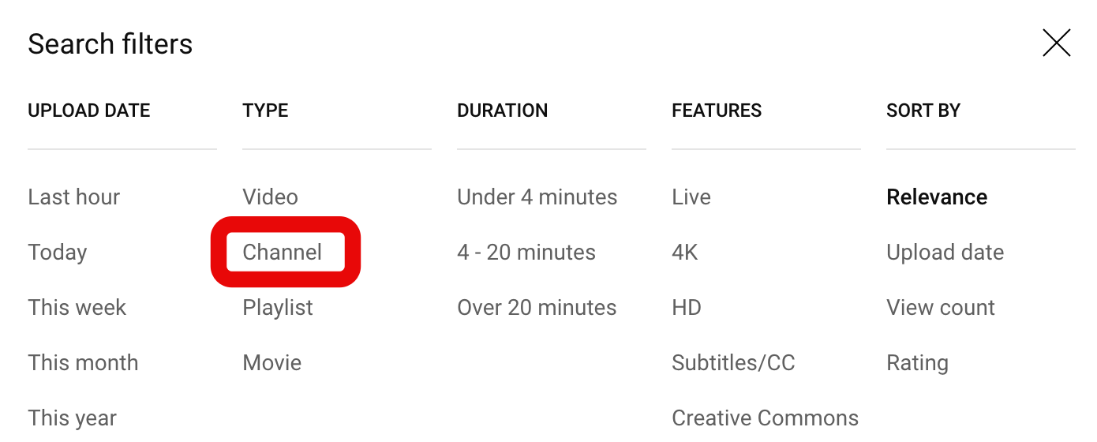
YouTube Channel Search - Filter

Slide 8
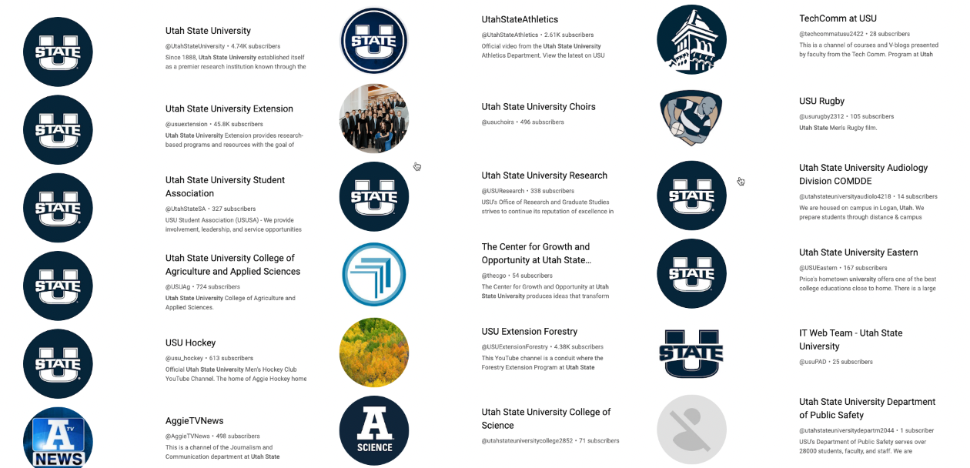
YouTube Channel Search - Results

Slide 9
Website Information – Analytics
Page Title | URL | Video URL | Users | Views
Scholarships | /scholarships | https://www.youtube.com/watch?v=LTHE7hYCzk0 | 154 | 187
Time Management | /help/time-management | https://www.youtube.com/watch?v=Gy_CT-S8-gE | 132 | 154
Test Taking | /students/test | https://www.youtube.com/watch?v=Nuy9lGnTN3Y | 110 | 130
Federal Aid | /finance/federal-aid | https://www.youtube.com/watch?v=a-TwgHXzh7s | 86 | 90

Slide 10
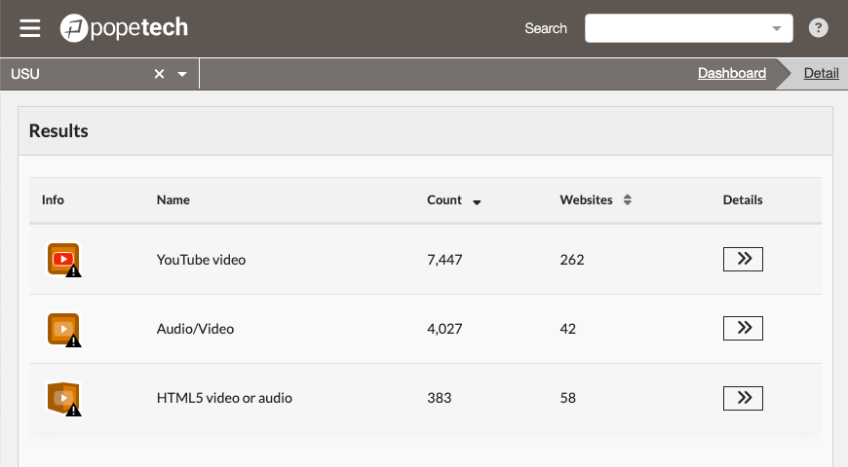
Website Information – Pope Tech

Slide 11
Inventory Channel Information
Channel Name
Channel URL
Channel ID
Number of Videos
Number of Captioned Videos
Channel Owner

Slide 12
Jump Start Early Efforts
Awareness
No deadlines, no pressure
Focus on benefits
Celebrate wins

Slide 13
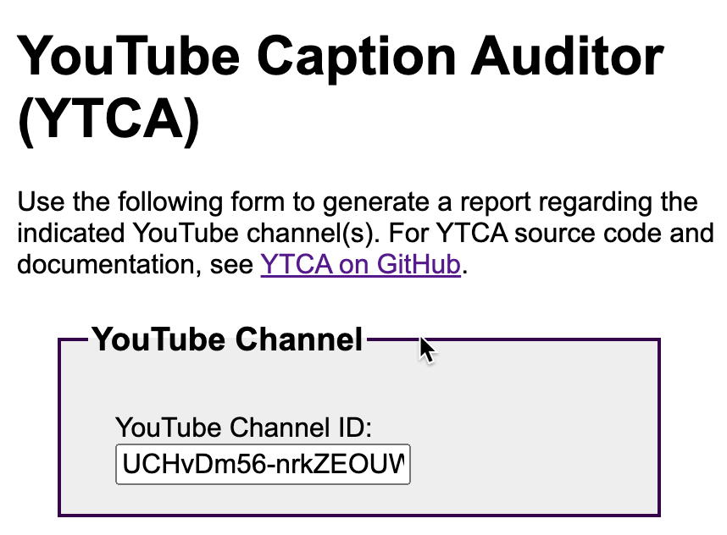
Share Helpful Information
Meet with as many people as you can to share this information (consider face-to-face if possible).

Slide 14
Celebrate Any Progress
Look for easy wins
Congratulate and celebrate
Identify & nurture champions

Slide 15
Establish a Standard
Find good examples
Identify reasonable benchmarks
Involve relevant stakeholders

Slide 16
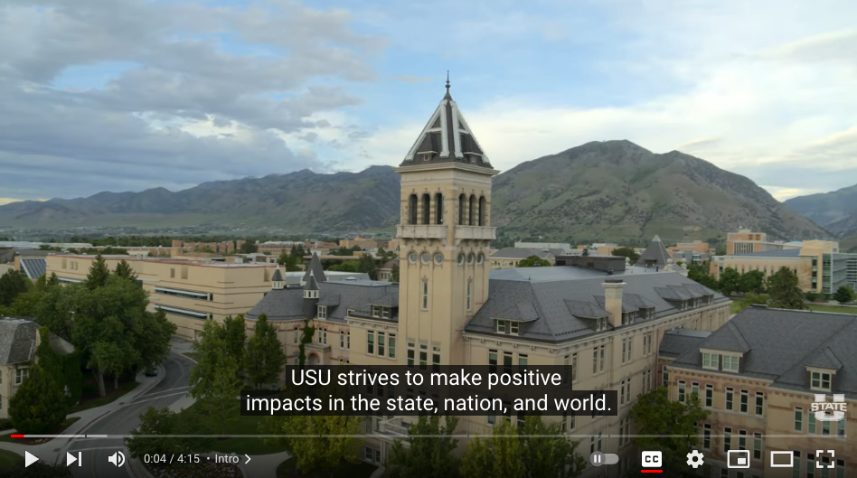
Key Ingredients
Definitions
Clear expectations
Specific timelines
Compliance process
USU Video and Audio Accessibility Standard

Slide 17
Finding Resources
Identify a funding model
Be clear about the necessary resources
Avoid victimhood

Slide 18
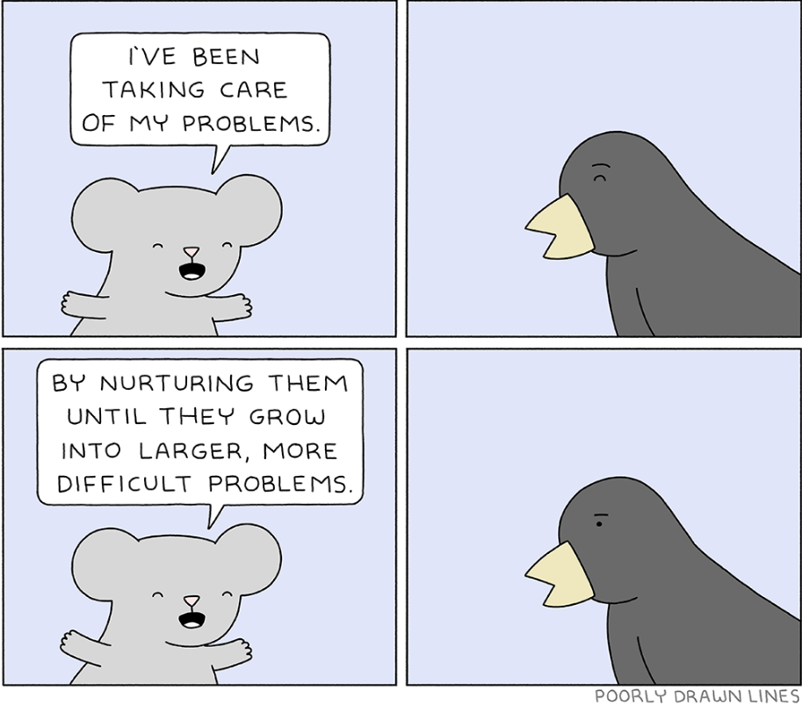
Identify Needed Resources
If there is a problem that you can’t fix…
Make the problem bigger until someone who can fix it will.
Source

Slide 19
Funding Model - Who's Paying?
“Unfunded mandate”
No centralized funding (yet)
Each division, college, or department is responsible for their own captions

Slide 20
Implementation of Standard
Gain administrative support
Provide resources & clear expectations
Build system support
Establish accountability

Slide 21
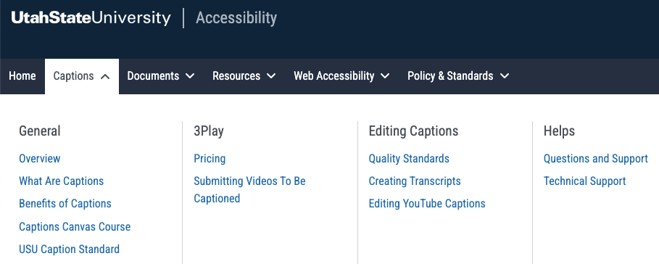
Implementation - Resources
USU Caption Website (usu.edu/accessibility/captions)

Slide 22
How Are Things Going?
Continuing to monitor channels
Finding more channels
Developing new tools
Review website videos
Ongoing conversations

Slide 23
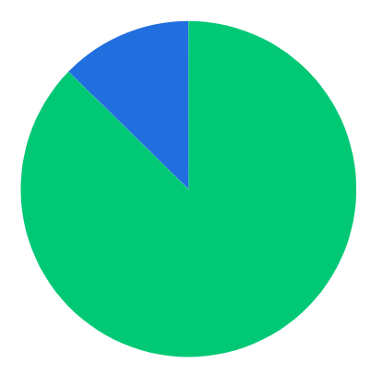
Lots of Public Video Content!
75 Active YouTube Channels
115 Inactive Channels
20 Abandoned Channels
Of Active Channels:
Compliant – 100% Captioned: 87.3%
Compliant – Legacy Captions Needed: 12.7%

Slide 24
Goal: 100% of Videos Captioned
Total Videos
Captioned Videos

Slide 25
Implementation – Automations

Slide 26
Key Information for Each Channel
Subscribers
Total Views
Most Recent Video
Total Videos
Captioned Videos
Seconds of Video
Seconds of Captioned Video
Seconds of Uncaptioned Video

Slide 27
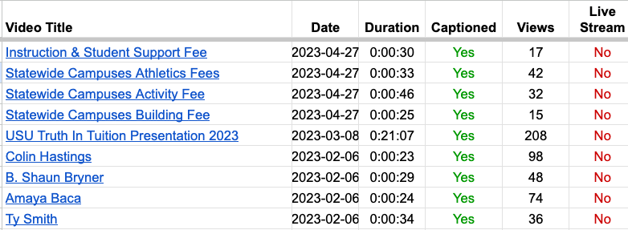
Shared Report with Video Details
Every Video:
Video Title
Date
Duration
Captioned
Views
Live Stream

Slide 28
Shared College Reports
Shared with an Accessibility Liaison from each college

Slide 29
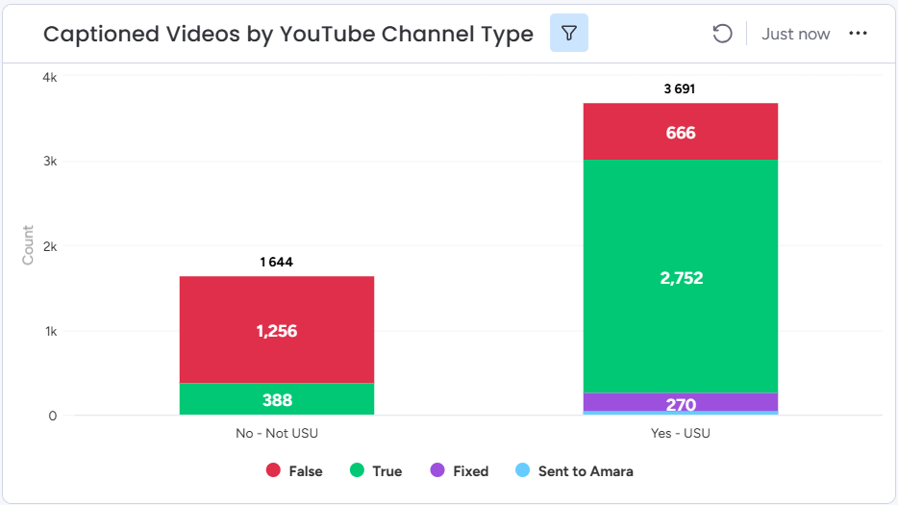
Videos on Websites

Slide 30
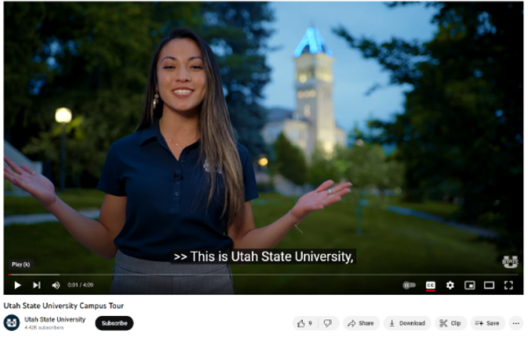
Ongoing Challenges/Opportunities
Governance
3rd party videos
Live captions
Social media captions
New technologies

Slide 31
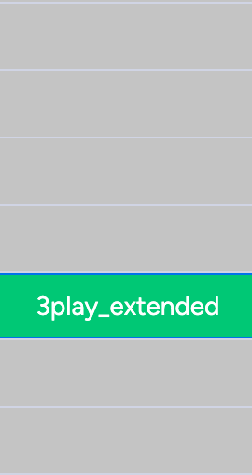
Canvas Captions Tool

Slide 32
Conclusion
NOT: “Why should I caption my content?”
INSTEAD: “Why on earth wouldn’t I caption my content?”

Slide 33
Thank you!
bit.ly/captioning-your-content
captions@usu.edu
usu.edu/accessibility

